Slide 1


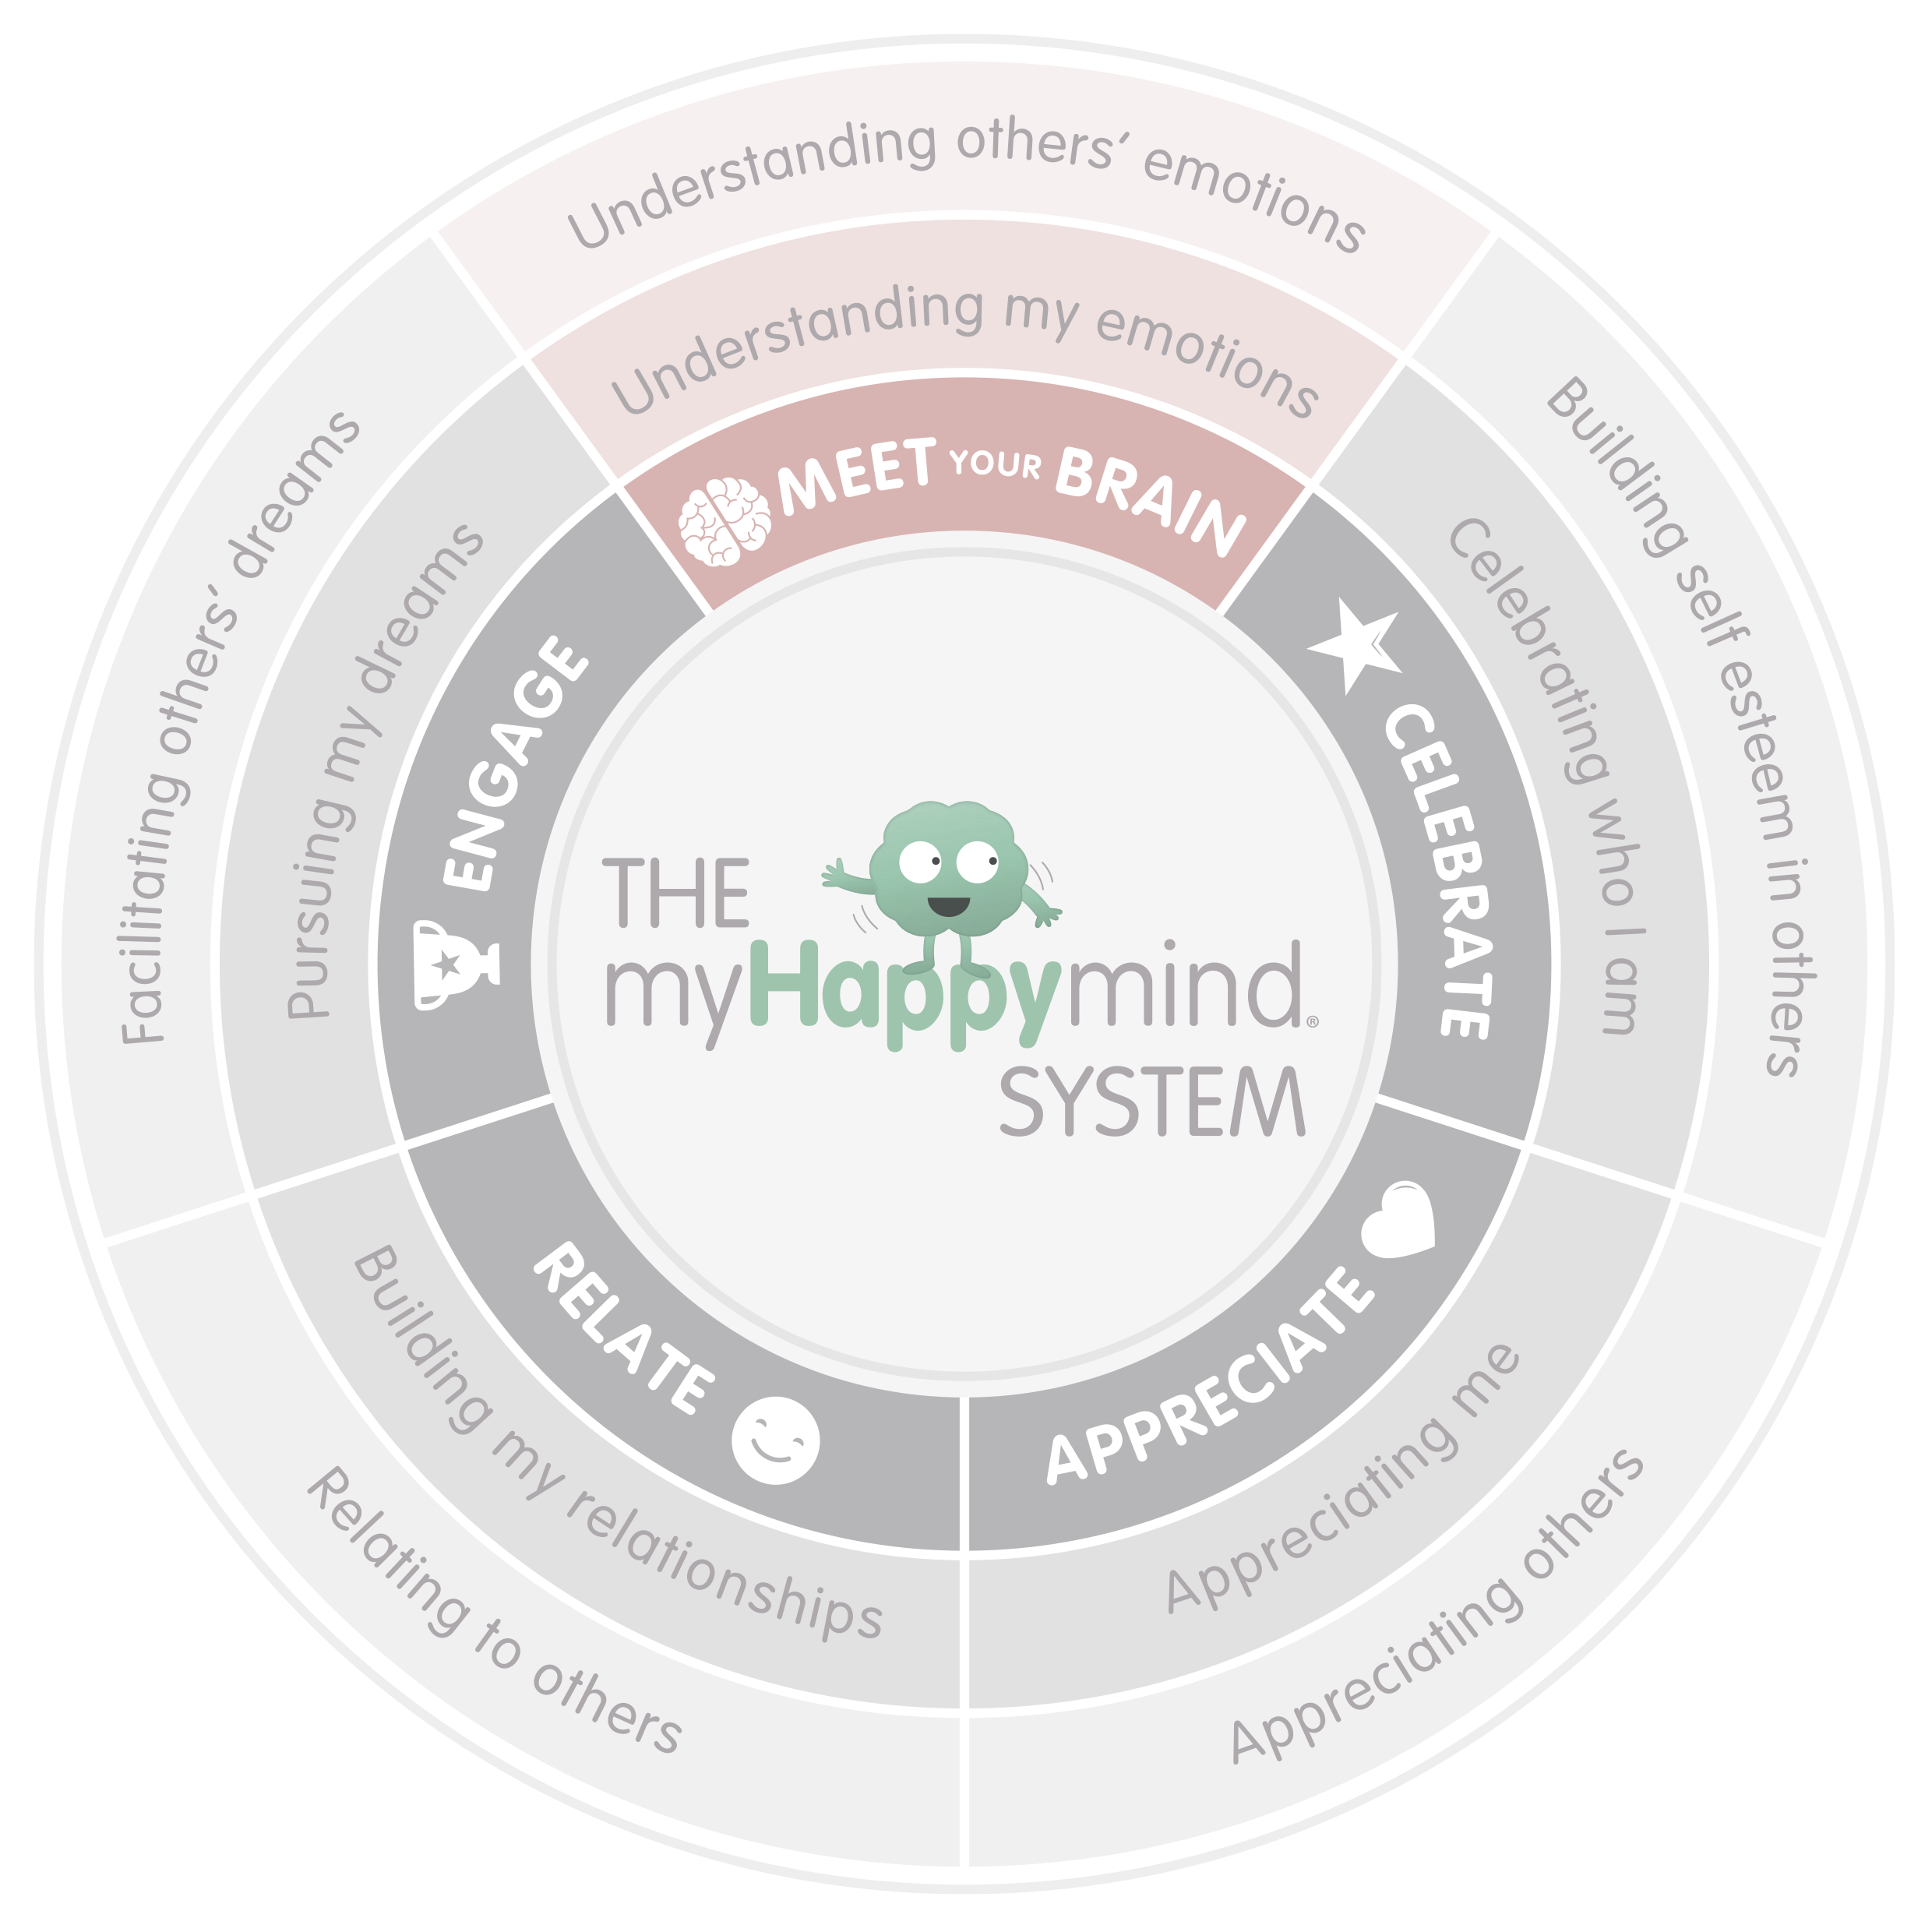
MEET YOUR BRAIN
PARENT NEWSLETTER

Slide 2

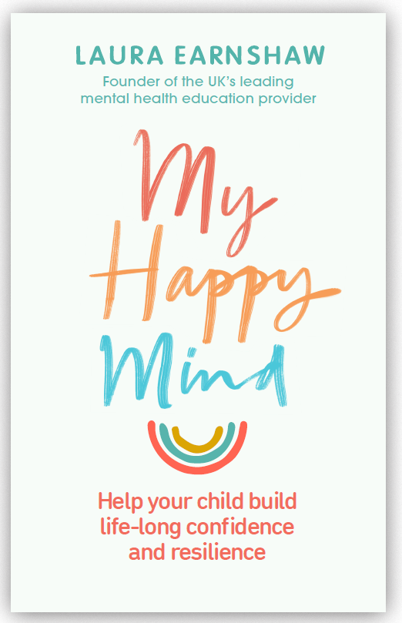
^{About myHappymind}
myHappymind is an award winning, whole school and nursery
curriculum. It teaches children preventative habits that
support positive mental health, resilience and self esteem.
Taught to every child in a school from Early Years through
to Year 6, myHappymind is delivered via an innovative
technology platform making learning easy and fun.
All of the concepts we teach are based in science and research
and grounded in neuroscience and positive psychology.
We are passionate about supporting teacher wellbeing
too and so all schools using the program have access to a
^{teacher wellbeing program.}
We are also proud to support parents and carers by providing them with a free app to continue the learning at home. You can learn more about how to access the app in this document.
To learn more: Check out our founder
Laura Earnshaw’s book, ‘My Happy Mind’.

Slide 3
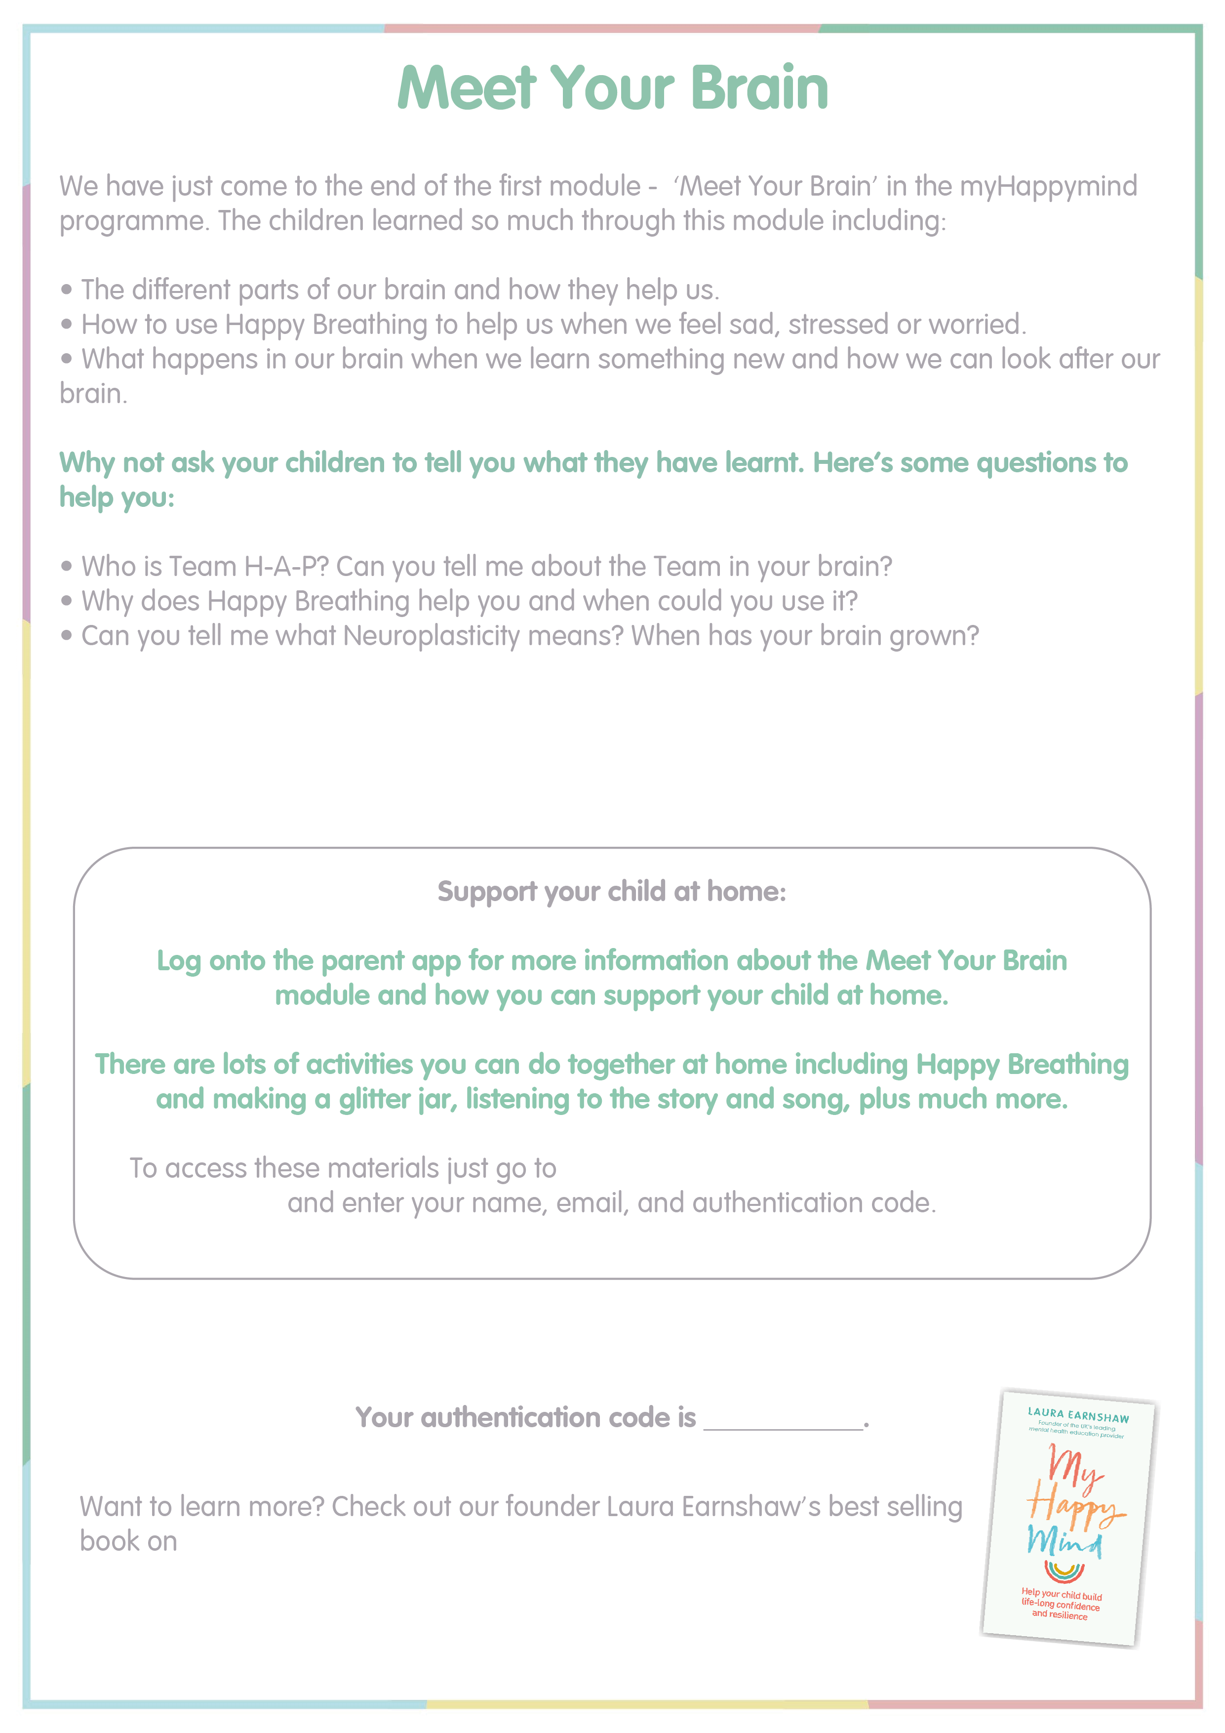
https://myhappymind.org/parent-resources
Type code here
Amazon.

Slide 4
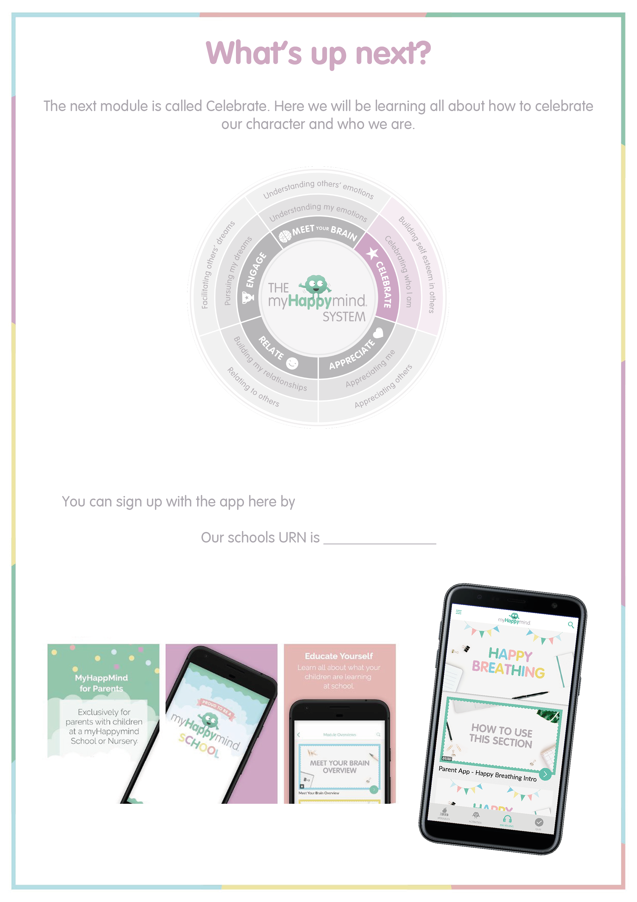
https://myhappymind.org/parent-resources.
Type URN here

Slide 5
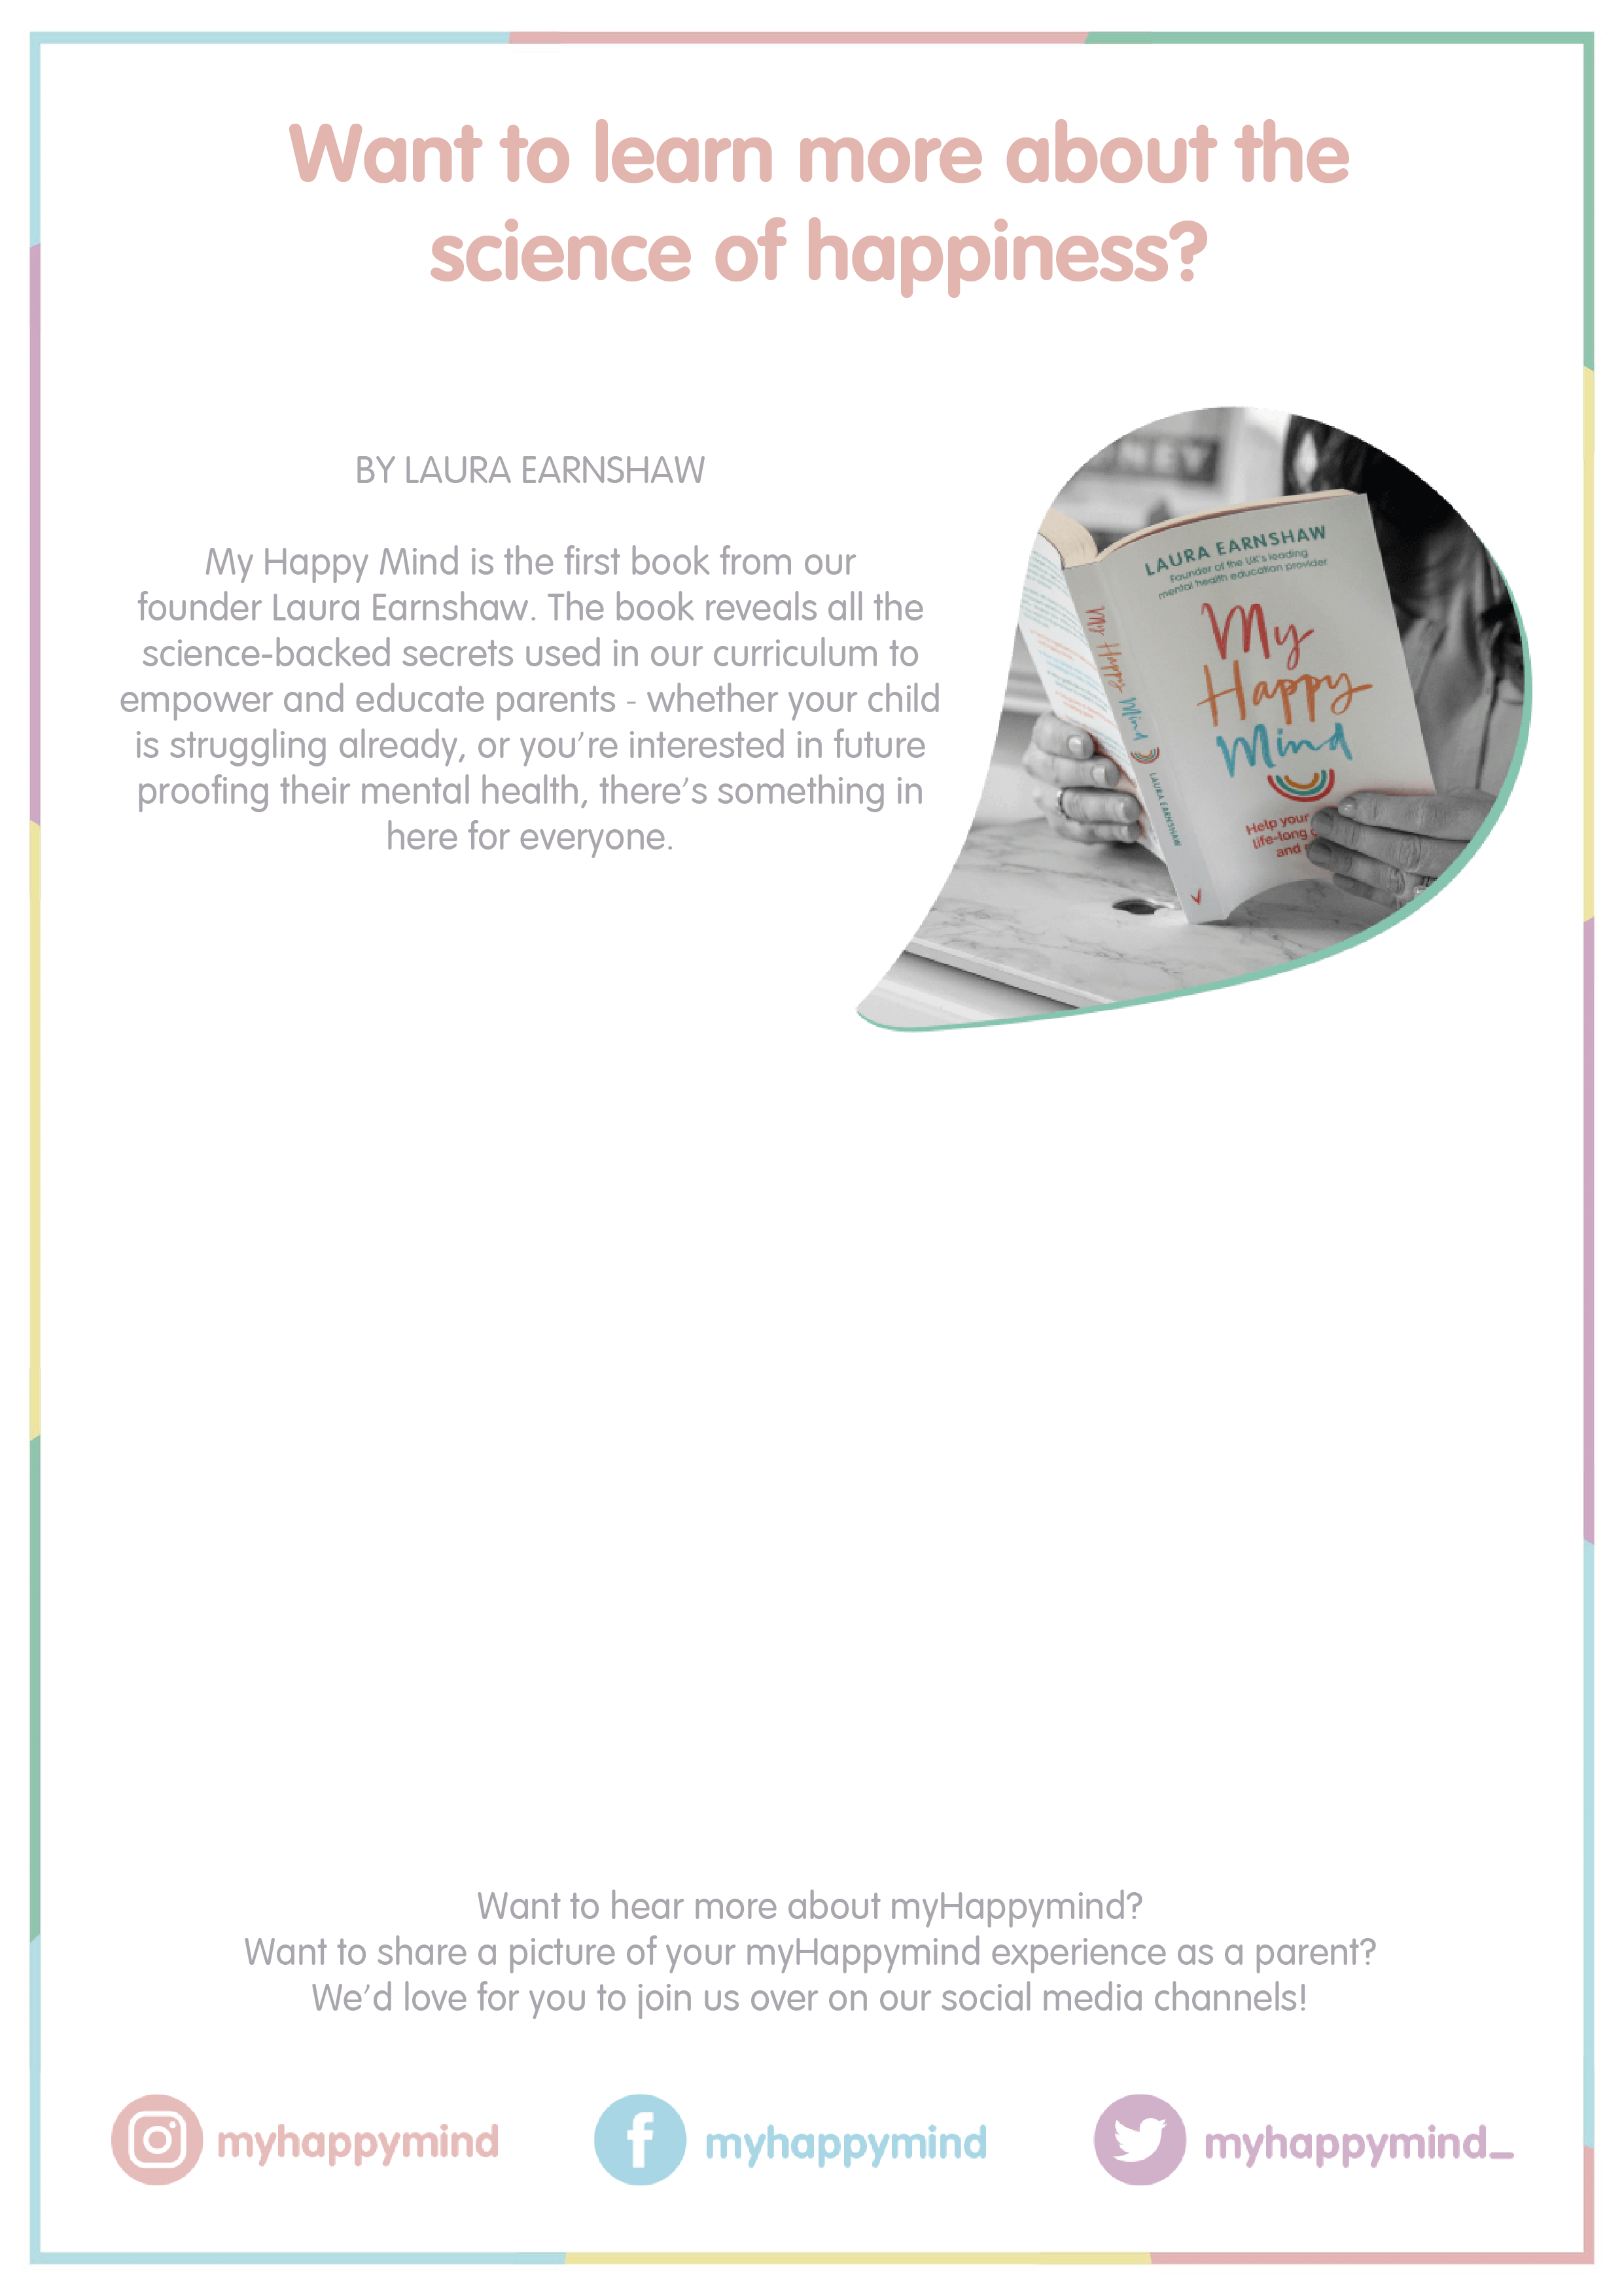
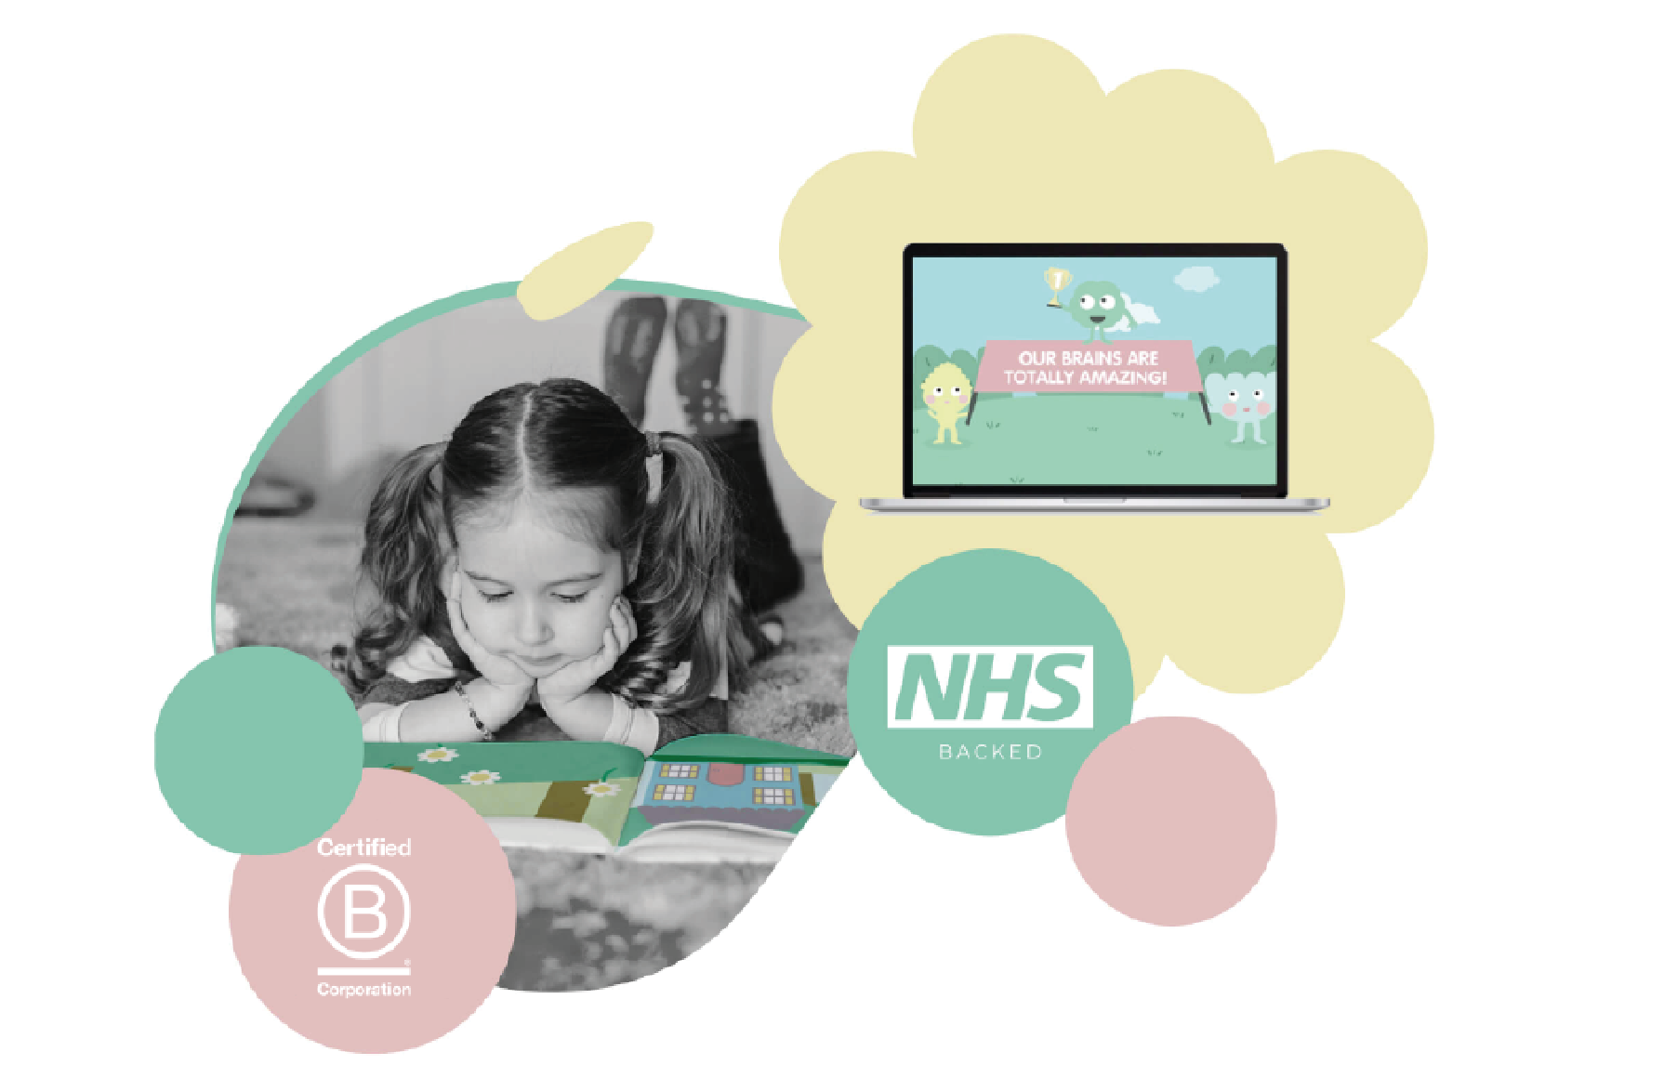

Slide 6

