Slide 1

MATHEMATICS IN THE EARLY YEARS
Workshop for parents

Slide 2
New EYFS Mathematics Curriculum 2021
ELG: Number
Children at the expected level of development will:
Have a deep understanding of number to 10, including the composition of each number
Subitise(recognise quantities without counting) up to 5
Automatically recall (without reference to rhymes, counting or other aids) number bonds to 5(including subtraction facts) and some number bond to 10, including double facts.
ELG: Numerical Patterns
Children at the expected level of development will:
Verbally count beyond 20, recognising the pattern of the counting system
Compare quantities up to 10 in different contexts, recognising when one quantity is greater than, less than or the same as the other quantity
Explore and represent patterns within numbers up to 10 including evens and odds, double facts and how quantities can be distributed equally

Slide 3

White Rose Maths Scheme

Slide 4
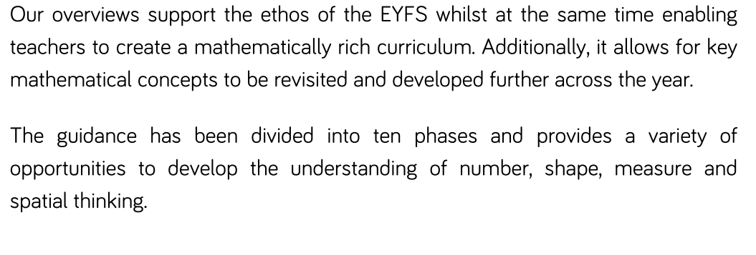

Slide 5
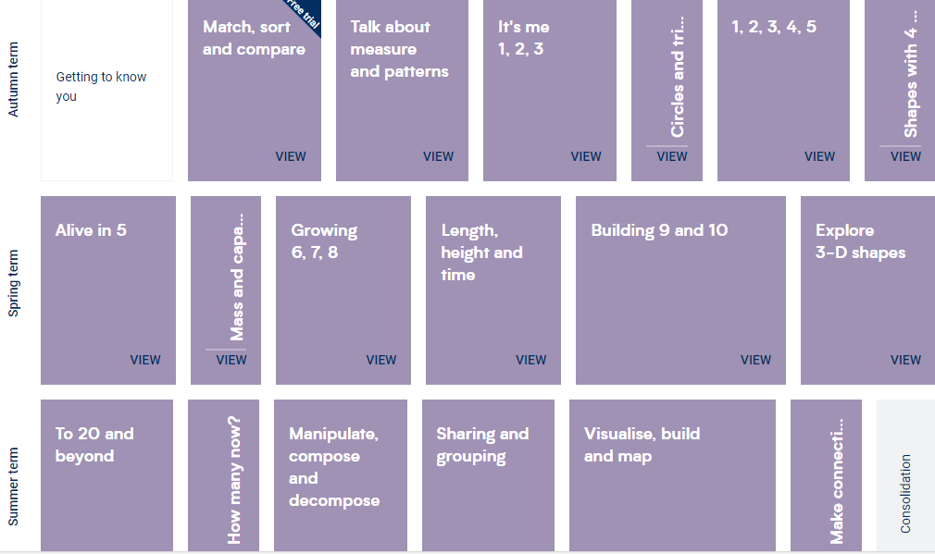

Slide 6




Numbers
1- How numbers are represented
2- Comparing numbers
3- Composition of numbers

Slide 7
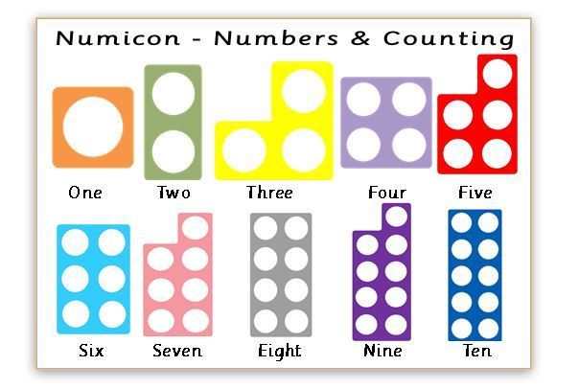

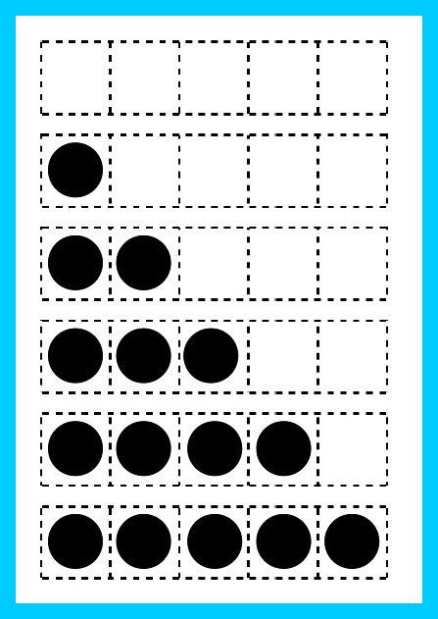

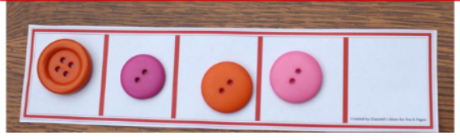
How to help
Numicon shapes
Games using a die/dice
Set of dominoes
Making a 5 frame for counitng

Slide 8
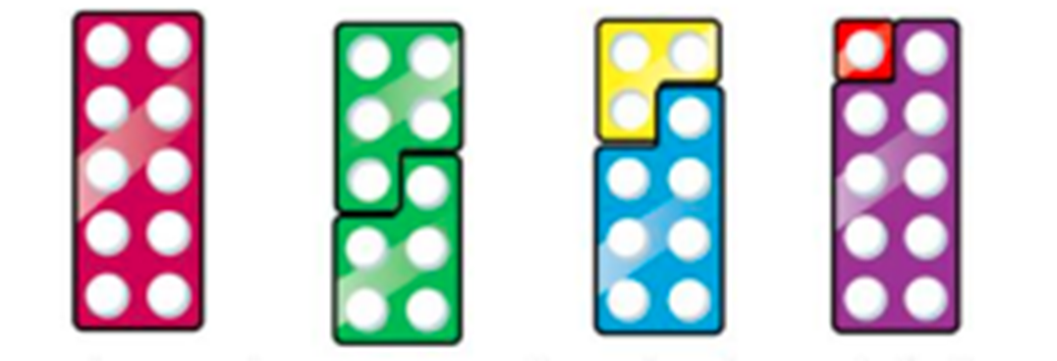
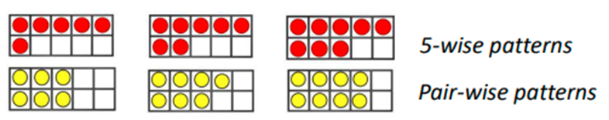
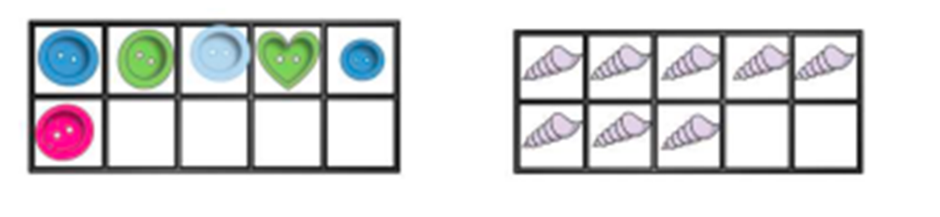
Numbers from 5 to 10

Slide 9
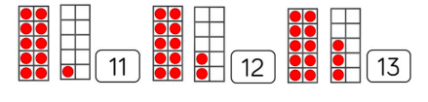
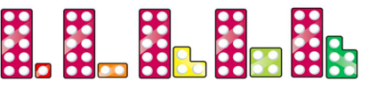
Numbers to 20 and beyond

Slide 10
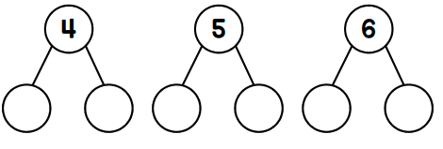
Number bonds to 10

Slide 11

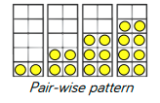

Doubling

Slide 12
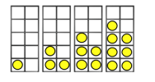



Odd and Even Numbers
Sharing and grouping

Slide 13
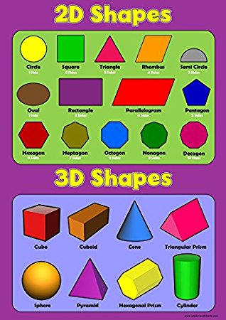
Shapes
sides
curved
faces
corners
straight

Slide 14
Understanding Position
over
between
Next to
behind
In front
in
under
on

Slide 15



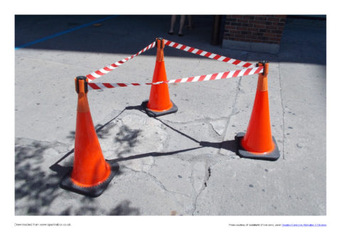

Aware of shapes in the Environment

Slide 16

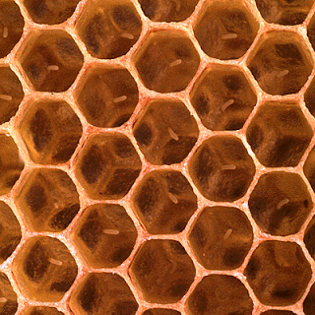

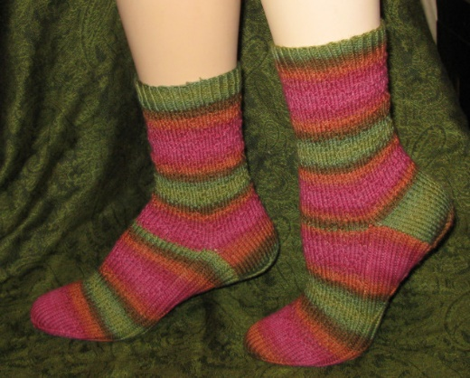
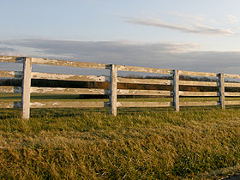

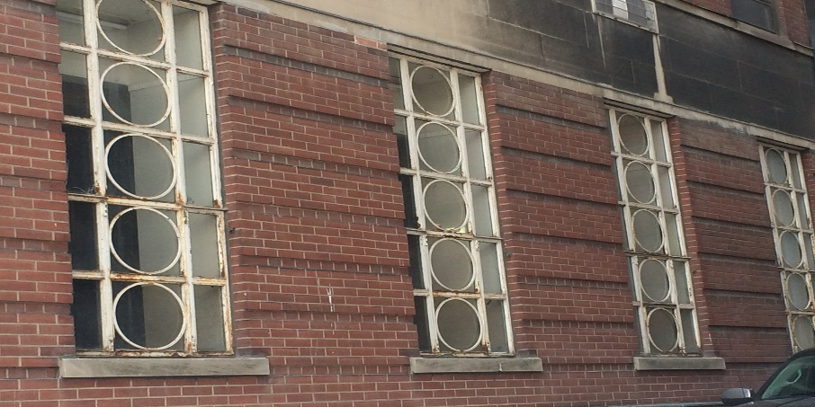
Patterns in the Environment

Slide 17

Measures
Time
Weight
Capacity
Length

Slide 18
Language and Vocabulary
less
more
TALK
How many?
full
short
heavy
light
long
wide
tall
empty

