Slide 1

Robins
2025-2026

Slide 2

Important information
This half term, we will have PE on a Wednesday (CEPD) and Friday – please send your child/children to school in their PE kit on these days. Next half term they will have PE on a Tuesday (Chester Cricket) and a Friday.
We will have outdoor exploring on a Wednesday 26th November and Wednesday 3rd December in the afternoon 1-3pm. The children will need to come to school in dark colour leggings/jogging bottoms on these days and bring water proofs. Please make sure your child has wellies in school.
Website – Please refer to the website for newsletter – we also post blogs so you can keep track on what the children have been up to.

Slide 3
Our timetable
We come into school from 8:40 – 8:55 children will be given an Early Morning Task (EMT).
8.55-9.10 Register and Arithmetic Ninjas
My Happy Mind – Monday 1-1.30pm
Worship – Mon-Fri 9.10-9.30am
Break time is at 10:45 – 11.00
Lunch time is at 12:00 – 13:00
Afternoon break is at 14:00 – 14:15
Home time is 15:15

Slide 4
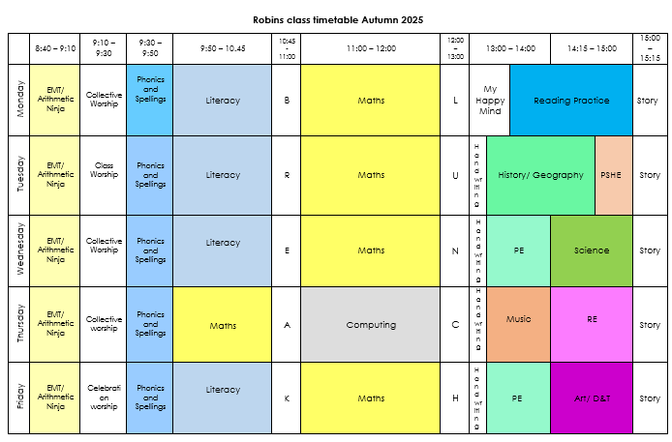

Slide 5

Homework
Homework will be given out on a Tuesday and will be due the following Monday.
Please encourage your child to have a look over their homework before the weekend. Encourage the children to practise their spellings at least three times a week.
We will have a spelling test on the Monday or Tuesday.

Slide 6

The Tilston Code
Be Ready
Be Respectful
Be Safe

Slide 7

The Tilston Code
What happens if we don’t follow the Tilston code?
Redirection
Reminder
Caution
Time out
Missed time from break (2-5mins) and ‘think sheet’ recorded

Slide 8

Dates to remember
Nativity – Tuesday 9th December 2pm – (Grandparents Only)
Nativity – Wednesday 10th December 2pm and 6pm
Story house – Wednesday 17th December(cost TBC)

Slide 9

Assessments
We assess the children throughout the year in various ways.
Half termly phonic assessments – Keep up, Rapid Catch up
Reading and Spelling of common exception words
End of unit science and maths.
Statutory Assessments
Year 2 – SATs – We do not sit the government optional SATs, however we do complete past papers of the End of Key Stage assessments.
Year 1 – June the children will complete the Phonic Screening Test

Slide 10

What can I do to help my child at home?
Encourage independence
Complete homework
Reading every night. Re-reading books for fluency and pace is really important and helps a lot with confidence.

Slide 11

Any questions?

