Slide 1
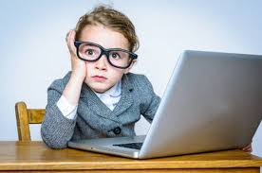
Kestrels
Some important information

Slide 2
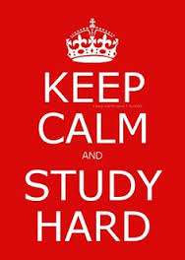

The school day
8:40- 9:10 Register/lunch/Maths activity
9-10:9:30 Worship in the hall
9:30 -10:30 White Rose maths
10:45 – 11:15 Spellings/ Reading comprehension
11:15 12:15 English – Star of Fear, Star of Hope
1:00 -3:15 Science/History/Geography/DT/PE

Slide 3
Learning this term……
Maths: We will be focusing on place value followed by addition and subtraction. After half term we will be studying multiplication and division before moving on to fractions.
English: The children will be studying the beautiful and thought-provoking text Star of Fear, Star of Hope by Jo Hoestlandt. After half term, Kestrels will be reading a conservation book ‘Can we save the Tiger by Martin Jenkins. All written work this term will be inspired by these books.
Science: Our topic is Light. The children will explore how light works and take part in lots of exciting investigations. Later, we will study the different forms of renewable energy.
History: We will be learning about the Anglo-Saxons and their lasting legacy on the culture and landscape of the British Isles.

Slide 4
PE – The Kestrels will have a Cheshire Cricket coach for the first half term. In addition to cricket, the children will take part in hockey, tag rugby and fitness activities.
Art – The children will focus sketching skills and perspective.
Computing – Coding and online safety.
Music – The children will be using the Charanga scheme to play different types of jazz.
PSHE – A focus on keeping healthy as we’re growing up.
RE – Kestrels will be studying how different religions show equality, justice and fairness.
French – Identifying the names of items found around your house.
Design Technology – Links closely with the PSHE, the class will look at healthy foods.

Slide 5
Assessments
End of each term in Reading and Maths –tests.
Half termly in Writing – teacher assessments
Year 6 will be working through previous SATs papers and begin booster sessions after Christmas.

Slide 6



Reading books
English lessons this half term
Own reading for pleasure book
Class reading book

Slide 7
Extras
Outdoor learning – November sessions
After school clubs
Visits –
Safety Hub (1st December),
Story House – Beauty and the Beast (December),
Robinwood -PGL (Monday 30th March – Weds 1st April)

Slide 8
Homework
Homework will be handed out every Monday and will consist of:
Spellings
Grammar
Maths
Homework is important - please ensure your child completes their homework and brings it back to school on the following Monday. Year 6 will begin to receive more specific, SATs related homework as we move through the term.

Slide 9
Additional information
Communications out via school spider –app/email/school gate
Email – astrefford@tilston.cheshire.sch.uk

Slide 10
Any questions?

