Slide 1

Sandiway Primary School
Phonics and Early Reading
Information Evening
March 2024

Slide 2
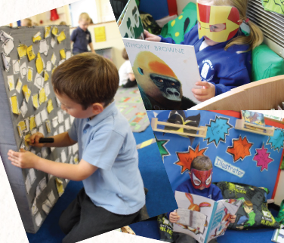
Welcome to Sandiway
Mrs Atkinson
Mrs Harvey
Mrs Forsyth

Slide 3
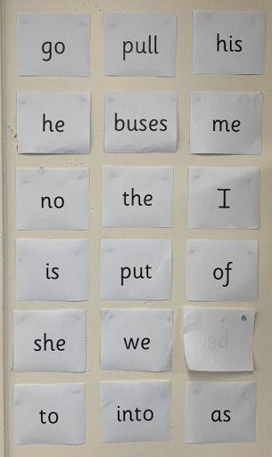
What Is Phonics?
Cracking the Code
Phonics is key to learning to read.
It develops phonemic awareness – the ability to hear, recognise and use the sounds within words.
Children are also taught the link between sounds and the graphemes that represent them.
Children will also be taught other skills, such as whole-word recognition (‘harder to read and spell words’), book skills and comprehension.
Notes:
Typically, children begin to develop the listening skills essential to phonics in their preschool years. Some children begin to learn letter sounds at preschool but most children will begin their main phonics learning once they start their reception year at primary school (age 4-5). This teaching continues through year 1 (age 5-6) and into year 2 (age 6-7) until the child is a confident and fluent reader.
Once children are fluent readers, the emphasis in reading teaching moves more towards comprehension and analysis skills.
Book skills include holding books correctly, turning pages right to left, recognising that print represents words, talking about pictures, retelling familiar stories, asking and answering questions about stories and non-fiction texts and treating books with respect.

Slide 4

Did You Know…?
The English language has:
26 letters
X
Y
Z
44 sounds
over 100 ways to spell those sounds
It is one of the most complex languages to learn to read and spell.

Slide 5
The Jargon – A Quick Guide
phonics – The teaching of reading by developing awareness of the sounds in words and the corresponding letters used to represent those sounds.
Phoneme/sound - Any one of the 44 sounds which make up words in the English language.
grapheme – How a phoneme is written down. There can be more than one way to spell a phoneme. For example, the phoneme ‘ay’ is spelt differently in each of the words ‘way’, ‘make’, ‘fail’, ‘great’, ‘sleigh’ and ‘lady’.
digraph – two letters making one sound. E.g. /ai/ /ee/ /ow/
trigraph – three letters making one sound. E.g. /igh/ /ear/ /air/
quadgraph- four letters one sound /ough/ /eigh/
blending – Putting together the sounds in a word in order to read it, e.g. ‘ch– i – p, chip’. Here we use Blending Hands.
segmenting – Breaking a word into its separate sounds in order to spell them, e.g. ‘frog, f – r – o – g’’. This is a time when we would use our Robot Arms.
Harder to read and spell words- words that children need to recognise but are not phonetically decodable at this time.
Notes:
It can be interesting to see how many ways there are to spell other sounds – try ‘igh’, ‘ee’ or ‘ow’.
A fun way to learn blending with young children is to talk to them in segmented words, for example ‘Please g – e – t’ the ‘m – i – l – k’ out of the ‘f – r – i – dge’.
When children begin to segment to spell they will often use the wrong spelling of phonemes, for example ‘I luv yoo’ or ‘Migh naym is…’. This is not a problem, as the key skill at this stage is that they can hear the sounds in the words and have a go at writing them down.

Slide 6
So what does this mean?
sh
e
l
f

Slide 7
Segmenting Activity
Can you spot how many sounds are in each word.
        Cat
        Shelf
        Cow
        snow
        light
        string

Slide 8
Did you get it right?
cat = c-a-t =3 sounds
cow = c-ow =2 sounds
snow = s-n-ow =3 sounds
light = l – igh – t =3 sounds
string = s – t – r – i – ng =5 sounds

Slide 9
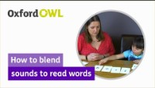

Slide 10

The Importance of
Listening
Phonic learning relies on children being able to hear and distinguish the sounds within words.
Children with poor listening and/or attention skills can struggle with phonics learning.
Listening skills begin at birth and there are lots of things that parents and carers can do to support these skills.
For example: listening to simple instructions, playing games, listening to stories, taking turns, what can you hear when you are out and about?
The first phase of formal phonics education (Phase 1 which is taught in Nursery) also focuses on these key listening skills. Without these skills, children may struggle to master the next stage of their phonics learning.

Slide 11
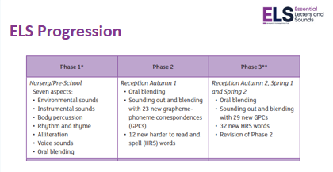

Slide 12
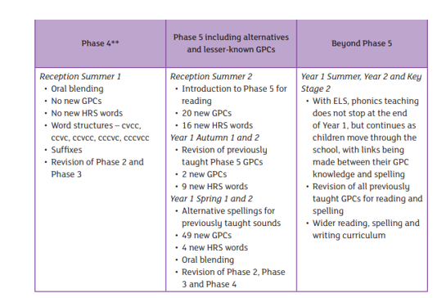

Slide 13
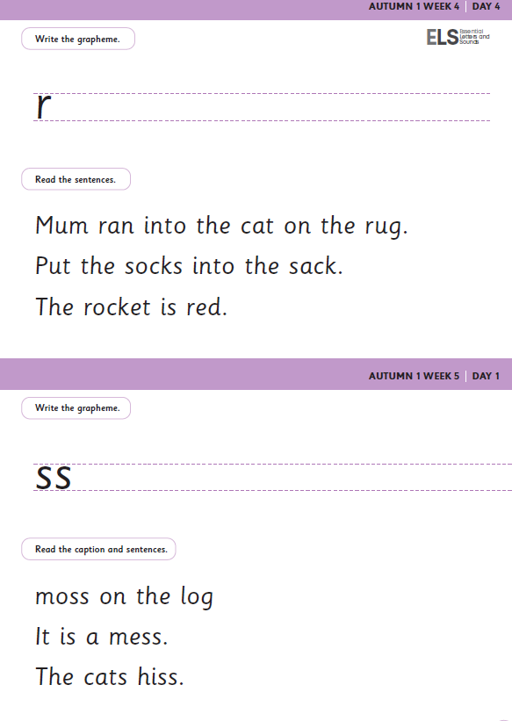

Slide 14
Phonics Screening Check
This takes place in the Summer Term of Year 1.
The children are asked to read 20 real words and 20 pseudo words.
These words are all phonetically decodable.

Slide 15
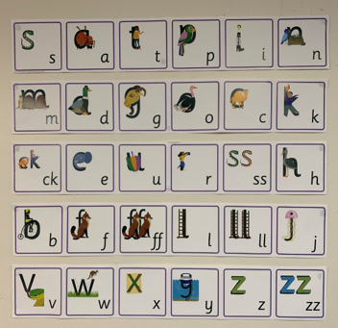
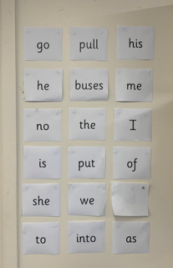
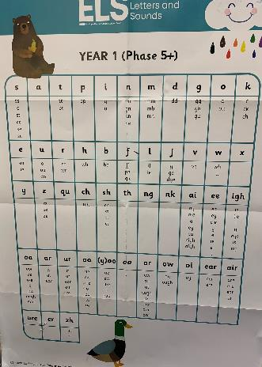
What does phonics look like for your child in school?

Slide 16

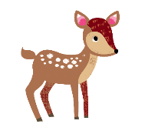

Supporting your child with reading at home
Children are only reading from books that are entirely decodable
Your child should be able to read their book confidently
We only use pure sounds when decoding words (no ‘uh’ after the sound)
We want them to practise reading their book 4 times across the week working on these skills:
decode
fluency
expression
© Oxford University Press 2021
Notes:
We want children to only have success when learning to read
Decode – explain this meaning
Fluency – recognising the sound for spelling within the word and blending fluently
expression – model this for the children in school, when reading at home we want children to start to think about expression and intonation. For example, if someone is asking a question let’s get the children to make their voices sound like they are asking a question.

Slide 17
New eBooks available for your child
We have recently subscribed to a new eBook library which uses ELS books.
You will have a password and a username.
A book will be chosen each week for your child to read
This is in addition to the book your child brings home each week.
© Oxford University Press 2021
Notes:
We want children to only have success when learning to read
Decode – explain this meaning
Fluency – recognising the sound for spelling within the word and blending fluently
expression – model this for the children in school, when reading at home we want children to start to think about expression and intonation. For example, if someone is asking a question let’s get the children to make their voices sound like they are asking a question.

Slide 18


Top tips for reading at home
Following their interests will keep them engaged and they will see reading as fun
Read the same book – repetition. This could be a football magazine.
If you are reading the book to them, let them turn the pages, return to pages and let them interrupt you – even if it feels like they are getting off track.
Any time spent sharing or talking about a book is beneficial.
Explain new vocabulary to the children.
Find a regular time for reading in your child’s day. Bedtimes are not always the best time for children to be reading to you.
.

Slide 19
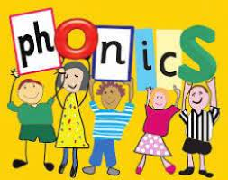
Thank you for listening.
If you have any further questions please contact your class teacher who will be very happy to help.

Slide 20


