Slide 1


Class Welcome Meeting
9th September '26

Slide 2
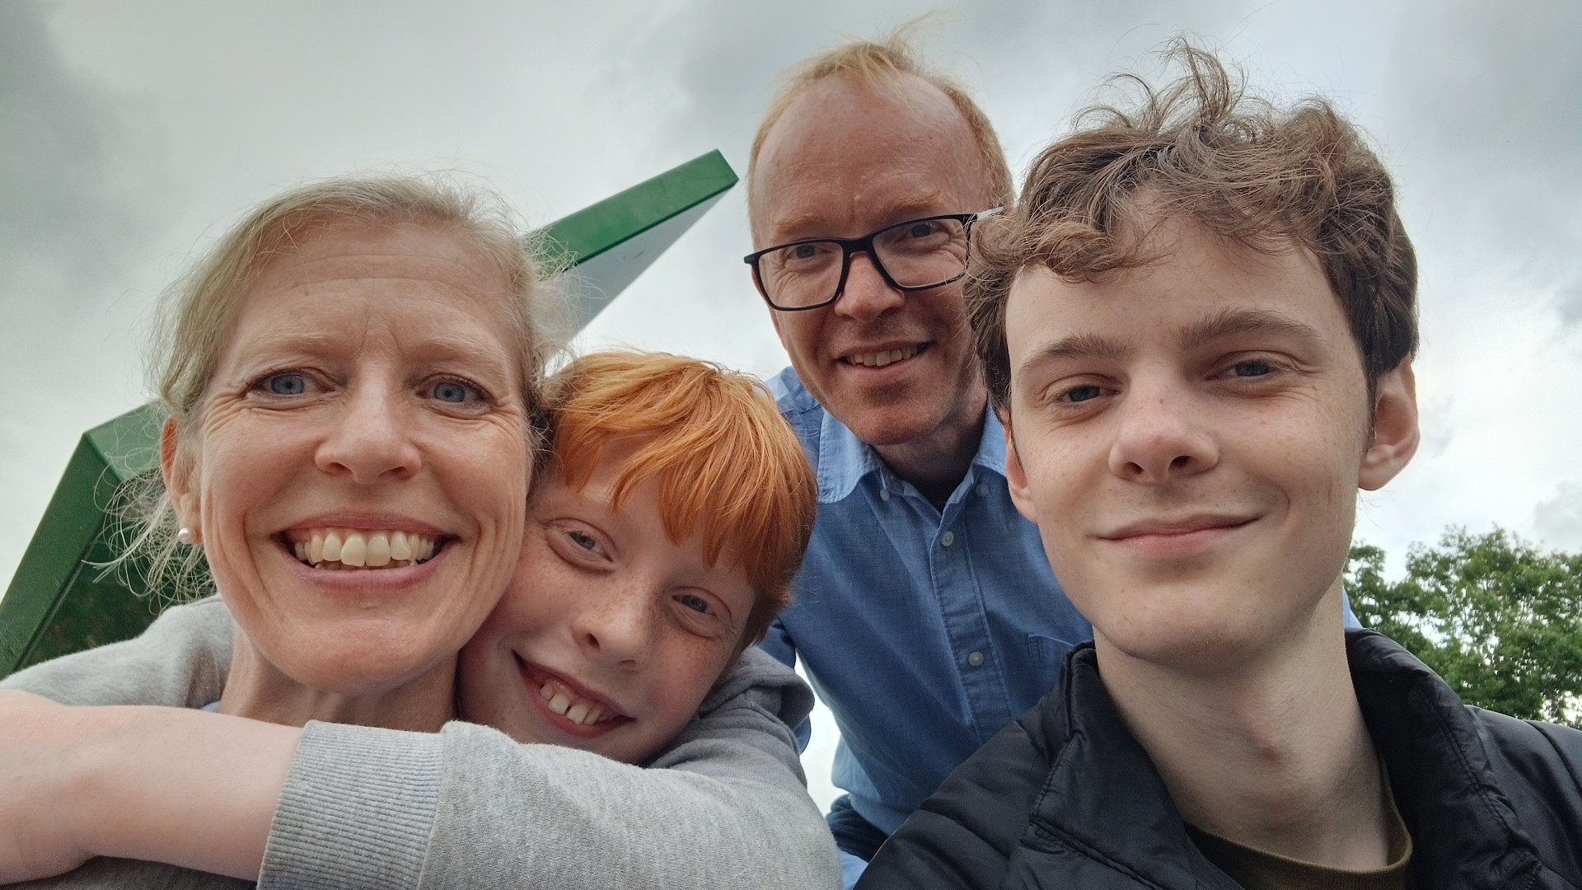
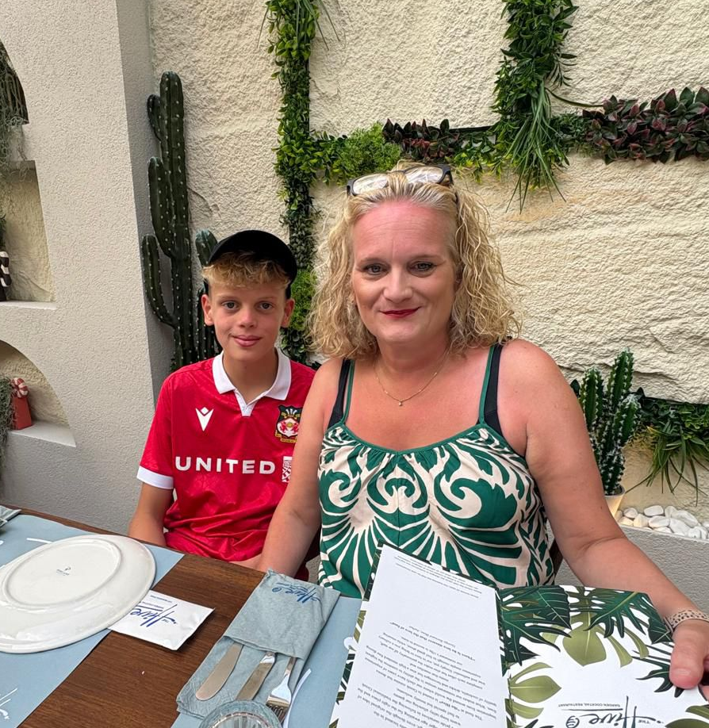
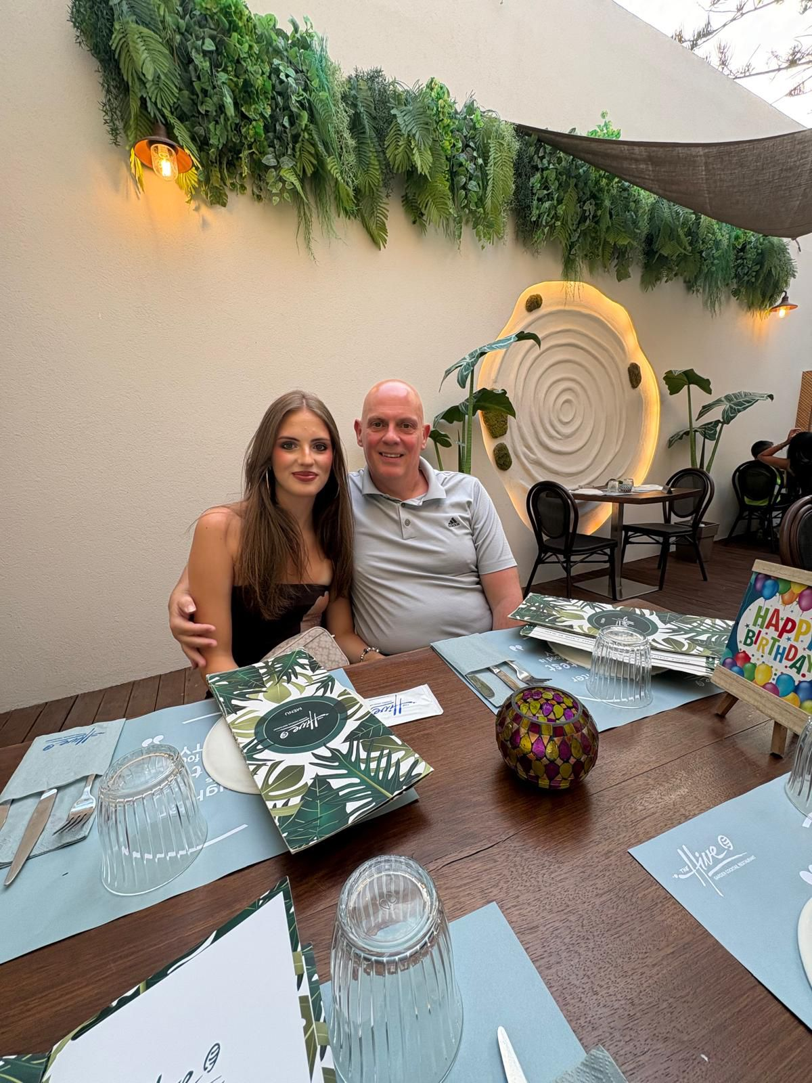
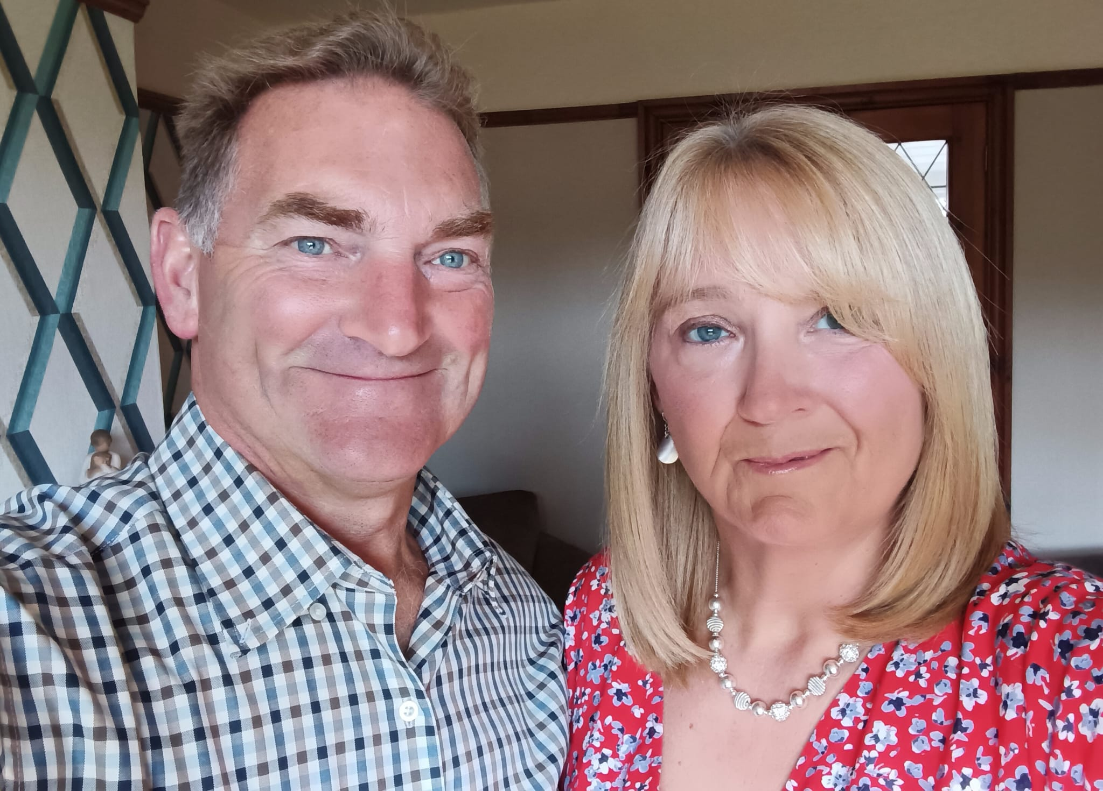
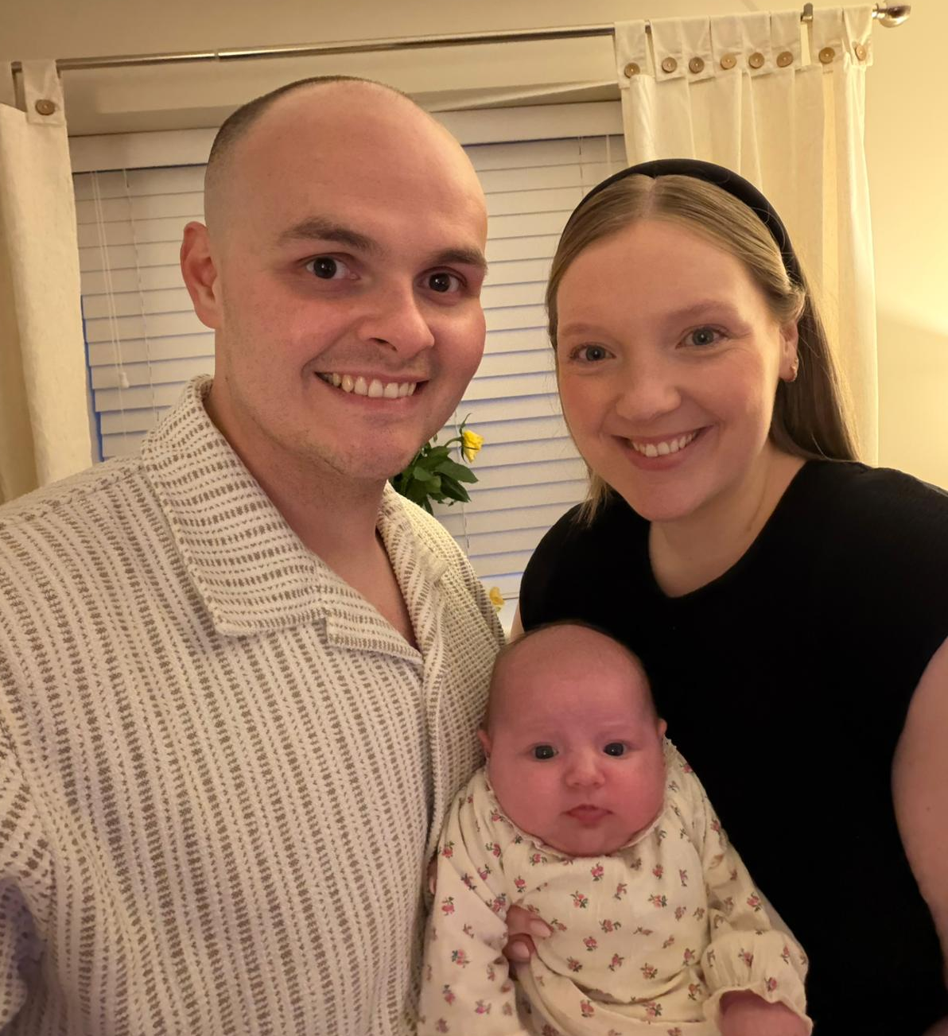
Who we are...

Slide 3
Who is Who?
Mrs Nicoll will be teaching the class. Monday to Thursday.
Mrs Forsyth will be teaching all day on Friday.
Mrs Tucker will be teaching in Year 2 on Monday before break. She will be teaching Music and Phonics/Spelling.
Mrs Grindel will be supporting specific children in Year 2

Slide 4
Learning in Year 2
GROWING AND ACHIEVING TOGETHER
Together we take ownership, care for and respect each other, our environment and our community.
We ROCK!
We show Respect
We take Ownership of our actions
We are Caring
and we are Kind
This term our focus is being SAFE and being KIND.

Slide 5
Our Curriculum Intent…
By the time our pupils leave Sandiway they have a broad range of skills and knowledge across a variety of subject areas and are ready for the next phase of their education. They foster a life- long curiosity in their own learning and that of others from a diverse range of traditions, times and cultures. Our progressive, enquiry-based curriculum engages, excites and empowers our pupils.

Slide 6
Our Curriculum
Broad and balanced curriculum
Subject specific knowledge and skills
Regular lessons
Retrieval of previous learning
Well-Being and Personal Development
Visits/visitors/trips to enhance learning
YEAR 2 CLASS PAGE – WEBSITE
Sandiway Primary School: Year 2

Slide 7
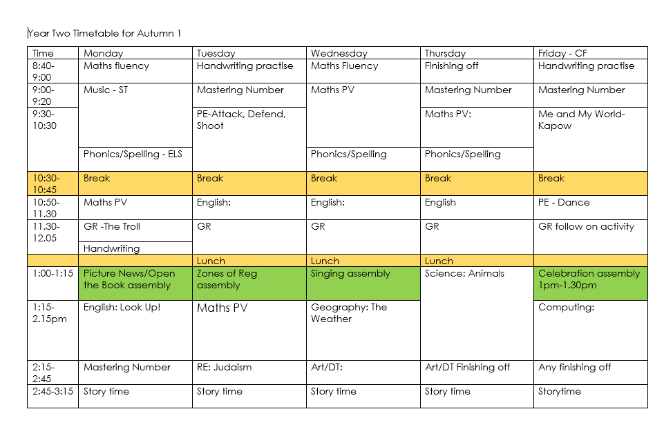
What does our week look like?

Slide 8
English
Reading
  Focus on establishing a Love of Reading
  Both word reading and comprehension.
  Read aloud sessions every day after lunch
Writing
  Range of genres, both fiction and non-fiction across the year.
  Focus on creativity and exciting writing.
  Consistently applying capital letters, full stops and finger spaces
Grammar, Punctuation and Spelling
  Taught both discretely and during English lessons.
  List of Y1/Y2 spellings displayed on class page of the website.
  Handwriting to be cursive

Slide 9

Reading Expectations
Pathways to Read
Whole Class Guided Reading
Continue with phonic development and application learnt
Recognise words automatically
Read aloud with greater fluency, using punctuation marks
Re-tell stories and poems
Make predictions
Recognise fiction/non-fiction
Children will be listened to read weekly
Books will be changed weekly (have reading
records and books in school every day please).
There will be access to Reading books online.

Slide 10
Moving on from Phonics
Those that still require Phonics will continue to access the ELS programme.
Regular retrieval of phonics
Transition to Spellings
ELS Spelling
Spelling homework each week- largely based on harder to read and spell words or spelling families

Slide 11
Maths
Count, read and write numbers to 100
Know 10 more /10 less of a given number to 100
Count in steps of 2, 3, 5 and 10
Recall and use multiplication facts for 2, 5,10
Tell the time o’clock, half past, quarter to/past
Use different coins to make the same amount
Times tables up to 12x12 at a good pace of recall should be known by the end of Year 4.
  Year 2 focus on 2, 5 and 10. TTRS to start after Christmas

Slide 12
Teacher Assessments
Ongoing throughout the year to build up a picture of your child’s achievement and progress through:
  Formal tests
  Comprehensions,
  Dictated sentences
  Marking, observation and feedback.
  Discussion and questioning
  As well as us assessing the children, we encourage them to assess themselves, reflect and evaluate on their own learning.
  Year 2 NTS papers

Slide 13
Homework
KS1 Weekly expectation:
Reading and mental maths practise.
Reading at least 4 times a week
Reading records – please sign and comment in the reading record for any reading.
Mental Maths: Practise of mental maths skills, times tables, doubling, halving etc. Numbots will also be used.
Spelling activity.
Home work tasks will be set on See-Saw every Thursday (not on the website). Physical Homework books will be handed out on a Thursday to record the tasks and collected in on a Tuesday. Please maintain these books to show high expectation at home and at school.

Slide 14




Slide 15
Useful Information
PE is currently on Tuesday and Friday. Come to school in PE kit.
Forest School is during Spring 1.
Reading books are changed once a week.
Homework will be given out on a Thursday and is due in on Tuesday the following week.
Our class page on the website, alongside Seesaw posts, keep you up to date about what we have been learning.
Additional notes/class info will be sent out via homework books wherever possible and Seesaw.

Slide 16

How can I help at home?
Read, read, read (great list of recommended reads on the Year 2 class page, including first chapter books)
Support with homework and spelling activities, revisit spellings over the week.
Practice letter and number formation to 100.
Encourage both effort and positive attitude
Talk about your child’s learning use the curriculum overview and seesaw as a guide.
Encourage your child to be independent – taking responsibility for own property, their own behaviour and their own attitude to learning
Let us know of any significant changes.
Order lunches at home (via school gateway) and let your child know what they are having.

Slide 17
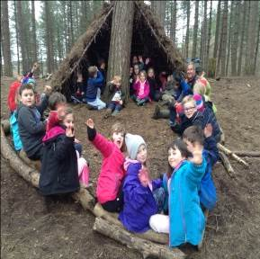
Looking ahead:
Class Visits/trips – Shire Horse Centre at Christmas TBC
Cauliflower Christmas card orders – in the coming weeks
Christmas: Y2 will have main parts in the Christmas Performance
Forest School – Spring 1
Fox Howl Residential
  Date Wednesday 24th – Thursday 25th March 2027, Spring 2
  One night

Slide 18
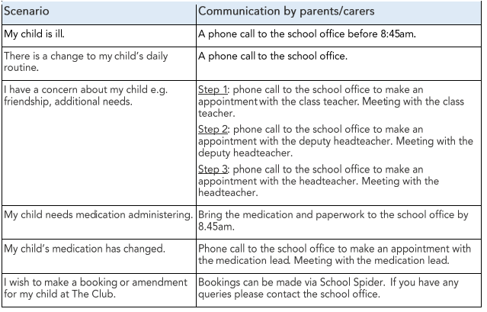
Communication
School website - check homepage, class newsletters, homework
Email admin@sandiway.cheshire.sch.uk

Slide 19
Use of social media relating to school
We politely ask that any photos of children taken are not to be shared online.
Please voice questions/ queries directly with school so we can help directly.
We appreciate your understanding in this matter.

Slide 20
....and finally!
No toys, please limit things that are being brought into school.
All jumpers and cardigans must be named
Please provide healthy snacks for school, fruit/veg is provided in afternoon break. Please remember no nuts! Avoid chocolate, sweets, cake and crisps please.
Water bottles – No juice, only water and please name bottles too.
Children need to learn how to tie their own laces please.
Wherever possible, please keep the gate areas free at the beginning of the school day.

