Slide 1



Slide 2
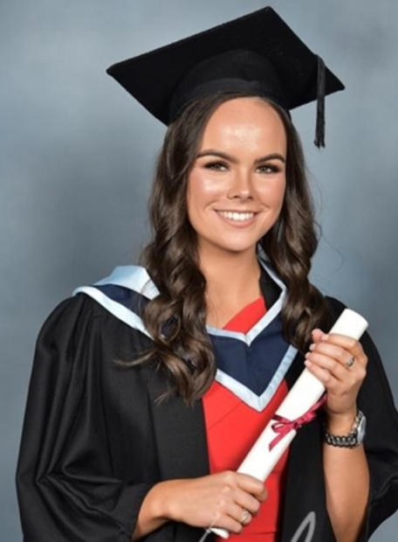
Get to know me
I am so excited to begin this new journey at Sandiway with all of you! My name is Ciara, I am 26 years old and originally from Ireland. I graduated from university in 2024 and have spent the last two years teaching Year 2 in a school in Manchester. I have loved every moment of my teaching journey so far and am now looking forward to this exciting new adventure with you all in Year 4.
One of the main reasons I became a teacher is because I love seeing children grow in confidence and achieve their goals. When I was in primary school, I had a wonderful teacher who made a huge difference in my life. She believed in me, encouraged me to work hard, and inspired me to aim high. I still admire her today, and she is a big reason why I chose to become a teacher. My hope is to be that same source of encouragement and support for my own pupils, helping them to believe in themselves and reach their full potential.

Slide 3
Learning in Year 4;
GROWING AND ACHIEVING TOGETHER
Together we take ownership, care for and respect each other, our environment and our community.
We ROCK!
We show Respect
We take Ownership of our actions
We are Caring
and we are Kind

Slide 4
Our curriculum intent;
By the time our pupils leave Sandiway they have a broad range of skills and knowledge across a variety of subject areas and are ready for the next phase of their education. They foster a life- long curiosity in their own learning and that of others from a diverse range of traditions, times and cultures. Our progressive, enquiry- based curriculum engages, excites and empowers our pupils.

Slide 5
Our Curriculum
Broad and balanced curriculum
Subject specific knowledge and skills
Retrieval of previous learning
Well Being and Personal Development
Visits/visitors/trips to enhance learning
YEAR 4 CLASS PAGE – WEBSITE
Sandiway Primary School: Year 4
YEAR 4 CURRICULUM
39287543_grade_file.pdf

Slide 6
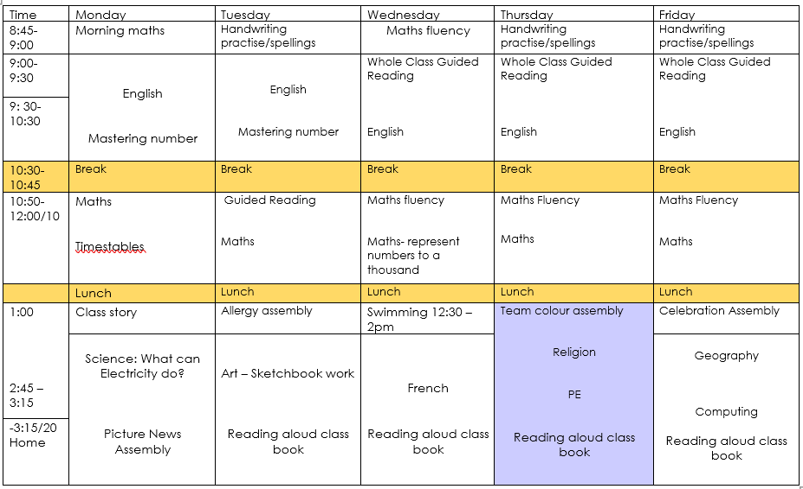
What does our day look like?

Slide 7

Strive for five!
In everything we do, we strive for five!
Trying our best with…
Presentation
Handwriting
Spellings
Punctuation
Quantity and Quality

Slide 8
English
Reading
- Focus on establishing a Love of Reading
- Both building fluency and comprehension.
- Read aloud sessions every day
Writing
- Range of genres, both fiction and non fiction across the year.
- Focus on creativity and exciting writing.
Grammar, Punctuation and Spelling
- Taught both discretely and during English lessons.
- List of Y1/Y2 spellings and Y3/4spellings displayed on class page of the website. Spelling linked to homework.
Handwriting
- Cursive, joined handwriting

Slide 9
Reading expectations
- Whole Class Guided Reading (Use of Pathways to Read)
- Read aloud with greater fluency and speed
- Re-tell and sequence stories and poems (Storyhouse)
- Continue to retrieve information and develop inference skills
- Children will be listened to read in school regularly
- Books will be changed weekly (have reading records and books in school every day please)
- Use of Seesaw to record books going home
- 1 instructional book and 1 reading for pleasure book.

Slide 10
Maths
Mathematics: Developing mental and written methods.
Mastery Approach
  Fluency: learning and practising a skill, concept or method.
  Reasoning and Problem Solving: applying and explaining their knowledge in various contexts as well as solving problems.
  Only then can we really say they have ‘mastered’ that skill.
Times tables up to 12x12 at a good pace of recall should be known by the end of Year 4.
  Year 4 focus is on 6, 7, 9, 11 and 12.
  But, we will also continue to work on 2, 5,10, 3, 4 and 8 where needed.
  Homework focus. Support from home in hugely important!
  Children in Year 4 are also expected to undertake a statutory Times Table Check.
  (June, x25 questions, 6 seconds per question)

Slide 11
Teacher Assessments
Ongoing throughout the year to build up a picture of your child’s achievement and progress through:
  Formal tests (NTS paper 2 x per year, statutory MTC)
  Comprehensions,
  Dictated sentences
  Marking, observation and feedback.
  Discussion and questioning
  Encouraging independence

Slide 12
Homework in KS2
Reading at least 4 times a week
Reading records – please encourage children to sign and comment in the reading record for any reading or complete yourselves. What is their reading diet?
Mental Maths: Practise of mental maths skills, times tables, doubling, halving etc.
Spelling activity.
Homework books are handed out on a Thursday and collected in on a Tuesday. Please maintain these books to show high expectation at home and at school.
To be set on Seesaw. Please use the QR codes to get set up ready.

Slide 13
Useful Information
PE is currently on Wednesday (swimming until Christmas) and Thursday. Come to school in PE kit.
Forest School during Spring 2
Reading books- aim to change them once a week.
Seesaw and class page on website to keep up to date about what we have been learning about.
Additional notes/class info will be sent out via homework wherever possible.

Slide 14

How can I help at home?
Read, read, read (great list of recommended reads on the Year 4 class page, including first chapter books) 7779027_grade_file.pdf
Support with homework and spelling activities, revisit spellings over the week.
Practice letter and number formation- presentation/handwriting
Encourage both effort and positive attitude
Talk about your child’s learning use the curriculum overview and seesaw as a guide.
Encourage your child to be independent – taking responsibility for own property (names in please), their own behaviour and their own attitude to learning
Let us know of any significant changes.
Order lunches at home (via school gateway) and let your child know what they are having.
Add what you have been up to onto Seesaw to discuss with the children.

Slide 15
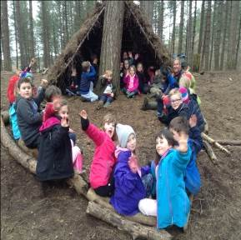
Looking ahead:
First Access Music- Spring term
Class Visits/trips – TBC
Forest School – Spring 2
Ironbridge Residential
  Date TBC
  Two nights

Slide 16
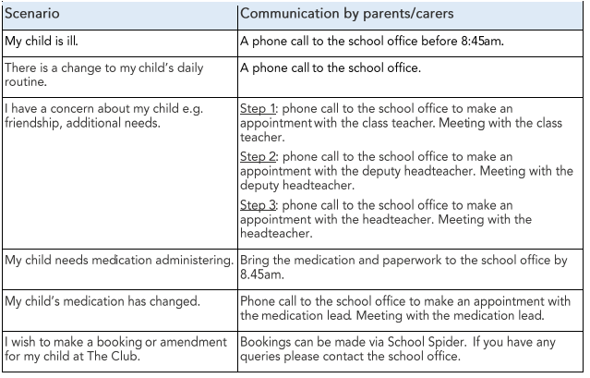
Communication
School website - check homepage, class newsletters, homework, seesaw
Email admin@sandiway.cheshire.sch.uk

Slide 17
Use of social media relating to school
We politely ask that any photos of children taken are not to be shared online.
Please voice questions/ queries directly with school so we can help directly.
We appreciate your understanding in this matter.

Slide 18
....and finally!
No toys, please limit things that are being brought into school.
All jumpers and cardigans must be named
Please provide healthy snacks for school, fruit/veg in afternoon break please except after swimming. Please remember no nuts! Avoid chocolate, sweets, cake and crisps please.
Water bottles – No juice, only water and please name bottles too.
Children need to learn how to tie their own laces please.

Slide 19

Any questions?
We look forward to an exciting year full of challenges and new experiences for our children.
Many thanks for joining us this evening.

