Slide 1
Welcome to
Year Three (KS2)
2025 - 2026

Slide 2
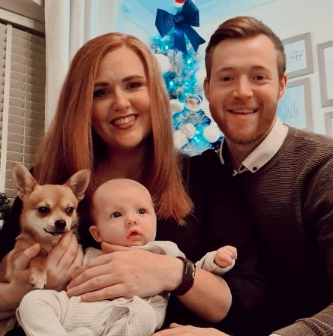
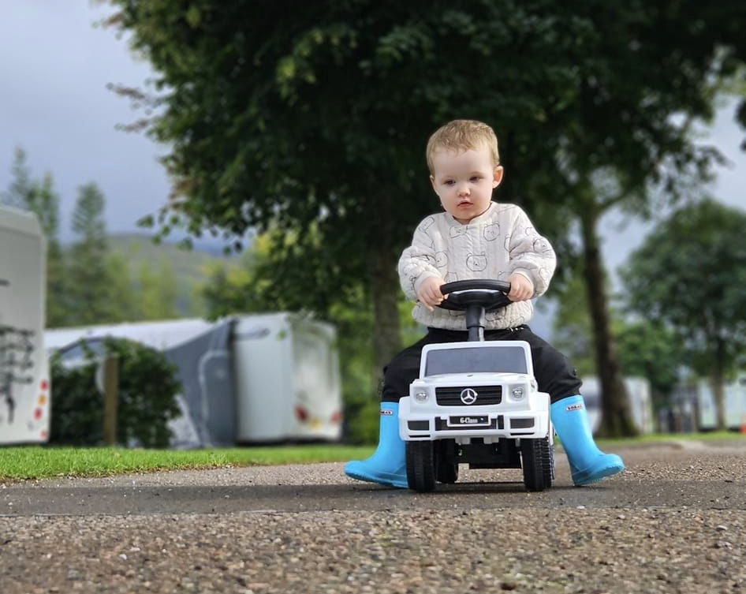
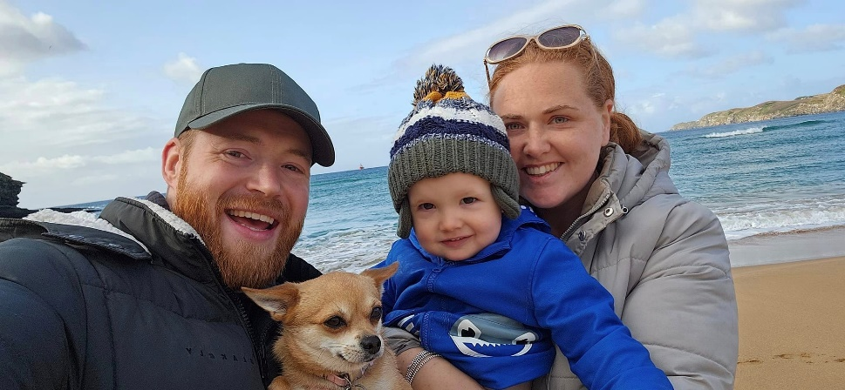
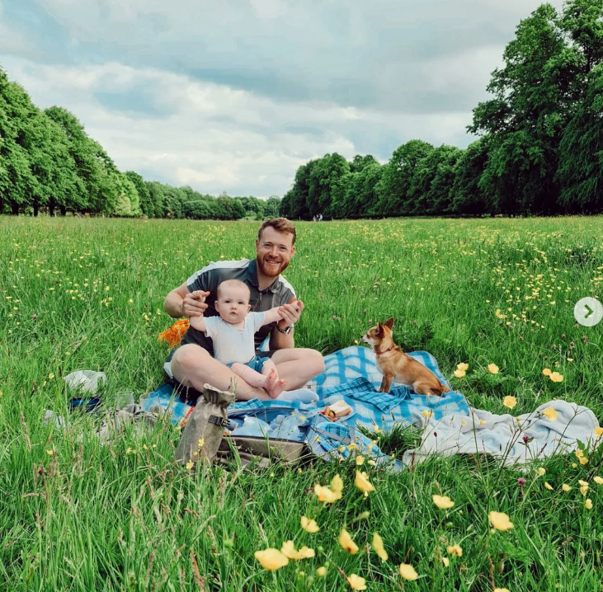
A little about me.
I am excited to be Teaching Year 3 at Sandiway this year. Here’s a little bit about me. I have a range of experience across both KS1 and KS2. My teaching philosophy is based all around the growth mindset and positive thinking. I am great believer in teaching children the importance of learning from our mistakes and of the power of ‘Yet’. In my teaching I have a particular passion for reading, computing and the outdoors. I also believe in the importance of delivering lessons through different media’s and techniques to ensure learning is accessible for all.

Slide 3
Year 3 team…
Mr Graham (full time – Friday afternoon PPA)
Mrs Tucker (Music, PSHE, PE)
Mrs Dalton – Class support (TA) (Shared)
Mr Coleclough – Tuesday afternoons PE and Thursday mornings for Forest school.

Slide 4
Our school values
GROWING AND ACHIEVING TOGETHER
Together we take ownership, care for and respect each other, our environment and our community.
We ROCK!
We show Respect
We take Ownership of our actions
We are Caring
and we are Kind

Slide 5
Learning in Year Three
All children receive Quality First Teaching
  Exciting
  Engaging
  Empowering
  Ways of working and procedures in class to ensure a safe working environment for us all
  When and where appropriate, learning may be adapted according to individual learning needs.
    TA support.
    Additional and extra support work as required
    Additional challenge.

Slide 6
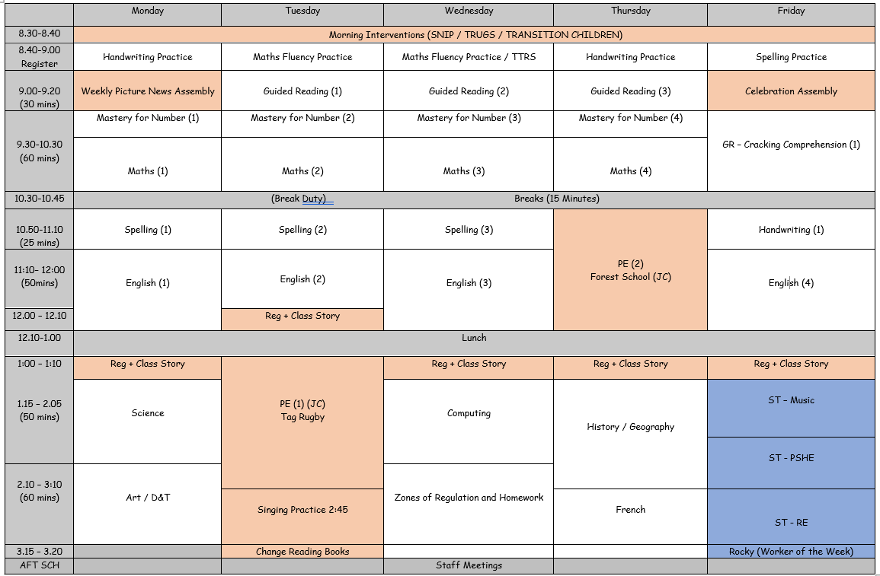
Our Curriculum
We have a subject specific approach to our learning.

Slide 7

Year Overview

Slide 8
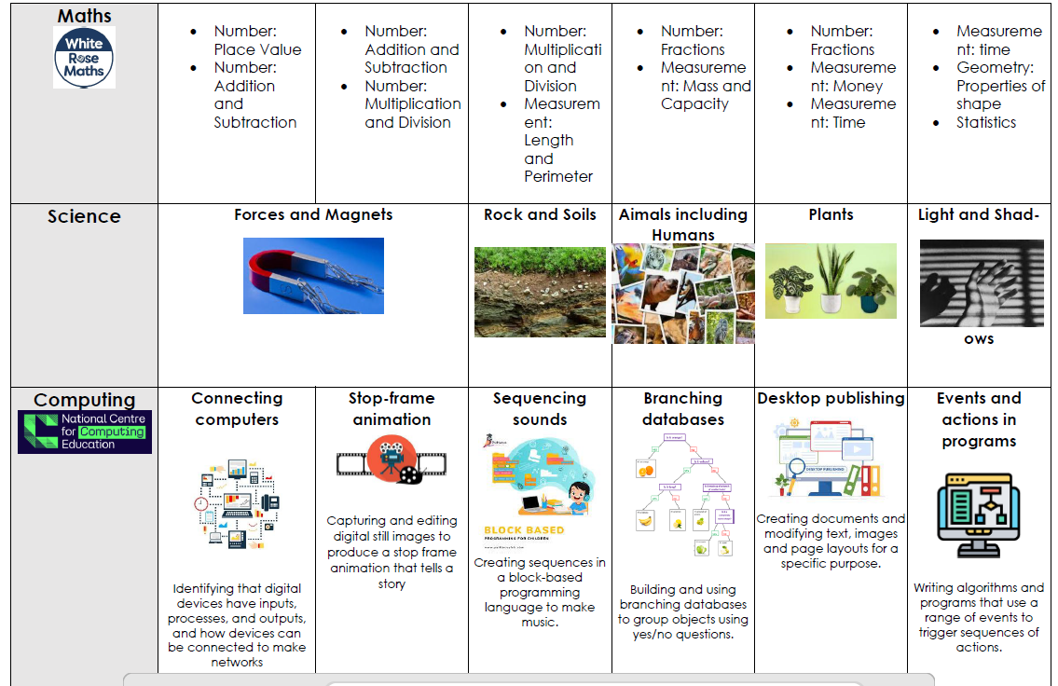

Slide 9
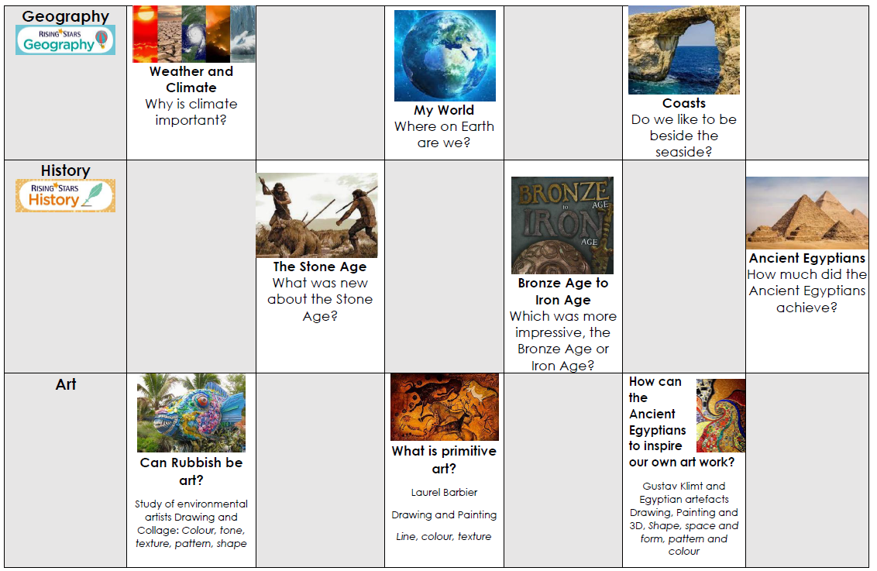

Slide 10
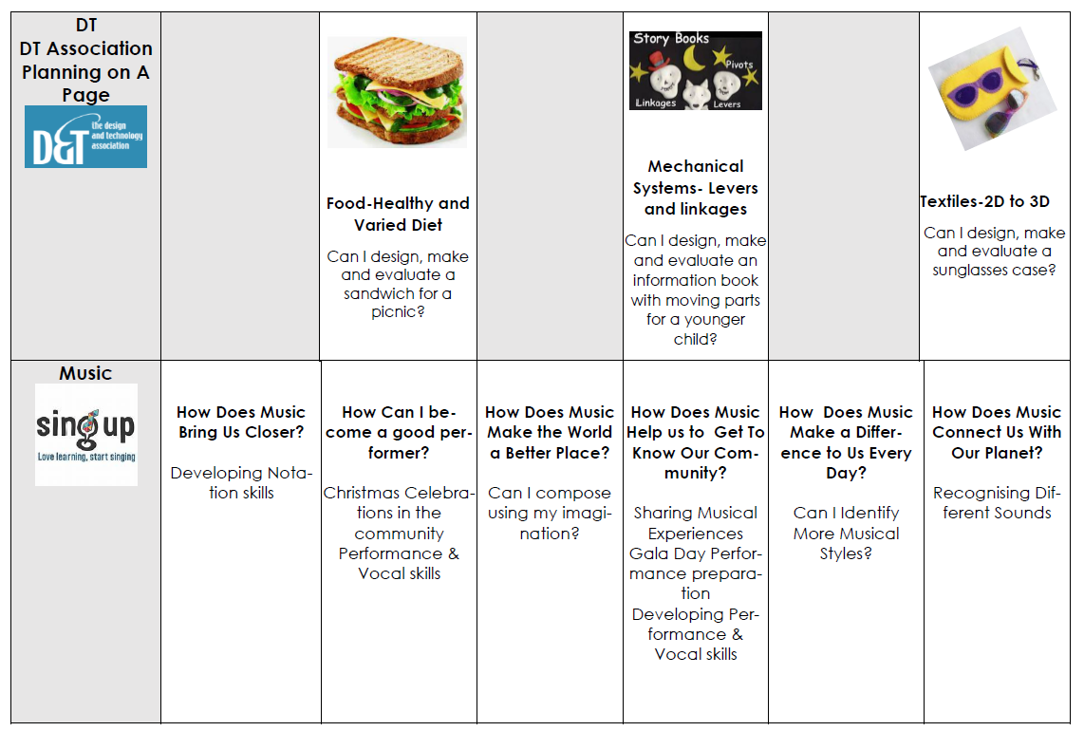

Slide 11
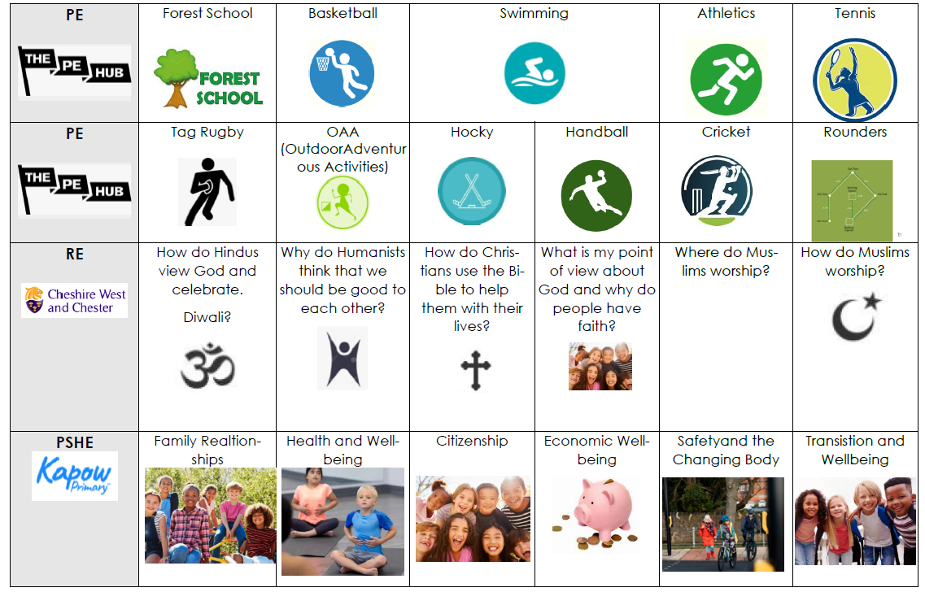

Slide 12
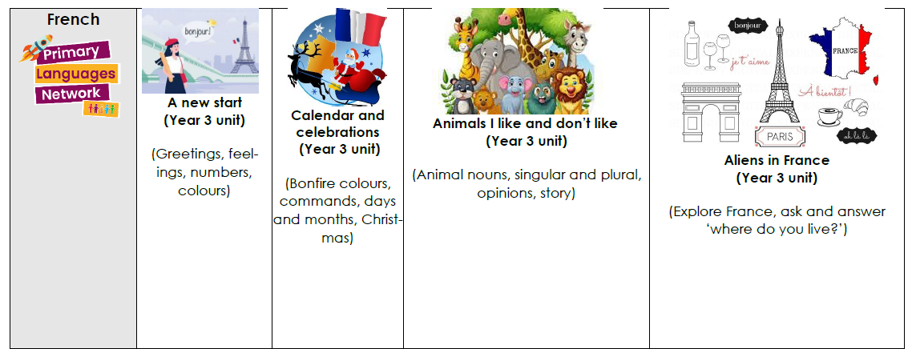

Slide 13
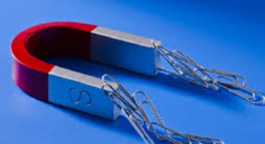
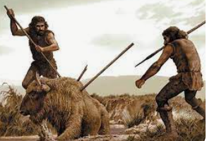
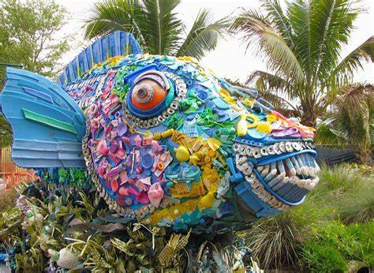
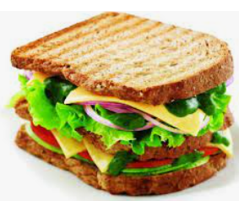







Forces and Magnets
Stone Age
Healthy and varied diet
Can Rubbish be art?
Computing systems and Networks
Hinduism
Families and relationships
Weather, Climate and biomes
A new start - greetings

Slide 14
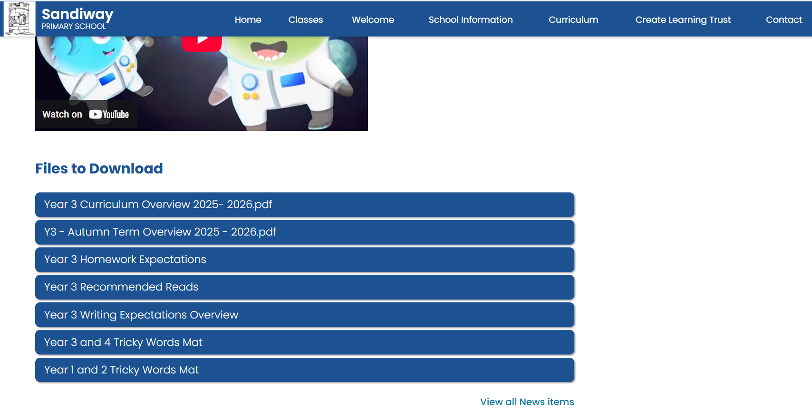

Slide 15

English
Writing
  Pathways to Write
  Range of genres, both fiction and non fiction across the year.
  Focus on creativity and exciting writing.

Slide 16

Grammar, Punctuation and Spelling
  Taught both discretely and during English lessons.
  Pathways to Spell.
  List of Year 3/4 spellings are displayed on the Year 3 page of the website. (set as homework)
Reading
  Pathways to Read
  Both word reading and comprehension. Increased focus on higher level comprehension skills as Y3 progresses.

Slide 17

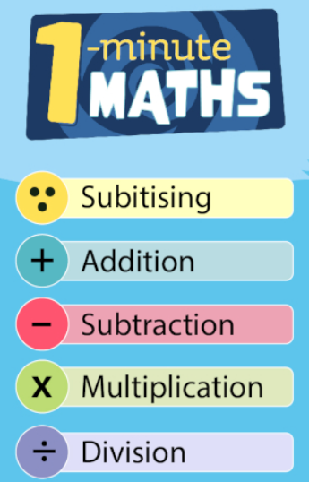
Maths
Mathematics: Developing mental and written methods.
Mastery Approach
  Arithmetic sessions: learning and practising a skill, concept or method.
  Fluency, Reasoning and Problem Solving: applying and explaining their knowledge in various contexts as well as solving problems.
    Only then can we really say they have ‘mastered’ that skill.
  Times tables - Year 3 focus is on 2, 5,10, 3, 4 and 8
  Times tables up to 12x12 at a good pace of recall should be known by the end of Year 4 in readiness for the National Times table check.
  Homework focus. Support from home in hugely important!

Slide 18
Teacher Assessments
Throughout the year to build up a picture of your child’s achievement and progress through:
  Formal tests (termly)
  Dictated sentences and spelling tests (weekly)
  Times table checks
  Marking and observation.
  Discussion and questioning
  As well as us assessing the children, we encourage them to assess themselves, reflect and evaluate on their own learning.
  All skills must be consistently applied to achieve the Year 3 curriculum.

Slide 19

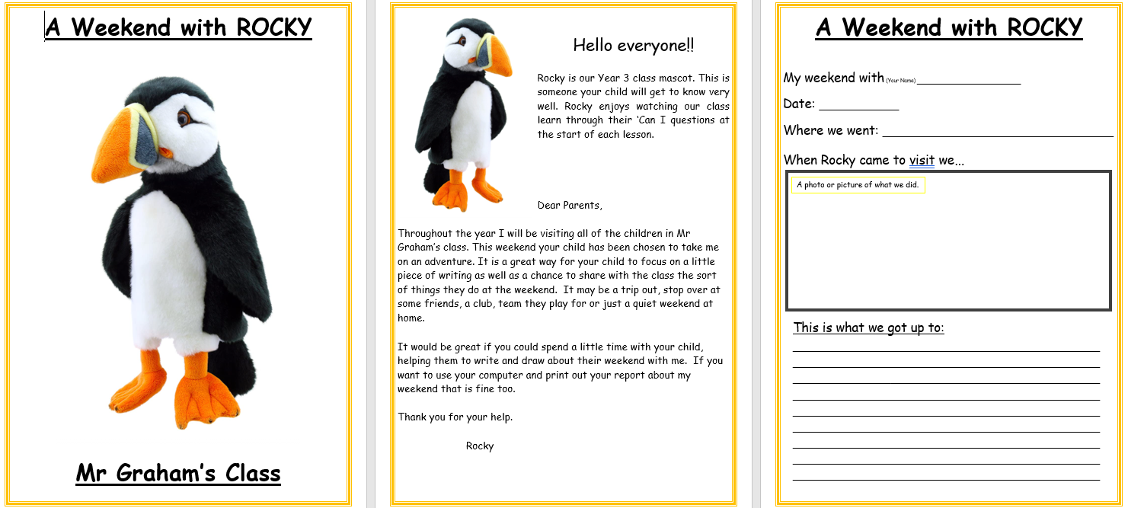



Changes this year…
KS2

Slide 20
Homework
Clear instructions given on homework sheets and expectation for homework can be found on first page.
Homework consists of:
1) Times tables/arithmetic practice
2) Reading to an adult at least x4 times a week and preferably daily.
  The children have an appropriate instruction book (Colour band) and a library book of their choice (For fun).
  Please sign/comment in the reading record for any reading.
Homework given out on a Thursday and handed in on a Tuesday.

Slide 21
Helpful information…
  PE will initially be on Tuesday afternoons (Tag Rugby) and Thursdays morning for Forest School.
  (Please come to school in PE kit).
  Sensibly sized bag (homework, reading diaries, water bottle, lunch box, PE kit).
  Please order lunches wherever possible.
  Check the class Seesaw for information about our learning as well as our class page for updates on our curriculum and learning intent.
  Please communicate via Mrs Foy in the school office if you need to make an appointment to see me. admin@sandiway.cheshire.sch.uk
  Afternoon snack

Slide 22
Seesaw
All forms of daily Class communication.
Homework
Home share stories
Updates
School learning (Photos and work)
QR – Codes easy access. (Download the app)

Slide 23

How can you help?
Support with homework, reading and times tables
An analogue watch will support your child with telling the time.
Encouraging effort, a positive attitude and independence.
Talk about your child’s learning use the Curriculum Overview as a guide.
Let us know if there are any significant changes at home.
KS2 Ready: Encourage your child to be independent – taking responsibility for own property, their own behaviour and their own attitude to learning

Slide 24
Looking ahead:
Class Visits: please keep an eye out for letters ASAP
(hard and email copies).
Art trip to British Ironwork Centre – TBC 9th October? (£12)
Exciting opportunity to work with Story House this year.
Forest school
Swimming
Class Workshops?
Burwardsley Residential
  Summer Term (more information to follow)
  One night
  Relating to our geography and history subjects

Slide 25
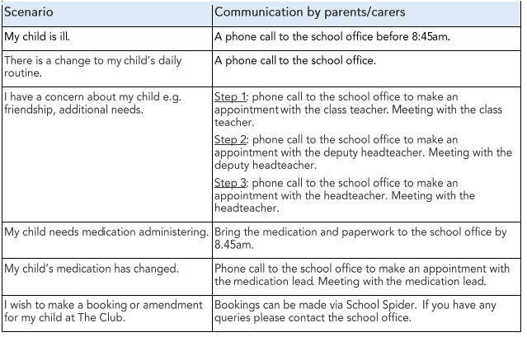
Communication
School website - check homepage, class newsletters, homework
New channel of communication as outlined in the newsletter:

Slide 26
....and finally!
Social Media
We politely ask that any written comments that make reference to school, specific classes and particularly members of staff are done so in a courteous and respectful manner.
As professionals, we try incredibly hard to make the right choices for our children. Therefore, should we be made aware of malicious comments, school may intervene.
Please voice any concerns or questions directly with school so we can help directly.
We appreciate your understanding in this matter.

Slide 27
Open Communication
48 Hours Respond
☺

Slide 28
Any question?
?

