Slide 1

Being a Parent Governor:
The Role of a Governor
Parent Governors
As a parent governor you would have the opportunity to contribute to the overall management of the school. Working with a team of other governors, you would help to ensure that the school is doing all it can to provide the best possible education for all children - both in terms of the direct teaching and learning but also by ensuring a good provision of resources, activities, opportunities and a positive, safe, learning environment.
School governors are people who want to make a positive contribution to children’s education. They have an important role to play in raising school standards. (National Governors Association)
Core Functions
The main role of the Governing Body and all governors is to:
• set the vision, ethos and strategic direction for the school
• challenge teaching and learning
• oversee the school finances and premise management
Personal Attributes
• a strong commitment and enthusiasm for the role and to improving outcomes for all children
• the inquisitiveness to question and analyze
• the willingness to learn
The Role:
The Governing Body meets once each half term. In addition, all governors sit on at least one of the committees which usually hold meetings shortly before the full governing body meetings. As part of their monitoring function, it is hoped that all governors will also plan and make visits to the school in order that they can report on their link areas/classes. The term of office for a parent governor is 4 years. All training is provided through a governor training program, and it is expected that all governors will take part in this training. It is also hoped that governors will use those skills which they bring to the role to assist in moving the school forward. Out of pocket expenses can be reimbursed pursuant to the Governor Expenses Policy
Middlewich Primary School
Park Road, Middlewich, Cheshire CW10 9BS
Tel: 01606652321
Email: admin@middlewichpri.cheshire.sch.uk

Slide 2
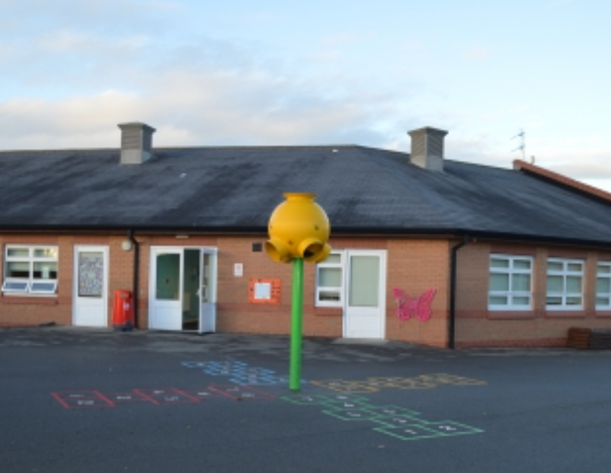
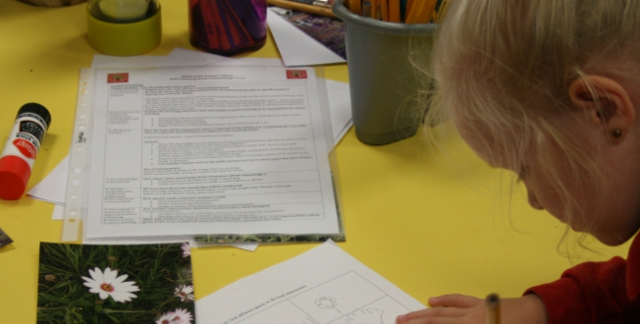
What else do school governors do:
Eligibility:
All applicants must be at least 18 years of age. They must have a child on the register of the school. The term ‘parent is used to include:
• natural or adoptive parents
• a person who has or has held parental responsibility for, or cares for, or has cared for a child or young person
• a person the child lives with and who looks after the child regardless of what their relationship is with the child, e.g. step-father, grandparents and foster parents.
No parent or carer engaged in paid employment at the school for more than 50 hours in any consecutive 12-month period can stand for election as a parent governor of that school, nor can an elected member of the Local Authority.
be a critical friend to the school, offering support and advice
help the school respond to the needs of parents and the community
work with the school on planning, developing policies and keeping the school under review
exercise its responsibilities and powers in partnership with the Head Teacher and staff
make the school accountable to the public for what it does
keep the pressure up on school improvement
help the school to set high standards by planning for the school’s future and setting targets for school improvement
The Application Process:
Any parent interested in applying to fill one of the parent governor vacancies should complete the nomination form attached to the Head Teacher’s letter. Please feel free to attach a copy of your CV as well, should you wish to do so (this will not be circulated). This nomination form must be received at the School Office, addressed to the Head Teacher by the date specified in the Head Teacher’s letter. If you have any questions related to the role, please do not hesitate to contact the Chair of Governors, by leaving a message and your contact details at the school office. If you have any questions related to the application process, please speak to one of the staff in the School Office
Elections:
If there are more applicants than vacancies, an election will take place on the date specified in the Head Teacher’s letter. This ballot will be conducted via secret ballot. Each parent with at least one child at the school shall be eligible to vote. Proxy voting will not be allowed. Responsibility for counting the votes will rest with the School Office who shall act as returning officer. Election will be by majority vote. Ties will be determined by the drawing of lots.

