Slide 1
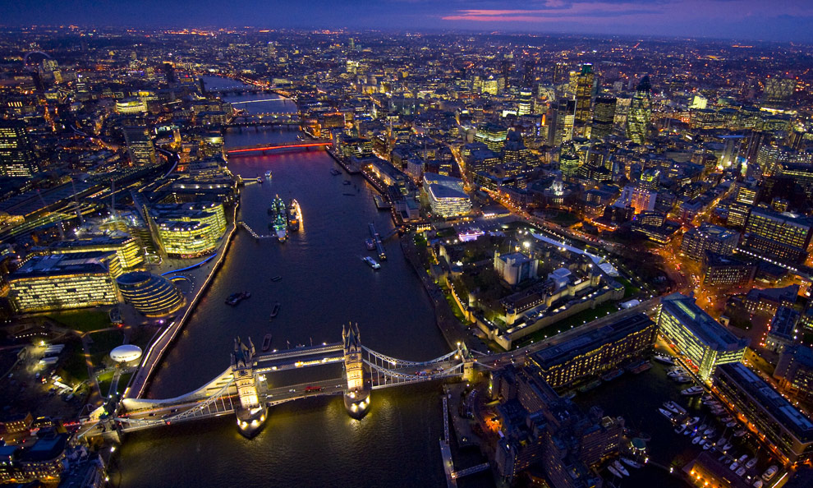
The Naughty Bus Visits London

Slide 2
London
London is the biggest city in Britain.
8,000,000 people live in London.
London has an underground train called the ‘tube’.
Lots of people visit London to see many famous sites.

Slide 3
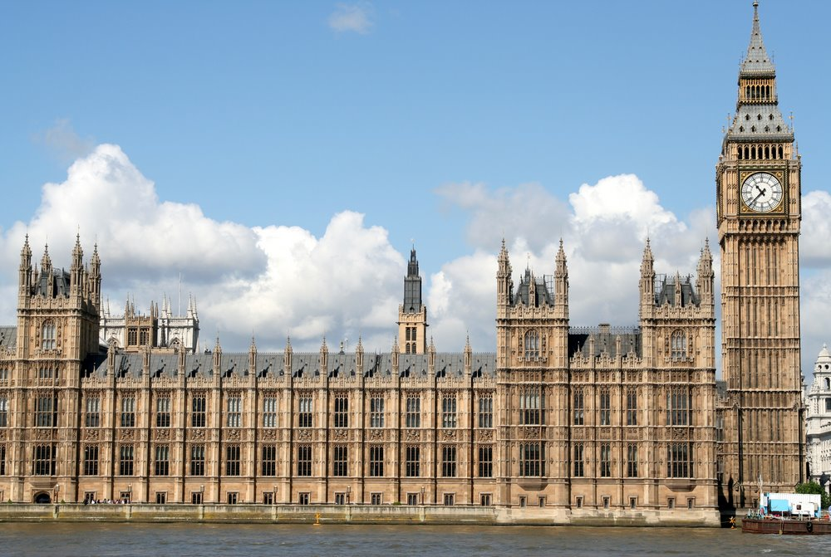
Houses of parliament
It is where all British laws are decided.
There are 1000 rooms in the Houses of Parliament.

Slide 4
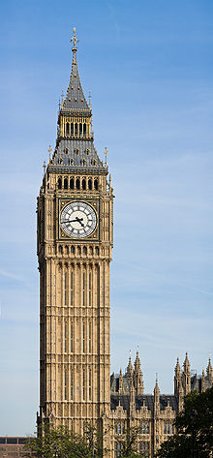
Big Ben
Big Ben is a famous London clock.
It is 96 metres tall!
It can be heard far away.

Slide 5
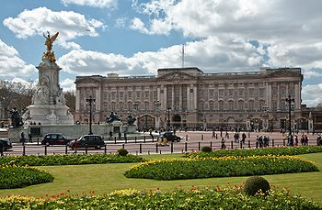
Buckingham palace
This is where the Queen lives.
It has 775 rooms.
There are 760 windows in Buckingham Palace.
A flag always flies above Buckingham Palace.

Slide 6
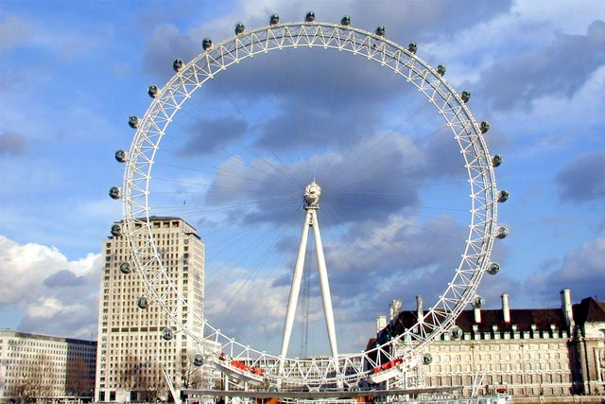
London eye
The London Eye lets people see all of London.
There are 32 pods on the London Eye.
It takes 30 minutes to go all the way around.

Slide 7
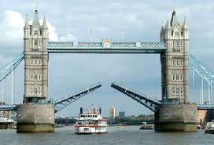
tower bridge
It is over the River Thames.
The middle part of the bridge raises up to let ships through.
The River Thames is the second longest river in England.

Slide 8
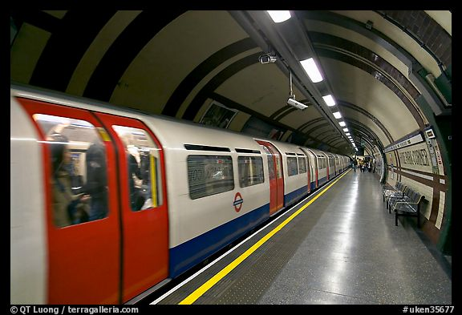
Tube trains
London was the first country in the world to have an underground railway.
Underground trains go really fast!
The trains go under the city.
There are 270 stations underneath the ground.

Slide 9
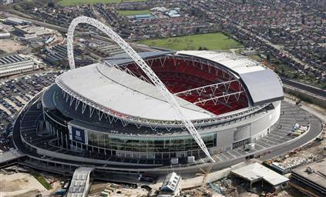
Wembley Stadium
You can watch football and rugby here.
You can listen to music here.
The Olympic Games were here.

Slide 10
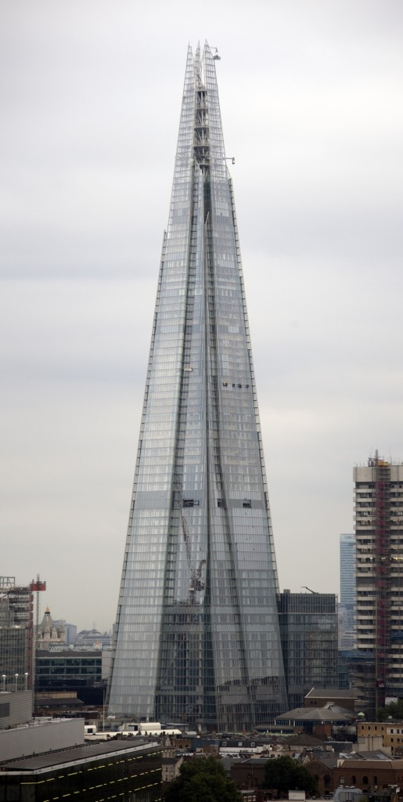
The Shard
It is a big building.
People eat, sleep and work here.
It is very tall!

Slide 11
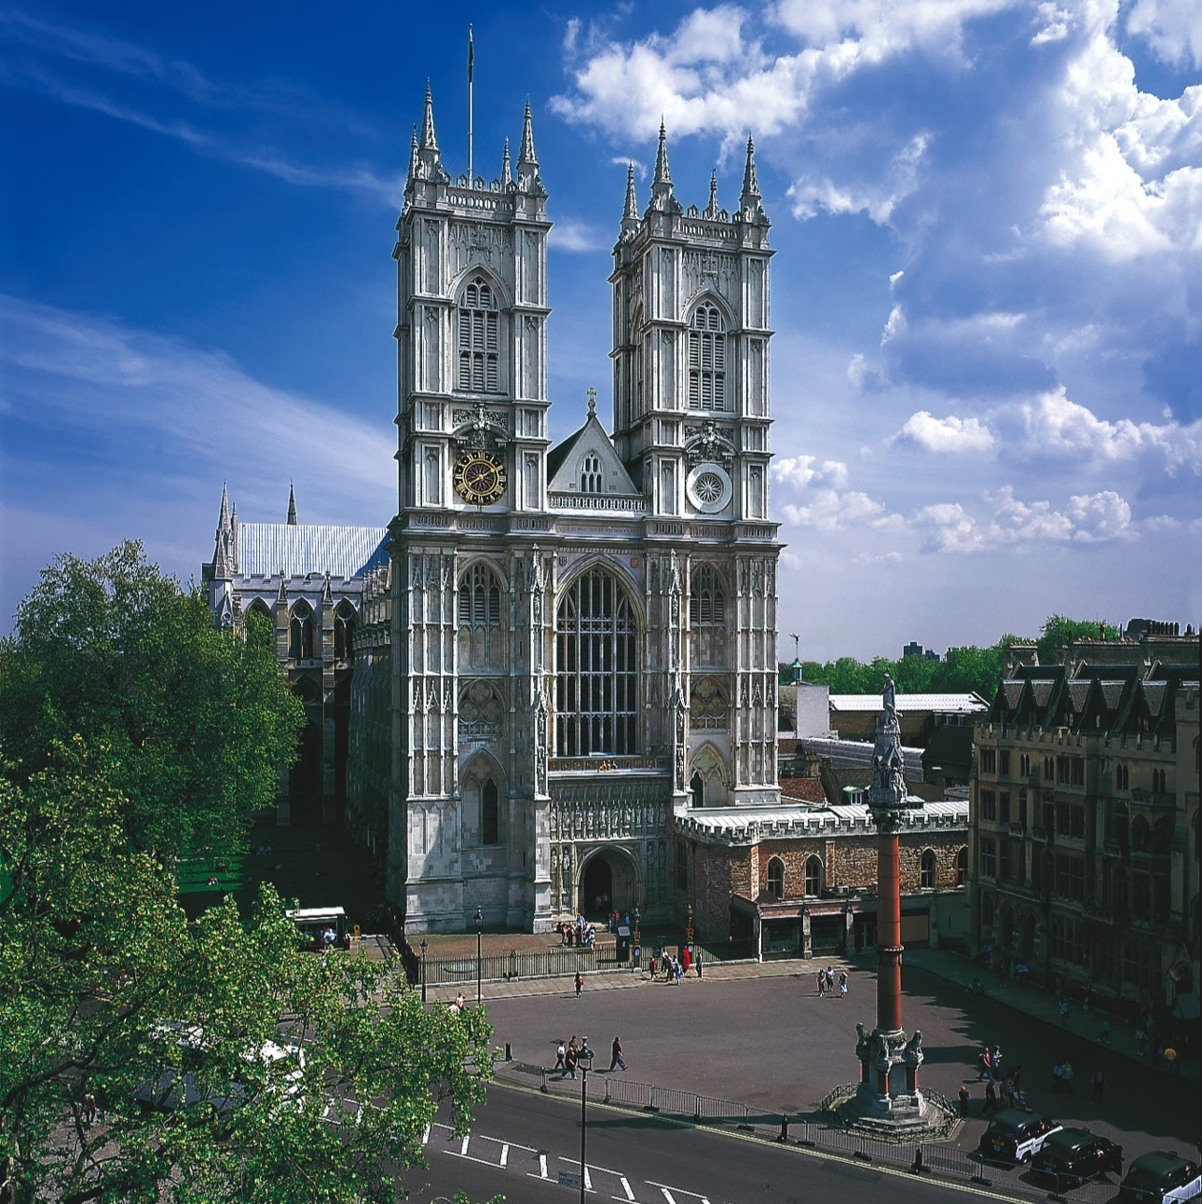
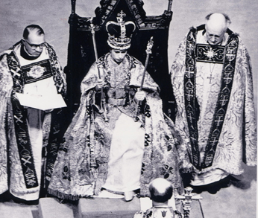
Westminster Abbey
It is a big Church.
It is where the Queen was given her crown.
Lots of Royal people are married here.

Slide 12
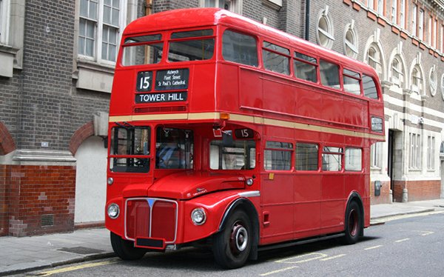
London Bus

