Slide 2
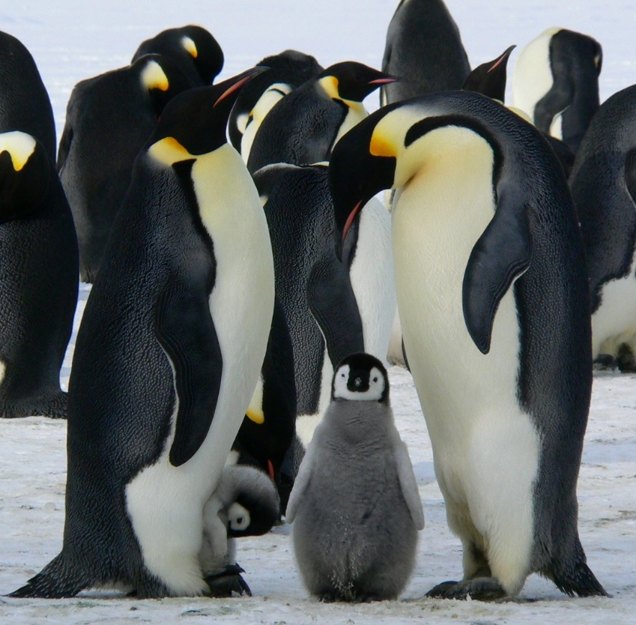
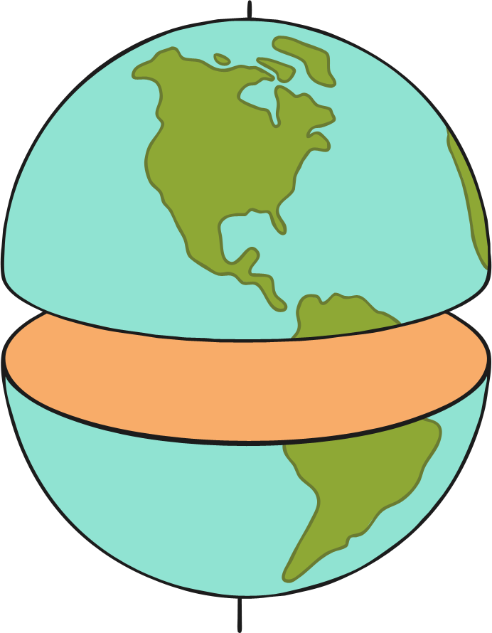
Penguins
Penguins live in the southern hemisphere, which is the bottom half of the world.

Slide 3
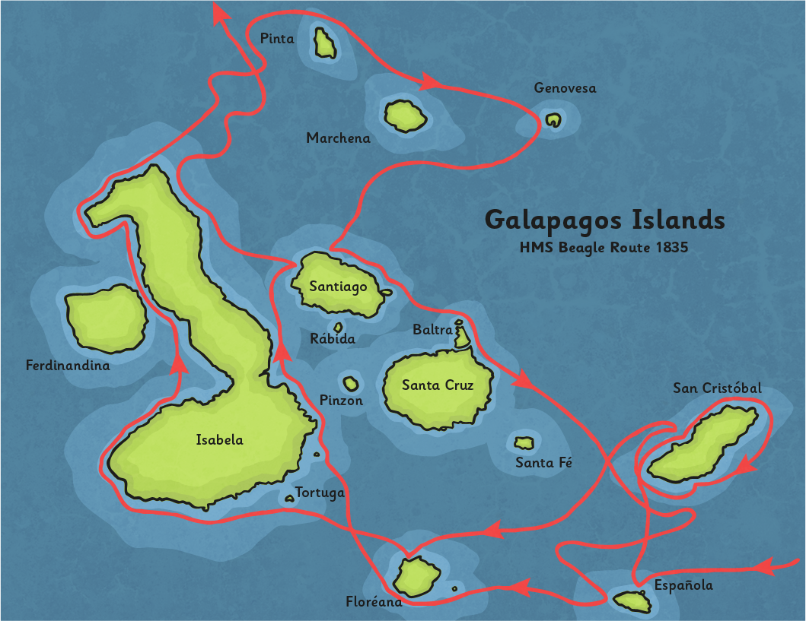
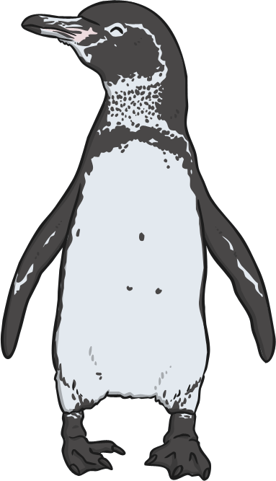
Penguins
Most people imagine penguins living in snow and ice. Lots of penguins do live in cold regions, but some species have made their homes in warmer places.
Galápagos penguins are found in the Galápagos Islands, where the weather
is warm and the penguins live
in burrows.

Slide 4
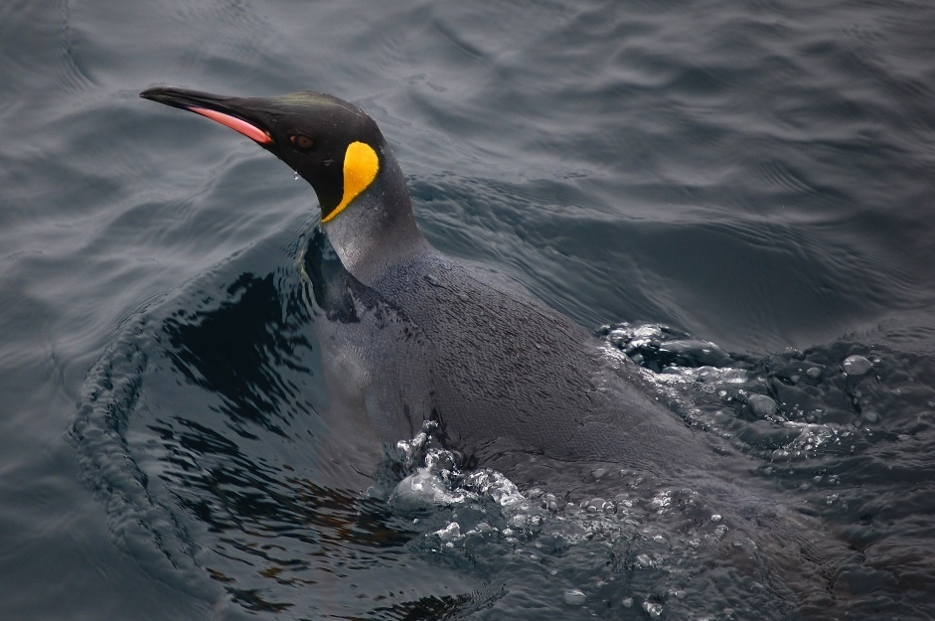
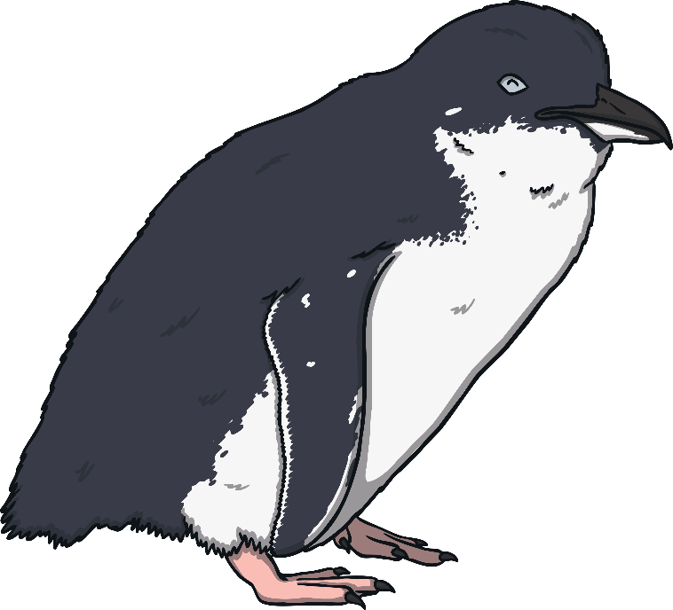
Penguins
Penguins spend most of their lives in the water and they are able to swim expertly. They have sleek, waterproof feathers, which lie flat against their bodies, letting them glide through the water.
Because their bodies are designed to swim, they find it hard to move about on land, waddling slowly while balancing with their wings.

Slide 5
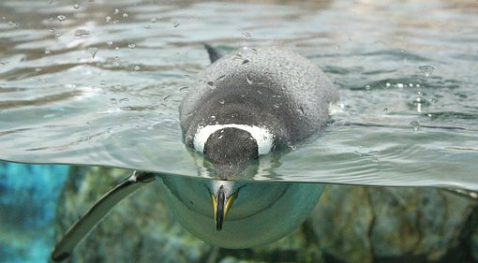
Penguins
They also have a thick layer of fat, which helps to insulate their bodies.
Insulate means to trap heat inside.
They can spend large amounts of time in cold water so it is important for them to stay warm.

Slide 6
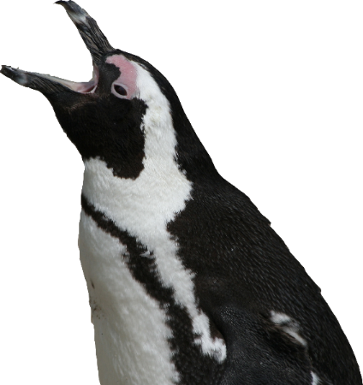
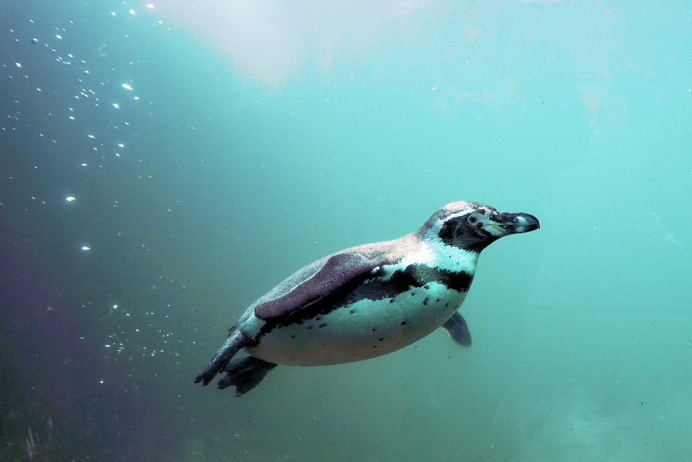
Penguins
Penguins survive by hunting and eating fish.
They are able to open their beaks wide to allow
them to swallow fish whole.
Though penguins can swim well and hold their breath for up to 30 minutes, they never dive down too deeply, as the fish they hunt swim near the surface.

Slide 7
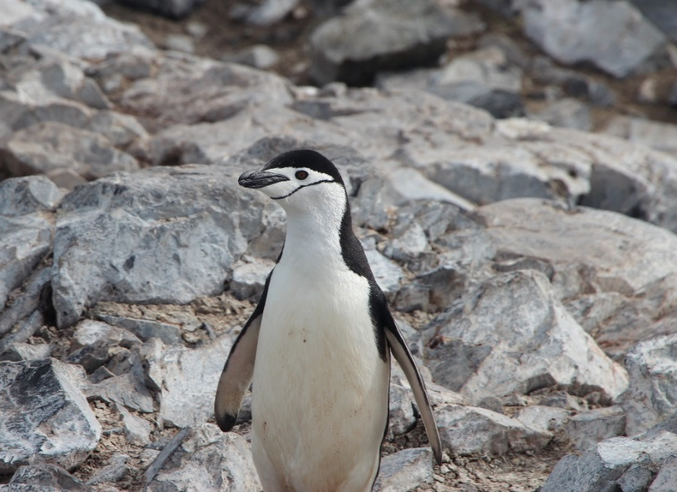
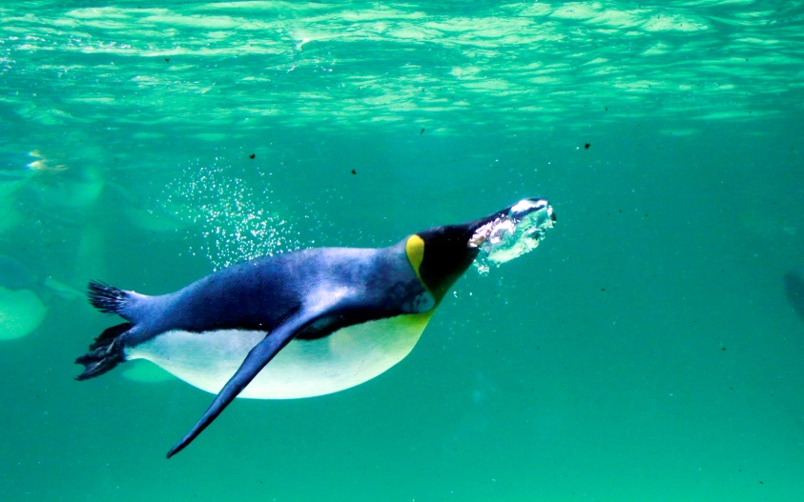
Feathers
Their feathers are very special. Not only are they waterproof, but they have another important job.
The colours allow them to blend in with their surroundings.
When they are swimming, the feathers stop them from being spotted by animals that might hurt them.
Photo courtesy of Bill Harrison (@flickr.com) - granted under creatve commons licence – attribution

Slide 8
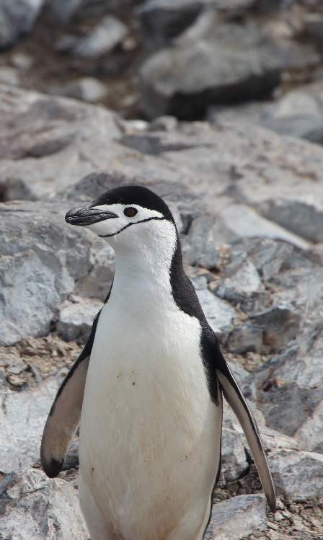
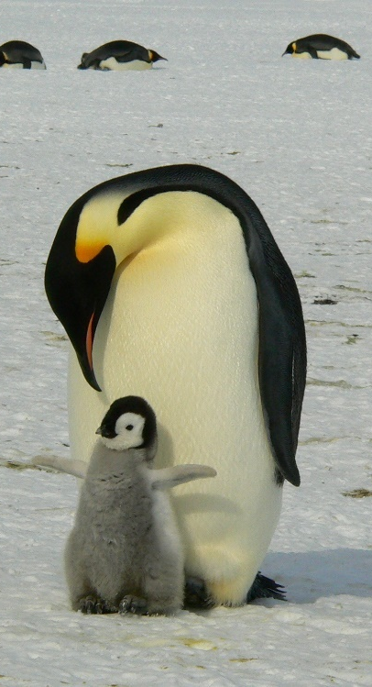
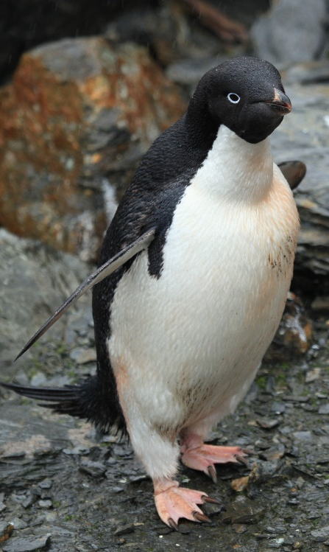
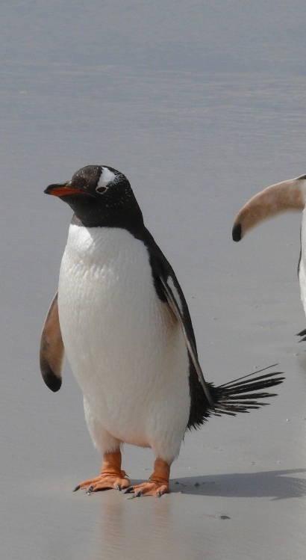
Antarctic Penguins
Some species of penguin are found in the Antarctic.
chinstrap
emperor
Adélie
Gentoo
Photo courtesy of liamq(@flickr.com) - granted under creative commons licence – attribution

Slide 9

Emperor Penguins
Emperor penguins have their chicks during the Antarctic winter.
Baby emperor penguins are cared for by both the mother and father. The female lays the egg, and the male keeps it warm while the female hunts
for food.

Slide 10
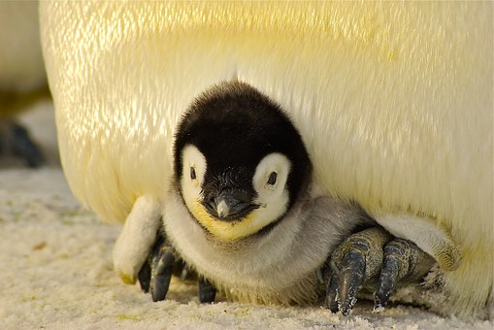
Emperor Penguins
After the egg has hatched, they then take turns to care for the chick.
To stop the chicks from getting too cold, they will sit on their parents’ feet, tucked in warm, underneath their feathers.

Slide 11
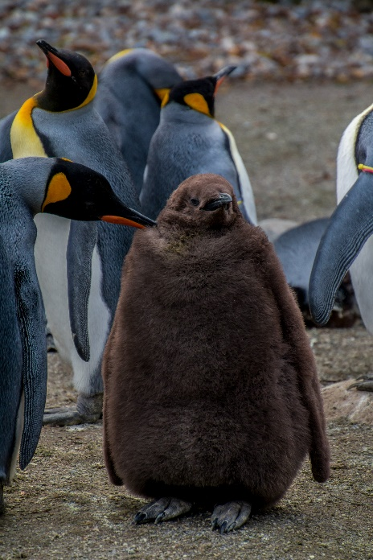
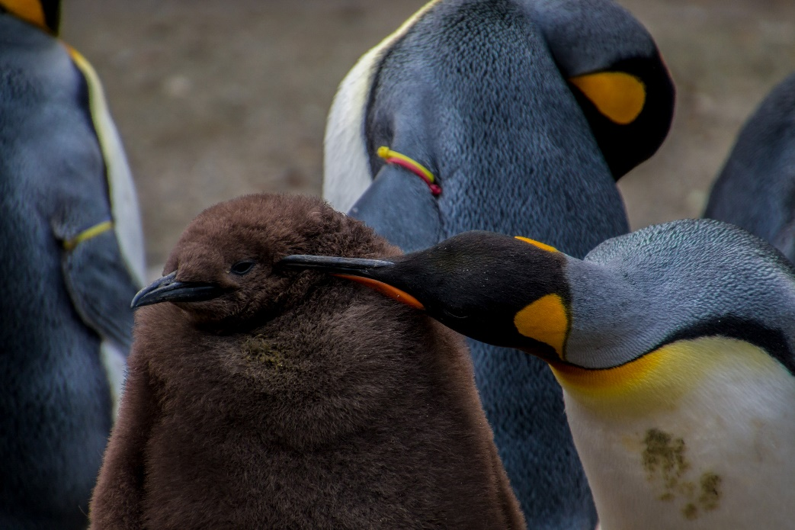
Emperor Penguins
The chicks are covered in a thick layer of downy feathers to keep them warm as they grow. They cannot head out to swim with these feathers.
As they get older and stronger, they lose their baby feathers and get their sleek, shiny, waterproof adult feathers.

Slide 12

Fun Facts
Emperor penguins can grow up to 122cm tall and
weigh up to 45kg.
During the winter, adult emperor penguins trek for
up to 120km across the ice to breed!
Emperor penguins usually live to around 20 years
old, although some can live for as long as 50 years.

