Slide 1
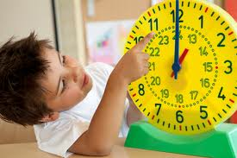
How do we measure time?

Slide 2
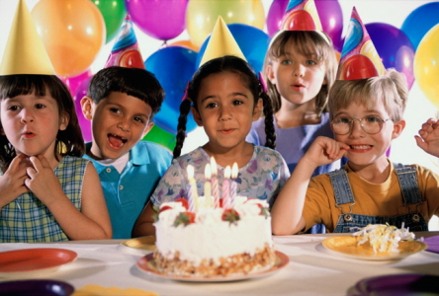
We measure time in years.
Each year we have a birthday!

Slide 3

Each year we celebrate the New Year.

Slide 4
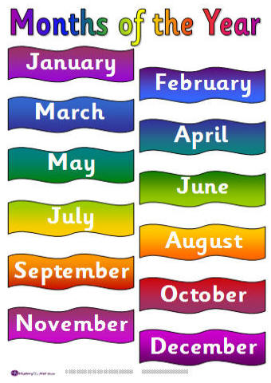
We also measure time in months.

Slide 5
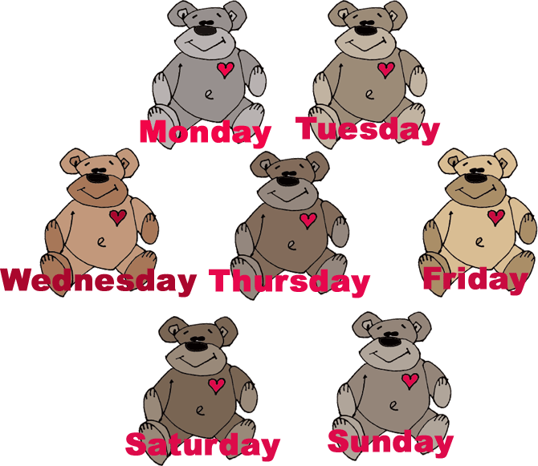
We also measure time in weeks…

Slide 6
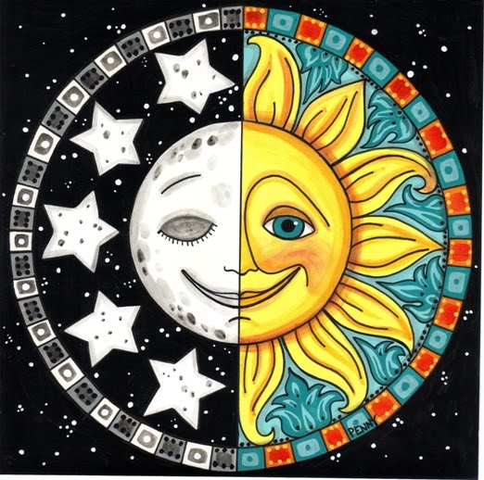
and in days.

Slide 7
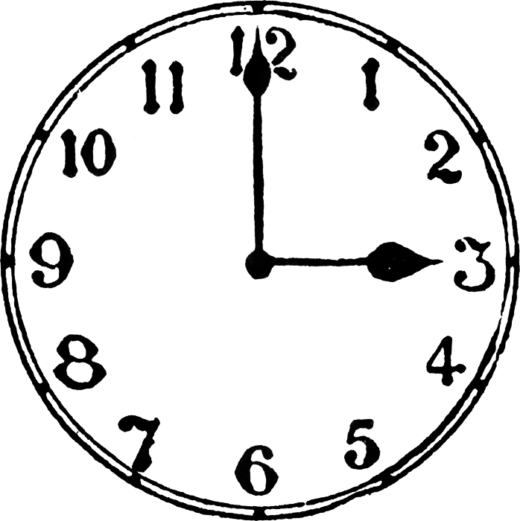
We measure time in hours,

Slide 8
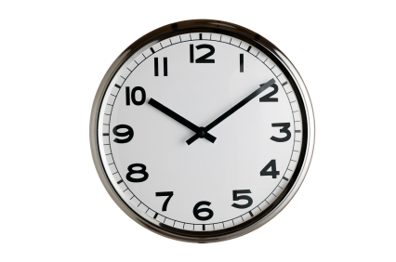
minutes,

Slide 9
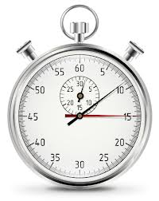
and seconds.

Slide 10

How can we measure one minute?

Slide 11
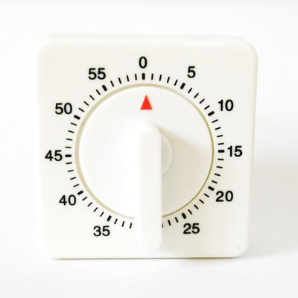
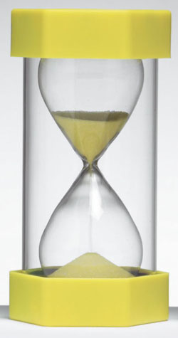
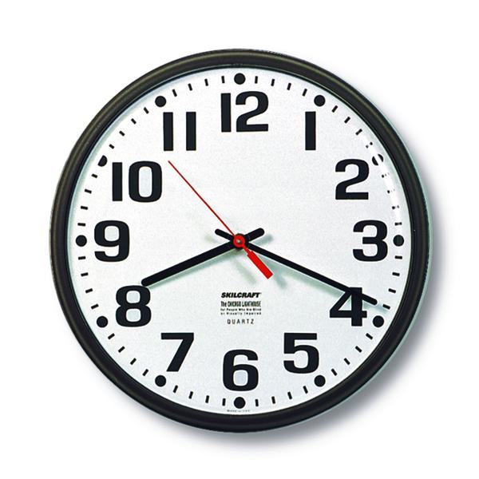
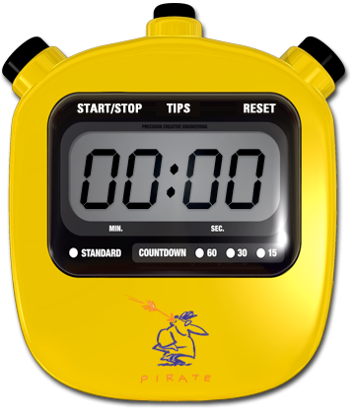
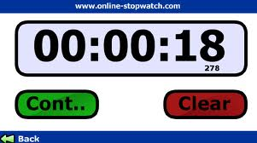
Using a kitchen timer
Watching the second hand on a clock
One minute sand timer
Using an online timer
Using a stopwatch

Slide 12
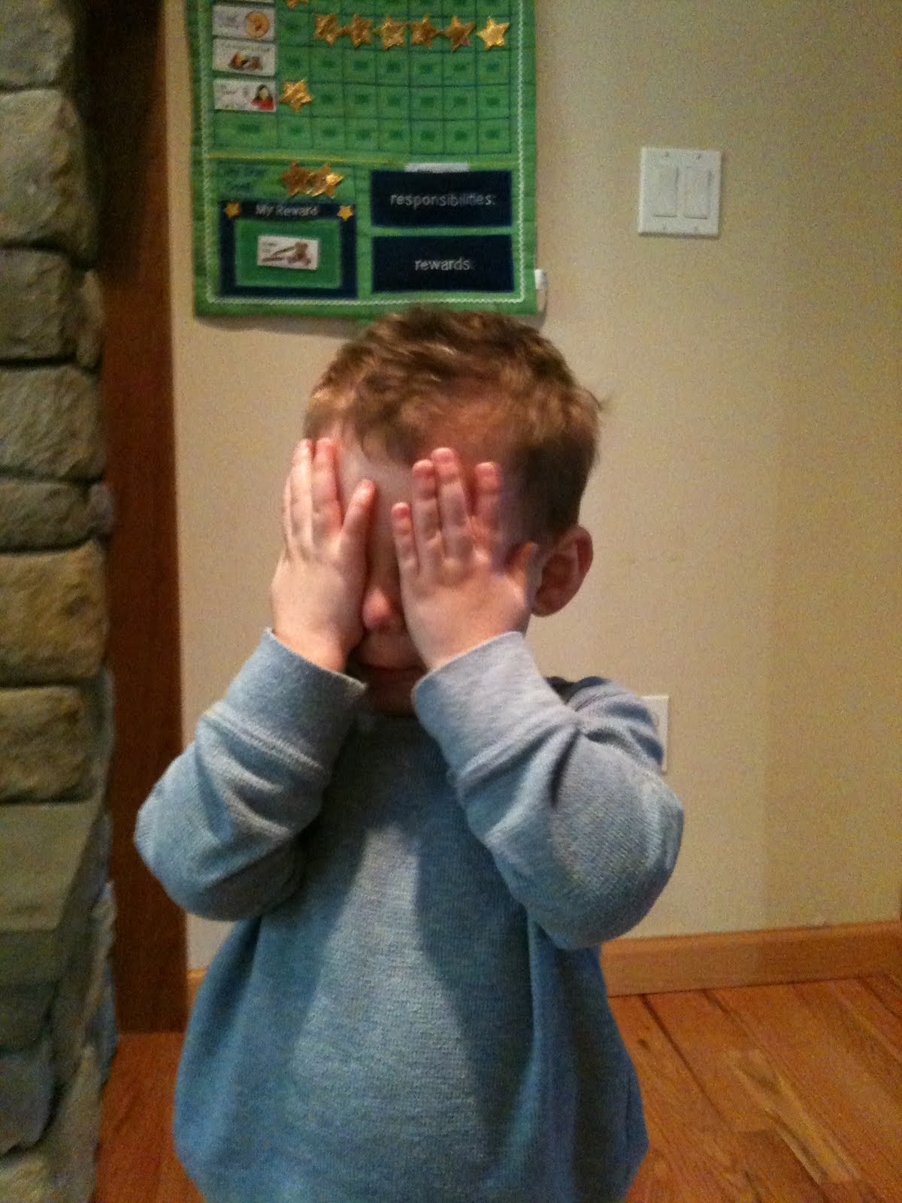
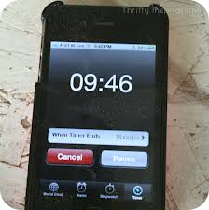
Using a timer or stopwatch on a phone
By counting, one mississippi, two mississippi …

Slide 13

Measuring time is fun.

