Slide 1


Slide 2

Welcome Page
Online Gaming
Making Friends
Online Bullying
Sharing Information
www.onlinesafety.com
The Internet is amazing when used safely and correctly.
Here are some simple rules that will help you stay safe online.
Loading ….
Be smart and safe by making the right choices.

Slide 3

Welcome Page
Online Gaming
Making Friends
Online Bullying
Sharing Information
www.onlinesafety.com
If you see something online that upsets you:
STOP - Stop what you are doing. Do not click on the page or reply to any messages.
CLOSE - Close the laptop. Put your phone or tablet down.
TELL - Tell a trusted adult.

Slide 4

Welcome Page
Online Gaming
Making Friends
Online Bullying
Sharing Information
www.onlinesafety.com/onlinegaming
Online Gaming
Always ask a trusted adult before you play games online.
Use a username instead of your real name when playing games online. PROTECT YOUR PERSONAL INFORMATION!
It is important to be nice to people so that you don't upset them. Remember to treat others how you would like to be treated.

Slide 5

Welcome Page
Online Gaming
Making Friends
Online Bullying
Sharing Information
www.onlinesafety.com/makingfriends
Making Friends
Only talk to people you know online. If someone you don’t know sends you a request or message, ask a trusted adult. They may put pressure on you or try to manipulate you to do and give them something.
Never agree to meet someone in person that you met online. Some people on the Internet might not be who they say they are.

Slide 6

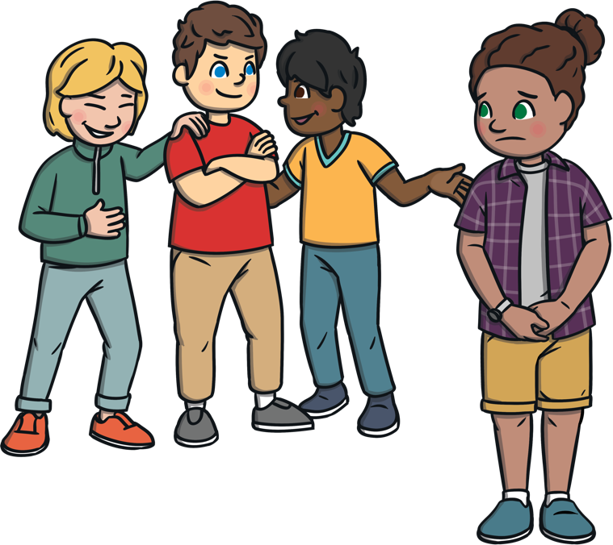
Welcome Page
Online Gaming
Making Friends
Online Bullying
Sharing Information
www.onlinesafety.com/onlinebullying
Online Bullying
Show whatever you receive to a trusted adult, so they can help you.
Online bullying is a type of bullying. It can take place when playing games or talking to people online.
Don’t keep online bullying to yourself! Tell a trusted adult. People want to help you and make it better.
If someone says something that upsets you, tell a trusted adult, such as a teacher or parent, and block the bully.

Slide 7

Welcome Page
Online Gaming
Making Friends
Online Bullying
Sharing Information
www.onlinesafety.com/sharinginformation
Sharing Information
Never share any of your personal information online, such as your name, address or school.
Instead of using a photograph, use an avatar to represent your face.
Before you share a photograph of you or your friends online, check with a trusted adult.
If you get sent a photograph that upsets you, tell a trusted adult.

Slide 8







You see a pop-up while playing an online game.
Is it okay to download this?
Yes! Free coins sound like a great deal! Downloading it will give you cool game items.
No! Fake downloads could include viruses that harm your device. Always download from official websites or stores.

Slide 9


Always watch out for pop-ups offering free stuff. Remember that you don’t often get something for nothing!
What information do they want in return for some free coins? Don’t give away your personal information to tricksters.
No! Fake downloads could include viruses that harm your device. Always download from official websites or stores.

Slide 10
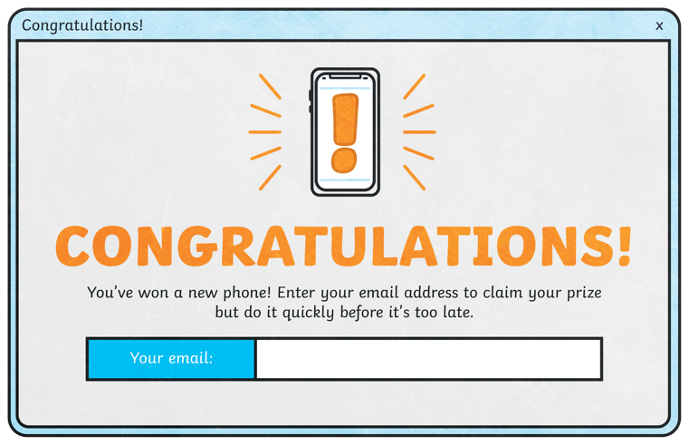
A message pops up on your device.
Should you enter your email?
Yes! You’ve won a prize! You can’t remember entering a competition but you don’t want to miss out so you need to hurry.
No! Scammers use fake prizes to trick you into giving personal information. If it seems too good to be true, it probably is!

Slide 11
Don’t be rushed into responding immediately.
Stop and think!
Have you entered a competition recently?
Scammers will try to make you act before you think.
How’s your score looking now?
Are you a top scam spotter?
No! Scammers use fake prizes to trick you into giving personal information. If it seems too good to be true, it probably is!

Slide 12
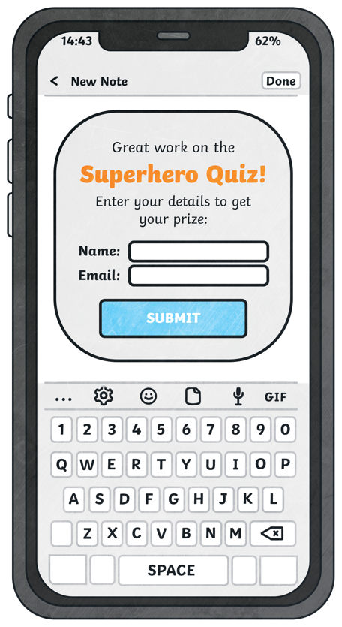
You finish an online quiz.
Should you fill in your details to get the prize?
No! This could be a scam! Scammers use fake quizzes to collect your personal information. Never enter personal details online.
Yes! It’s just a fun quiz and you’ll get a free prize! You should enter your details.

Slide 13
You can enjoy taking this fun quiz but don’t be tricked into sending your personal information to people you don’t know. They might sell your information on to someone else.
No! This could be a scam! Scammers use fake quizzes to collect your personal information. Never enter personal details online.

Slide 14
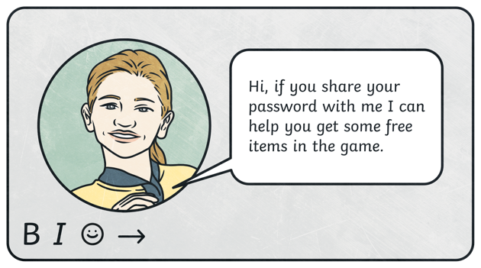
Is it wrong to share your password with this person?
Yes! Never share your passwords. Real friends will never ask for your private information like passwords.
No! If they’re going to be kind and give you free items, it’s worth sharing your password.

Slide 15
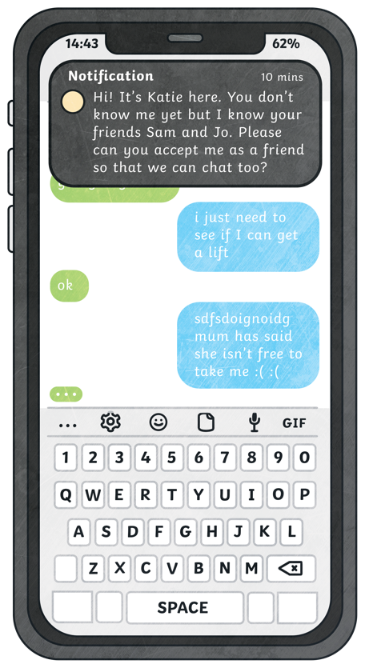
You get a friend request on your phone.
Should you accept the request?
No! Only accept friend requests from people you know in real life. Scammers sometimes pretend to be someone they're not to get your information.
Yes! It’s great to make new friends. Since they know your friends, it's okay to share your information with them.

Slide 16
This new friend may not be who they claim to be. Stick to playing with the friends you know in real life so that you can stay safe online.
No! Only accept friend requests from people you know in real life. Scammers sometimes pretend to be someone they're not to get your information.

Slide 17
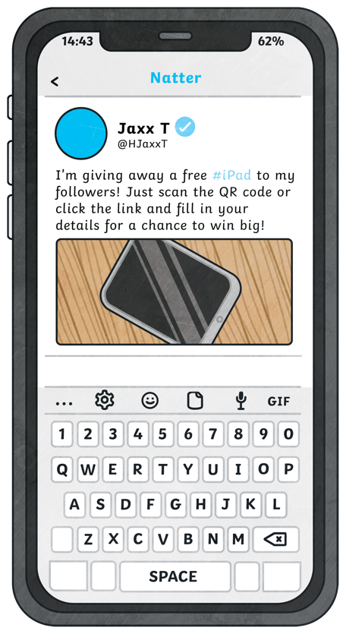
A popular influencer posts a new message.
Is it safe to do what they say?
Yes! Influencers give out free stuff all the time. You can’t win if you don’t enter and they only want your name and email address.
No! Don’t give away your personal details and always check with a trusted adult. You can never be sure who you are dealing with online.

Slide 18
It’s easy to impersonate other people online. This website may have nothing to do with the influencer themselves. Never share your personal details with someone you don’t know.
No! Don’t give away your personal details and always check with a trusted adult. You can never be sure who you are dealing with online.

Slide 19
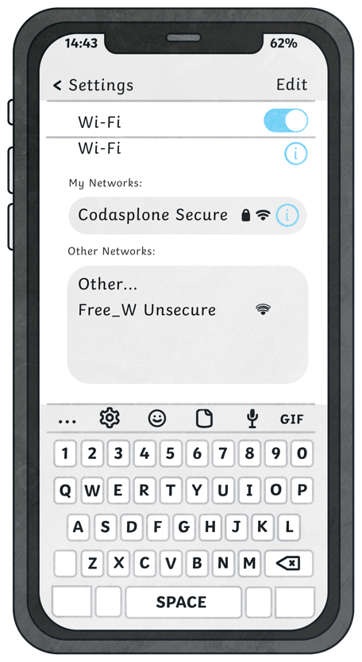
You're out at a café with your family, and you see a Wi-Fi network called "Free_WiFi." It doesn’t ask for a password and you can connect easily.
Should you use this Wi-Fi network?
No! Scammers can set up fake Wi-Fi networks to steal your information. Always use trusted, secure networks and ask a trusted adult if you’re unsure.
Yes! It’s free Wi-Fi provided by the café and you’re there with your family so it’s safe to use.

Slide 20
Don’t use Wi-Fi you are not sure about. Show your family and they can ask the café for the real Wi-Fi details.
No! Scammers can set up fake Wi-Fi networks to steal your information. Always use trusted, secure networks and ask a trusted adult if you’re unsure.

Slide 21
Remember these four top tips to help you avoid online scams!
Don’t share personal information
such as your name, address, or passwords.
Think before you click on any messages, links or attachments from unknown senders.
If something feels strange or too good to be true, check with a trusted adult and don’t be rushed into doing anything.
Always check if websites and apps are safe by using trusted sources or asking a trusted adult.

Slide 22

What Are AI Technologies?
AI stands for
artificial intelligence.

Slide 23






Where Do We Find AI Technologies?
Some systems that might use AI technologies include:
AI technologies are a part of our everyday lives, even if we don’t realise.
They can be found in our home, at school and even on our roads.
voice assistants
games
smart TVs
search engines
traffic lights

Slide 24
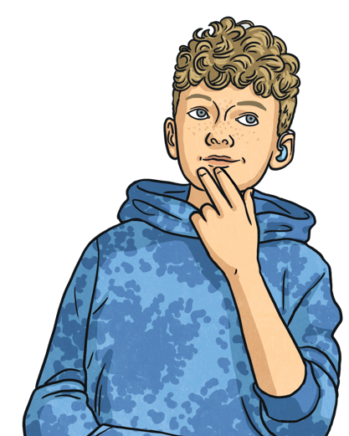
How Can We Use AI Technologies Safely and Responsibly?
What are some of the risks involved with using AI technology?
AI technology can be helpful but we can become reliant on it and begin to stop solving problems ourselves.
AI tools can be used to generate fake content, making it hard for us to know what is real and what is fake.
AI systems can be biased and spread incorrect information.

Slide 25


How Can We Use AI Technologies Safely and Responsibly?
Question everything! AI technologies can
get things wrong and generate incorrect information. Always check the results.
Here are some tips to remember!
Most importantly, always speak to a trusted adult before using AI technologies, as most AI tools have been made to be used by children aged 13 or older.
Never share personal information, such as your full name, home address or school location, with AI technologies.
Don’t become too reliant on AI technologies.

Slide 26

Welcome Page
Online Gaming
Making Friends
Online Bullying
Sharing Information
STOP CLOSE TELL
STOP - Stop what you are doing. Do not click on the page or reply to any messages.
CLOSE - Close the laptop. Put your phone or tablet down.
TELL - Tell a trusted adult. Tell your trusted adults when there might be a scam or you are using AI.

