Slide 2
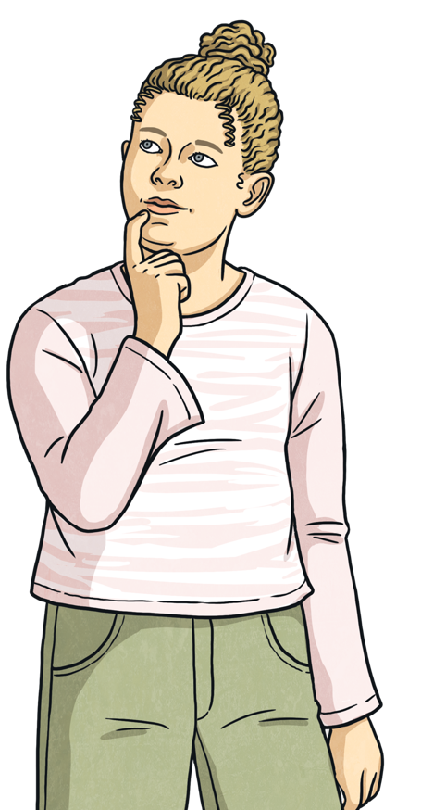
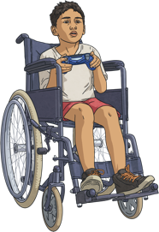
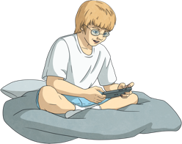
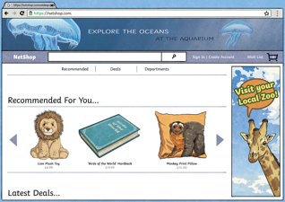
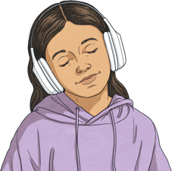
Online Activities
Did you say...?
Time to discuss: What can we do online?
Why do people go online?
People may go online to learn something new, help them relax or connect with friends or family.
watching films, tv shows or videos
Time to think: What is your favourite online activity?
playing games
shopping
listening to music

Slide 3
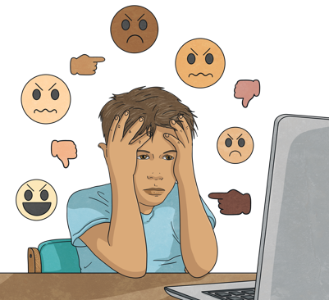
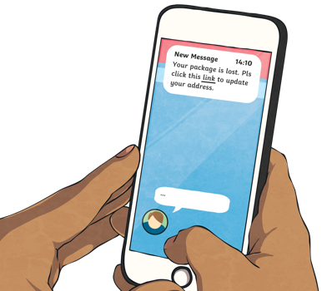
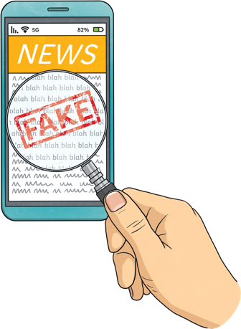
Why Is It Important to Stay Safe Online?
It’s important to be safe online to protect ourselves from possible dangers, such as online bullying, inappropriate content, scams, people who might not be who they say they are and fake news.

Slide 4
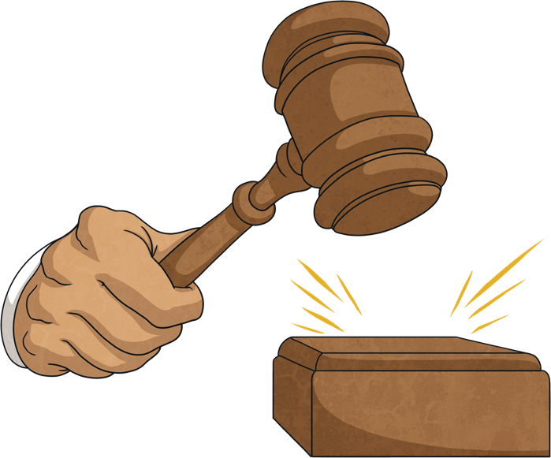

What Is Put in Place to Keep Us Safe?
The aim of the Online Safety Bill is to give us and our trusted adults more control over what we see online, reducing the risk of us seeing things we do not want to or should not see.
Misinformation is false information that has been created or shared unintentionally.
In October 2023, the UK government passed a bill that changed the laws around online safety.
The new law holds digital platforms responsible for inappropriate, harmful or illegal content. Platforms must show that they are committed to removing and preventing this type of content.
Disinformation is false information that has been created or shared deliberately .
The bill also aims to reduce the amount of incorrect information spread online. This can include misinformation or disinformation.
Ultimately, it means that if platforms do not tackle or remove the content, they are breaking the law.
The bill wants to ensure that the Internet is a fun, informative and, most importantly, a safe place to be.
Click me!
Click me!

Slide 5




What Is Put in Place to Keep Us Safe?
Privacy Settings
Age Restrictions
Privacy settings help us limit who can see our personal information, such as our location or photos we post. It is important to regularly check and update privacy settings to keep ourselves safe.
Age ratings and restrictions can help us understand if a game, video or website will be appropriate for us.
Most social media sites have an age restriction of 13+.
Games and films may use age ratings to indicate the level of violence or inappropriate language. Some games are age restricted because they require spending money within the game to unlock certain features or items.
In the Online Safety Bill, there is a requirement for tech companies to place age limits on certain websites. This means you may not be able to access websites containing content that is deemed not appropriate for your age.

Slide 6
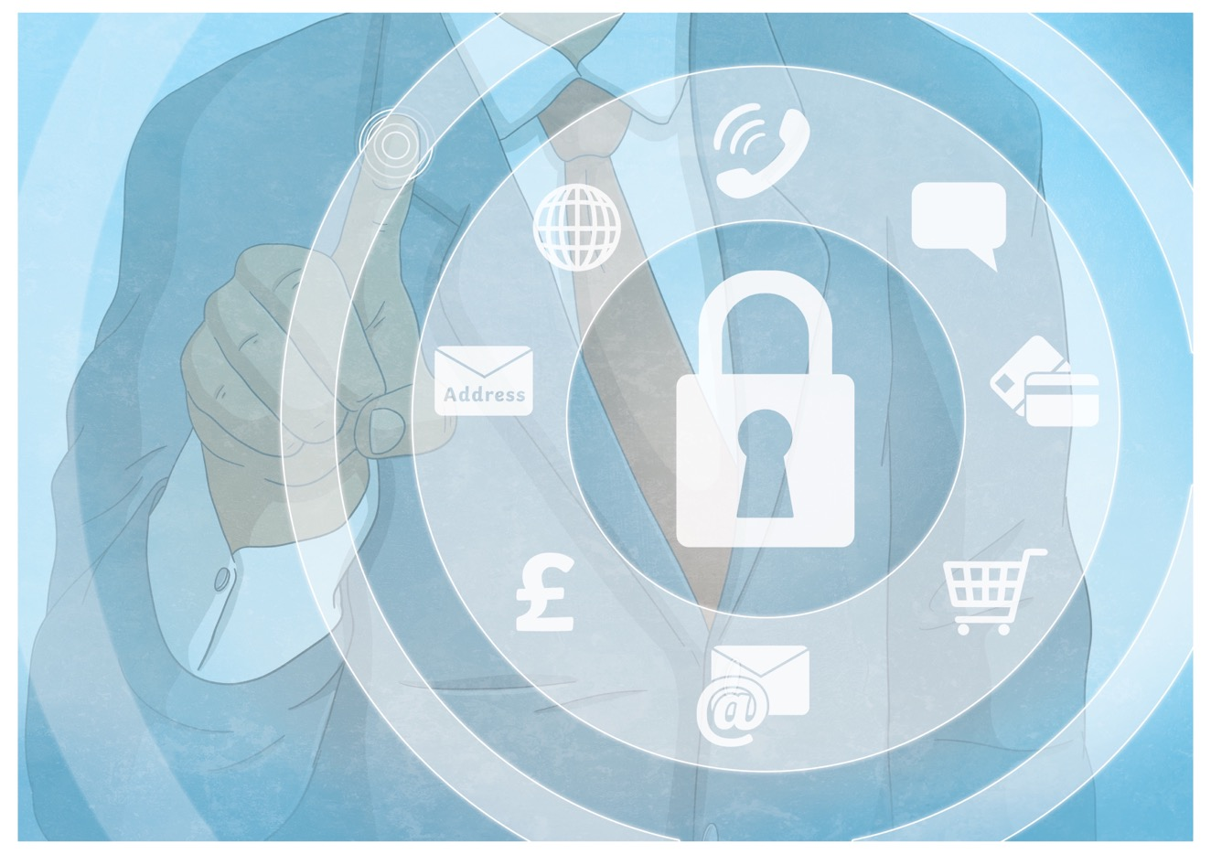
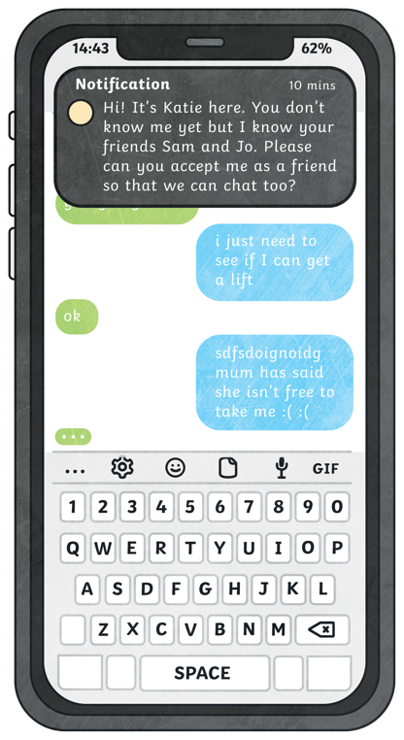
What Can We Do to Stay Safe and Secure?
We can stay secure by keeping our personal information out
of the wrong hands.
Never share your personal information, such as your full name, address, school or location, with anyone online including chatbots.
Only chat with people you know in real life. Be cautious if someone you don’t know tries to talk to you online.

Slide 7

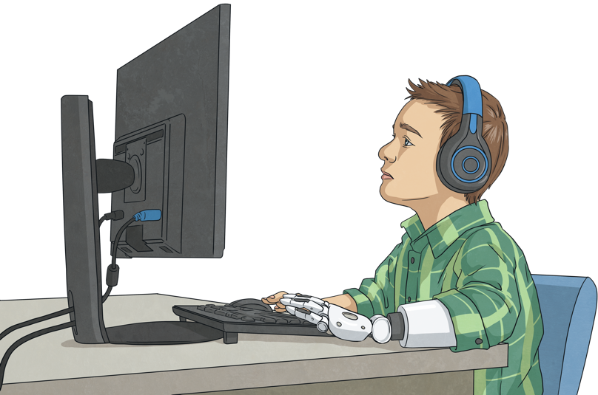
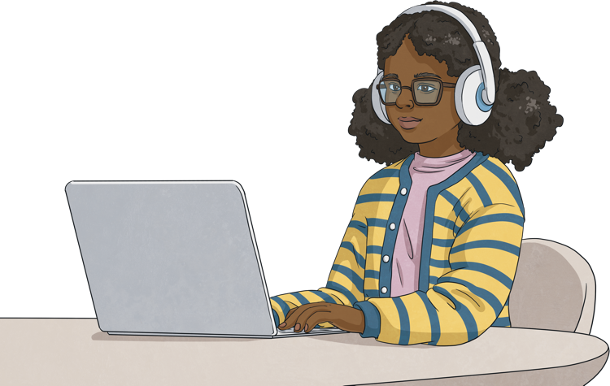
What Can We Do to Stay Safe and Secure?
Critical thinking is the ability to question and analyse information to form an informed judgement. It means not just accepting what you see or read online as true but instead asking yourself questions such as, 'Is this true?' or 'Does this make sense?'.
Anyone can post information online without checking facts or correcting mistakes. AI technologies can create false news stories and fake images, videos or audio recordings known as deepfakes.
If we don’t think critically, we may fall victim to online scams, clickbait or end up spreading misinformation.
We need to be critical about what we see and read online.
So, what is critical thinking?
But why?

Slide 8

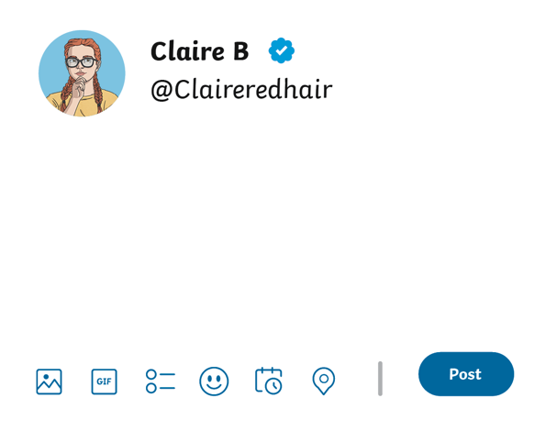
Think Before Posting
What do you know about communicating safely online?
Read the following online posts and decide what the person could do to stay safe online.
Claire should remove the personal information she has included in her post.
She could also use a different username and avatar to protect her identity.
I'm so excited to have a new bike! I've been wanting one for ages, and I can't wait to go on lots of adventures with it. I'm going to ride it to my school - Twinkl Primary School.

Slide 9
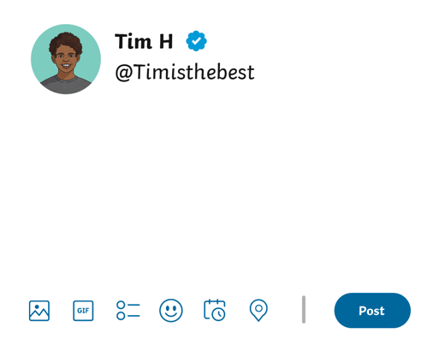
Think Before Posting
What do you know about communicating safely online?
Read the following online posts and decide what the person could do to stay safe online.
Tim should not share his location online as people he doesn’t know may read it.
Tim should not meet anyone that he doesn’t know in real life.
He could also use a different username and avatar to protect his identity.
Anyone going to the fair on Twinkl Street after school? I’ll be there around 5pm. Message me if you want to meet up!

Slide 10
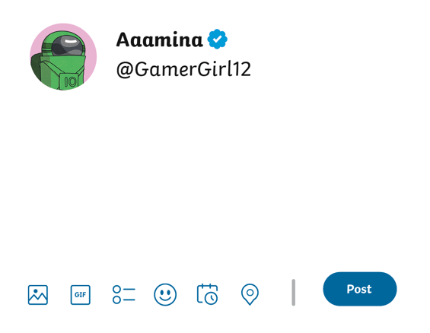
Think Before Posting
What do you know about communicating safely online?
Read the following online posts and decide what the person could do to stay safe online.
Aamina should use her critical thinking skills to help her decide if the information is true before believing it.
I’ve just heard the teachers say school is closed for the next three fridays! I love long weekends!

Slide 11



Safe Behaviours Checklist
What do you think are the most important rules to follow to make sure you are behaving safely online? Make a checklist of five rules to follow.
Here is a list to help you:
Always think about the person’s feelings before posting or
commenting online.
Respect other people’s privacy and choices.
Only talk to people that you know and trust.
Do not share personal information.
Never do or say anything online that you would not do or say offline.
Only play games or visit websites that are age appropriate.
Think critically before believing what you see or read online.
Frequently check and update privacy settings.

Slide 12
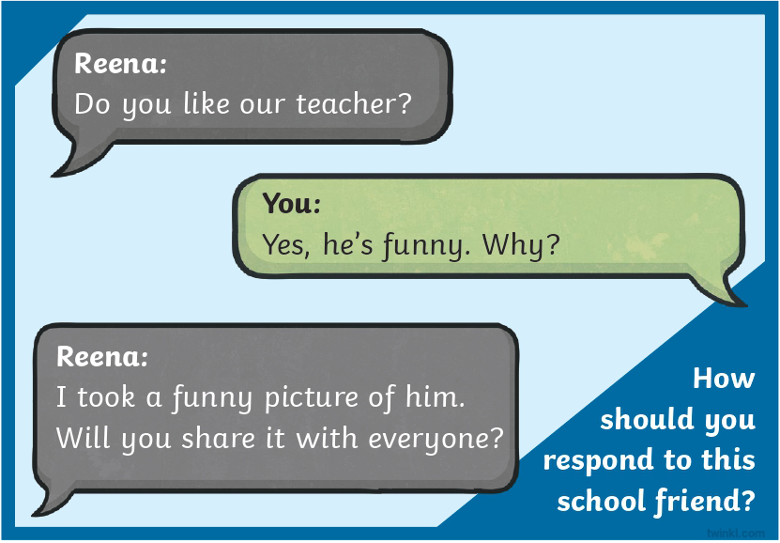
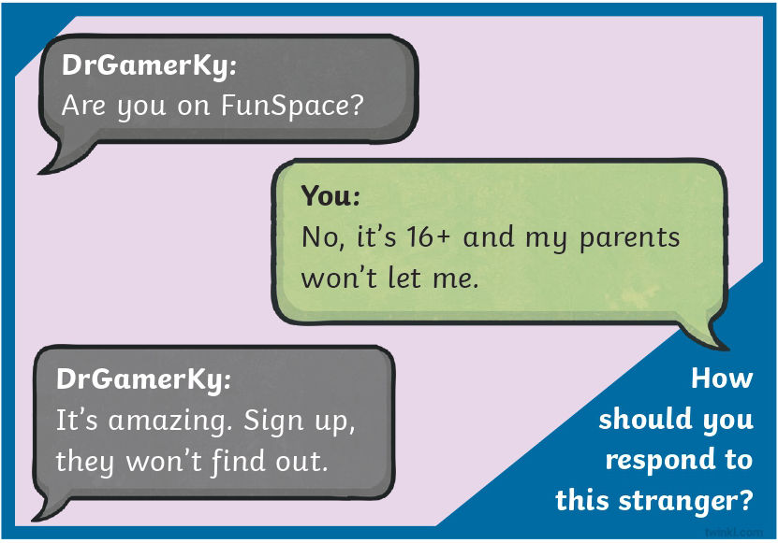
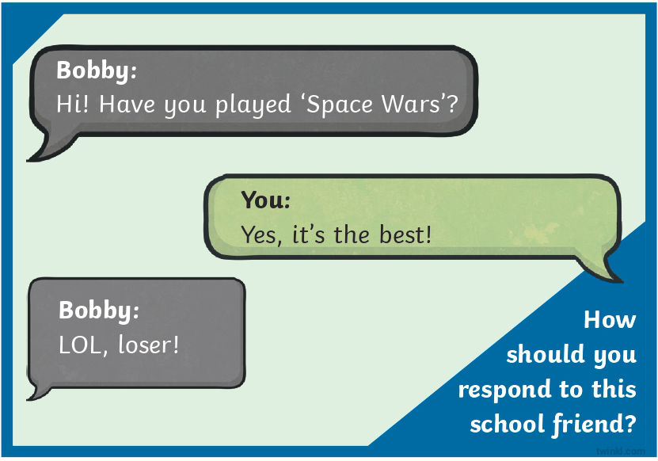
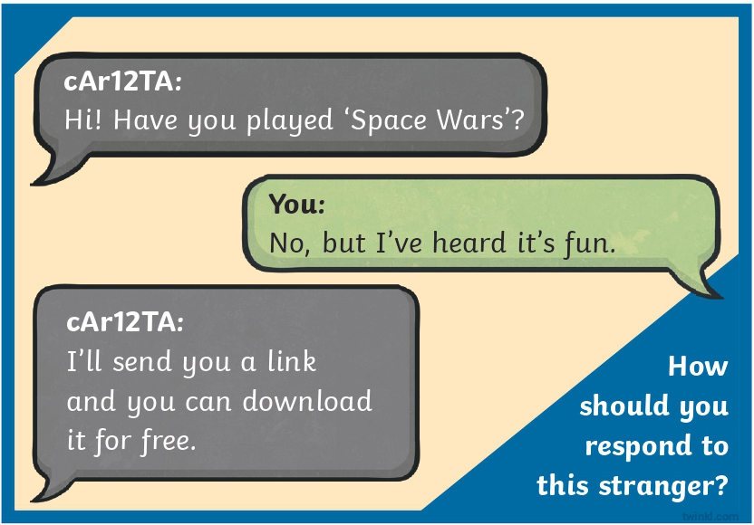
What Would You Do?
Read the following scenarios and decide what steps you would take. Don’t forget to use your checklist to help you!

Slide 13


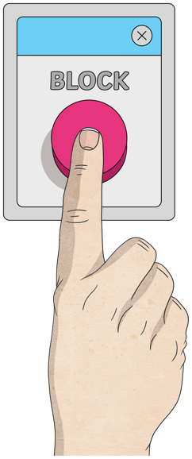
Online Safety Strategy
Even though you might not have intended to see anything inappropriate, sometimes content we don’t wish to see appears on a platform we are using.
Report
Report via the online site that you experience it on, then tell a trusted adult about it and ask for help.
Save
Keep evidence; take screenshots.
Block
Block the person or group of people responsible.

