Slide 1
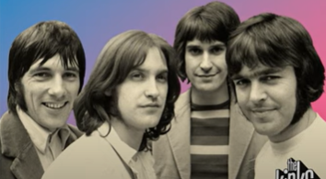
Autumn Almanac by The Kinks

Slide 2
The Kinks were an English rock band formed in London in 1963 by brothers Ray and Dave Davies, and Pete Quaife.
They are regarded as one of the most influential rock bands of the 1960s. Some of their well known songs include Sunny Afternoon and Waterloo Sunset.

Slide 3
Listen to the song Autumn Almanac https://www.youtube.com/watch?v=kwOxTpdbDPw

Slide 4
KS1
Raise your hand whenever they hear the word Autumn.
Now clap along with the steady beat.
How does it make your feel? Happy? Sad? Relaxed? Energetic?

Slide 5
KS2
We will Split the hall into 3 sections.
Each section has a different body percussion part - section A claps the beat, section B pats knees, section C clicks.
We’ll listen to the song again and add the different beats.
This time when we listen, put your hand up when you hear the words Autumn, leaves, roast beef and tree.

