Slide 1
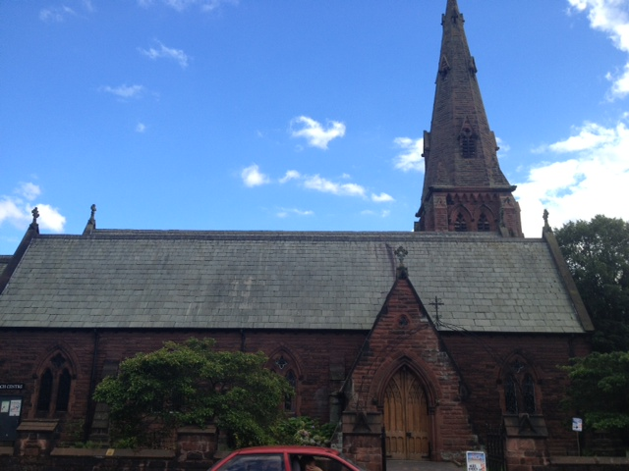
All Saints Church outside
Notes:
Teachers Notes Instruction: As children come into the classroom display the photograph above. If possible play some suitable church music: eg hymns or choruses. Ask: Who belongs here? Share ideas.

Slide 2

Let’s find out………
Notes:
Teachers Notes Explain: ‘We are going to find out today the answer to this question: How do we know when someone belongs to a church community?’

Slide 3
Who do you belong to?
Who do I care about?
Who matters to me?
Notes:
Teachers Notes Instruction: Show the three questions above. Allow the children to think quietly about the 3 questions, then Think, Pair, Share. Then class feedback.

Slide 4
I belong to.....
Notes:
Teachers Notes: Instruction: Give each child an A4 copy of the slide above. Encourage children to complete this diagram on their own by drawing a picture or one word in each circle, eg dance club, my family , my school. Reduce the number of circles if preferred.

Slide 5
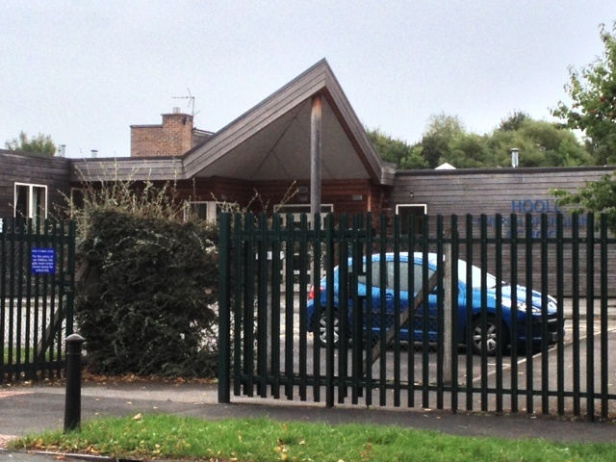
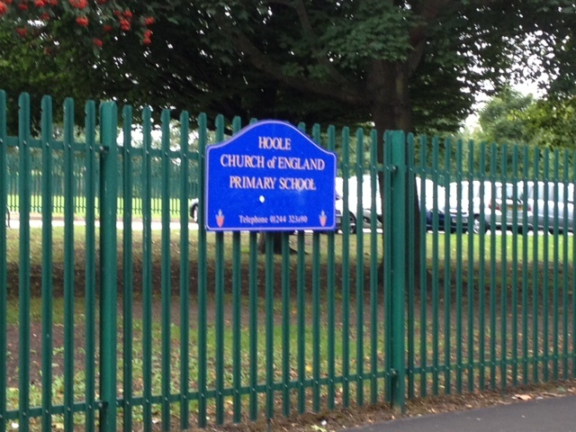
I wonder what it would be like to belong here ?
Notes:
Teachers Notes: NB You may prefer to use photographs of the inside and outside of your own school.
Ask: What would someone be able to tell about your school if they came when no one was there? What would people be able to tell about us from the empty building? Would people be able to tell what we think is important? What would we want people to know? Instruction: Write these questions on large pieces of card and display each one around the whiteboard as you ask the question. Explain you are going to show the class a few photographs of the inside of different school buildings. As you show them the slides ask them to think about what they think might be important to these schools. Play suitable music as you show the next few slides if appropriate eg children singing in your school.

Slide 6
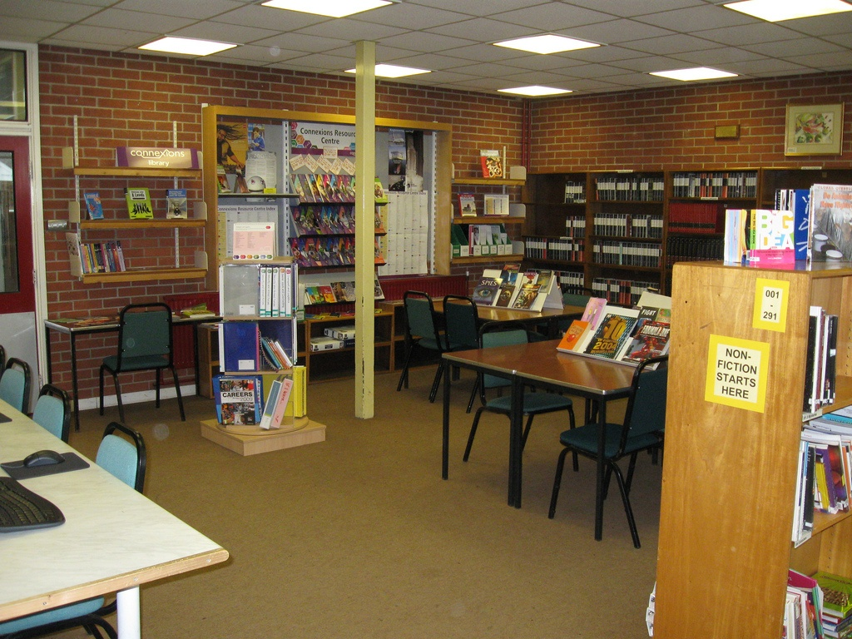
Lets find out………
Notes:
Teachers Notes: You could use photographs of your own school.

Slide 7
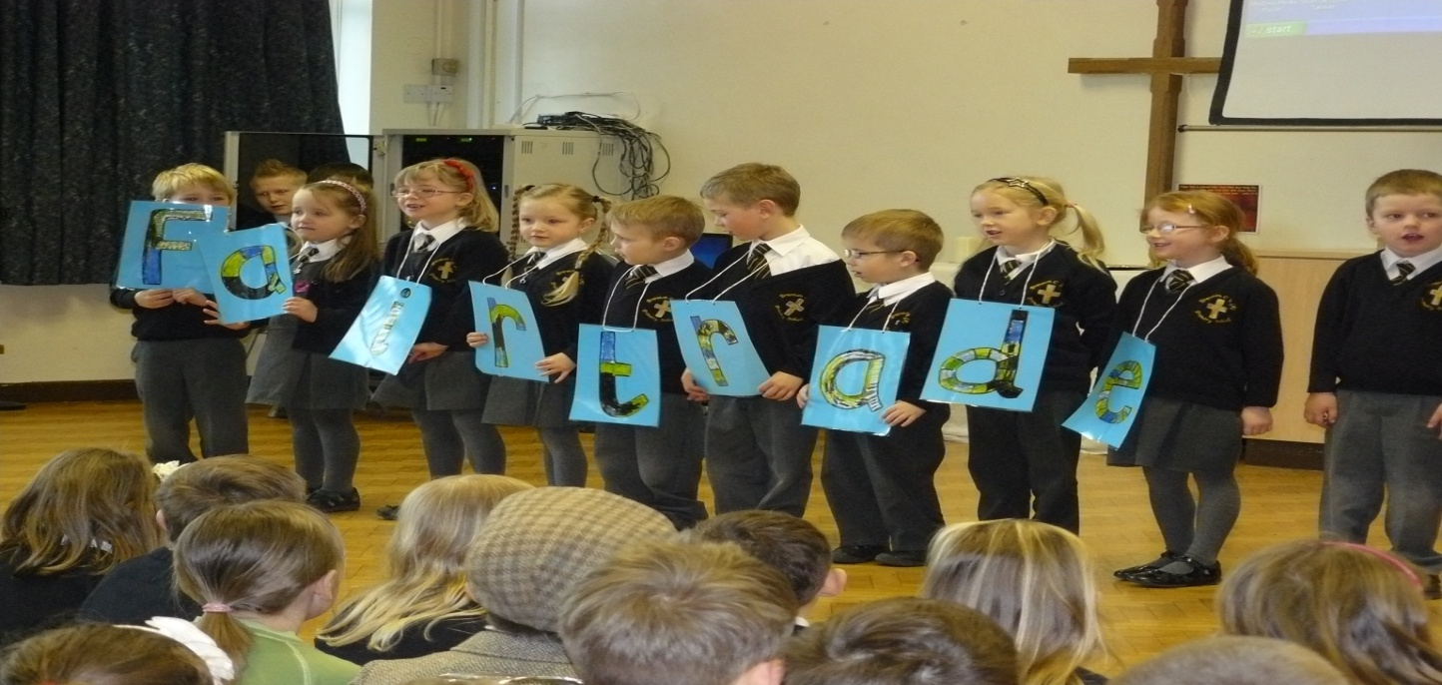
Notes:
Teachers notes: You could use photographs of your own school.

Slide 8
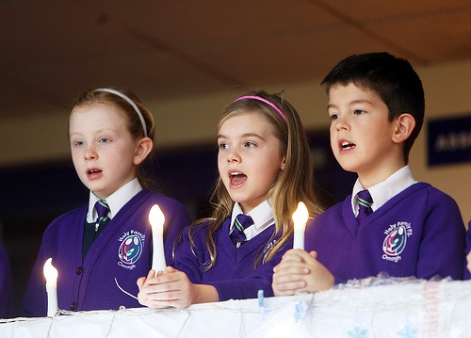
Notes:
Teachers notes: You could use photographs of your own school.

Slide 9
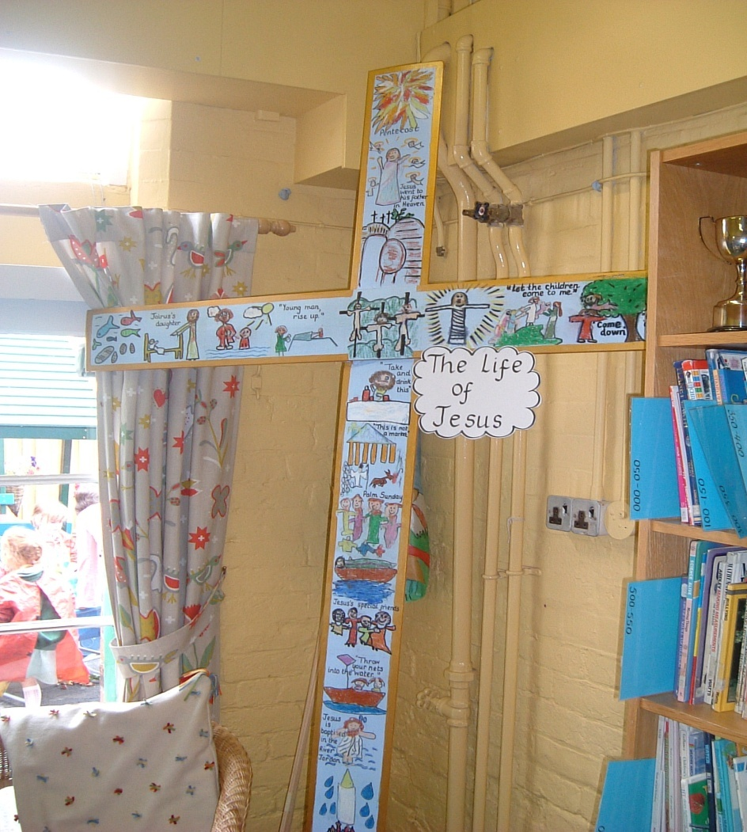
Notes:
Teachers notes: You could use photographs of your own school.

Slide 10
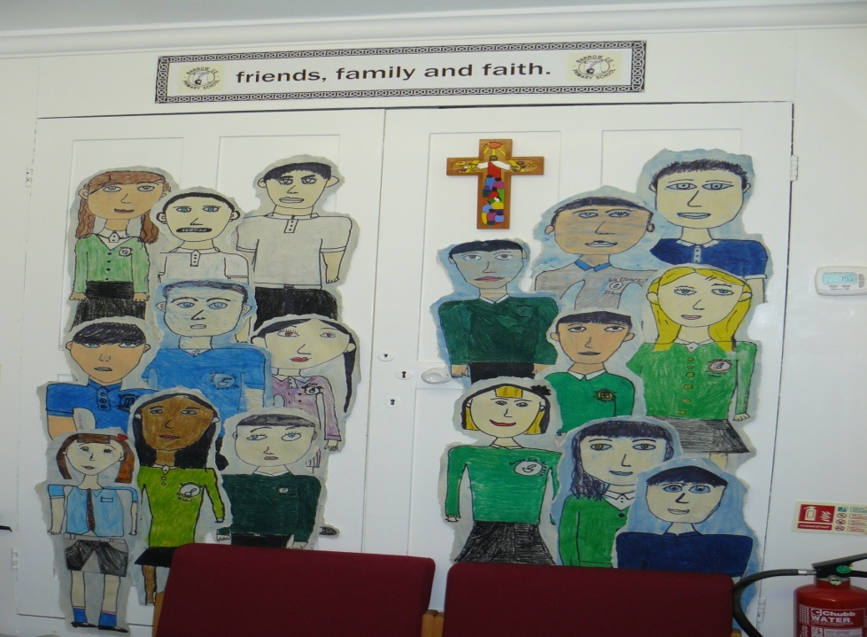
Notes:
Teachers Notes: Instruction: After showing the slides ask: What do you think was important to these schools? Discuss together.

Slide 11

What do you think is most important to us in our school?
Notes:
Teachers Notes: Heads down quiet thinking. Ask: what is it like to belong to my school? What do you think is most important to us in our school? Can they imagine the answer in their minds?

Slide 12

Think Pair Share
What do you think is most important to us in our school?
Notes:
Teachers Notes: Think, Pair, Share then class feedback. Vote on what you think as a class is most important in your school.

Slide 13
All Saints Church outside
Notes:
Teachers Notes: Ask: I wonder what is it like to belong here? What can we tell about the people who go here from the outside of this building? What do they think is important? Share and list ideas on the board. Show each of the following pictures and ask the questions.

Slide 14
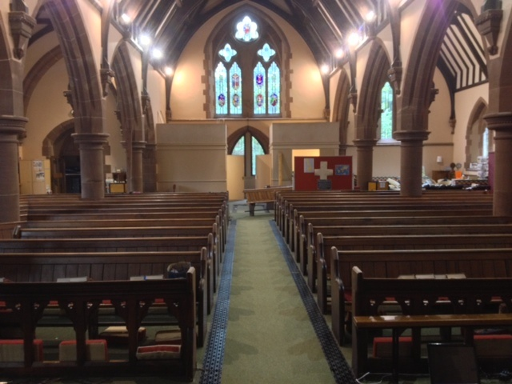
Notes:
Teachers Notes: Ask: I wonder what this part of the building is used for? I wonder if it is important?

Slide 15
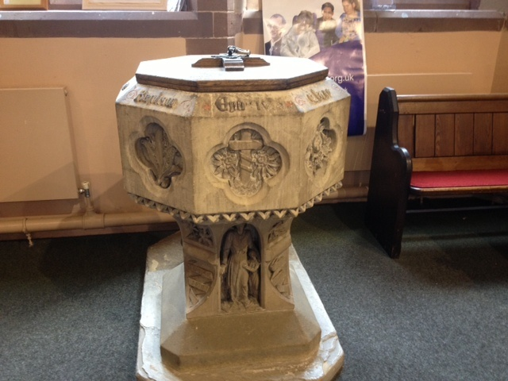
Notes:
Teachers Notes: Ask: I wonder what this is? I wonder what it is used for? I wonder what it tells us about the people who go to this building?

Slide 16
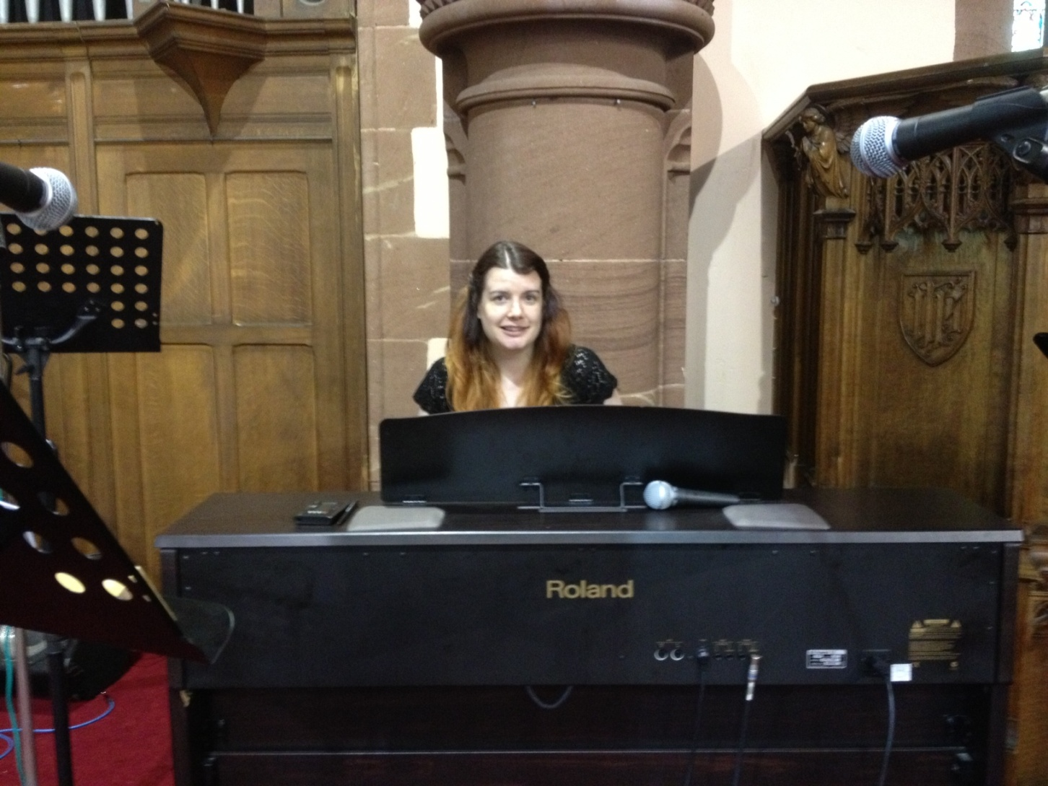
Notes:
Teachers Notes: Ask: I wonder what this lady is doing? Why might music be important? I wonder who this lady is?

Slide 17
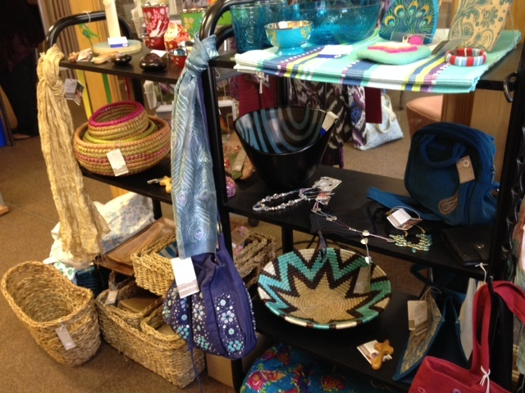

Notes:
Teachers Notes: Say: These are all things than can be bought sometimes in the church. I wonder why they are sold in church?
(Fairtrade goods/Traidcraft – sold for charity)

Slide 18
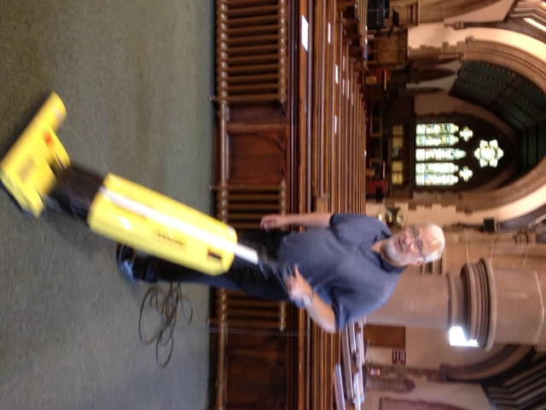
I wonder why this man is helping?
Notes:
Teachers Notes: Ask: I wonder why this man is helping?

Slide 19
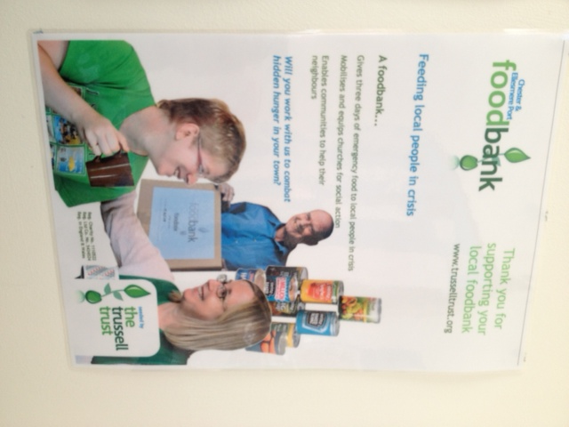
Notes:
Teachers Notes: Say: This is a poster on the wall of the church building. Ask: I wonder why the people are collecting food?

Slide 20

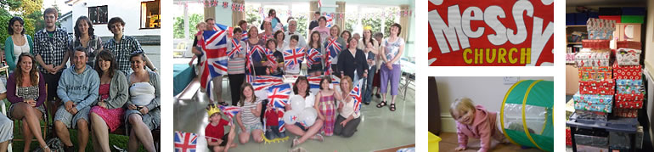

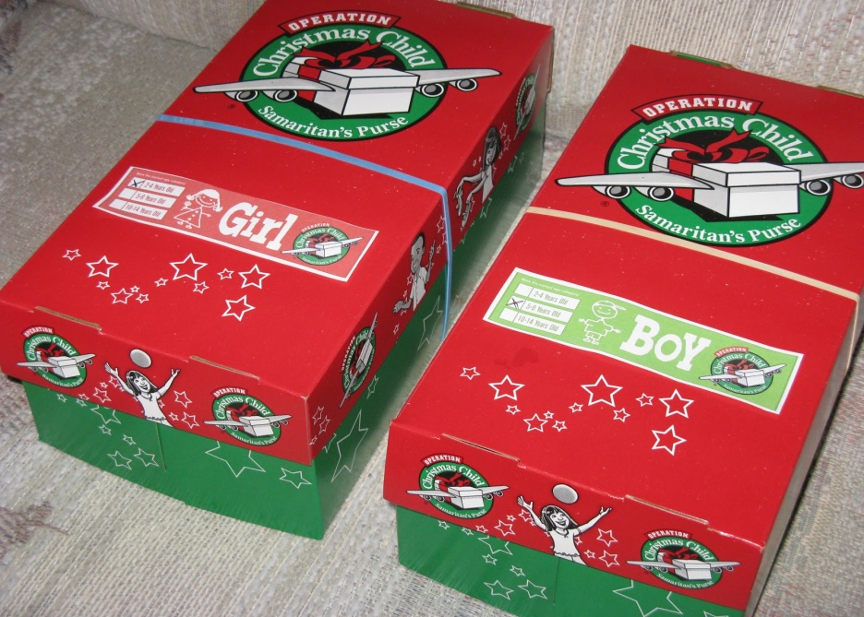
Notes:
Teachers Notes: Ask: I wonder what is happening in these photographs? Pause for response. ‘These are things that happen in the church’.
(Top : Messy church- weekly church with craft, food and games for the community : they may have a thought for the day etc
Bottom : Who let the dads out? Dads and Toddler group . Operation Christmas Child shoeboxes collected at Christmas).

Slide 21
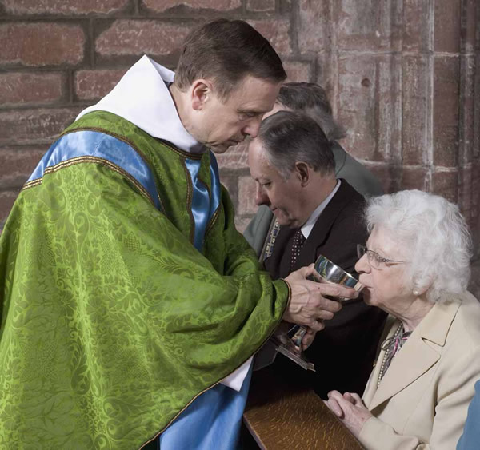
Notes:
Teachers Notes: Ask: I wonder what the man in green is doing? What do you notice in the picture?

Slide 22
Let’s think about this a bit more………
Notes:
Teachers Notes: Instruction: Place large copies of the photographs in slides 16-24 on tables in the classroom together with the questions previously asked about each slide. The question: ‘I wonder what is important to these people/man/lady?’ should also be included with each photograph. The children visit/look at each photograph in small groups, discuss their answers to the questions. At a suitable point ask them to stop and ‘write’ or ‘draw’ a picture to answer the question: what is important to the people in this church? Class feedback then ask: How we know when someone belongs to a church community? Record ideas on wall.

Slide 23
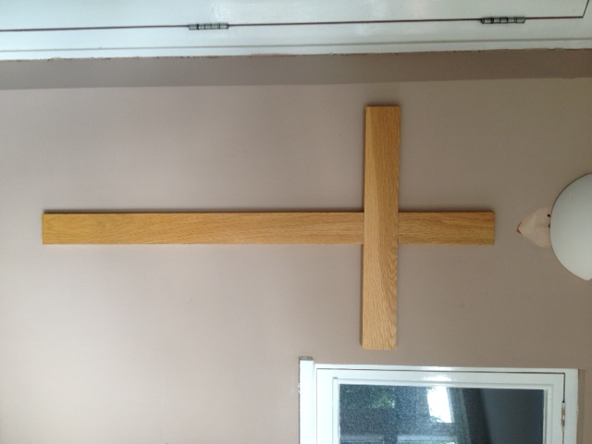
Notes:
Teachers Notes: Instruction: Have a very large symbol of a cross cut out on the floor. Say: ‘Let us think about this a little bit more. Here is another photograph from the church. I wonder why this is in the church? Why might this symbol be important to the people?’ Share ideas. Think about what you have learnt about Christians today? Ask the children to stick their words or pictures on to the large cross. Reflective music is then played and children are asked to whisper to each other as they go out what they have learned about people belonging to a church and how they would know when someone does.

