Slide 1
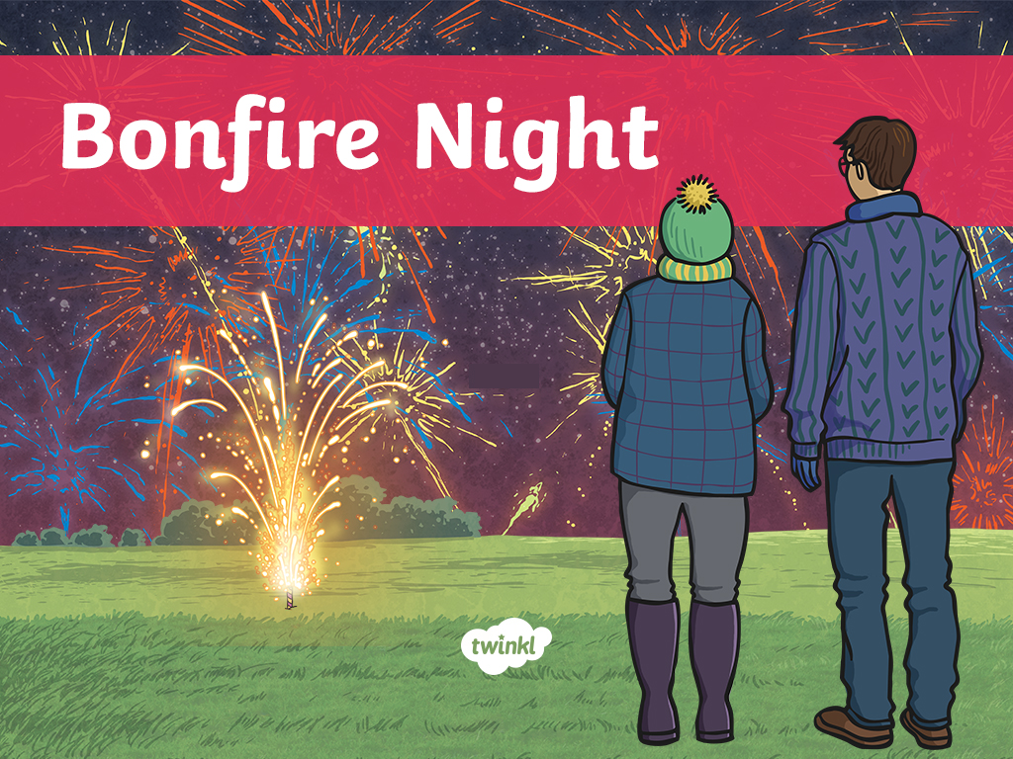

Slide 2
Aim
To learn about the events of Bonfire Night and how it is celebrated.

Slide 3
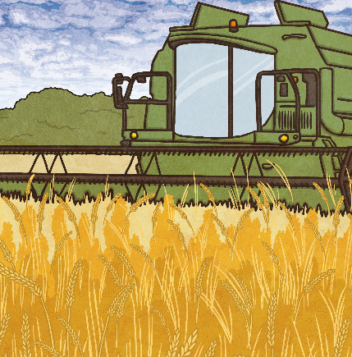
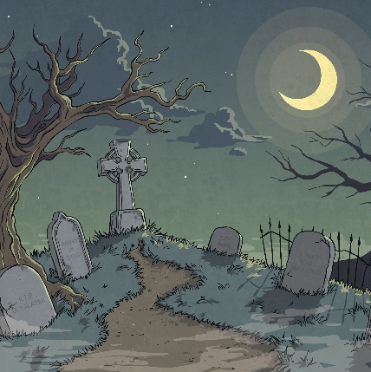
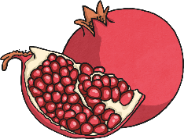
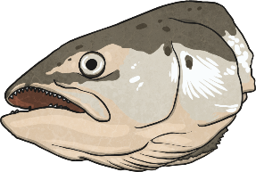
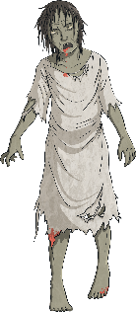
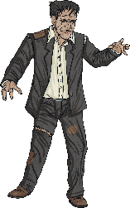
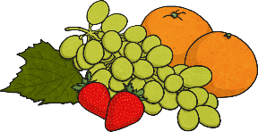
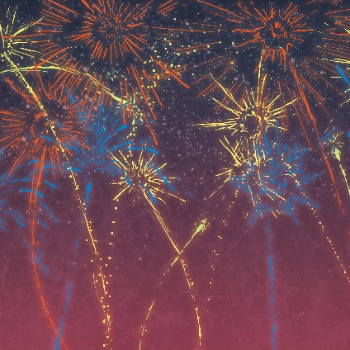
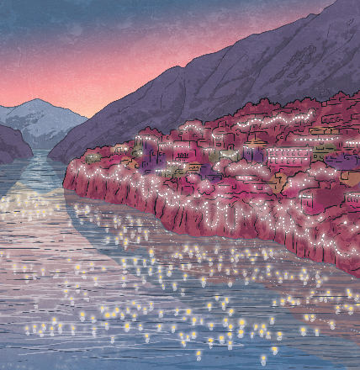
Autumn Festivals
Rosh Hashanah
Harvest
Halloween
Bonfire Night
Diwali

Slide 4
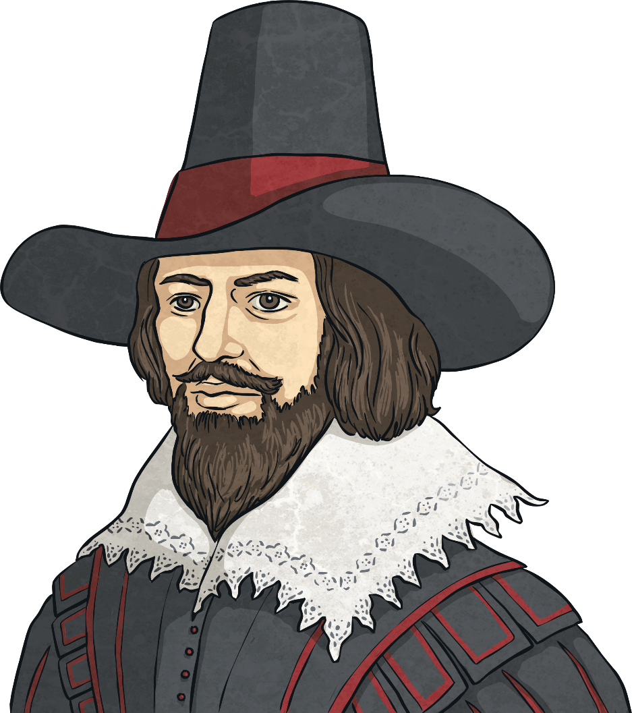
Bonfire Night
The events of the original Bonfire Night happened in 1605.
It is also known as the Gunpowder Plot or Guy
Fawkes’ Night, after one of the people involved in the events.
King James I was king at this time. He had
previously been known as James VI of Scotland.
He inherited the throne of England from his
distant cousin, Elizabeth I and the two countries
had been unified in 1603.

Slide 5
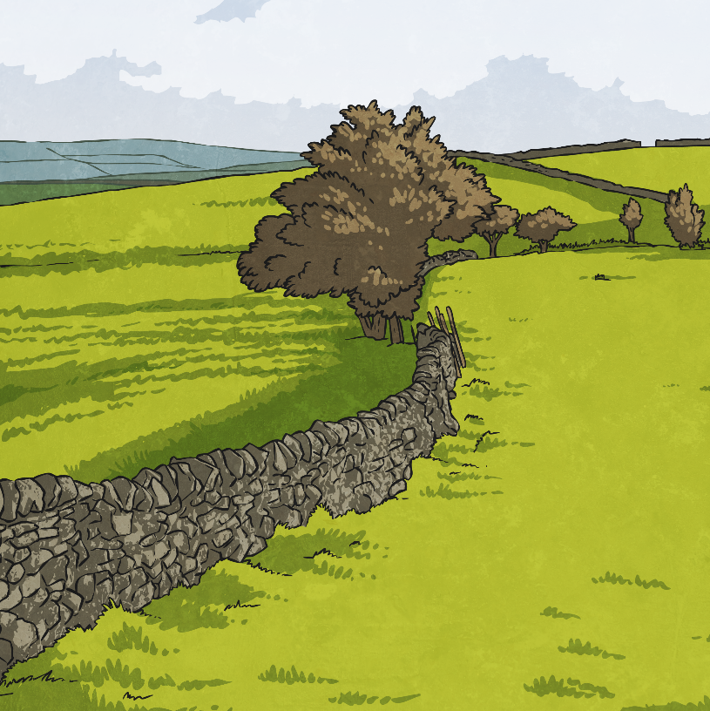
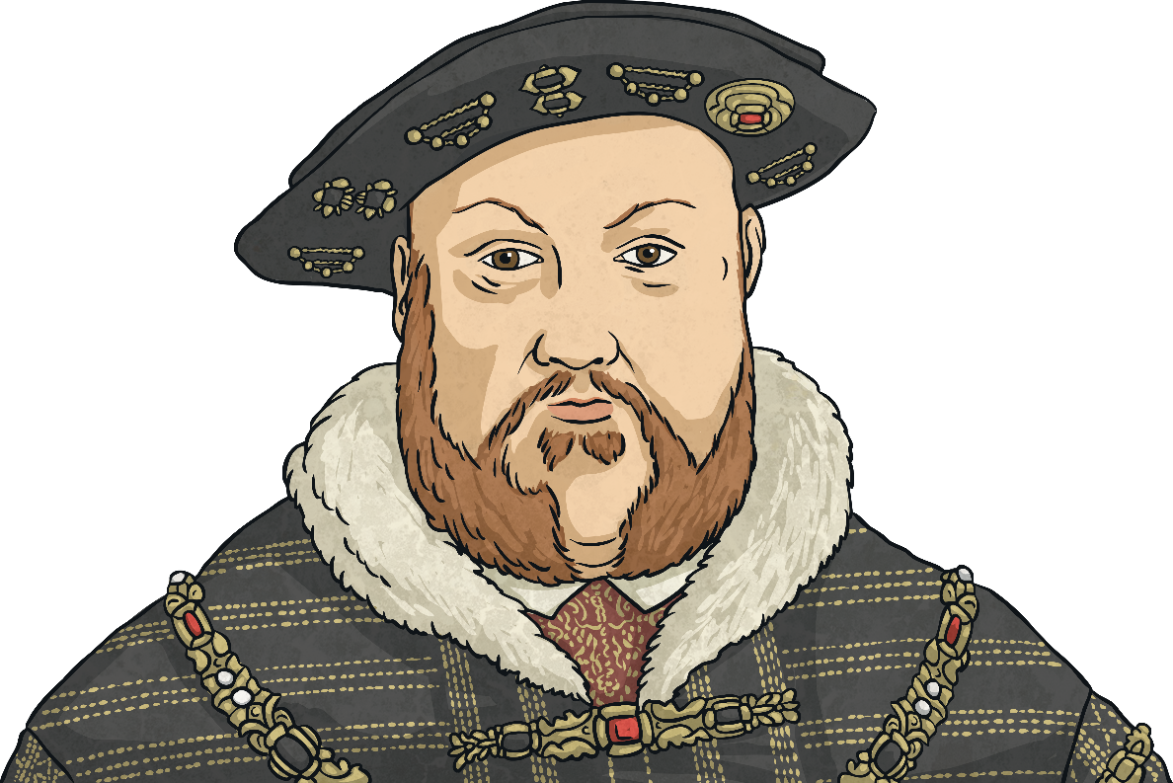
The Background to Bonfire Night
Much of Europe was on the brink of war due to problems about religion.
The problems were between the Catholic and Protestant faiths.
Henry VIII brought England out of the Catholic faith. He destroyed monasteries, where Catholic monks lived, and took all the land which had belonged to the Catholic church. Some Catholics lost their positions of power. Many had to practise their religion in secret for fear of being arrested. Others, including priests, were executed when they refused to accept the new religion and Henry VIII as head of the new church.

Slide 6
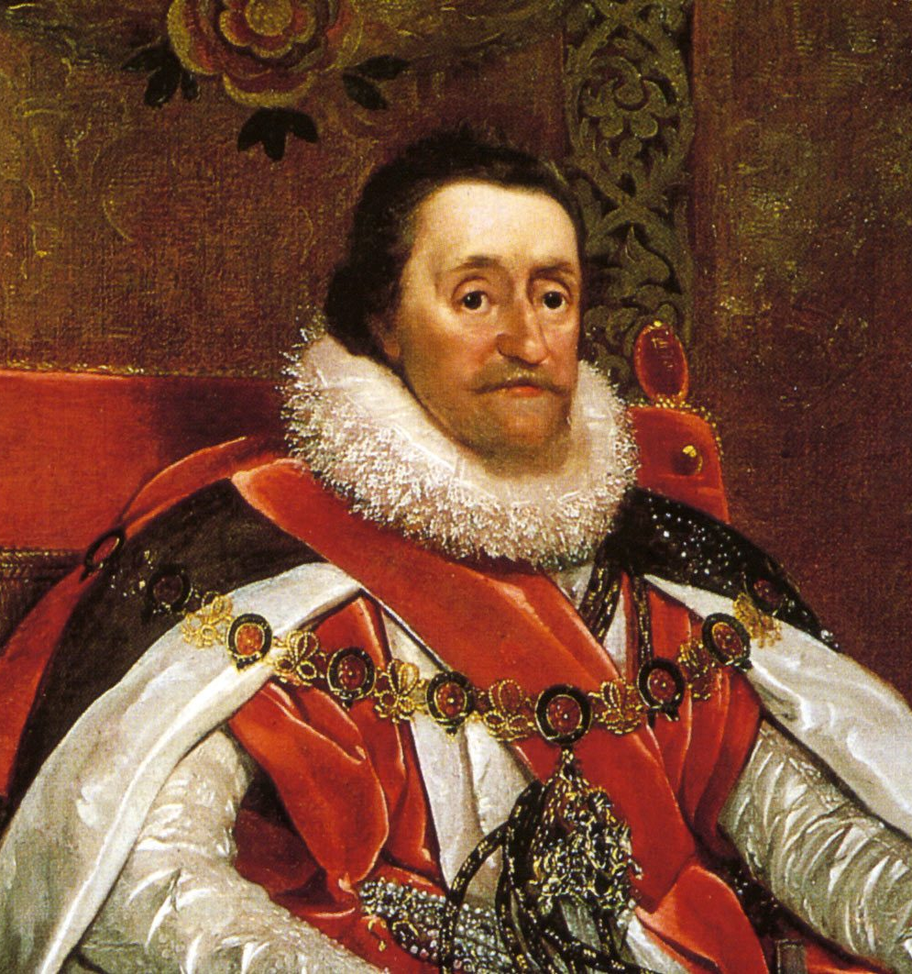
The Background to Bonfire Night
When James I became King of England, he hoped to bring peace and stability. His wife, Anne of Denmark, became a Catholic and it was hoped that both groups of people could live peacefully. However, many members of the House of Commons were very anti-Catholic and put pressure on James I to continue to make life difficult for Catholics.

Slide 7
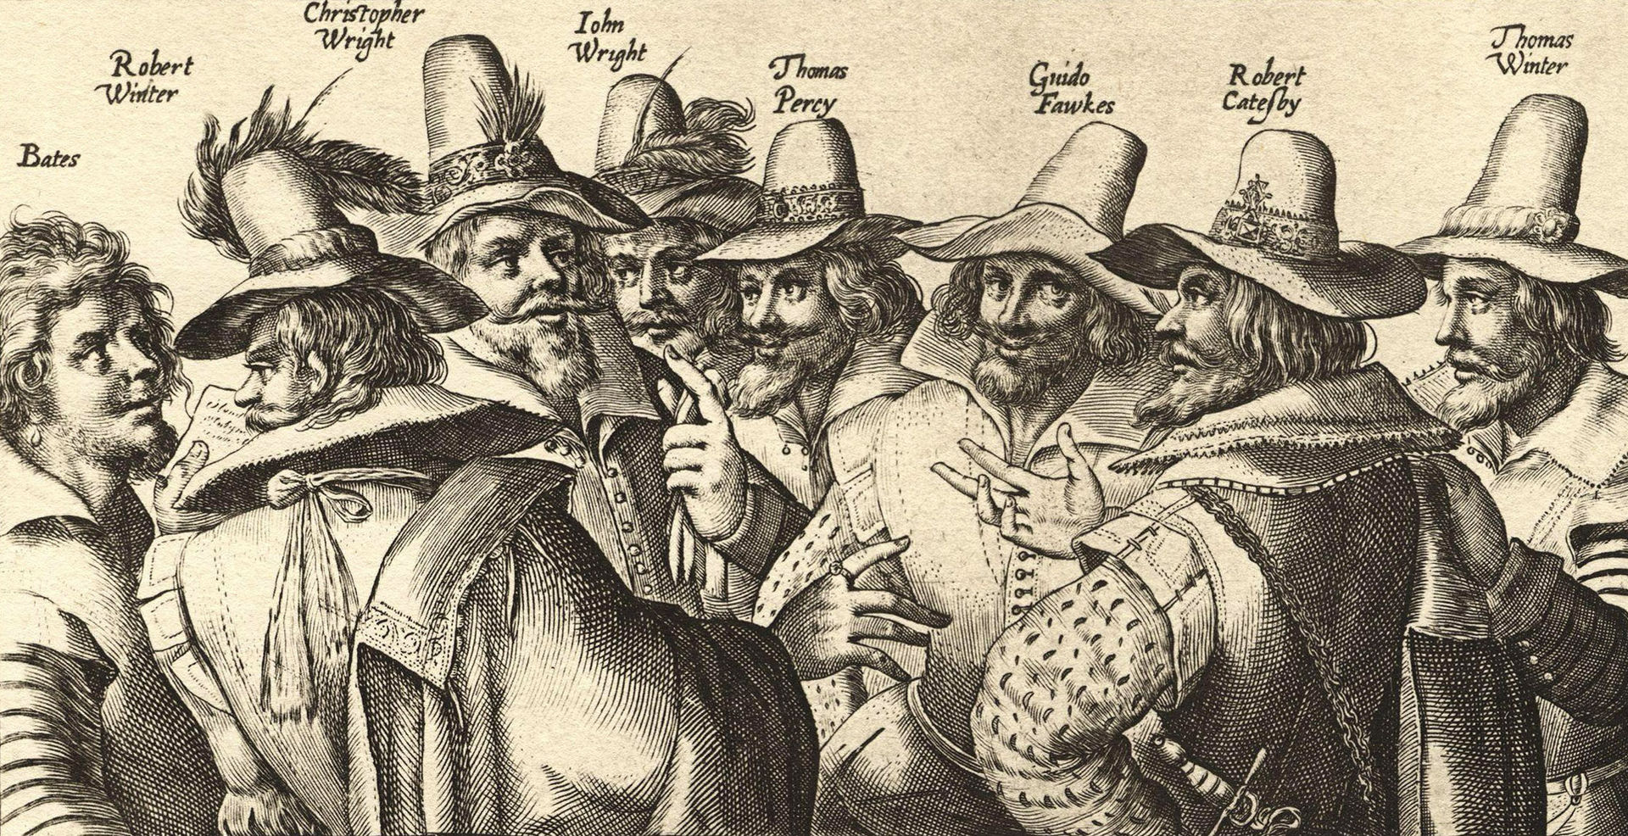
What Was the Gunpowder Plot?
“Un bosquejo contemporáneo de los conspiradores” by [Crispijn van de Passe the Elder] is licensed under creative commons licence.

Slide 8
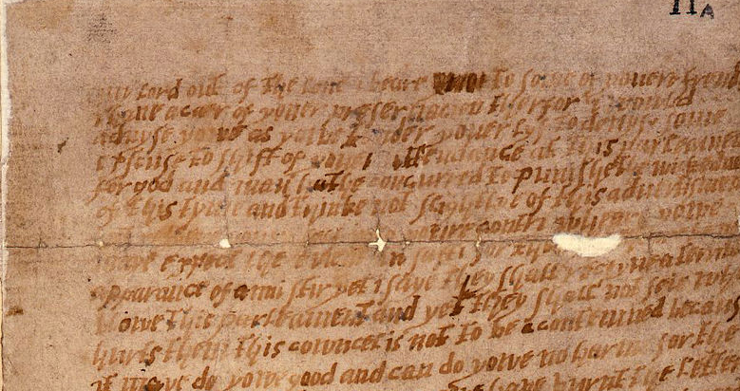
The Plot Is Discovered!
“Monteagle letter” by [The National Archives] is licensed under creative commons licence.

Slide 9
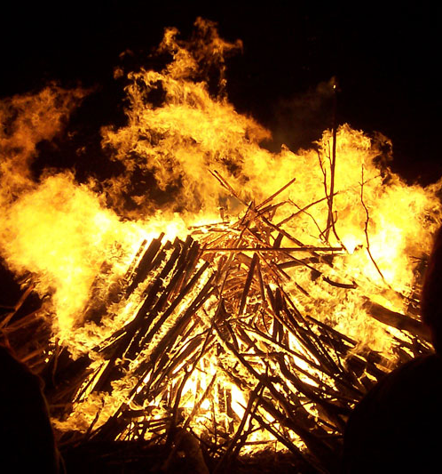
Celebrating
The very evening of the Gunpowder Plot, people lit bonfires to celebrate. Since that time, people have celebrated 5th November by lighting bonfires.
Sometimes the bonfires have figures of Guy Fawkes put on them. Traditionally, children would create this ‘guy’ and carry it around asking for a ‘penny for the guy’.
People often go to firework displays. The fireworks symbolise the explosions that would have happened if the gunpowder plot had succeeded.

Slide 10
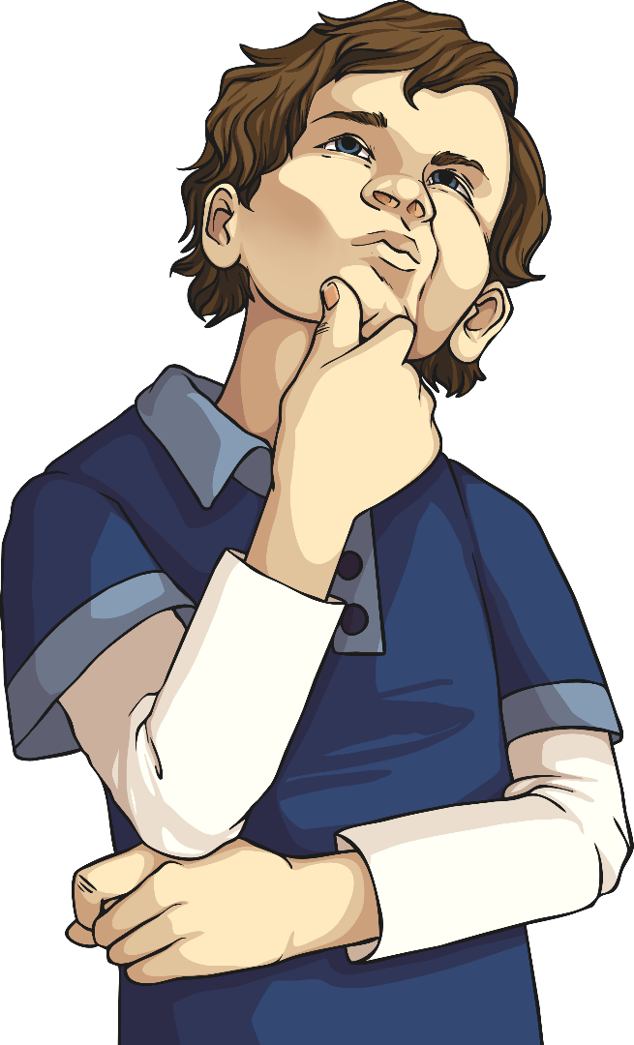
Safety on Bonfire Night
Only adults should set up fireworks and bonfires.
Make sure you stand at a safe distance from bonfires and fireworks.
If a firework hasn’t gone off, still don’t go near it.
Have a torch, buckets of water and buckets of earth and gloves.
Always wear gloves when you are holding a sparkler.
Hold sparklers at arm’s length..
When the sparkler has finished, put it in a bucket of cold water..

Slide 11
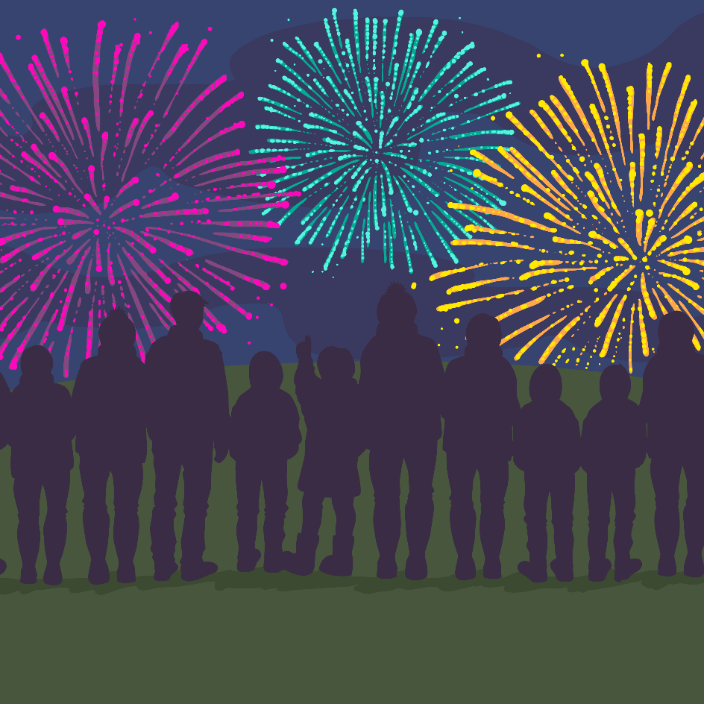
Time to Think

