Slide 1
What celebrations take place in autumn?

Slide 2
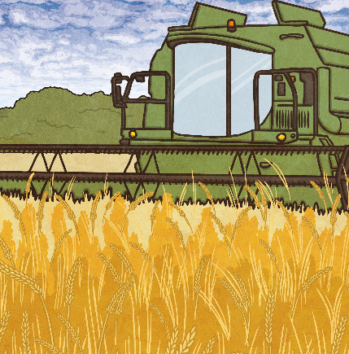
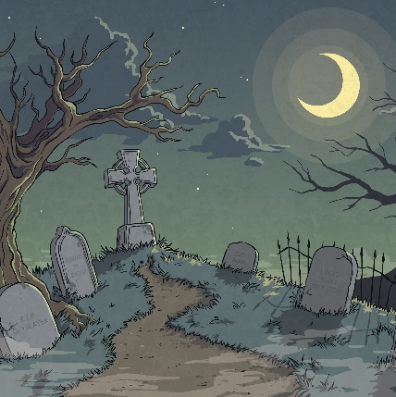
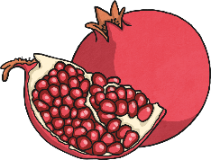

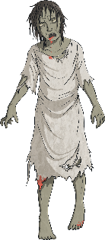
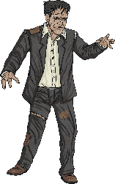

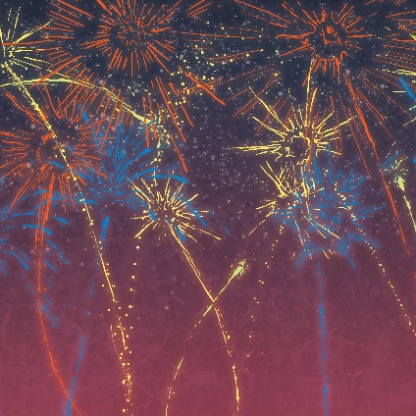
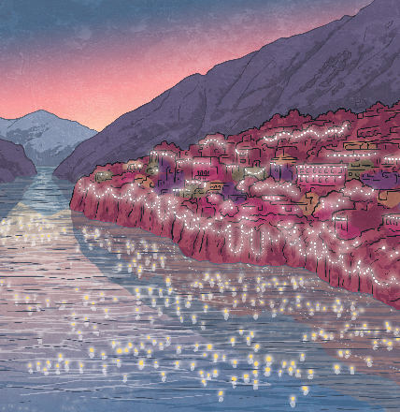
Autumn Festivals
Rosh Hashanah
Harvest
Halloween
Bonfire Night
Diwali

Slide 4
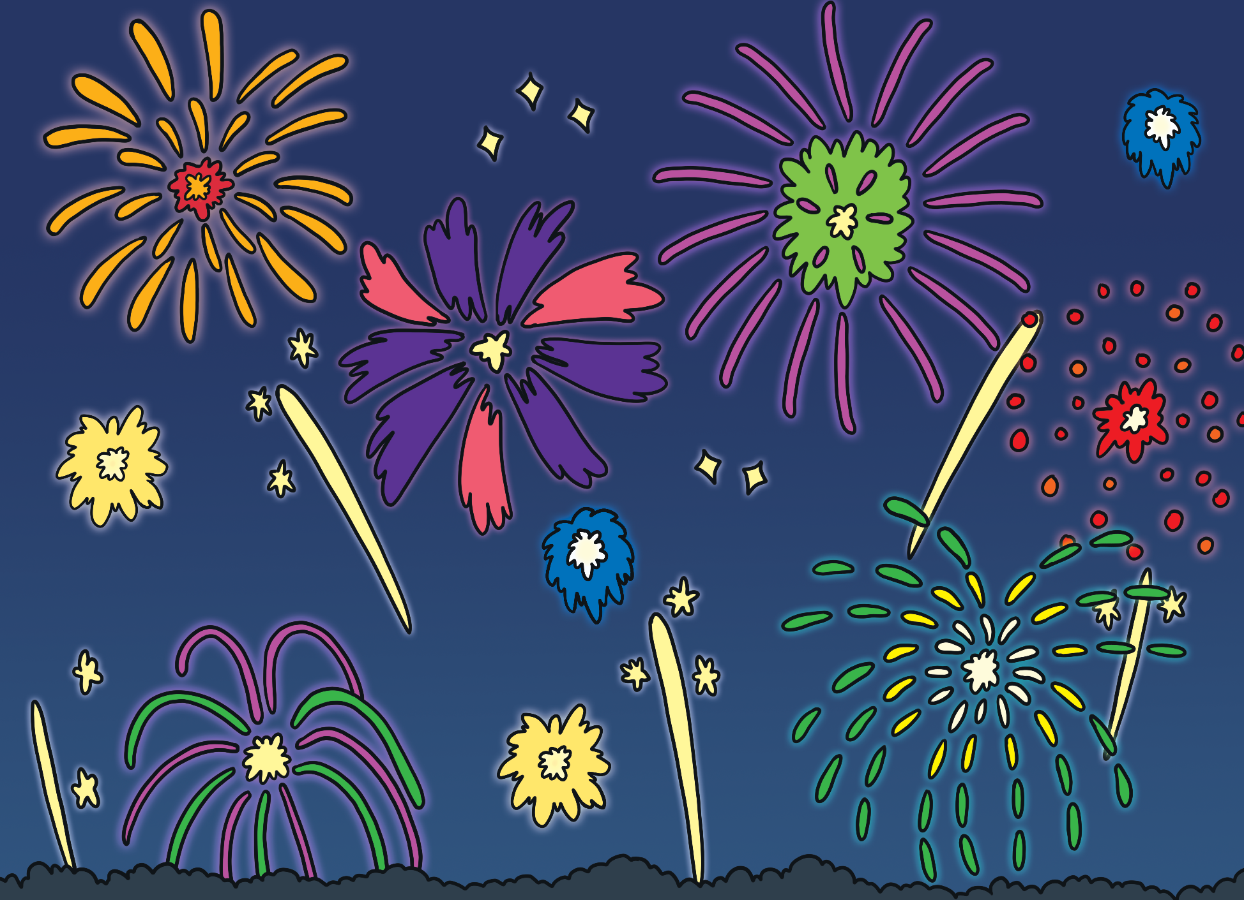
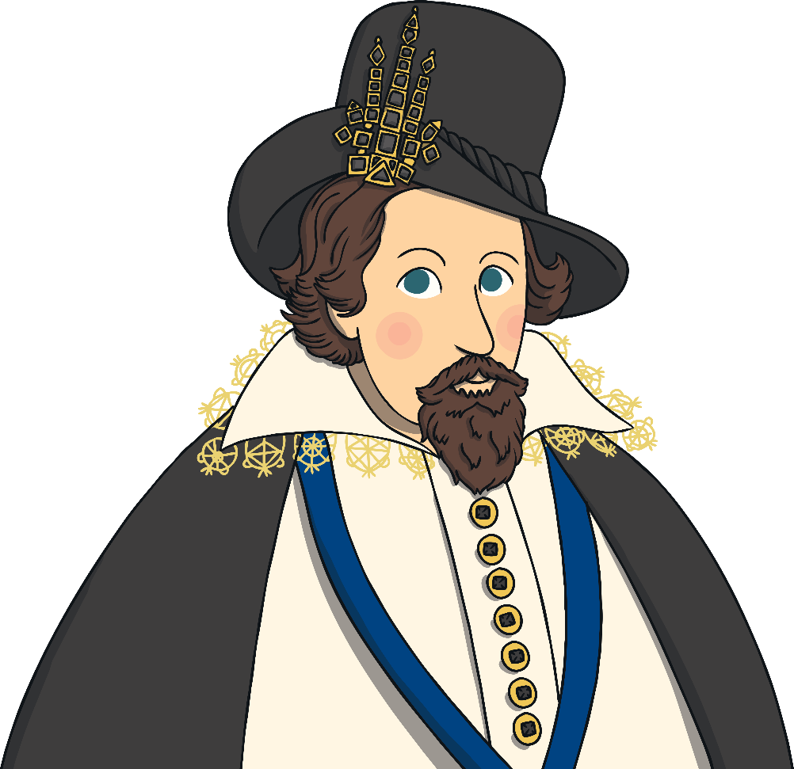
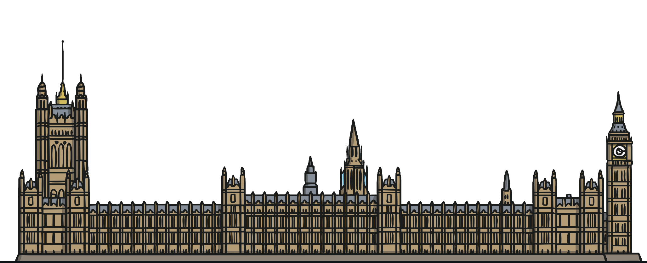
What Is Bonfire Night?
Bonfire Night is celebrated annually on 5th November.
A man named Guy Fawkes plotted to blow up the Houses of Parliament in 1605. This could have killed King James I and other members of the English Royal Family and government.
Guy Fawkes was captured and the plot failed. King James decided that 5th November should become an official celebration.

Slide 5
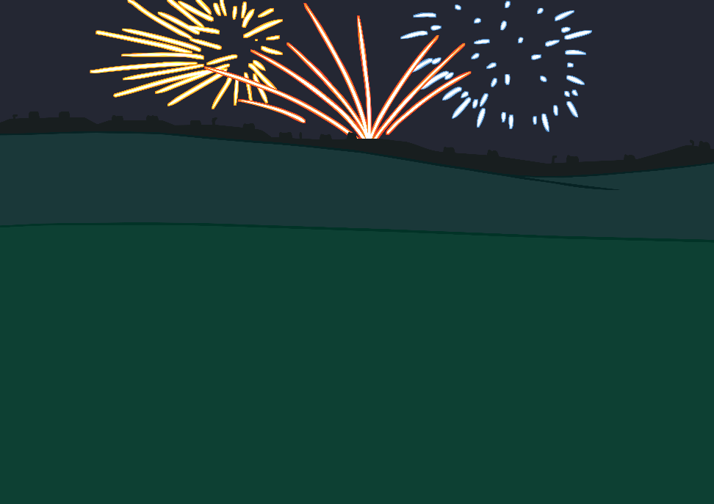
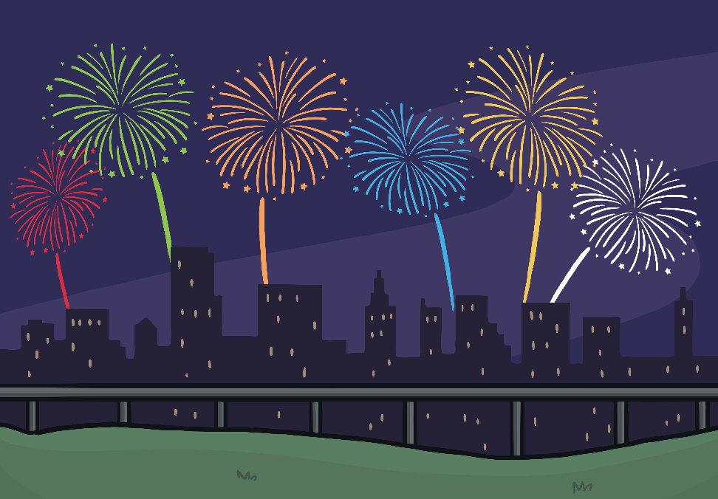
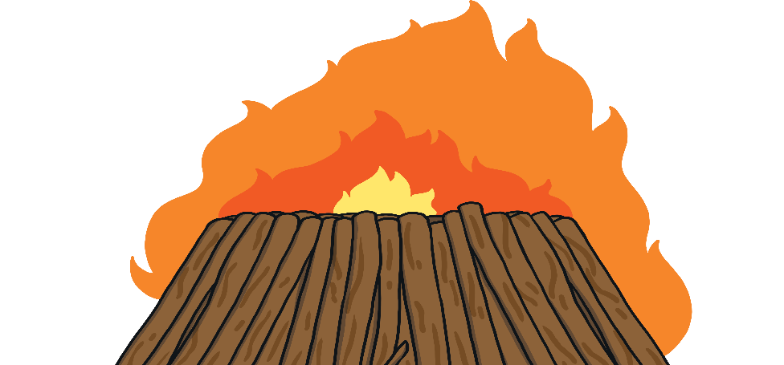

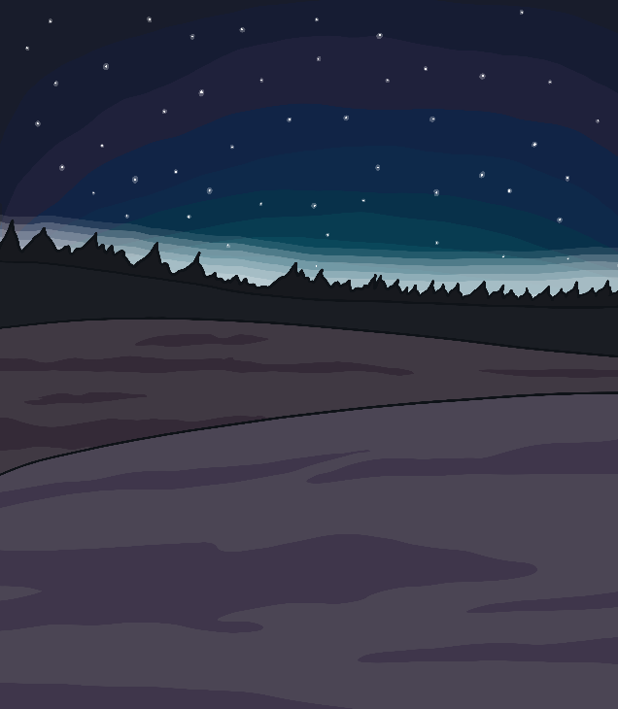
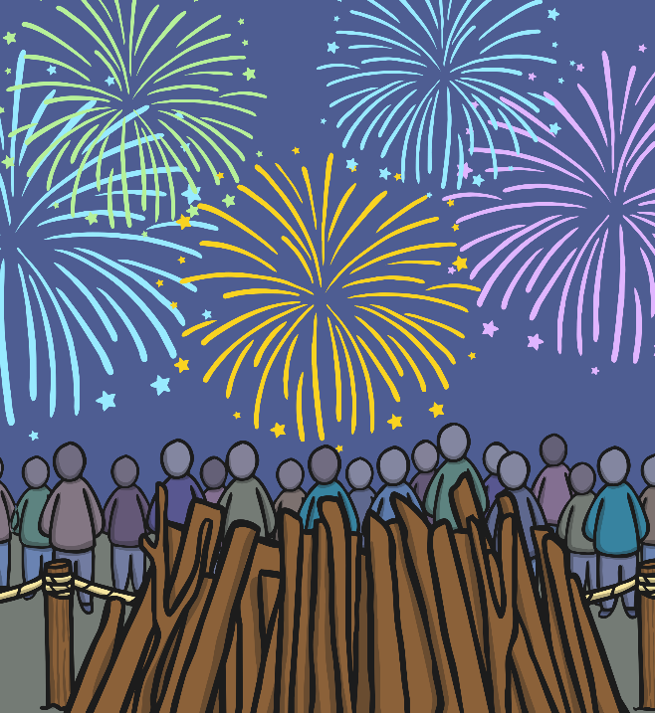
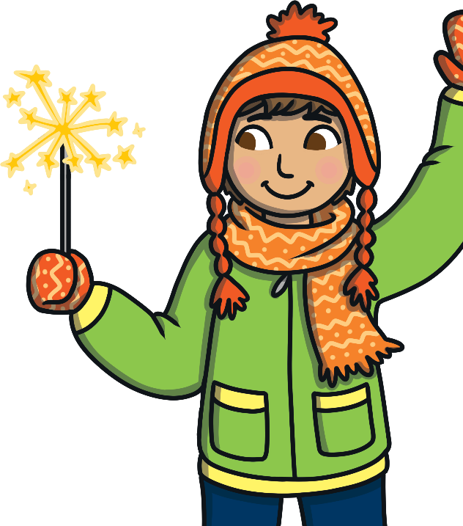
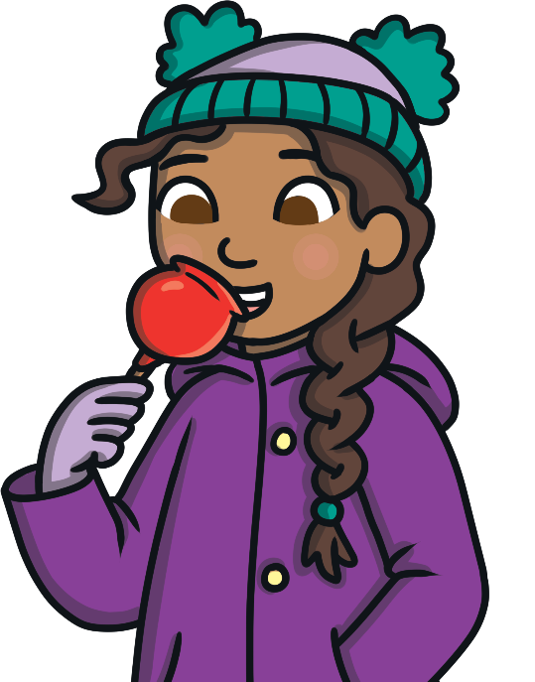
How Do People Celebrate Bonfire Night?
Bonfire Night is celebrated across the United Kingdom.
bonfire
fireworks
sparklers
special foods
public firework displays
Many families have their own traditions. How do you celebrate Bonfire Night?

Slide 6

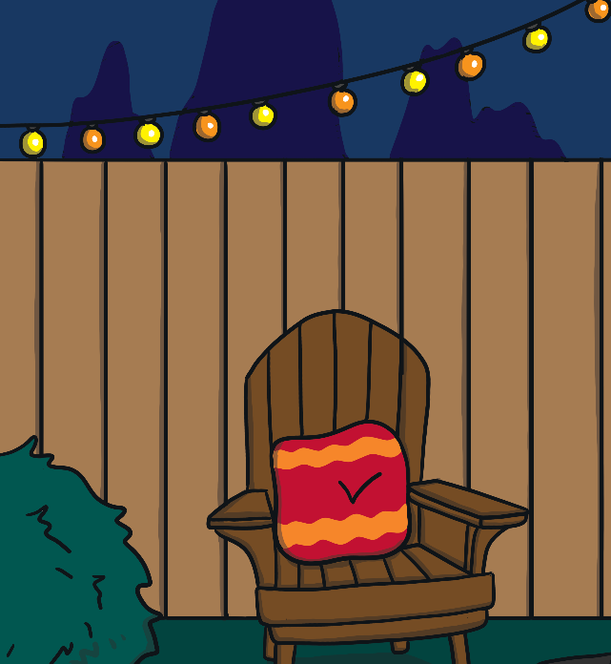

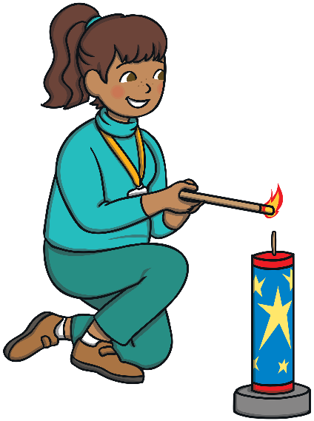
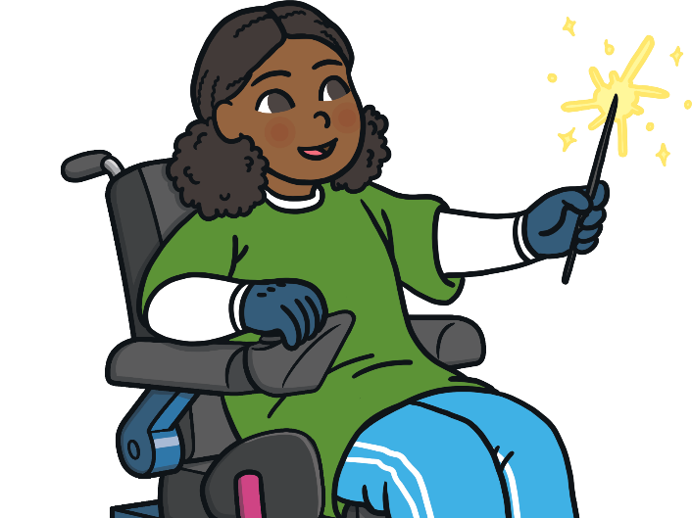

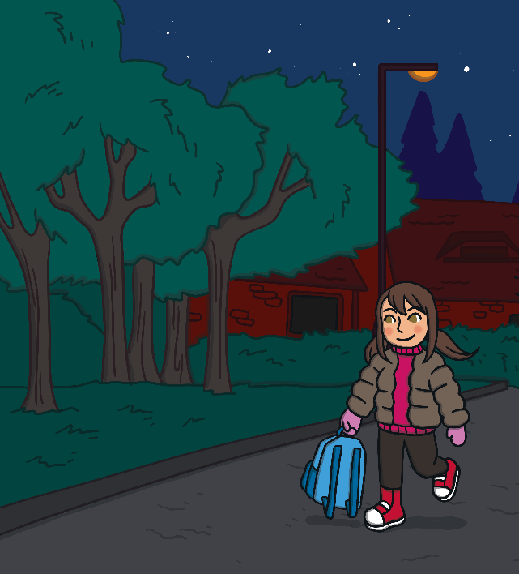
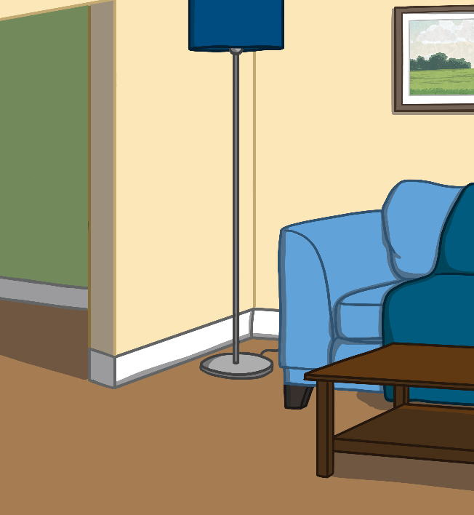

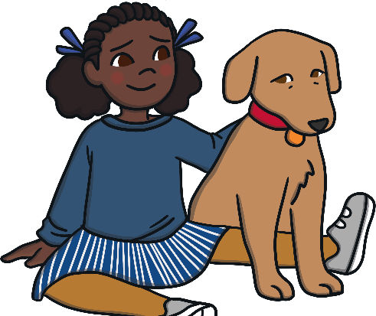
What Dangers Do You Think There Are on Bonfire Night?
firework displays
sparklers
lighting fireworks
bonfire
walking in the dark
dangers to pets

Slide 7
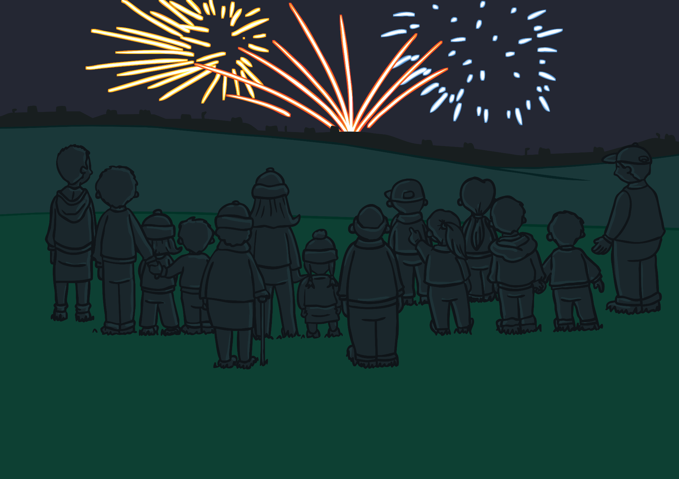
Fireworks
Fireworks should not be used by children. Never try to light fireworks yourself. Only adults should handle fireworks.
Whether at home or at a public display, you should always stand well back from the fireworks, leaving a safe distance.
Even if it doesn’t go off straight away, it could still explode later.

Slide 8
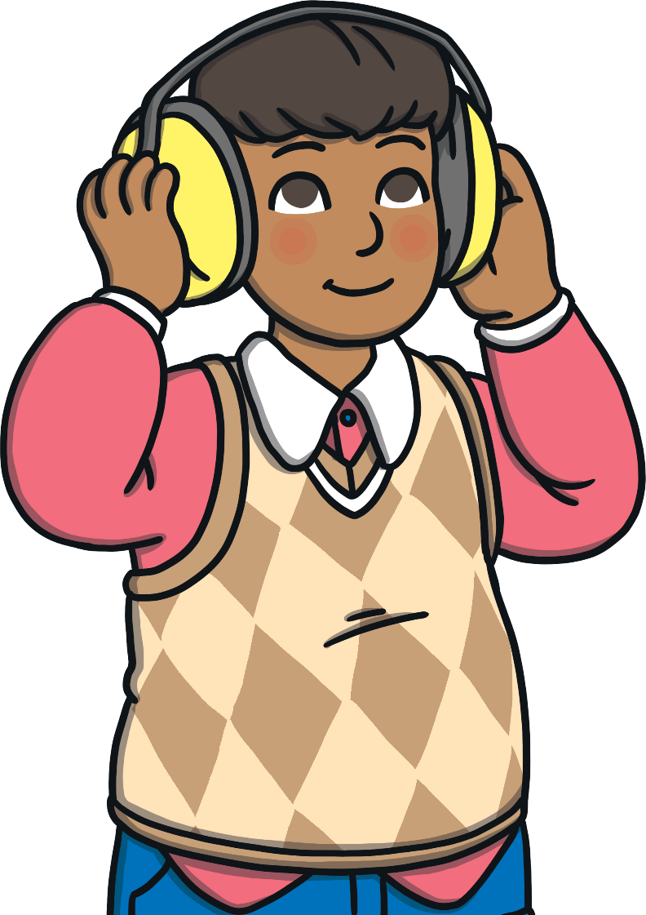
Fireworks
Fireworks are exciting but they can be noisy. Some people choose to wear earmuffs or ear defenders.

Slide 9

Fireworks
Animals are often scared of fireworks. Always keep pets inside and make them as comfortable as possible.

Slide 10
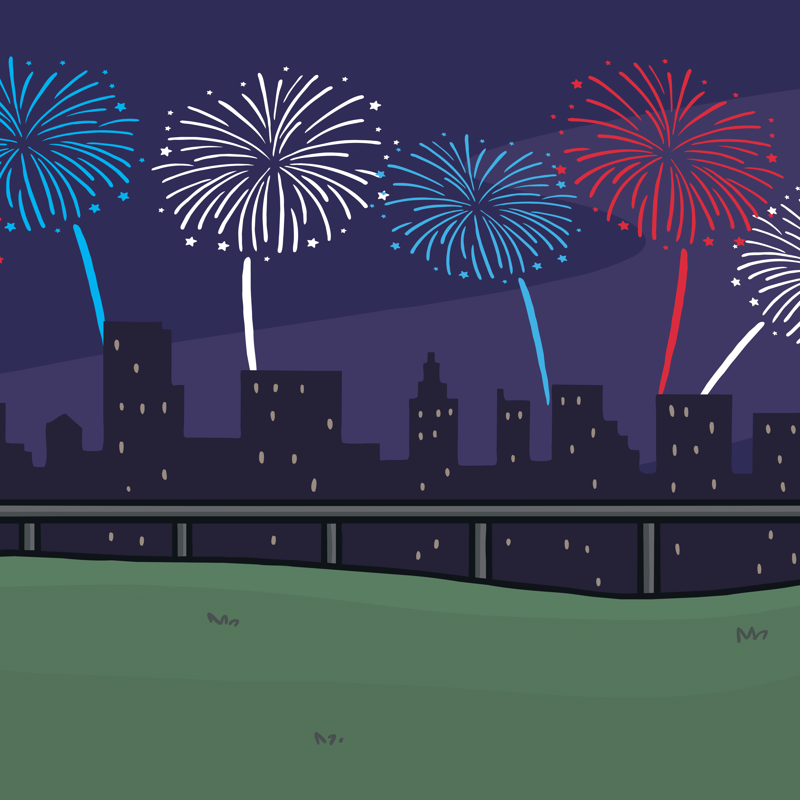
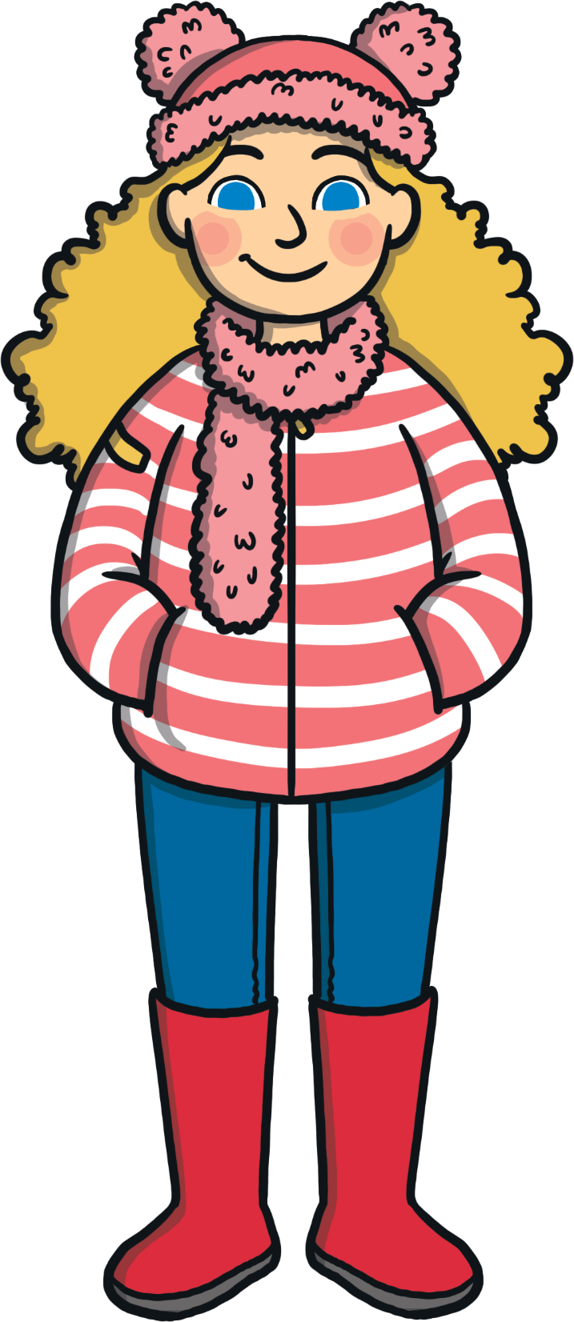
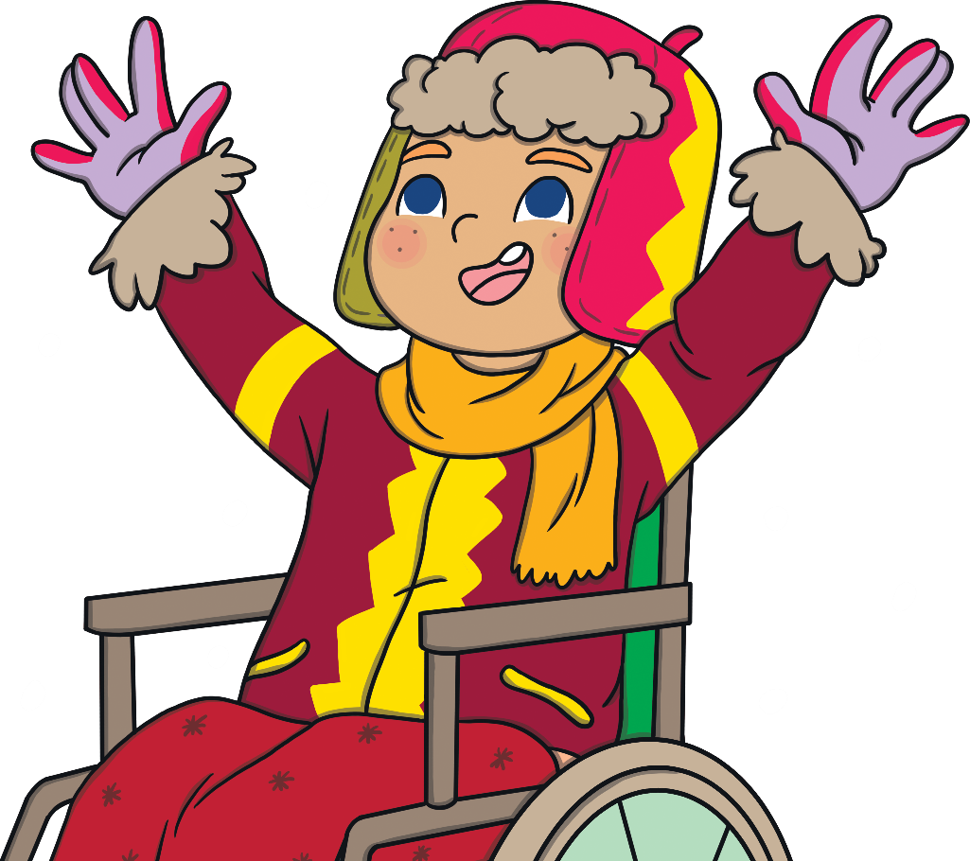

Fireworks
When attending a public firework display, it can often be busy and dark. Stay with an adult to keep safe.

Slide 11

Bonfires
Don't stand too close to a bonfire. Stand a safe distance away.
Some people choose to have small bonfires at home on Bonfire Night. What could they do to make sure they stay safe?

Slide 12
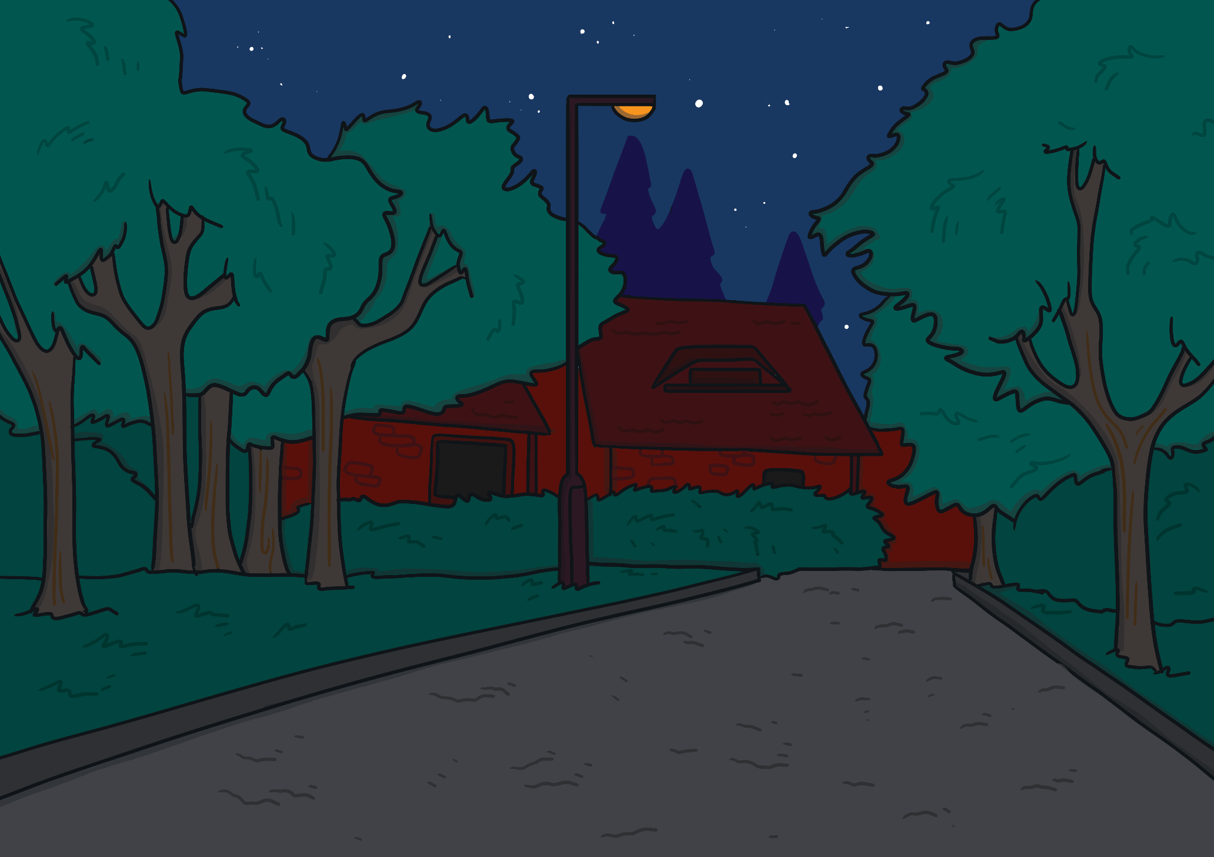
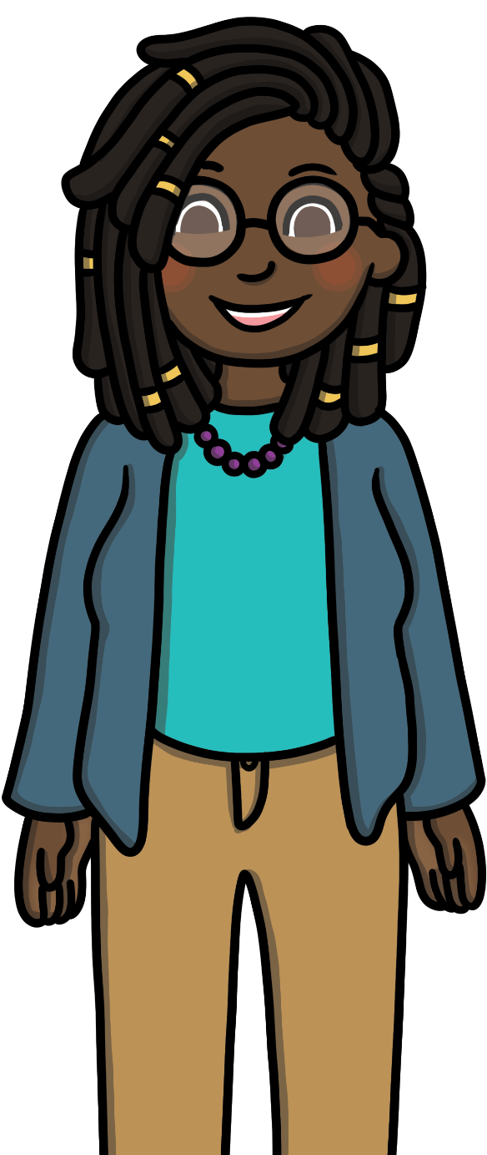

Sparklers
Sparklers can be great fun and might seem harmless but they are still fireworks.
Sparklers should always be used under adult supervision.
Hold sparklers away from your body, at arm’s length. Always wear gloves.

Slide 13
Keep Safe
3
3
Celebrating Bonfire Night can be lots of fun but you need to remember to keep safe.
Turn to a partner and give them three tips for keeping safe on Bonfire Night.
What safety tips will you share with your family?
Remember, have fun and keep safe!

