Slide 1









Our Bank of Values

Slide 2

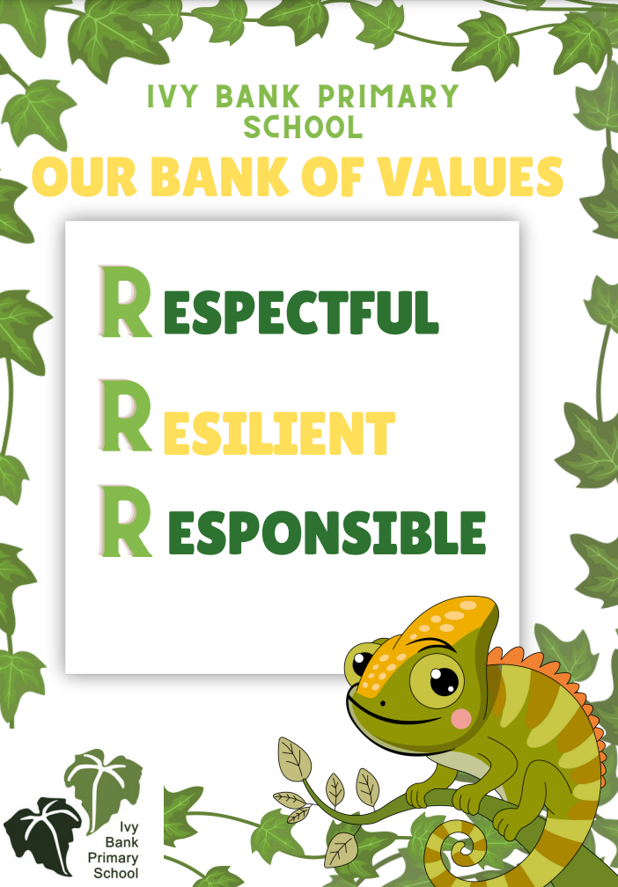


Slide 3

Respectful
Being respectful means treating others the way you want to be treated. It means using kind words, listening when someone is speaking, and taking care of school property.
Listening when someone is talking – it shows you care about what they’re saying.
Using kind words – even when you’re upset, you can still speak nicely.
Taking turns and sharing – this helps everyone feel included.
Looking after school property – like books, toys, and classroom furniture.
Following rules – they help keep everyone safe and happy.
Being polite – saying “please,” “thank you,” and “excuse me”

Slide 4


When we are respectful:
We make others feel happy and safe.
We build strong friendships.
We help our school be a great place to learn and grow.

Slide 5
Resilient
Being resilient means not giving up, even when things are hard. It’s about trying your best, learning from mistakes, and bouncing back when something doesn’t go your way.
Keep trying even if your work feels tricky.
Ask for help when you need it – that’s being brave!
Learn from mistakes – they help us grow.
Stay calm when things don’t go as planned.
Believe in yourself – you can do it!

Slide 6

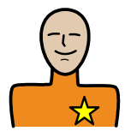
When we are resilient:
We become stronger learners.
We feel proud of ourselves for not giving up.
We learn that it’s okay to make mistakes – that’s how we improve!
We help others feel brave too.

Slide 7
Responsible
Being responsible means doing the right thing, even when no one is watching. It’s about taking care of yourself, helping others, and making good choices.
Doing your homework and bringing the right things to school.
Looking after your belongings and school equipment.
Helping to tidy up after activities.
Being honest and owning up if you make a mistake.
Following rules and being safe.
Trying your best in everything you do.

Slide 8


When we are responsible:
People can trust us.
We help make our school a safe and happy place.
We learn to be independent and confident.
We show that we care about ourselves and others.

Slide 9



