Slide 2
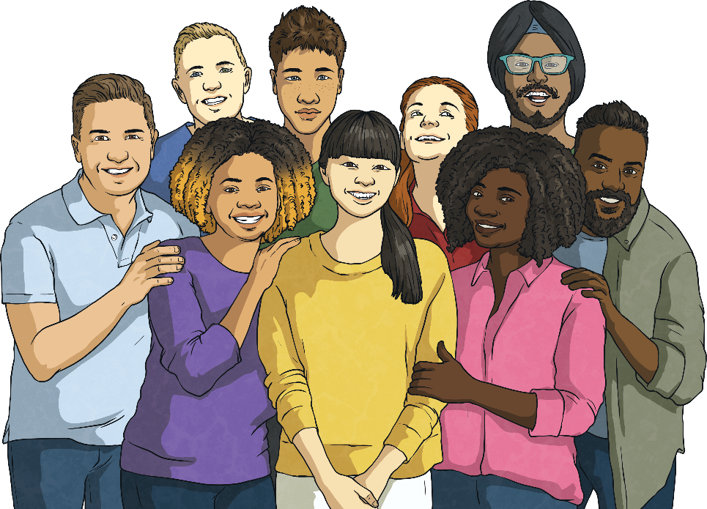
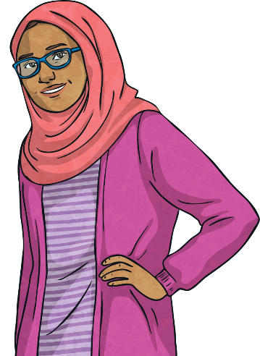
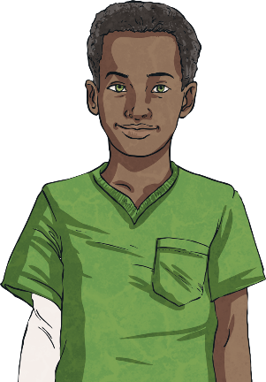
What Is Respect?
Respect means thinking about other people and their feelings.
Respect means thinking about other people and their feelings.
We can show respect in many ways, through how we act and in
what we say.
Ngbfnjfvnbgfnj
gnnj

Slide 3
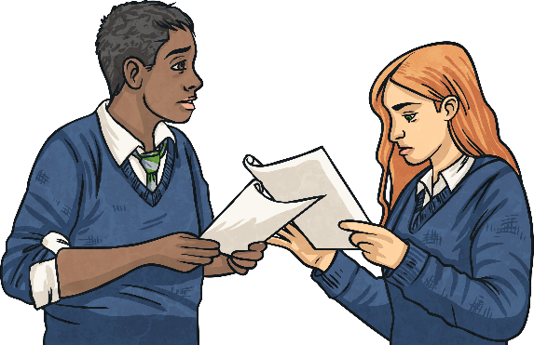

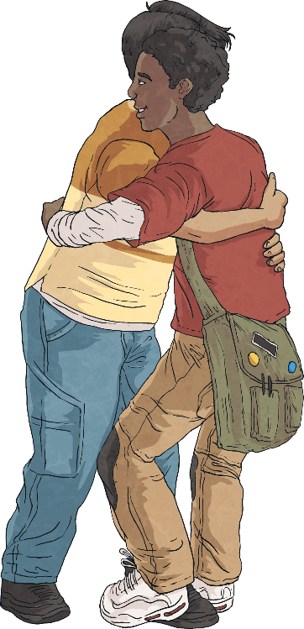
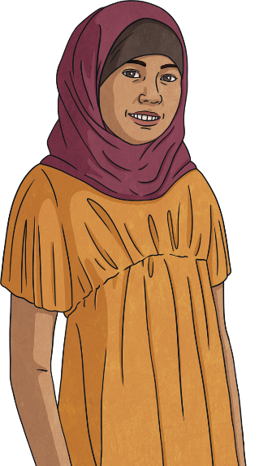
How Can We Show Respect in School?
We can show respect by:
Respect means thinking about
listening to others;
following school rules;
saying kind things to others;
waiting our turn;
including others in our activities;
using good manners.

Slide 4
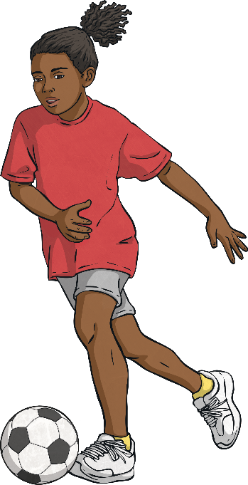
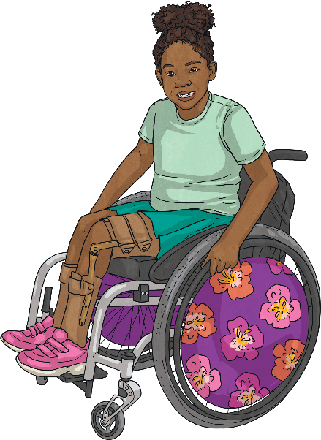
How Do We Respect Ourselves?
It's not only important to respect others - it's important to respect ourselves too!
We should look after our bodies.
We should pursue our passions
and interests.
We should love ourselves and believe in our abilities.
Ngbfnjfvnbgfnj

Slide 5
How will you show respect today?

