Slide 1


Early Years
Foundation Stage
Information Evening
“When we give every child the best start in their early years, we give them what they need today. We also set them up with every chance
of success tomorrow.” – Development Matters

Slide 2
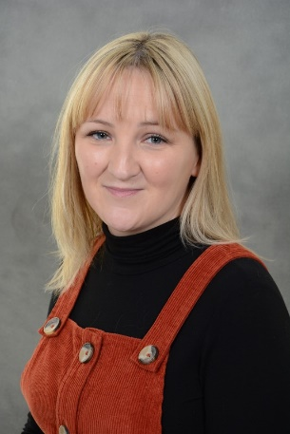
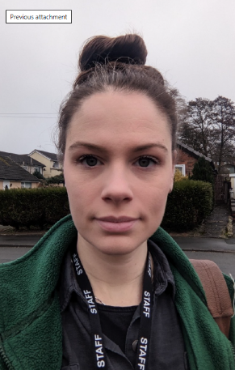


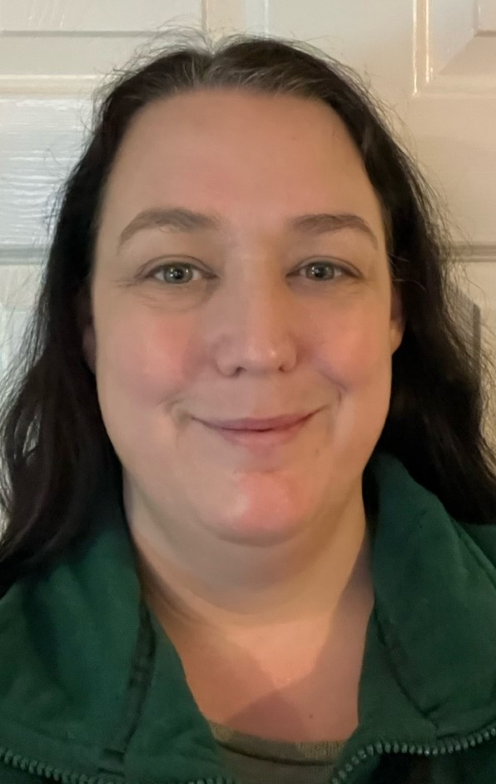



Nursery Staff
Mrs Barber
EYFS Lead & Deputy Headteacher
Miss Nicholas
Higher Level Teaching Assistant
Miss Davies
Teaching Assistant
Miss Tomlinson
Teaching Assistant
Mrs Heathcote
Teaching Assistant
Miss Forshaw
Midday Assistant
Mrs Hulley
Midday Assistant
Mrs Barber
Midday Assistant

Slide 3
Nursery Sessions
Morning session: 9.15am – 12.15pm
Afternoon session: 12:15pm – 3:15pm
Please keep staff informed if there are any changes regarding the collection of your child.
For the safety of your children, we operate a password system. If at any time somebody we do not recognise comes to collect your child, they will be asked to provide your unique password.

Slide 4
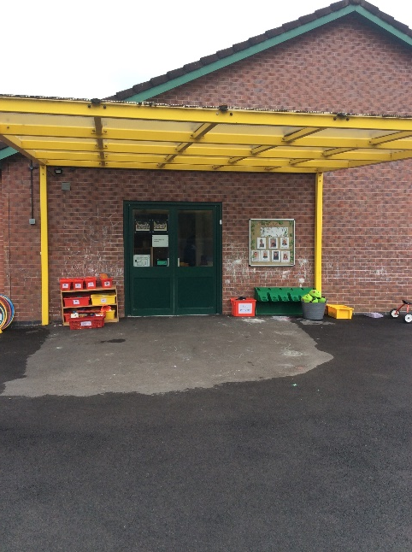
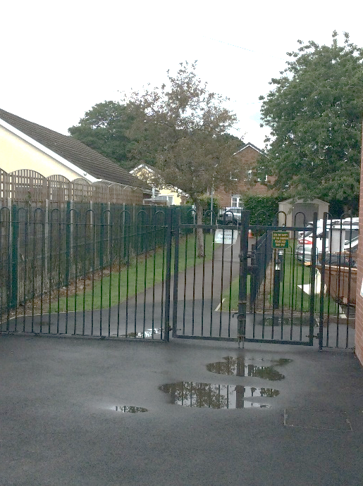
Nursery Drop Off and Pick Up
Nursery is accessed via the gate to the right of the school.
When your child enters, a member of nursery staff will be there to help them hang up their belongings and guide them inside.

Slide 5
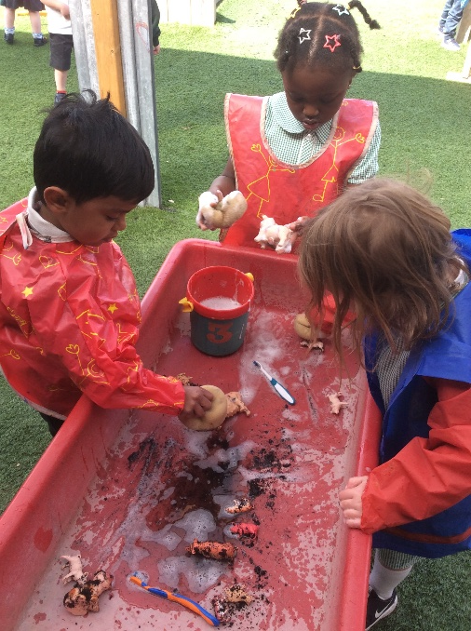
Our Nursery Day
Registration and singing
3 Carpet sessions – Maths, English and Phonics
Squiggle Whilst You Wriggle
Independent learning
Adult led activities
Outdoor play
• Milk & snack
PE in the school hall
Lunch in the school hall
• Story time and nursery rhymes

Slide 6
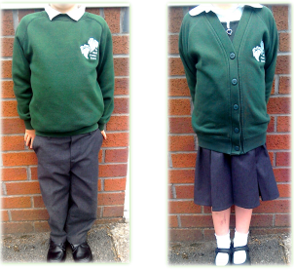
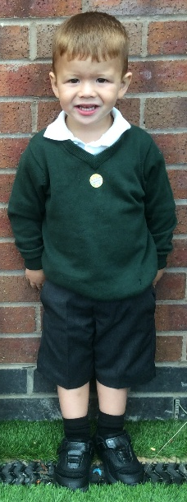
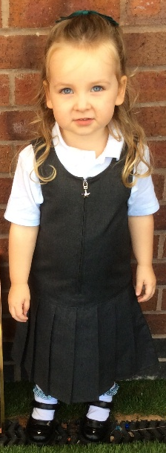
Uniform
Nursery and Reception have the same uniform as the main school.
All items of clothing need to be clearly labelled with your child’s full name, label EVERYTHING!
Since we use the outdoor learning environment whatever the weather, please ensure your child wears a warm waterproof coat with hood, hat, scarf and gloves in cold weather and a sun hat/cap in sunnier weather.
On the day we have PE, your child will
need to come into nursery/school in a PE kit.
The specific day will be shared with you
in September.
Velcro fastening shoes are ideal and support
independence. (Please no laces!)

Slide 7
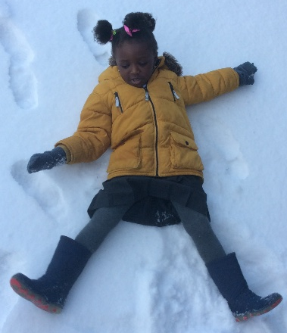
Nursery - What does my child need?
Water bottle - Please provide a clearly named water bottle in Nursery each day for your child. We ask that this is filled with water.
Bags - Children must bring their belongings in a ruck sack style bag that will easily fit a large book inside.
Spare Clothes - If your child has a toileting or wet play 'accident' in Nursery; we will change them and provide clean clothes. It would be helpful if you could provide a labelled bag containing a complete change of labelled spare clothes to keep in Nursery in case of any accidents. If your child does come home in Nursery clothing, please aim to return them as soon as possible, as our supplies are limited.
Wellies – to be kept on your child’s peg in a waterproof drawstring bag so we can use the grassy and water areas without notice.

Slide 8
Toileting
We kindly ask that your child is toilet trained before they start nursery.
The NHS shares that by the age of 3, most children—around 9 out of 10—are dry most days. That said, little accidents can still happen, especially when children are excited, upset, or really focused on playing (which is totally normal!)
Changing nappies does take time and means an adult is not always available to support children with learning and play.
If your child isn’t quite there yet, don’t worry—you’re not alone. You can speak to your health visitor for support or check out the ERIC website, which has lots of helpful advice on toilet training.
Home - ERIC

Slide 9
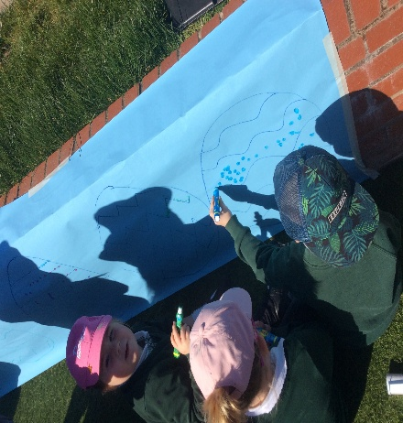
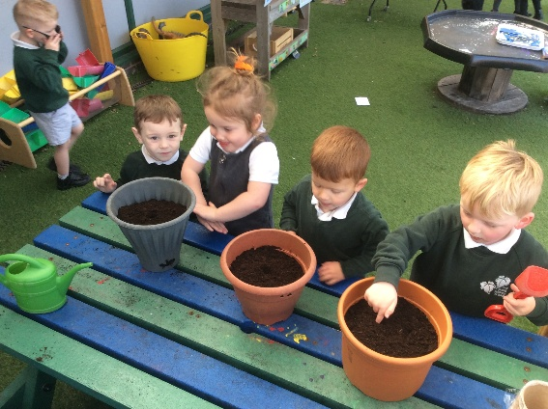
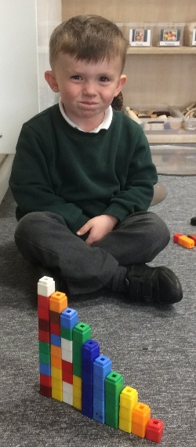
How is our Nursery different to a private day nursery?
The nursery is overseen by a qualified teacher.
There are no ‘key-workers' - we work as a team.
Our nursery caters for the pre-school age (children turning 4 years old within the academic year.)
Opening times: 9.15am – 3.15pm.
Wrap around can be offered for 4-year-olds and above by Ivy Leaves.
Structured day with phonics, maths and literacy.
Emphasis on preparing your child for reception.
No daily updates. Parents are kept informed via the weekly newsletter, termly reports and parent evenings.
Homework...! Children will have a reading record and odd tasks.

Slide 10
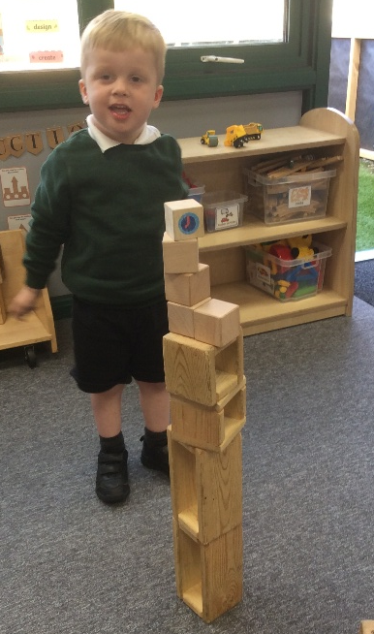
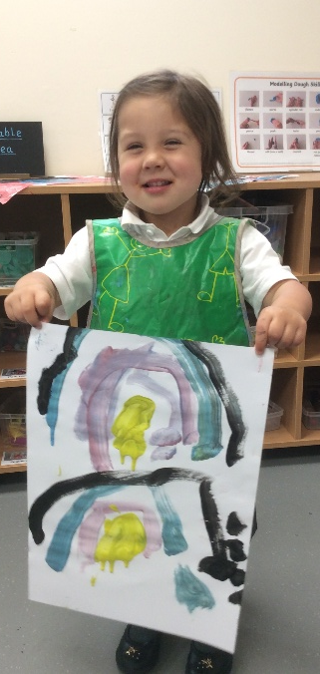
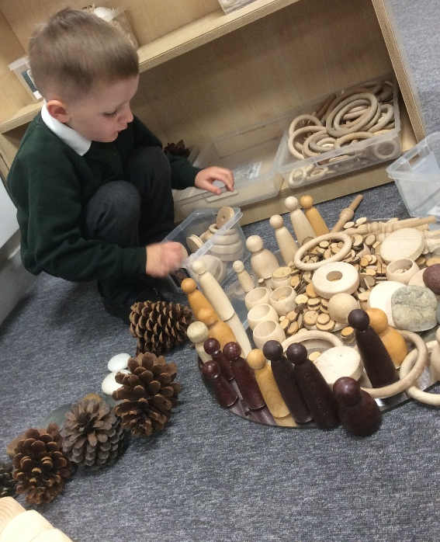
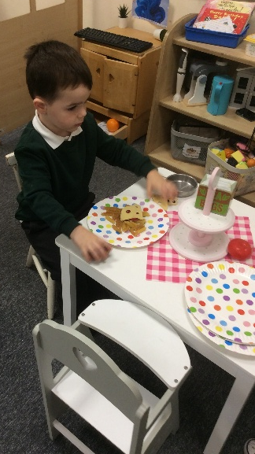
EYFS Learning
Areas
Home Corner
Transient/Natural Art
Construction and Small World
Investigative Area
Writing Area
Playdough Area
Painting & Junk Modelling

Slide 11
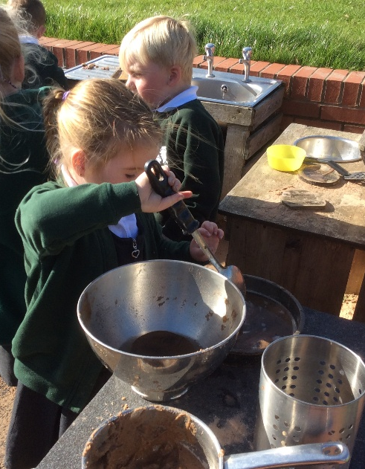
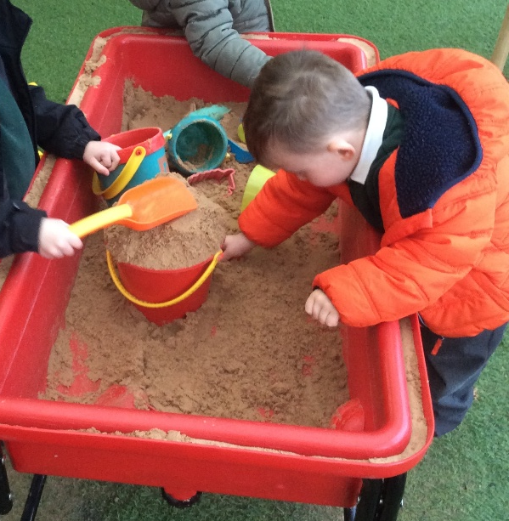
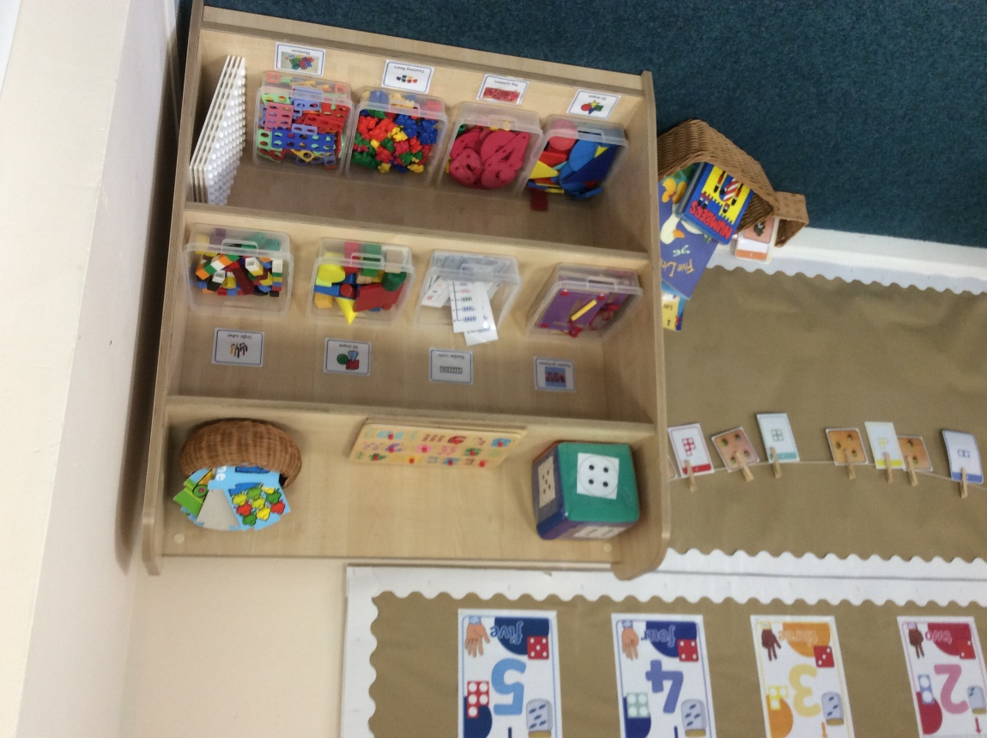
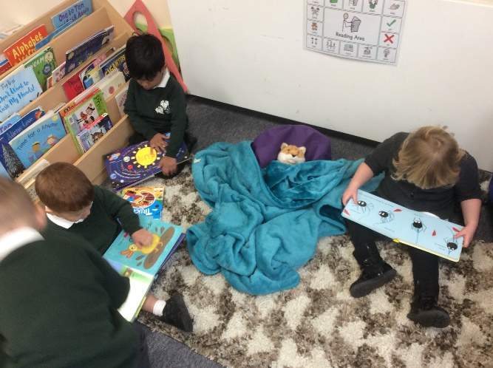
EYFS Learning
Areas
Reading Area
Outdoor Sand and Water
Outdoor Kitchen
Maths Area
Outdoor Role Play
Outdoor Stage (in Nursery)

Slide 12
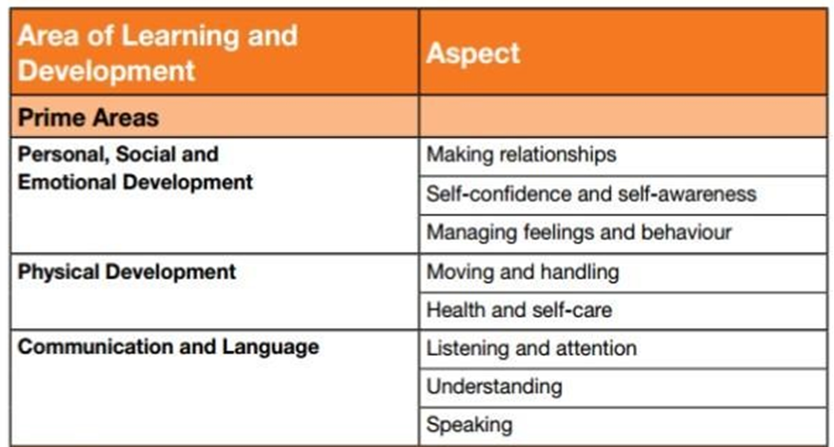
Our Learning: Three Prime Areas

Slide 13
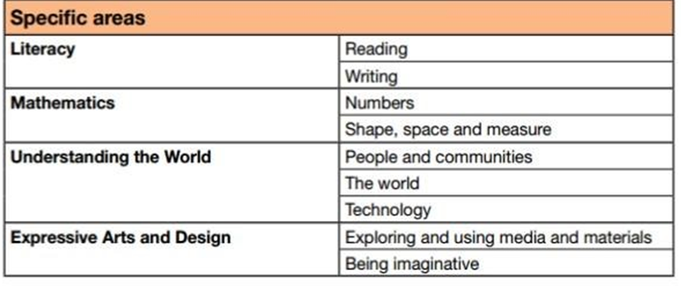
Our Learning: Four Specific Areas

Slide 14
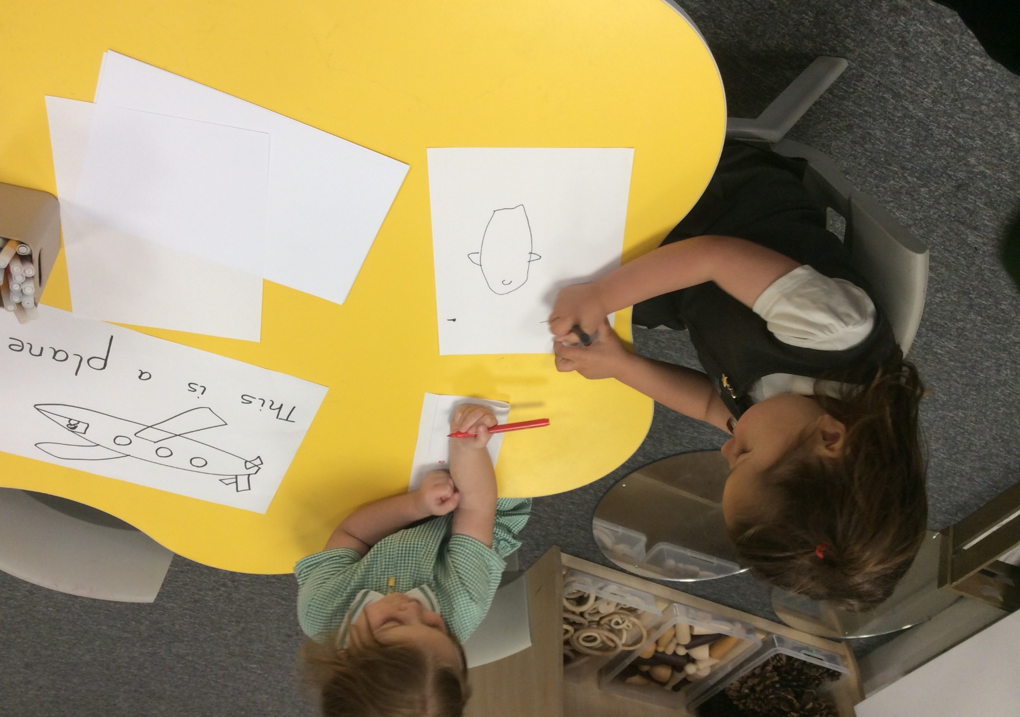
Our Learning
Our curriculum has been devised to meet the needs of the children and the learning requirements of the Statutory Framework for the Early Years Foundation Stage. We also use ‘Development Matters’, the non-statutory curriculum guidance.
Our curriculum is sequenced to ensure all children make progress and are ready for the next stage of their education.

Slide 15
Observations and Assessments
As EYFS staff, we regularly work alongside the children in the
areas, initiating conversations, asking questions and supporting
play ideas. During this time, we observe the children as they work
and gain a secure insight into their personalities, their interests,
their learning styles and abilities.
We gain a clear understanding of how the children are applying skills in their independent learning which help inform next steps in their learning.
“Assessment is about noticing what children can do and what they know. It is not about lots of data and evidence.” – Development Matters

Slide 16

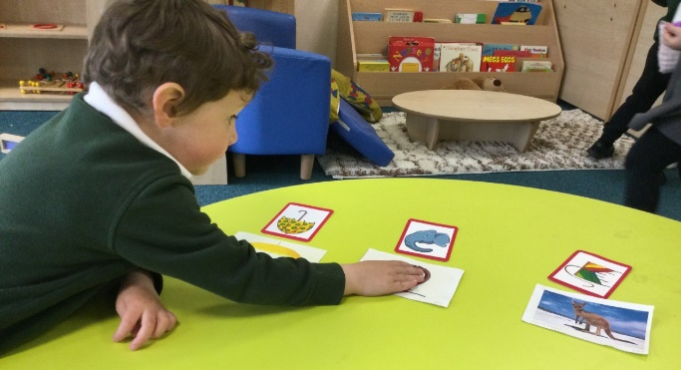
Phonics
At Ivy Bank Primary School, we teach Phonics through a scheme called Little Wandle Letters and Sounds Revised.
Once the children have settled into Nursery, and when we feel they are ready, we will begin our scheme to teach the hearing and recognition of sounds.
This will provide the foundations of early reading and covers:
• Environmental sounds
• Instrumental sounds
• Alliteration
• Rhyme
• Body percussion
• Recognition of initial sounds in words
• Oral segmenting and blending
Further information can be found on the school website.

Slide 17
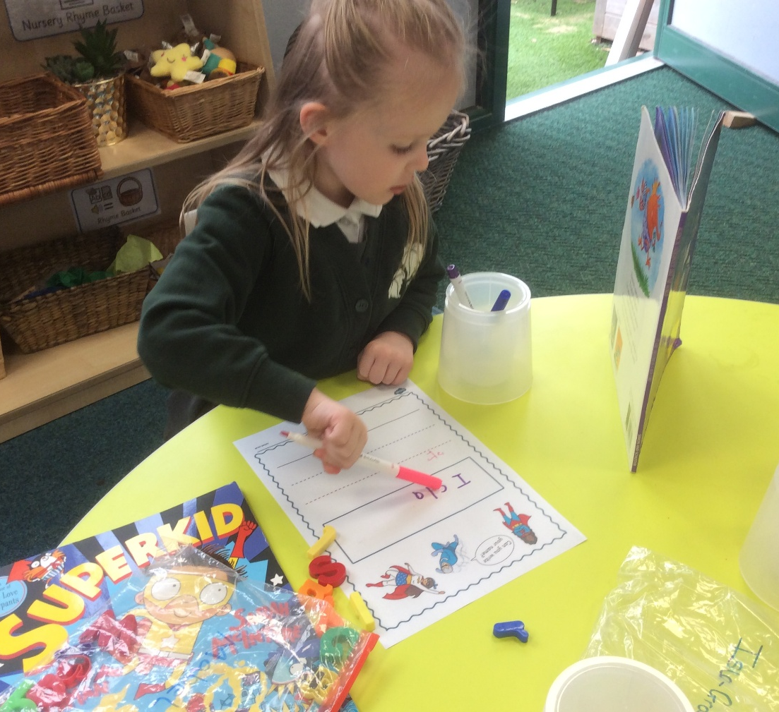
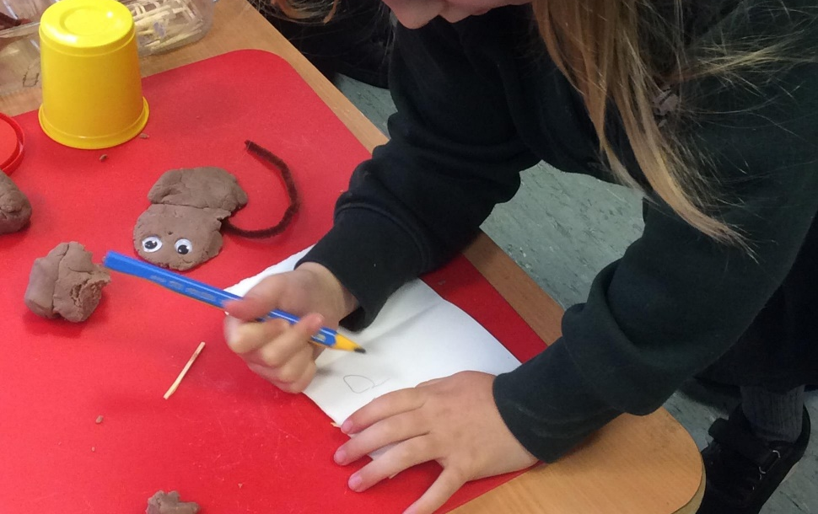
Writing
In EYFS we provide lots of opportunities for the children to mark-make independently, practise their writing skills.
We encourage the development of fine motor skills through a range of activities such as rolling playdough, tweezing and threading.
Nursery children take part in daily ‘Squiggle Whilst You Wriggle’ sessions.
These activities improve the muscles to allow children to hold a pencil correctly and then form letters correctly.
Once secure in pencil-holding, Nursery children can then work towards letter formation, encouraging the children to begin writing letters in their name.

Slide 18
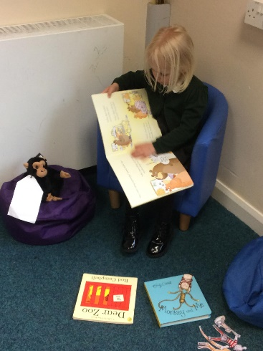
Reading
Encouraging children to have a love of reading is very important in the Foundation Stage.
We share stories every day, through Literacy based activities, reading stories together during independent learning or sharing a story at the end of the session.
We also have use of the school library and children are encouraged to choose a book to share at home together. Please read with your child and sign their reading diary.
“Children who begin reading for pleasure from a young age tend to perform better at cognitive tests and have better mental health.”
- study by the University of Cambridge and Fudan University in China.

Slide 19
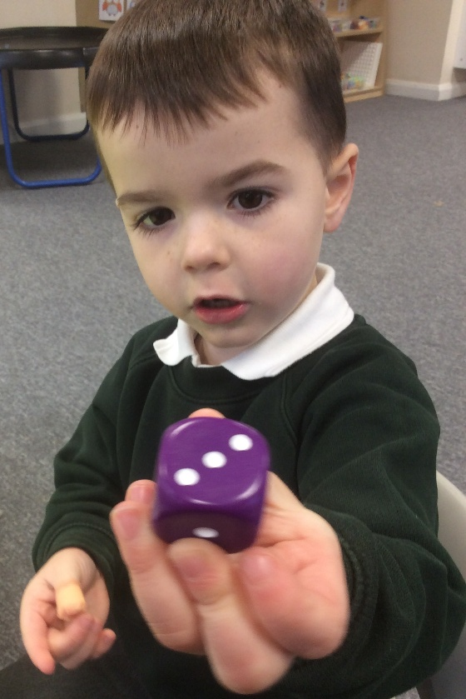
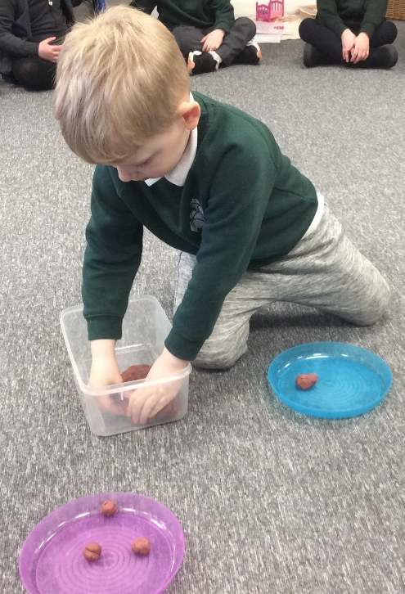
Maths in Nursery
In Nursery children will experience number through a range of activities including counting objects, matching and sorting games and songs.
Our aim by the end of their nursery year is for children to be secure and have an in depth understanding of numbers to 5. To do so, we initially work on rote counting (verbally counting) moving on to counting small groups of objects using 1:1 correspondence, sorting and comparing small groups of numbers and identifying numerals and matching numerals to small quantities.
Children are likely to become faced with daily challenges, so we always encourage the use of problem-solving skills when working with adults, or during child-initiated learning.

Slide 20
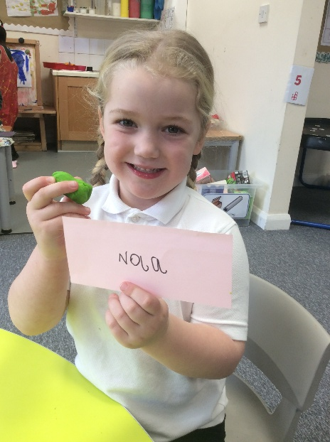
Our Aims in Nursery
I can write my name.
I can write some letters correctly.
I can count to 10 – forwards and backwards.
I can hold a pencil using the correct grip.
I know that the last number reached when counting a small set of objects tells you how many there are in total (‘cardinal principle’).
I can show ‘finger numbers’ up to 5.
I can link numerals and amounts: for example, showing the right number of objects to match the numeral, up to 5.
I can sing a large repertoire of songs.
I know many rhymes.
I can talk about familiar books and be able to tell a long story.

Slide 21
Useful links
Some of our favourite books for children. Whether they're nervous or excited, these books are perfect for preparing your little ones for that big step: Starting School | BookTrust
Strong Foundations: Strong foundations in the first years of school - GOV.UK
Concerned about your child's communication development? Come and have a chat and get some tips from a Speech and Language therapist: Virtual Talking Walk Ins Tickets, Multiple Dates | Eventbrite
Cheshire East Family Hub: Start for life (0 - 5) (cheshireeast.gov.uk)
Potty Training: When should we start potty training? (18 to 30 months) | NHS (youtube.com)
Promoting ‘healthy bladders and bowels’ (bbuk.org.uk)
Our Ref: (eastcheshire.nhs.uk)
Ditching the dummy :: Tips for ditching the dummy | Toddler | Health for Under 5s
Ivy Bank website page: https://www.ivybank.cheshire.sch.uk/
Development Matters Framework: https://www.gov.uk/government/publications/development-matters--2

Slide 22
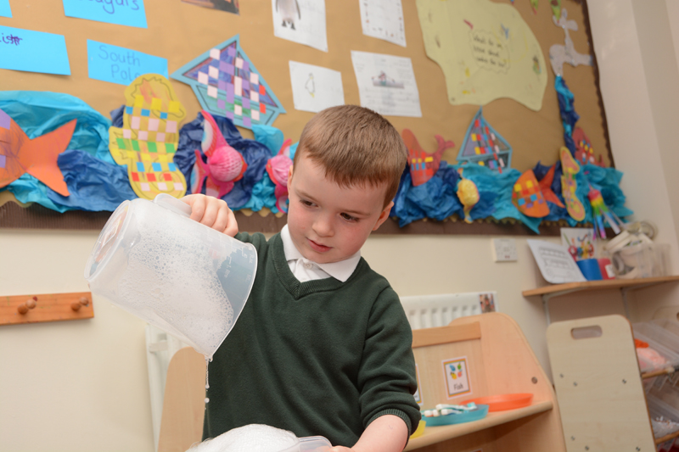
What have you done today?
“I can’t remember.”
“We just played!”

Slide 23
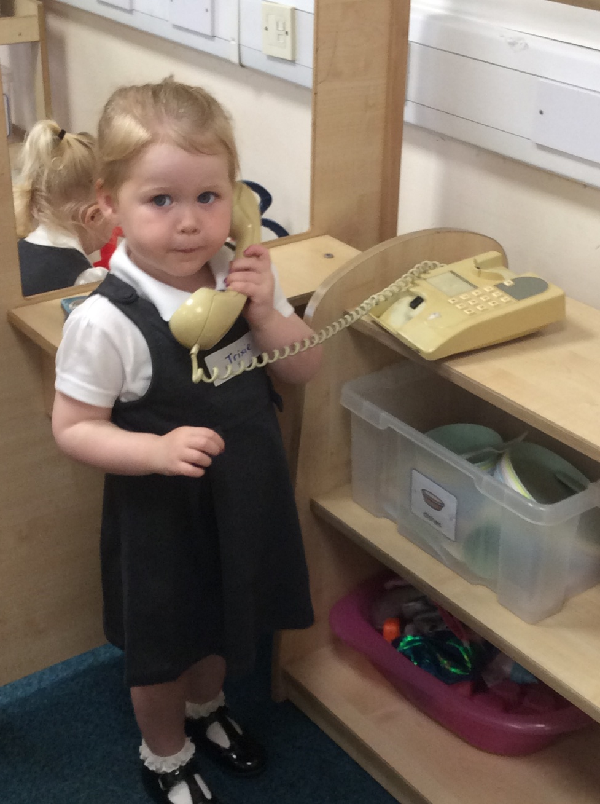
Contact details
School website:
https://www.ivybank.cheshire.sch.uk/
Mrs Barber’s email:
kbarber@ivybank.cheshire.sch.uk
Mrs Thomas's email:
sthomas@ivybank.cheshire.sch.uk
Mrs Hayhurst's email:
lhayhurst@ivybank.cheshire.sch.uk
Mrs Cairns’s (Nursery Administrator)
rcairns@ivybank.cheshire.sch.uk
Twitter:
@IvyBankPrimary
Phone number:
01625 448014

Slide 24
We look forward to welcoming you to Ivy Bank
Primary School!

