Slide 1


Teach reading: change lives
Phonics and early reading at Ivy Bank Primary School

Slide 2
“A love of reading is the biggest indicator of future academic success.”
OECD (The Organisation for Economic Co-operation and Development)

Slide 3


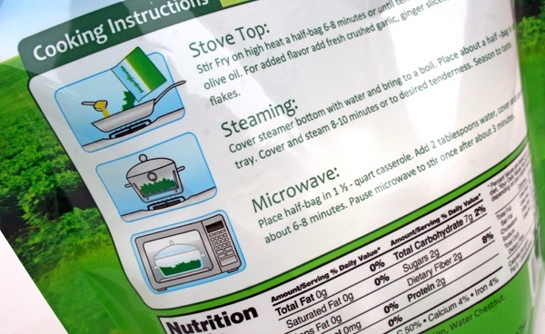
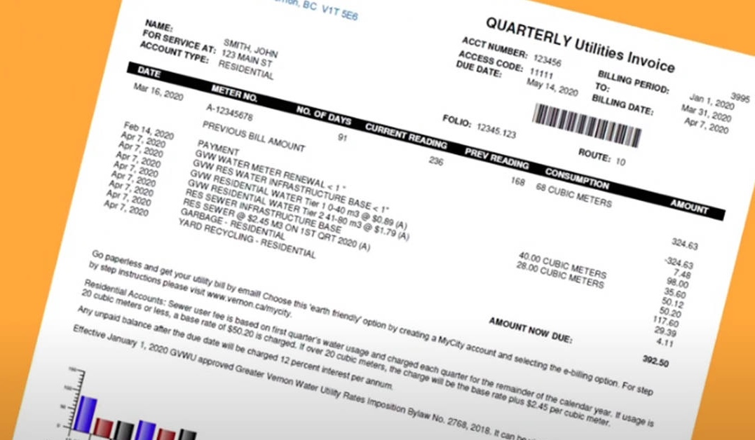
How many times have you already read today?

Slide 4

Phonics

Slide 5
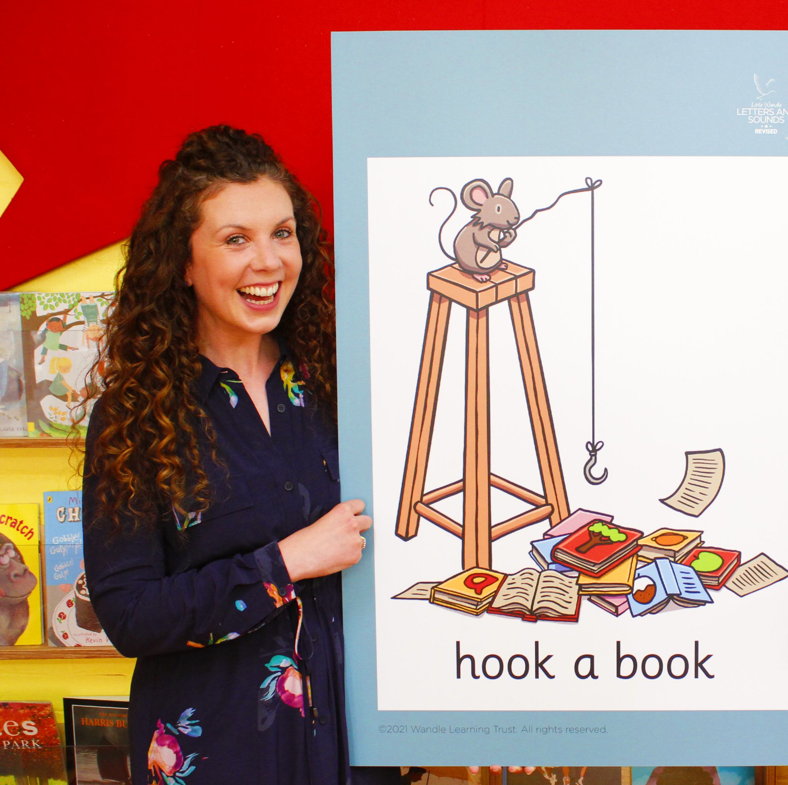
Little Wandle Letters and Sounds Revised
Our school has chosen
Little Wandle Letters and Sounds Revised as our systematic, synthetic phonics (SSP) programme to teach early reading and spelling.

Slide 6
Phonics:
is making connections between the sounds of our spoken words and the letters that are used to write them down.
We teach phonics every day for about 20 minutes. It is fast-paced, involves hearing, blending, segmenting, reading and writing.

Slide 7
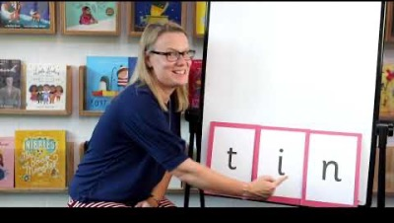
Blending to read words

Slide 8
Terminology
Phoneme
Split vowel digraph
Grapheme
Blend
Digraph
Segment
Trigraph

Slide 9
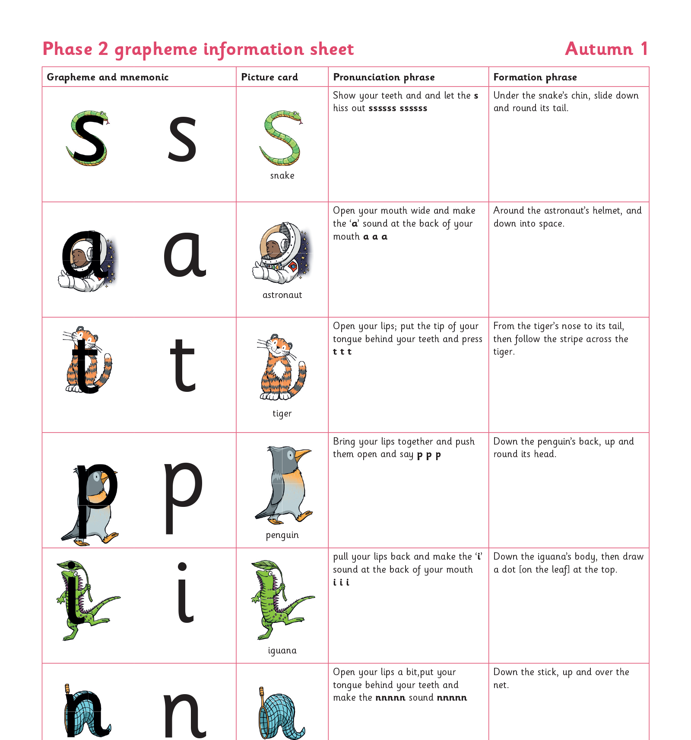
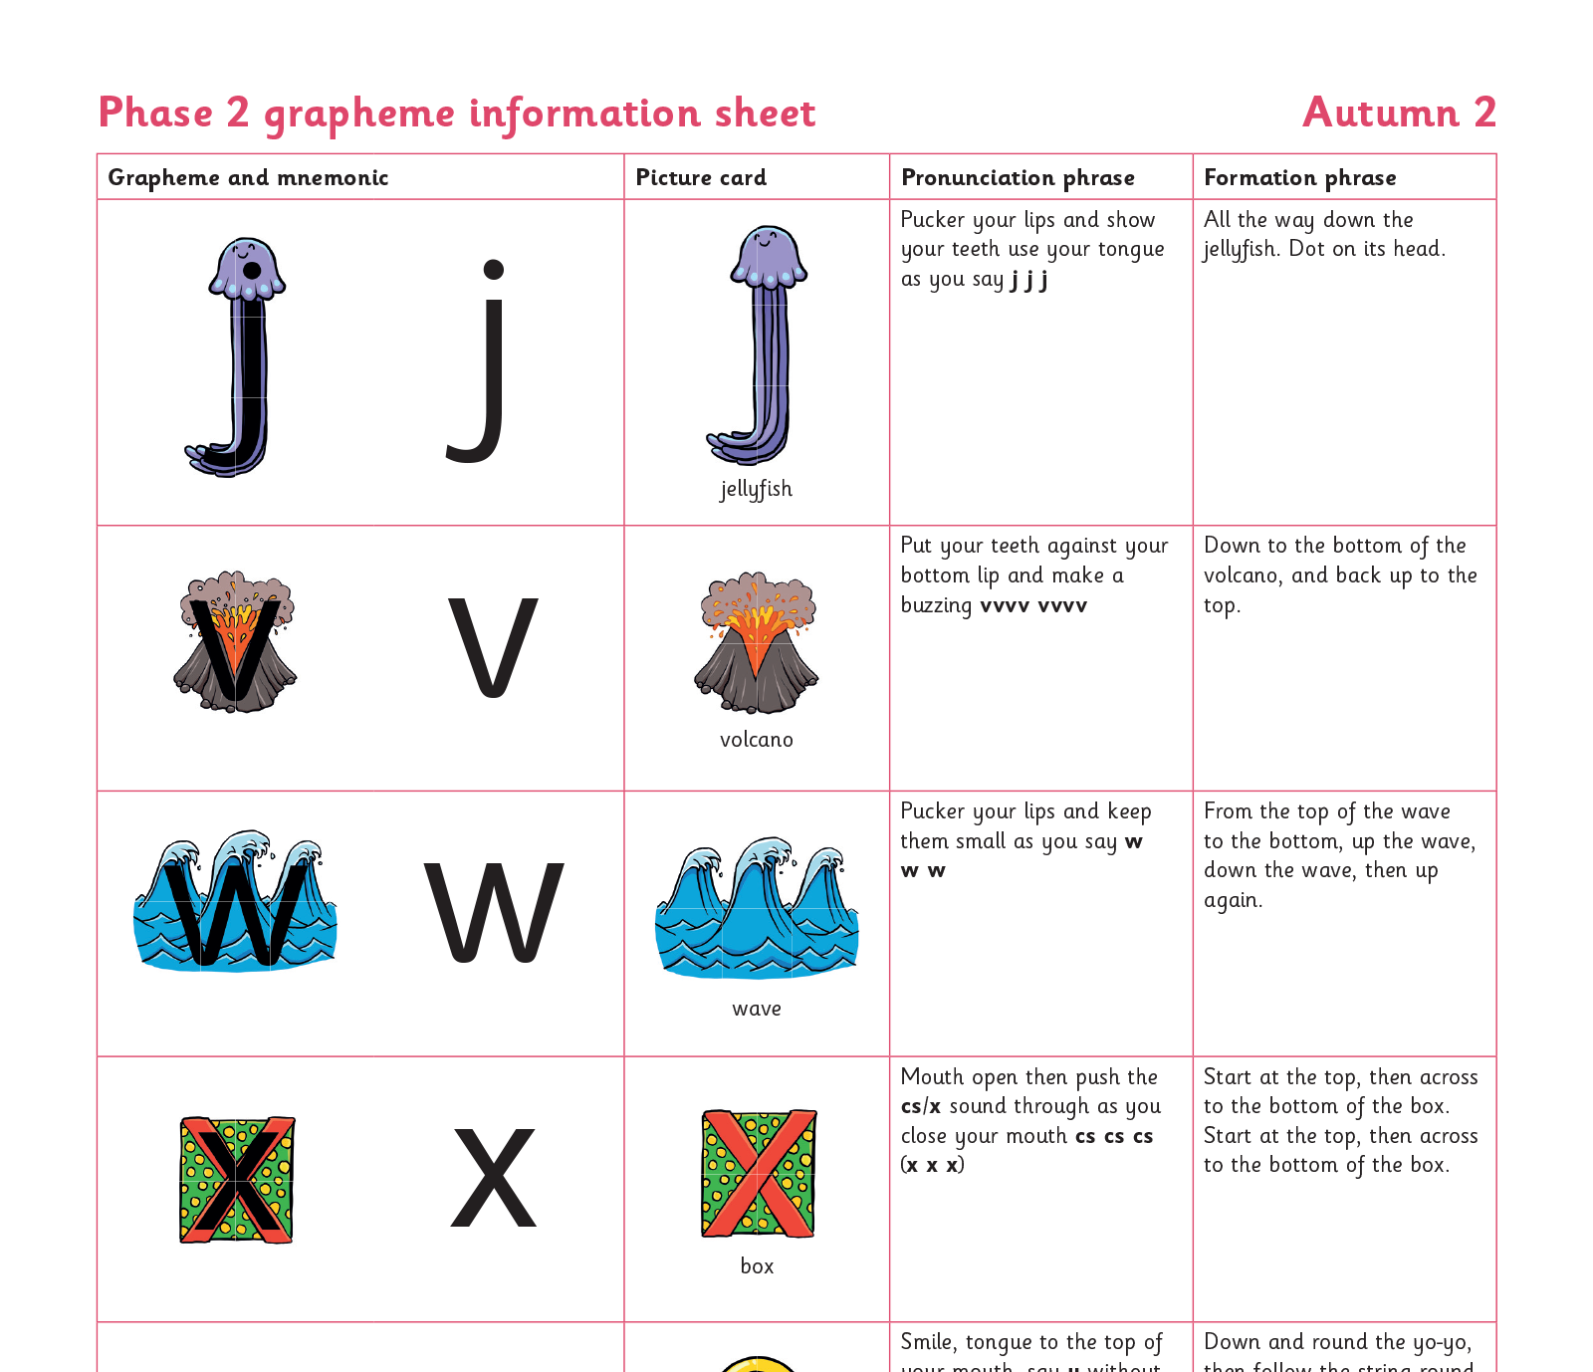
Teaching order

Slide 10
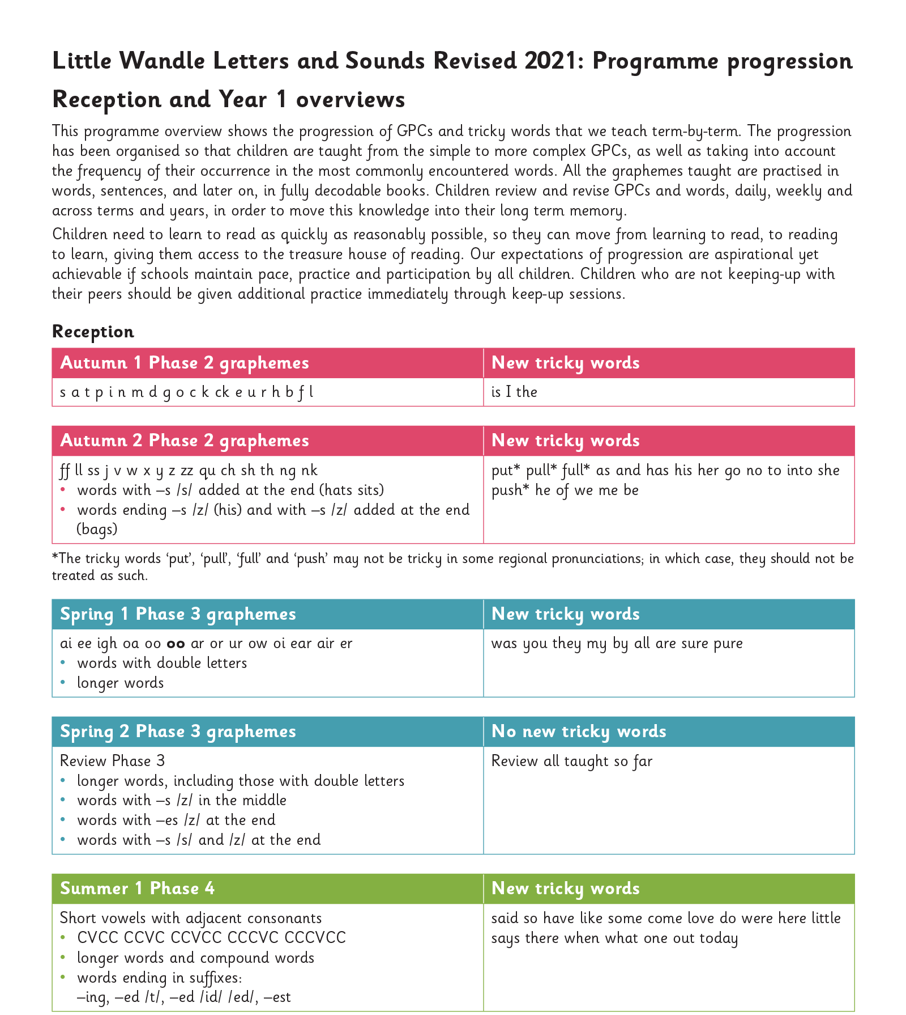
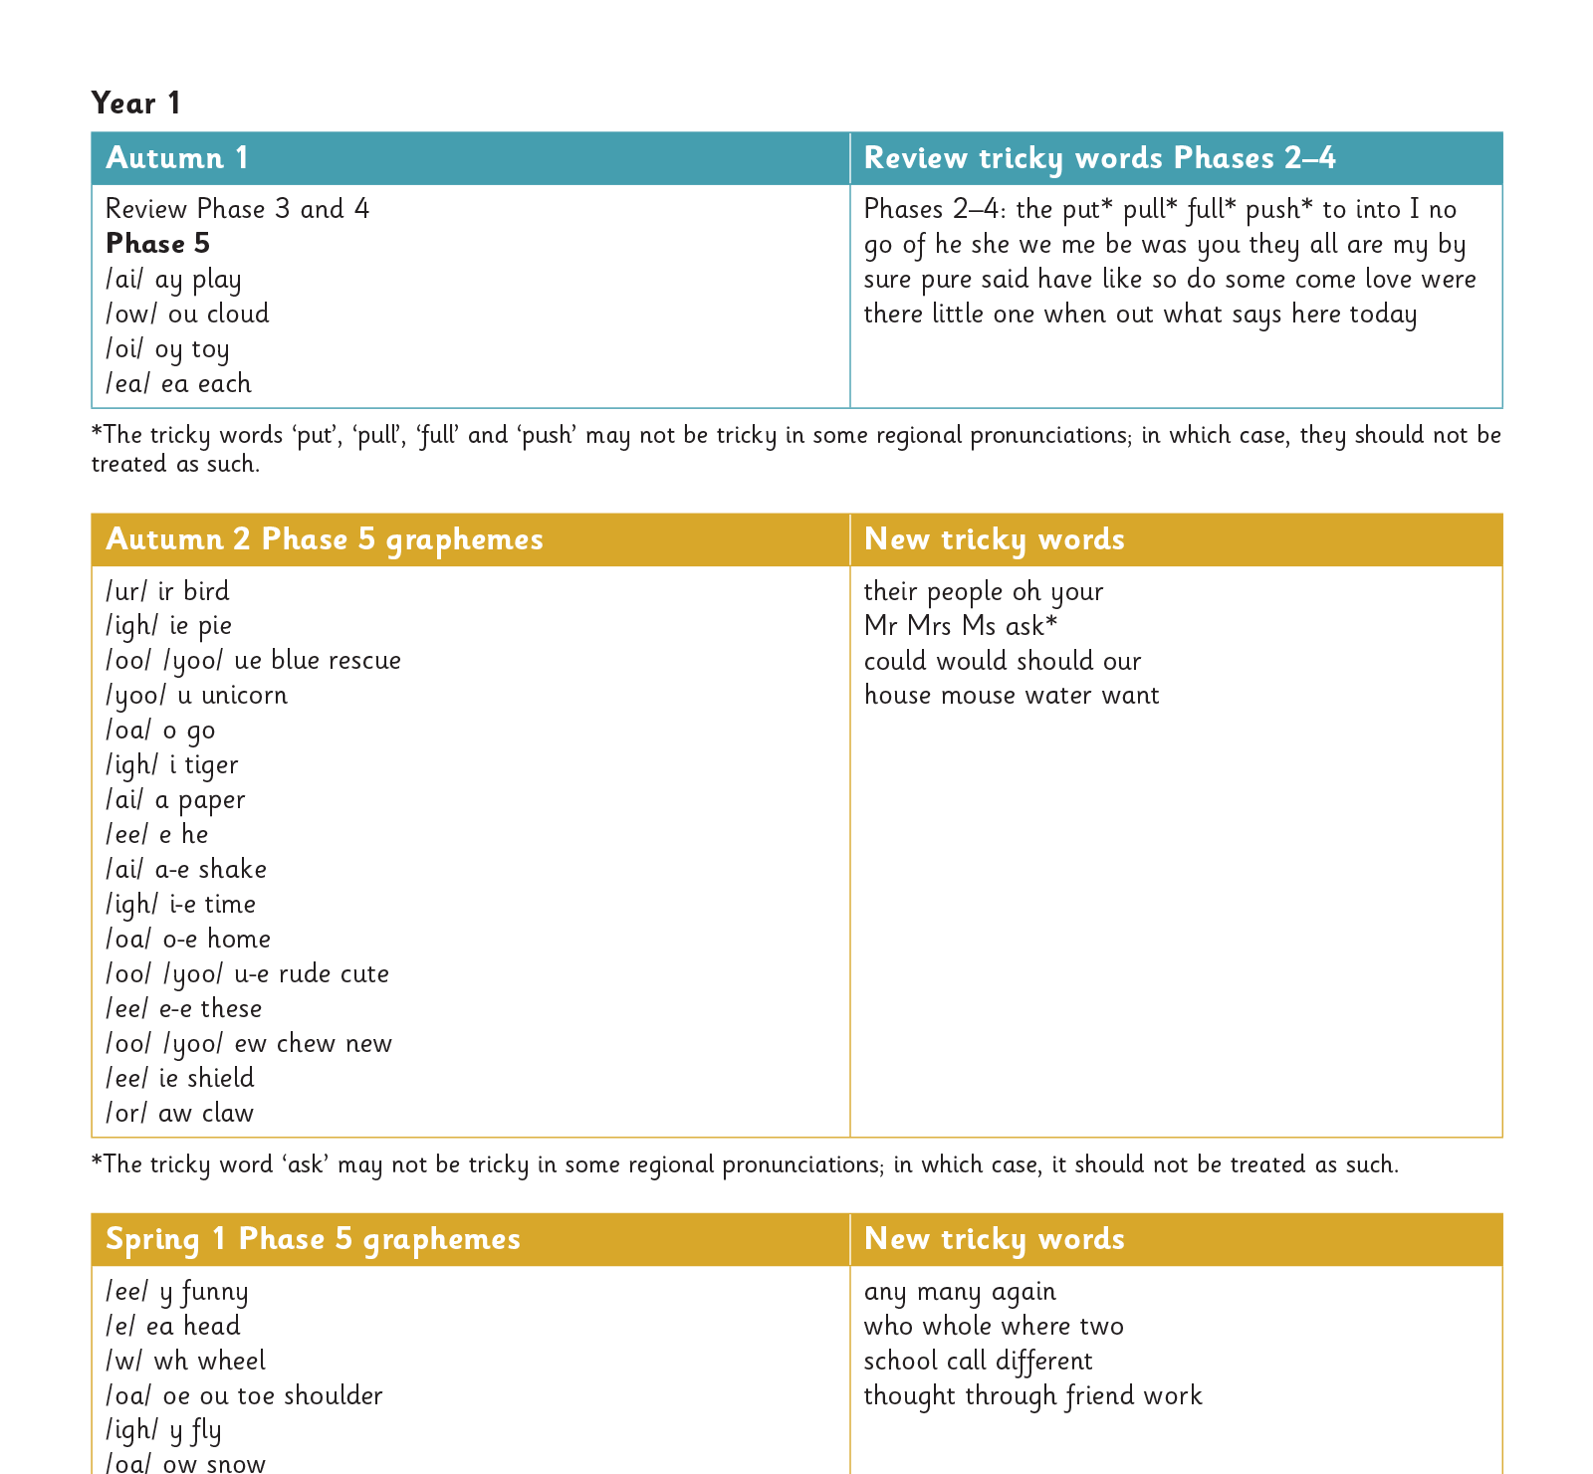
Gradually your child learns the entire alphabetic code:

Slide 11
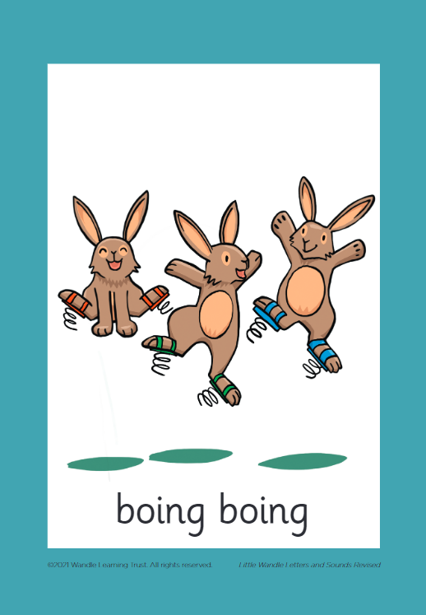



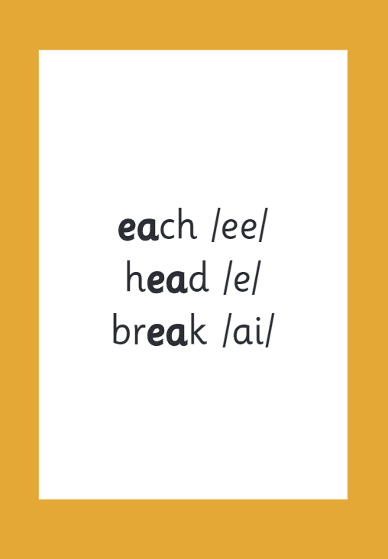

How we make learning stick

Slide 12
Reading and spelling

Slide 13
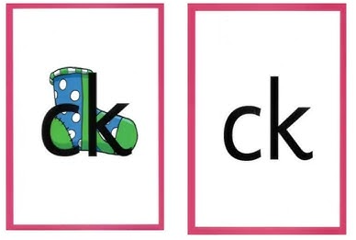

Reading and spelling

Slide 14
Over the first 3 years of learning phonics, children will learn all the different ways to write different phonemes e.g. sh:
shell
chef
special
caption
mansion
passion
In reception, we only learn the basic sh digraph –the rest will follow in KS1.

Slide 15
Tricky words
Tricky Word Video

Slide 16

Spelling
Say the word.
Segment the sounds.
Count the sounds.
Write them down.

Slide 17
How do we teach reading in books?
Reading practice sessions are:
timetabled three times a week
taught by a trained teacher/teaching assistant
taught in small groups.

Slide 18
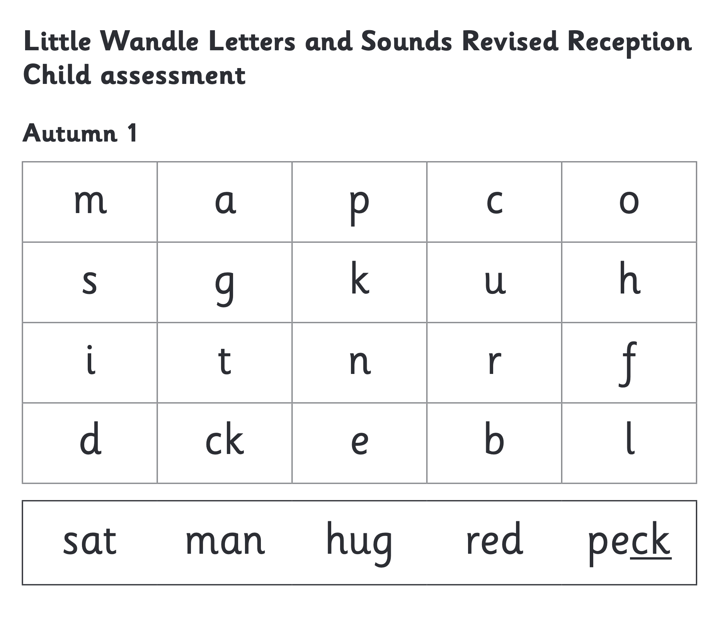
We use assessment to match your child the right level of book

Slide 19
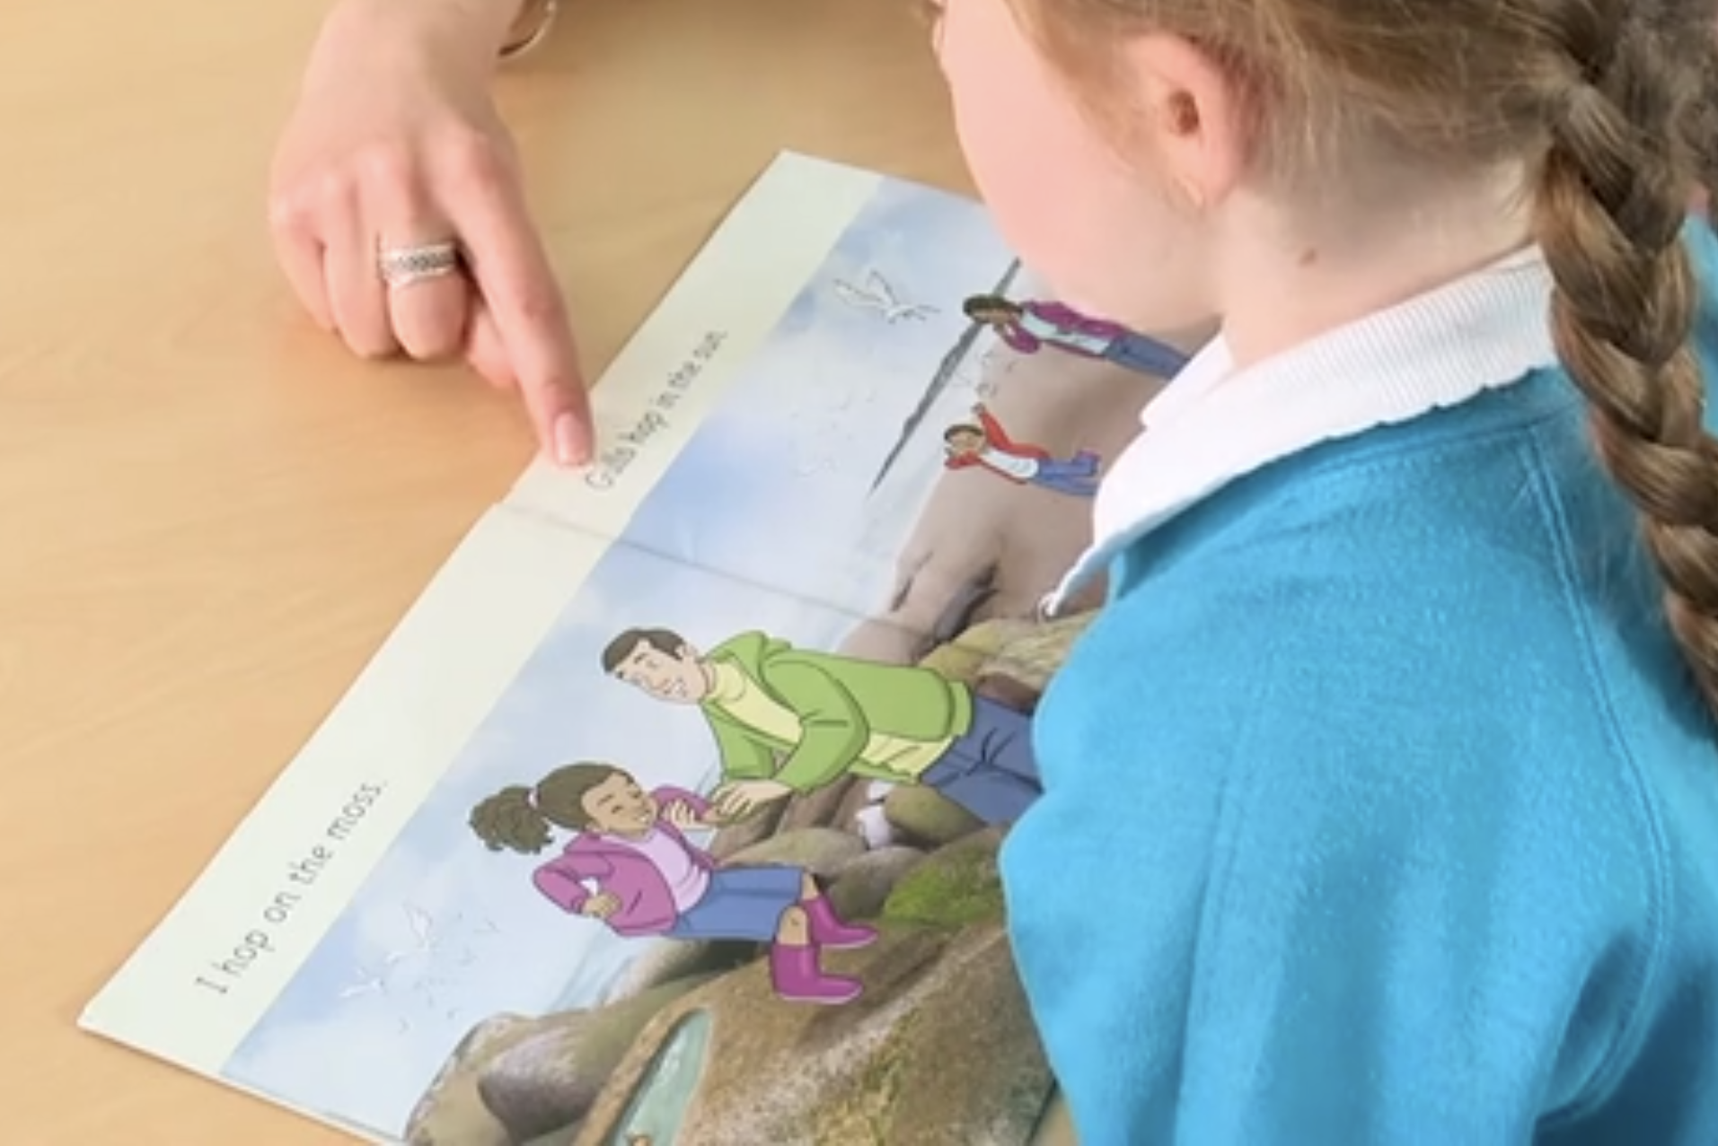
Reading a book at the right level
This means that your child should:
Know all the sounds and tricky words in their phonics book well
Read many of the words by silent blending (in their head) – their reading will be automatic
Only need to stop and sound out about 5% of the words by the time they bring the book home – but they should be able to do this on their own.

Slide 20

Supporting your child with phonics

Slide 21

Supporting your child with phonics

Slide 22

Supporting your child with phonics

Slide 23
Reading at home

Slide 24

The most important thing you can do is read with your child
Reading a book and chatting had a positive impact a year later on children’s ability to…
understand words and sentences
use a wide range of vocabulary
develop listening comprehension skills.
The number of books children were exposed to by age 6 was a positive predictor of their reading ability two years later.
Parental involvement in the development of children’s reading skills: A five-year longitudinal study (2002) Senechal, M. and Lefvre, J

Slide 25

Books going home

Slide 26
Listening to your child read their phonics book
Your child should be able to read their book without your help, but they still need you to pay attention and listen to them!
If they can’t read a word read it to them or help them to sound it out.
Talk about the book and celebrate their success.

Slide 27

Read to your child
The shared book is for YOU to read:
Make the story sound as exciting as you can by changing your voice.
Talk with your child as much as you can:
  Introduce new and exciting language
  Encourage your child to use new vocabulary
  Make up sentences together
  Find different words to use
  Describe things you see.

Slide 28
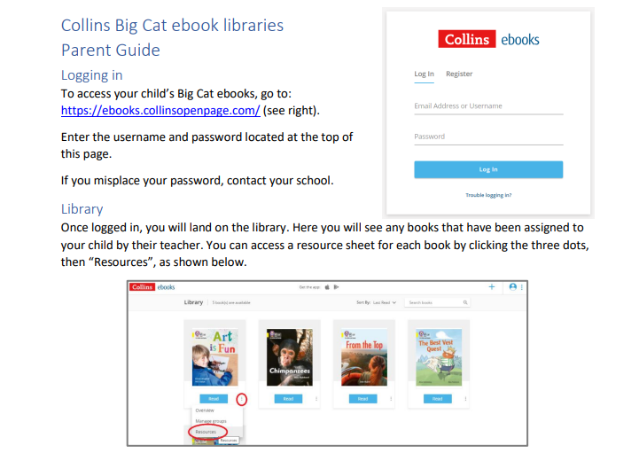
Collins Big Cat ebook library

Slide 29
“One of the greatest gifts adults can give, is to read to children.”
Carl Sagan

