Slide 1


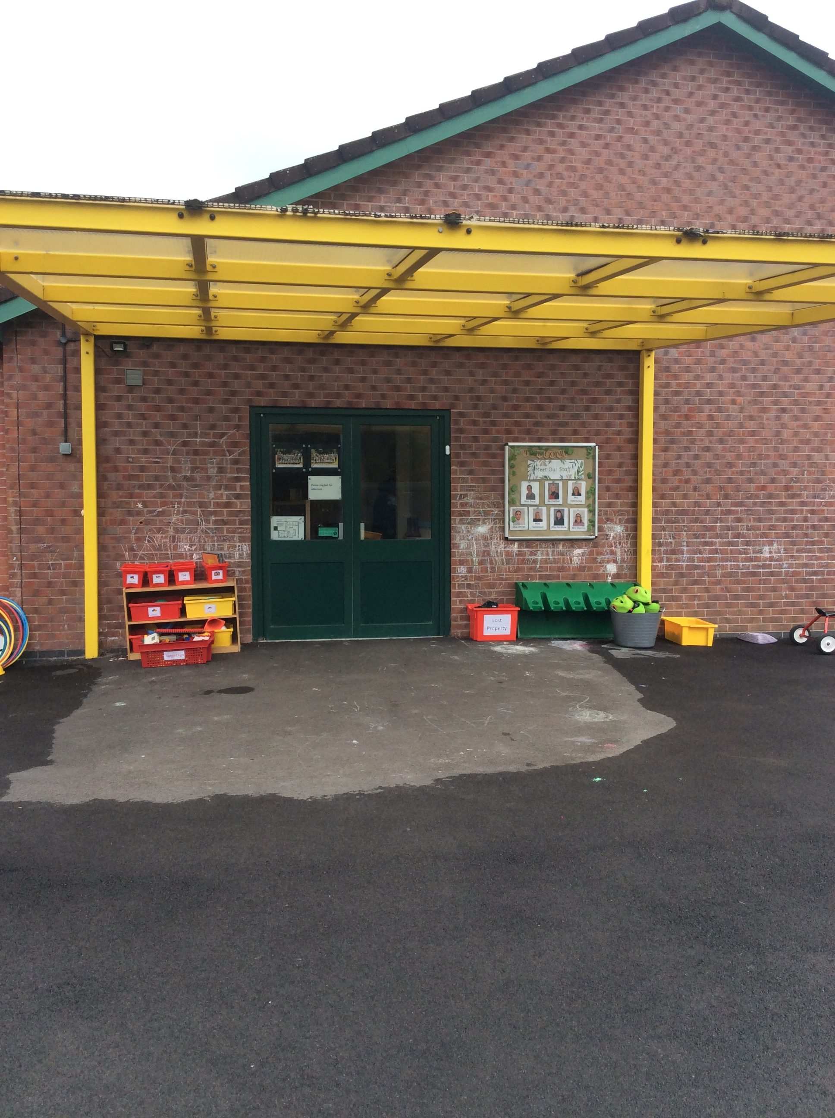
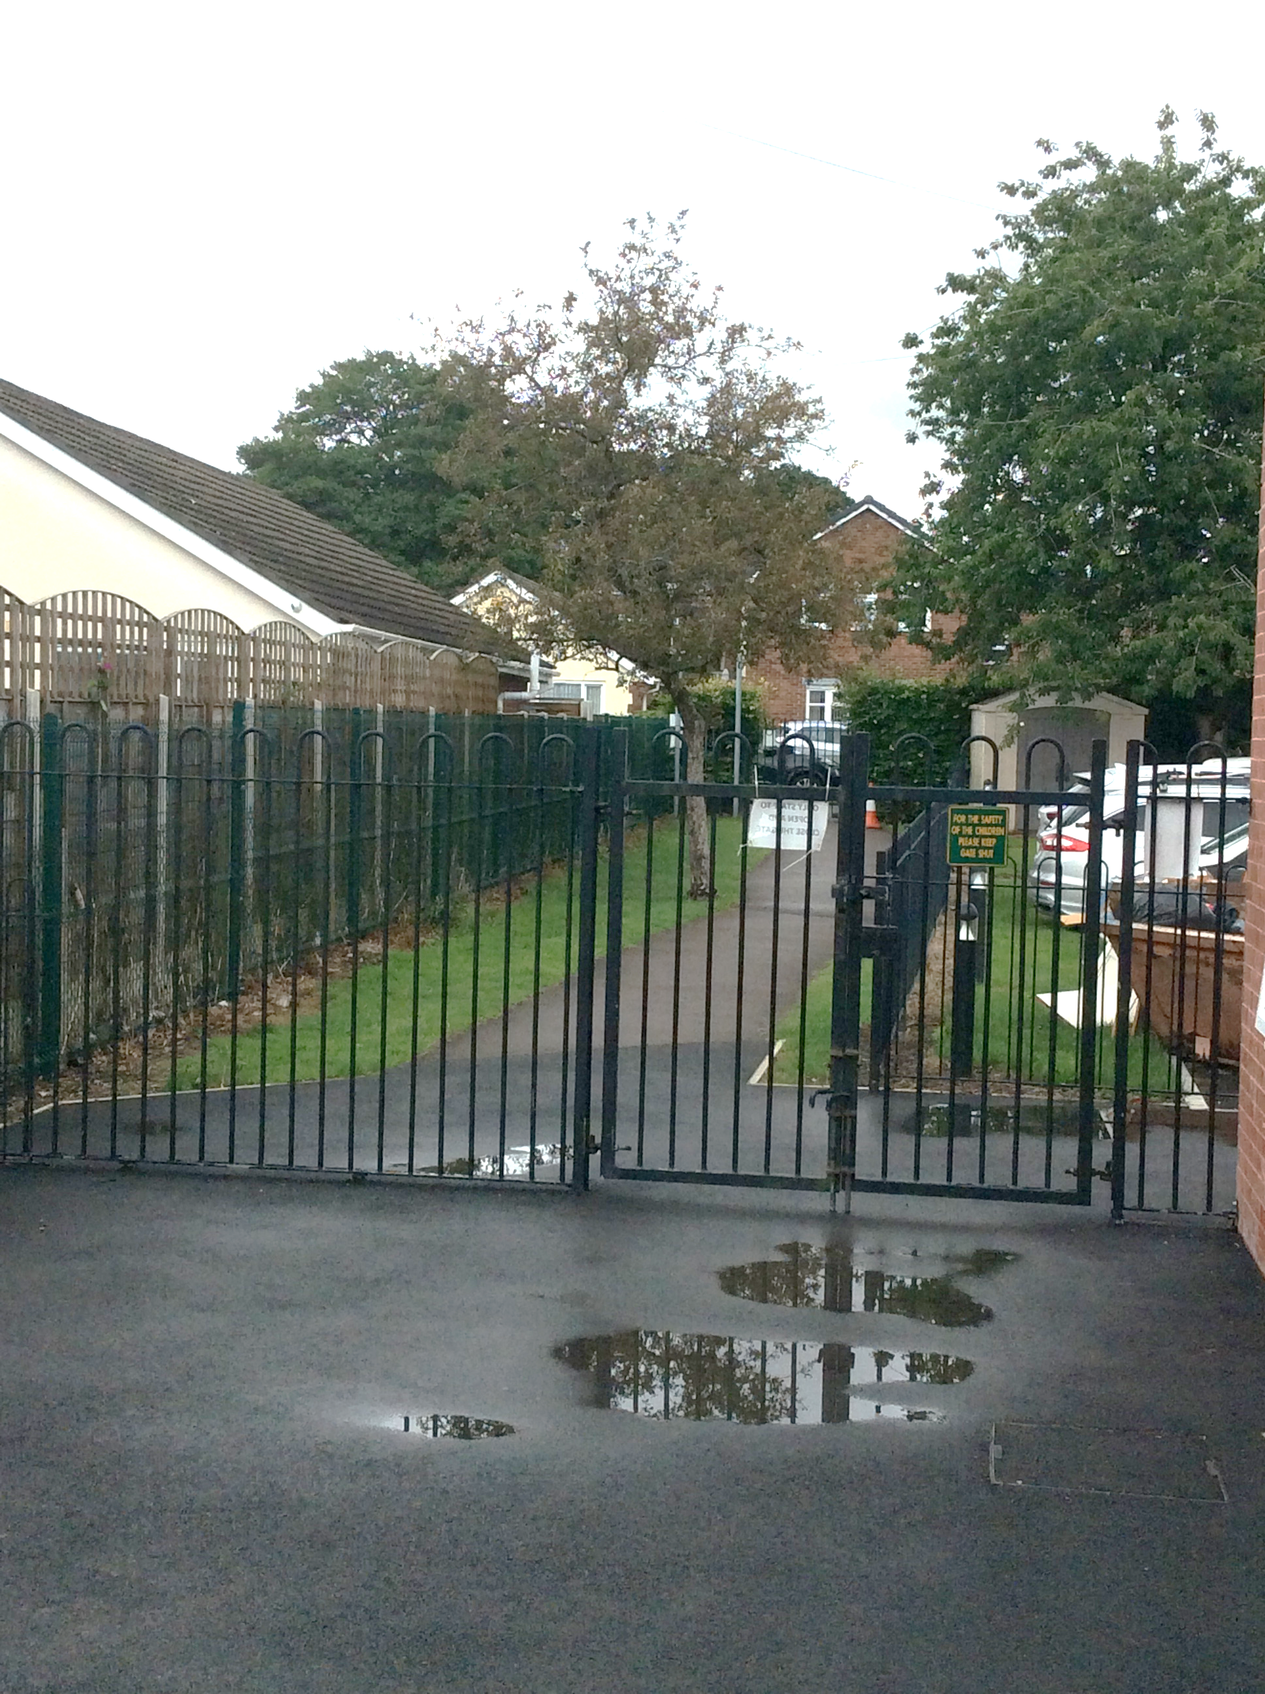
Ivy Bank Nursery
This is your new Nursery. We know you are going to have the most amazing time in Nursery and look forward to meeting you soon!

Slide 2
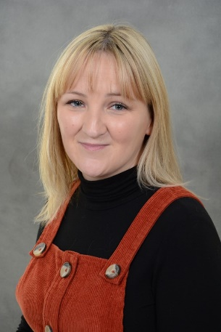
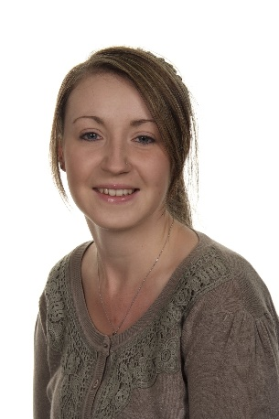
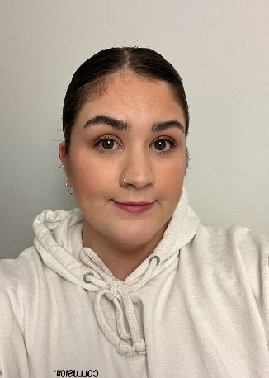
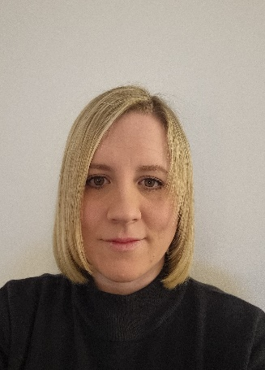
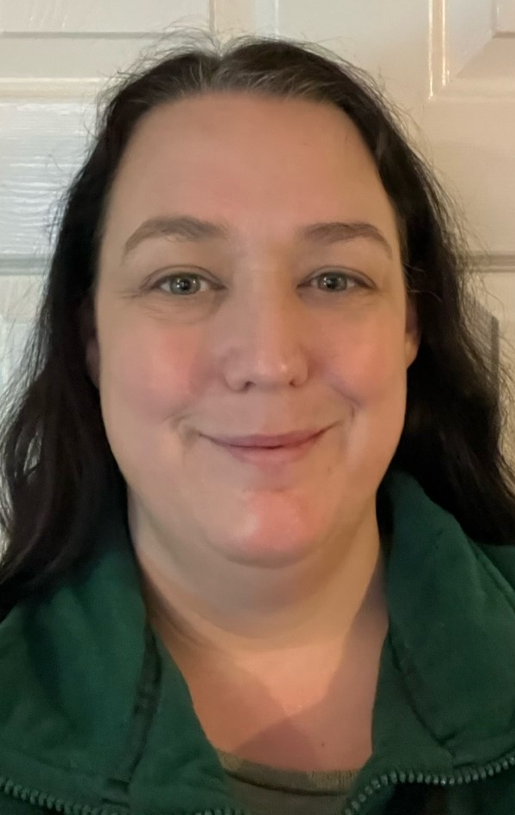
My Teachers
Hello!
My name is Mrs Barber, I will be your teacher
Miss Prest
Teaching Assistant
Miss Davies
Teaching Assistant
Miss Tomlinson
Teaching Assistant
Mrs Heathcote
Teaching Assistant

Slide 3
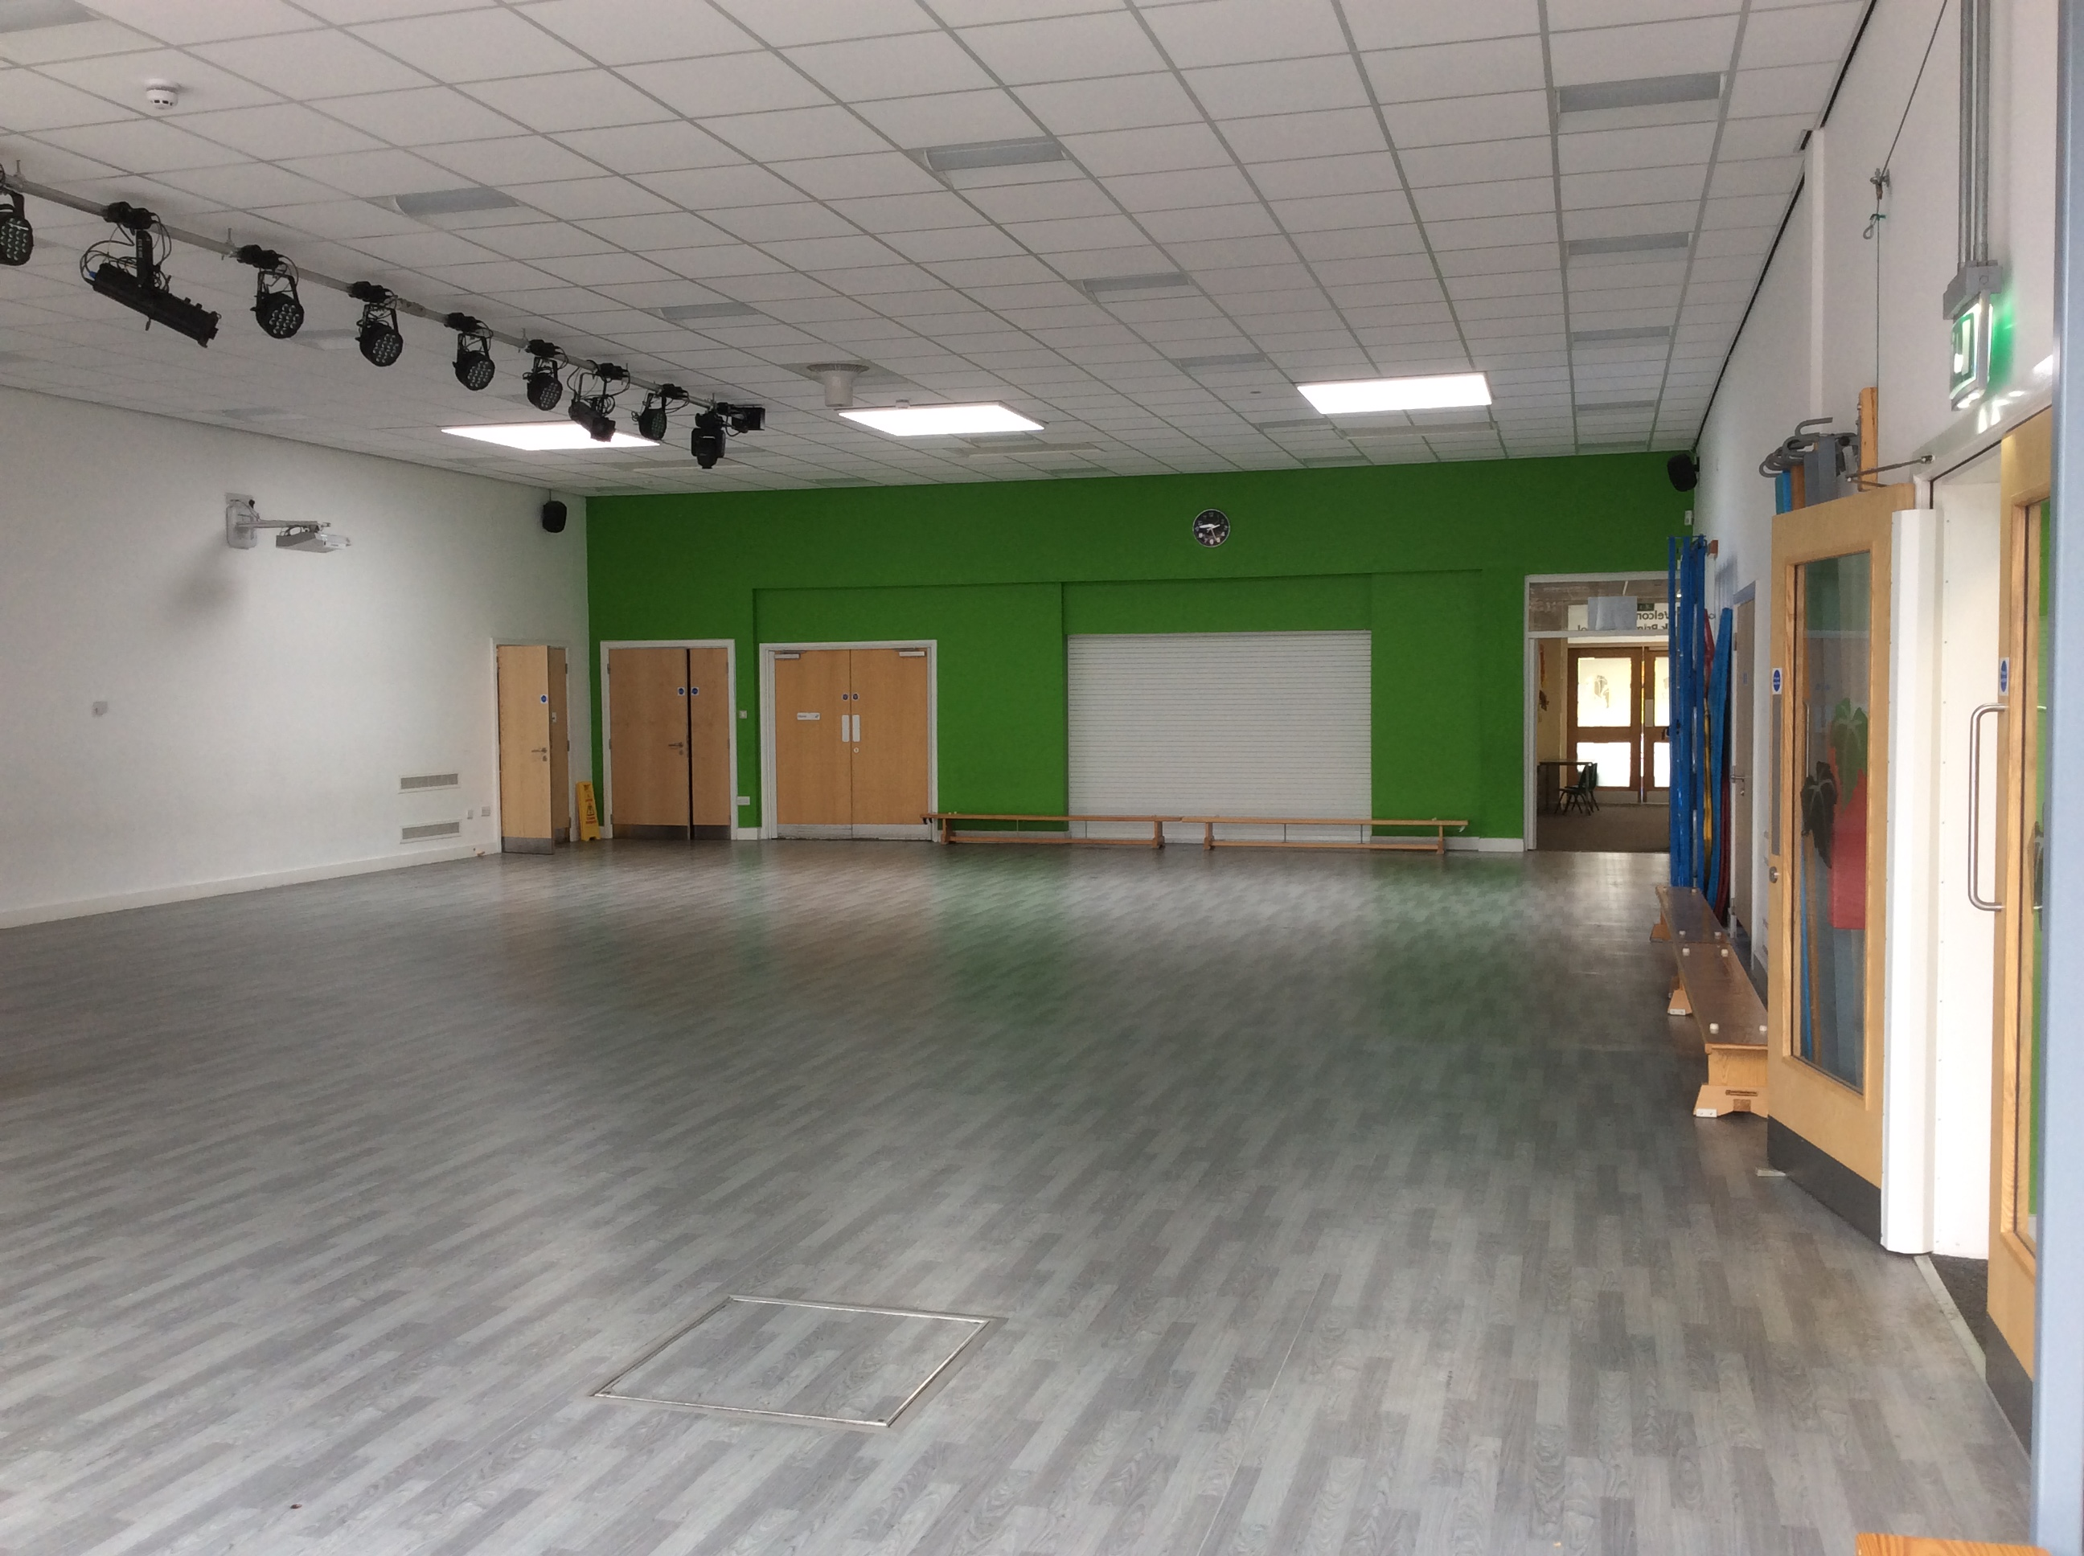
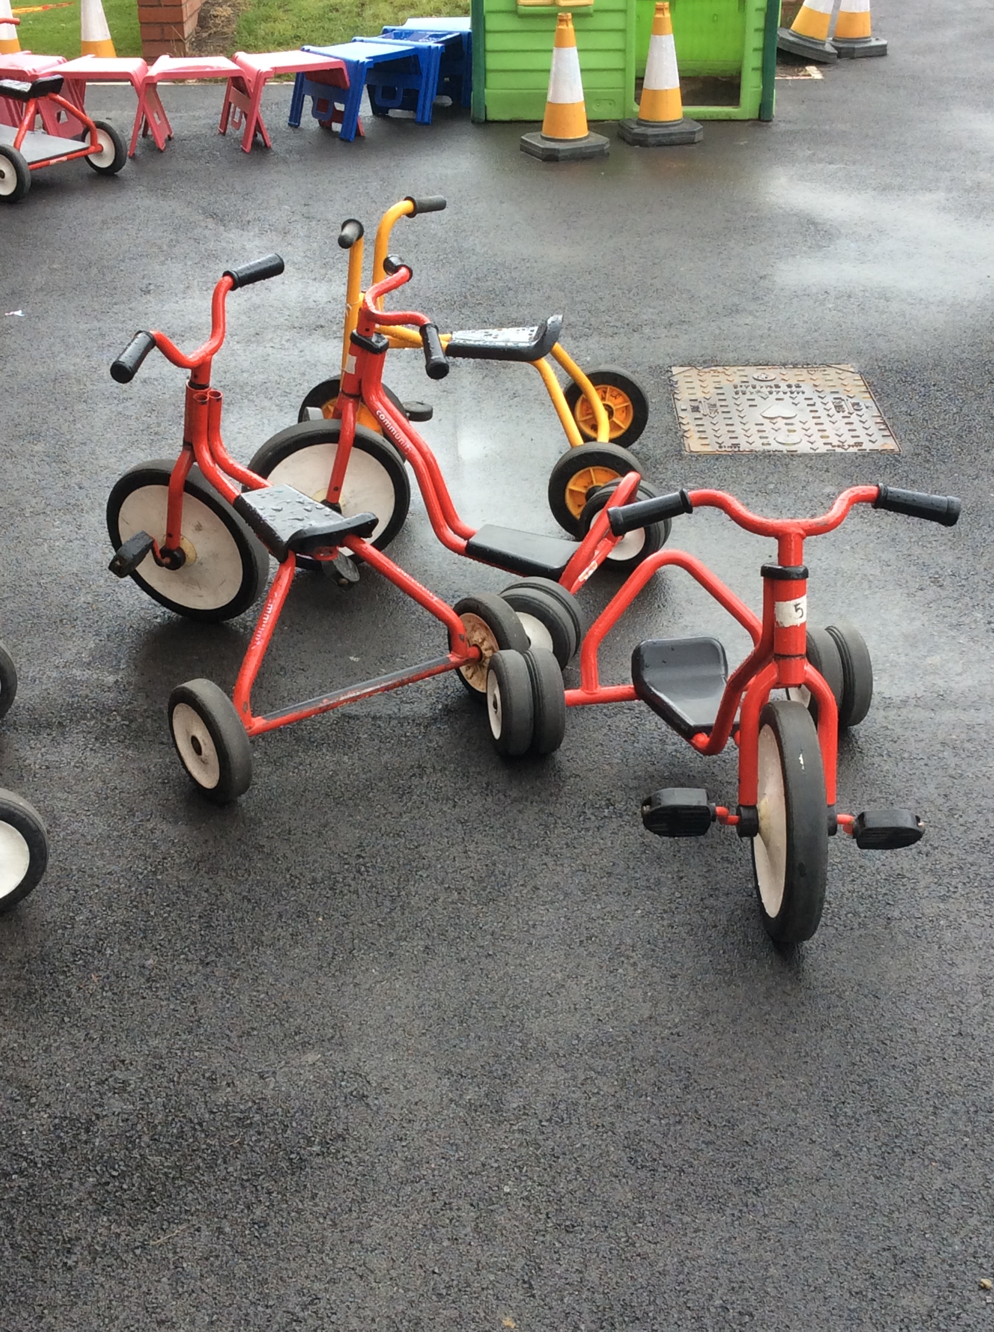
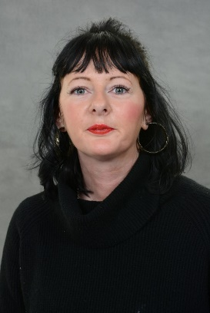
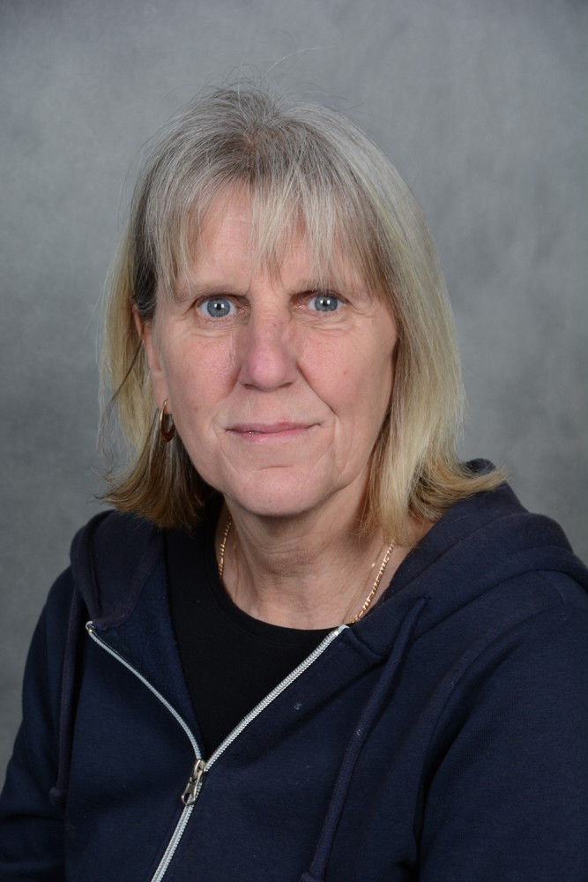
Lunchtime
At lunchtime we eat our dinner in the school hall. After lunch, we go outside and play on the bikes.
Miss Forshaw and Mrs Hulley help us at lunchtimes.

Slide 4
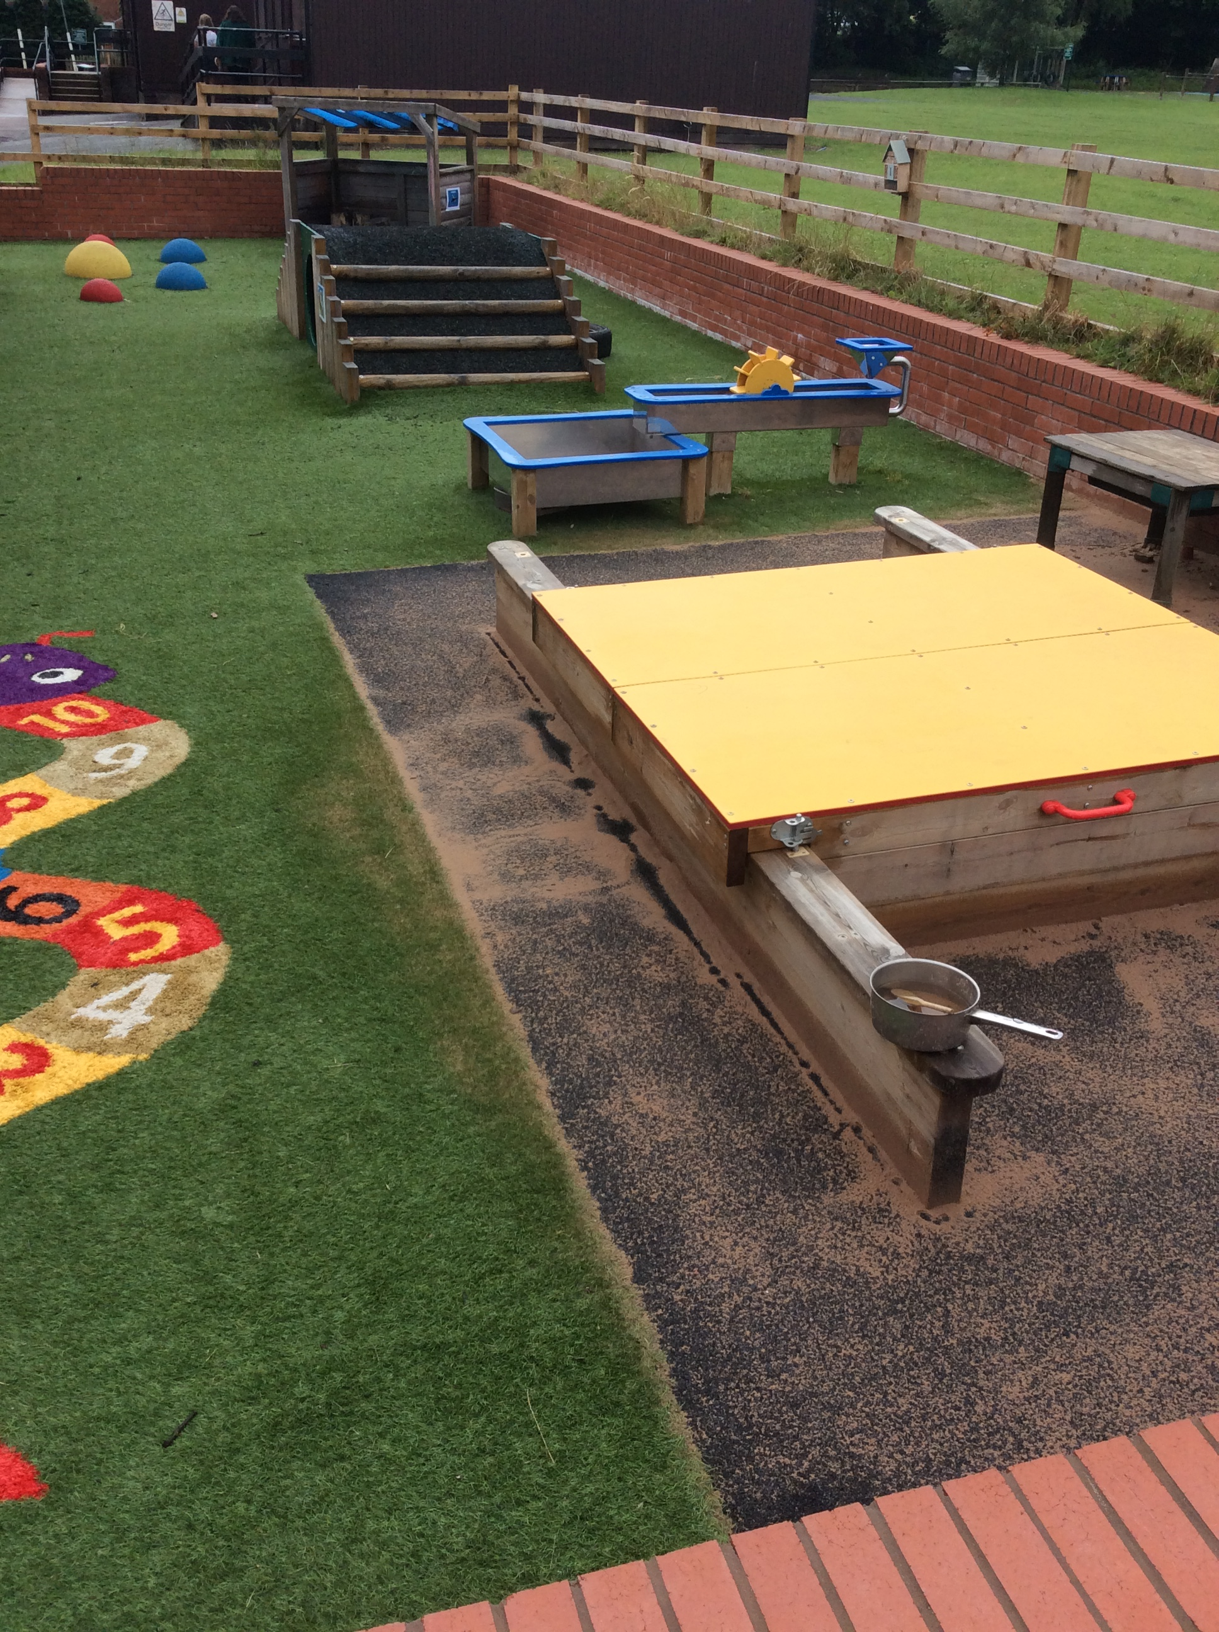
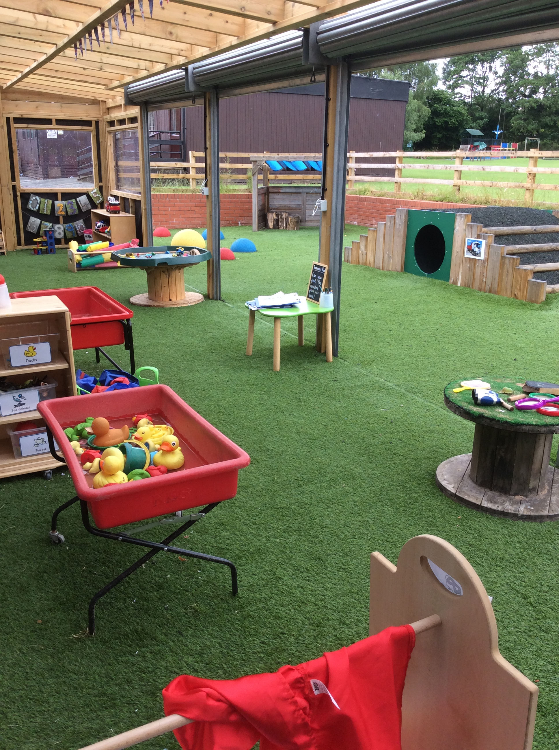
Outdoor Area
This is our outdoor area. We have a sandpit, water tray, tunnel, bridge and lots of toys!

Slide 5
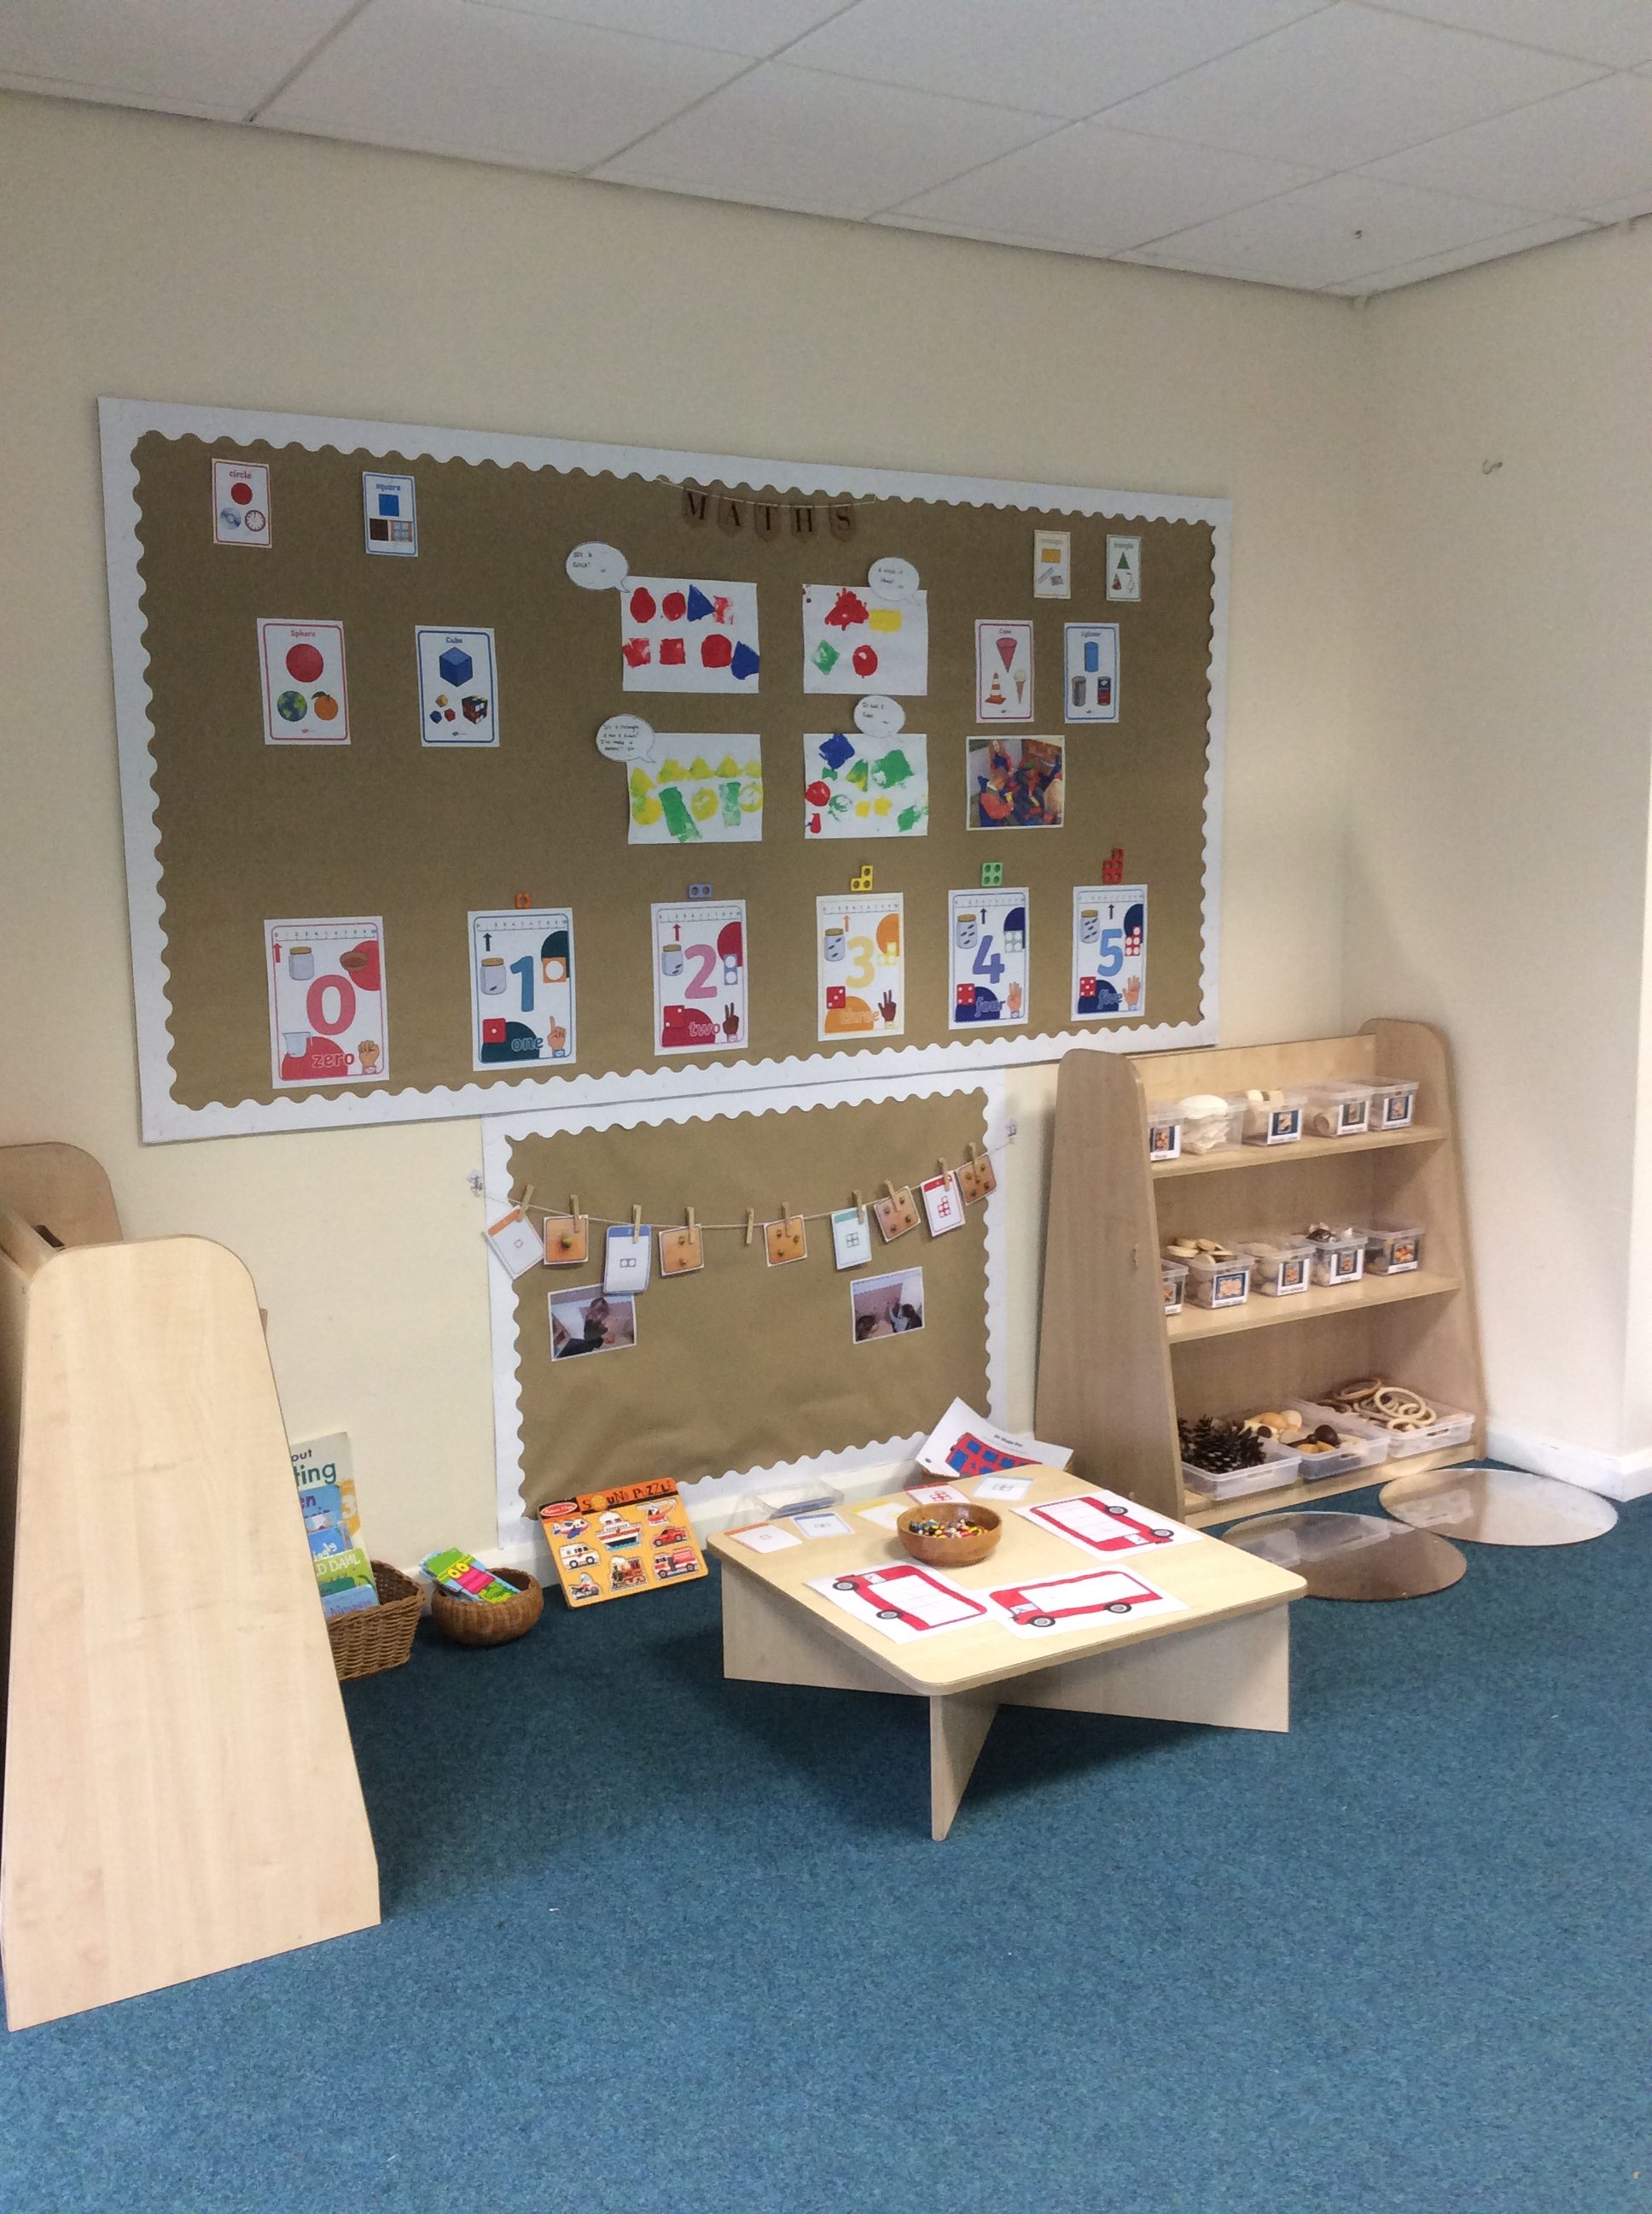
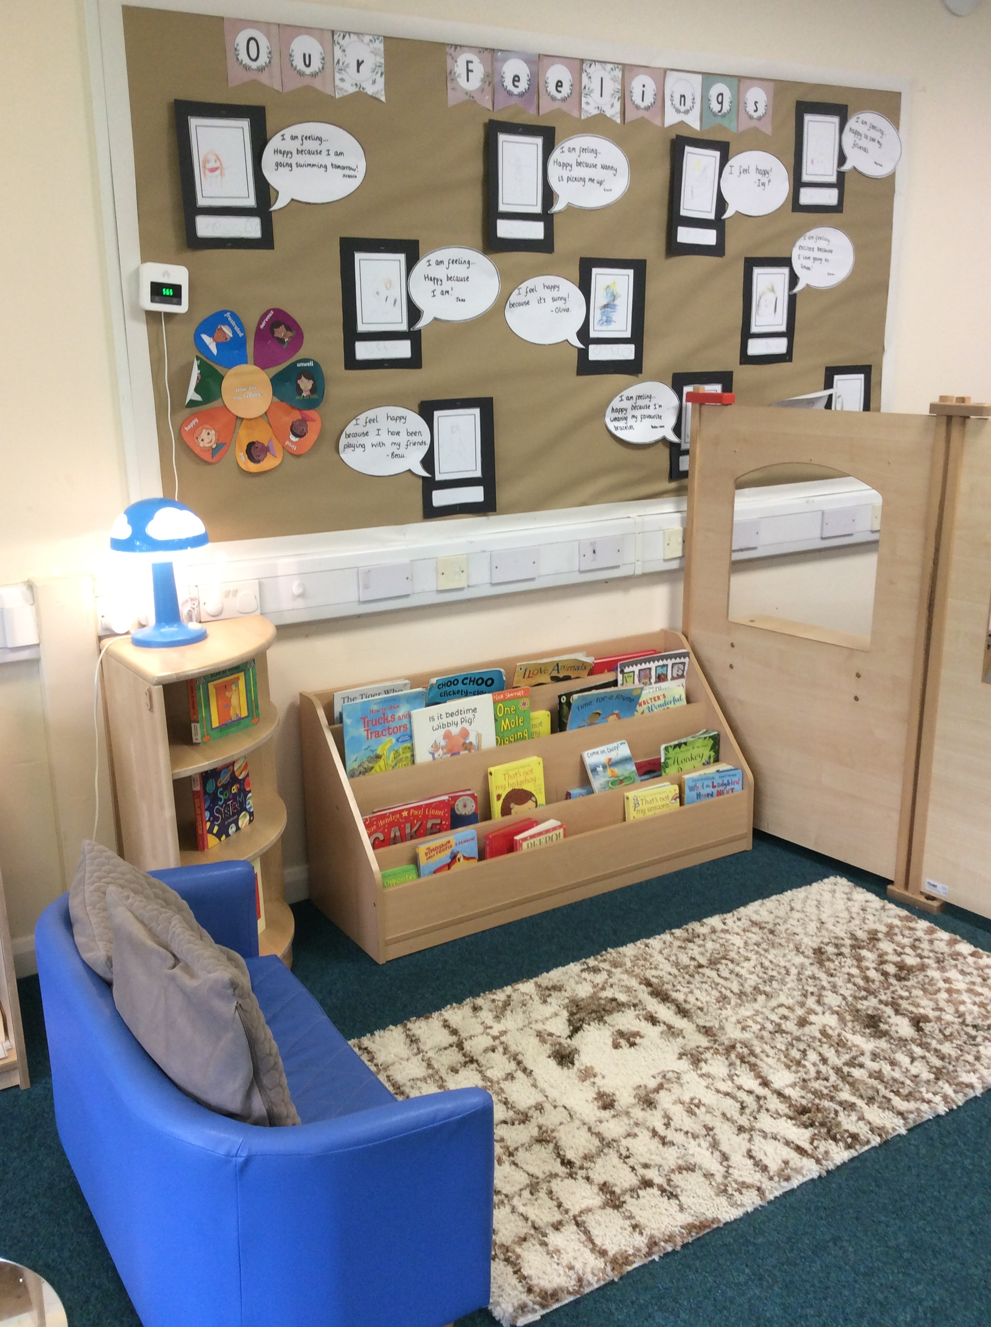
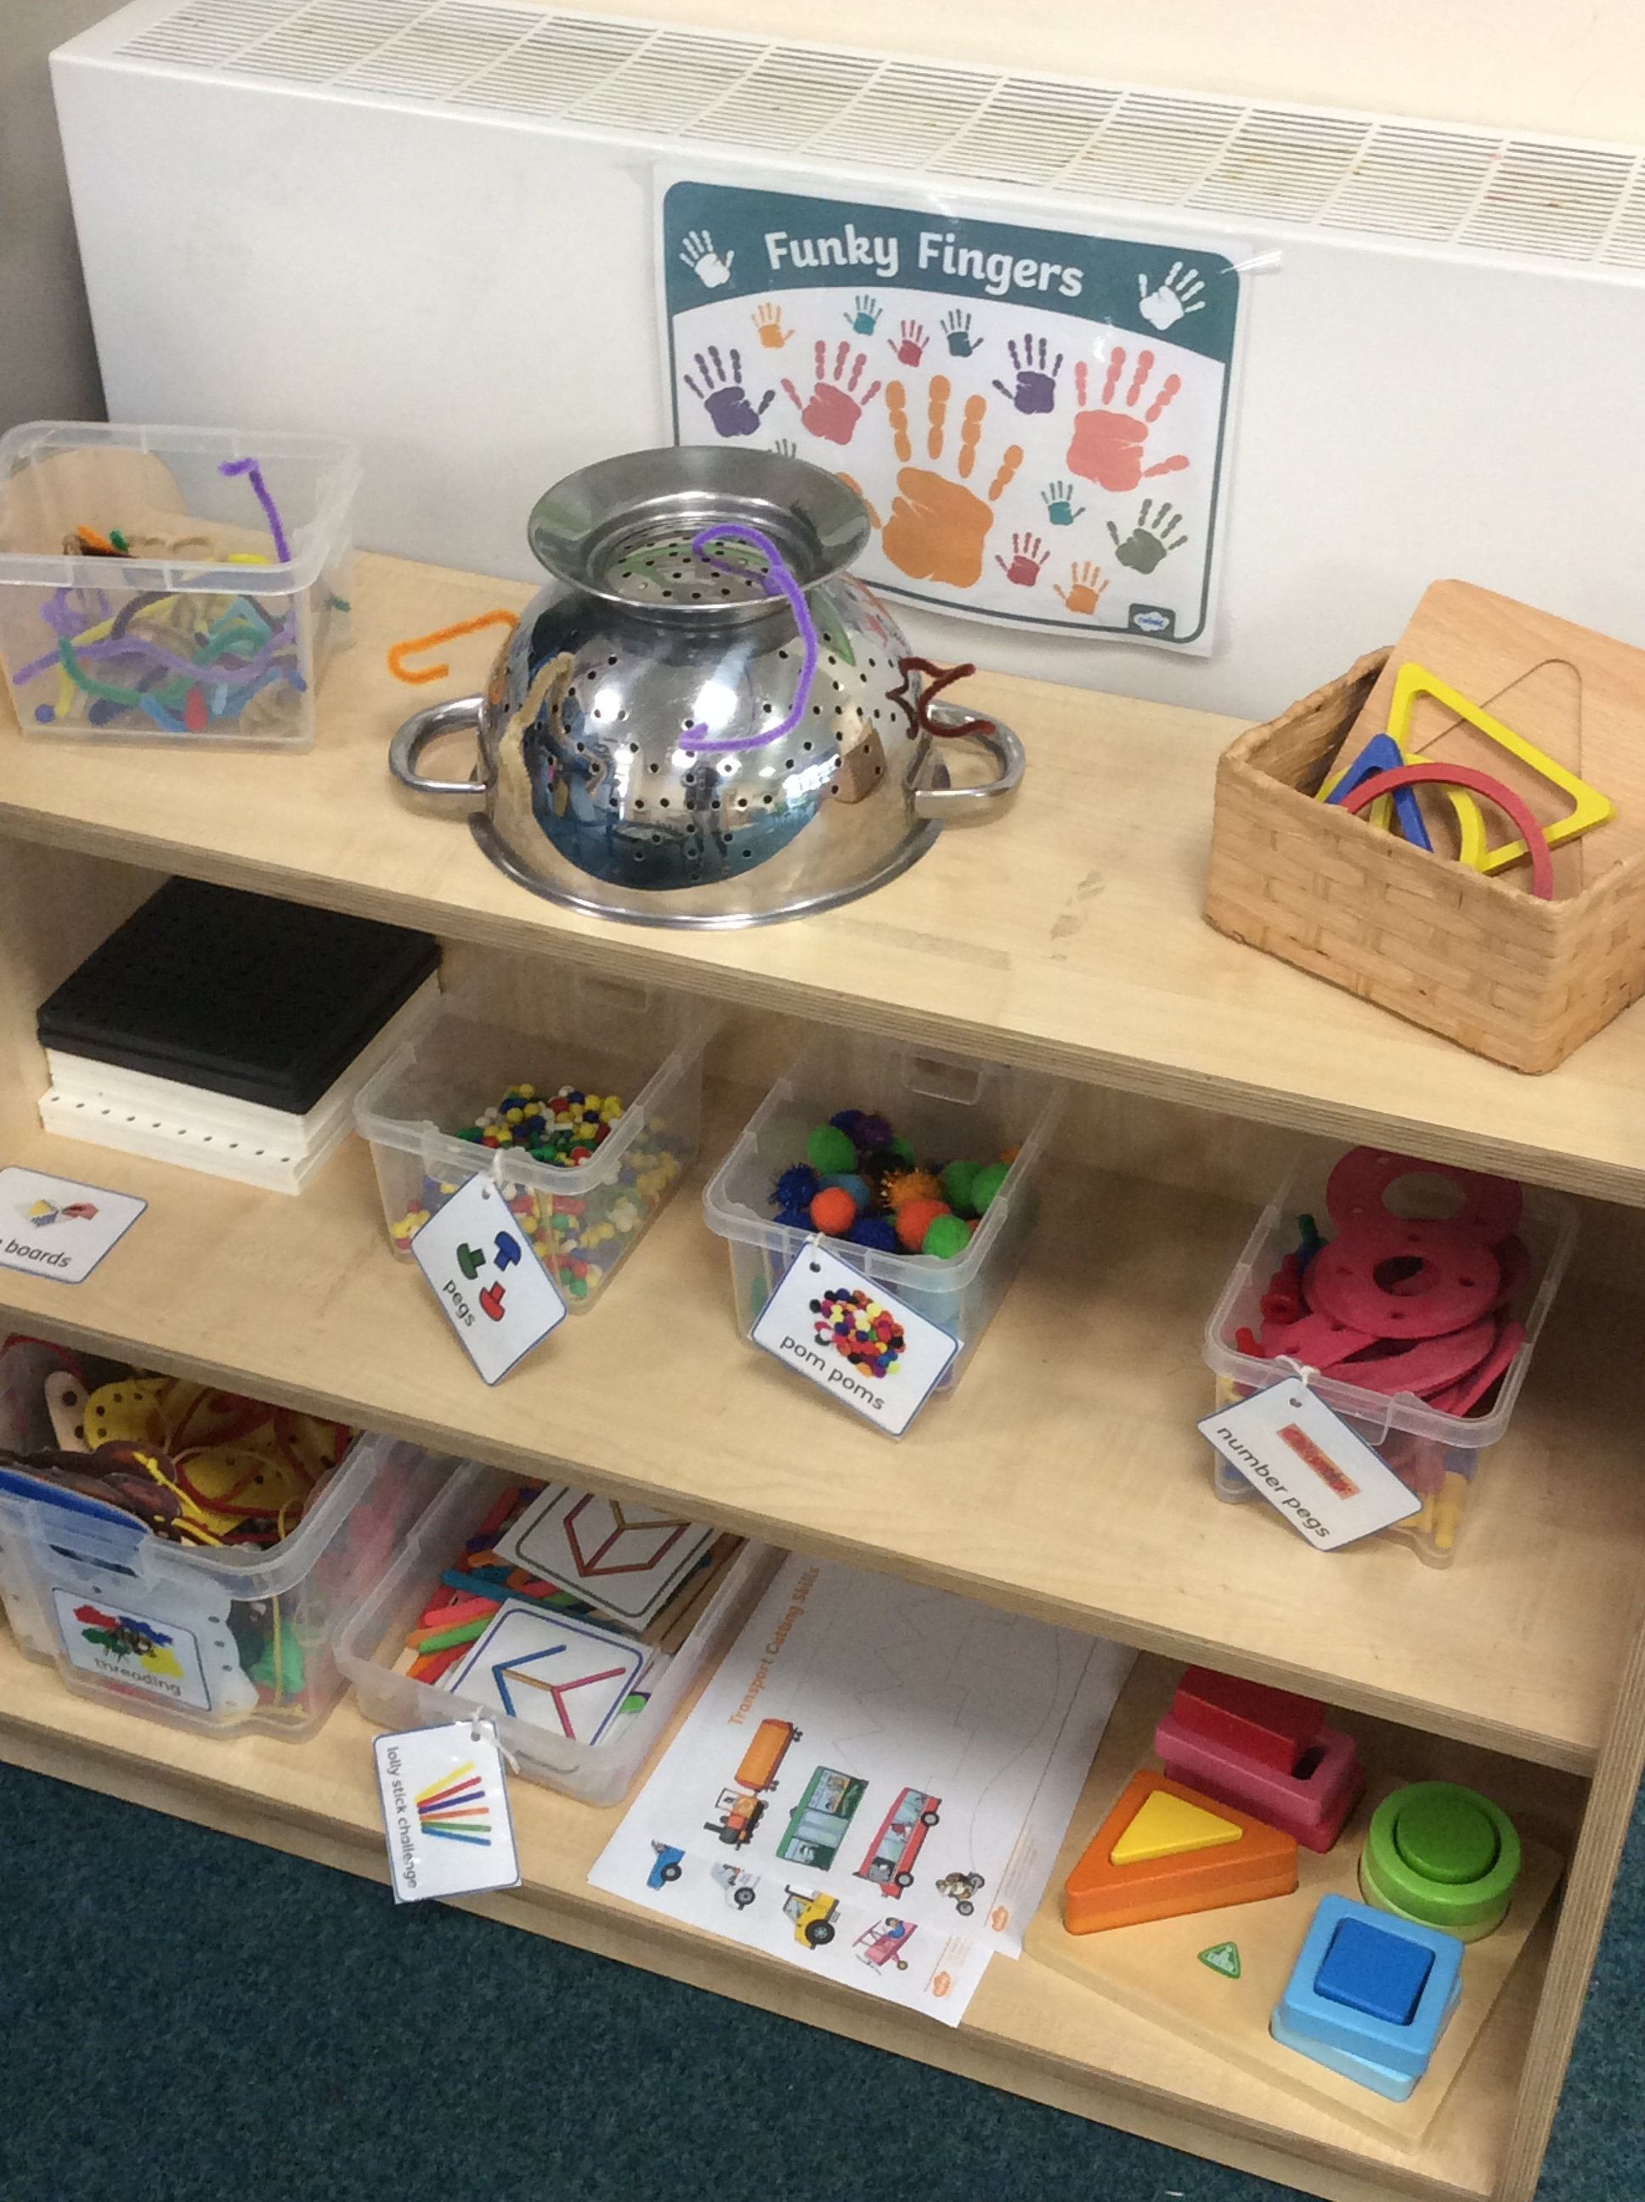
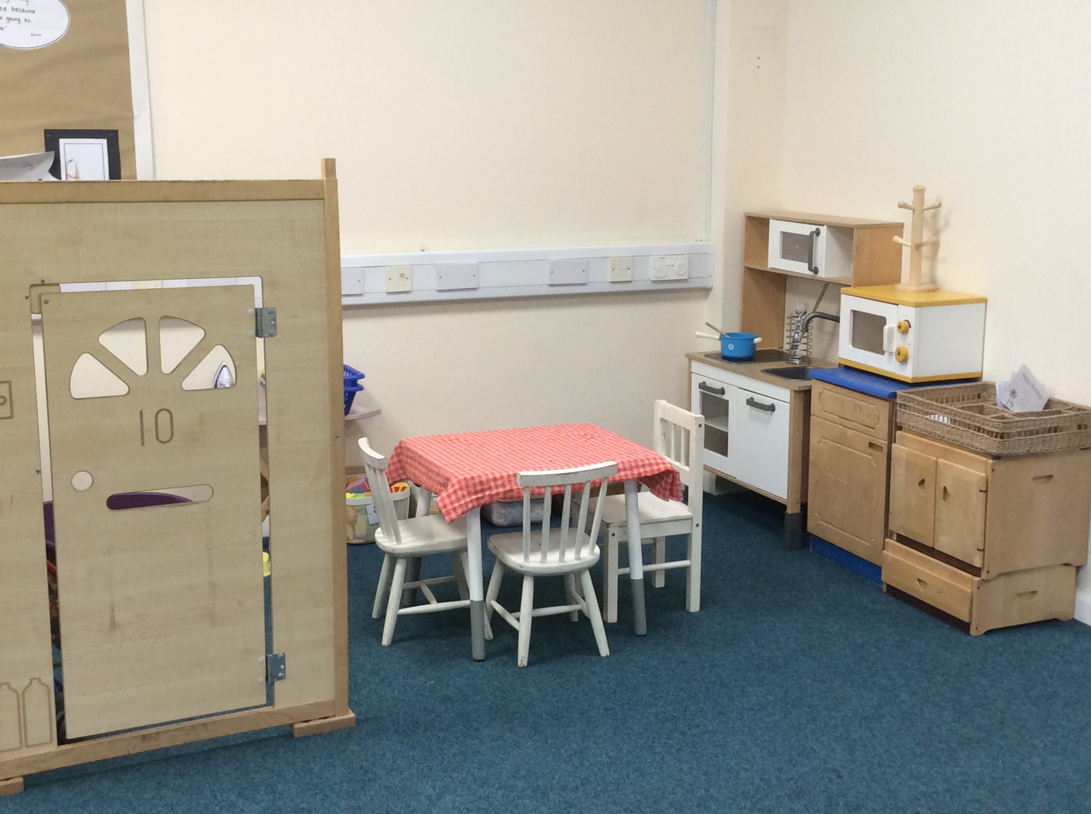
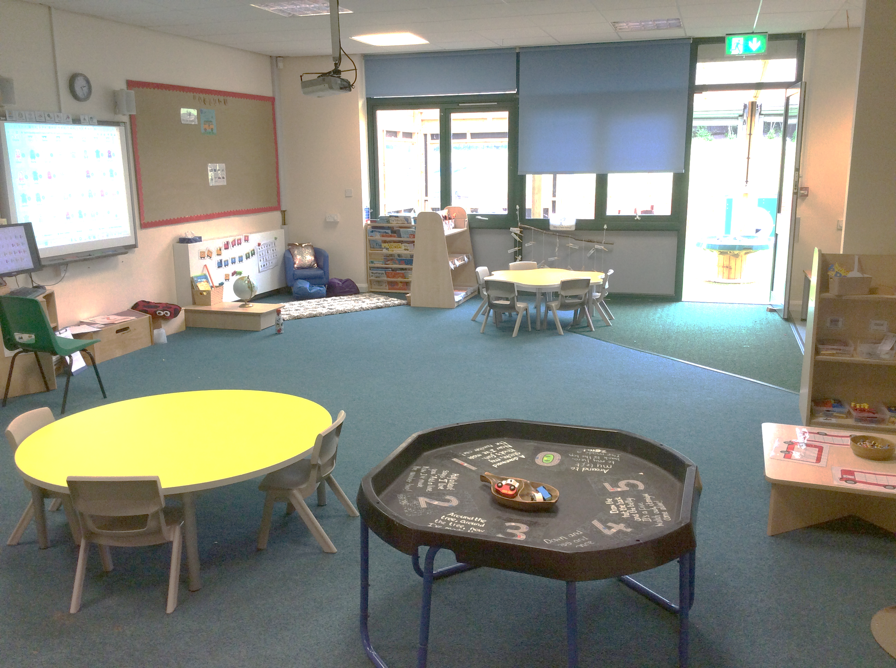
Our Classroom
This is our classroom. We have:
A creative area where you can paint.
A maths area.
A reading area.
A home corner.
Construction area.
Funky Fingers area.
Writing area.
Investigative area.
Small world area.

