Slide 1
Lesson 1:
Computing Scheme of Work
Unit 5.3 - Spreadsheets
Conversions of Measurements
Notes:
All resources can be found on the Purple Mash page for this lesson. From here they can be set as 2Dos for children if required.
• Set Converting Measures as a 2Do for the class.

Slide 2
Learning Objectives
To use formulae within a spreadsheet to convert measurements of length and distance.
(Optional) To explore the use of the display of decimal places.
Notes:
Outline the learning objectives.

Slide 3
Success Criteria
Children can create a formula in a spreadsheet to convert metric measurements of length and distance.
Children can apply this to creating a spreadsheet that converts between metric and imperial measures.
(Optional) Children can use a spreadsheet to set the number of decimal places displayed.
Notes:
Outline the success criteria.

Slide 4
Vocabulary Overview
Words encountered previously
New in this lesson
Spreadsheet: A computer program that represents information in a grid of rows and columns.
Cell: An individual section of a spreadsheet grid. It contains data or calculations.
Row: Boxes running horizontally (left to right) on a spreadsheet.
Column: Boxes running vertically (top to bottom) on a spreadsheet.
Cell address: Every cell has an address. This can be found by reading the column letter then row number.
Formula bar: Formula Bar: An area of the spreadsheet into which formulae can be entered using the ‘=’ sign to open the formula.
Data table: An organised display of information laid out in rows and columns.
Converting values*: The process of changing a value measured in a particular unit to the equivalent value in a different unit. For example, converting between kilometres and metres.
Imperial measures*: A system of measurement. It uses units including inches (distance), miles (distance), pounds (mass), pints (volume). It has mostly been replaced by the metric system.
Metric measures*: A system of measurement that uses the metre, litre, and gram as base units of distance, volume and mass.
*Predominantly mathematics terms rather than computing terms.
Notes:
This slide can be used to review words from previous spreadsheet units and introduce new vocabulary.
The vocabulary is repeated at the end of the lesson where it can be used to review lesson vocabulary.

Slide 5
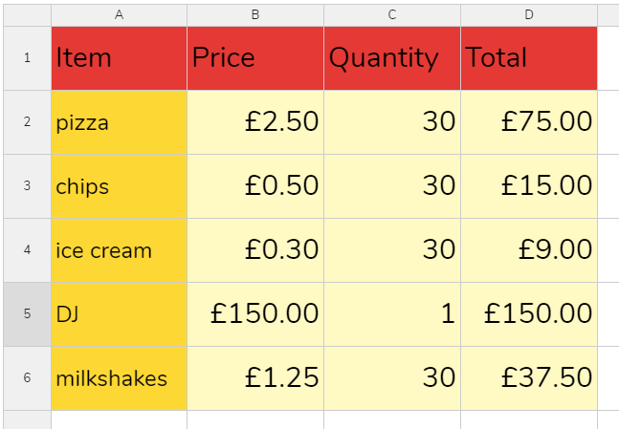
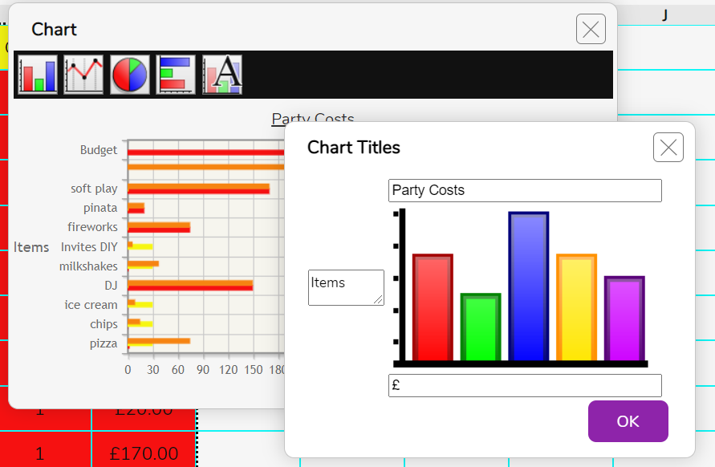

What are spreadsheets?
Spreadsheets are used for organising information.
School Records - Storing & organising children’s names, ages, class.
Planning events - calculating costs, making lists.
Displaying information as tables and graphs.
Can you think of any other examples?
Notes:
Children saw this slide when they completed the spreadsheet unit in year 3. Click through the slide and ask children if they remember using spreadsheets before.

Slide 6
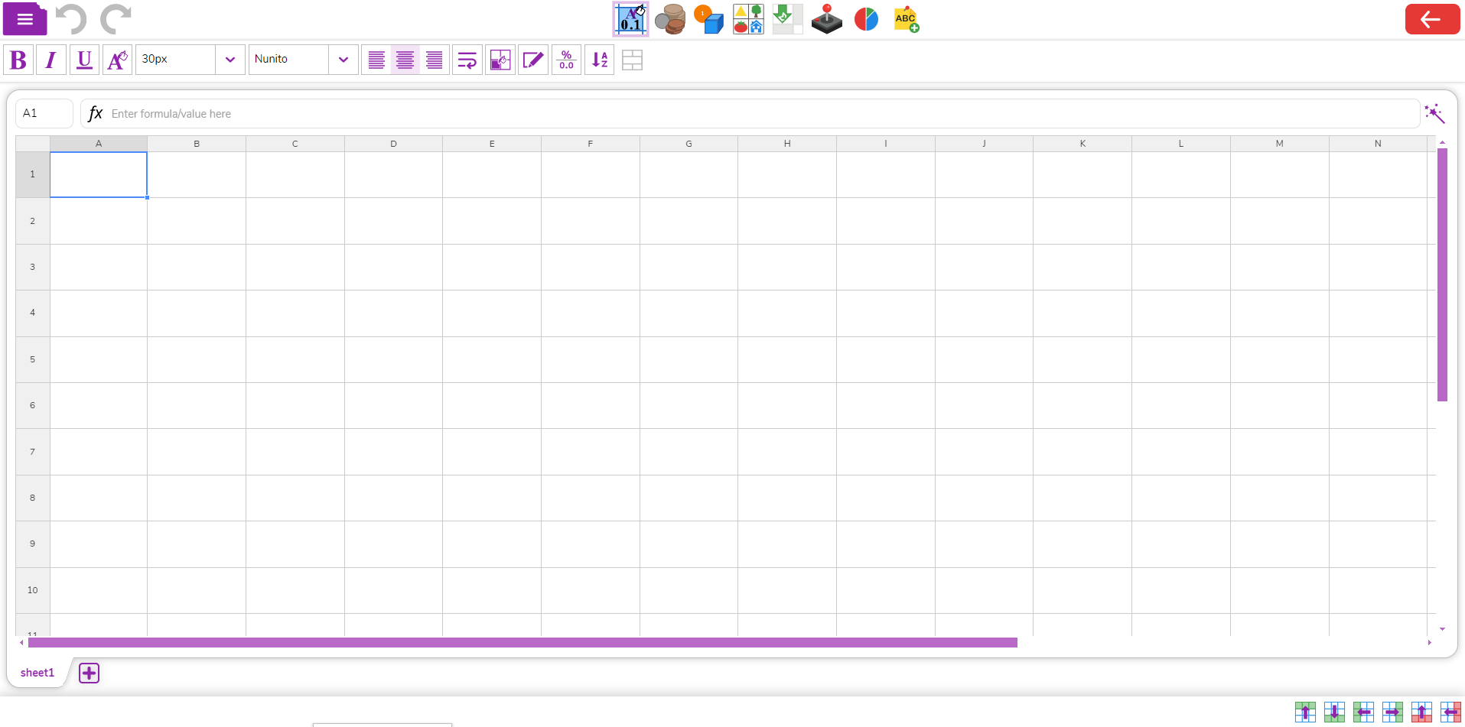
2Calculate
You have previously used 2Calculate; the spreadsheet program in Purple Mash.
Formula bar
Formula wizard
row 1
row 2
Column A
Columns of a spreadsheet
Cell
Cell
Cell
rows of a spreadsheet
Each of the boxes on the spreadsheet is called a cell.
Cells can contain words, numbers, colours or symbols (such as + - = ).
Notes:
Children saw this slide when they completed the spreadsheet unit in year 3. Click to point out the areas of a spreadsheet and associated vocabulary.

Slide 7
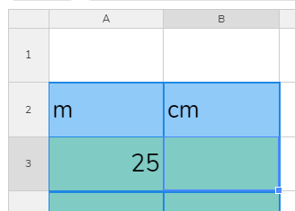


Converting between cm and m
What do you need to do to a measurement in metres, to convert to centimetres?
You multiply by 100.
In this spreadsheet, what formula would go in cell B3 to convert the value in cell A3 to centimetres?
Remember that to insert a formula in a cell, you need to type the equals sign ‘=‘ in the formula bar to indicate that you are entering a formula and then use cell addresses to refer to cells.
The formula would be:
Notes:
Children might need a reminder about entering formulae in a spreadsheet

Slide 8
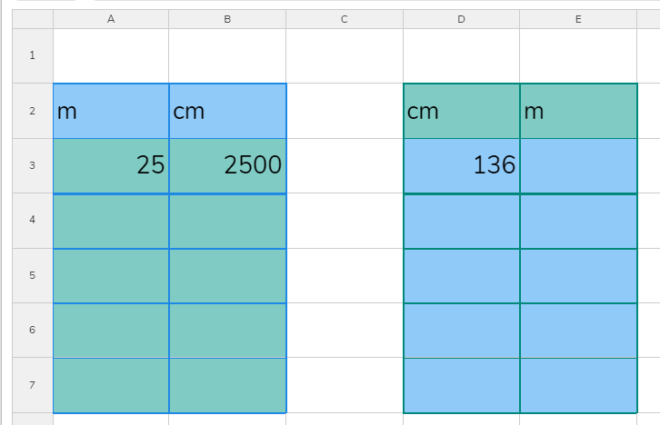

Converting between m and cm
What do you need to do to a measurement in centimetres, to convert to metres?
You divide by 100.
In this spreadsheet, what formula would go in cell E3 to convert the value in cell D3 to metres?
Remember when representing divide to use the forward slash ‘/’.
The formula would be:
Notes:
Children might need a reminder about entering formulae in a spreadsheet

Slide 9
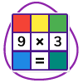
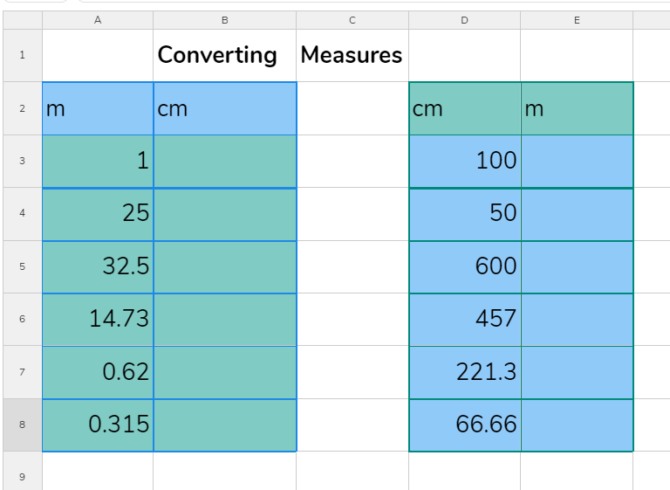
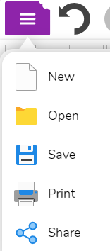
Activity 1: Converting between m and cm
Open the file Converting m and cm from your 2Dos.
Write the formulas to complete the data tables.
Save your work.
Notes:
Instruct children to open the file from their 2Dos and complete the formula.

Slide 10
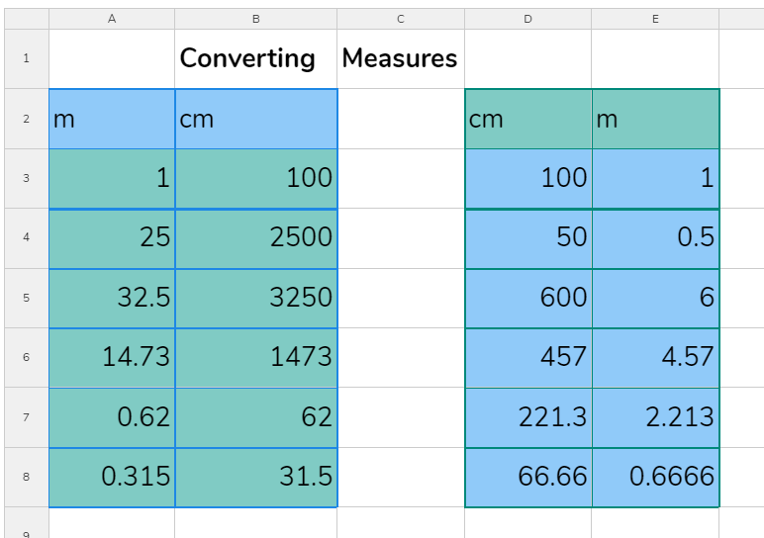
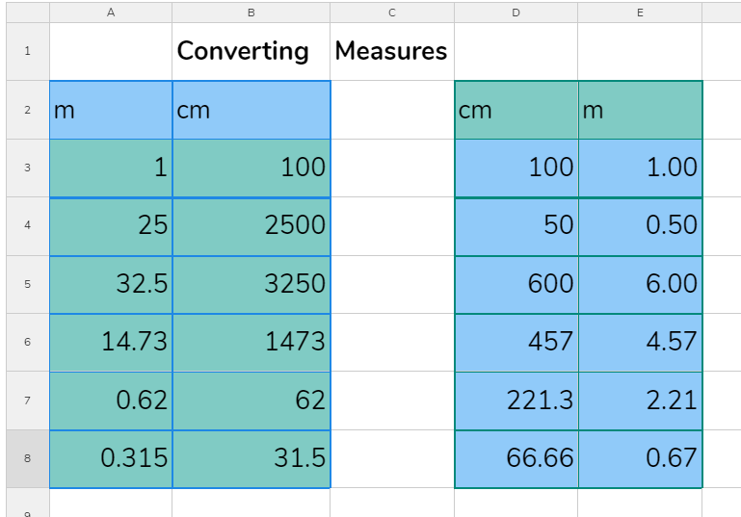




Decimal places
These are the answers that you should have got.
Notice that some of the answers are decimal numbers.
What happens to a decimal number if it is unchecked?
You can select cells and use the formatting tools to set the format to decimal. You have the option to show or hide decimal places.
Notes:
Rounding numbers is taught in the year 6 maths curriculum. This slide can be skipped if preferred.

Slide 11
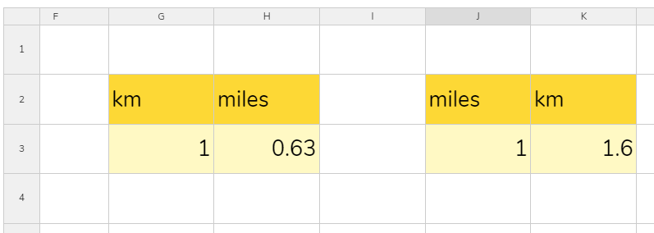
Activity 2: Converting between km and miles
Add some new data tables to your spreadsheet to convert between km and miles.
1km is equal to 0.63 miles, 1 mile is equal to 1.6km.
Use the information in the images below to write your formulae.
Add some more rows to the data tables with distances that have been converted.
x 0.63
x 1.6
Save your work.
Notes:
Support children in converting between a metric and imperial measure of distance. An alternative if this task is too difficult for some children, is to convert between metres and kilometres; adapt the slide as desired.

Slide 12
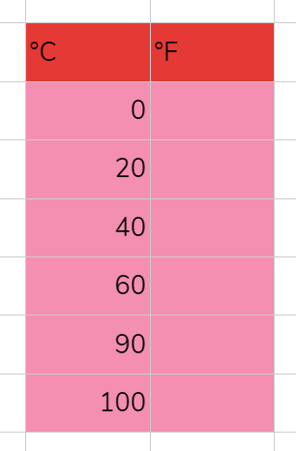


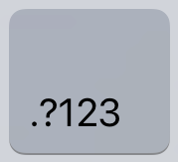
Extension: Converting Measures of Temperature
Create a spreadsheet that converts between ºF and ºC .
Your table should look like the example below.
The conversion formula that you need is
You will need to use brackets in the formula. Do not use degree symbols in the formula.
ºF = (1.8 x ºC) + 32
Inserting the degrees symbol into cell headings (˚)
On a device with a keyboard with a number pad, make sure that num lock is selected; check the light for it is on.
Then hold down the Alt key while you type the numbers 0176 on the number pad.
On a tablet, tap the key to bring up the number keypad. Hold your finger down on the zero key and the degrees symbol will appear as a choice.
If you managed this, create a table to convert from °F to °C.
ºC = (ºF - 32) ÷ 1.8
Save your work.
Notes:
Converting measures of temperature.

Slide 13

Vocabulary Review
Spreadsheet
Cell address
Formula bar
Spreadsheet: Spreadsheet: A computer program that represents information in a grid of rows and columns.
Cell address: Cell address: Every cell has an address. This can be found by reading the column letter then row number.
Formula bar: An area of the spreadsheet into which formulae can be entered using the ‘=’ sign to open the formula.
Data table
Imperial measures
Metric measures
Data table: An organised display of information laid out in rows and columns.
Imperial measures: A system of measurement. It uses units including inches (distance), miles (distance), pounds (mass), pints (volume). It has mostly been replaced by the metric system.
Metric measures: A system of measurement that uses the metre, litre, and gram as base units of distance, volume and mass.
Notes:
The slide can be used to review vocabulary. Click on the words to reveal the definitions.

Slide 14
Review Success Criteria
I can create formulae in a spreadsheet to convert metric measurements of length and distance.
I can create formulae in a spreadsheet to convert between metric and imperial measures.
(If taught) I can use a spreadsheet to set the number of decimal places displayed.
Notes:
Review the success criteria. Children could rate how well they achieved this using a show of hands.

