Slide 1




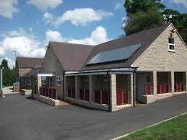
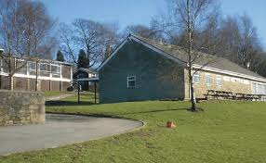

Stanley Head
February 2026
19th January – 23rd January
2026

Slide 2
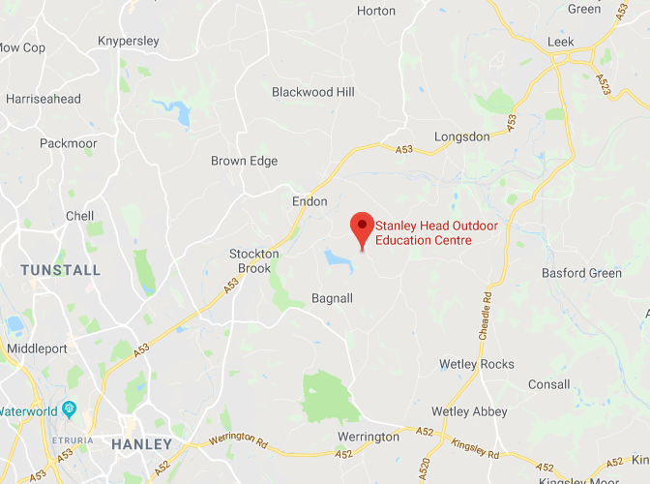
Where is Stanley Head?
Ten minutes from Leek and Stoke on Trent
Surrounded by farmland, a country park, woodland and a lake.

Slide 3
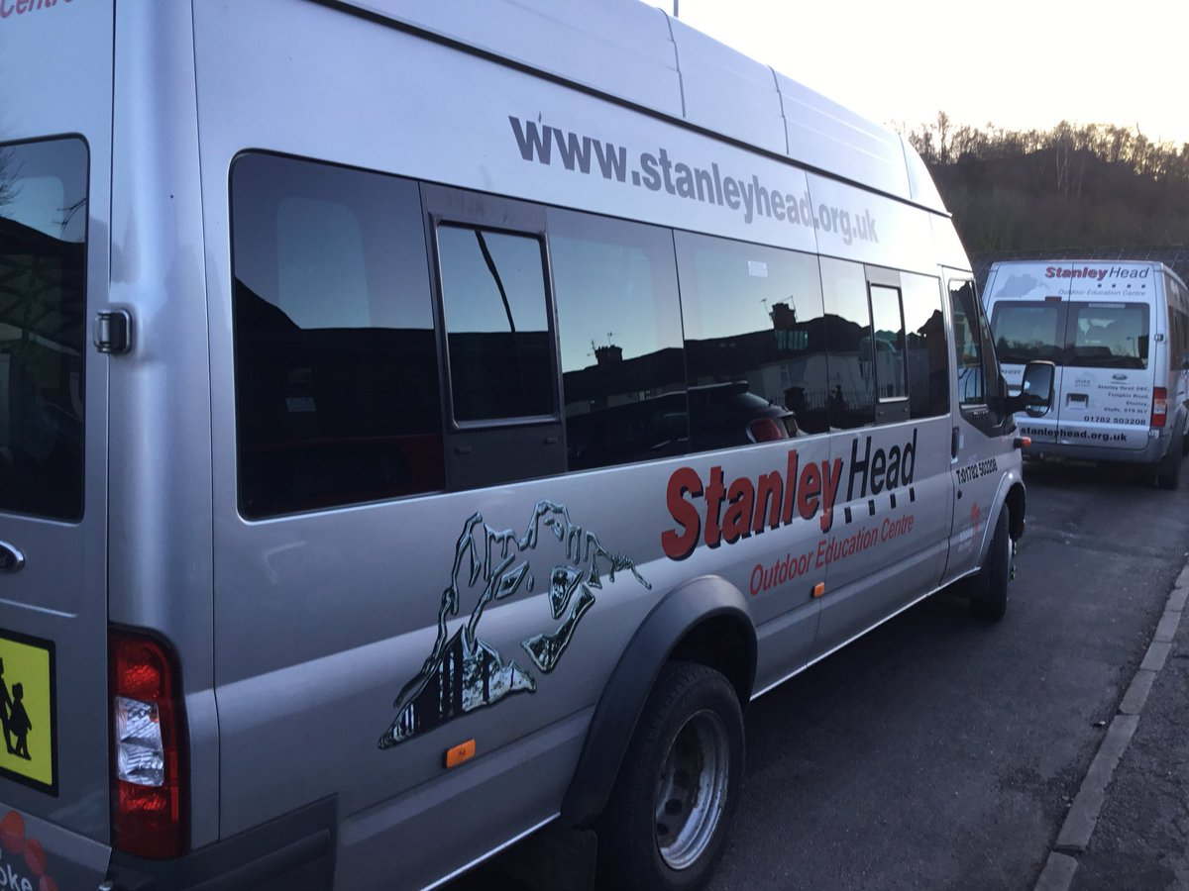
Travel Arrangements
Stanley Head have their own
minibuses and will come to school
to pick us up and bring us back.
One of the minibuses will pull a
trailer for our cases and bags.
Staffing for the trip:
Ms Dickenson
Mrs Hall
Mrs Stokes

Slide 4

Food and Drink
No packed lunch is required on day one.
Stanley Head will provide all meals.
Please bring a named water bottle.
Children will choose their meals for the week when they arrive. There is usually a good choice of options, even for very fussy eaters.
Children will be asked to bring one packet of biscuits, a mug and a tea towel. A few packets of biscuits will be opened and shared every evening with hot chocolate after evening activities. The children will then have to wash up.

Slide 5
Accommodation
All the girls will share one dormitory and all the boys will share another.
The beds will be bunk beds
All bedding will be provided.
Children will make their own beds upon arrival and keep their rooms tidy
Heaters are in the rooms but it is recommended that warm pyjamas are taken and even some warm bed socks if it is really cold. You may wish to pack a small blanket if your child is sensitive to cold.
A teacher’s bedroom is directly outside both dorms.
Both dorm areas have security keypads.
A member of centre staff will be on duty during the night.
Staff will have walkie talkies to communicate with night warden.

Slide 6
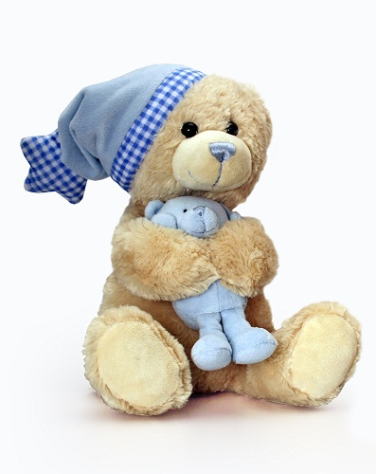
Bring a teddy!
Even the bravest of children in school can be worried about being away from home for
four nights.
You may also bring a small game (such as cards); a book or a puzzle book to use during our free time.

Slide 7
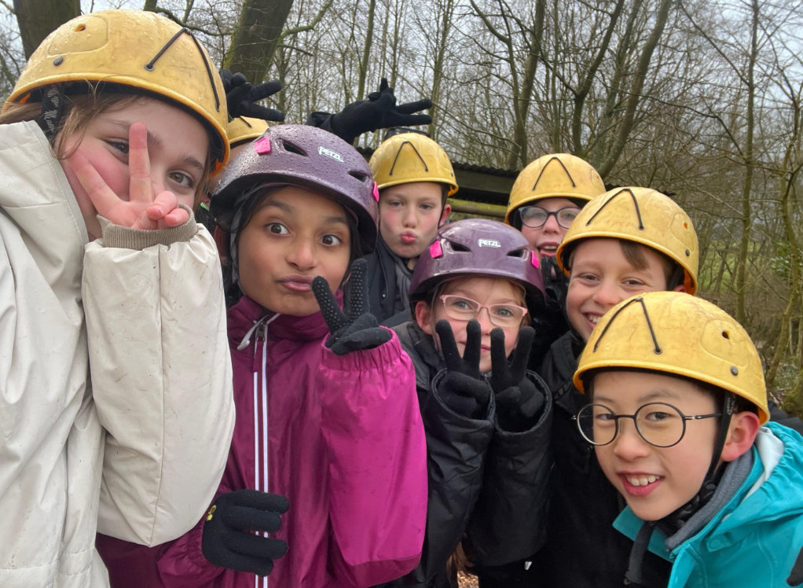

Slide 8
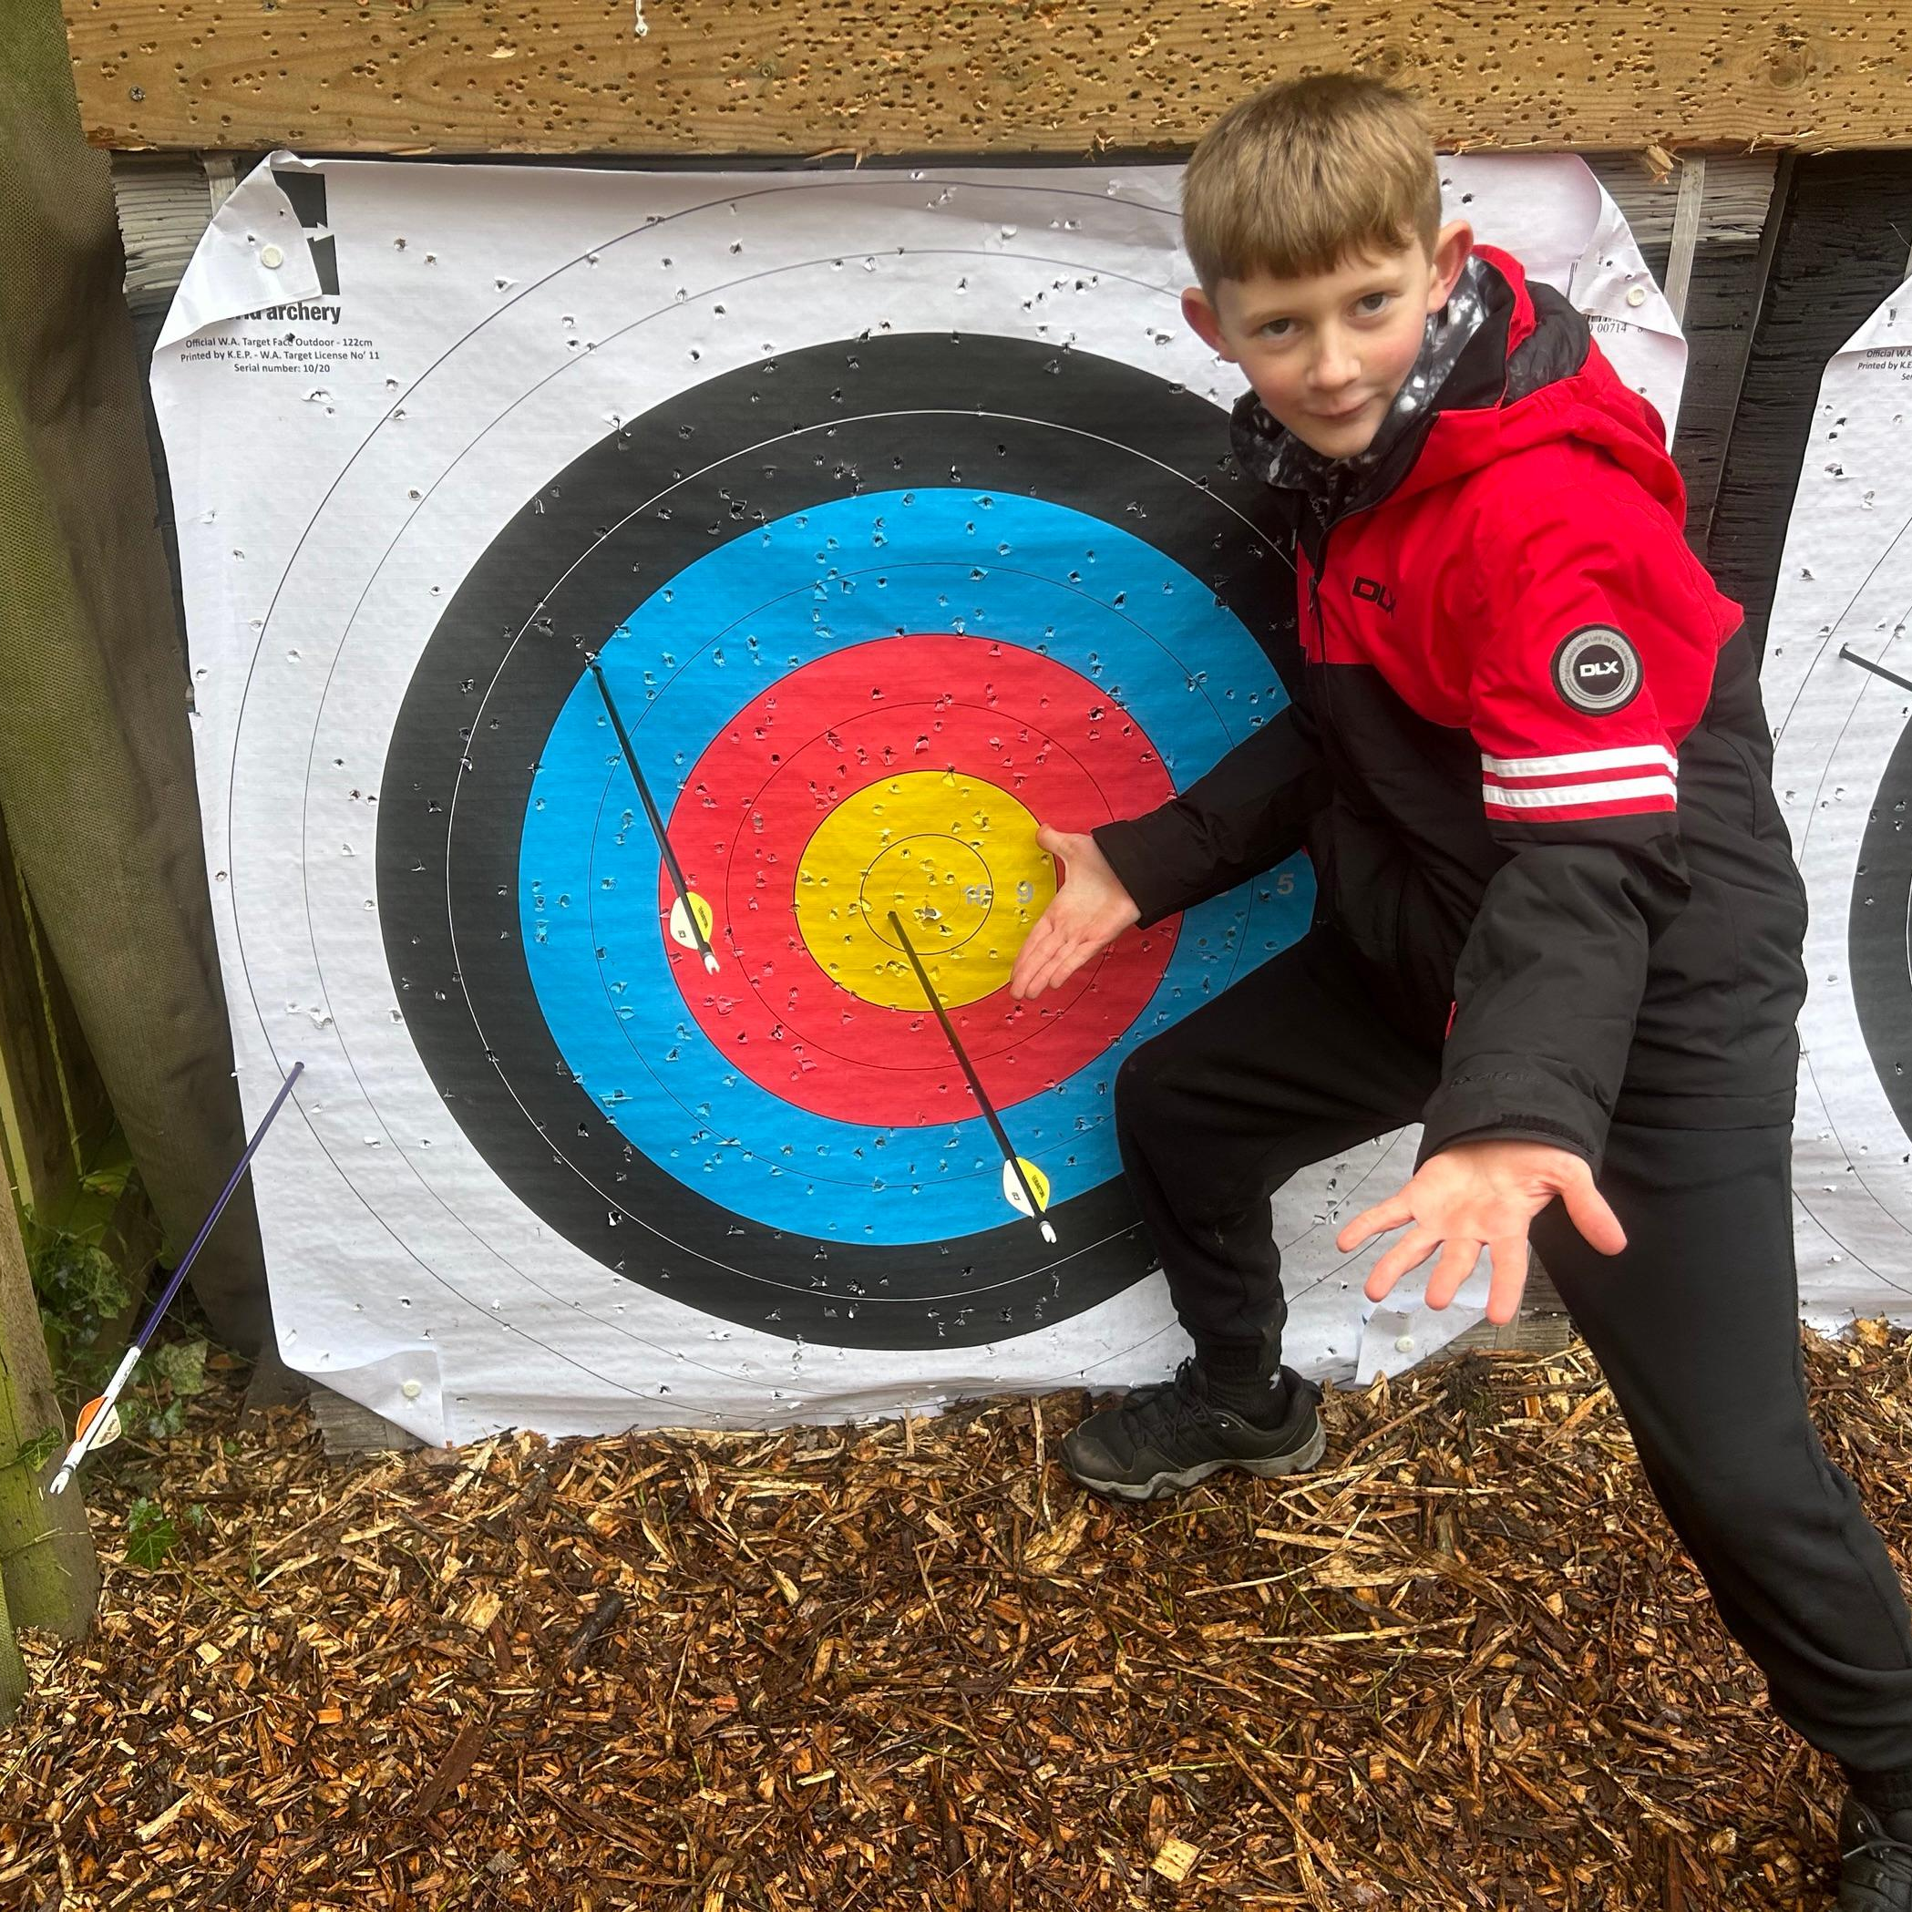

Slide 9
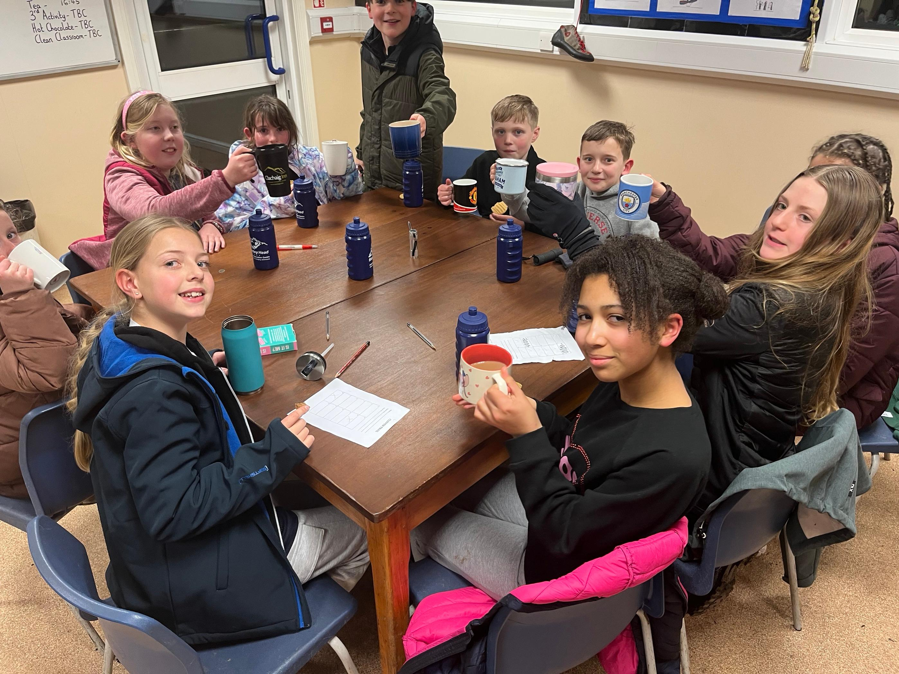

Slide 10
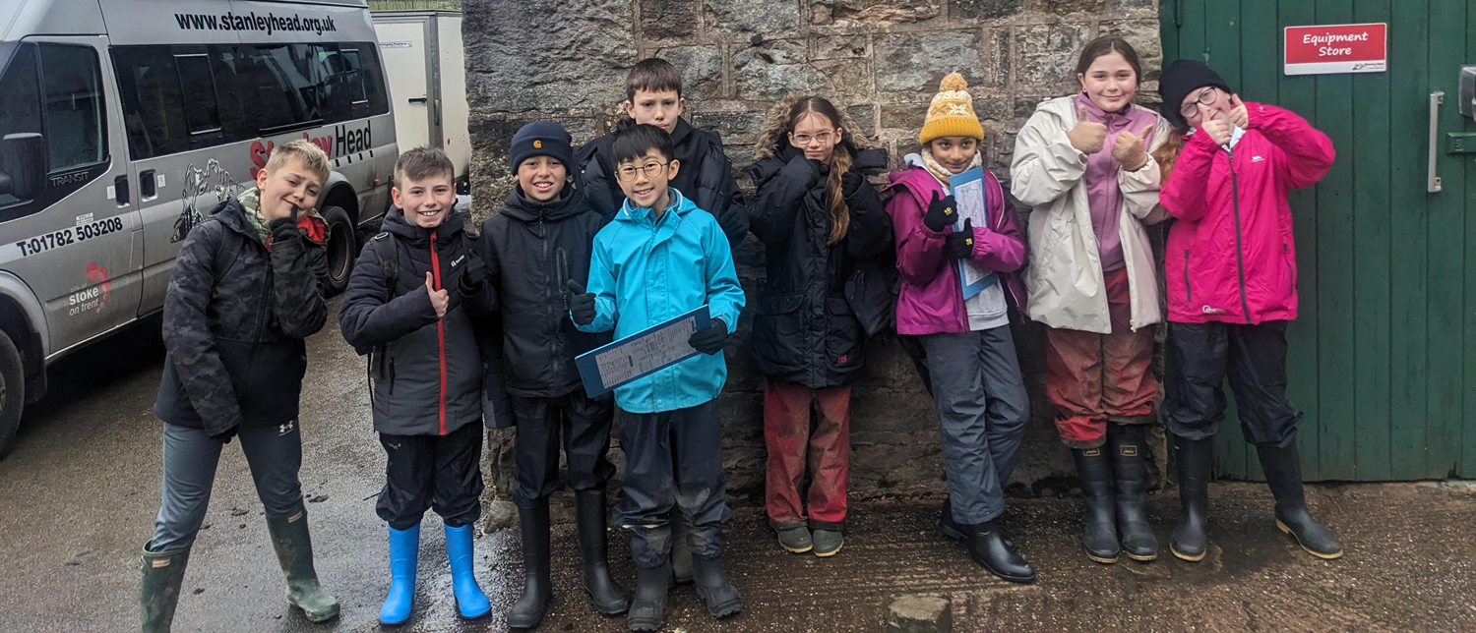

Slide 11
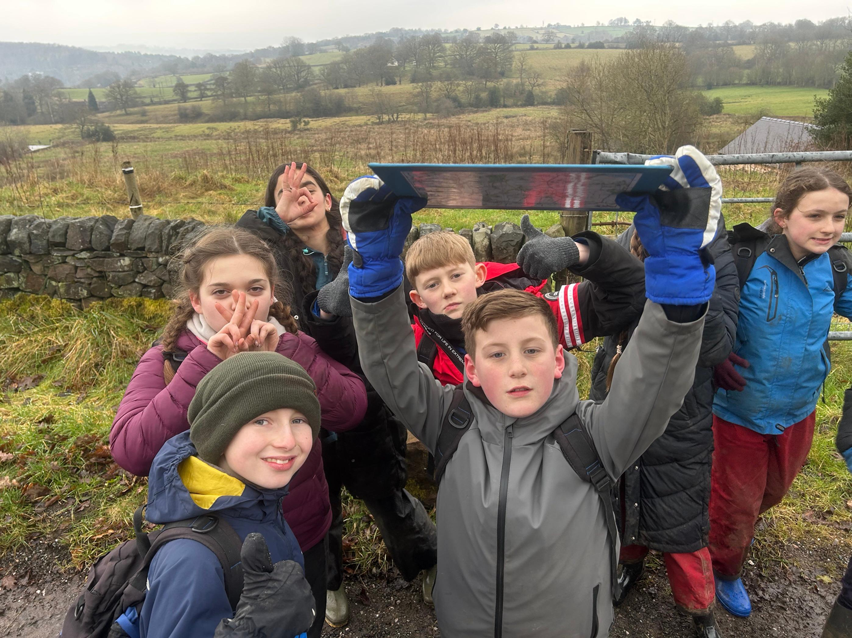

Slide 12
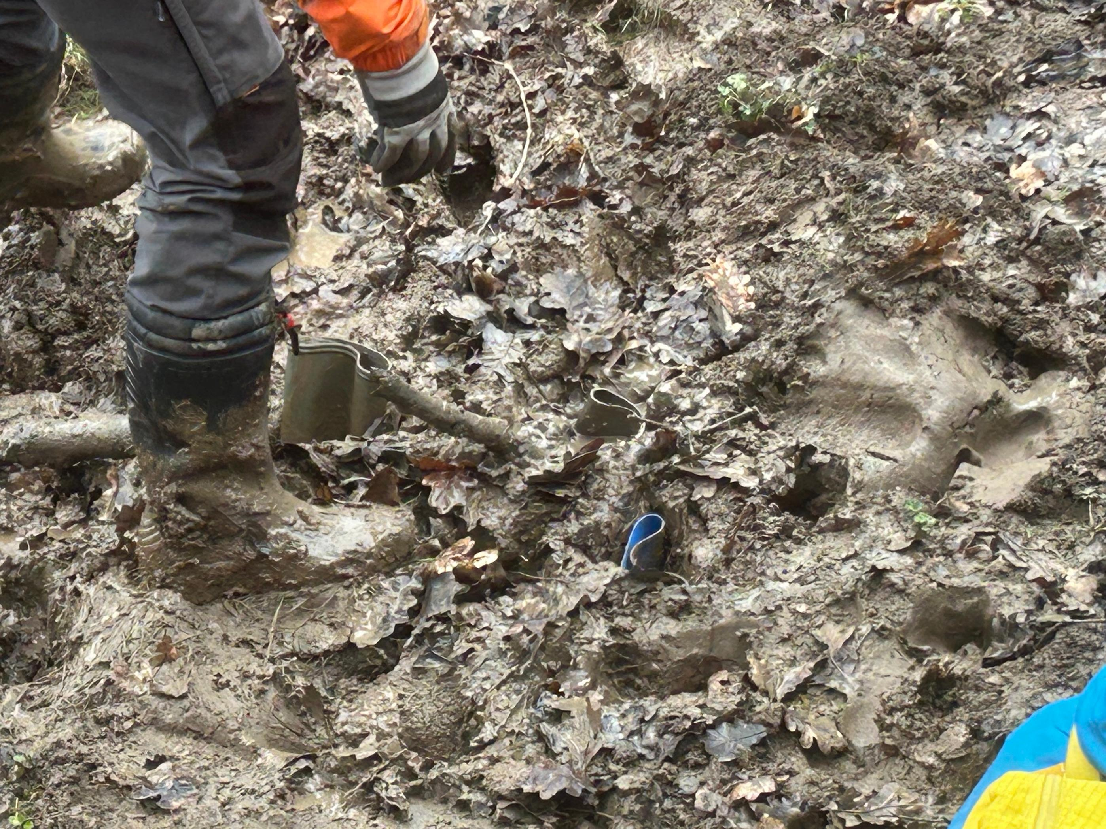

Slide 13
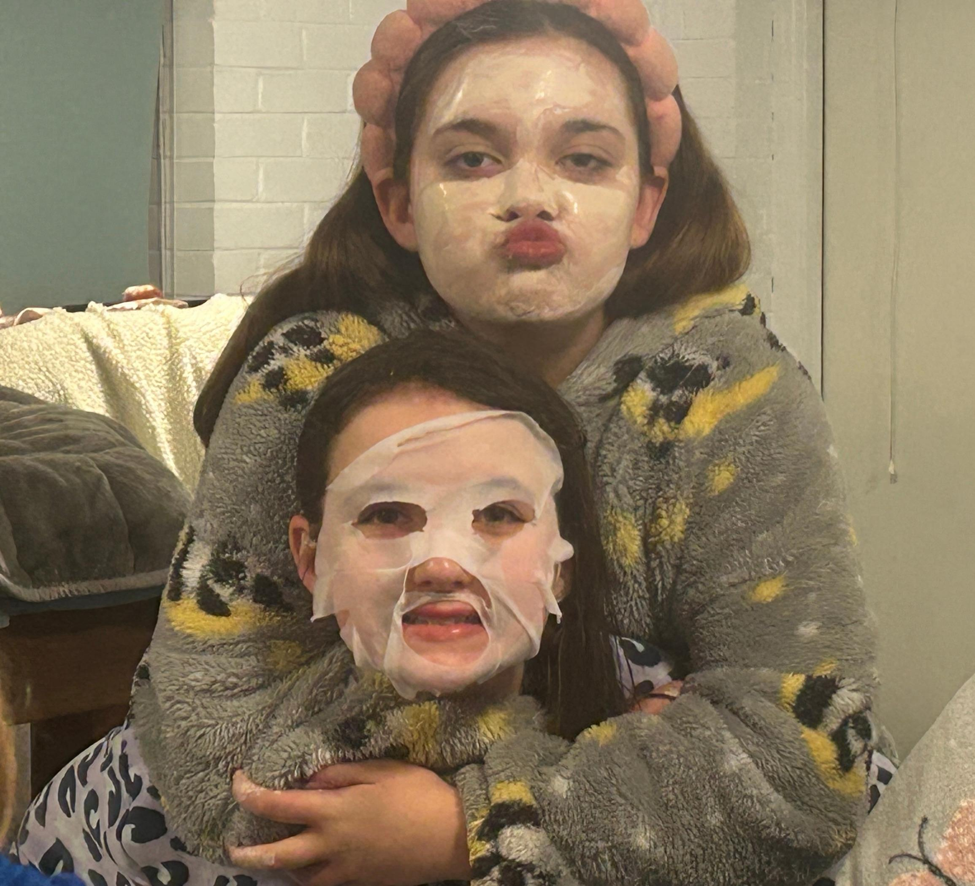

Slide 14
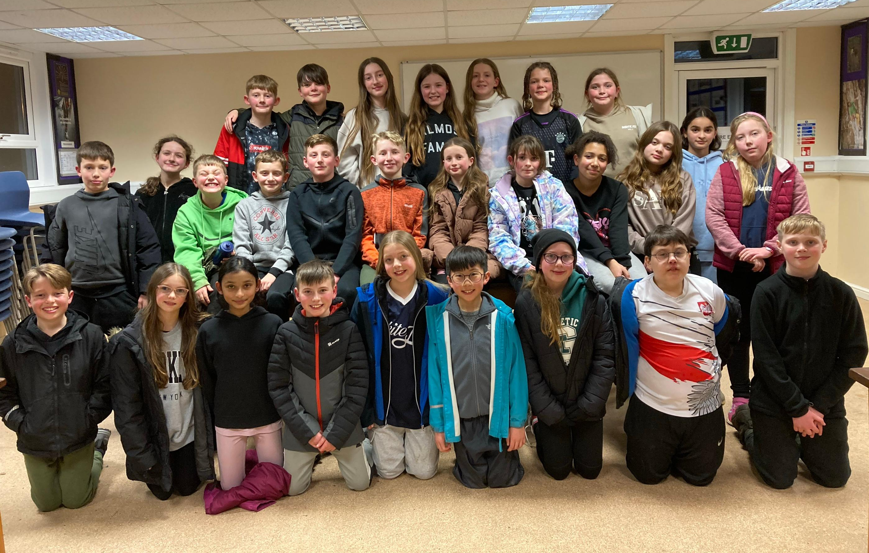

Slide 15
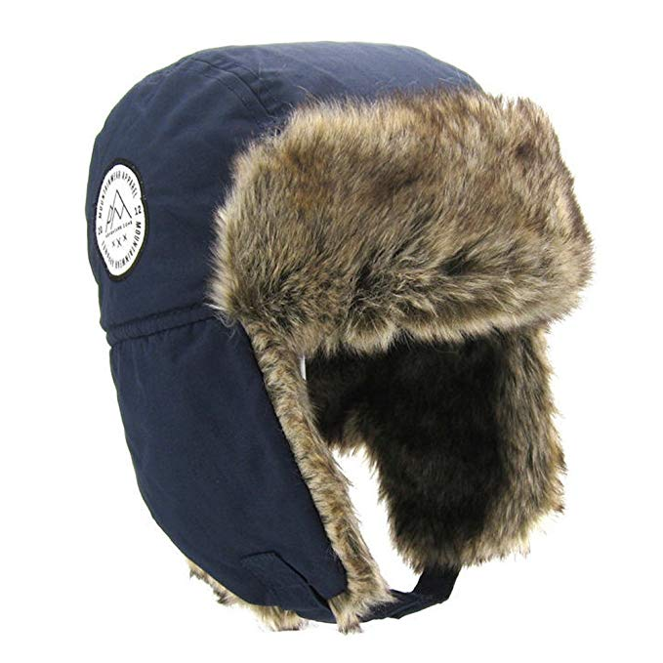
Clothing
We will be spending 3 hours outside during every activity. On two days, we will be outside all day off site. It is vital that your child is warm and comfortable.
The recommended kit list is available for you to take home tonight.

Slide 16
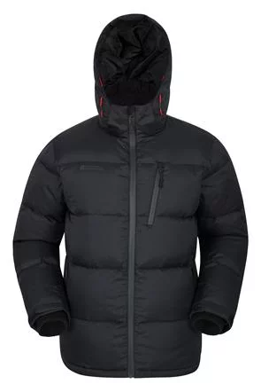

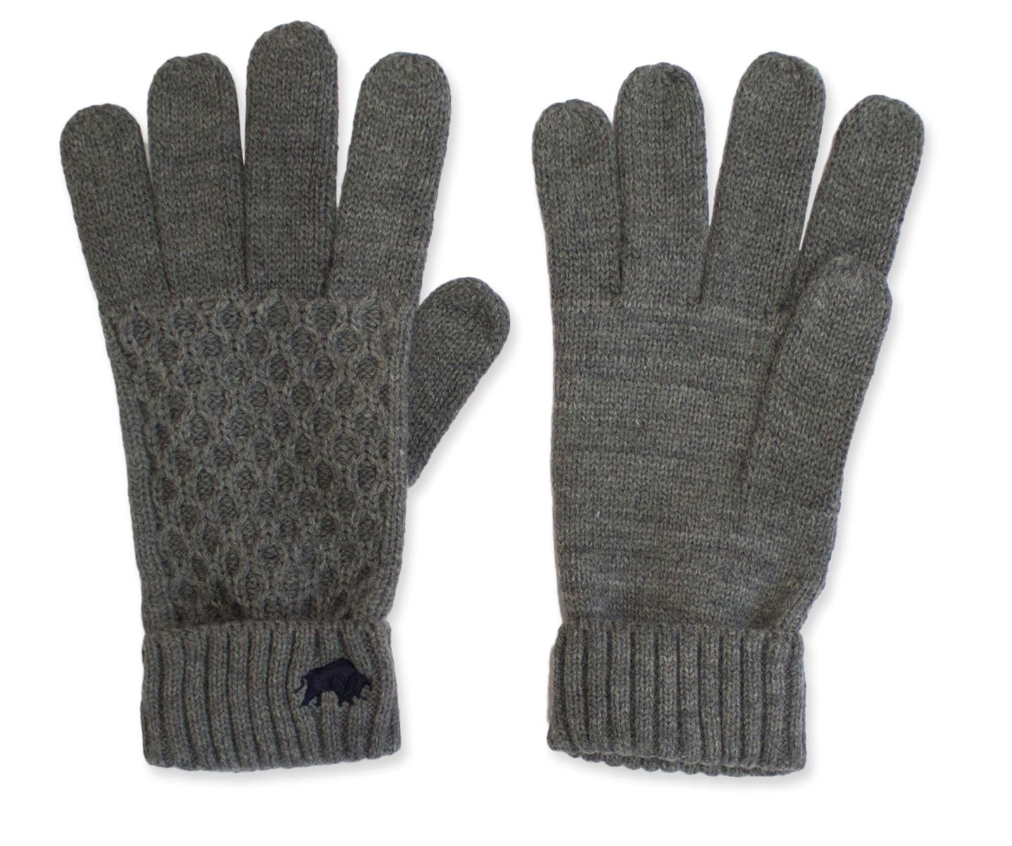
Essential items:

Slide 17
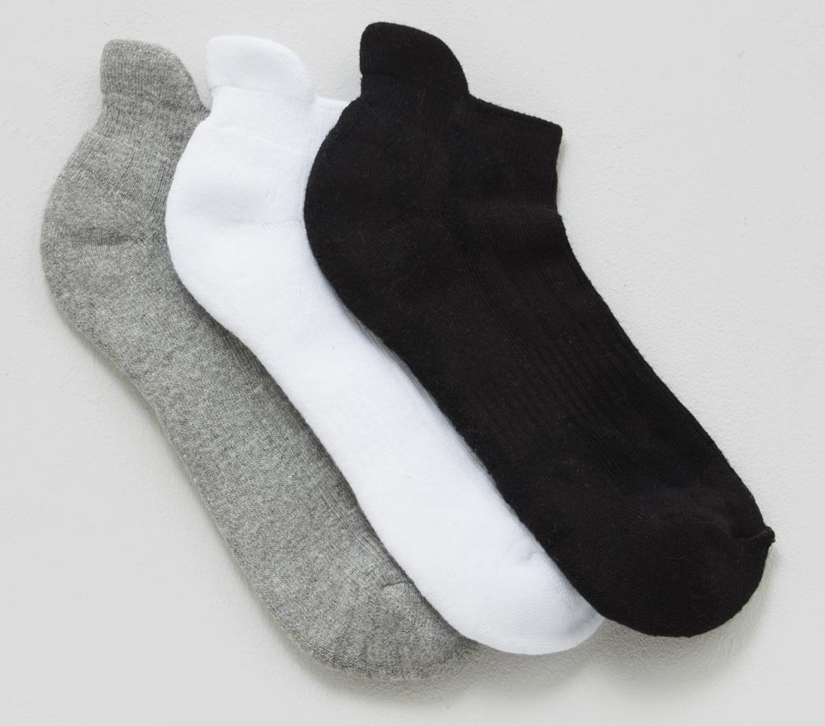
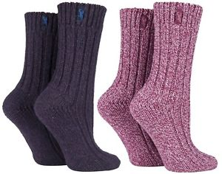


Socks
Lots and lots! You can’t have too many warm pairs of socks.

Slide 18
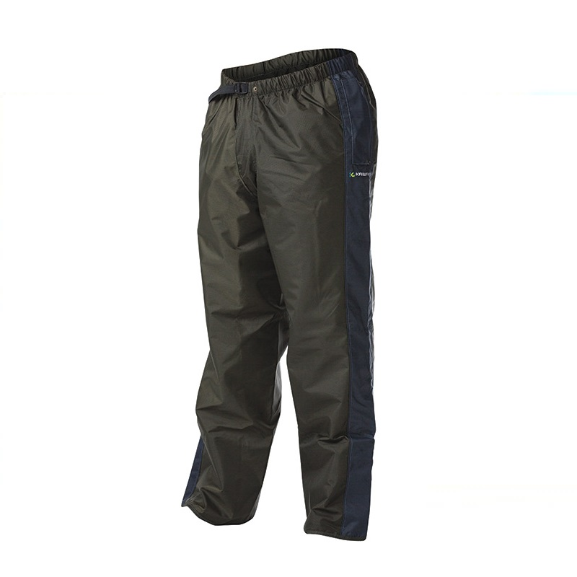
Over trousers
Stanley Head can provide these, if you don’t have any.

Slide 19
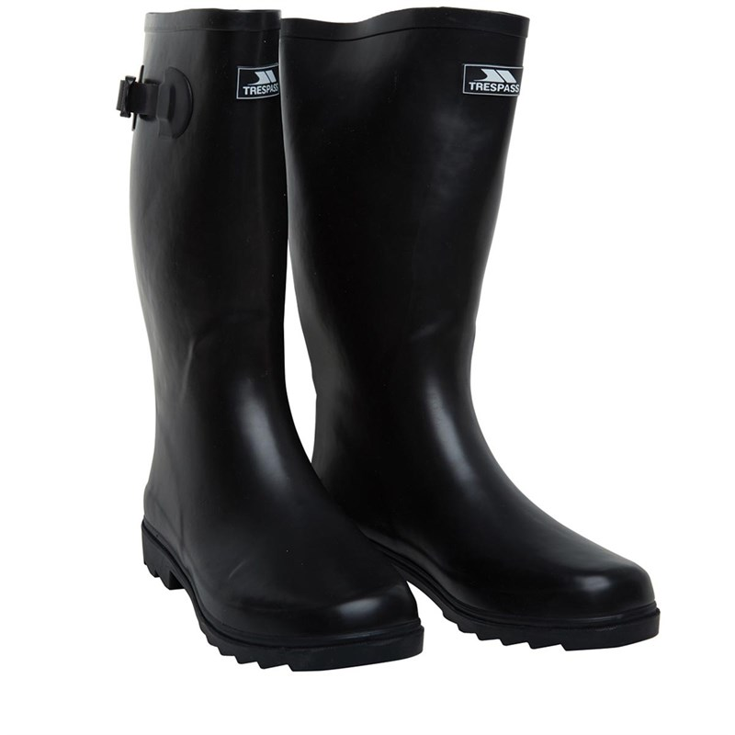
Wellies
The long type are better for deep mud. Please make sure they do not have a high heel.
Stanley Head can provide
these if necessary, but taking your own can mean a good fit.
Most activities can be done in wellies.

Slide 20
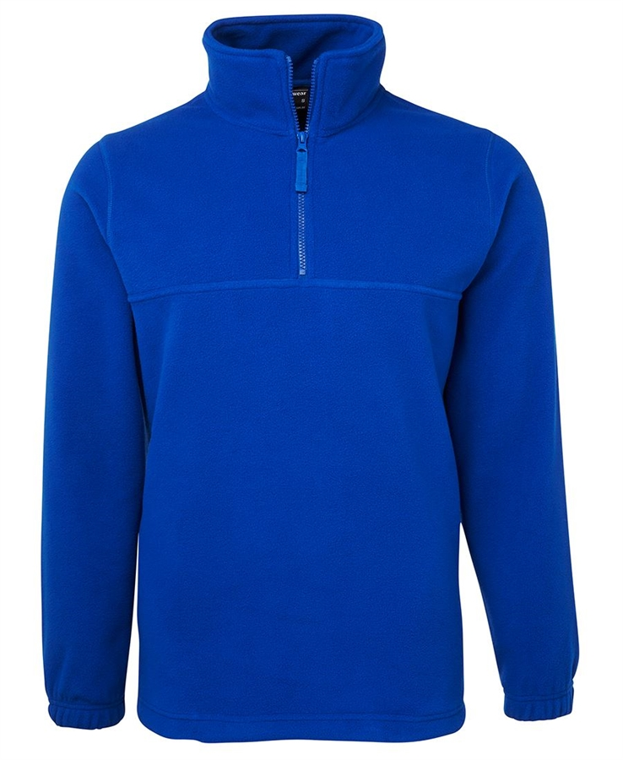
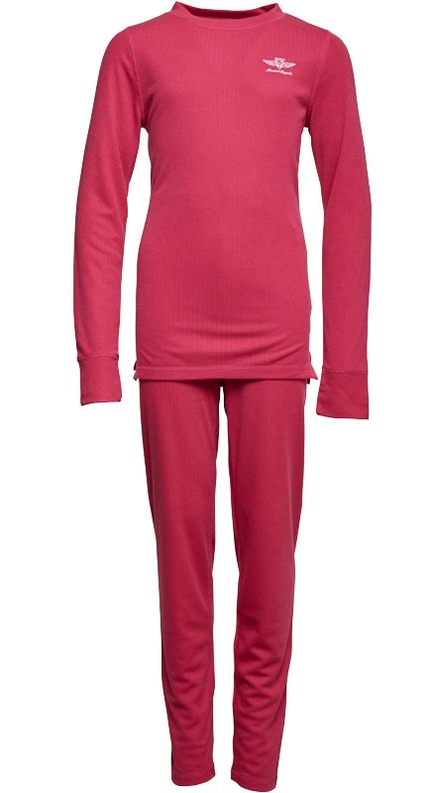
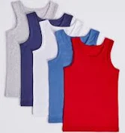
Vests, fleeces and thermals

Slide 21
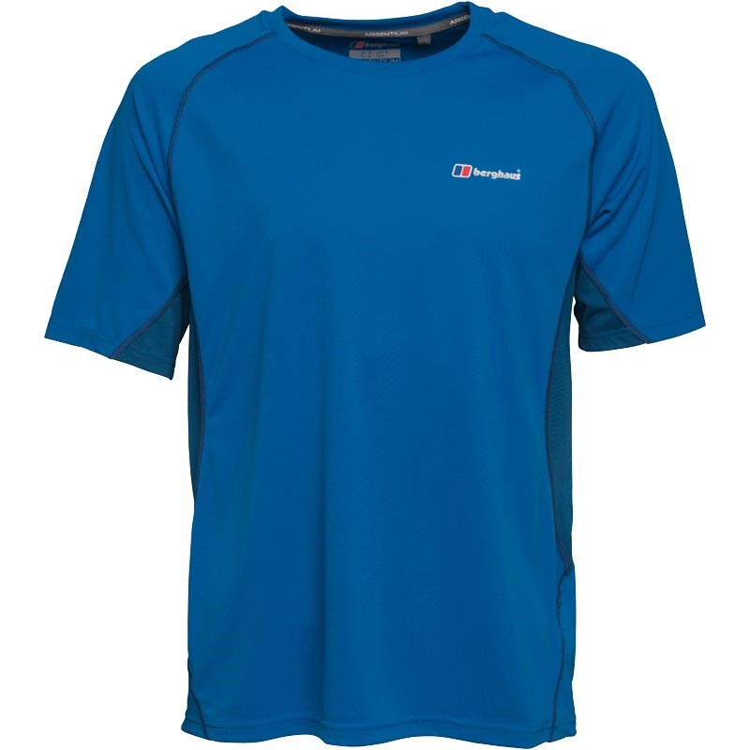
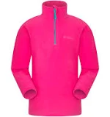

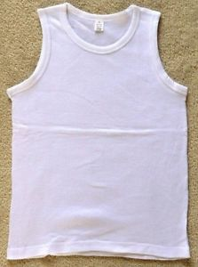
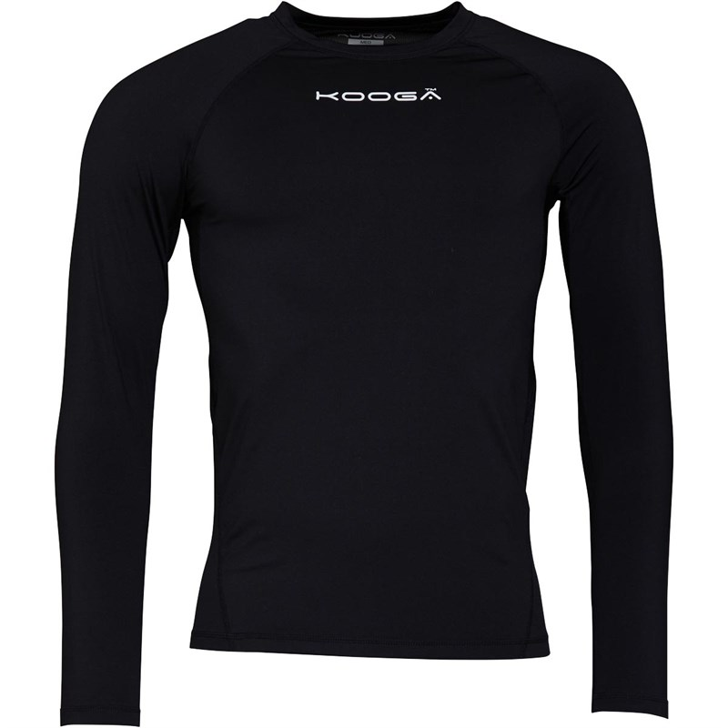
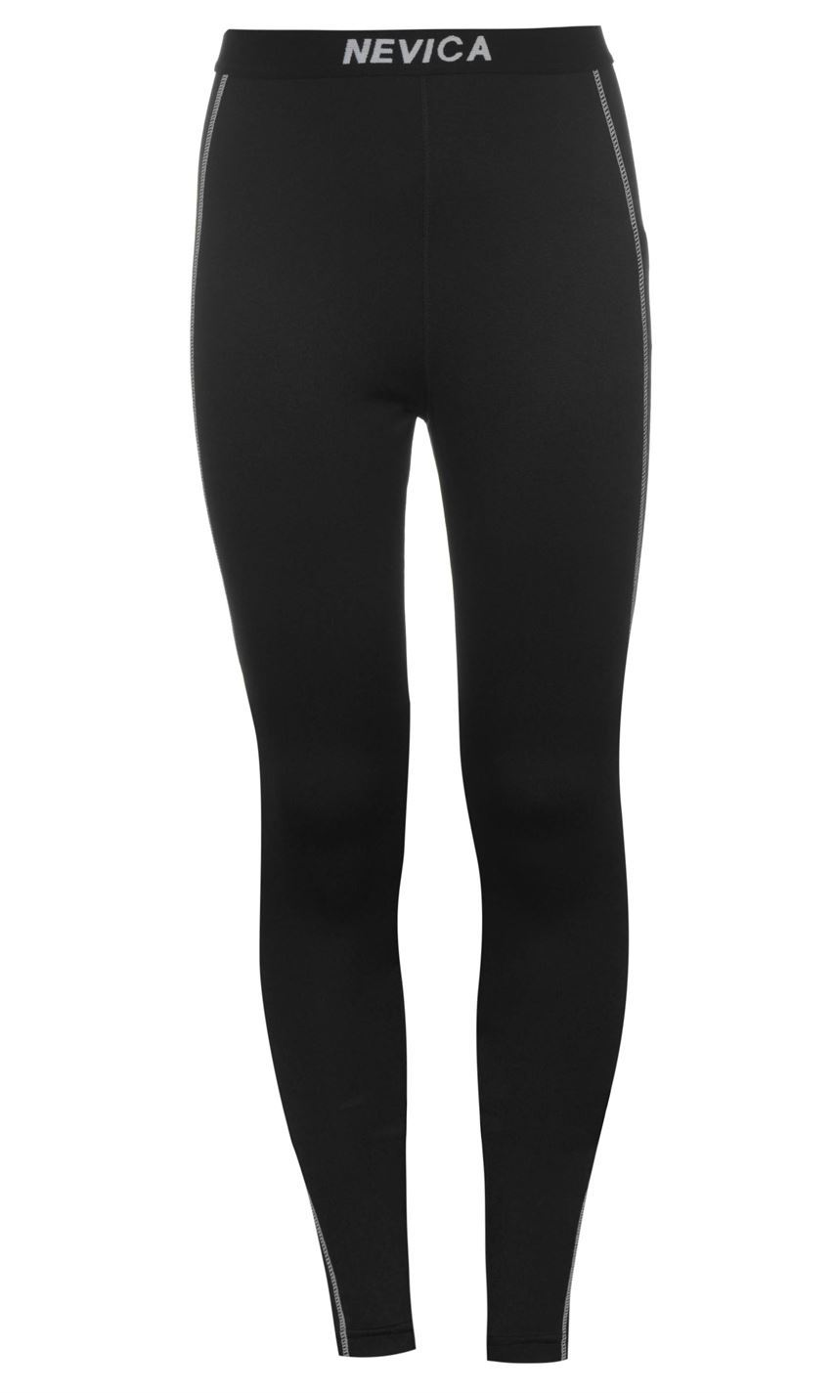
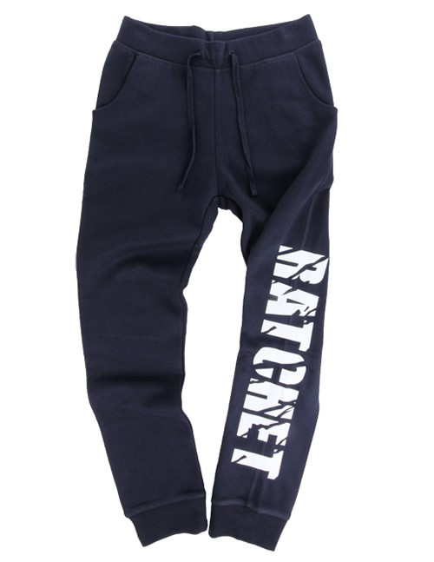

Think about layering

Slide 22
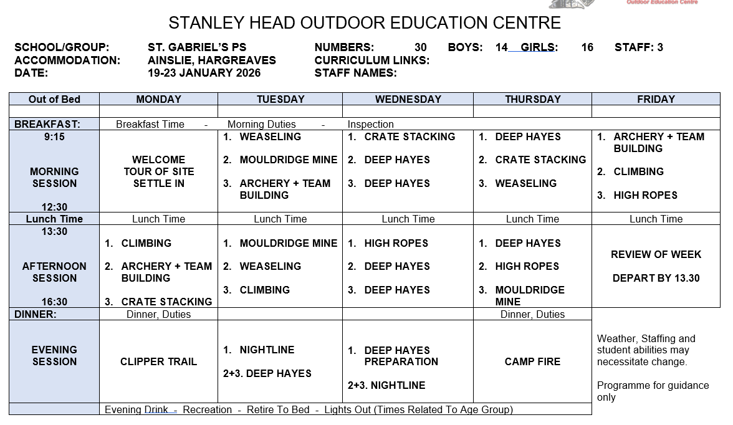

Slide 23

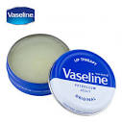
Finally….
No money is required.
No mobile phones.
A disposable camera is permitted.
Lip balm essential.
A torch is required for evening activities
No smart watches please.

