Slide 1
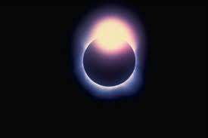
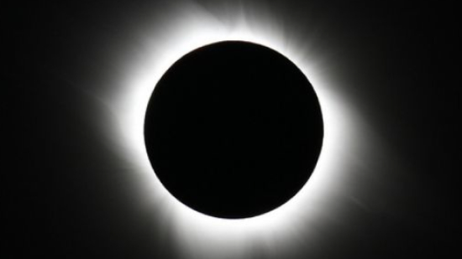
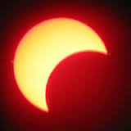


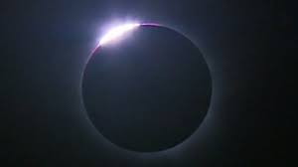
SOLAR ECLIPSE
THE UK HAS NOT SEEN A SOLAR ECLIPSE SINCE 1999
BY ELLA AND ELLIE
A SOLAR ECLIPSE IS WHEN THE MOON COVERS THE SUN.
The next eclipse in the UK will be in 2026
At first the sky only looks dim.
YOU CAN’T LOOK DIERECTLY AT THE SUN WHEN A SOLAR ECLIPSE HAPPENS.
PEOPLE HAVE SPECIAL GLASSES TO PROTECT THEIR EYES.
In the UK the best place to see the eclipse was the Faroe islands

