Slide 1
Curriculum Evening
Phonics Workshop
Wednesday 19th September
St. Vincent’s Catholic Primary School

Slide 2
Agenda
The aims of this workshop are to –
Discuss why phonics is taught daily in schools.
Give an insight into how phonics is taught.
Discuss the impact that phonics can have on children’s reading and writing.
Learn more about the assessment of phonics and the Y1 Phonics Screening Check.
Discuss how you can support your child at home.

Slide 3
Successful readers and writers have lots of early opportunities to:
Talk and Listen
Share books and have stories read to them
Play listening games
Sing songs and rhymes

Slide 4
What is Phonics?
The Technical Vocabulary
Phoneme – The units of sounds in a word. There are around 44 different phonemes or sounds that make up spoken English.
Grapheme – Letters are graphemes- ways of writing down the sounds.
Segmenting – Identifying the individual sounds in a spoken word and writing them down or saying them.
Blending – Reading and saying the sounds quickly from left to right to make the word.
Digraph – Two letters that represent one sound e.g. oo, ee, sh
Trigraph – Three letters that represent one sound e.g. igh, air, ear

Slide 5
Phase 1
Main Purpose
To develop language structures through speaking and listening activities
To increase vocabulary
To improve the ability to distinguish between environmental sounds
To become familiar with rhyme, rhythm and alliteration
To develop oral blending
Children will -
explore and experiment with sounds and words
show a growing awareness and appreciation of rhyme, rhythm and alliteration.
talk confidently about, and distinguish between different sounds in the environment
begin to develop awareness of the differences between phonemes.

Slide 6
Phase 2
Main Purpose:
To teach at least 19 GPCs
To move children from oral blending and segmentation to blending and segmenting with letters/graphemes
to introduce the reading of two syllable words and simple captions
To learn some HFW/’tricky words’
Children will
Say the phoneme when given any Phase 2 grapheme
Orally blend and segment VC and CVC words
Read HFW words the, to, I, no, go

Slide 7
Phase 3
Main Purpose:
To teach another 25 GPCs (mostly digraphs and some trigraphs)
To continue to blend and segment CVC words
To apply their phonic knowledge to reading and spelling
To learn the letter names
To continue to read more HFW/’tricky’ words
To learn to spell some of these words
Children will be able to
42/43 phonemes including common digraphs
Blend and segment CVC words
Readily apply phonic knowledge
Read the HFW he, she, we, me, be, was, my, you, her, they, all, are
Spell the HFW the, to, I, no, go
Write each letter correctly when following a model

Slide 8
Phase 4
Main Purpose:
To blend and segment CCVC and CVCC words (consolidate knowledge of Graphemes)
To continue to blend and segment CVC words
To apply their phonic knowledge to reading and spelling
To practise blending for reading and segmenting for spelling
Continue to read more HFW/’tricky’ words
To learn to spell some of these words
Children will -
Read words containing adjacent consonants (not taught in word families)
Begin to acquire instant recognition of graphemes
Readily apply phonic knowledge
Read and spell some HFW words
Duration – 4-6 weeks (Reception/Y1

Slide 9
Phase 5
Main Purpose:
To broaden knowledge of graphemes and phonemes for use in reading and spelling
Learn new graphemes and alternative pronunciations
To apply their phonic knowledge to reading and spelling
Learn to choose appropriate graphemes to represent phonemes when spelling
Build word specific knowledge of the spelling of words
Children will -
Quickly recognise GPCs that have more than one letter
Write the common graphemes for any phoneme
Readily apply phonic knowledge in reading – prime approach
Read automatically the 100 HFW
Spell accurately most of the 100 HFW
Form each letter correctly
Duration – Throughout Year 1

Slide 10
The Daily Session

Slide 11
Suggested Daily Teaching
Introduction
review
teach
practise
apply
Assess learning against criteria.
Cross curricular application
Notes:
Intro – Objectives and criteria for success
Review – practise previously learned letters
- oral blending and segmentation
Teach – a new sound
- blending and/or segmenting (weeks 2 and 3)
- one or two tricky words (week 3 onwards)
Practise – reading and /or spelling words with the new letter
Apply – read or write a caption using HFW and words containing the new letter
Assess – against the success criteria
Cross Curricular Application – in all areas of quality continuous provision.

Slide 12
Enunciation – Voicing the Phonemes.

Slide 13

The 44 phonemes
/b/ | /d/ | /f/ | /g/ | /h/ | /j/ | /k/ | /l/ | /m/ | /n/ | /ng/
/p/ | /r/ | /s/ | /t/ | /v/ | /w/ | /y/ | /z/ | /th/ | /th/ | /ch/
/sh/ | /zh/ | /a/ | /e/ | /i/ | /o/ | /u/ | /ae/ | /ee/ | /ie/ | /oe/
/ue/ | /oo/ | /ar/ | /ur/ | /au/ | /er/ | /ow/ | /oi/ | /air/ | /ear/ | /ure/
Notes:
Anna

Slide 14
Assessment and The Phonics Screening Check

Slide 15
Assessment of Phases
The children will be assessed at the end of each phase.
This will be 1;1 with the teacher or teaching assistant to ascertain if they know most of the sounds covered in that particular phase.
Your teacher will inform you of any particular sounds they need to concentrate on.

Slide 16
How can you support your child at home?
Useful websites: www.letters-and-sounds.com/ www.phonicsplay.com
Reading
Practising sounds using word mats
Flashcards
Bug Club on www.activelearn.co.uk
Playing phonics games
Notes:
Anna

Slide 17
What is the Phonics screening check?
The Phonics screening check is a statutory assessment for all children in Year 1.
The phonics screening check takes place during June in the summer term.
The check is designed to confirm whether individual children have learnt phonic decoding to an appropriate standard.

Slide 18
Why are the children being screened?
Every Year 1 child in the country will be taking the phonics screening check in the same week in June.
The aim of the check is to ensure that all children are able to read by the end of year two.
This ‘midpoint check’ will ensure that we have a clear understanding of what the children need to learn in year 2.

Slide 19
What will the children be expected to do?
The check is very similar to tasks the children already complete during phonics lessons.
Children will be asked to ‘sound out’ a word and blend the sounds together.eg d-o-g - dog
The focus of the check is to see which sounds the children know and therefore the children will be asked to read made up ‘nonsense’ words.

Slide 20
What will the phonics screening check look like?
The check will include a ten page booklet with four words on each page.
The check contains 40 words divided into two sections of 20 words.
Each page will contain either four pseudo-words or four real words.

Slide 21
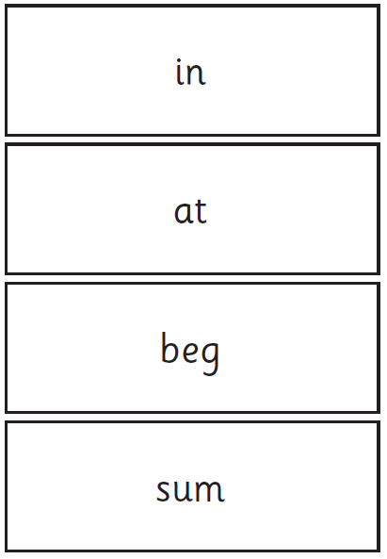
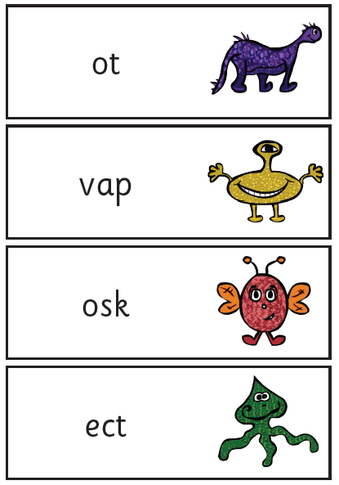
Examples of words

Slide 22
How long will the check take?
There is no time limit for the check. The children can take as long as they like.
The pilot phonic checks that took place found that most children took between 4 and 9 minutes and we have found this to be true as a school.
For those children who can not concentrate for long periods, the check can be broken up into short periods and administered over a period of time, such as a day.

Slide 23
Scoring the check
The child will work one-to-one with a familiar teacher.
The child will work through each word in order.
The teacher will record whether the child has said the word correctly or not.
A score is awarded and compared against the national benchmark score to see if the child has met the required standard or not.
Parents will be informed of this as part of the end of year report they receive.

Slide 24
My child has not met the required standard
If your child has not met the expected standard by the end of Year 1 then they will follow a revision programme and retake the test in the June of Year 2
Interventions are rigorous both in their planning and delivery by staff

Slide 25
What happens to the results?
The school is required to report the results to the local authority
Children identified as not having met the required standard will be highlighted for phonics support work .

Slide 26
What impact does Phonics have in our school?
Year 1 Phonics Screening Check
88% of Year 1 pupils met the threshold for the Phonics Screening Check (2017)
90% of Year 1 pupils met the threshold for the Phonics Screening Check. (2018)

