Slide 1
Instructions
This PowerPoint will encourage children to explore half and halving
a group of objects to 10.
The pirates are not very fair and do not take half the coins. Can the children identify when the pirates are not being fair and say how many half would be?
By clicking the question mark button, reasoning questions will appear to deepen your children’s understanding.
Click the coin in the corner to share the coins between the treasure chests. The coins will not be shared equally in halves until the ‘answer’ button is clicked. This will allow the children time share their thoughts and answers.

Slide 3


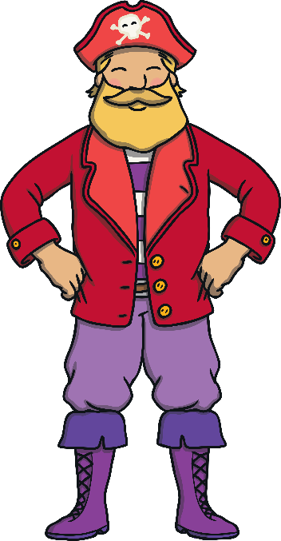
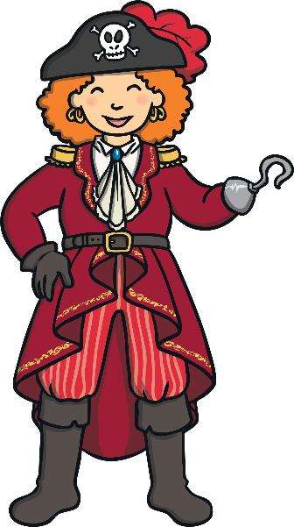

The pirates have found 6 coins.
They need to take half each.
Do the pirates have half each?
answer
?
How many is half of 6?
What does half mean?

Slide 4
The pirates have found 4 coins.
They need to take half each.
Do the pirates have half each?
answer
?
What do you notice about the halves?
How many is half of 4?

Slide 5

The pirates have found 8 coins.
They need to take half each.
Do the pirates have half each?
answer
?
Can one pirate have more?
How many is half of 8?

Slide 6

The pirates have found 10 coins.
They need to take half each.
Do the pirates have half each?
answer
?
How can you check that they both have half?
How many is half of 10?

Slide 7


Pirate Pansy and Captain Cuthbert have learnt how to be fair!
They are having biscuits to celebrate.
Can they take half each?
Well done pirates, half of 2 is 1!

