Slide 1
Practising handwriting by writing dialogue
Building handwriting fluency through speed, choices and writing dialogue

Slide 2
How our teaching resources are designed for the classroom

Slide 3
I can write correctly punctuated dialogue in legible, cursive handwriting.

Slide 4
direct speech
the term used for a character speaking out loud in a text
inverted commas
a pair of punctuation marks that signal direct speech to the reader
speech first sentence
a sentence that includes direct speech first before the reporting clause
speech second sentence
a sentence includes direct speech second after the reporting clause

Slide 5

Practising handwriting by writing dialogue
Handwriting warm-up
Writing speech first sentences
Writing speech second sentences

Slide 6
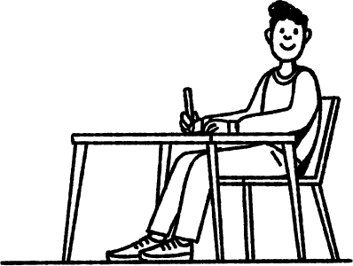
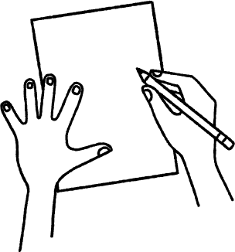
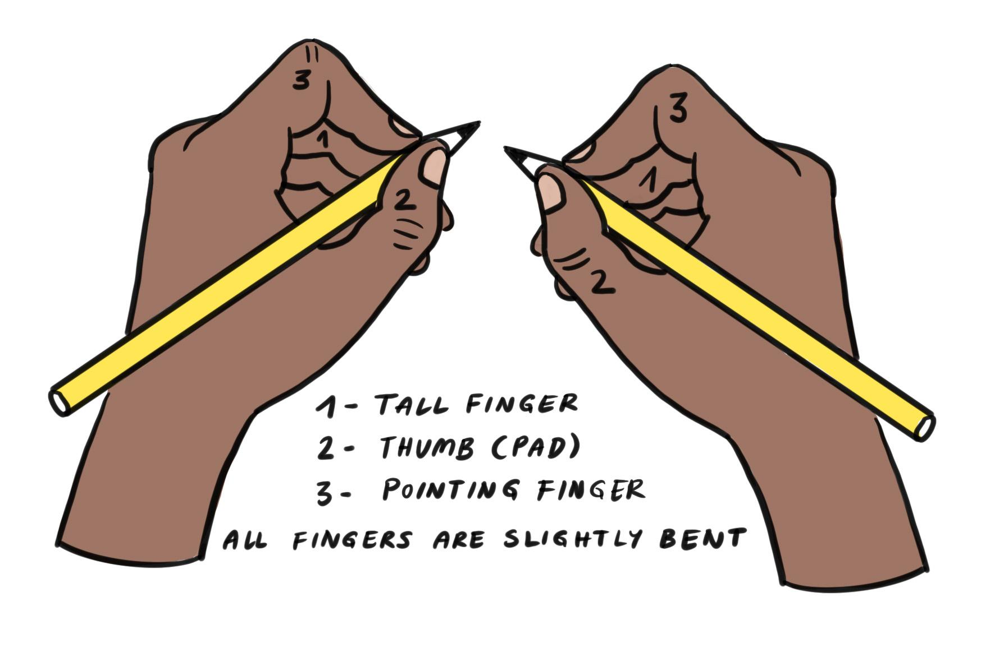
Handwriting warm-up
Before we start, what are these pictures reminding you to do?
sit on a chair at a table
feet flat on the floor
back against the chair
angle your paper correctly
non-writing hand supports
hold your pencil in the tripod grip

Slide 7

Handwriting warm-up
Before starting to write, it is important to warm up your hand and wrist muscles.
Your hands and wrists get stronger when you exercise them.
Warming up your hands before writing will help to improve your handwriting.
Making your hands stronger will help to speed up your handwriting.

Slide 8
Handwriting warm-up
I choose and do a hand and wrist warm-up.
hand squeeze
finger touch
playing piano
wrist circles
wiper wrists
wrist shake
You choose and do a hand and wrist warm-up.

Slide 9
Handwriting warm-up
Practising writing patterns helps us to prepare for writing and joining letters.

Slide 10
Handwriting warm-up
I will choose a writing pattern to do in the air with my finger.
You will choose a writing pattern to do in the air with your finger.

Slide 11
Handwriting warm-up
Copy and continue these patterns using your tripod grip.
Remember, don’t lift your pencil when forming the pattern. Focus on keeping the movement smooth and flowing.

Slide 12
Handwriting warm-up
Copy and continue these patterns using your tripod grip.
Did you use your tripod grip?
Did you keep your pencil on the page?
Was your movement smooth?

Slide 13
Practising handwriting by writing dialogue
Handwriting warm-up
Writing speech first sentences
Writing speech second sentences

Slide 14
Writing speech first sentences
We use direct speech to show that a character is speaking out loud.
These are the words the characters said out loud.
This is direct speech.
“What a lot of noise!” cried Miss Ofoedu.
“I just can’t do it, Miss,” sighed Jun sadly.
“Shall I help you?” Aisha asked kindly.
“__”
Direct speech is shown to the reader using inverted commas:
The inverted commas tell us where the words the character said begin and end.

Slide 15
Writing speech first sentences
The inverted commas go around the words that were spoken out loud by the character - the direct speech.
“Let’s get out our books,” said Mr Clarke calmly.
This is the reporting clause.
It tells us who said the direct speech and how.
Because the direct speech has come before the reporting clause, we call this a speech first sentence.
It is good to practise writing speech first sentences, as they will appear a lot in your writing. It will improve the speed and flow of your handwriting.

Slide 16
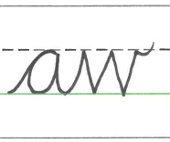
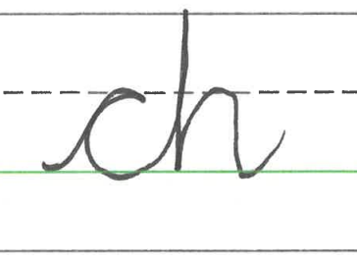
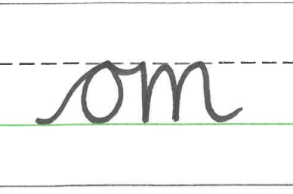
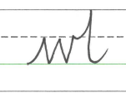
Writing speech first sentences
Can you remember the four joins in cursive handwriting?
first join | second join | third join | fourth join
The first join is from the baseline to the x-height line.
The second join is from the baseline up towards the ascender line.
The third join is from the x-height line to the x-height line.
The fourth join goes from the x-height line up towards the ascender line.

Slide 17
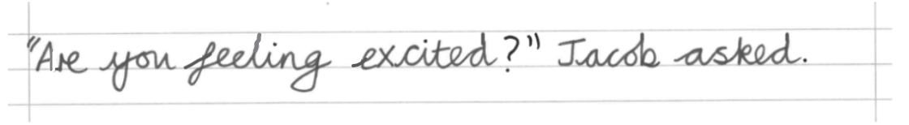
Writing speech first sentences
Let’s look closely at a speech first sentence.
What do you notice about the letter formations?
capital letters
lead ins
lead outs
looped lead in
looped lead out
x-height letters
descender letters
ascender letters
inverted commas
break letter

Slide 18
Writing speech first sentences
The direct speech is enclosed within inverted commas.
The speech sentence starts with a capital letter.
The proper noun ‘Jacob’ starts with a capital letter.
Capital letters don’t join to the next letter in the letter string.
The letter after the capital letter starts with a lead in from the baseline.
All of the other words have a lead in and a lead out.
The direct speech is a question, therefore a question mark is used.
All four cursive letter joins are used when writing this speech first sentence.

Slide 19
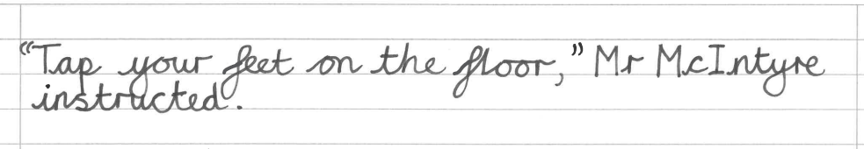
Writing speech first sentences
Let’s look closely at another speech first sentence.
What do you notice about the letter formations?
capital letters
lead ins
lead outs
looped lead in
looped lead out
x-height letters
descender letters
ascender letters
inverted commas
even letter spacing

Slide 20
Writing speech first sentences
The direct speech is enclosed within inverted commas.
The speech sentence starts with a capital letter.
The proper noun ‘Mr McIntyre’ has three capital letters in its formation.
Capital letters don’t join to the next letter in the letter string.
The letter after the capital letter starts with a lead in from the baseline.
There is a comma after the direct speech and before the inverted commas.
The first, second and third joins are used when writing this speech first sentence.

Slide 21

Writing speech first sentences
Select the correctly punctuated sentence.
Shall I help you? Aisha asked kindly.
“Shall I help you?” Aisha asked kindly.
“Shall I help you?” aisha asked kindly.

Slide 22
Writing speech first sentences
Let’s practise writing some speech first sentences.
"Are you feeling excited?" Jacob asked.
"Tap your feet on the floor," Mr McIntyre instructed.
Remember:
Sit comfortably and hold your pencil in the tripod grip.
Start with the inverted commas and then the capital letter.
Start the next letter with a lead in from the baseline.
To join, keep your pencil on the page and only take your pencil off the page once the letter string is complete.
Keep your pencil flowing smoothly as you connect the letters.
Ensure the letter spacing and letter formations are correct so your writing is legible.

Slide 23
Writing speech first sentences
After forming a capital letter in cursive you should…
join it to the next letter in the letter string.
lift your pencil as capital letters do not join to other letters.
continue to write the rest of the sentence in capital letters.

Slide 24
Writing speech first sentences
1. Copy the following speech first sentences in cursive handwriting on your writing lines.
"Are you feeling excited?" Jacob asked.
"Tap your feet on the floor," Mr McIntyre instructed.

Slide 25
Writing speech first sentences
Did you remember the inverted commas?
Did you start with a capital letter?
Did you ensure your letters were the correct size and formation?
Did you remember the letter ‘x’ is a break letter?

Slide 26
Practising handwriting by writing dialogue
Handwriting warm-up
Writing speech first sentences
Writing speech second sentences

Slide 27
Writing speech second sentences
Another way of showing direct speech is to use a speech second sentence.
Jacob sighed, “Are we nearly there?”
The teacher yelled, “That’s enough!”
reporting clause
direct speech
The reporting clause now comes at the start of the sentence so it always has a capital letter.
The reporting clause is now always followed by a comma.

Slide 28
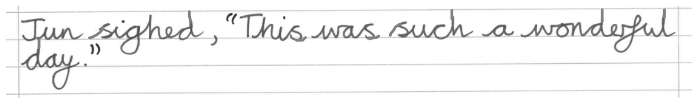
Writing speech second sentences
Let’s look closely at a speech second sentence.
What do you notice about the letter formations?
capital letters
lead ins
lead outs
looped lead in
looped lead out
x-height letters
descender letters
ascender letters
inverted commas
even letter spacing

Slide 29
Writing speech second sentences
The direct speech is enclosed within inverted commas.
The proper noun ‘Jun’ has a capital letter.
The first word of the direct speech has a capital letter.
The letter after the capital letter starts with a lead in from the baseline.
All of the other words have a lead in and a lead out.
There is a comma after the reporting clause.
All four cursive letter joins are used when writing this speech second sentence.

Slide 30
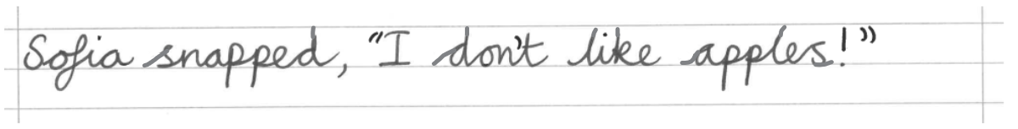
Writing speech second sentences
Let’s look closely at another speech second sentence.
What do you notice about the letter formations?
capital letters
lead ins
lead outs
looped lead in
looped lead out
x-height letters
descender letters
ascender letters
inverted commas
even letter spacing

Slide 31
Writing speech second sentences
The direct speech is enclosed within inverted commas.
The proper noun ‘Sofia’ has a capital letter.
The first word of the direct speech has a capital letter.
The letter after the capital letter starts with a lead in from the baseline.
All of the other words have a lead in and a lead out.
There is a comma after the reporting clause.
All four cursive letter joins are used when writing this speech second sentence.
There is an exclamation mark at the end of the sentence.
The letter spacing is equal so the writing is legible.

Slide 32
Writing speech second sentences
Select the correctly punctuated sentence.
Aisha muttered, “I just want to go home”
Aisha Muttered, “I just want to go home.”
Aisha muttered, “I just want to go home.”

Slide 33
Writing speech second sentences
Let’s practise writing some speech second sentences.
Jun sighed, "This was such a wonderful day."
Sofia snapped, "I don't like apples!"
Remember:
Sit comfortably and hold your pencil in the tripod grip.
Start the sentence with a capital letter.
Start the next letter with a lead in from the baseline.
To join, keep your pencil on the page and only take your pencil off the page once the letter string is complete.
Keep your pencil flowing smoothly as you connect the letters.
Ensure the letter spacing and letter formations are correct so your writing is legible.

Slide 34

Writing speech second sentences
Can you spot the mistake in this speech second sentence?
The comma is missing after the reporting clause.

Slide 35
Writing speech second sentences
1. Copy the following speech first sentences in cursive handwriting on your writing lines.
Jun sighed, "This was such a wonderful day."
Sofia snapped, "I don't like apples!"

Slide 36
Writing speech second sentences
Did you remember the inverted commas?
Did you remember both capital letters?
Did you remember the comma after the reporting clause?

Slide 37
Practising handwriting by writing dialogue
direct speech is signalled to the reader in text by inverted commas
direct speech can be written in a speech first sentence or a speech second sentence
direct speech always starts with a capital letter
after forming a capital letter, you need to lift your pencil to start the next part of the word
the cursive letter joins used when writing dialogue depends on which letters are joining to which letters in the letter string
the letter spacing and letter formation needs to be correct to ensure the writing is legible

Slide 38

© Oak National Academy 2024.
Produced in partnership with Fox Federation.
Licensed on the Open Government Licence v3.0, except where otherwise stated. See Oak terms and conditions.

