Slide 1

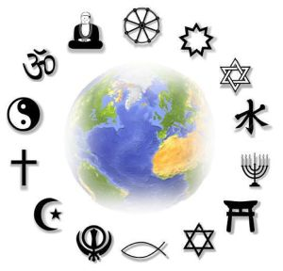
Holmes Chapel Primary School
RE Curriculum

Slide 2

RE at Holmes Chapel Primary School
Intent | To help children acquire and develop knowledge and understanding of Christianity and other principal religions and cultures represented in Great Britain. To learn from those cultures and religions To ask questions about the world and reflect in their own beliefs and values Develop a sense of identity and belonging through self-awareness and reflection Promote respect and open mindedness towards others of different faiths, beliefs, values and lifestyles. The above should be inclusive and accessible to all children. Through the key questions and themes the children experience an enquiry based RE curriculum, covering the major world faiths, and each year their knowledge and understanding of each faith is built on. The children are encouraged to share their experiences and relate the experience of others to their beliefs and lives. Cheshire East state that the RE curriculum should reflect that the religious traditions in Great Britain are in the main Christian while taking into account the teaching and practises of other principal religions represented in Great Britain. Academies are free to follow a local Agreed Syllabus if they choose.
Implementation | RE is taught through Discovery RE scheme which provides 59 enquiry modules covering the main faiths in Great Britain, Christianity, Judaism, Islam, Hinduism and Sikhism. Christianity is taught in every year group with Christmas and Easter taught each year progressively to develop children’s learning, so previous learning is built upon. This reflects and promotes the diversity of our country, our village, our school and individual classes. Using this scheme encourages big questions, enhances critical thinking and evaluation skills, supports spiritual development and equips the children for a world of diversity. The scheme adopts the enquiry approach in line with Ofsted recommendations. By following this scheme and working in this way, the children’s cultural capital will greatly increase. The Discovery Scheme closely follows the Agreed Syllabus for Cheshire set out by the local SACRE and every locally agreed syllabus must reflect that the religious traditions of Great Britain (which are in the main Christian), while taking account of the teaching and practices of the other principal religions represented in Great Britain.
Impact | Assessment is carried out by the teacher throughout a lesson, making judgements based on progress against lesson objectives and final end points. This assessment may be through discussion or a variety of recorded work. End points are used to formulate learning objectives and design activities. Pupils develop their RE knowledge and thinking skills, building on what has been taught before, so they can reach the end points. Teachers also plan self-assessment opportunities in lessons by clear explanation of the learning objectives and the learning outcomes. At Holmes Chapel Primary School, we ensure the children have time and space within the lessons to reflect on their learning as well as identifying next steps. This again may be recorded in their book or through discussion. Assessing is therefore a combination of teacher assessment and pupil self and sometimes peer assessment.

Slide 3
How we teach RE
Engagement/questioning: Children think about how religion feels in their own world. Children’s own ideas and experiences (if any) of different religions. In a diverse society there may be a number of different religions/views in one class.
Enquiry Children to deepen their understanding, make secure connections between faiths, may using an enquiry based approach. It also helps them to utilise higher level thinking skills, involving sustained learning, gathering information and draw conclusions before reflecting. They can extend their initial thoughts. Bloom’s taxonomy to be used to create deeper thinking questions such as What do I need to find out to be able to answer the key questions? How can I show this?
Knowledge base/researching: Develop factual, accurate knowledge of a religion by examining artefacts, answering key questions and listening to members of faith communities to gain a first-hand perspective of what life is like. Visits to explore buildings to gain first-hand experiences similar to the practitioners of the faith. Makes the learning more “real” and come alive rather than book/paper based activities. Use of religious texts and stories as many religious teachings and ideas come from stories related to a particular faith. Use of IT for research
Evaluation: Children discuss what has been learnt from a religion and their response linked to their own beliefs and how they can use that knowledge going forward.
Expression: Children to reflect on differences the study has made to them. Have they changed their views on the aspect studied? Has it made them think more deeply about why/how certain people express their faith?
Religious vocabulary: Children to understand and use the specific and appropriate vocabulary used by all faiths.
Inclusive: Learning accessible to all.

Slide 4





RE at Holmes Chapel Primary School
The RE Curriculum and Fundamental British Values
Democracy | Rule of Law | Individual Liberty | Mutual Respect | Tolerance
In RE, the children are taught to respect each other’s rights to have a say. They learn the significance of each person’s ideas and experiences through discussion. In debating the fundamental questions of life, pupils learn to respect a range of perspectives. | The children learn to respect each other and the classroom they are in. In RE, pupils examine different examples of codes for human life, including commandments and rules offered by different religious communities. They learn to appreciate how individuals choose between good and evil, right and wrong, and they learn to apply these ideas to their own communities. | In RE lessons, the children are encouraged to develop their individual responses/opinions in order to answer key enquiry based questions whilst respecting the religious beliefs of the faith. They also consider questions about identity, belonging and diversity, learning what it means to live freely. | The children are taught how to talk, demonstrating kindness and empathy, founded on mutual respect. The RE curriculum focuses on developing mutual respect between those of different faiths and beliefs, promoting an understanding of what a society gains from diversity. The children learn about diversity in religions and worldviews and how we can show respect to people who see the world differently to themselves. | Our RE curriculum introduces the children to a wide range of religions, beliefs and cultures from around the world. A baseline for a fair community is that each person’s right to ‘be themselves’ is to be accepted by all. RE can challenge children and young people to be increasingly respectful and to celebrate diversity, but tolerance is a starting point.

Slide 5
RE Overview
Year Group | Autumn 1 | Autumn 2 | Spring 1 | Spring 2 | Summer 1 | Summer 2
Reception | Special people | Christmas Diwali | Celebrations |  | Easter | Special places
Year 1 | Religion: Christianity Key question: Does God want Christians to look after the world? | Religion: Christianity Key question: What gifts might Christians in my town have given Jesus if he had been born here rather than in Bethlehem? | Religion: Christianity Key question: Was it always easy for Jesus to show friendship? | Religion: Christianity Key question: Why was Jesus welcomed like a king or a celebrity by the crowds on Palm Sunday? | Religion: Judaism Key question: Is Shabbat important to Jewish children? | Religion: Judaism Key question: Are Rosh Hashanah and Yom Kippur important to Jewish children?
Year 2 | Religion: Christianity Key question: Is it possible to be kind to everyone all of the time? | Religion: Christianity Key question: Why do Christians believe God gave Jesus to the world? | Religion: Islam Key question: Does praying at regular intervals help a Muslim in his or her everyday life? | Religion: Christianity Key question: How important is it to Christians that Jesus came back to life after his crucifixion? | Religion: Islam Key question: Does going to a mosque give Muslims a sense of belonging? | Religion: Islam Key question: Does completing Hajj make a person a better Muslim?
Year 3 | Religion: Sikhism Key question: Does joining the Khalsa make a person a better Sikh? | Religion: Christianity Key question: Has Christmas lost its true meaning? | Religion: Christianity Key question: Could Jesus heal people? Were these miracles or is there some other explanation? | Religion: Christianity Key question: What is good about Good Friday? | Religion: Sikhism Key question: Do Sikhs think it important to share? | Religion: Sikhism Key question: What is the best way for a Sikh to show commitment to God?
Year 4 | Religion: Judaism Key question: How special is the relationship Jews have with God? | Religion: Christianity Key question: What is the most significant part of the Nativity story for Christians today? | Religion: Judaism Key question: How important is it for Jewish people to do what God asks them to do? | Religion: Christianity Key question: Is forgiveness always possible for Christians? | Religion: Judaism Key question: What is the best way for a Jew to show commitment to God? | Religion: Christianity Key question: Do people need to go to church to show they are Christians?
Year 5 | Religion: Hinduism Key question: What is the best way for a Hindu to show commitment to God? | Religion: Christianity Key question: Is the Christmas story true? | Religion: Hinduism Key question: How can Brahman be everywhere and in everything? | Religion: Christianity Key question: How significant is it for Christians to believe that God intended Jesus to die? | Religion: Hinduism Key question: Do beliefs in Karma, Samsara and Moksha help Hindus lead good lives? | Religion: Christianity Key question: Does belief in the Trinity help Christians make better sense of God as a whole?
Year 6 | Religion: Islam Key question: What is the best way for a Muslim to show commitment to God? | Religion: Christianity Key question: Do Christmas celebration help Christians understand who Jesus was and why he was born? | Religion: Christianity Key question: Is anything ever eternal? | Religion: Christianity Key question: Is Christianity still a strong religion two thousand years after Jesus was on Earth? | Religion: Islam Key question: Does belief in Akhirah (life after death) help Muslims live good lives?

Slide 6
What does our learning in RE look like?
Key Stage 1
EYFS RE in EYFS lays the foundations of key concepts of all religions. It links with Understanding of the World and PSE, as well as characteristics of learning and British Values. It starts with the child’s experience. The children learn about special people, celebrations, stories and special places linked to different faiths – Christianity, Judaism, Islam, Hinduism and Sikhism as well as learning about the specific Christian festivals of Christmas and Easter. The concepts of incarnation and salvation will be taught through the key questions “What makes people special?” “What is Christmas?”” How do people celebrate?” “What is Easter?” “What can we learn from stories?” “What makes places special?” The learning is achieved through story, visits, visitors, role play, small world and activities in taught groups and through continuous provision. Key vocabulary is taught throughout the year.
Year 1 The two faiths studied are Christianity and Judaism as the local SACRE/ agreed syllabus sets out that it should reflect the main religions of Great Britain which are in the main Christian, which build on the Jewish tradition. Looking at the key concepts of God, creation, incarnation and salvation. These key concepts build on from EYFS focussing on looking after the world, Jesus as a friend, Jesus as king or celebrity on Palm Sunday, and the importance of Shabbat and Yom Kippur and Rosh Hashanah to Jewish children.
Year 2 In year 2 the children continue to learn, building on previous learning, about the Christian festivals of Christmas and Easter looking at the key concepts of incarnation and salvation answering the key questions “Why do Christians believe God gave Jesus to the world?” “How important is it to Christians that Jesus came back to life after his crucifixion?” This year, the children start to look at Islam to extend their knowledge and experience of other world faiths, which are also represented widely in our country, by answering key questions relating to prayer, the mosque (community) and Hajj.

Slide 7
What does our learning in RE look like?
Key Stage 2
Year 3 In year 3, the children again build on their knowledge of Christianity but also start to learn about either Sikhism. The key concepts of incarnation and salvation are again covered. The children continue to learn about Christmas and Easter and the key questions they cover are “Has Christmas lost its true meaning?” “What is good about Good Friday?” They also learn about Jesus’s miracles asking the key question “Could Jesus heal people and were these miracles or is there another explanation?” These questions help the children to delve deeper into the beliefs of the Christian faith. When Sikhism is studied in year 3, the children will learn about the Amrit ceremony and PSE is linked in the unit on community asking the key question “Sikhs think it is important to share?” They will also learn about Sikh prayer and worship as within our school we have members of the Sikh community.
Year 4 In year 4, the children continue building on their learning about Christianity and Judaism. Again the key concepts are incarnation and salvation. The key questions covered in Christianity are “What is the most significant part of the nativity story for Christians today?” “Is forgiveness always possible for Christians?” and “Do people need to go to church to show they are Christians?” Beliefs and practices of the Jewish faith are studied through the key question “How special is the relationship Jewish people have with God?” “How important is it for Jewish people to ask what God asks of them?” “What is the best way for a Jewish person to show commitment to God?”
Year 5 In year five, the children continue to learn about Christianity and are introduced to Hinduism. The concepts of incarnation and salvation run through the Christianity strand once again. The three key questions asked in the Christianity strand are “Is the Christmas story true?” “How significant is it for Christians to believe God intended Jesus to die?” “Does belief in the Trinity help Christians make better sense of God as a whole? Here the children are challenged to question and delve deeper into the beliefs of Christians. The Hinduism strand asks these key questions: “What is the best way for a Hindu to show commitment to God?” “How can Brahman be everywhere and in everything?” “Do beliefs in Karma, Samsara and Moksha help Hindus lead good lives?”
Year 6 By year 6, the children’s questioning should be well developed as should their critical thinking and evaluation skills enabling them to deal with the key questions from Christianity dealing with the concepts of incarnation, salvation and gospel. They will also be covering deeper questions from Islam related to Jihad which will be covered in a sensitive way. The key questions for the Christianity strand are “Do Christmas celebrations and traditions help Christians understand who Jesus was and why he was born?” “How significant is it that Mary was Jesus’ mother?”” Is Christianity still a strong religion 2000 years after Jesus was on Earth?” “Is anything ever eternal?” The key questions in the Islam strand being “What is the best way for a Muslim to show commitment to God?” “Does belief in Akhirah (life after death) help Muslims lead good lives?”

Slide 8
Reception - Personal, Social and Emotional Development (self-Regulation, Managing Self, Building Relationships)
Children’s personal, social and emotional development (PSED) is crucial for children to lead healthy and happy lives, and is fundamental to their cognitive development. Underpinning their personal development are the important attachments that shape their social world. Strong, warm and supportive relationships with adults enable children to learn how to understand their own feelings and those of others. Children should be supported to manage emotions, develop a positive sense of self, set themselves simple goals, have confidence in their own abilities, to persist and wait for what they want and direct attention as necessary. Through adult modelling and guidance, they will learn how to look after their bodies, including healthy eating, and manage personal needs independently. Through supported interaction with other children, they learn how to make good friendships, co-operate and resolve conflicts peaceably. These attributes will provide a secure platform from which children can achieve at school and in later life.
Learning priorities: Linked to Development matters 2021
Autumn | Spring | Summer
Self-Regulation Talk with others to solve conflicts. Help to find solutions to conflicts and rivalries … fair, agree, turns, together, share How to compromise and negotiate to solve problems Use □ book talk □ puppets □ real life experiences Begin to express feelings and consider the feelings of others Identify and name emotions … emotion, lonely, sad/happy, confident, pleased, frightened, angry, confused, disappointed, nervous/worried, excited Link book character’s emotion to own experiences … expression, mood, feeling/emotion Begin to set own goals and show resilience and perseverance in the face of challenge Set a shared goal with a friend Begin to identify and moderate own feelings socially and emotionally Focus on □ keeping calm □ being patient □ waiting for a turn □ sharing □ tidying up after themselves Managing Self Manage own self-care needs … fasten Independent use of □ zips □ buttons □ coats □ shoes Develop confidence to try new activities and show independence Access all types of enhancements (indoors & outdoors) Know and begin to talk about the different factors that support their overall health and wellbeing: Tooth brushing – importance and how … clean, decay Talk about importance of daily exercise and healthy eating … exercise, healthy / unhealthy, heartbeat, fit Building Relationships Begin to see self as a valuable individual Describe self, positively … proud, special, love (use books: ‘Happy in Our Skin’ & ‘My Hair’) Begin to build constructive and respectful relationships Use social language to develop friendships | Self-Regulation Express feelings and consider the feelings of others Set own goals and show resilience and perseverance in the face of challenge Identify and moderate own feelings socially and emotionally Think about the perspectives of others Managing Self Manage own self-care needs Know and talk about the different factors that support their overall health and wellbeing: □ sensible amounts of ‘screen time’ □ having a good sleep routine □ being a safe pedestrian Building Relationships See self as a valuable individual Build constructive and respectful relationships | Self-Regulation Show an understanding of their own feelings and those of others, and begin to regulate their behaviour accordingly Set and work towards simple goals, being able to wait for what they want and control their immediate impulses when appropriate Give focused attention to what the teacher says, responding appropriately even when engaged in activity, and show an ability to follow instructions involving several ideas or actions. Managing Self Be confident to try new activities and show independence, resilience and perseverance in the face of challenge Explain the reasons for rules, know right from wrong and try to behave accordingly Manage their own basic hygiene and personal needs, including dressing, going to the toilet and understanding the importance of healthy food choices. Building Relationships Work and play cooperatively and take turns with others Form positive attachments to adults and friendships with peers Show sensitivity to their own and to others’ needs.

Slide 9
RE Curriculum Map – Year 1
Term | In this unit of work, pupils learn … Religion/Key Question | End Points
Autumn 1 | Christianity Key question: Does God want Christians to look after the world? | to know the Christian creation story and can talk about it to know how it feels to create something to be able to express an opinion about the Christian belief about creation
Autumn 2 | Christianity Key question: What gifts might Christians in my town have given Jesus if he had been born here rather than in Bethlehem? | Identify a gift that is special to them To know some of the Christmas story To identify a gift they would give to Jesus
Spring 1 | Christianity Key question: Was it always easy for Jesus to show friendship? | To identify reasons they like their friends To know a story about Jesus showing friendship and be able to talk about it To know how Jesus tried to be a good friend
Spring 2 | Christianity Key question: Why was Jesus welcomed like a king or a celebrity by the crowds on Palm Sunday? | To identify a person they admire To know parts of the Easter story and recognise some symbols in the story To begin to show understanding that Jesus is special to Christians and be able to say why
Summer 1 | Judaism Key question: Is Shabbat important to Jewish children? | To identify a favourite day of the week and food I would like to share in a special meal To know the right names of things that are special to Jewish people during Shabbat and explain why To begin to make a connection between being Jewish and decisions about behaviour
Summer 2 | Judaism Key question: Are Rosh Hashanah and Yom Kippur important to Jewish children? | To know how it feels to say sorry and give examples To know what Rosh Hashanah and Yom Kippur are To know why Rosh Hashanah and Yom Kippur are important to Jewish people

Slide 10
RE Curriculum Map – Year 2
Term | In this unit of work, pupils learn … Religion/Key Question | End Points
Autumn 1 | Christianity Key question: Is it possible to be kind to everyone all of the time? | To identify a time when they have been kind to others even when it is difficult To know a story Jesus told about being kind To know the importance of Christians being kind
Autumn 2 | Christianity Key question: Why do Christians believe God gave Jesus to the world? | To know how showing love can help solve a problem To know the Christmas story To know that Christians believe Jesus was a gift from God and explain why
Spring 1 | Islam Key question: Does praying at regular intervals help a Muslim in his or her everyday life? | To know that commitment can be hard and can interrupt what you are doing To know how Muslims pray and begin to explain why they do it To know how praying 5 times a day can help in Muslims’ everyday lives
Spring 2 | Christianity Key question: How important is it to Christians that Jesus came back to life after his crucifixion? | To explain my beliefs about dying and how they remember people close to them To know what Christians believe happened on Easter Sunday To suggest a different explanation as to what happened to Jesus
Summer 1 | Islam Key question: Does going to a mosque give Muslims a sense of belonging? | To understand how meeting in a certain place can give a sense of belonging To know what happens when Muslims pray along or at the mosque To know how Muslims feel a sense of belonging amongst other Muslims and through prayer
Summer 2 | Islam Key question: Does completing Hajj make a person a better Muslim? | To identify and explain a special journey To know some of the events that happen during Hajj and why these are important to Muslims

Slide 11
RE Curriculum Map – Year 3
Term | In this unit of work, pupils learn … Religion/Key Question | End Points
Autumn 1 | Sikhism Key question: Does joining the Khalsa make a person a better Sikh? | To know the significance of an initiation ceremony and the impact it has on belonging To know what happens during a the Amrit ceremony and why a Sikh might choose to do this To compare their own experiences of joining/belonging to a Sikh’s experience of the Amrit ceremony/Khalsa
Autumn 2 | Christianity Key question: Has Christmas lost its true meaning? | To know what Christmas means to them and the significance of giving and receiving gifts To know that Christians believe that Jesus was God in human form and why God gave him to the world To know what Christmas means to Christians
Spring 1 | Christianity Key question: Could Jesus heal people? Were these miracles or is there some other explanation? | To identify some of the things in the world that people think of as miracles To know an example of Jesus’ healing miracles To have an opinion on whether Jesus actually healed people
Spring 2 | Christianity Key question: What is good about Good Friday? | To know how a person might rescue/help others who are in difficult situations To know why Christians believe Jesus’ death was important To have an opinion on Christian’s belief about Jesus’ death
Summer 1 | Sikhism Key question: Do Sikhs think it important to share? | To know why it is important to share even though it is not always easy To know some ways that Sikhs share and know why this is important to them
Summer 2 | Sikhism Key question: What is the best way for a Sikh to show commitment to God? | To know when showing commitment may be difficult To know some of the ways Sikh’s show commitment to God and be able to evaluate these

Slide 12
RE Curriculum Map – Year 4
Term | In this unit of work, pupils learn … Religion/Key Question | End Points
Autumn 1 | Judaism Key question: How special is the relationship Jews have with God? | To understand what an agreement/contract is and express how they would feel if one was broken To know what makes Jewish people believe they have a special relationship with God To know some of the ways Jewish people express their special relationship with God and understand how this makes them feel
Autumn 2 | Christianity Key question: What is the most significant part of the Nativity story for Christians today? | To design a symbolic object to show the significance of Christmas To know one thing a Christian might learn about Jesus from a Christian symbol To ask questions about what Christmas means to Christians and compare this to their own beliefs
Spring 1 | Judaism Key question: How important is it for Jewish people to do what God asks them to do? | to know some of the things Jews do to show respect to God to know how Jews might feel to keep Kashrut
Spring 2 | Christianity Key question: Is forgiveness always possible for Christians? | To know what a Christian might learn about forgiveness from a biblical text To understand how Christians believe God can help them show forgiveness
Summer 1 | Judaism Key question: What is the best way for a Jew to show commitment to God? | To identify some things they are committed to and evaluate their importance To know some of the ways that Jews show commitment to God To express an opinion on which is the best way for Jews to show commitment to God
Summer 2 | Christianity Key question: Do people need to go to church to show they are Christians? | To identify a special place for them and know how it makes them feel To know some of the ways Christians use churches To know the impact a Christian’s special place has on him/her

Slide 13
RE Curriculum Map – Year 5
Term | In this unit of work, pupils learn … Religion/Key Question | End Points
Autumn 1 | Hinduism Key question: What is the best way for a Hindu to show commitment to God? | To know why people show commitment in different ways To know how different practices enable Hindus to show commitment to God and understand their significance
Autumn 2 | Christianity Key question: Is the Christmas story true? | To know that ‘true’ can mean different things to different people To know that incarnation means God in human form (as Jesus) To form an opinion on whether the Christmas story is true
Spring 1 | Hinduism Key question: How can Brahman be everywhere and in everything? | To understand that they have different roles in life but they are still themselves To make links between Hindus belief regarding Brahman and how they lead their lives To express my understanding of how Brahman can/cannot be in everything
Spring 2 | Christianity How significant is it for Christians to believe that God intended Jesus to die? | To identify someone with a strong sense of purpose in their life To explain whether they believe personally that God intended Jesus to be crucified or whether it was a consequence of events during Holy Week
Summer 1 | Hinduism Key question: Do beliefs in Karma, Samsara and Moksha help Hindus lead good lives? | To express own views on life after death To compare Hindu to Christian beliefs relating to life after death and know how these make a difference to believers’ lives
Summer 2 | Christianity Key question: Does belief in the Trinity help Christians make better sense of God as a whole? | to understand the meaning of the word consubstantial to know what the Holy Trinity is and that there is only one God to know the attributes of the 3 persons of the Holy Trinity

Slide 14
RE Curriculum Map – Year 6
Term | In this unit of work, pupils learn … Religion/Key Question | End Points
Autumn 1 | Islam Key question: What is the best way for a Muslim to show commitment to God? | To understand why people show commitment in different ways To know different practices which enable Muslims to show their commitment to God and the significance of these
Autumn 2 | Christianity Key question: Do Christmas celebration help Christians understand who Jesus was and why he was born? | To know that some ways they choose to celebrate Christmas are directly linked to the event and others are not To know how Christians use different celebrations around Christmas to remind them of Jesus’ birth and life To know that people choose to celebrate Christmas in different ways and identify whether these relate to Jesus
Spring 1 | Christianity Key question: Is anything ever eternal? | To identify a situation that they would like to last forever and express their feelings on this To understand the Christian belief of eternity and compare this to their own belief
Spring 2 | Christianity Key question: Is Christianity still a strong religion two thousand years after Jesus was on Earth? | To understand the effect other people can have on them and what they believe to be important To know that people used to believe that Christianity was a strong religion and how that can be challenged today To give their own opinion on whether Christianity is a strong religion now
Summer 1 | Islam Key question: Does belief in Akhirah (life after death) help Muslims live good lives? | To recognise times their choices have been influenced and changed when they considered the consequences that might follow To know how believing in Akhirah influences Muslims to do their best to lead good lives To recognise what motivates or influences themselves to lead a good life and compare it to the Muslim belief
Summer 2

Slide 15
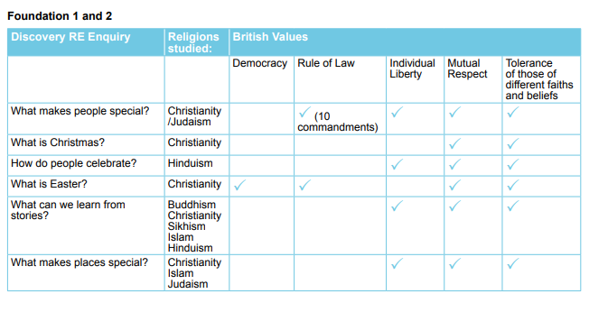
How does Discovery RE support the promotion of British Values?
Specific links between British Values and Discovery RE by Key Stage: Please note for “Rule of Law”, ticks have been added because even though Discovery RE does not teach UK law, it teaches children of the laws of that religion so that they understand what a law might be. As the whole point of any RE curriculum is to promote tolerance of those of different faiths and beliefs and mutual respect, these values are ticked throughout. Because this is a detailed scheme of work (medium term planning), not individual lesson plans, many of the values will be covered or not by the way the teacher/practitioner explains the concepts included and the language used. The ticks below represent the most likely/feasible connections that can be made although the teacher may well be able to make further connections to e.g. individual liberty and democracy by consciously deciding to include them.

Slide 16
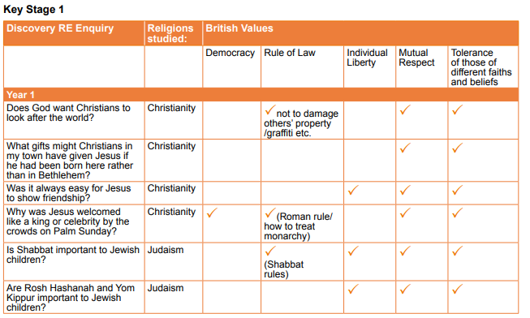
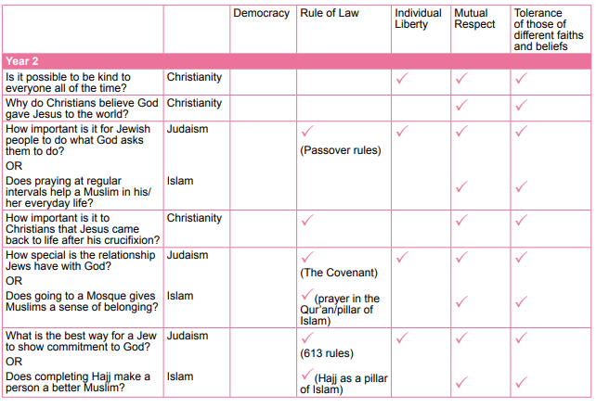

Slide 17
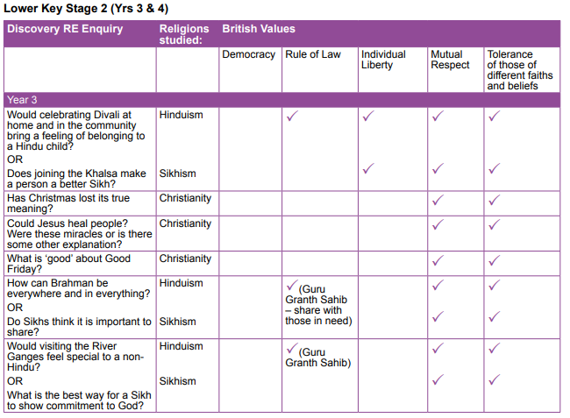
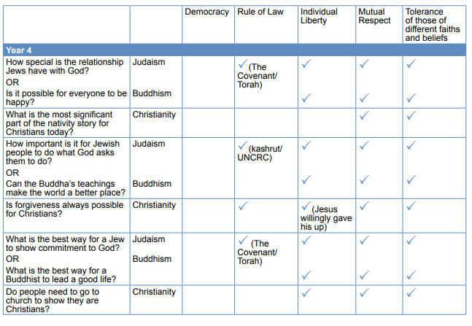

Slide 18
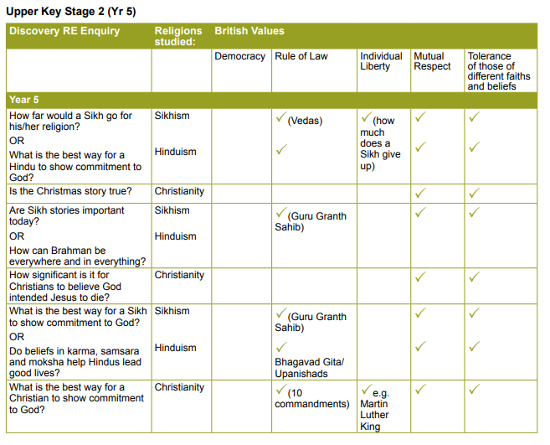
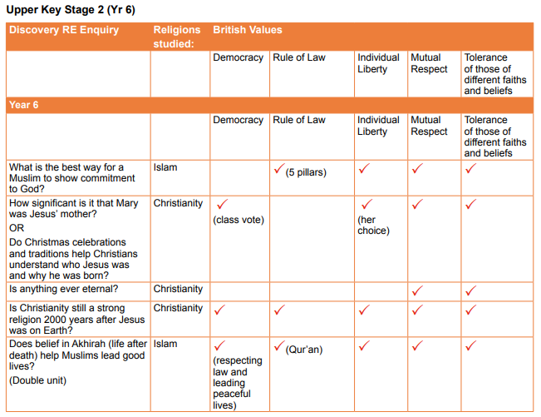

Slide 19
Cheshire East RE expectations cross referenced – Key Stage 1
Cheshire East’s end of key stage expectations | Where HCPS meets this using Discovery RE
Essential Content: Christianity
Recall the main events from the Christmas Bible stories linking these stories with Christianity. For example, put six pictures in order to show what happened on the first Christmas | Reception + Year 1 – Autumn 2
Recall the main events from the Easter Bible stories linking these stories with Christianity. For example, recall and order the five key events that happened during Jesus’ last week on Earth; entry into Jerusalem, Last Supper, arrest, crucifixion, and resurrection | Year 1 +2 – Spring 2
Identify at least four aspects of how Christians celebrate Christmas, Easter, and Baptism, explaining why each event might be important to them. (Use examples from different church traditions). | All year groups – Autumn 1 + Spring 2 (Christmas and Easter) Year 4 – Summer 2 (Baptism)
Talk about who Christians say Jesus is e.g. called the Son of God; God in human form | Year 1 – Spring 2
Explain that the Bible is the Christian holy book (for most Christians) and identify different kinds of genre/writing | Year 1 – Autumn 2
Recognise the features of a church building and identify at least 3 artefacts found in a church explaining why they are important to Christians. (Use examples from different traditions). | Church visit
Describe at least three things a minister/church leader might do. (Use examples from different traditions) | Church visit
Cheshire East’s end of key stage expectations | Where HCPS meets this using Discovery RE
Essential Content: Judaism
Identify that the Torah is a holy book for Jewish people and how the rules in the Torah can guide a Jew in their lives, eg why they believe it is wrong to steal. (Use different interpretations/views) | Year 4 – Autumn 1
Describe some of the things that happen at the synagogue and why Shabbat is important to some Jews. | Year 1 – Summer 1
Describe at least three things a Rabbi might do eg take part in a naming ceremony | Year 1 – Summer 2

Slide 20
Cheshire East RE expectations cross referenced – Years 3 and 4
Cheshire East’s end of key stage expectations | Where HCPS meets this using Discovery RE
Essential Content: Christianity
Explain that most Christians see God as ‘three in one,’ (Father, Son and Holy Spirit known as the Trinity). (Use examples from different traditions). | Year 5 – Summer 2
Explain what Christians can learn about Jesus from the nativity stories, e.g. ‘God with us ‘Emmanuel’ | Year 3 – Autumn 2
Describe and suggest reasons why most Christians call Jesus ‘Saviour’ using references from some key texts studied, eg Creation; The Fall, Christmas; The Story of Zacchaeus and Easter | Year 3 – Spring 2
Explain with reference to the creative arts how God has a salvation plan for humans.
Explain how the Bible is used in the local Church by Christians for guidance, devotion, and inspiration. (Use examples from different traditions). Compare and contrast different Christian places of worship
Compare and contrast ‘infant’ and ‘believers’ baptism’, suggesting why they are important to most Christians | Year 4 – Summer 2
Describe and explain how Christians live their life as disciples. Make a link between: New Testament Bible stories/teaching; examples from local/global church communities and church worship. (Include references to Bible teaching, eg the two most important commandments, love and forgiveness stories, ‘The Parable of the Good Samaritan’, ‘The Parable of the Prodigal Son’, ‘The Parable of the Sower’, ‘The Lord’s Prayer’). (Use examples from different traditions). | Year 2 – Autumn 1 Year 4 – Summer 2

Slide 21
Cheshire East RE expectations cross referenced – Years 3 and 4 (continued)
Cheshire East’s end of key stage expectations | Where HCPS meets this using Discovery RE
Essential Content: Islam
Explain how Muslims describe Allah, eg using 99 names | Year 2 – Spring 1
Know Muslims believe Muhammad (pbuh) to be a ‘messenger of ‘God’, (Prophet of God). (Use examples from different traditions). | Year 2 – Summer 1
Recall five key facts about the story of the ‘Night of Power’ - Muhammad’s (pbuh) first revelation. For example, Muhammad (pbuh) received messages from God; He told everyone that he was speaking words God gave him; people wrote them down exactly; the words later became the Qur’an and afterwards Muhammad (pbuh) became known to all Muslims as the ‘Prophet of God’
Recognise a Qur’an and identify it with Islam. Explain how and why Muslims treat it with respect and many Muslims believe it to be the exact words of ‘Allah’ (God). (Use examples from different traditions). | Year 2 – Summer 2
Make a link between two Muslim artefacts (e.g. Qur’an stand and Prayer mat); fasting during Ramadan and the celebration of Id-ul-Fitr. (Use examples from different traditions). Compare different mosques | Year 2 – summer 1 Year 2 – Summer 2 Year 6 – Autumn 1
Explain how Muslims organisations help people in need. | Year 2 – Summer 2
Cheshire East’s end of key stage expectations | Where HCPS meets this using Discovery RE
Cheshire East’s end of key stage expectations | Where HCPS meets this using Discovery RE
Essential Content: Judaism
Describe three key ways in which Jews celebrate. Explain why at least one festival is important, eg Passover; Yom Kippur or Rosh Hashanah. (Use examples from different traditions). | Year 1 – Summer 2
Explain the key events in a Jew’s life (eg Bat/Bar Mitzvah) and suggest why they are important to Jews | Year 4 – Summer 1
Explain two key aspects of the ‘covenant’ God made with the Jews. Make reference to key texts e.g. Abraham | Year 4 – Autumn 1

Slide 22
Cheshire East RE expectations cross referenced – Years 5 and 6
Cheshire East’s end of key stage expectations | Where HCPS meets this using Discovery RE
Essential Content: Christianity
Explain the roles of ‘Father, Son and Holy Spirit’ (Trinity) in some Christian views of God. (Use examples from different Christian viewpoints) | Year 5 Summer 2 Year 6 Spring 1
Describe why many Christians say Jesus is the ‘Son of God’; the ‘Christ’ and both ‘God and man’. (Use examples from different viewpoints) | Year 5 Autumn 2 Year 5 Spring 2
Identify ways in which some Christians believe the Old Testament prophecies speak about Jesus. | Year 5 Summer 2
Explain how the celebration of Easter links to the idea of Jesus reconciling people to God so that Christians can live forgiven in a relationship with God, (sacrifice and reconciliation). (Use examples from different viewpoints) | Year 5 Spring 2
Suggest answers to questions that the resurrection of Jesus might raise | Year 5 and 6 Spring 2
Identify ways Christians believe God is with them in hard times eg: prayer; worship; peace. (Use different views)
Explain using key texts, (eg parables, miracles, teaching) the Christian idea of the ‘Kingdom of God’ and how Christians seek to live to advance the Kingdom on earth. Example key texts: Beatitudes; The Lord’s Prayer; Jesus’ Temptations; Parables of the Kingdom. (Use examples from different viewpoints)

Slide 23
Cheshire East RE expectations cross referenced – Years 5 and 6 (continued)
Cheshire East’s end of key stage expectations | Where HCPS meets this using Discovery RE
Essential Content: Islam
Identify and understand that Muslims believe the Prophets who came before Muhammad (pbuh) all taught the same message. (Use examples from different traditions).
Explain how majority of Muslims believe that Muhammad (pbuh) is the last and final prophet
Understand many Muslims believe that to have ‘inner peace with God’ humans must follow and submit to Allah’s guidance and will | Year 6 Autumn 1
Explain and assess how all Muslims are part of the ‘Ummah’ by showing how the Five Pillars enable most Muslims to have peace with God. (Use examples from different traditions eg Sunni and Shi’ite) | Year 2 Summer 2
Identify, describe, and explain key Muslim beliefs related to Allah (God); marriage and life after death | Year 6 Summer 1
Describe three ways in which Muslim worship shows devotion to Allah making reference to life at home and in the Mosque. (Use examples from different traditions). | Year 6 Autumn 1
Explain why the Qur’an is so important to Muslims. (use key texts to explain ideas) | Year 6 Summer 2

Slide 24
Cheshire East RE expectations cross referenced – Years 5 and 6 (continued)
Cheshire East’s end of key stage expectations | Where HCPS meets this using Discovery RE
Essential Content: Hinduism
Describe various forms of worship that happen in the Hindu Mandir (Temple), including Puja | Year 5 Autumn 1
Outline some of the stories of Vishnu, Rama and Sita and explain their significance for many Hindu | Year 5 Spring 1
Identify key Hindu Dharma symbols and explain their meaning, eg Aum, Swastika | Year 5 Spring 1
Describe how and suggest why many Hindus celebrate Diwali and Holi. (Use examples from different traditions).
Compare/contrast Hindu ways of welcoming a child with all religious/non-religious views previously studied.
Analyse and evaluate Hindu Dharma beliefs about reincarnation, vegetarianism and caring for the environment | Year 5 Summer 1
Compare and contrast some Hindu Dharma ways of understanding family with other religious/non-religious views about family. (Use examples from different traditions)

