Slide 1

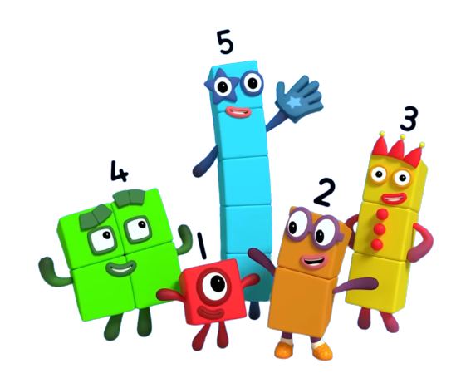
Holmes Chapel Primary School
Maths Curriculum

Slide 2

Maths at Holmes Chapel Primary School
What does our learning in Maths look like?
Intent
At Holmes Chapel Primary School, we follow a curriculum that engineers success using a mastery approach. This enables all children to master the mathematics curriculum through careful curriculum sequencing and small-step progression.
Our aim is to develop a positive mindset of mathematics and ensure depth of conceptual understanding through progressive mathematical fluency, problem-solving and reasoning skills for all children. This helps our children to know more and remember more. Our mathematics curriculum is planned and sequenced using the small step progression unit sequence from the Oak National Academy Curriculum Plans for KS1 and KS2. Children learn to build networks of connections in mathematics by constructing understanding of mathematical ideas and awareness of the relationships between concrete experiences, language, pictures, and mathematical symbols (Haylock and Thangata 2007).
In order to support our continuing development of teaching for mastery, we participate in our local Maths Hub - Cheshire and Wirral. This has supported our school through regular meetings and training. This has informed our vision for maths and has helped to identify areas for us to develop.
Lessons are designed around the NCETM’s Five Big Ideas in teaching for Mastery. Teachers ensure a coherent progression through the curriculum. Representations are used to expose mathematical structure and children use precise mathematical language to describe their thinking. Tasks are carefully planned to ensure concepts are varied to draw attention to critical features. Fluency, the efficient and accurate recall of key number facts is built through recognising relationships and making connections.

Slide 3





Maths at Holmes Chapel Primary School
The Maths Curriculum and Fundamental British Values
Democracy | Rule of Law | Individual Liberty | Mutual Respect | Tolerance
In maths, children often work in pairs and groups which lead to class discussions; children take turns to listen to everyone speak and give their answers and explanations. We take into account the views of others in shared activities. All pupils know that their views count and we encourage everyone to value each other’s opinions and values. | Within maths, there are opportunities to study areas where numerical data (statistics) is part of the rule of law. The children learn how to apply rules in calculations, algebra and geometry. | We provide opportunities for all students to develop their self-knowledge, self-esteem and increase their confidence in their own abilities, for example, through allowing learners to 'take risks' and make mistakes in a lesson and talk through their ideas to help become ‘unstuck’. | Our maths lessons include a lot of ‘maths talk’ where we use our oracy strategies of instigate, build and challenge. Children listen to and ‘build’ on each others’ ideas or ‘respectfully challenge’ if they think something different – children are taught to use this language in their mathematical responses. Children are taught to respect each others’ reviews, which may differ from their own, for example: the best strategy to solve a problem. | Through the curriculum, we can use maths to learn about different faiths and cultures around the world (e.g. looking at patterns/shapes within different religions and the Arabic roots of Algebra).

Slide 4
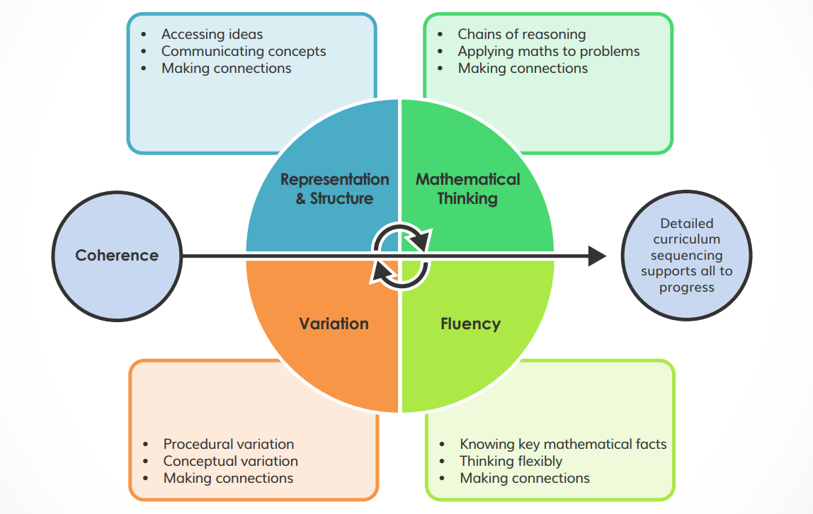
Maths at Holmes Chapel Primary School
What does our learning in Maths look like?

Slide 5
What does our learning in Maths look like?
Implementation
At Holmes Chapel Primary School, we the Oak National Academy maths curriculum to children’s learning. Children are taught in mixed attainment classes and are supported to reason and solve problems throughout their small steps of learning, using the prompts ‘What do you see? (How do you see it?) What do you notice? (Why is that happening?) What do you wonder? (How could you find that out?). Where necessary, adaptations are made to ensure that children can access the same learning as their peers through bespoke manipulatives and representations. Additionally, scaffolding and directed support are used to ensure children are mastering the small steps of progression at roughly the same rate.
We ensure challenge for all children by giving everyone the opportunity to develop fluency and reasoning skills at an appropriate level across a range of contexts, including through targeted questioning. Collaborative learning and dialogic teaching strategies support the use of rich mathematical talk, giving children the opportunity to explore mathematical concepts, resolve mistakes and identify misconceptions with growing independence. Mistakes in maths are valued and celebrated. Unpicking misconceptions so that children evaluate their thinking, and make changes and adaptations to future work, is vital in scaffolding them towards greater independent learning.

Slide 6
What does our learning in Maths look like?
Implementation
Early Maths – EYFS
We understand that every child is unique and will join us in the Early Years with different experiences and at different stages of development. Through Reception, we work towards the end of year Early Learning Goals, which focus on Number and Pattern. Our curriculum is informed by the age related expectations in Development Matters, as well as 'Learning Trajectories’ and the six key areas of early mathematics learning from the NCETM. These provide a platform for everything children will encounter as they progress through their maths learning at primary school.
In Reception, children access their early maths curriculum through the NCETM Mastering Number programme, which aims to secure firm foundations in the development of good number sense, patterns in number, confidence and flexibility.
Maths is taught daily, through whole class teaching. Learning is then consolidated through Continuous Provision activities, which children access through small group sessions, supported by an adult and independent activities where they can apply their learning in different contexts.

Slide 7
What does our learning in Maths look like?
Implementation
SEND
Teachers have high expectations of all pupils, including pupils with SEND, and do not compromise on the requirement for overlearning to ensure automaticity. We strongly believe that all children can achieve in mathematics. Any gaps in learning are identified in a timely manner using the DfE's non-statutory Maths Guidance: key stages 1 and 2, which sets out the essential 'ready to progress’ core criteria for each year group. Whenever possible, gaps are addressed through timely intervention to ensure children start each new unit of learning ‘lesson ready’. Early identification of gaps is a key component of our approach to ensure that where possible children ‘keep-up’ so ‘catch-up’ interventions are not required. Diagnostic assessment tools, such as the Sandwell Early Numeracy Assessment are also used to ascertain the next small steps for the small proportion of pupils progressing outside the age-related expectations of their year group.

Slide 8
What does our learning in Maths look like?
Implementation
Mastering Number
We use the Mastering Number for Reception, KS1 and KS2 materials across school to secure firm foundations and develop good number sense for all children across school. All children participate in lessons, which are taught outside of the main maths lesson for 10 to 15 minutes, on four days each week. In these short sessions, children are encouraged to notice, explore and explain patterns and connections they see when exploring mathematical concepts.

Slide 9
What does our learning in Maths look like?
Implementation
Assessment
Before children start a new unit of learning, they will complete a pre-assessment using the ‘example assessment questions’ from the previous year/unit from the Maths Guidance: key stages 1 and 2. This will focus on the essential skills, knowledge and understanding that children need from the previous year group(s) to enable the teacher to ascertain the starting points and any gaps in knowledge so that all children are ready to progress onto the new learning.
At the end of the unit, children will complete a post-assessment using the ‘example assessment questions’ from the current year/unit. This will be used to provide pupils with information about their performance during the assessments, with the goal of helping them to improve their learning and as an opportunity for teachers to find out what a child can and cannot do or does and does not know as a tool to inform future ‘keep-up’ interventions.
Children are then assessed at the end of each academic year, on all key areas from the Maths Guidance: key stages 1 and 2 for their year group.

Slide 10
What does our learning in Maths look like?
Implementation
The rationale behind our mathematics curriculum is based upon guidance from:
The Education Endowment Foundation Improving Mathematics in Early Years and Key Stage 1 and Improving Mathematics in Key Stage 2 and 3
The Ofsted Research Review of Mathematics Research review series
The Department for Education non-statutory for the National Curriculum Mathematics guidance: key stages 1 and 2
The National Centre for the Teaching of mathematics (NCETM) Home | NCETM
A Typical Lesson at Holmes Chapel Primary School
Lessons are underpinned by three key principles:
They are connected: New learning happens when linked to prior knowledge
Learning is chunked: Information is provided in small steps to minimise cognitive load and to maximise understanding and retention
Teaching is clear: Language used is clear and this is essential to ensure pupils understand and remember concepts.
A typical daily lesson would take approximately one hour and would contain some, or all of the following elements on the next slide.

Slide 11
What does our learning in Maths look like?
Our lessons are structured around the Oak National Academy learning cycles. Lessons begin by Connecting to prior knowledge, and then Exploring a key representation to introduce the small step. This is then followed by the learning cycle and each learning cycle covers several phases: Explain, Check, Practice and Feedback. Each learning cycle teaches one small step in learning. In most lessons we will move through 2 learning cycles (small steps). They become part of our daily lesson structure.
Connect– building new knowledge onto prior knowledge. At the beginning of the lesson, teachers will use an Oak National Academy starter quiz to enable all children to retrieve information from their long-term memory, linking previously taught vocabulary, representations and models to new learning.
Explore–A low floor-high ceiling task which provides an entry point for all learners to access the new learning. A representation is displayed, and all children are encouraged to share their ideas through careful use of ‘what do you see?’, ‘What do you notice?’ and ‘What do you wonder?’ questioning.
Explain– This involves explicit teaching, explaining the new learning in small steps, minimising cognitive load. Teachers use the Oak National Academy slide deck, concrete manipulatives and questioning to reveal new learning.
Check – Throughout the lesson, teachers regularly check for understanding and address misconceptions.
Practice– This is an opportunity for pupils to apply and consolidate their learning and helps to commit new knowledge and skills to memory. Teachers use the Oak National Academy tasks, activities and questions to provide children opportunities to demonstrate their learning
Feedback– In this part of the lesson, children are provided with information about their performance on a task or activity, with the goal of helping them improve their learning. It is an opportunity to find out what a child can and cannot do and allows us to adapt our teaching to support all learners.
Debrief– Using the summary slide from the Oak National Academy slide deck, we consolidate learning and agree generalisations. We may also use an exit quiz to ensure children have learnt what was intended.

Slide 12
Maths at Holmes Chapel Primary School
What does our learning in Maths look like?
Impact
At Holmes Chapel Primary School, our pupils will:
become fluent, competent and efficient mathematicians.
have the ability to recall facts and procedures, including the recollection of times tables.
have the ability to recognise relationships and make connections and patterns in maths.
have the ability to clearly explain their reasoning and justify their thought processes.
have the flexibility to move between different contexts and representations of maths.
have the skills, knowledge and confidence to unpick and solve problems.
have high aspirations, which will see them through to further study, work and a successful adult life.

Slide 13
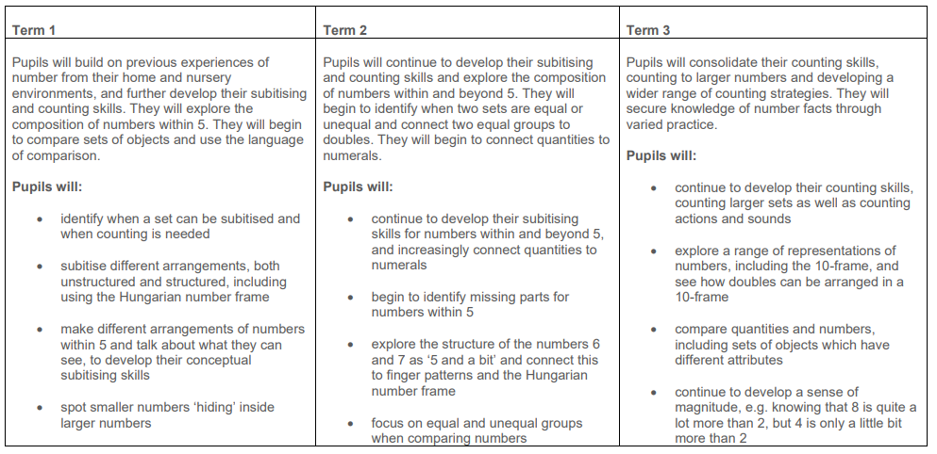
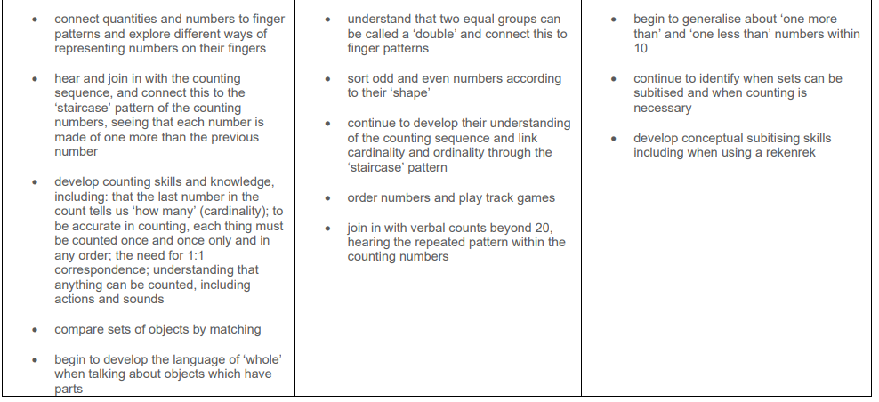
Maths Long Term Overview
EYFS

Slide 14
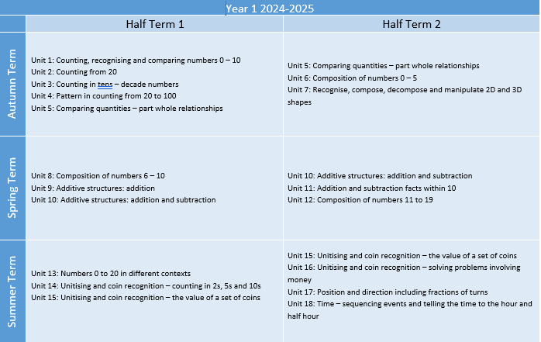
Maths Long Term Overview
Year 1

Slide 15
Maths Curriculum Overview
Year 1
Number and Place Value | Number Facts | Addition & Subtraction | Geometry | Other Topics
Counting within 100 Comparing quantities What is a part? What is a whole? Numbers 0-5 Numbers 0-10 Numbers 0-20 (teen numbers) Compose numbers 20 – 100 Find numbers to 20 on a number line Use < , > , = | Addition and subtraction facts within 10 Count forwards and back in 2s, 5s and 10s. Odd and even numbers | Compose numbers to 10 from two parts Partition numbers to 10 into parts Recognise odd and even numbers | 2D and 3D shapes Recognise shapes Make shapes Find shapes within shapes Manipulate shapes | Position and direction Time

Slide 16
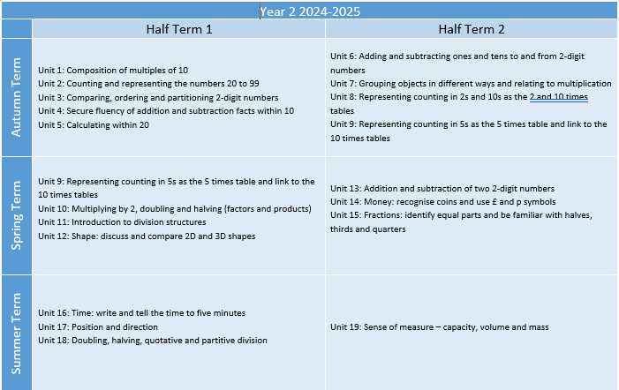
Maths Long Term Overview
Year 2

Slide 17
Maths Curriculum Overview
Year 2
Number and Place Value | Number Facts | Addition & Subtraction | Multiplication & Division | Geometry | Other Topics
Numbers 10-100 Multiples of 10 Compose and decompose 2 digit numbers in different ways Locate 2 digit numbers on a number line Identify previous and next multiples of 10 | Fluently add and subtract within 10 | Add and subtract across 10 Find the difference Find ‘how many more?’ Add and subtract within 100: Add/subtract ones to/from any 2 digit number Add/subtract tens to/from any 2 digit number Add two 2 digit numbers Subtract two 2 digit numbers | Represent equal groups Times tables: 2, 5, 10 Doubling and halving Use division to find a missing factor Quotitive and partitive division | Describe 2D and 3D shapes Reason about the similarities and differences of shapes | Money Fractions Time Position and direction Sense of measure (capacity, volume and mass)

Slide 18
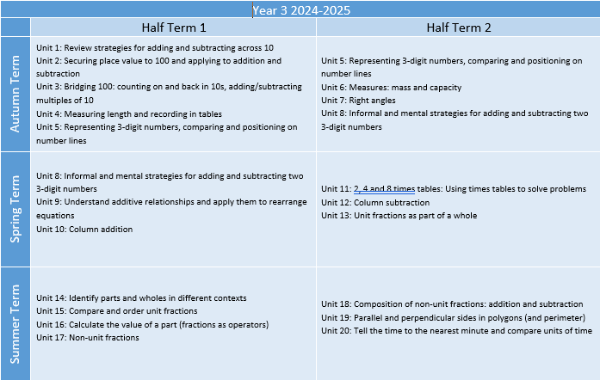
Maths Long Term Overview
Year 3

Slide 19
Maths Curriculum Overview
Year 3
Number and Place Value | Number Facts | Addition & Subtraction | Multiplication & Division | Fractions | Other Topics
Numbers to 1000 Know 10 tens are equivalent to 100 and other equivalences Compose and decompose 3-digit numbers Locate numbers on a number line Divide 100 into 2, 4, 5 and 10 parts | Add and subtract across 10 Calculate compliments to 100 Use known addition and subtraction facts to calculate Recall multiplication and division facts in the 10, 5, 2, 4 and 8 times tables. | Understand that addition is the inverse of subtraction and subtraction is the inverse of addition Securing mental calculation strategies Add and subtract up to 3-digit numbers using columnar methods | 2, 4, 8 times tables Solve multiplication and division problems with different structures (partitive and quotitive) Understand terms ‘product’ and ‘multiple’ Recall facts in 10, 5, 2, 4 and 8 times tables Use known facts to extend multiplication and division | Unit Fractions: Interpret and write fractions which are one part of a whole Find fractions of quantities Non-unit Fractions: Interpret and write fractions which are several parts of a whole Add and subtract fractions with the same denominator (within 1) | Parallel and perpendicular lines Drawing and describing polygons Right angles Time

Slide 20
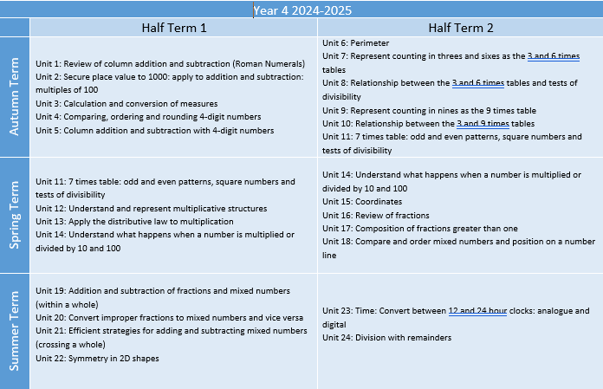
Maths Long Term Overview
Year 4

Slide 21
Maths Curriculum Overview
Year 4
Number and Place Value | Number Facts | Addition & Subtraction | Multiplication & Division | Fractions | Other Topics
Numbers to 10,000 Know that 10 hundreds are equivalent to 1,000 and other equivalences Compose and decompose 4-digit numbers Locate 4-digit numbers on a number line Round numbers to the nearest 1,000 and 100 Divide 1,000 into 2, 4, 5 and 10 equal parts Read scales | Times tables: 3, 6, 9 and 7 Use known addition, subtraction and multiplication facts to calculate Recall multiplication and division facts up to 12 x 12 | Add and subtract up to 3-digit numbers using columnar method | Times tables: 3, 6, 9 and 7 Recall multiplication and division facts up to 12 x 12 Multiply and divide whole numbers by 10 and 100 Understand the commutative and distributive properties of multiplication Division with remainders | Interpret and write fractions which are one or several parts of a whole Fractions greater than 1: Locate mixed numbers on a number line Convert mixed numbers to improper fractions Add and subtract improper fractions and mixed numbers with the same denominator | Identify regular polygons Find the perimeter of regular and irregular polygons Identify lines of symmetry in 2D shapes Reflect shapes in a line of symmetry Complete a symmetric pattern Time

Slide 22
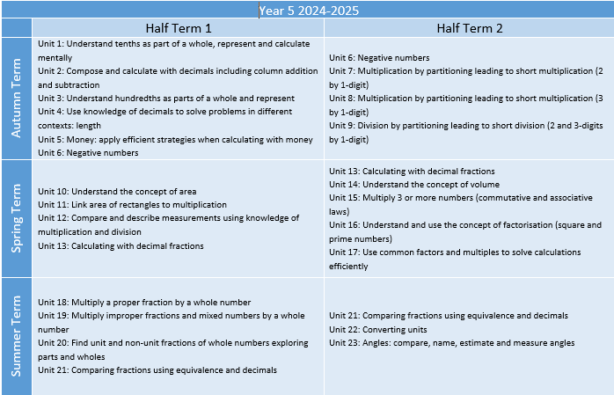
Maths Long Term Overview
Year 5

Slide 23
Maths Curriculum Content
Year 5
Number and Place Value | Number Facts | Addition & Subtraction | Multiplication & Division | Fractions | Other Topics
Decimal fractions Know that 10 tenths are equivalent to 1 one and other equivalences to hundredths Compose and decompose numbers with up to 2 decimal places Locate numbers with two decimal places on a number line Round numbers to the nearest 1 and 0.1 Divide 1 into 2, 4, 5 and 10 into equal parts | Use known addition, subtraction and multiplication facts to calculate | Addition and subtraction of money | Multiply a whole number with up to 4 digits by a 1 digit number using written method Multiply and divide numbers by 10 and 100 Interpret remainders Find factors and multiples of whole numbers Find common factors and common multiples | Find non-unit fractions of quantities Find equivalent fractions and position them on a number line Recall decimal fractions for ½ , 1/3, ¼ and 1/10 and multiples of these proper fractions. | Calculate the area of rectangles Use measure and comparison to understand scaling Convert between units of measure, including using common decimals and fractions Count, compare and calculate with negative numbers Compare, estimate and measure angles in degrees Draw angles of a given size

Slide 24
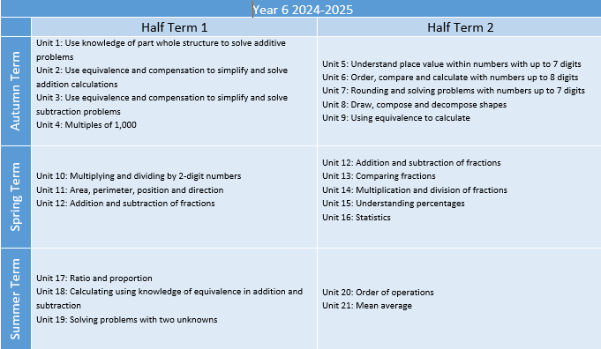
Maths Long Term Overview
Year 6

Slide 25
Maths Curriculum Content
Year 6
Number and Place Value | Addition, Subtraction, Multiplication & Division | Fractions | Geometry | Other Topics
Numbers up to 10,000,000 Understand the relationships between powers of 10 Compose and decompose numbers to 10 million Locate numbers up to 10 million on a number line Round numbers Multiples of 1,000 up to 1,000,000 Divide powers of 10 into 2, 4, 5 and 10 equal parts Read scales | Understand the relationships between addition and multiplication Use the part-part whole strategy to understand structures of multiplication and addition Derive related calculations Use equivalence and compensation to calculate Multiplying larger numbers Divide by 2-digit divisors Solve problems with two unknowns Combine multiplication and division with addition and subtraction | Simplify fractions Compare fractions Find common denominators Add and subtract fractions Multiply and divide fractions by a whole number Connect fractions, decimals and percentages | Draw shapes according to their properties Area and perimeter Angles | Statistics Ratio and proportion Mean averages

