Slide 1

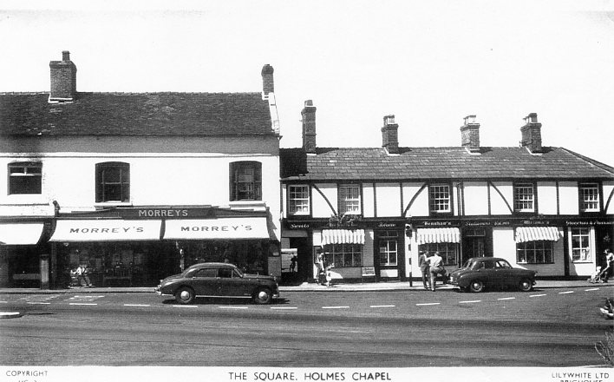
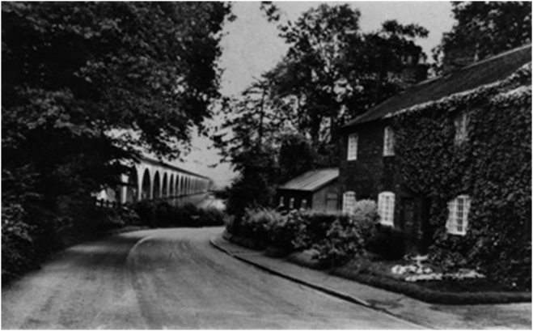
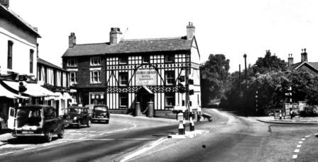
Holmes Chapel Primary School
History Curriculum

Slide 2

History at Holmes Chapel Primary School
Intent | At Holmes Chapel Primary School, we aim for all our children to develop a love of history and to be inspired, curious and knowledgeable about the past. Through rich memorable historical learning experiences, our children develop an understanding of their locality, its place within history and they gain a coherent knowledge about Britain’s past and that of the wider world. Children discover how people’s lives have shaped the nation and how Britain has influenced and been influenced by the wider world. Through working as historians, and knowing how historians work, our children develop independence to ask and answer historically valid questions; think critically about changes, causes and consequences and they use a range of sources of evidence from the past, to make comparisons and give reasons for their own opinions using historical vocabulary. Children also apply their deepening knowledge and understanding of local, British and world history by creating their own structured historical accounts, including written narratives within and across historical periods studied.
Implementation | Children are encouraged to work as historians, through exposure to a variety of sources – including visits and fieldwork - developing their ability to ask perceptive questions, critically interpret and question the past, and understand the chronology of events in Britain and the wider world. As children move through school, they begin to recognise that different things were happening in different places in the world at the same time. Every unit of work includes a focus on chronology, to help children understand where the period of history they are studying fits within their knowledge to date of the past. We use an enquiry-based approach through which they are taught key historical knowledge in a variety of ways. First hand sources, or where not possible replicas or pictures are used in all units of work to support the children in being historians, developing the skills to find out about the past. Children learn and explicitly use key historical vocabulary which is planned and developed with regular opportunities to be revised and reapplied. Cross-curricular learning, where appropriate, is implemented in order to support and deepen historical knowledge. Children are challenged to undertake high quality research using a range of mediums and present their findings confidently, both orally and in exercise books. They gain an ability to think, reflect, debate, discuss and evaluate the past by formulating and refining questions and lines of enquiry.
Impact | Children will understand and be able to demonstrate the skills needed to work as a historian by: using historical vocabulary orally and in writing; interpreting and evaluating sources of evidence; constructing arguments and giving valid reasons to support opinions. Pupils will be able to talk about and share their learning which will provide the subject leader with the information required to measure historical knowledge and understanding and the application of core vocabulary. Pupils’ work, in written and photographic forms, will demonstrate children’s knowledge of historical periods studied and their understanding of historical concepts. This evidence is used to inform teacher assessment, both formative and summative, and the subject leader as part of the monitoring process.

Slide 3





History at Holmes Chapel Primary School
The History Curriculum and Fundamental British Values
Democracy | Rule of Law | Individual Liberty | Mutual Respect | Tolerance
Democracy is learnt through a historical lens as the children explore the impact of change over time by considering local, national and global issues. We encourage a democratic classroom where all children have an equal right to be heard. The children gain an understanding of the concept of fairness, they learn to consider different perspectives and respect the views of others. | Our children explore the rule of law through cause and effect. Opportunities enable them to learn about laws that were created as a result of a historical event and past civilisations. They use a range of sources and reflect upon why historical accounts may differ and evaluate the views of opposing sides. The children also gain an understanding about how this value was fundamental in the past and why it is in society today. | In History, the children compare similarities and differences between their lives and those of others. By using a range of historical sources of evidence, they learn to consider how the actions of people impact on others. They find out about significant people and historical role models who stood by their beliefs. Through discussion and debate, the children learn how to voice their opinion in a safe and supportive environment. | Our children learn the value of mutual respect by expressing their own opinions and beliefs about different historical periods of time. Opportunities enable them to explore different views through narrative, debate and discussion. They are guided and encouraged to show respect to each other’s beliefs, feelings and opinions and share these, with the expectation that they must be listened to. | Tolerance is fostered throughout the history curriculum. The children have opportunities to discuss identity and belonging when learning about different beliefs throughout historical time periods. They learn to understand other viewpoints, make comparisons and consider the impact on the lives of people in past societies.

Slide 4
Substantive Threads and Historical Concepts
Substantive threads are taught explicitly, where appropriate, within the periods of history studied: Homes and Settlements Trade and Transport Innovations and Achievements Governance
Historical concepts are taught and progressively embedded within each year group: Continuity and Change Cause and Consequence Similarity and Difference Significance Evidence and Interpretation

Slide 5
Early Years Curriculum
Historical significance of people, places and events Legacy and Impact (what changed as a result of… | Chronological understanding (Where does it fit in time?) | Historical Enquiry (How do we know?) Sources Evidence and Interpretation | Similarity and Difference Change and Continuity | Vocabulary
Recognise and describe special times or events for family or friends | Understand chronology within their own living memory Order and sequence familiar events | Compare and comment on images from the past Ask appropriate questions based on own knowledge | Comment on images of familiar situations in the past Talk about their immediate family and begin to understand what the past was like Know about similarities and differences between themselves and others | Long ago Same/ different Change People Lives Past/ now Modern Old New Yesterday Discuss
Early Years Themes
Autumn Term | Spring Term | Summer Term
Marvellous Me Fabulous Festivals Explore family links How we change as we grow Family tree Guy Fawkes Black History Month Remembrance Toys from the past (Christmas) | Space and Sky Julia Donaldson Chinese New Year Moon landing | Journeys The Olympics (including transport) The history of the Olympics How transport has changed over time

Slide 6
Key Stage 1 Curriculum
Year 1
Areas of Study | Key Vocabulary
Local Study- Changes within living memory: Holmes Chapel and Houses Over Time | People, lives, way of life, home life, parents, grandparents, great grandparents, transport, materials, leisure
Significant historical events, people, places beyond living memory: The Great Fire of London | London, Houses of Parliament, fire, Pudding Lane, bakery, St Paul’s Cathedral, Samuel Pepys, water, firebreak, extinguish Local, buildings, architecture
Changes over time nationally: Homes and life in London
Year 2
Areas of Study | Key Vocabulary
Local Study- A Famous Landmark The History of Jodrell Bank (invented by Sir Bernard Lovell). | Explorer, voyage, journey, navigate, discovery, space, rocket, achievements, experience
Significant historical events, people, places beyond living memory: The lives of Children During World War 2 | World War 2, government, allies, evacuation, evacuee, The Blitz, blackout, bombing, rationing,
Vocabulary | History, past, present, change, now, modern, old, new, same, similar, different, order, compare, significant, timeline, order, artefact, fact/opinion, event, source, evidence, invention, question, cause, consequences, reason, connections, century, decade, living memory, periods of time

Slide 7
Year 1
Chronology | Enquiry and Interpreting | Knowledge and Understanding
Recount past changes from their own lives Sequence events in chronological order | Find out about the past- using pictures, stories, online sources and artefacts Begin to ask and answer simple questions using historical sources | Identify/name key events and people Begin to describe similarities and differences between then and now (using pictures, artefacts and other historical sources)
Changes within living memory: Holmes Chapel and Houses Over Time | Significant historical events, people, places beyond living memory: The Great Fire of London | Changes over time nationally: Homes and life in London
Know and be able to recount key events from within and before living memory Understand a timeline that lists significant events in chronological order Know about and describe similarities and differences of houses over time | Know how the Great Fire of London started, spread and was put out, and why it lasted so long Name key events (1666) and people Know why some houses/companies had a fire mark Know about the similarities and differences of equipment and resources used to fight the fire Know what changes happened in London as a consequence of the fire | Know about the similarities and differences of homes and life in the past and present and how they have changed over time Know about the similarities and differences of household items between the past and present day

Slide 8
Year 2
Chronology | Enquiry and Interpreting | Knowledge and Understanding
Place historical figures, events and artefacts in order on timelines Begin to use dates and labels on timelines | Find out about the past using artefacts, pictures, stories, online sources and databases Begin to ask and answer relevant historical questions | Give reasons why people from the past acted in the ways they did Describe similarities and differences between then and now using information gained from sources
Significant historical events, people, places beyond living memory The lives of children during WW2 | The lives of significant individuals who have contributed to national and international achievements Local Study- A Famous Landmark The History of Jodrell Bank (invented by Sir Bernard Lovell).
Know about what life was like during the 1940s and 1950s and how it was impacted by significant events of the time Know key facts about World War 2 Know about what it was like to be a child during the war, particularly those who were evacuated, and how they kept safe during The Blitz Know about how information about the war was shared Know about life in post-war Britain | Know when Jodrell Bank was first built and what Holmes Chapel looked like during this time Know what Jodrell Bank is used for and why it is a famous landmark Know when the first telescope was invented and how it has changed overtime Know who Bernard Lovell is and why he is a significant person Know how some innovations have changed from the past to the present day

Slide 9
Lower Key Stage 2 Curriculum
Year 3
Areas of study | Key Vocabulary
Changes in Britain from the Stone Age to the Iron Age 3000 BC – 750 AC | Paleolithic, hunter-gatherers, Mesolithic, Neolithic, farmer, deforestation, Skara Brae, Bronze Age, hill fort, tribal kingdoms, settlement, craftsman, weapons, tools Civilization, irrigation, mummification, pyramid, slave, pharaoh
Ancient Egypt: The achievements of the earliest civilisations, an overview of where and when the first civilisations appeared.
Year 4
Areas of study | Key Vocabulary
Ancient Greece Study of Greek life and achievements and their influence on the Western World. | Western world, democracy, philosophy, Olympic Games, Athens, Parthenon, acropolis
The Roman Empire and its impact on Britain. | Julius Caesar, Claudius, invasion, conquest, resistance, Boudica, Romanisation, hypocaust, viaduct, aqueduct, gladiator, coliseum, amphitheatre, Hadrian’s Wall
Vocabulary | As per KS1, plus – chronological, millenium, prehistoric, ancient, archaeology, influence, trends over time, impact, settlement, landscape, architecture, trade, art and culture, dynasties, empire, climate, worship, sacrifice, temple, leisure, prosperity, wealth, myth, legend, conquer, power, peace, worship, technology

Slide 10
Year 3
Chronology | Enquiry and Interpreting | Knowledge and Understanding
Use dates to place historical figures, events and artefacts in order on timelines | Use various sources of historical evidence to find out about the past Ask and answer relevant historical questions Begin to give reasons for opinions (using historical evidence) Begin to compare historical sources of evidence | Describe features of periods studied eg clothes, beliefs, homes, attitudes Describe similarities and differences between people, events and actions over time
Stone Age to the Iron Age How did Britain change during this period? | Ancient Egypt What were the achievements and how did they impact on Egyptian lives and the wider world?
Know what life might have been like for people during the Stone Age Know about the most important aspects of living in the Bronze Age (religion, technology and travel) and how inventions and changes impacted on everyday lives | Know what everyday life might have been like for people in Ancient Egypt Know about Ancient Egyptian lifestyle including architecture, construction techniques, beliefs, technology Know why people settled along the River Nile and how trade and transport affected their lives and the wider world

Slide 11
Year 4
Chronology | Enquiry and Interpreting | Knowledge and Understanding
Begin to add evidence and dates to timelines to show an understanding that changes occur over time Use dates relating to significant events | Use various sources of historical evidence to find out about the past Ask and answer relevant historical questions Give reasons for opinions using historical evidence Make comparisons between historical sources of evidence Explore causes and consequences of main events, situations and changes | Give reasons for the changes in the features of the period studied eg. Clothes, beliefs, homes and attitudes Describe how past events and actions of people affect life today
Ancient Greece How did Ancient Greece influence the Western World? | The Roman Empire How did the Romans impact Britain?
Know what life was like for people living in Ancient Greece Know how Ancient Greek achievements in democracy influenced the rest of the world Know how the legacy of the Olympics has impacted modern day Know some of the differences between the city states of Athens and Sparta | Know the names of significant people who ruled and their achievements Know the reasons for Ancient Romans invading and settling in Britain Know about the invasions and about British resistance Know about tactics and equipment used by the Roman army Know about the impact of and the legacy of Roman culture on later periods in British history (including art, architecture, technology)

Slide 12
Upper Key Stage 2 Curriculum
Year 5
Areas of study | Key Vocabulary
Anglo-Saxons and Scots - What was the impact on Britain of the settlement of Anglo-Saxons and Scots? | Roman, withdrawal, empire, dark ages, invasion, settlements, kingdoms, Christian conversion, Canterbury, Lindisfarne, Sutton Hoo
Vikings - How and why did the Vikings invade Britain? | Viking, raids, invasion, society, resistance, Alfred the Great, Athelstan, Danegeld, Edward the Confessor
Baghdad c.AD900 A non-European Society – which provides contrasts with British history | Islam, Prophet Muhammad, Muslim, mosque, caliphs, Golden Age, astrolabes
Year 6
Areas of study | Key Vocabulary
Local study – Transport (With a focus on the influences of transport developments.) How has Holmes Chapel changed over time? | Merchant, Industrial Revolution, commerce, modes of transport, trade, economy, settlement, port, trade routes
Vocabulary | As per lower KS2, plus – cause and effect, propaganda, bias, society, empire, point of view, objectivity, subjectivity, legacy, modern British values, perspective, judgement, symbolic, social history, community, economy, expansion

Slide 13
Year 5
Chronology | Enquiry and Interpreting | Knowledge and Understanding
Add evidence and dates to timelines to show an understanding that change and continuity occurs over time Identify significant changes within and across historical periods | Begin to independently select and use reliable sources of historical evidence to find out about the past Ask and answer relevant historical questions and give reasons for opinions Use given sources to support a viewpoint Compare historical sources and begin to form opinions about historical events Describe causes and consequences of main events, situations and changes | Begin to use evidence to show an awareness of social, cultural, religious and ethnic diversities of societies studied in Britain and wider world Identify links and changes within and across the time periods and localities studied
Anglo-Saxons and Scots What was the impact on Britain of the settlement of Anglo-Saxons and Scots? | Vikings How and why did the Vikings invade Britain? | Baghdad c.AD900 A non-European Society – which provides contrasts with British history
Know where the Angles, Jutes, Frisians came from and in which parts of England they settled Know and describe what life may have been like in Anglo-Saxon Britain | Know about Viking raids and invasion Know about the daily life of Vikings, the structure of their society and beliefs Know about the resistance of Alfred the Great and Athelstan Know about Anglo-Saxon laws and justice Know about Edward the Confessor and his death in 1066 | Know what life may have been like in Baghdad during the Dark Ages Know about the House of Wisdom it’s innovations and why it was significant in this time period Know what the Silk Road was used for Know how Baghdad’s achievements have influenced the world (past and present)

Slide 14
Year 6
Chronology | Enquiry and Interpreting | Knowledge and Understanding
Use a timeline to identify and related significant changes within and across historical periods and make comparisons Describe and explain key changes in historical periods (begin to refer to political, cultural, social, religious and technological changes) | Independently select and use reliable sources of historical evidence Ask and answer relevant historical questions and give reasons for opinions Independently choose relevant sources to support a viewpoint, and give reasons for choices Independently compare historical sources and begin to form opinions Begin to evaluate the usefulness and accuracy of different sources of evidence Show an understanding that some evidence is propaganda, opinion or misinformation and that this effects interpretations | Use research evidence to show an awareness of social, cultural, religious and ethnic diversities of societies studied in Britain and wider world Explain and evaluate causes and consequences of main events, situations and changes across time periods studied
Local study - Transport (With a focus on the influences of transport developments.) How has Holmes Chapel changed over time?
Know that transport changes over time due to need (related to finance, commerce, people, geography) Know and understand why Holmes Chapel is located where it is and why it has certain modes of transport and not others Know what commodities were transported in and out of Cheshire and the North West, and how salt, cattle and cheese were all affected by different modes of transport (pottery from Staffordshire by canal, first passenger railway from port of Liverpool to Manchester – cotton/textiles) Know the impact of the Industrial Revolution on modes of transport

