Slide 1

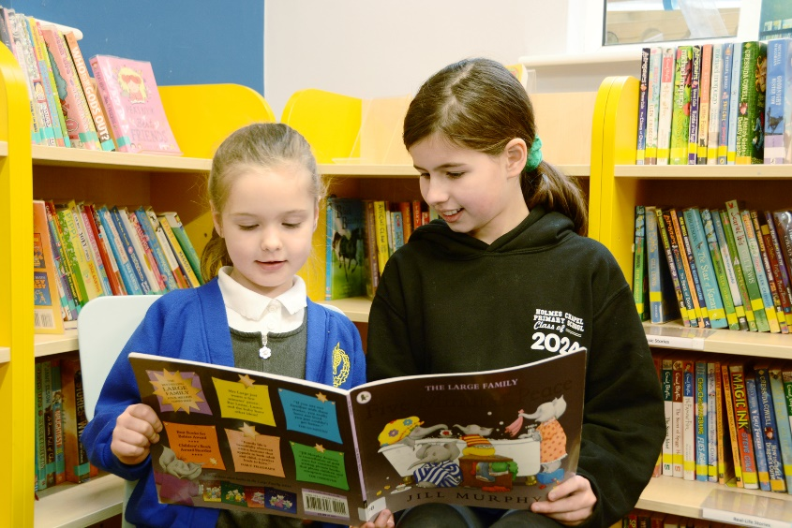
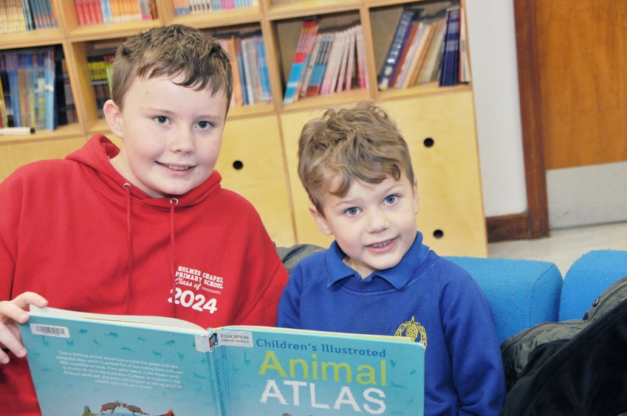
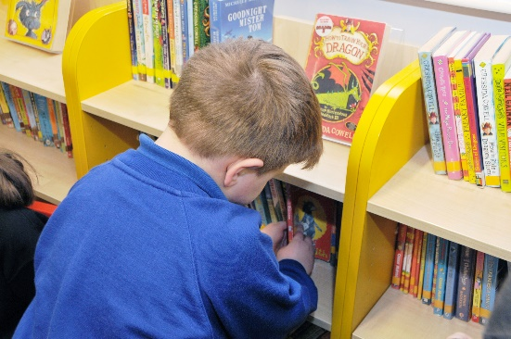
Holmes Chapel Primary School
English Curriculum - Reading

Slide 2

Reading at Holmes Chapel Primary School
Intent | At Holmes Chapel Primary School, we recognise the value of English as a means of communicating through the elements of spoken language, reading and writing. We aim to promote high standards of language and literacy in our children by equipping them with a strong command of the spoken and written word, and develop their love of literature through widespread reading for pleasure and enjoyment. At Holmes Chapel Primary School, we believe that the ability to read is fundamental to pupils’ development as independent learners, during their time at school and beyond. Reading is central to our ability to understand, interpret and communicate with each other and the world around us. Success in reading has a direct effect on progress in all areas of the curriculum; therefore reading is given a high priority at Holmes Chapel Primary School, enabling the children to become enthusiastic, independent and reflective readers across a wide range and types of literature, including different text types and genres, book, posters, magazines, signs and newspapers. Reading is a complex skill with many components. Successful approaches to the teaching of reading should encourage children to use a variety of strategies in their pursuit of meaning. It is important to lay firm foundations in this crucial area of the curriculum and establish a consistent whole school approach to the teaching of reading.
Implementation | Reading at Holmes Chapel Primary School is taught and celebrated in a range of ways. Some of these are generic across the whole school, whilst others are specific to key stages. These may be implemented by the class teacher or support staff. In Key Stage 1 Reading is taught through the Little Wandle Letters and Sounds Revised programme (and throughout Key Stage 2 where required) whilst in Key Stage 2, sequences of lessons from the Just Imagine… Take One Book framework are used to structure whole class reading sessions. Whole class reading also takes place in Year 2. We also aim to develop, through our teaching of reading, the following attitudes: • Curiosity and interest • Pleasure and thoughtfulness • Critical appraisal • Independence • Confidence • Perseverance • Respect for other views and cultures • Reflection • Action and Implementation
Impact | Teachers use the end of year objectives grids to assess children and monitor progress half termly. Teachers use this document as a working document and record/highlight assessment on individuals or groups of children. Year 1 children are assessed against the Governments standardised Phonics Assessment. Year 6 children are assessed against the Governments standardised Reading Test.

Slide 3





Reading at Holmes Chapel Primary School
The Reading Curriculum and Fundamental British Values
Democracy | Rule of Law | Individual Liberty | Mutual Respect | Tolerance
The KS2 reading curriculum provides opportunities for discussions that focus on democracy. Texts are chosen to allow students to refer to issues around democracy. Pupils are taught to respect each other’s rights to have a say when discussing texts. | The KS2 reading curriculum also provides opportunities for discussions that focus on the rule of law. Texts can be chosen to allow students to explore the issue of rule of law and equality. | Group and one-to-one discussions in Reading lessons give the opportunity to discuss the children’s individual liberty. Students will often explore aspects of their own lives and the extent to which they have and use their freedoms when comparing to texts. | In Reading, each year group has a selection of high quality texts which are based on or written by people of a diverse range of backgrounds. | Due to the diverse range of texts, the children learn about different cultures and faiths and what makes everybody different. From these texts, discussions about tolerance and respect take place.

Slide 4
What does our learning in Reading look like?
Phonics
We want children to be able to confidently identify graphemes/phonemes and have the skills to blend them for reading and segment them for spelling. All children should understand that the letters on a page represent sounds in spoken words and ultimately recognition of graphemes and decoding will become automatic and does not require conscious effort. We follow the Little Wandle Letters and Sounds Revised programme and teach children to understand that they need to be able to recognise both the sounds (phonemes) in words and the letters, or groups of letters that make the sounds (graphemes). The children have daily Phonics lessons in Reception and Year 1. These whole-class sessions run alongside daily intervention and practice reading sessions. The children start by learning the single letter sounds, then move on to learning about the more complex digraphs and trigraphs. Little Wandle continues to be taught in Year 2, where fluency and confidence is developed through the practice reading sessions and whole-class phonics sessions.
See Phonics at Holmes Chapel for further information.

Slide 5
What does our learning in Reading look like?
EYFS (Reception) and Key Stage 1
Reading is taught in the following ways:-
Shared Reading, using a big book, text on the interactive whiteboard or sets of texts, with small groups or the whole class
Practice reading of the same text in small groups, including teaching of decoding, prosody and comprehension 3 times a week
Daily Little Wandle phonics lessons
Little Wandle daily phonic interventions for individuals and small groups lead by support staff in each class where needed
High frequency/tricky words in EYFS and Y1 are taught daily as part of the Little Wandle scheme
Reading of texts linked to curriculum work
Story time in which the class teacher or support staff reads to the class
Library visits
World book day involving local authors, booksellers, poets, storytellers and a range of book related activities

Slide 6
What does our learning in Reading look like?
EYFS (Reception) and Key Stage 1
Children encounter a range of reading learning opportunities in school to ensure that fundamental skills are securely in place.
Daily phonics sessions provide a very structured approach (see Phonics at Holmes Chapel). Children are taught in class groups and progress is assessed every five weeks. Whole class teaching also takes place and texts are often used as a stimulus for further English based activities. In practice reading sessions, pupils work in small, adult-led groups to explore texts, building particularly on comprehension and early inference skills. Children take their practice reading book home at the end of the week to share with their family.
In addition pupils read regularly on a 1:1 basis to ensure both accuracy and understanding. Whilst this may be with a teacher or teaching assistant, we are fortunate in that we are supported by a committed team of volunteers comprising parents, grandparents and friends of the school.
Children are encouraged to read at home and take a minimum of three books home a week.
Books taken home include a decodable book linked to the child’s phonetic ability, one extra reading book and one book chosen by your child from the reading corner as a Reading for Pleasure book. For those children who read the Little Wandle practice read books (as informed by their end of unit Little Wandle assessment) there are also e-books available which match the paper copies.
Year 2
A blended approach of Little Wandle phonics (as above) and whole class reading sessions using a range of books and sequences of lessons from the Just Imagine… Take One Book framework (see KS2).

Slide 7
What does our learning in Reading look like?
Key Stage 2
As pupils progress through Key Stage 2, the emphasis switches from decoding skills to developing comprehension and inference skills.
In Key stage 2, reading lessons are whole class taking place three to four times per week. Staff use a range of books and sequences of lessons from the Just Imagine… Take One Book framework to structure their reading sessions. Each unit length is typically three to four weeks, enabling us to develop deeper reading learning for our children by sharing approximately two texts per half term. These lessons enable the children to develop the high levels of inference and understanding needed for secondary school. Pupils also have the opportunity to explore and respond to texts through follow up tasks and activities. Further texts frequently provide a focal point for English work, often linking with ongoing curriculum work. There remains an expectation for children to read at home on a regular basis.
Throughout school, reading resources are regularly reviewed and updated both in class and in the school library. We also borrow from the Cheshire Education Library service. The mobile library visits regularly and children are involved in choosing class collections. Children also enjoy Reading for Pleasure opportunities where they can share books with their teacher and friends. Each year in March we celebrate World Book Day, by enjoying different reading themed activities. We also host twice yearly book fairs which are really popular and well supported.

Slide 8
What does our learning in Reading look like?
Reading for Pleasure
At Holmes Chapel Primary School the active encouragement of reading for pleasure is a core part of every child’s educational entitlement, whatever their background or attainment.
Holmes Chapel Primary School takes the view that extensive reading and exposure to a wide range of texts makes a vital contribution to every child’s educational achievement. Reading for pleasure aims to establish each child as a lifetime reader. Studies show that promoting reading can have a major impact on children, their future and their life chances.
Our classroom libraries encompass the following important functions of an effectively designed classroom book area:
Provide a central location for classroom reading resources Help each child learn about books and the pleasure of reading Provide opportunities for independent reading and curricular extension Serve as a place where each child can talk about and interact with books Support literacy instruction. In order to fulfil these functions, each classroom library will offer a wide range of categories of reading materials | Stories and narrative accounts, e.g. Fairy tales, folk tales, and biographies Picture books with thought-provoking images and examples of artistic talent Short reads and long reads Information books Joke books, comic books, word-puzzle books Internet based texts, accessed via tablets and PCs Children’s own work (within books and displays) Miscellaneous reading materials, such as popular magazines, newspapers, catalogues, recipe books, encyclopaedias, maps, reports, captioned photographs, posters, diaries and letters
Stock is restocked regularly by introducing books from the school library, the Cheshire Education Library service and the library van

Slide 9
What does our learning in Reading look like?
SEN and Equal Opportunities
Those children who, through observations or assessment, are identified as requiring extra support, will be monitored closely by the Class Teacher and the SENCO. Individual interventions will be put in place to support these children. Our policy is monitored to ensure that all pupils have equality of access to a range of reading opportunities and experiences so that all pupils achieve to the best of their potential regardless of gender, race or culture.
Role of Parents and Carers
Parents and carers are strongly encouraged to be actively involved in their children’s reading at all ages, by listening to them read, reading to their children, and by promoting a home environment in which books are valued. They are encouraged to write on their child’s reading record when they have heard them read to support the communication between home and school.

Slide 10
Reading Curriculum Map
Key Stage 1
 | Autumn 1 | Autumn 2 | Spring 1 | Spring 2 | Summer 1 | Summer 2
EYFS | Little Wandle reading texts
Year 2 | Little Wandle reading texts
Year 2 | Little Wandle reading texts Moth by Isabel Thomas Pip and Egg by Alex Latimer | Little Wandle reading texts Once Upon a Raindrop: The Story of Water by James Carter | The Night Gardener by Terry and Eric Fan Grey Island, Red Boat by Ian Beck | Where Do Clothes Come From? by Chris Butterworth | Boundless Sky by Amanda Addison | Message from the Moon and Other Poems by Hilda Offen
Texts selected from Just Imagine…Take One Book framework

Slide 11
Reading Curriculum Map
Key Stage 2
 | Autumn 1 | Autumn 2 | Spring 1 | Spring 2 | Summer 1 | Summer 2
Year 3 | Elisabeth and the Box of Colours by Katharine Woodfine Cinderella of The Nile by Beverley Naidoo | Who’s Afraid of the Big Bad Book by Lauren Child Blue John by Berlie Doherty | Moon Juice by Kate Wakeling The Secrets of Stonehenge by Mick Manning | Our Tower by Joseph Coelho | The Steadfast Tin Soldier by Hans Christian Andersen Extra Yarn by Jon Klassen | Featherlight by Peter Bunzl Water by Catherine Barr
Year 4 | I Ate Sunshine for Breakfast by Michael Holland FLS The Language of Cat by Rachel Rooney | Walter Tull’s Scrapbook by Michaela Morgan Cloud Tea Monkeys by Mal Peet & Elspeth Graham | Hermelin: the Detective Mouse by Mini Grey King of The Sky by Nicola Davies | The Tear Thief by Carol Ann Duffy | Charging About: The Story of Electricity by Jacqui Bailey Wisp by Zana Fraillon | Earth Shattering Events by Robin Jacobs The Fog Catcher’s Daughter by Marianne McShane
Year 5 | The Promise by Nicola Davies | The Song from Somewhere Else by A.F. Harrold Curiosity: The Story of a Mars Rover by Markus Motum | Town is By the Sea by Joanne Schwartz & Sydney Smith Cloud Busting by Malorie Blackman | Floodland by Marcus Sedgwick | Varmints by Helen Ward One Million Insects by Isabel Thomas | The Unforgotten Coat by Frank Cottrell-Boyce William Shakespeare by Mick Manning and Brita Granstrom
Year 6 | A Story like the Wind by Gill Lewis The Story of Captain Nemo by Dave Eggars | Clockwork by Philip Pullman The Snow Goose by Paul Gallico | Beowulf by Kevin Crossley-Holland | Rose Blanche by Ian McEwan | On the Origin of Species by Sabina Radeva Between Worlds by Kevin Crossley-Holland | New and Collected Poems by Carol Ann Duffy
Texts selected from Just Imagine…Take One Book framework

Slide 12
Reading Attainment – End of Year Objectives
Year 1
Enjoying my reading | Reading words | Exploring language | Recounting and summarising | Making inferences | How do writers make you feel? | Comparing with my other reading | Learning by heart | Identifying features and conventions of texts | Talking about my reading
I enjoy listening to a range of stories, poems and non-fiction read to me. | I can use phonics to sound out and blend new words. | I can talk about meanings of words. | I can retell a familiar story e.g. traditional tales and fairy stories. | I can find clues in what has been said and done. | I can explain how the storyline and pictures make me feel. | I can identify similarities and differences between stories. | I can recite some poems and rhymes, including nursery rhymes. | I can recognise and join in with repeated patterns and phrases. | I can link what I have read to my own experiences.
I enjoy reading different books and talking about them. | I can read tricky words and words with one or more syllable, including common exception words. | I can find words with similar meanings. | I can identify the beginning, middle and end of a story. | I can make predictions based on clues from the text. |  |  | I can use actions to learn simple texts off by heart. | I can name and explain different parts of a book. E.g. front cover, page, title, end papers, gutter | I can talk about stories I like and listen to other children’s views.
 | I can read words with –s,-es,- ing,-ed,-er and –est endings. |  | I can tell you about what I have read. |  |  |  |  |  | I can describe my favourite parts of a story.
 | I can read contractions (e.g. I’m, I’ll, we’ll) and understand that the apostrophe stands for the missing letter. |  |  |  |  |  |  |  | I can explain my understanding of a book that is read to me.
 | I can read accurately books that are consistent with my phonic knowledge and re-read these books to build up my fluency and confidence in words reading.

Slide 13
Reading Attainment
Year 2
Enjoying my reading | Reading words | Exploring language | Recounting and summarising | Making inferences | How do writers make you feel? | Comparing with my other reading | Learning by heart | Identifying features and conventions of texts | Talking about my reading
I enjoy listening to a range of stories, classic, contemporary poetry and non-fiction. | I can read fluently and use phonics to decode and blend unfamiliar words. | I can find out what a new word means. | I can retell a range of stories, traditional tales and fairy stories. | I can find clues in what has been said and done. | I can give my opinion about a story, poem or non-fiction text | I can discuss and share my opinions about different texts. | I can learn and recite poetry with appropriate intonation. | I can identify a sequence of events in a book. | I can talk about books and poems that are read to me.
I choose to read different books and enjoy sharing them | I can read tricky words and words with two or more syllables. | I can talk about my favourite words and phrases. |  | I can make predictions based on clues from the text. |  | I can recognise words that are used across different stories and poems |  | I can identify and use the structure of non-fiction books. | I can talk about books and poems that I have read.
 | I can check that the text makes sense as I read and make corrections. | I can begin to use dictionaries to check the meaning of words I have read with support. |  |  |  |  |  |  | I can ask and answer questions about my reading.
 | I can identify and read words with common suffixes and common exception words.

Slide 14
Reading Attainment
Year 3
Enjoying my reading | Reading words | Exploring language | Recounting and summarising | Making inferences | How do writers make you feel? | Comparing with my other reading | Learning by heart | Identifying features and conventions of texts | Talking about my reading
I can enjoy listening to, reading and discussing a wide range of fiction, poetry, plays, non-fiction and reference books. | I can use my knowledge of decoding to read unfamiliar words, including further exception words. | I can use dictionaries to check the meaning of words I have read with support. | I can retell a wider range of stories orally. E.g. fairy stories, myths and legends | I can infer a character's feelings, thoughts and motives through their actions. | I can give my opinion on a story, poem or non-fiction text. | I can compare texts that are structured in different ways. | I can prepare poems to read aloud and perform using intonation and visual expression. | I can identify common themes in a wide range of books. | I can participate in discussion about books that are read to me.
I can read a range of books, including fairy stories, myths and legends, and retelling some of these orally with increasing familiarity. | I can apply my knowledge of root words, prefixes and suffixes to understand new words. | I can discuss words and phrases that capture the reader’s interest and imagination. | I can use a range of graphic organisers to enhance my comprehension of a text. | I can justify inferences with evidence. | I can begin to justify my opinion about a text. | I can compare books by the same and different authors. |  | I can recognise different forms of poetry. | I can participate in discussion about books that I have read myself.
I can discuss books written by a familiar author. |  | I can check a text makes sense using an understanding of the words in context. | I can identify and summarise main ideas in a text. | I can make predictions based on details from the text. |  |  |  | I can use the structure of a non-fiction book to retrieve information. | I can ask questions about a text to improve my understanding.

Slide 15
Reading Attainment
Year 4
Enjoying my reading | Reading words | Exploring language | Recounting and summarising | Making inferences | How do writers make you feel? | Comparing with my other reading | Learning by heart | Identifying features and conventions of texts | Talking about my reading
I can enjoy listening to, reading and discussing a wide range of fiction, poetry, plays, non-fiction and reference books. | I can apply my knowledge of root words, prefixes and suffixes to understand new words. | I can confidently use dictionaries to check the meaning of words I have read. | I can identify the main ideas from the text and summarise them in my own words. | I can infer the characters’ feelings, thoughts and motives through their actions. | I can draw on experiences from texts. | I can use evidence to justify my opinions when comparing. | I can prepare poems and play scripts to read aloud and perform, showing my understanding through tone, volume and action. | I can identify themes and conventions in a wide range of books. I can recognise different forms of poetry (narrative and free verse). | I can ask questions to enhance my understanding of the text.
I can read a range of books, including fairy stories, myths and legends, and retelling some of these orally with increasing familiarity. | I can use my knowledge of decoding to read unfamiliar words. | I can check a text makes sense using an understanding of the words in context and explain it. | I can retell a wide range of stories orally. | I can justify inferences with evidence. | I can give my opinion on similar themes and characters across texts. | I can identify themes and conventions used by different authors. |  | I can understand how language, structure and presentation adds meaning to the text. | I can make predictions from details in the text from what is implied.
I can talk about books by a familiar author and explain why I like or dislike them. |  | I can discuss words and phrases that capture the reader’s interest and imagination. | I can use a range of graphic organisers to enhance my comprehension of a text. | I can make predictions based on details from the text and my own experiences. |  | I can compare texts that are structured in different ways. |  | I can use the structure of a non-fiction book to retrieve and record information. | I can respectfully challenge others’ views and ideas.
 |  |  |  |  |  |  |  | I can use the structure of a non-fiction book to retrieve and record information.

Slide 16
Reading Attainment
Year 5
Enjoying my reading | Reading words | Exploring language | Recounting and summarising | Making inferences | How do writers make you feel? | Comparing with my other reading | Learning by heart | Identifying features and conventions of texts | Talking about my reading
I can read a wide range of books including myths, legends and traditional stores, modern fiction, fiction for our literary heritage and books from other cultures and traditions. | I can use my knowledge of root words, prefixes and suffixes to understand the meaning of unfamiliar words. | I can begin to use evidence to explain how authors’ use of language impacts on the reader. I can evaluate the impact of figurative language on the reader. | I can deliver a formal presentation about texts I have read. | I can draw inferences from the text about characters’ feelings, thoughts and motives through their actions. I can use evidence from the text to support my decisions. | I can discuss and evaluate how authors use language for effect. | I can compare themes and conventions across a wide range of genres. | I can learn a range of poems off by heart to perform to an audience. | I can understand the features of different texts. | I can build on my own and others’ ideas in discussions.
I enjoy continuing to read and discuss an increasingly wide range of texts (fiction, poetry, plays and non-fiction books) for read for a range of purposes. | I can read and pronounce unfamiliar words using my knowledge of letter strings. | I can distinguish between statements of fact and opinion. | I can summarise key points from paragraphs. | I can use evidence from the text to support my decisions. | I can give reasons to justify my views | I can give reasoned opinions for my views when comparing within and across texts. | I can perform poems and plays showing a good level of intonation, tone and volume when I speak. | I can comment on why texts have been structured in different ways. | I can give justifications to support my views.
I can select and read books written by a favourite author. I can recommend and comment positively on texts that I have read | I can read around unfamiliar words to help me understand their meaning. | I can understand, explore and explain the meaning of words in con text with guidance | I can link my paragraph summaries to main ideas. | I can make predictions from what is stated and what is implied. |  |  |  | I can retrieve, record and present information from non-fiction texts. | I can build on my own and others’ ideas and challenge views courteously.

Slide 17
Reading Attainment
Year 6
Enjoying my reading | Reading words | Exploring language | Recounting and summarising | Making inferences | How do writers make you feel? | Comparing with my other reading | Learning by heart | Identifying features and conventions of texts | Talking about my reading
I enjoy continuing to read and discuss an increasingly wide range of texts (fiction, poetry, plays and non-fiction books) for read for a range of purposes. | I can read and pronounce unfamiliar words using my knowledge of letter strings. | I can understand, explore and explain the meaning of words in context. | I can deliver a formal presentation about key details and themes in a text I have read. | I can draw inferences from the text about characters’ feelings, thoughts and motives through their actions. | I can discuss and evaluate how authors use language for effect including figurative language. | I can compare themes and conventions across a breadth of texts. | I can use conventions to learn poems and plays off by heart. | I can confidently comment on the structure and layout of a text. | I can participate in discussions about books I am reading or books I have read with clarity.
I can read a wide range of books including myths, legends and traditional stores, modern fiction, fiction for our literary heritage and books from other cultures and traditions. | I can confidently use my knowledge of root words, prefixes and suffixes to understand the meaning of unfamiliar words. | I can discuss vocabulary and phrases chosen by authors. | I can summarise main ideas from more than one paragraph. | I can use evidence from the text to support my decisions. | I can participate in discussions about books and build on my own and others’ ideas. | I can give reasoned justifications for my views across a breadth of texts | I can suitably perform a range of poems and plays for different audiences. | I can compare structures of different texts and comment on their effectiveness. | I can explain and discuss my understanding of what I have read through formal presentations and debates.
I can recommend authors and texts to others and give reasons for my choices. | I can read around unfamiliar words to help me understand their meaning. | I can use evidence to explain how authors’ use of language impacts on the reader |  | I can make predictions from what is stated and what is implied. | I can challenge views courteously. |  | I can select appropriate intonation, tone and volume so that the meaning is clear to an audience. | I can identify how the structure of texts supports and guides the reader. | I can use technical and other terms for discussing what I read and hear eg metaphor, analogy, imagery, style and effect.
I can select and read books written by a favourite author.

Slide 18
Reading Attainment
Year 1 Non-statutory guidance
Pupil’s should have extensive experience of listening to, sharing and discussing a wide range of high-quality books with the teacher, other adults and each other to engender a love of reading at the same time as they are reading independently.
Pupil’s vocabulary should be developed when they listen to books read aloud and when they discuss what they have heard. Such vocabulary can also feed their writing. Knowing the meaning of more words increases pupils’ chances of understanding when they read by themselves. The meaning of some new words should be introduced to pupils before they start to read on their own, so that these unknown words do not hold up their comprehension.
However, once pupils have already decoded words successfully, the meaning of those that are new to them can be discussed with them, so contributing to developing their early skills of inference. By listening frequently to stories, poems and non-fiction that they cannot yet read for themselves, pupils begin to understand how written language can be structured in order, for example, to build surprise in narratives or to present facts in non-fiction.
Listening to and discussing information books and other non-fiction establishes the foundations for their learning in other subjects. Pupils should be shown some of the processes for finding out information. Through listening, pupils also start to learn how language sounds and increase their vocabulary and awareness of grammatical structures. In due course, they will be able to draw on such grammar in their own writing.
Rules for effective discussions should be agreed with and demonstrated for pupils. They should help to develop and evaluate them, with the expectation that everyone takes part. Pupils should be helped to consider the opinions of others
Role-play can help pupils to identify with and explore characters and to try out the language they have listened to.

Slide 19
Reading Attainment
Year 2 Non-statutory guidance
Pupils should be encouraged to read all the words in a sentence and to do this accurately, so that their understanding of what they read is not hindered by imprecise decoding (for example, by reading ‘place’ instead of ‘palace’).
Pupils should monitor what they read, checking that the word they have decoded fits in with what else they have read and makes sense in the context of what they already know about the topic.
The meaning of new words should be explained to pupils within the context of what they are reading, and they should be encouraged to use morphology (such as prefixes) to work out unknown words.
Pupils should learn about cause and effect in both narrative and non-fiction (for example, what has prompted a character’s behaviour in a story; why certain dates are commemorated annually). ‘Thinking aloud’ when reading to pupils may help them to understand what skilled readers do.
Deliberate steps should be taken to increase pupils’ vocabulary and their awareness of grammar so that they continue to understand the differences between spoken and written language.
Discussion should be demonstrated to pupils. They should be guided to participate in it and they should be helped to consider the opinions of others. They should receive feedback on their discussions.
Role-play and other drama techniques can help pupils to identify with and explore characters. In these ways, they extend their understanding of what they read and have opportunities to try out the language they have listened to.

Slide 20
Reading Attainment
Year 3/ Year 4 Non-statutory guidance
The focus should continue to be on pupils’ comprehension as a primary element in reading. The knowledge and skills that pupils need in order to comprehend are very similar at different ages. This is why the programmes of study for comprehension in years 3 and 4 and years 5 and 6 are similar: the complexity of the writing increases the level of challenge.
Pupils should be taught to recognise themes in what they read, such as the triumph of good over evil or the use of magical devices in fairy stories and folk tales.
They should also learn the conventions of different types of writing (for example, the greeting in letters, a diary written in the first person or the use of presentational devices such as numbering and headings in instructions).
Pupils should be taught to use the skills they have learnt earlier and continue to apply these skills to read for different reasons, including for pleasure, or to find out information and the meaning of new words.
Pupils should continue to have opportunities to listen frequently to stories, poems, non-fiction and other writing, including whole books and not just extracts, so that they build on what was taught previously. In this way, they also meet books and authors that they might not choose themselves. Pupils should also have opportunities to exercise choice in selecting books and be taught how to do so, with teachers making use of any library services and expertise to support this.
Reading, re-reading, and rehearsing poems and plays for presentation and performance give pupils opportunities to discuss language, including vocabulary, extending their interest in the meaning and origin of words. Pupils should be encouraged to use drama approaches to understand how to perform plays and poems to support their understanding of the meaning. These activities also provide them with an incentive to find out what expression is required, so feeding into comprehension.
In using non-fiction, pupils should know what information they need to look for before they begin and be clear about the task. They should be shown how to use contents pages and indexes to locate information.
Pupils should have guidance about the kinds of explanations and questions that are expected from them. They should help to develop, agree on, and evaluate rules for effective discussion. The expectation should be that all pupils take part.

Slide 21
Reading Attainment
Year 5/ Year 6 Non-statutory guidance
Even though pupils can now read independently, reading aloud to them should include whole books so that they meet books and authors that they might not choose to read themselves.
The knowledge and skills that pupils need in order to comprehend are very similar at different ages. Pupils should continue to apply what they have already learnt to more complex writing.
Pupils should be taught to recognise themes in what they read, such as loss or heroism. They should have opportunities to compare characters, consider different accounts of the same event and discuss viewpoints (both of authors and of fictional characters), within a text and across more than one text.
They should continue to learn the conventions of different types of writing, such as the use of the first person in writing diaries and autobiographies.
Pupils should be taught the technical and other terms needed for discussing what they hear and read, such as metaphor, simile, analogy, imagery, style and effect.
In using reference books, pupils need to know what information they need to look for before they be The skills of information retrieval that are taught should be applied, for example, in reading history, geography and science textbooks, and in contexts where pupils are genuinely motivated to find out information, for example, reading information leaflets before a gallery or museum visit or reading a theatre programme or review. Teachers should consider making use of any library services and expertise to support this.
Pupils should have guidance about and feedback on the quality of their explanations and contributions to discussions.
Pupils should be shown how to compare characters, settings, themes and other aspects of what they read. They should be shown how to use contents pages and indexes to locate information.

