Slide 1

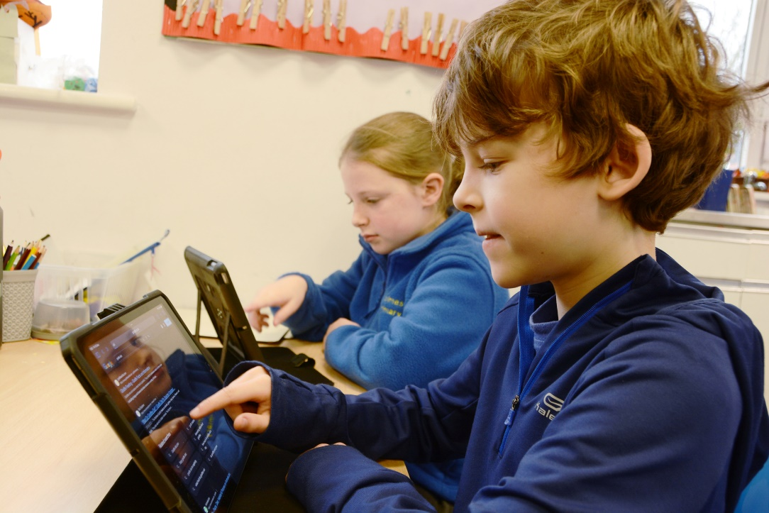
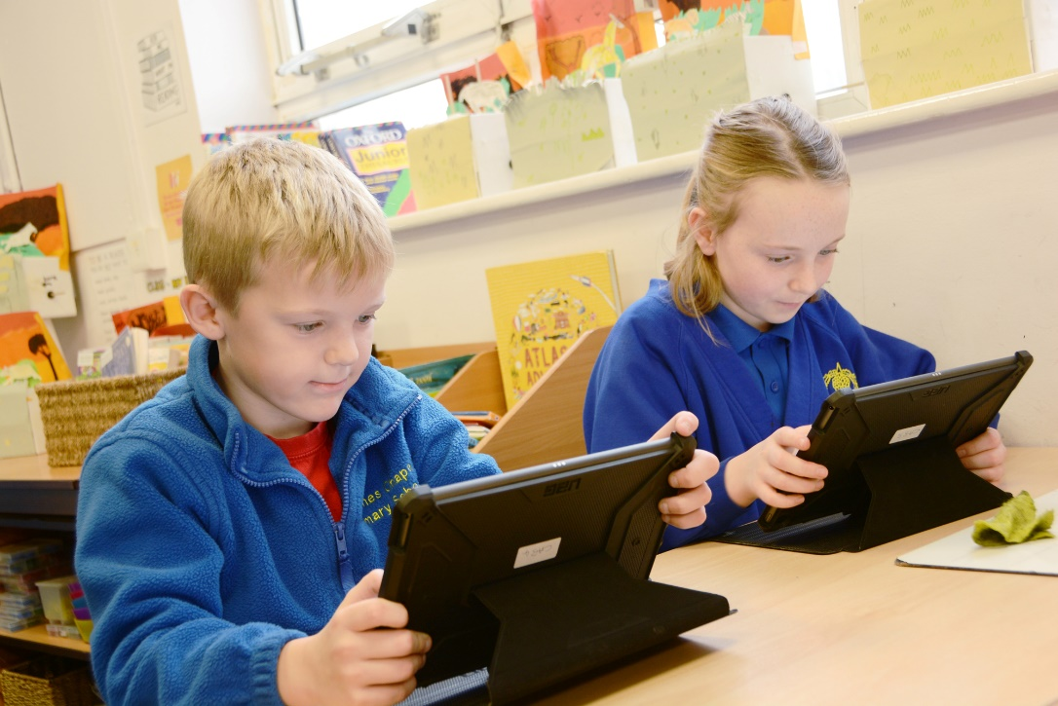
Holmes Chapel Primary School
Computing Curriculum

Slide 2

Computing at Holmes Chapel Primary School
Intent | At Holmes Chapel Primary School, we prepare our children to be confident and competent within a world that is heavily shaped by technology. The intent of the computing curriculum is to: show how computing is relevant to the real world, and how it can be incorporated across the curriculum rather than a standalone subject develop children’s problem-solving skills by using a range of different software where children of all ages can find, analyse, and present information and further evaluate their presentations in a practical way. enable children to be confident, creative, and independent learners by allowing children to choose how they use ICT to present their work promote creative or analytical work to enhance the understanding that computing makes whatever you do easier encourage independent learning in ICT lessons rather than teacher driven promote co-operative learning in ICT lessons, by giving children structured opportunities to collaborate with others in their class to both improve and consolidate their subject expertise enhance computing out of the classroom learning use technical equipment accurately and effective be inclusive and meet the needs of all pupils
Implementation | Our computing curriculum is designed to ensure high standards of teaching and learning in computing, we implement a curriculum that is progressive throughout the whole school. Our implementation of the computing curriculum is in line with 2014 Primary National Curriculum requirements for KS1 and KS2 and the Foundation Stage Curriculum in England. This provides a broad framework and outlines the knowledge and skills taught in each key stage. We use and follow the Purple Mash computing scheme of work from Year 1-6, ensuring consistency and progression throughout the school. We recognise that computing is a specialist subject and not all teachers are computing specialists. Computing lessons are taught by our teaching staff with additional support from our Computing lead. The Purple Mash scheme of work enables clear coverage of the computing curriculum whilst also providing support and CPD for less confident teachers to deliver lessons. Our school uses Purple Mash to support the learning of each strand of the Computing curriculum. Each child has a log in and password to use at school and at home meaning children can access their schoolwork at home as a way of extending their Computing learning. Purple Mash also offers opportunities for children to complete cross curricular work, helping to embed their Computing skills at every opportunity.
Impact | Teachers carry out ongoing assessment during lessons. These assessments inform teaching, and progression to the next lesson. The final independent piece of work is assessed against exemplars (within each Purple Mash unit document is a section called Assessment Guidance) of how a child at emerging, expected and exceeding level of achievement could demonstrate this in their work through the unit.

Slide 3





Computing at Holmes Chapel Primary School
The Computing Curriculum and Fundamental British Values
Democracy | Rule of Law | Individual Liberty | Mutual Respect | Tolerance
In computing, students are taught to respect each other’s rights to have a say. | The children learn to respect each other and the classroom they are in. We promote a sense of responsibility and cost, communicating to the children that the materials and equipment need to be respectfully used and cleared away carefully at the end of each lesson. | In computing lessons, children are encouraged to develop their individual responses. They are encouraged to express their opinions on how to complete their work as their own and their peers, whilst respecting the opinions of others. | The children regularly discuss the work of other children in lessons. They are taught how to talk, demonstrating kindness and empathy, founded on mutual respect. They are taught how to help each other to make progress. | Throughout the computing curriculum, the children are introduced to a wide range of tools to complete topic work about different nationalities, backgrounds and cultures from around the world.

Slide 4
What does Computing look like?
E-Safety - We provide a variety of opportunities for computing learning inside and outside the classroom. Computing and safeguarding go hand in hand and we provide a huge focus on internet safety inside and outside of the classroom. Additional to all pupils studying an online safety unit through their computing lessons, every year we also take part in National Safer Internet Day in February. The Computing Lead alongside class teachers plan additional internet safety lessons and activities linking to current trends and potential issues. Internet Safety assemblies are also held as well as parent internet safety workshops and parent home activities. The E-Safety curriculum works in conjunction with our PHSE curriculum. Enquiry approach - Through using Purple Mash and cross-curricular link we ensure that a child’s learning is engaging, broad and balanced. Using an enquiry approach is central to Computing learning; when engaged in inquiry, students can describe objects and events, ask questions, construct explanations, test those explanations against current computing knowledge, and communicate their ideas to others. They can identify their assumptions, use critical and logical thinking, and consider alternative explanations. In this way, students actively develop their understanding by combining computing knowledge with reasoning and thinking skills. Independent learning - Teachers ensure that ICT and computing capability is also achieved through core and foundation subjects and where appropriate and necessary ICT and computing is incorporated into work for all subjects. Children are expected to work as independently as they can during a lesson so that they demonstrate their ability to complete the ICT task and achieve the learning intention on their own. Adults give targeted support to those who require it. Computing teaching is practical and engaging and a variety of teaching approaches and activities are provided based on teacher judgement and pupil ability. We have a wide range of resources to support our computing teaching. Pupils may use laptops or iPads independently, in pairs, alongside IT support or in a group with the teacher. Teachers and pupils are also aware of the importance of health and safety and pupils are always supervised when using technology and accessing the internet.

Slide 5
Computing in Early Years
EYFS For our very youngest learners in the foundation stage we provide children with a broad, play-based experience of computing in a range of contexts, including outdoor play. We believe that Computing is not just about computers, and so our Early years learning environments feature computing scenarios based on experience in the real world, such as in role play. Children gain confidence, control, and language skills through opportunities to ‘paint’ on the whiteboard or drive a remote-controlled toy. Outdoor exploration is an important aspect of the EYFS, supported by ICT toys such as metal detectors, controllable traffic lights and walkie-talkie sets. The Early Years, in accordance with the EYFS Framework also regularly use Beebots (programmable robots), Learn Pads and paint programs as well as using the interactive whiteboard in the classroom to access and play games. They cover E-Safety regularly throughout sessions using technology. Teachers also use the twenty-five topic packs within Purple Mash covering all Early Years topics, each containing a range of themed activities and resources. With simple visual navigation, it covers all the areas of prime development in an engaging way. Our Computing progression model is broken down into KS1 and KS2. Each progression model contains three strands that make up the computing curriculum. These are Computer Science, Information Technology and Digital Literacy. Computer Science underlines the knowledge and skills relating to programming, coding, algorithms, and computational thinking. Information Technology underlines the knowledge and skills relating to communication, multimedia and data representation and handling. Digital Literacy underlines the knowledge and skills relating to online safety and technology uses. All of which are covered whether combined or discreetly. To ensure that UKS2 have a rounded view of communication, multimedia and data representation and handling teachers will incorporate Microsoft programs such as Word, PowerPoint and publishers using a cross -curricular approach. Through our Purple Mash subscription our teachers deliver thematic, cross curricular lessons providing flexibility, using an online portal of age-appropriate software, games, and activities as well as topic materials and materials to support children’s learning in other subject areas for all key stages. Computing teaching delivers these requirements through discrete units.

Slide 6
Computing in Key Stage 1 and Key Stage 2
Key Stage 1 Children are taught to: Understand what algorithms are; how they are implemented as programs on digital devices; and that programs execute by following precise and unambiguous instructions Create and debug simple programs Use logical reasoning to predict the behaviour of simple programs Use technology purposefully to create, organise, store, manipulate and retrieve digital content Recognise common uses of information technology beyond school Use technology safely and respectfully, keeping personal information private; identify where to go for help and support when they have concerns about content or contact on the internet or other online technologies. Key Stage 2 Children are taught to: Design, write and debug programs that accomplish specific goals, including controlling or simulating physical systems; solve problems by decomposing them into smaller parts Use sequence, selection, and repetition in programs, work with variables and various forms of input and output Use logical reasoning to explain how some simple algorithms work and to detect and correct errors in algorithms and programs Understand computer networks including the internet; how they can provide multiple services, such as the world wide web; and the opportunities they offer for communication and collaboration Use search technologies effectively, appreciate how results are selected and ranked, and be discerning in evaluating digital content Select, use and combine a variety of software (including internet services) on a range of digital devices to design and create a range of programs, systems and content that accomplish given goals, including collecting, analysing, evaluating and presenting data and information Use technology safely, respectfully, and responsibly; recognise acceptable/unacceptable behaviour; identify a range of ways to report concerns about content and contact.

Slide 7
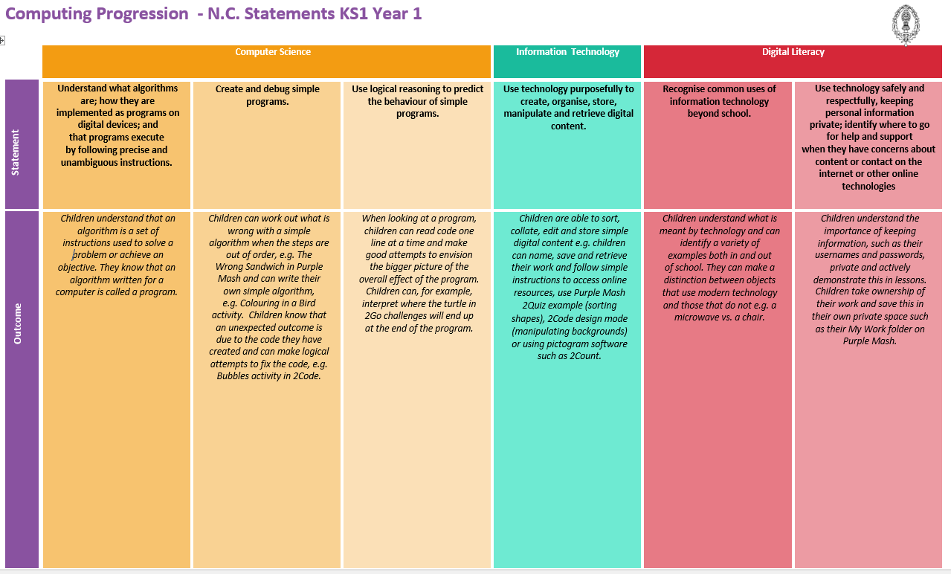
Computing curriculum progression – Year 1

Slide 8
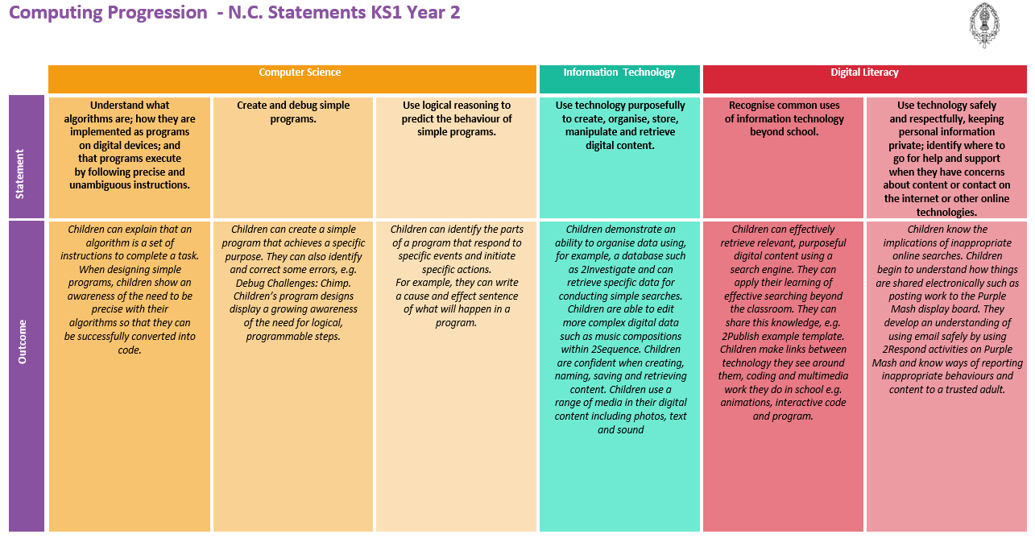
Computing curriculum progression – Year 2

Slide 9
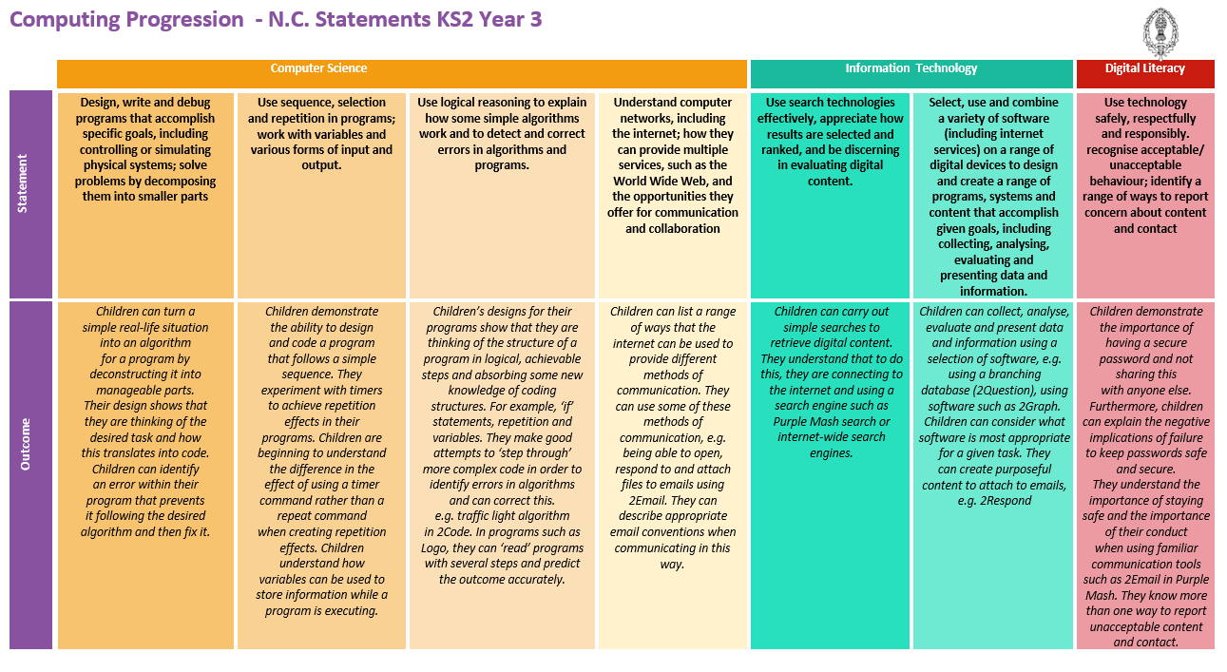
Computing curriculum progression – Year 3

Slide 10
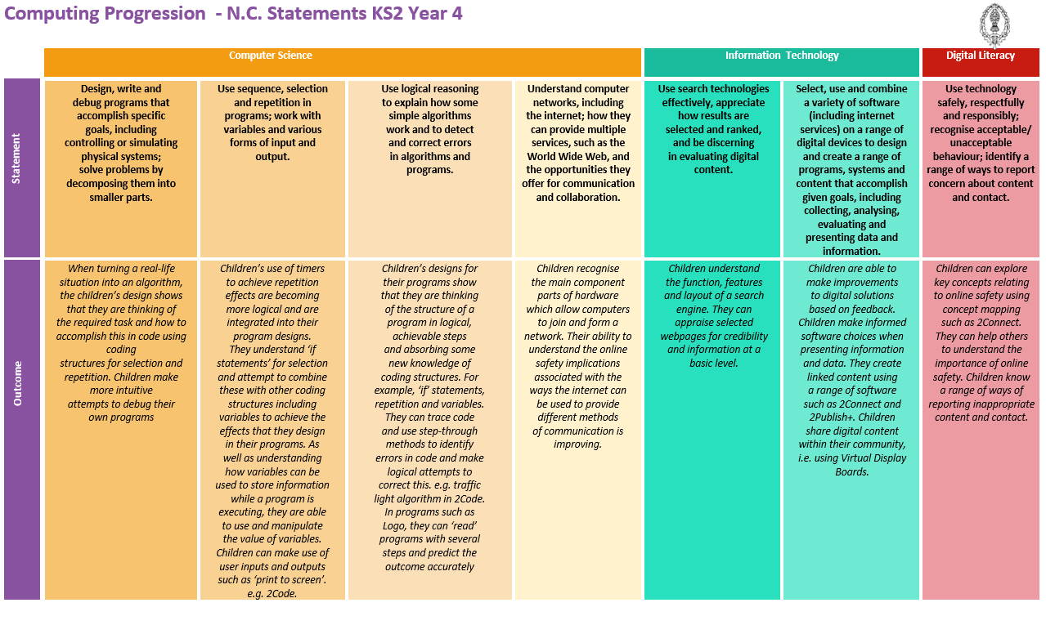
Computing curriculum progression – Year 4

Slide 11
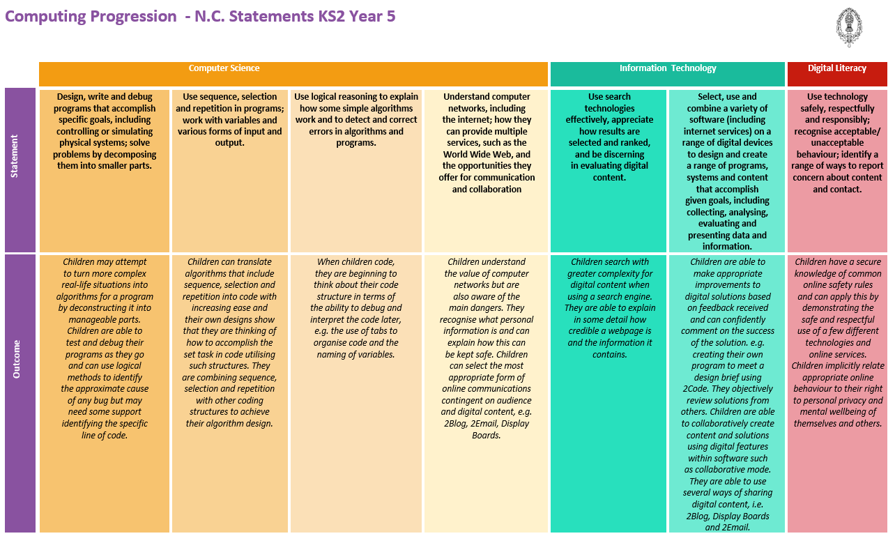
Computing curriculum progression – Year 5

Slide 12
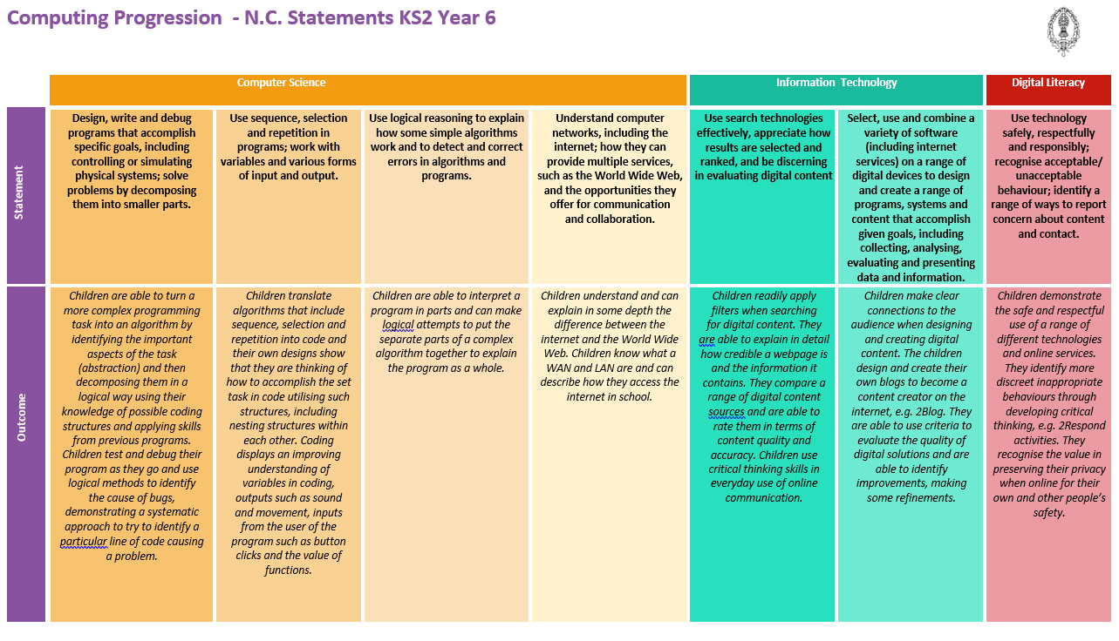
Computing curriculum progression – Year 6

Slide 13
How does Purple Mash meet the National Curriculum statements in Key Stage 1?
National Curriculum Statement | Purple Mash Resource
Understand what algorithms are; how they are implemented as programs on digital devices; and that programs execute by following precise and unambiguous instructions. | 2Go (Write Simple Instructions) | 2Code – (Coding)
 | 2Logo (Controlling An Object Using Commands)
Create and debug simple programs | 2Code – (Coding)
Use logical reasoning to predict the behaviour of simple programs. | 2Go (Write Simple Instructions) | 2Code – (Coding)
 | 2Logo (Controlling An Object Using commands)
Use technology purposefully to create, organise, store, manipulate and retrieve digital | 2Paint (Painting Program) | 2Calculate (Spreadsheet)
 | 2Publish (Publishing Templates) | 2Count (Pictograms)
 | 2Sequence (Music Creation) | 2DIY (Make your own games and quizzes)
 | 2Animate (Animation) | Mashcams (Use your webcam to make topic themed images – combine with text)
 | 2Create A Story (Animated Stories) | Various
Recognise common uses of information technology beyond school | Topic based projects | 2Count, 2Graph, 2Question, 2Investigate Simple programs for collecting and presenting ‘real life’ data
 | 2Calculate Spreadsheet Scheme of Work models applications of technology to solving ‘real world’ problems
Use technology safely and respectfully, keeping personal information private; identify where to go for help and support when they have concerns about content or contact on the internet or other online technologies. | Internet Safety Activities

Slide 14
How does Purple Mash meet the National Curriculum statements in Key Stage 2?
National Curriculum Statement | Purple Mash Resource
Design, write and debug programs that accomplish specific goals, including controlling or simulating physical systems; solve problems by decomposing them into smaller parts. | 2Code – (Coding) | 2Chart (flowcharts)
 | 2Logo
Use sequence, selection and repetition in programs; work with variables and various forms of input and output. | 2Code – (Coding) | 2DIY (Allows the user to sequence events)
 | 2Logo (Controlling an Object Using Commands) | 2Chart (flowcharts)
Use logical reasoning to explain how some simple algorithms work and to detect and correct errors in algorithms and programs. | 2Code – (Coding)
 | 2Logo (Controlling An Object Using Commands)
 | 2Chart (flowcharts)
Understand computer networks including the Internet; how they can provide multiple services, such as the world-wide web; and the opportunities they offer for communication and collaboration. | Topic based resources | 2Blog Blogging and commenting on blog posts within a safe environment
 | 2Email Emailing, especially use of 2Respond Creator (see guide) to create simulations for children to respond to. | Real-time Collaborative tools in Purple Mash: 2Connect 2Write 2Race

Slide 15
How does Purple Mash meet the National Curriculum statements in Key Stage 2 (continued)?
National Curriculum Statement | Purple Mash Resource
Use search technologies effectively, appreciate how results are selected and ranked, and be discerning in evaluating digital content | Searching for Images Internet Research Seeing an Upsetting Video - advice Effective Searching General Internet resources
Select, use and combine a variety of software (including internet services) on a range of digital devices to design and create a range of programs, systems and content that accomplish given goals, including collecting, analysing, evaluating and presenting data and information | 2Publish Plus (Publishing Templates) | 2Animate (Animation)
 | 2Calculate (Spreadsheet) | 2Create A Story (Animated Stories)
 | 2Design And Make (3D Modelling) | 2Graph, 2Question, 2Investigate Simple programs for collecting, analysing, evaluating and presenting data and information
 | 2DIY 3D (3D Game Creation) | 2DIY (Make your own games and quizzes)
 | Mashcams (Use your webcam to make topic themed images – combine with text) | Various
Use technology safely, respectfully and responsibly; recognise acceptable/unacceptable behaviour; identify a range of ways to report concerns about content and contact | Internet Safety Activities

