Slide 1
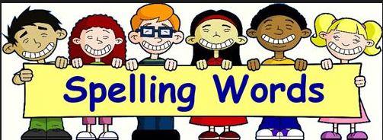
Welcome to the spelling workshop ☺
The importance of spelling in your child’s learning

Slide 2
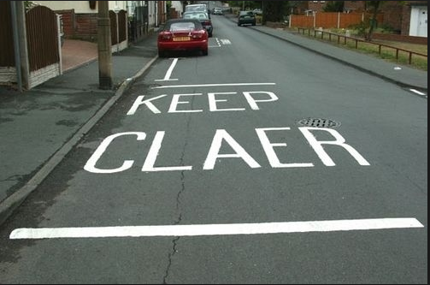

Slide 3
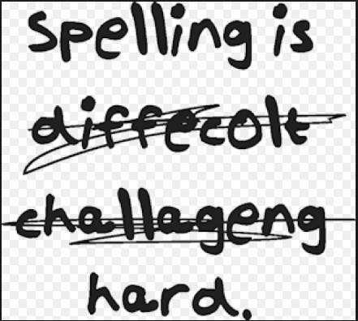

Slide 4
School website
All the information and ideas from tonight’s meeting are on our school VLE in School Information – Spelling section.

Slide 5
Put yourself in your child’s shoes
Beautiful
Everybody
Straight
Possession
Occasionally
Calendar
Environment
Necessary
Parliament
Ferociously

Slide 6
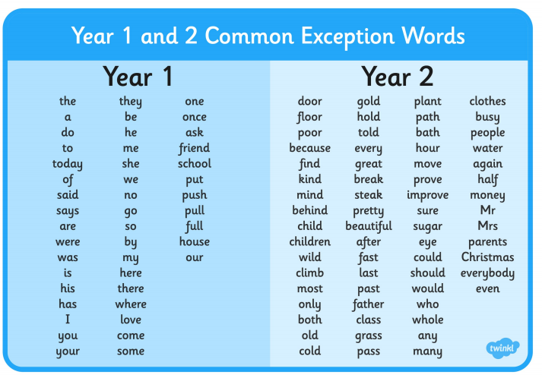
National Curriculum

Slide 7
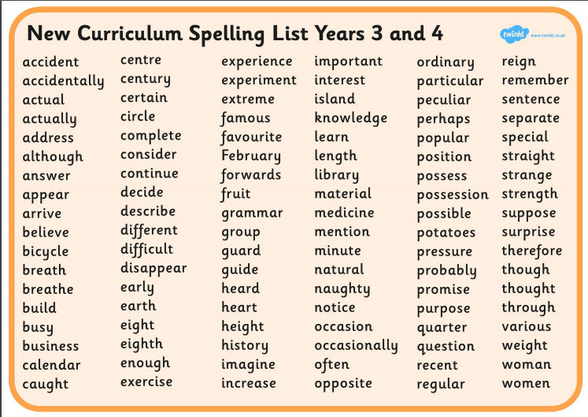

Slide 8
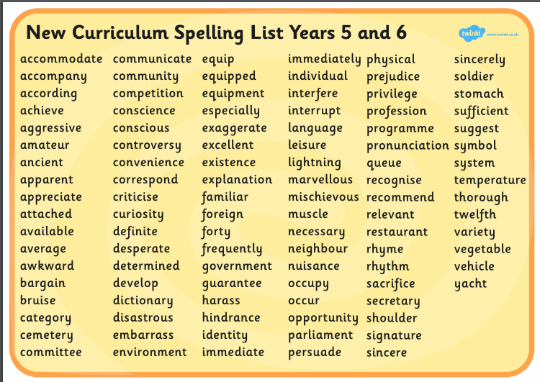

Slide 9
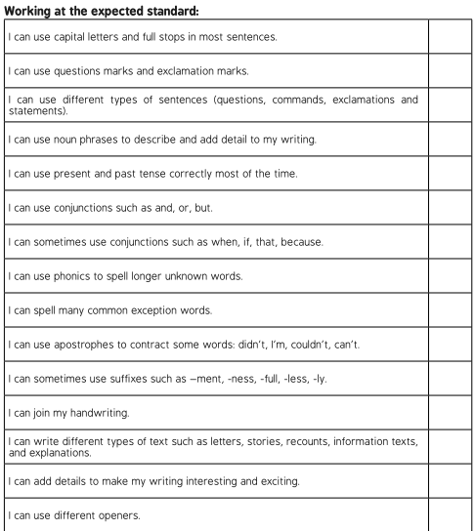
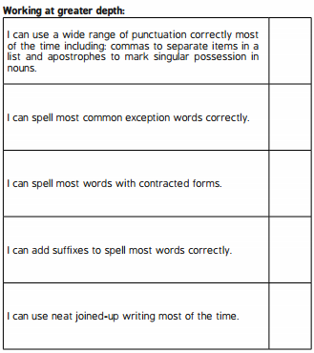
What does this means for your child in KS1?

Slide 10
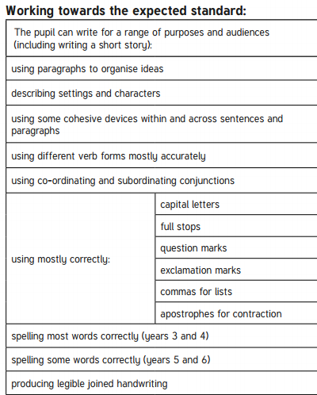
What does this means for your child in KS2?

Slide 11
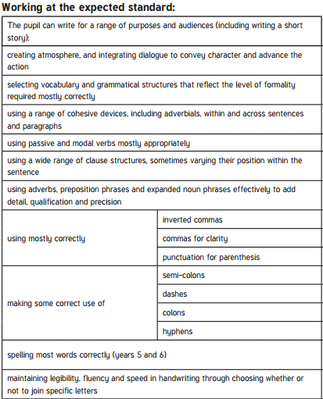

Slide 12
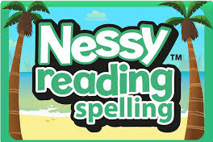
So, how do we help?
Spelling practice in school every day.
Teaching rules/ strategies
Games
Dictation words/sentences
Look, cover, write, check
Investigations
Spelling tests/ homework
Access to Nessy Spelling in school & home

Slide 13
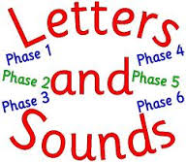
Phonics teaching in KS1
Phonics in KS1 teaches early reading and spelling skills
Children learn letter sounds (phonemes), letter shapes (graphemes) and letter names
They learn digraphs (eg. sh, ea) and trigraphs (eg. igh), and alternative spelling of phonemes (eg. ay, ai, a_e)

Slide 14

Soundtalk (blending)
A vital skill for reading
Separate sounds (phonemes) are spoken aloud, throughout each word, then they are merged together to say the whole word
Merging the sounds is called ‘blending’
E.g. c-a-t = cat

Slide 15
Soundtalk (segmenting)
A vital skill for spelling
Whole words are spoken aloud, then broken into sounds
Saying the sounds clearly is important for spelling
E.g. cat = c-a-t, boat=b-oa-t

Slide 16
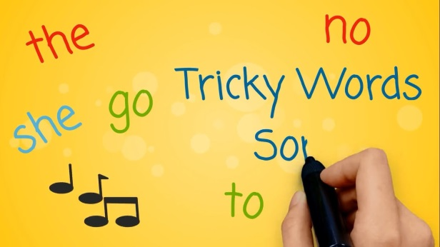
Tricky Words
‘Tricky’ words – spellings have to be learnt because they cannot be ‘sounded out’
E.g. they to are no

Slide 17
Rules
‘i before e except after c’
Believe / receive
Changing "y" to "ies“
Key – keys
(if the letter before ‘y’ is vowel, just add ‘s’)
baby – babies
(if the letter before ‘y’ is consonant, change to ‘ies’)

Slide 18
Strategies
Chunking
breaking the word up /clap the syllables
No-vem-ber
Use words I already know
Could, would and should

Slide 19
Strategies
Mnemonics - make a sentence to help remember
ould (would, could) O U lucky duck
ough (ought, brought, thought) O U greedy hog
Necessary
Never eat cake eat salad sandwiches and remain young
Island
An island is land surrounded by water

Slide 20
Strategies
Tricky parts – visual representations

Slide 21
Looking for words in words
Strategies
Teacher
Brother
How can this help?

Slide 22
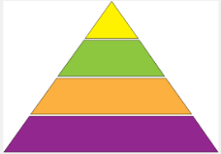
Spelling pyramids
Strategies
B
Be
Bec
Beca
Becau
Because

Slide 23
Homophones

Slide 24

Strategies
Stare at the word for 30 seconds.
How many times can you write the word in 20 seconds?
Check your spellings

Slide 25
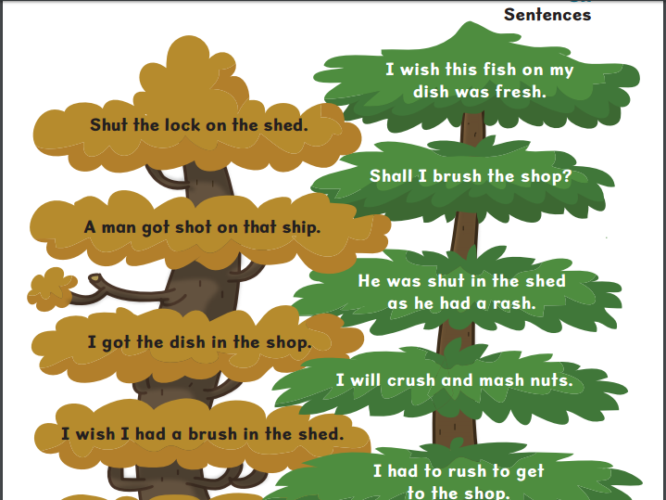
Dictation
Use the word / rule in sentences

Slide 26
Summary
Learn rules and practise strategies
Apply it into writing – this is the real test
Daily practice
Learn more ABOUT words
Practice makes permanence

Slide 27
School website
All the information and ideas from tonight’s meeting are on our school VLE in School Information – Spelling section.
Google search - Nessy

