Slide 1
Welcome to Year 5

Slide 2
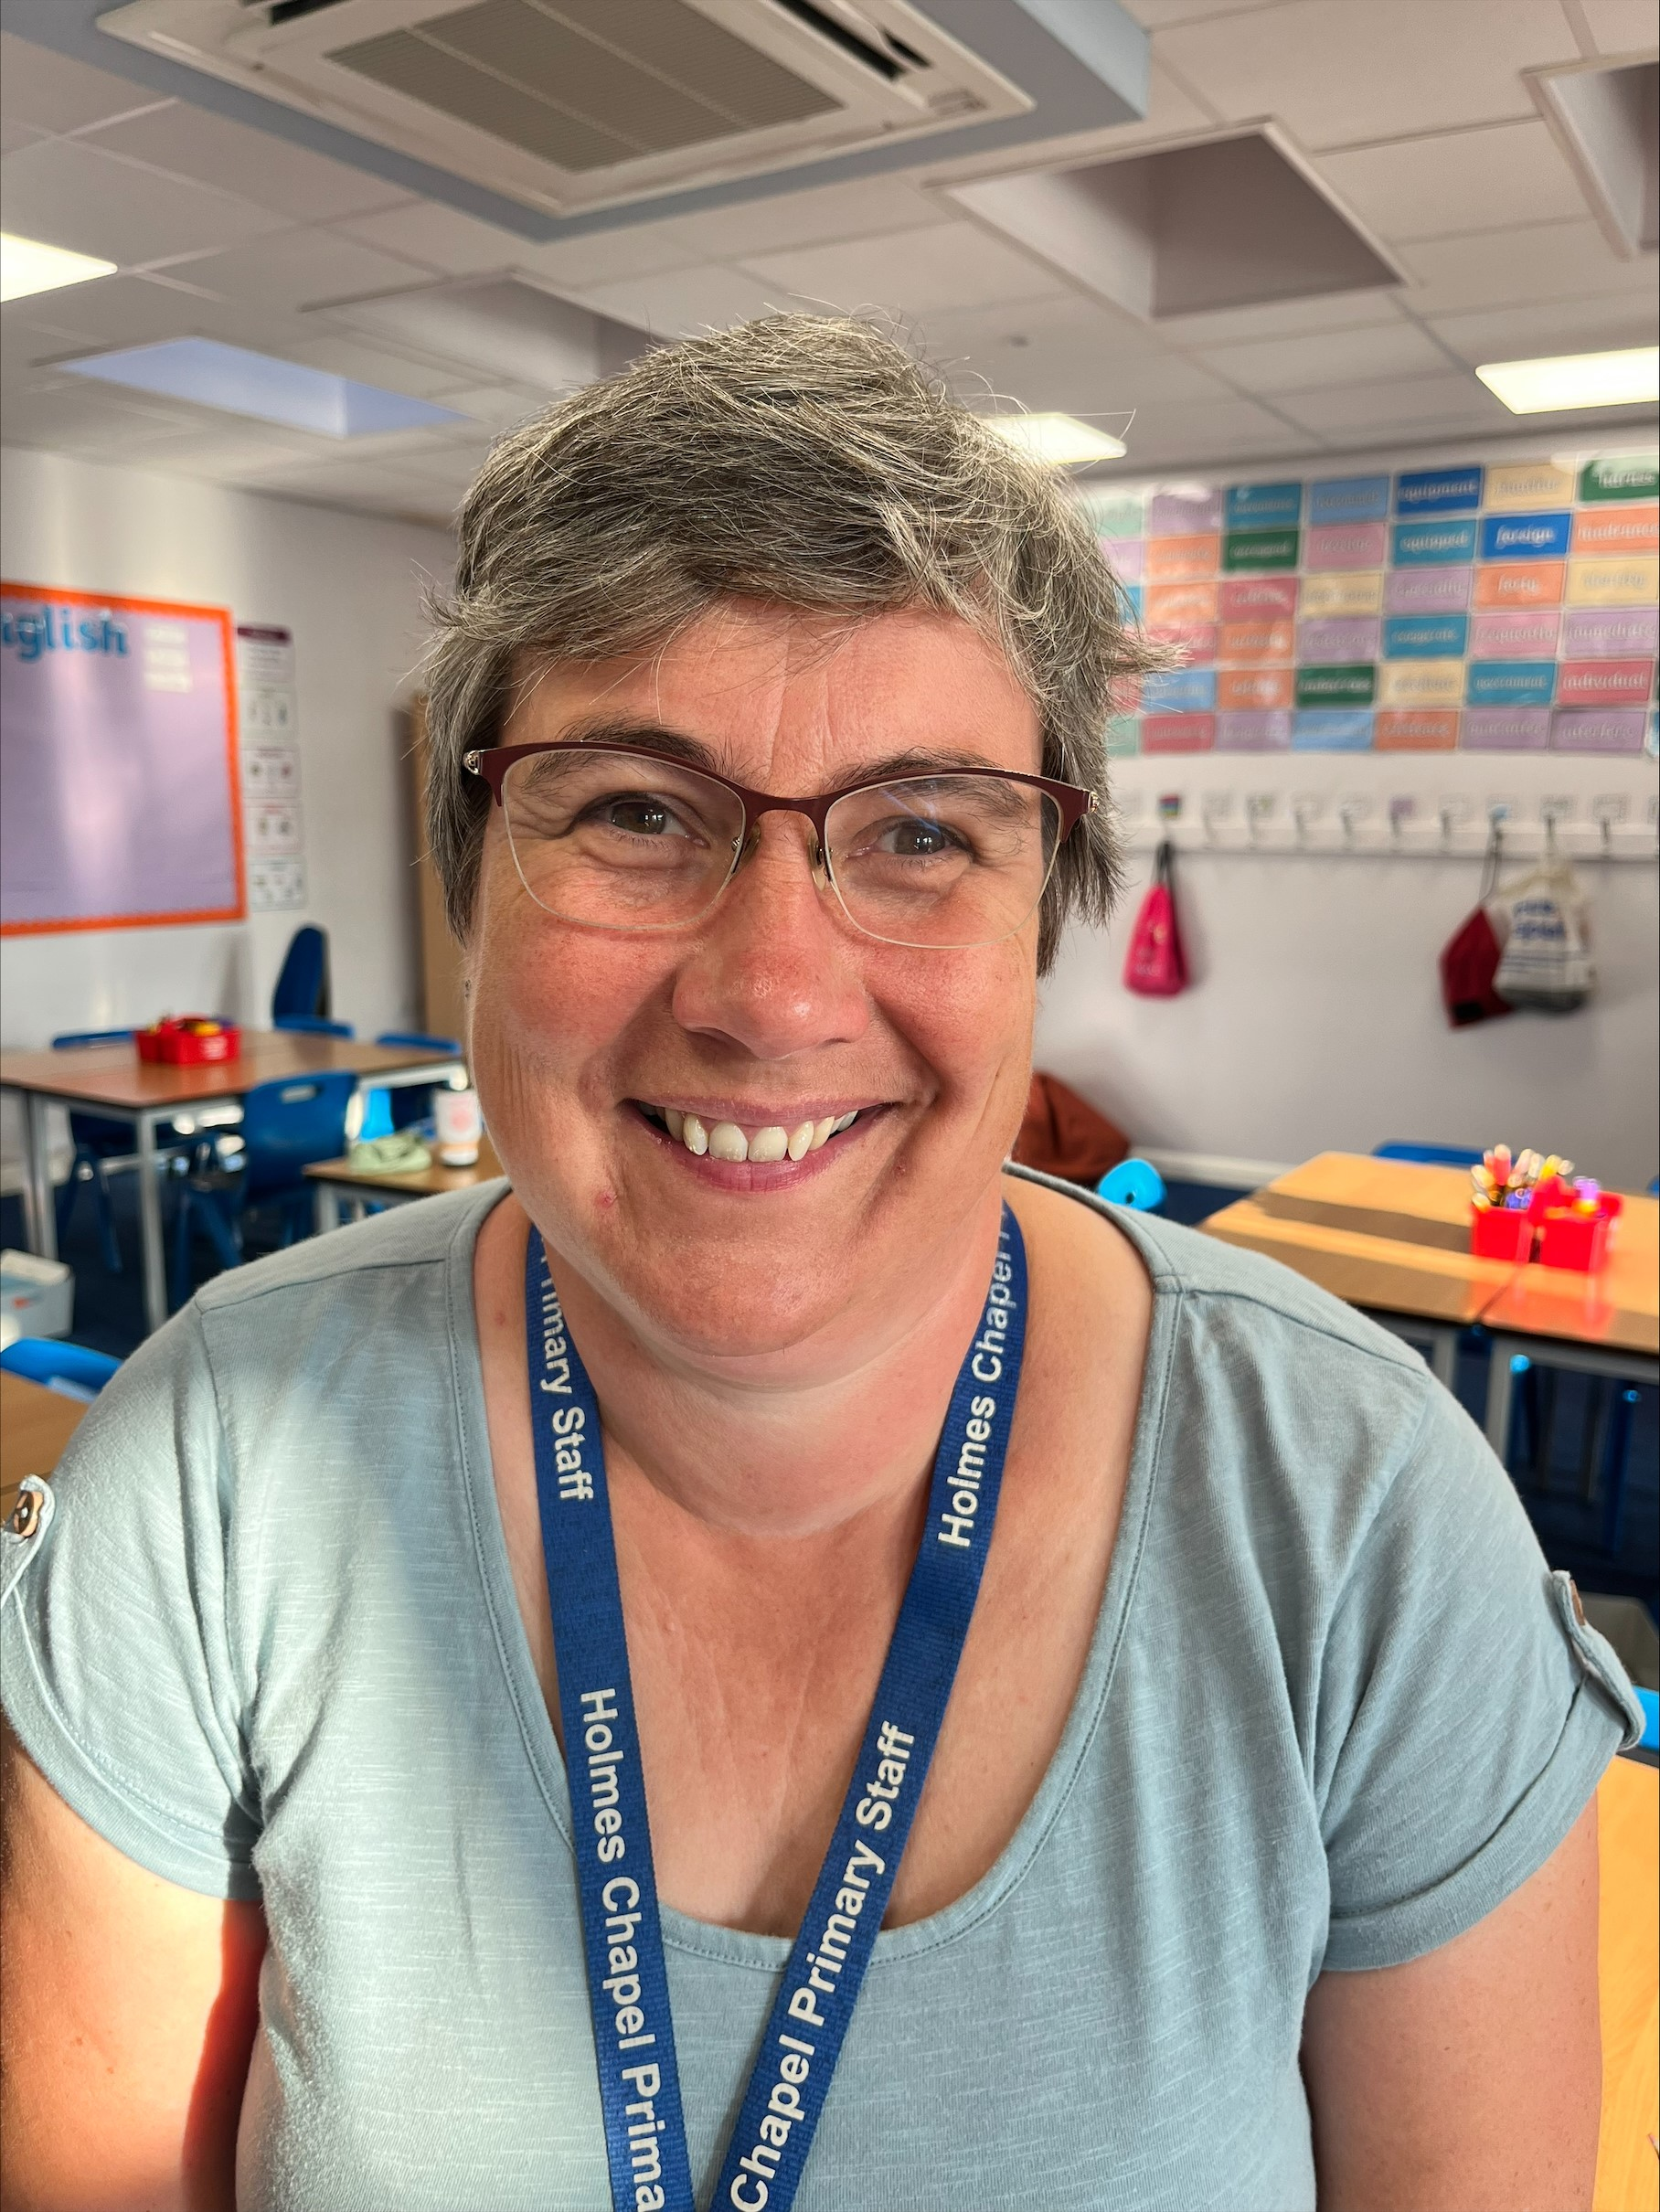
ADults in Year 5
Class 5a
Teacher- Mrs Wall and Mrs Waddington
Teaching assistants-
Mrs Jackson

Slide 3
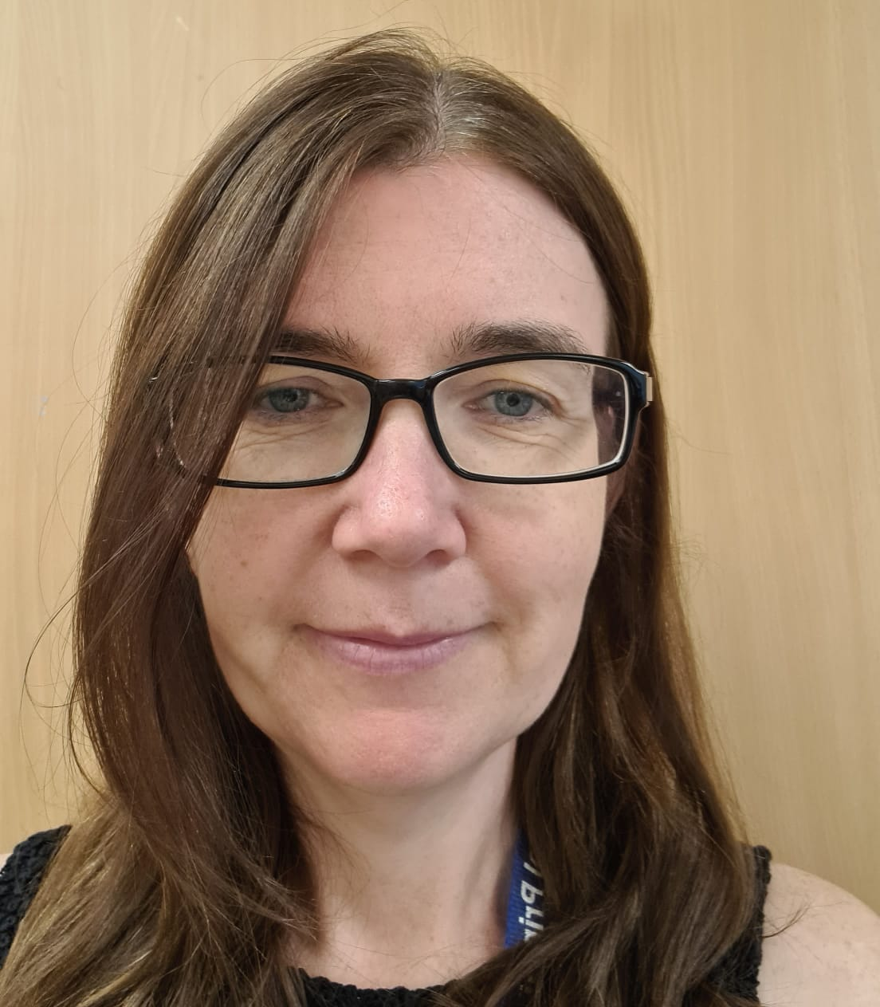
ADults in Year 5
Class 5
Teacher- Mrs May
Teaching assistants –
Mrs Jones

Slide 4
Other Adults in school
Mrs Gresty – Principal
Mrs Bradford – Head of School and SENCO
Mrs Woods– Head of KS2
Mrs Williams – Head of KS1
Mrs Lavin – Learning Mentor

Slide 5
CONTACT- Year 5 team
What is the best way to contact us at school?
For anything urgent, please contact the school office. admin@holmeschapelprimary.cheshire.sch.uk
We no longer have a class email. Please use the in app message/email via ARBOR and/or contact the school office.
School will contact parents through the email via Arbor or school office.
Any questions you have please just ask – we are more reliable than Facebook!

Slide 6
Contact- senior leadership
If you would like to speak to our Principal, Mrs Gresty, please call the school office or email
principal@holmeschapelprimary.cheshire.sch.uk
If you would like to speak to our Head and SENCO, Mrs Bradford, please call the school office or email
headofschool@holmeschapelprimary.cheshire.sch.uk

Slide 7
CONTACT- Learning mentors
If you would like to speak to our Learning Mentor (Mrs Lavin). Please call the school office or email…
Learningmentor@holmeschapelprimary.cheshire.sch.uk
Learning mentors help children and parents deal with emotional needs, social needs and overall wellbeing of everyone within the HCPS community.

Slide 8
Year 5 information
On our school website, you can find information about the school, the curriculum and what is happening in the following week in Year 5. We also put any messages on for the following week.
Any urgent/important messages will be sent out via Arbor.

Slide 9
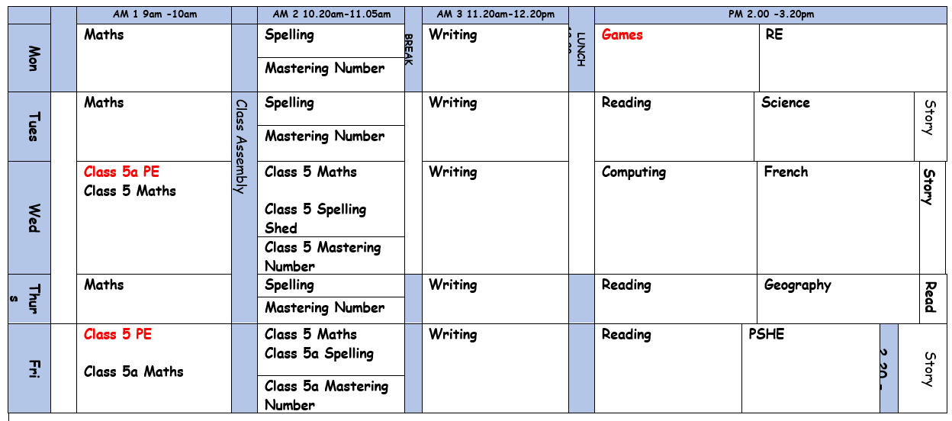
Year 5 timetable

Slide 10
Entering and leaving school
The gates open at 8.40 and school will start at 8.50.
Children will enter through the main playground and go up the stairs to the classroom.
The children will exit through the same doors and go to find their adult on the playground. If their adult is not there, they need to come back to the door.

Slide 11
Whole school reminders
We have children in school with severe allergies. Therefore, we are a nut free school. Please do not send any food with nuts into school. This includes Nutella products.
Please remember no bikes or scooters are to be ridden on the playground and no dogs.
If they need to bring a mobile phone to school, they must be given to the class teacher at the beginning of the day (turned off) so they can be locked away safe. They will be returned at the end of the day.
Parents’ evenings are planned for the autumn term (Wednesday 21st and Thursday 22nd Oct) and spring term (Wednesday 10th and Thursday 11th Feb)

Slide 12
Food
Please bring a water bottle every day
Please provide your children with healthy snacks
Toast will be available
You are able to pre-book toast and bacon butties (Friday only) via Arbor

Slide 13
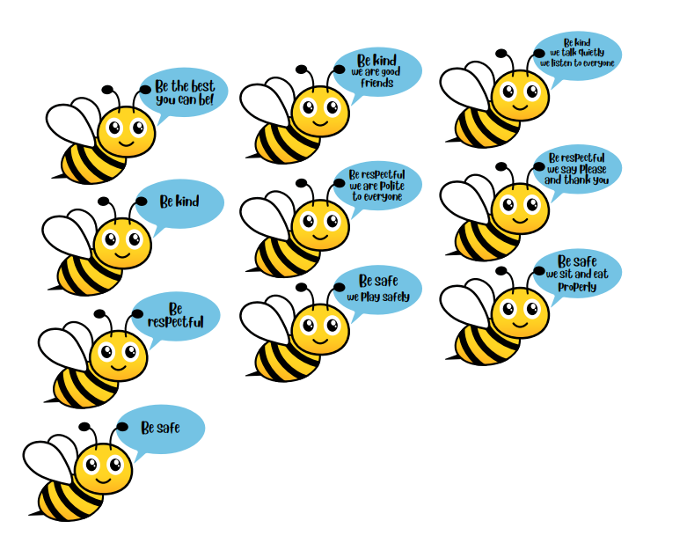
school rules
Playground
Lunch hall

Slide 14



Rewards
Behaviour charter will be distributed.

Slide 15
Reading books
In Year 5, we promote reading for pleasure and will be sharing lots of books linked to our topics.
Children are allowed to bring in reading books from home that they wish to read in school.
If children are on colour book band books, these will be sent out on a regular basis. To be read three times.
We expect children to be reading at home at least 4 times a week.

Slide 16


Class readers and Take one book

Slide 17
How to Read with a year 5!!!
Read aloud regularly, even for older children, to expose them to higher-level language and story structures
Encourage choice by letting your child select books that genuinely interest them
Make reading a shared experience through discussions about the plot, characters, and their favourite parts.
Create a comfortable reading environment, be a reading role model by reading yourself
Use the local library to access a wide variety of texts for free.

Slide 18
What will we be learning this year?
History: Vikings and The Golden Age of Islam: Baghdad AD900.
Geography: Mountains.
Computing: Coding, Online Safety, Spreadsheets, Databases.
PE: Football, Netball, Basketball, Rounders, Tag Rugby, Athletics, Dance, Gymnastics, Health Related Fitness, Dodgeball, Curling, Boccia.

Slide 19
What will we be learning this year?
RE: Hinduism and Christianity.
Science: Living Things, Animals including Humans, Space, Materials and Forces.
DT: Cooking, Alarm systems & circuits and Structures
French: Weather, Clothing and My Home.

Slide 20
PE
Our P.E days are Monday (outdoor), Wednesday 5a (indoor) and Friday 5 (indoor)
Swimming Monday afternoon in the summer term.

Slide 21
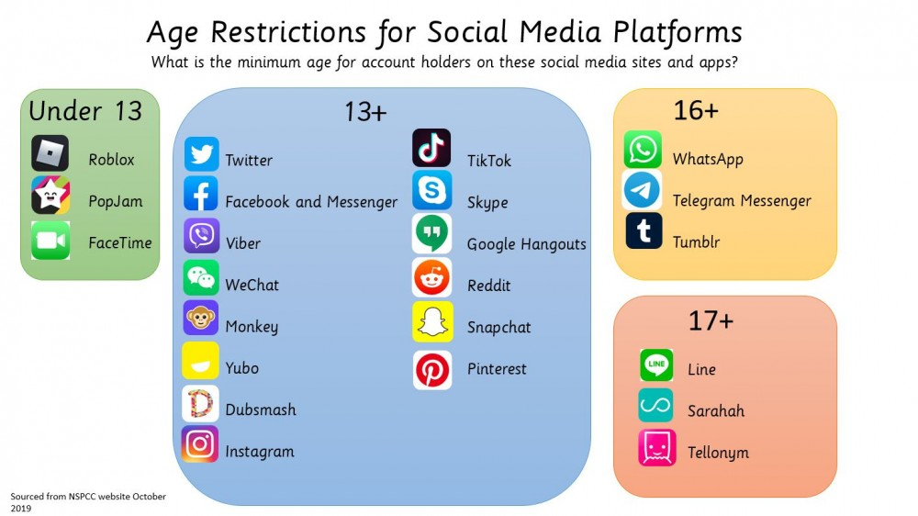
E-safety
As part of our PSHE curriculum, they will be learning about how to stay safe on the internet. The unit support children in staying safe and manage risks if socialising online. It touches on cybercrime.
CEOP – Play, Like, Share
CEOP – Connect
NCA – Making the right cyber choices

Slide 22


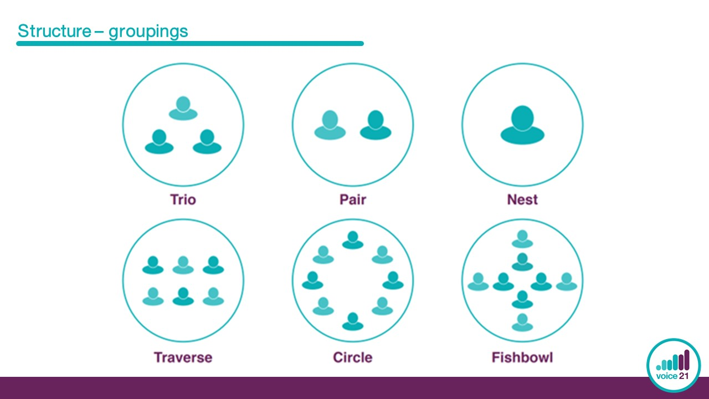




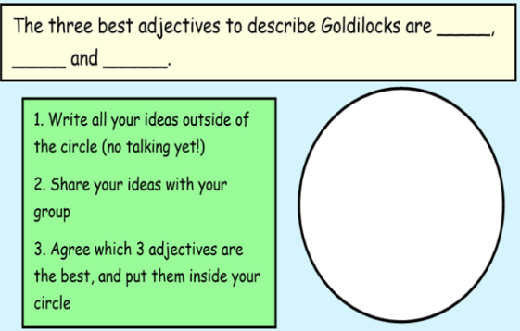
Instigate
I would like to start by saying…
I think…
We haven’t yet talked about…
Build
Challenge
Present an idea or open up a new line of inquiry
Develop, add to or elaborate on an idea
Disagree or present an alternative argument
I disagree because…
To politely challenge you X, I think…
I understand your point of view, but have you thought about…?
Building on X’s idea…
I agree and would like to add…
X’s idea made me think…

Slide 23
PE Kit
We expect children to wear HCPS PE kit and take Fitbits and earrings out for PE. They should come to school in their PE kits on a Monday and Wednesday.
HCPS PE kit-
Plain t-shirt in their house colour or plain white (with or without logo)
Navy or black plain shorts/skort, plain dark leggings or jogging bottoms (to wear over shorts if the weather is cold)
Trainers (preferably with Velcro fastening if they are unable to tie laces)
School royal blue sweatshirt (plus a plain blue/grey/black hoodie to go over the top during cold weather)
Children will also need a pair of plain black pumps to keep in school (these are particularly useful for gymnastics lessons in the hall, and to provide alternative footwear if their outdoor shoes get very muddy). These need to be clearly named and preferably kept in a named bag.
Please avoid ‘fashion’ items of PE kit such as crop tops and brightly printed leggings. Football kits are also not acceptable for PE lessons in school.

Slide 24
UNiform
White or blue polo shirt (with or without logo)
Royal blue sweatshirt, jumper or cardigan (with or without logo)
Royal blue school fleece (optional)
Grey trousers, shorts, skirt or pinafore (or blue and white checked summer dress)
Plain grey, black or white socks
Plain black sensible shoes or plain black trainers
Stud earings

Slide 25
Homework In year 5
Spelling homework will be set weekly on Spelling Shed
Times table challenges will be set on TTRockstars
Each half term we will set a Topic based homework grid. They can pick 1 or 2 (or more!) tasks to complete (just like in Year 4). We sent these home last week.
We expect children to read at least 4 times a week at home

Slide 26
TRIPS and Residential
Safety Central - Cheshire Fire and Rescue Service's award-winning education centre at Lymm near Warrington
Residential Trip: The Conway Centre in Anglesey.
22nd – 24th March 2027
While we are there, we will take part in some fantastic activities, such as canoeing, hiking, climbing and a zip wire!
More information to follow.
Cost TBC – will be able to pay in installments. Around £200.

Slide 27
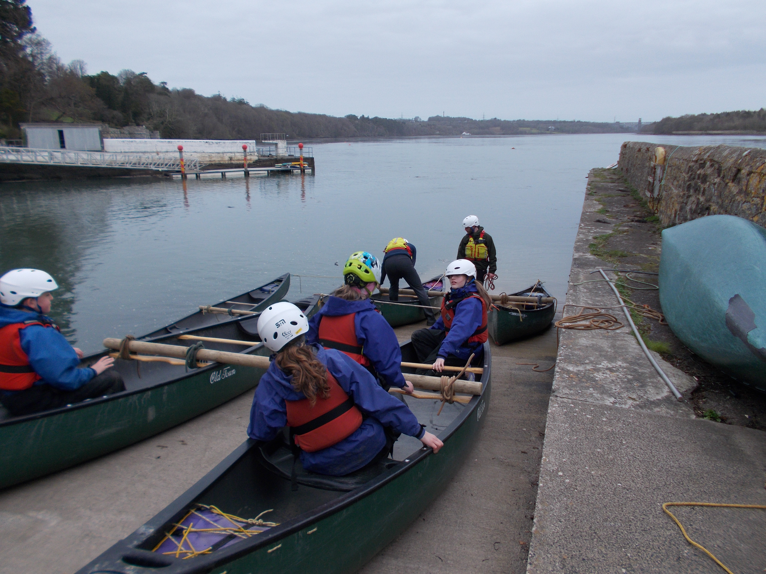

Slide 28
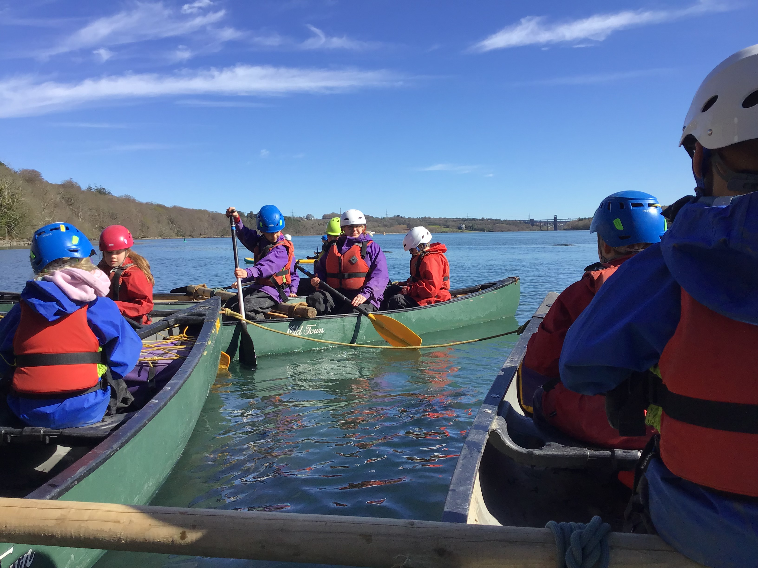

Slide 29
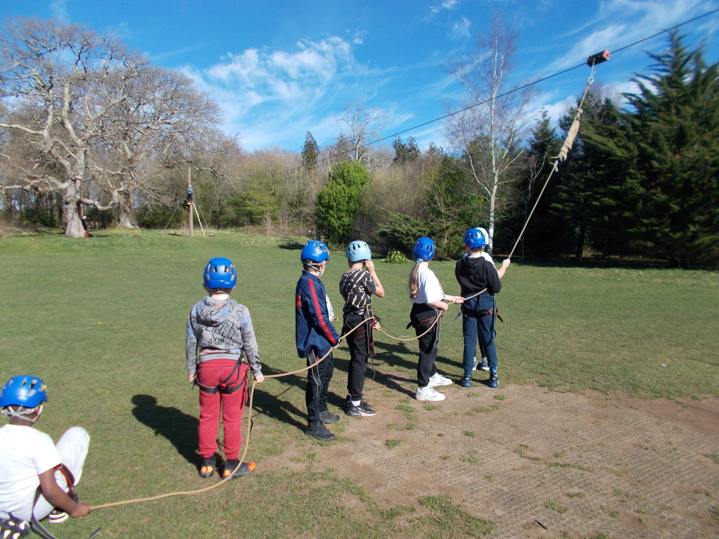
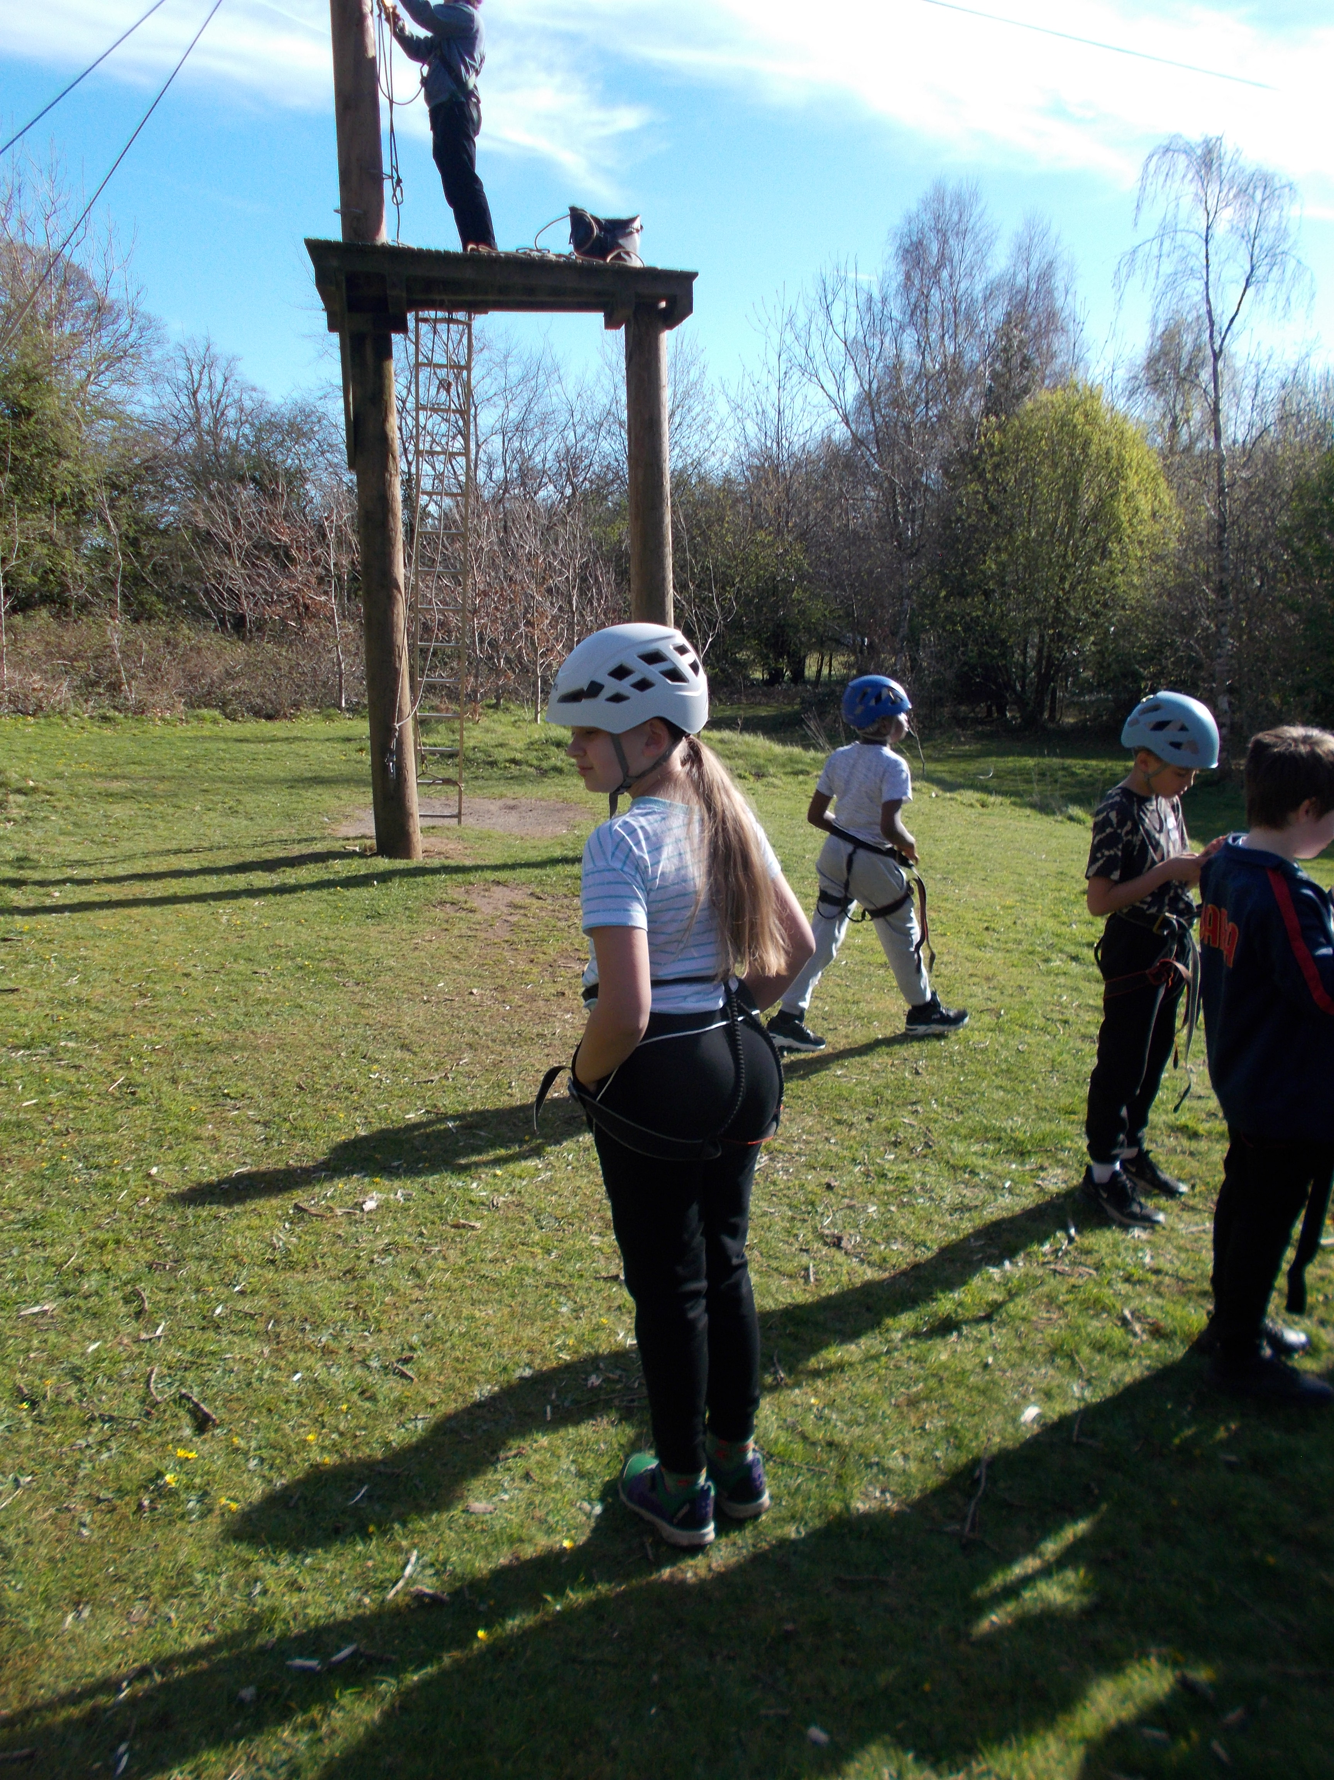

Slide 30
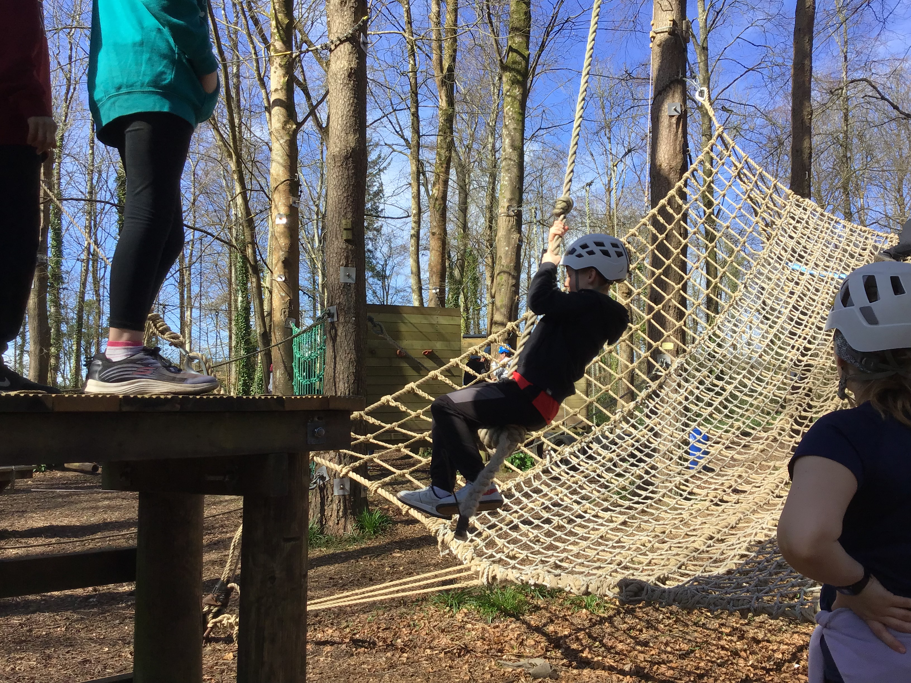

Slide 31
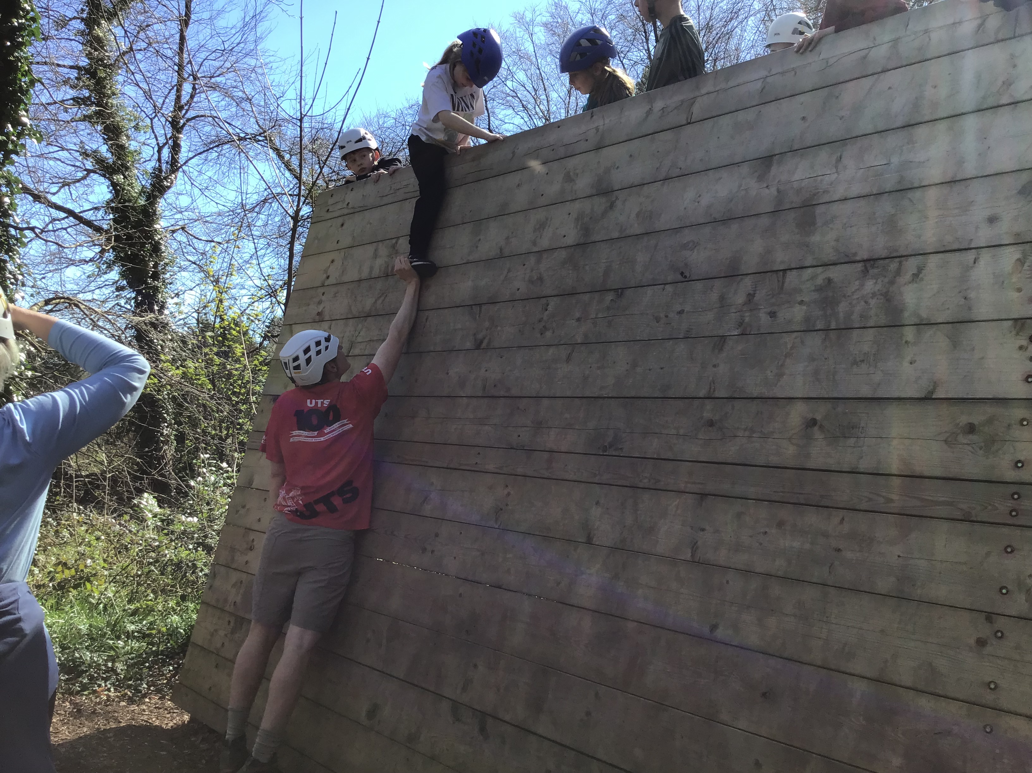

Slide 32
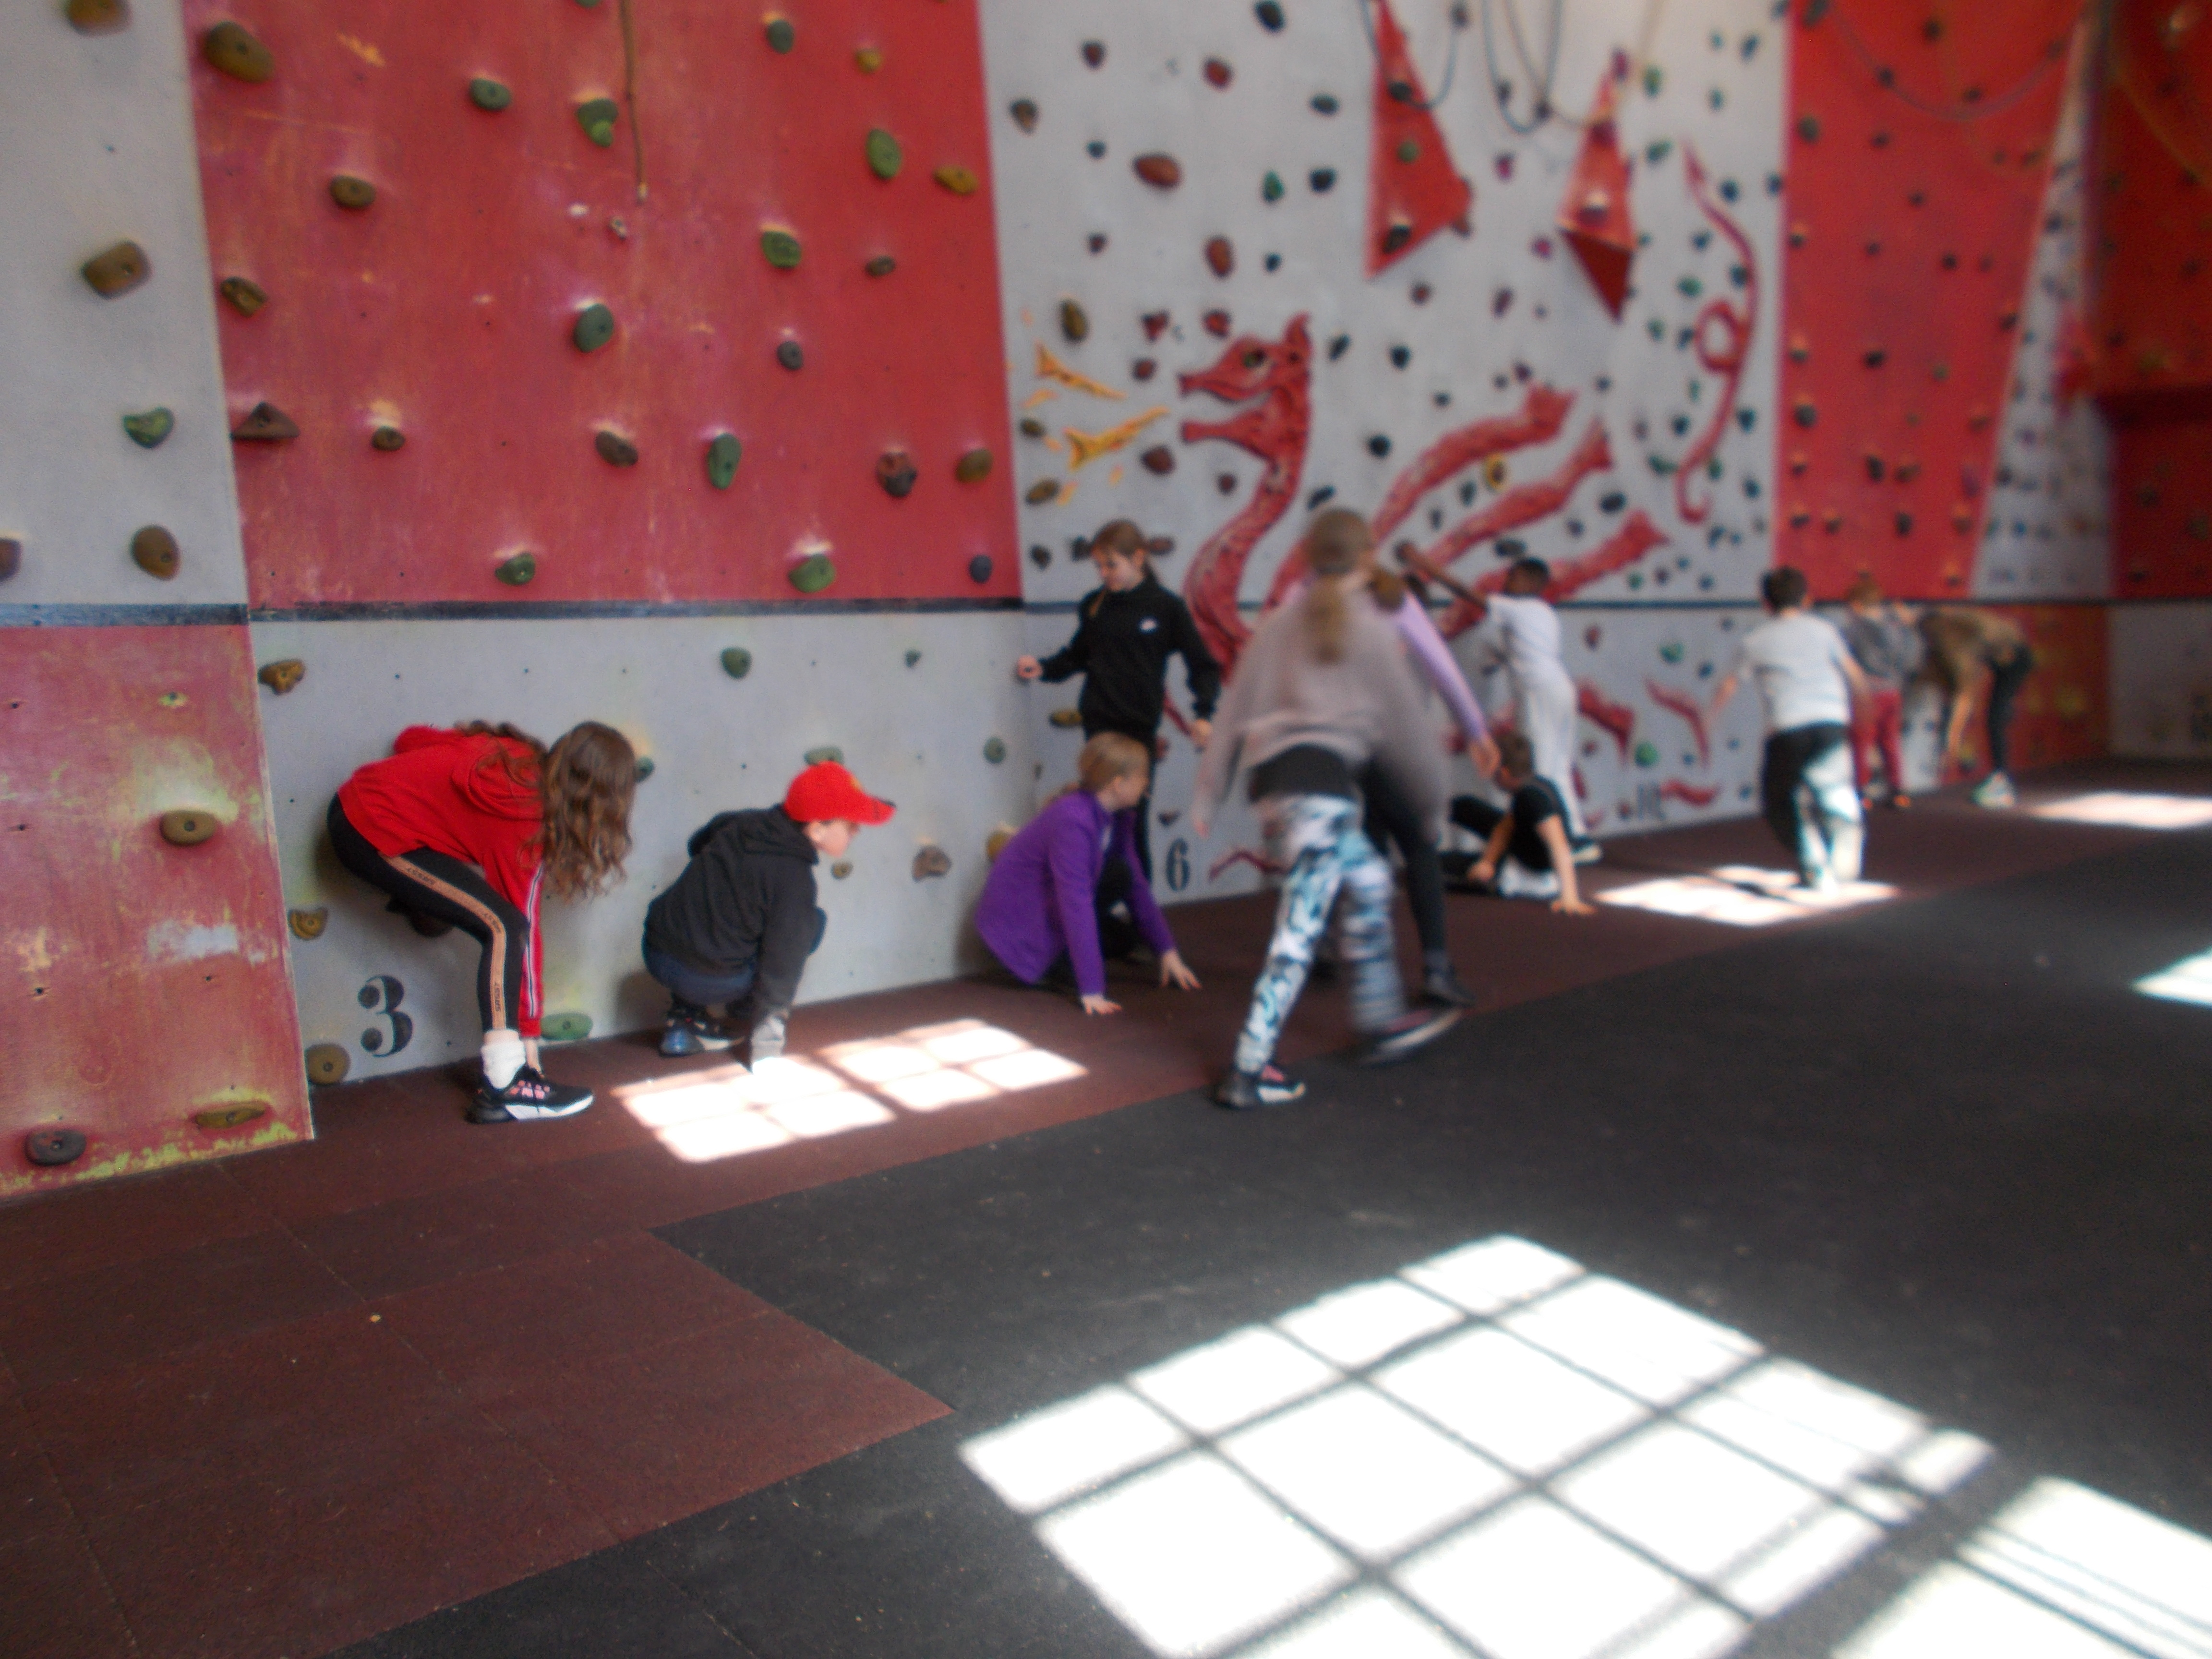

Slide 33
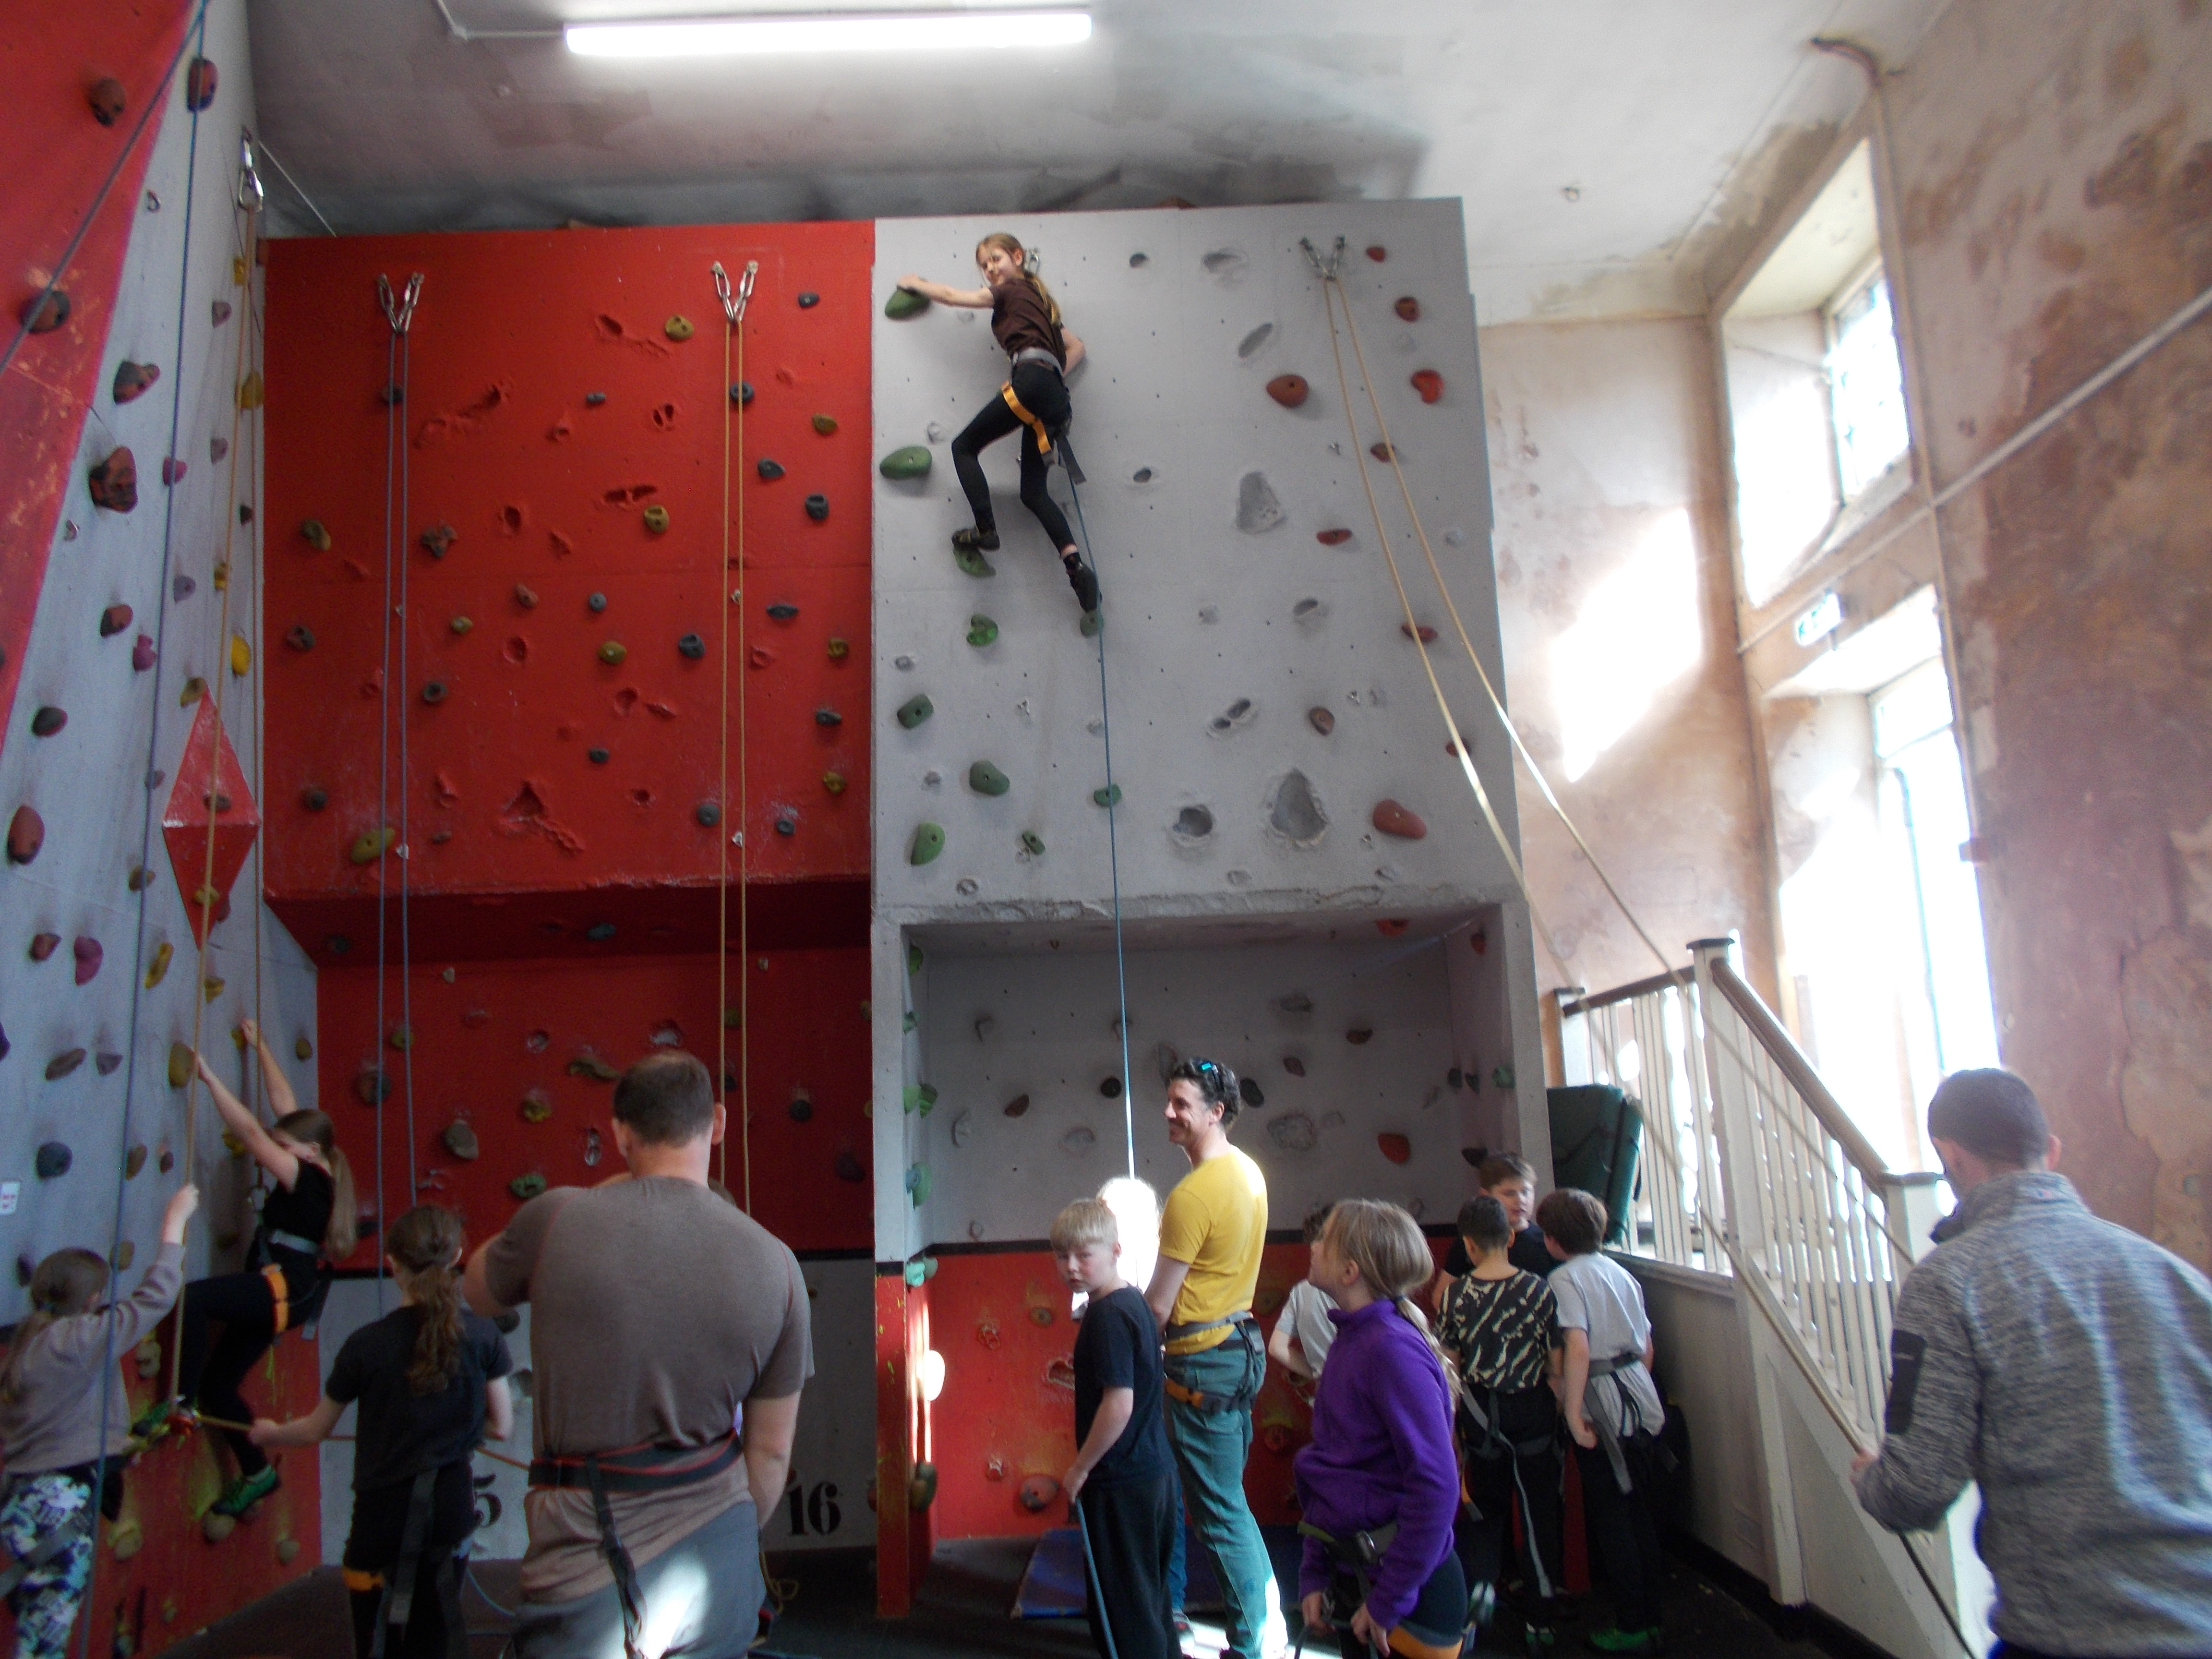

Slide 34
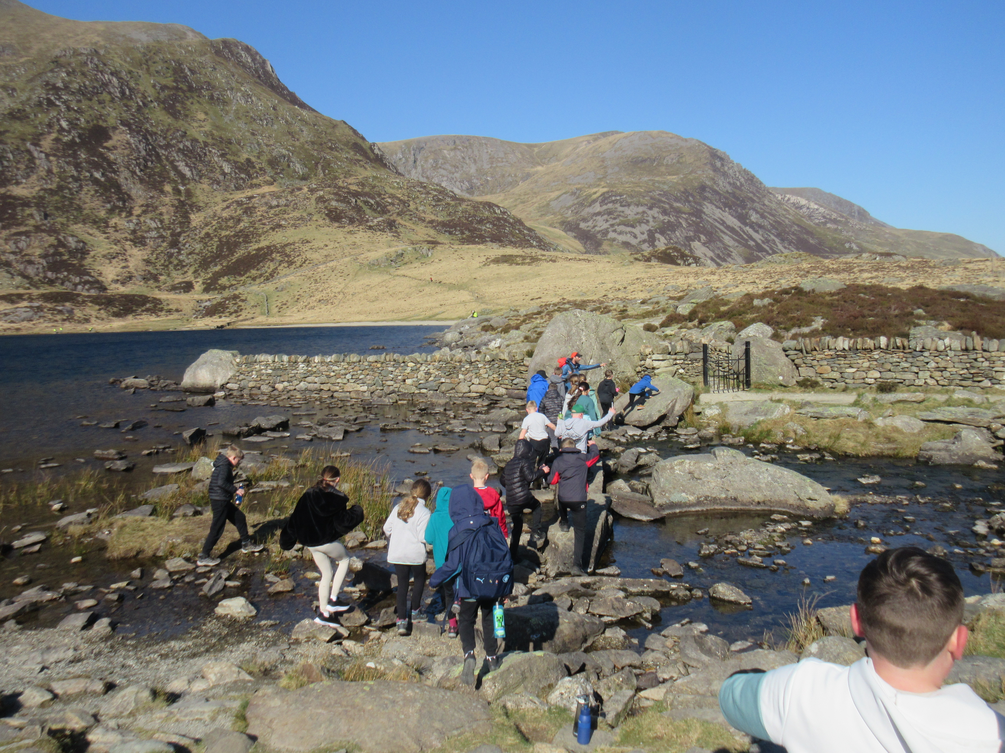

Slide 35
Any questions?

Slide 36
PARENTS EVENINGS
21st / 22nd October 2026 and 10th / 11th February 2027

