Slide 1
Welcome to Year 2!

Slide 2
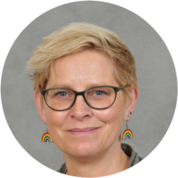
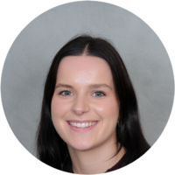
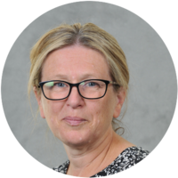
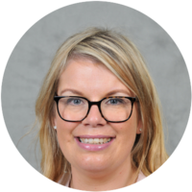
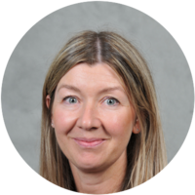
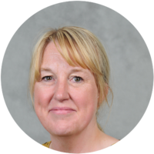
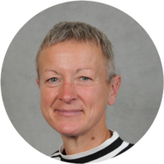
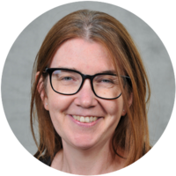
Teachers and Teaching assistants in Year 2
Class 2a
Class 2
Ms Lackford
Mrs Lal (Mon-Thurs)
Mrs Parker (Friday)
Miss Brett
Mrs Ventre
Mrs Whalley across the year (Mon-Thurs PM)
Miss Beechener and Mrs Jones on Tuesdays for PPA

Slide 3
What is the best way to contact us at school?
If there is anything you need to tell us, please either -
Email through Arbor or via the school office - it will be brought to our attention;
School will only call home in the event of a serious incident.
We may email via Arbor if there are incidents we need to inform you about.
Please note that we are no longer using class emails

Slide 4
If you have any concerns or worries and you can’t find us
Other points of contact:
Mrs Gresty - Principal
Mrs Bradford – Head of School
Mrs Williams - KS1 Assistant Head & Y1 teacher
Further Support -
Mrs Lavin (Learning mentor)
Mrs Bradford (SENDCo)

Slide 5
Daily routine in Year 2
8:40 – 8.50 Start of the day - Please enter from either Middlewich Road or Jubilee Walk gates, and send your child straight in through the doors at the end of the corridor. Register is taken at 8.50am and gates will be locked at 8.50am.
3:20 Home time – Children will be brought out through the end doors and taken to the area behind the cordon. Please let your child know where you will be standing so they can find you easily.
Children are not permitted to ride bikes and scooters on the playground, nor play on the play equipment before or after school. Dogs are not permitted on site.

Slide 6
What is covered in the curriculum in Year 2?
Main topics in Year 2
Autumn – India (Geography)
Spring – Local Study: Jodrell Bank (History)
Summer – The Lives of Children during World War 2 (History)

Slide 7
Trips
Trips in Year 2
Village Walk (October date tbc)
Stockport Air Raid Shelter – Wednesday 14th July 2027 (approximate cost £17)
Other trips e.g. library or church visits may arise.
We will need volunteers for our trips and will ask nearer the time!

Slide 8

Phonics & Reading – Little Wandle
The phonics scheme we follow in school is called Little Wandle Letters and Sounds which the children followed last year.
Year 2 > Phase 5 review > Bridge to Spelling >Spelling units
Children will be assessed regularly and this will inform reading book bands.
Further information can be found via this link: https://www.littlewandlelettersandsounds.org.uk/resources/for-parents/

Slide 9
Reading – Little Wandle
All children will read as part of a guided reading group three times per week
Books to be sent home:
Reading Practice Books
Sharing books – 1 Reading for Pleasure book
Books will be collected on Tuesdays and a new one sent home each Thursday. The expectation is that children read at home for a minimum of 10 minutes each day).
Re-reading a book is excellent for developing comprehension and fluency.

Slide 10
Reading folders
Reading folders will go home on Thursdays. Please send them back on Tuesdays.
Please check them every week.
They may contain: Notes and letters.
Homework and support materials.
Things your child has made (Easter cards, pieces of work that are important to them).

Slide 11

School Library
The children are encouraged to read for pleasure and each class intends to visit the school library weekly (they can keep books for longer than a week).
Please keep the books safe and return them once your child has finished reading it.
Class 2a will go to the library on Wednesdays and Class 2 will go on Thursdays (staff permitting).
This will be starting w/b 21.09.26.

Slide 12
Spelling
Year 2 spelling rules will be taught each week using the Little Wandle scheme which builds on Phonics teaching.
We have a 5 word assessment each Friday.
In the first half term we will send home tricky words.
After half term we will send home rules to learn with example words.

Slide 13
Feedback
We are eager to ensure that feedback for work completed is as effective as possible.
Written feedback will be used where it is appropriate;
Some feedback will be verbal (whole class, group or individual);
This means that there will not always be green pen on every piece of child’s work.

Slide 14

E-Safety
Through e-safety, the children are taught about many aspects:
Staying safe online
Digital trails
Cyber bullying
Effective internet searching using key words
Evaluating and choosing websites they like
Please support us in this by choosing age appropriate games, films and apps for your child. Guidance to age ratings can be found online.

Slide 15
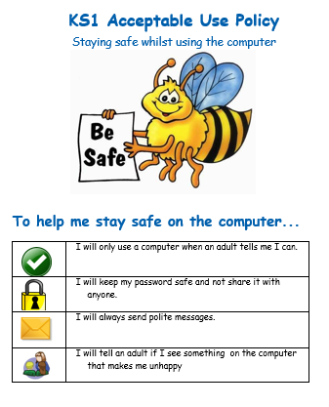
Online behaviour
The UK government recommends avoiding solo or passive screen time for children under two, limiting screen time to one hour a day for children aged two to five, and plans to implement a social media ban for under-16s by spring 2027.
We have our acceptable use policy which is shared with the children on a regular basis.

Slide 16
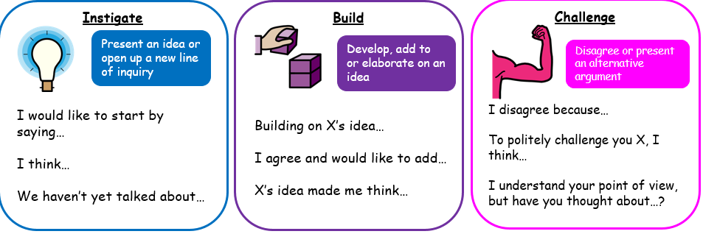
Oracy at HCPS
At our school, we believe that talk is central to learning. Oracy is about developing children’s ability to express their ideas, listen to others, explain their thinking, ask questions, build on what others say and communicate confidently in different situations.
We use talk in three important ways across our curriculum:
We teach through talk – we have purposeful discussions to help children think, explore ideas and organise their thoughts.
We teach about talk – we explicitly teach children the skills they need to become effective communicators.
We teach to talk – we give children opportunities to practise speaking for different purposes and audiences.

Slide 17
What homework can we expect in Year 2?
‘Homework Menu’ where the children choose at least one piece of homework to complete each half term; however, they can complete as many as they want! There will be a date when the homework is due in then the children will share it with their class. Please don’t send it before that as we don’t have time to share it!
Times tables (TTRockstars) – The children will receive login details for this at the Spring Parents Evening. By the end of Year 2, the children need to know their 10x, 2x and 5x tables.

Slide 18
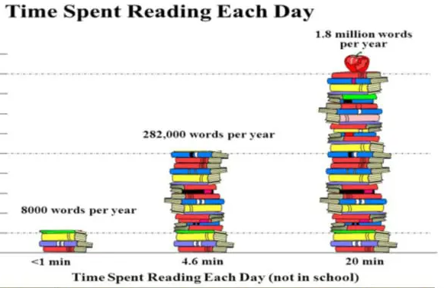
What homework can we expect in Year 2?
‘Reading – It is important for an adult to read at home with your child daily.

Slide 19
When are our PE Days?
All Year 2 children have indoor PE every Monday and outdoor PE every Thursday.
We will continue to go outside as the weather deteriorates.
Children should wear PE kit on PE days:
Plain t-shirt in their house colour or plain white (with or without school logo).
Navy or black plain shorts/skort, plain dark leggings or jogging bottoms (to wear over shorts if the weather is cold).
Plain black trainers – preferably with Velcro fastening (unless they can tie their own laces independently) .
School blue sweatshirt (plus a plain blue/grey/black hoodie to go over the top during cold weather – no slogan/logo).
Children must cover or remove earrings. Staff cannot do this for them.

Slide 20
Coats
Please ensure your child has a coat every day – we do go out even if it’s raining. Often it can rain on a day where it looks like it may not.
Please name the coats!

Slide 21


School Rules – Be the best you can be!
Be kind
Be respectful
Be safe

Slide 22

British Values
We will make reference to the five British Values during our teaching.

Slide 23
Behaviour Charter
You will all receive a paper copy of the behaviour charter to keep at home.
We share a child friendly version with the children and make references to it in class.
Please take the time to read through and discuss this charter as a family.
Please keep it at home for reference.

Slide 24
Rewards
Proud Cloud – linked to the school rules. When we spot children who make us proud, their peg moves onto the proud cloud.
Cube jar – Cubes are given to the whole class when they are working together positively as a class. Counters can also be collected for individual achievements. When the counter jar is full, the counters can be exchanged for a cube.
VIP – One child is chosen at random; they have special jobs to do in the classroom, have a special place to sit and they can line up at the front of the line as well as a number of other things.

Slide 25
Snacks & Water Bottles
Toast is available daily and is 25p per slice. Please order and pay on Parent pay.
Bacon sandwiches are available on a Friday. Please order and pay on Parent pay.
Fruit is available daily.
The children may bring in a healthy snack from home. There are children in school with severe milk allergies and nut allergies - we are a nut-free school
Children are encouraged to drink water regularly. Please ensure that water bottles have a sports cap, not a screw top as these often spill.
No juice!

Slide 26
What else do you need to know about Year 2?
Parents’ Evening
Autumn term parents’ evening will be in the week before October half term.
Spring term parents’ evening will be in February 2027.
SATS
SATs are no longer statutory for Year 2 children, however we will use past papers as informal assessments.

Slide 27
Further information…
Toys/fidget tools
Children are not to bring toys/large keyrings in from home.
Please don’t attach objects to bags as they will get tangled and might cause or be damaged. We will remove them and send them home.
Fidget tools will need to be recommended by external professionals, and agreed with the class teacher and SENCo. Please do not bring them in otherwise.
Parent Helpers
We always welcome helpers, especially reading helpers in KS1; If you are interested in coming in to school to help, please let us know.

Slide 28

Sports Events
Cross Country Competition
Friday 12th September
Children should wear their PE kit with coloured t-shirt.
Winners to be announced in assembly the following week.
Notes:
In order to raise the profile of sport even more, we will be introducing events throughout the year to enable more children to access sporting competition.
Starts with a cross country event on Friday 13th September. Children will compete for their house and the trophy will be awarded to the winning team in assembly.

Slide 29
School Website
We will update the Year 2 class page on the school website to say what is happening in Year 2 each week. In addition, any extra information about the following week will also be posted. The homework menu is on the main Year 2 page.
You can also find further information about how to help your child at home with reading, our topics, how to stay active, staying safe online, times tables and wellbeing.
http://www.holmeschapelprimary.org.uk/

Slide 30

PTFA
The PTFA is very keen to have more members join – please look on the school website for more information.

Slide 31
Any more questions?

