Slide 1
Meet the Teacher
Welcome to Year 6

Slide 2
Year 6 Team
Miss Roxburgh (6a)
Mrs Woods (6)
Mrs Wall (6 Fridays)
Mrs Hill (6a)
Mrs Mitchell (6)
Mrs Butler (6/6a)

Slide 3
What is the best way to contact us at school?
If you would like to speak to us, the best way is to communicate directly through the office either by telephone or via email as these are monitored every day. It would be helpful if you could indicate the nature of the conversation you would like to have. We are available at the end of the school day for quick queries and to arrange a longer meeting if necessary.
Parents can contact school by an in-app message/email via ARBOR and/or contact the school office.
Urgent messages should be sent via the office and will then be forwarded to the relevant member of staff.
Admin@holmeschapelprimary.cheshire.sch.uk
Please note we no longer have class emails.

Slide 4
Drop off and pick up
Start and end of the day timings for all children – 8.50am until 3.20pm.
Children are welcome to come into school from 8.40am with register taken from 8.50am. They will be recorded as late from 9.00am.
All children enter and leave through playground.
We use 8.40 – 9.00 to support children with their individual targets.
End of school day – please could you inform us if your child is allowed to walk home on their own.
Please remember no bikes or scooters to be ridden in the playground or in the car park.

Slide 5
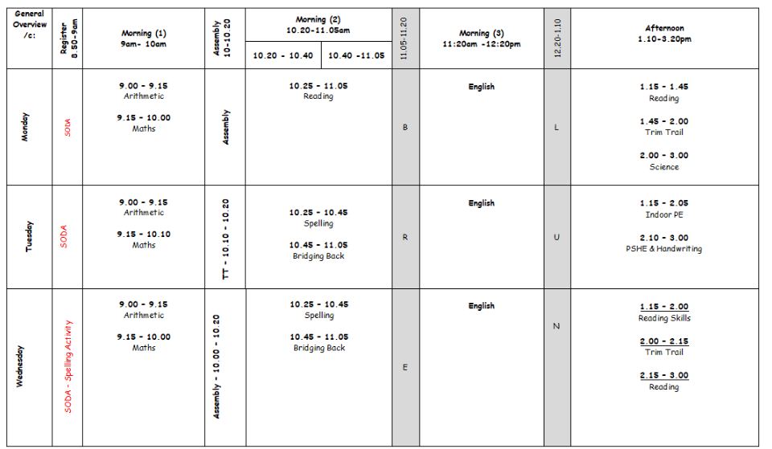
Daily Timetable
Our outline timetable looks like this.

Slide 6
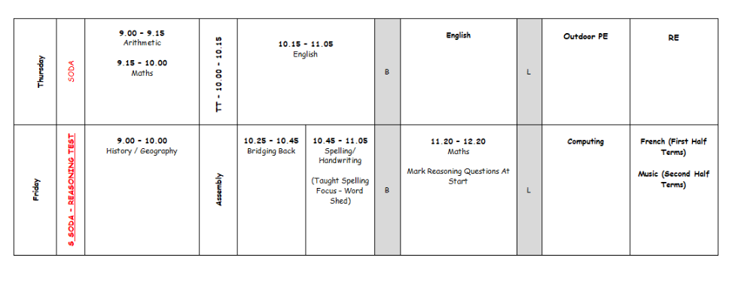
Daily Timetable
Our outline timetable looks like this.

Slide 7
Homework Expectations
Homework menu – One menu per term which will be sent home as a paper copy and will also be available on the website. The idea of this is that the children plan, prepare and produce a piece(s) of work over the term to a high standard, to then present to the rest of the class.
Expectations for
Reading – as a Year 6, we expect the children to read a wide range of books as this will support their wider learning and help them to access the Year 6 curriculum more readily. It also feeds to their longer writes. Better readers are better writers.
Borrowing books – the children can use the class libraries to borrow books from.
Spelling – Spelling Shed will be used in school and we would like children to also practise at home.
Times tables – Please work on these most days to keep skills sharp using Times table Rockstars

Slide 8
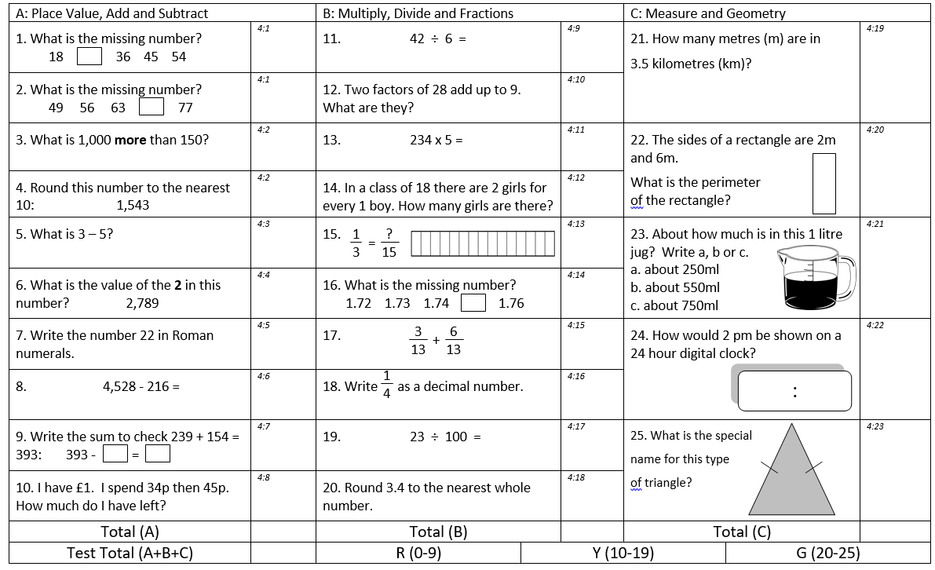
Homework
Set on a Wednesday – alternating English and Maths
To be completed and returned by following Tuesday
We encourage children to put a star * next to any questions they have struggled with
Marked together in class
Misconceptions can then be addressed
Children will bring home in a book

Slide 9
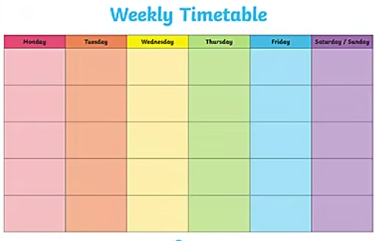
Homework Expectations

Slide 10
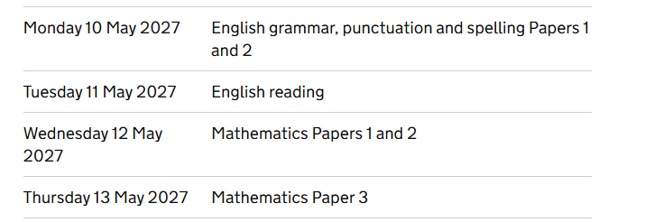
SATS
We will hold an online meeting nearer the time to discuss SATS in more detail. We will keep the website updated with websites that your children may find useful, and will also post a power point with points covered in the online meeting.
Monday 10th May – Thursday 13th May 2027

Slide 11
Exciting things to look forward to:
Bikeability sessions
Termly tournaments
Transition days at Holmes Chapel Comprehensive
Treat trip – TBC
Year 6 school production – Tuesday 13th July 2pm and Thursday 15th July 6pm
Leavers’ Assembly for parents – Tuesday 20th July 2pm

Slide 12
Autumn term’s curriculum - Topic – On our Doorstep!
Geography - 'The United Kingdom' (UK).
History - On the Move! A local study on how transport has shaped the local area, and how the local area has shaped transport.
Science - Animals including humans – The art of being human
French - (Taught by Mrs Jones) A l’école, Verbs and grammar/ project work
Music - (Taught by Mrs Jones) Unit 1: World unite Step dance performance
PHSE – Health and wellbeing
RE - Beliefs and Practices Key Question: What is the best way for a Muslim to show commitment to God?
Computing - Blogging
DT - Textiles – Christmas stockings
PE – Football, Netball, Basketball, Gymnastics
Art – Train posters, Stephenson’s Rocket, sculptures

Slide 13

P.E.
Our PE days are Tuesday (indoor) and Thursday (outdoor), children to wear PE kits and on the days they do clubs. If your child is unable to do PE, they must have a written letter explaining why. For PE, earrings must be covered with tape or taken out and watches taken off.
Plain t-shirt in their house colour or plain white (with or without logo)
Navy or black plain shorts/skort, plain dark leggings or jogging bottoms (to wear over shorts if the weather is cold)
Trainers
School royal blue sweatshirt (plus a plain blue/grey/black hoodie to go over the top during cold weather)
Pair of plain black pumps to keep in school (these are particularly useful for gymnastics lessons in the hall, and to provide alternative footwear if their outdoor shoes get very muddy). These need to be clearly named and preferably kept in a named drawstring bag.
Please avoid ‘fashion’ items of PE kit such as crop tops and brightly printed leggings. Football kits are also not acceptable for PE lessons in school.

Slide 14

We promote reading for pleasure – at school and at home!

Slide 15
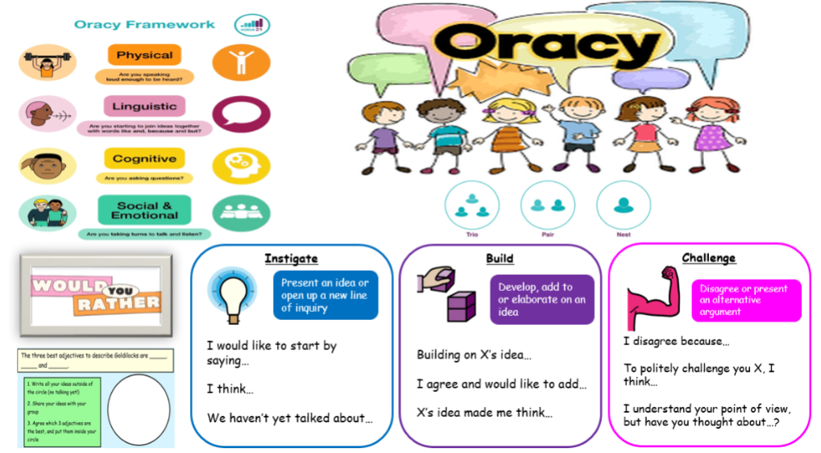

Slide 16

Be the best you can be!
Be Kind
Be Safe
Be Respectful

Slide 17

In Year 6 we use our website to update you on our weekly timetable. We will also update you on any events /changes or requirement for the following week.
We will update the pages regularly sharing any work we have photographed in class.

Slide 18

Online Safety
As we are aware, many year 6 children spend a lot of their time on social networks. We cover Esafety as part of our curriculum. We have had several issues concerning inappropriate use of such networks, in addition to texting and emails. This has led to some children becoming very stressed and upset in class.
When children bring issues relating to online activity into school, it can become very disruptive. Please be vigilant regarding your child’s online activity and encourage them to voice any of their concerns rather than try to deal with it on their own.
Should you need any more information please refer to the website.

Slide 19
Parents Evening
21st and 22nd October 2026
10th and 11th February 2027
All face to face sessions.

Slide 20
If you would like any help or advice regarding concerns you may have in relation to your child's mental health and emotional well-being, please do hesitate to contact our Learning Mentor/Mental Health Lead Mrs Lavin on
learningmentor@holmeschapelprimary.cheshire.sch.uk
Remember you can also talk to Mrs Gresty if you have any concerns – telephone 01477 533336 or email principal@holmeschapelprimary.cheshire.sch.uk

Slide 21
Concerns
Principal: Mrs F Gresty
Head of school and SENCO: Mrs V Bradford
Assistant Headteachers: Mrs T Noble (EYFS)
Mrs H Williams (KS1)
Mrs J Woods (KS2)
Learning Mentor: Mrs P Lavin
Please contact via their email or by telephone via the office.
Office Contact Details
Tel: 01477 (533336)
Email: Mrs Swindell in our school office will be happy to answer any questions or queries you may have.
Please email admin@holmeschapelprimary.cheshire.sch.uk

