Slide 1

Year 6 Parent
Information Evening

Slide 2
SATs
How are the children assessed?
ENGLISH
SPAG Tests
Paper 1 (Punctuation & Grammar)(50 marks)
Paper 2 (Spelling) (20 marks)
Reading Paper (50 marks)
MATHS
1 Arithmetic Paper (40 marks)
2 Reasoning Papers (35 marks each)
Your child will receive a raw score and a scale score, as well as a statement of either:
Standard met OR Standard not met
Notes:
Look at materials – explain how scores work
2

Slide 3
SATs
Timetable For The Week:
Monday 11th May 2026: SPaG Test- Grammar/Punctuation- 45 minutes
Monday 11th May 2026: SPaG Test- Spelling- 20 minutes
Tuesday 12th May 2026: Reading Test- 60 minutes
Wednesday 13th May 2026: Maths Paper 1 (Arithmetic)- 30 minutes
Wednesday 13th May 2026: Maths Paper 2 (Reasoning)- 40 minutes
Thursday 14th May 2026: Maths Paper 3 (Reasoning)- 40 minutes
Tests will be completed in the classrooms with all displays covered.
Notes:
Point out difference between teacher assessment and national assessment – a snapshot
Teacher assessment draws together everything the teacher or teachers know about a child, including observations, marked work and school assessments.
Tests are a ‘snapshot’ of a child’s abilities on that day.
There can be a difference between teacher assessment results and test levels.
3

Slide 4
The Tests
The test results will be available mid-July and will be issued with end of year reports if possible.
High schools will use the information to set targets for the children. They may also conduct their own assessments to ensure that groupings and activities are tailored to meet the learning needs of all individuals.
OFSTED use the SAT results as a key indicator of a school’s effectiveness.
Children’s progress, as well as their achievement, will be measured and reported on in school performance tables.
Notes:
4

Slide 5
Scaled Scores
What is meant by ‘scaled scores’?
It is planned that 100 will always represent the ‘national standard’.
Each pupil’s raw test score will therefore be converted into a score on the scale, either at, above or below 100.
Using the scaled score, the lowest a child can score is 80, with the highest being 120.
A child who achieves the ‘national standard’ (a score of 100) will be judged to have demonstrated sufficient knowledge in the areas assessed by the tests.
Each pupil receives:
a raw score (number of raw marks awarded);
a scaled score in each tested subject;
confirmation of whether or not they attained the national standard.
Notes:
5

Slide 6
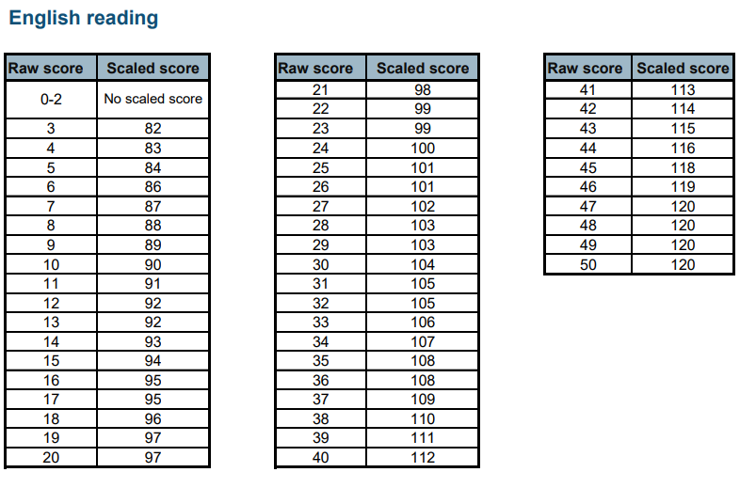
SATs
Notes:
Point out difference between teacher assessment and national assessment – a snapshot
Teacher assessment draws together everything the teacher or teachers know about a child, including observations, marked work and school assessments.
Tests are a ‘snapshot’ of a child’s abilities on that day.
There can be a difference between teacher assessment results and test levels.
6

Slide 7
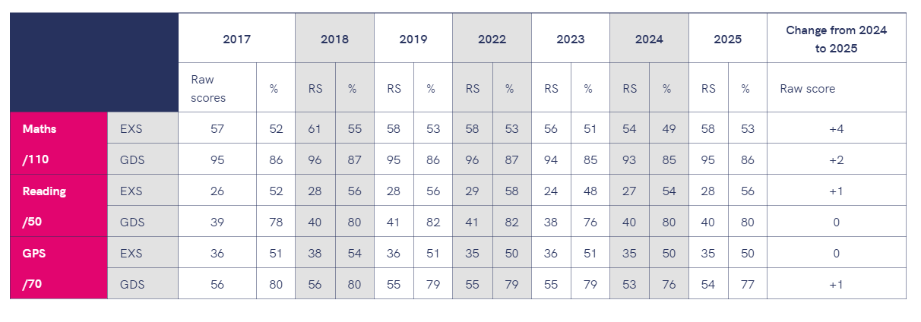
SATs
Notes:
Point out difference between teacher assessment and national assessment – a snapshot
Teacher assessment draws together everything the teacher or teachers know about a child, including observations, marked work and school assessments.
Tests are a ‘snapshot’ of a child’s abilities on that day.
There can be a difference between teacher assessment results and test levels.
7

Slide 8

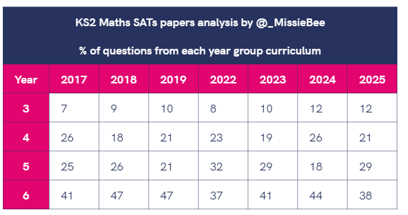
SATs
Notes:
Point out difference between teacher assessment and national assessment – a snapshot
Teacher assessment draws together everything the teacher or teachers know about a child, including observations, marked work and school assessments.
Tests are a ‘snapshot’ of a child’s abilities on that day.
There can be a difference between teacher assessment results and test levels.
8

Slide 9
Reading
The reading test consists of a single test paper with three unrelated reading texts. Children are given 60 minutes in total, which includes reading the texts and answering the questions.
A total of 50 marks are available.
Questions are designed to assess the comprehension and understanding of a child’s reading.
During the reading paper, a child’s inference and deduction skills are thoroughly tested. They will also be expected to answer questions on authorial choices: explaining why an author has chosen to use particular vocabulary, grammar and text features.
Some questions are multiple choice or selected response; others require short answers and some require an extended response or explanation.
Notes:
9

Slide 10
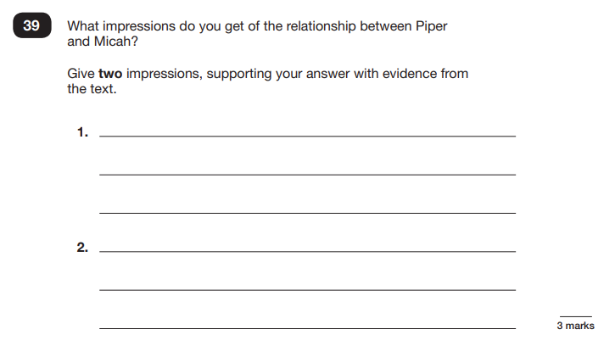
Sample Questions
Reading Paper
Notes:
10

Slide 11
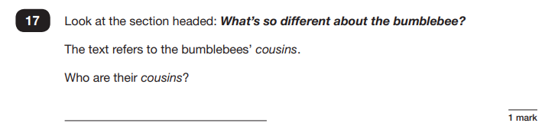
Sample Questions
Reading Paper
Notes:
11

Slide 12
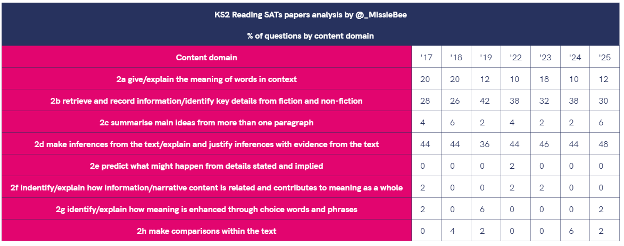
SATs
Notes:
Point out difference between teacher assessment and national assessment – a snapshot
Teacher assessment draws together everything the teacher or teachers know about a child, including observations, marked work and school assessments.
Tests are a ‘snapshot’ of a child’s abilities on that day.
There can be a difference between teacher assessment results and test levels.
12

Slide 13
Spelling, Punctuation and Grammar
The Grammar, Punctuation and Spelling Test:
The grammar test will last for 45 minutes and there will be a total of 50 marks available.
There is a specific focus on knowing and applying grammatical terminology with the full range of punctuation tested.
Technical terms in grammar will be tested.
There will be one test paper for grammar, punctuation and vocabulary and one test paper for spelling.
Notes:
13

Slide 14
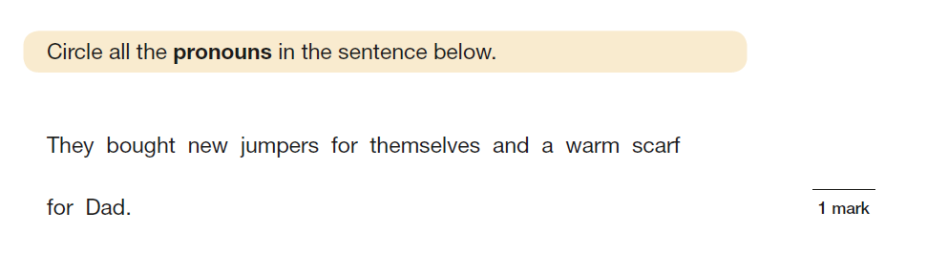
Sample Question
Notes:
14

Slide 15
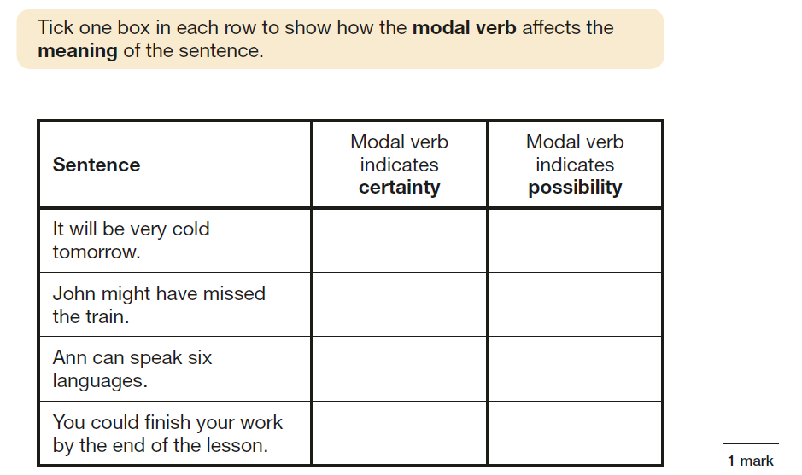
Sample Question
.
Notes:
15

Slide 16
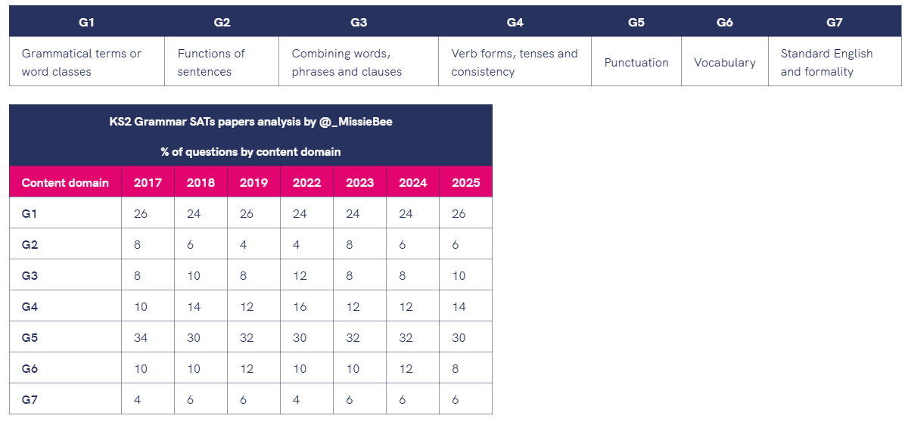
SATs
Notes:
Point out difference between teacher assessment and national assessment – a snapshot
Teacher assessment draws together everything the teacher or teachers know about a child, including observations, marked work and school assessments.
Tests are a ‘snapshot’ of a child’s abilities on that day.
There can be a difference between teacher assessment results and test levels.
TALK ABOUT WRITING HERE
16

Slide 17
Mathematics
Children will sit three tests: paper 1, paper 2 and paper 3.
Paper 1 is for arithmetic, lasting for 30 minutes, covering calculation methods for all operations, including use of fractions, percentages and decimals.
Papers 2 and 3 cover problem solving and reasoning, each lasting for 40 minutes.
Pupils will still require calculation skills but will need to answer questions in context and decide what is required to find a solution.
Notes:
17

Slide 18
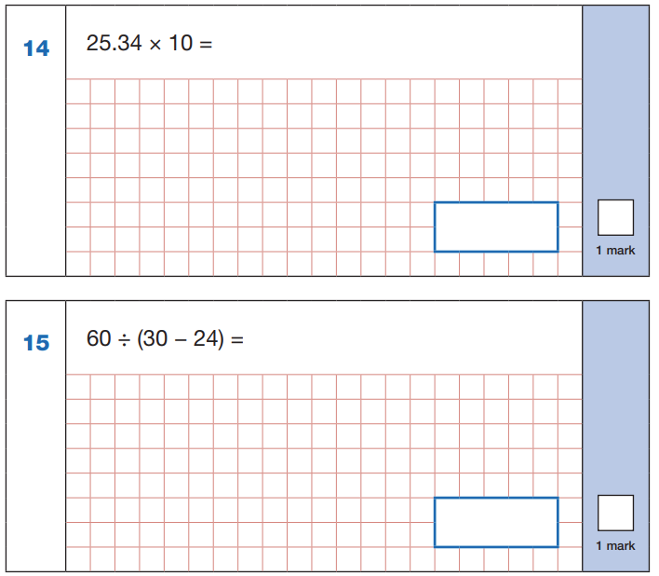
Sample Questions
Maths Paper 1: Arithmetic
Notes:
18

Slide 19
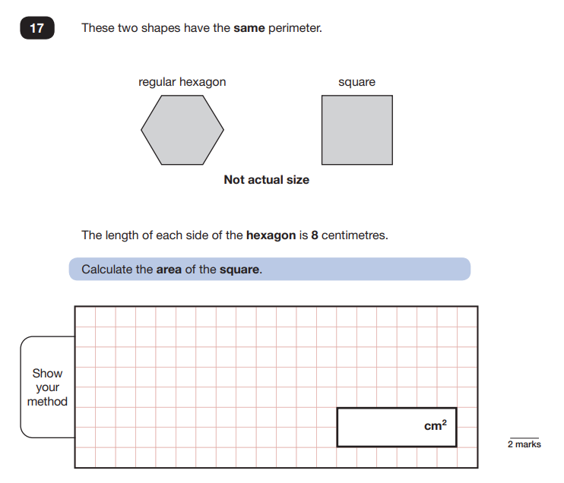
Sample Questions
Maths Paper 2 / Paper 3 : Reasoning
Notes:
19

Slide 20
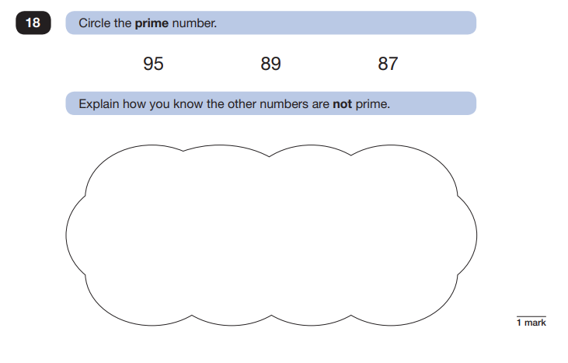
Sample Questions
Maths Paper 2 / Paper 3 : Reasoning
Notes:
20

Slide 21
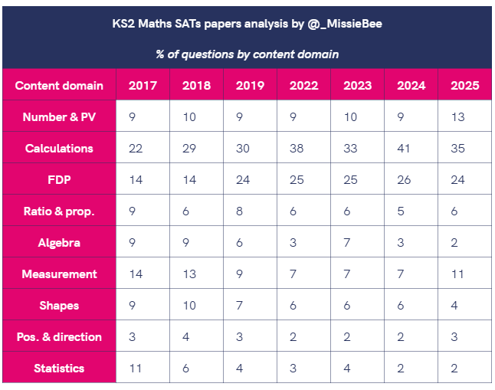
SATs
Notes:
Point out difference between teacher assessment and national assessment – a snapshot
Teacher assessment draws together everything the teacher or teachers know about a child, including observations, marked work and school assessments.
Tests are a ‘snapshot’ of a child’s abilities on that day.
There can be a difference between teacher assessment results and test levels.
21

Slide 22
Access Arrangements
Some pupils may be eligible for additional arrangements to be put in place so that they can take part in the key stage 2 tests.
Access arrangements are adjustments that can be made to support these pupils. We have considered whether any of our pupils will need access arrangements before we administer the tests.
Access arrangements are based primarily on normal classroom practice and they never provide an unfair advantage. The support given does not change the test questions and the answers are the pupil’s own.
Notes:
22

Slide 23
Access Arrangements
What happens if a child misses a SATs?
They are statutory so the child will have to sit them. When the child returns to school, they are not allowed to be with their friends and peers until they have completed the test they missed.
Notes:
23

Slide 24
Our Priority:
Happy
Confident
Prepared
Notes:
Children who feel as though they are challenged in their learning and work hard to achieve, feeling happy and successful.
Children who take responsibility for their own learning and work hard to ensure they reach their potential.
Children who know that there is more to life than Maths and English, who have time and space to invest in the things that they love doing.
Children who believe in themselves and feel equipped and prepared for the challenge in front of them.
Learning for life – some of our learning includes test technique, they have to feel prepared – but
Good Habits
Homework – SAT standard and keeps exposing and consolidating key skills.
Punctuality – Some of our most valuable learning and time is between 8.45 and 9am.
Attendance
Early nights and good breakfasts
If a child does not reach the expected standard in their SATs, it is important to remember that these tests are only one snapshot of their learning at a particular moment in time. They do not define a child’s overall ability or potential.
The results are primarily used to help teachers understand where pupils may need additional support as they move forward in their learning. If a child does not meet the expected standard, the secondary school will use this information, along with teacher assessments and other transition information, to ensure appropriate support is in place.
Our focus remains on helping every child continue to develop confidence, skills, and a love of learning. We will always work closely with families to support pupils in the areas where they need it most.
Continuous Assessment – identifying the gaps and helping to fill them
Focused arithmetic sessions
Focused GPS lessons (Spelling, Punctuation & Grammar)
Guided and Independent Reading
Modelled and independent writing assignments carried out regularly
Practising previous SATS papers
Teaching ‘test techniques’ and vocabulary
Home Learning to support teaching & learning in school
Booster groups and intervention groups
Keeping up to date with information provided by the DfE
Brain breaks
Full curriculum
.
24

Slide 25

Brainy Breakfast:
Notes:
Advertise evening
Purpose
Packs and resources
Ideas of how to make homework as pain free and purposeful as possible
Bring grandmas and grandads – film for children – childcare.
25

Slide 26
Dearne Valley 2025

Slide 27
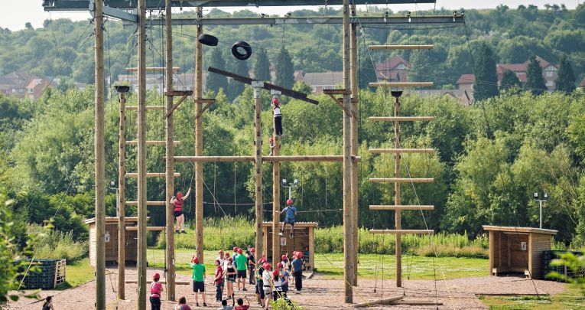
When and where?
PGL Dearne Valley is an outdoor activity and residential adventure centre located in South Yorkshire
Wednesday 1st July – Friday 3rd July
https://schoolsandgroups.pgl.co.uk/centres/dearne-valley/

Slide 28
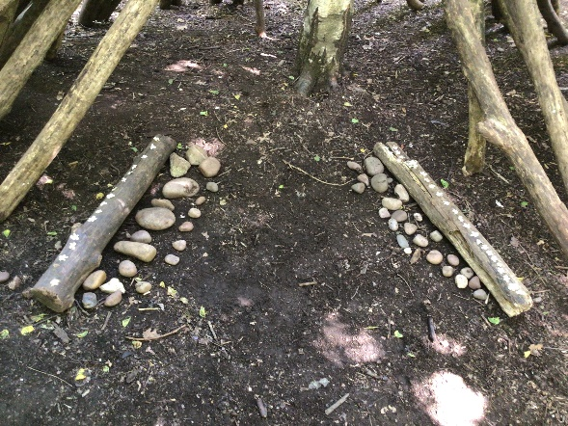
Adults on the trip
Miss Roxburgh
Miss Ackerley
Mrs Hill
Mrs Mitchell
Mrs Wall
TBC

Slide 29
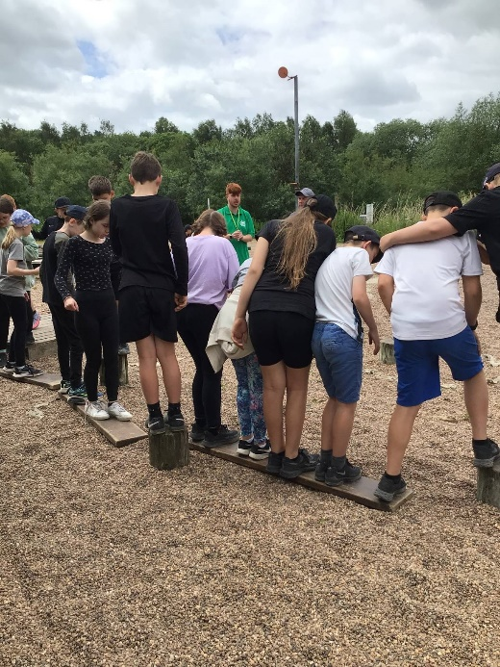
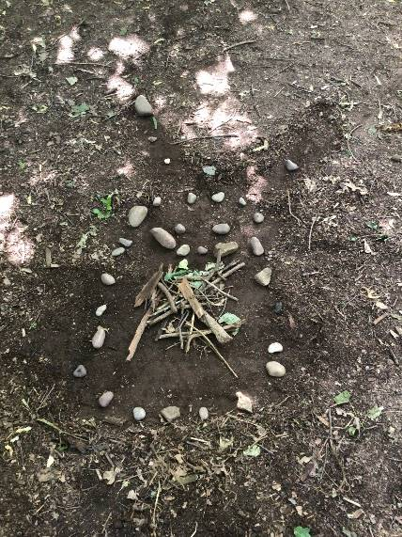
ACTIVITIES
Jacobs Ladder
Zip wire
Abseiling
Problem solving
Orienteering
Evening activities TBC
An instructor from the centre will deliver the activities and an adult from our school will be with the children for all the activities.

Slide 30
CLOTHING
The kit list suggests clothes and toiletries to bring. The best advice is layers!
Suncream
Children need long sleeved tops and trousers for certain activities – this is mandatory so please remember to pack a couple.
It is NOT a fashion show!! Grips on trainers/boots, warm layers and waterproofing are the most important things! Clothes may get snagged or torn so it is best to only bring OLD items.
Please label all items so we do not have any lost property issues!!

Slide 31
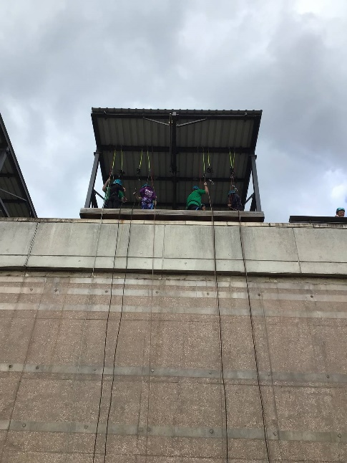
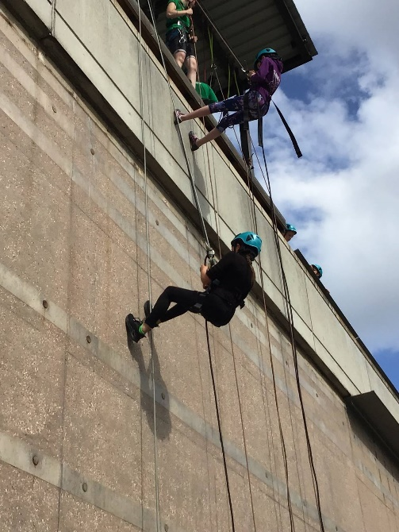
Children will need to be wearing suitable clothing for their first activity as soon as we reach the centre.

Slide 32
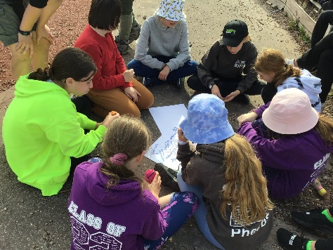
Cameras etc
We recommend that children do not bring cameras. We will take school cameras and iPads to capture lots of memories.
The children do not need to bring any money – all food, snacks etc. are provided and we are not visiting any shops.

Slide 33
Games
We recommend that children bring card games, doodle books or reading books to keep themselves busy on the coach/in their dorms.
NO phones or electronic games.
We ask parents not to pack children ‘midnight snacks’
Children are welcome (and encouraged) to bring a soft toy or blanket to make them feel comfortable at night.

Slide 34
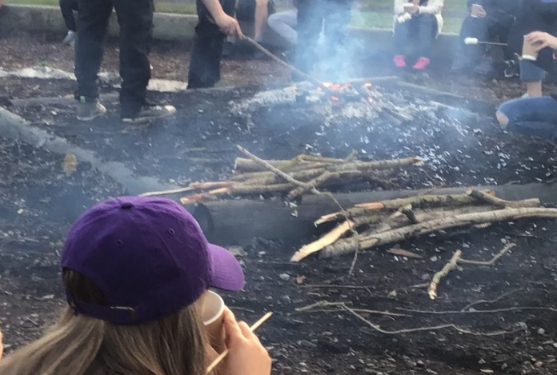
Food
https://schoolsandgroups.pgl.co.uk/menus-and-mealtimes-at-pgl/#menus
Breakfasts, packed lunches and evening meals will be provided by the centre each day apart from lunch on the first day (Wednesday).
There are plenty of lovely options so all children can choose a favourite.
If your child has any dietary requirements, please ensure that Arbor is up to date as that is where we will pull the information from.
If there is anything additional you feel we need to know, please contact us directly.

Slide 35
Accommodation
Children will be allocated dorms and put into activity groups.
We will give every child the opportunity to write down three children they would like to share a room with (1 guaranteed). From this information, we will start the allocation process.
En-suite rooms
Rooms vary in size from 4 to 10 beds
Rooms are single-gender
Please bring a pillow and sleeping bag as only the bottom sheet is provided by the centre.

Slide 36
Parental Consent Forms
As mentioned before, we will be gathering doctor’s details and dietary requirement from Arbor – please ensure this information is up to date. A consent box will be sent to you for you to confirm this.
We will send the following form home:
Request for the school to give your child medication (green)
Please ensure Arbor is updated and/or the form is returned to school by 25th April 2026
We will also provide a kit list / checklist (white) – this does not need to be returned.

Slide 37
Medication
Any medication, inhalers, travel sickness etc should be given to your child’s class teacher in a clearly labelled, sealed bag.
Please try to do this before the morning of our departure.
Mrs Mitchell will be in charge of medication. There will be a table set up in the hall for you to sign the medication in before we leave.
Details of dosage and frequency needs to be clearly outlined on a completed medication form.
Please also remember to collect and sign out the medication when we return.

Slide 38
The Day of Departure!
Children should bring all of their luggage labelled and medication labelled (if required) on Wednesday 1st July
Packed lunch in a disposable bag
Rucsack for the journey
Please arrive at school at normal time – they will be met by a member of staff on the playground to show them where to put their bags
The coach will depart at approx. 10am
Parents/family are more than welcome to wait and wave us off!!

Slide 39
And finally!!
Return to school Friday 3rd July 3.20pm
(traffic pending).
Your children will be very tired, but satisfied and proud!
They will have taken part in activities that they never imagined they were capable of and will have definitely have had a great time!
If we are back during school time, children will be collected from the playground as usual. If we are a little late, school will be in contact with you via Arbor with information.
We will also send out the emergency out of hours contact number via Arbor before we leave. This will be manned by a member of staff in Holmes Chapel, who will contact staff on the trip if necessary.

Slide 40
Payment
Thank you to everyone who has paid the 1st and 2nd payment
15th January £ 50.00
15th March £ 89.75
15th May £89.75
Confirmed cost: £229.50

Slide 41
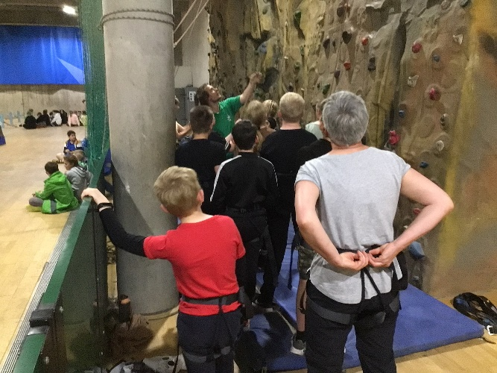
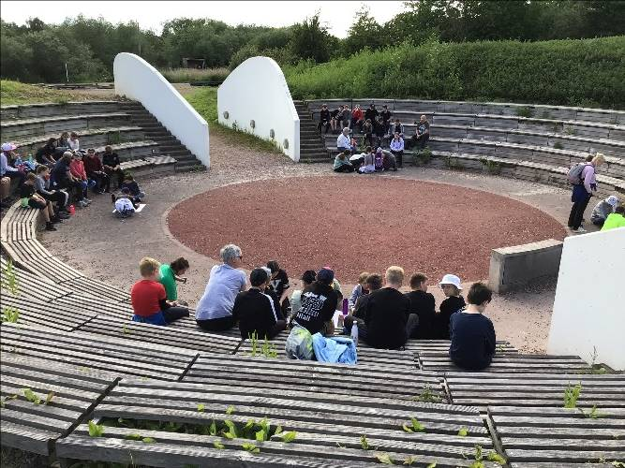
Any questions?

