Slide 1
Welcome to Year 2

Slide 2
Teachers and Teaching assistants in Year 2
Class 2
Class 2a
Ms Lackford
Mrs Lal (Mon-Thurs)
Mrs Parker (Friday)
Miss Brett
Mrs Ventre
Mrs Whalley across the year (Mon-Thurs PM)
Miss Beechener and Mrs Awoyomi on Tuesdays for PPA

Slide 3
What is the best way to contact us at school?
If there is anything you need to tell us, please either -
Write a note, and remind your child to give it to us;
Leave a message with the office - it will be brought to our attention;
If there is anything you are unsure of, please email the office if urgent admin@holmeschapelprimary.cheshire.sch.uk, or the class emails which will be checked approximately once a week:
Class2@holmeschapelprimary.cheshire.sch.uk
Class2a@holmeschapelprimary.cheshire.sch.uk
School will only call home in the event of a serious incident.

Slide 4
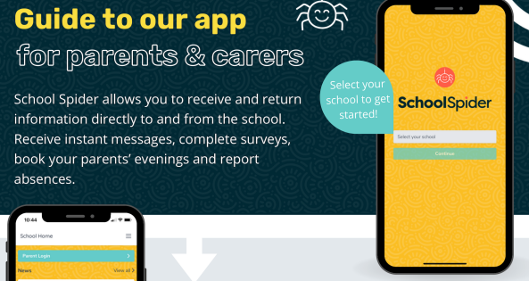
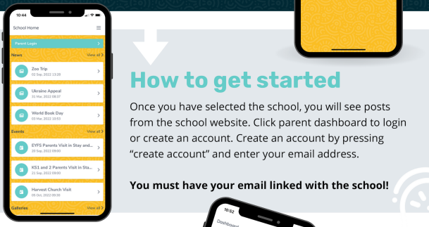
Communication – School Spider
The most efficient for you to stay up to date with communication.

Slide 5
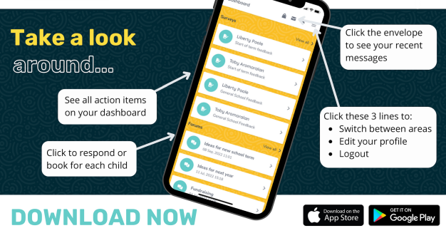
Communication – School Spider
Refer to email sent 9th September for more information.

Slide 6
If you have any concerns or worries and you can’t find us
Other points of contact:
Mrs Gresty - Principal
Mrs Bradford – Head of School
Mrs Williams - KS1 Assistant Head & Y1 teacher
Further Support -
Mrs Lavin (Learning mentor)
Mrs Bradford (SENDCo)

Slide 7
Daily routine in Year 2
8:40 – 8.50 Start of the day - Please enter from either Middlewich Road or Jubilee Walk gates, and send your child straight in through the doors at the end of the corridor. Register is taken at 8.50am and gates will be locked at 8.50am.
3:20 Home time – Children will be brought out through the end doors and taken to the area behind the cordon. Please let your child know where you will be standing so they can find you easily.
Children are not permitted to ride bikes and scooters on the playground, nor play on the play equipment before or after school.

Slide 8
What is covered in the curriculum in Year 2?
Main topics in Year 2
Autumn – India (Geography)
Spring – Local Study: Jodrell Bank (History)
Summer – The Lives of Children during World War 2 (History)

Slide 9
Trips
Trips in Year 2
Village Walk (September/ October)
Stockport Air Raid Shelter – Monday 15th June 2026

Slide 10
Phonics & Reading – Little Wandle
The phonics scheme we follow in school is called Little Wandle Letters and Sounds which the children followed last year.
Year 2 > Phase 5 review > Bridge to Spelling >Spelling units
Children will be assessed regularly and this will inform reading book bands.
Further information can be found via this link: https://www.littlewandlelettersandsounds.org.uk/resources/for-parents/

Slide 11
Reading – Little Wandle
All children will read as part of a guided reading group three times per week (week beginning 8th September 2025)
Books to be sent home:
Reading Practice Books
Sharing books – 1 Reading for Pleasure book
Books will be collected on Tuesdays and a new one sent home each Thursday. The expectation is that children read at home for a minimum of 10 minutes each day).
Re-reading a book is excellent for developing comprehension and fluency.

Slide 12
Reading folders
Reading folders will go home on Thursdays. Please send them back on Tuesdays.
Please check them every week.
They may contain: Notes and letters.
Homework and support materials.
Things your child has made (Easter cards, pieces of work that are important to them).

Slide 13
School Library
The children are encouraged to read for pleasure and each class visits the school library weekly.

Slide 14
Spelling
Year 2 spelling rules will be taught each week using the Little Wandle scheme which builds on Phonics teaching.

Slide 15
Feedback
We are eager to ensure that feedback for work completed is as effective as possible.
Written feedback will be used where it is appropriate;
Some feedback will be verbal (whole class, group or individual);
This means that there will not always be green pen on every piece of child’s work.

Slide 16
E-Safety
Through e-safety, the children are taught about many aspects:
Staying safe online
Digital trails
Cyber bullying
Effective internet searching using key words
Evaluating and choosing websites they like
Please support us in this by choosing age appropriate games, films and apps for your child. Guidance to age ratings can be found online.

Slide 17
What homework can we expect in Year 2?
‘Homework Menu’ where the children choose at least one piece of homework to complete each half term; however, they can complete as many as they want! There will be a date when the homework is due in then the children will share it with their class. We would like to encourage all work to be emailed in where possible, but it can be brought in.
Reading – It is important for an adult to read at home with your child daily.
Times tables (TTRockstars) – The children will receive login details for this from January. By the end of Year 2, the children need to know their 10x, 2x and 5x tables.

Slide 18
When are our PE Days?
All Year 2 children have indoor PE every Monday and outdoor PE every Thursday.
We will continue to go outside as the weather deteriorates.
Children should wear PE kit on PE days:
Plain t-shirt in their house colour or plain white (with or without school logo).
Navy or black plain shorts/skort, plain dark leggings or jogging bottoms (to wear over shorts if the weather is cold).
Plain black trainers – preferably with Velcro fastening (unless they can tie their own laces independently) .
School blue sweatshirt (plus a plain blue/grey/black hoodie to go over the top during cold weather – no slogan/logo).

Slide 19
Coats
Please ensure your child has a coat every day – we do go out even if it’s raining. Often it can rain on a day where it looks like it may not.

Slide 20
School Rules – Be the best you can be!
Be kind
Be respectful
Be safe

Slide 21

British Values
We will make reference to the five British Values during our teaching.

Slide 22
Behaviour Charter
You should have all received a paper copy of the behaviour charter to keep at home.
Please take the time to read through and discuss this charter as a family.
Please keep it at home for reference.

Slide 23
Rewards
Proud Cloud – linked to the school rules. When we spot children who make us proud, their peg moves onto the proud cloud.
Cube jar – Cubes are given to the whole class when they are working together positively as a class. Counters can also be collected for individual achievements. When the counter jar is full, the counters can be exchanged for a cube.
VIP – One child is chosen at random; they have special jobs to do in the classroom, have a special place to sit and they can line up at the front of the line as well as a number of other things.

Slide 24
Snacks & Water Bottles
Toast is available daily. Please order and pay on ParentPay
Bacon sandwiches are available on a Friday. Please order and pay on ParentPay
Fruit is available daily.
The children may bring in a healthy snack from home. There are children in school with severe milk allergies and nut allergies - we are a nut-free school
Children are encouraged to drink water regularly. Please ensure that water bottles have a sports cap, not a screw top as these often spill.
No juice!

Slide 25
What else do you need to know about Year 2?
Parents’ Evening
Autumn term parents’ evening will be on Wednesday 22nd and Thursday 23rd October 2025.
Spring term parents’ evening will be on Wednesday 11th and Thursday 12th February 2025.
SATS
SATs are no longer statutory for Year 2 children, however we will use past papers as informal assessments.

Slide 26
Further information…
Toys
Children are not to bring toys in from home, please.
Please don’t attach objects to bags as they will get tangled and miht cause or be damged. We will remove them and send them home.
Parent Helpers
We always welcome helpers, especially reading helpers in KS1; If you are interested in coming in to school to help, please let us know.

Slide 27

Sports Events
Cross Country Competition
Friday 12th September
Children should wear their PE kit with coloured t-shirt.
Winners to be announced in assembly the following week.
Notes:
In order to raise the profile of sport even more, we will be introducing events throughout the year to enable more children to access sporting competition.
Starts with a cross country event on Friday 13th September. Children will compete for their house and the trophy will be awarded to the winning team in assembly.

Slide 28
School Website
Each week, we will update the Year 2 class page on the school website to say what is happening in Year 2 each week. In addition, any extra information about the following week will also be posted. The homework menu is on the main Year 2 page.
You can also find further information about how to help your child at home with reading, our topics, how to stay active, staying safe online, times tables and wellbeing.
http://www.holmeschapelprimary.org.uk/

Slide 29
PTA
The PTA is very keen to have more parent members join – please look on the school website for more information.

Slide 30
Questions?
If you have any questions, please see us at the end of the school day or email us on the class email address:
Miss Brett – Class2@holmeschapelprimary.cheshire.sch.uk
Ms Lackford - Class2a@holmeschapelprimary.cheshire.sch.uk
Please note, these are only checked once a week.

