Slide 1

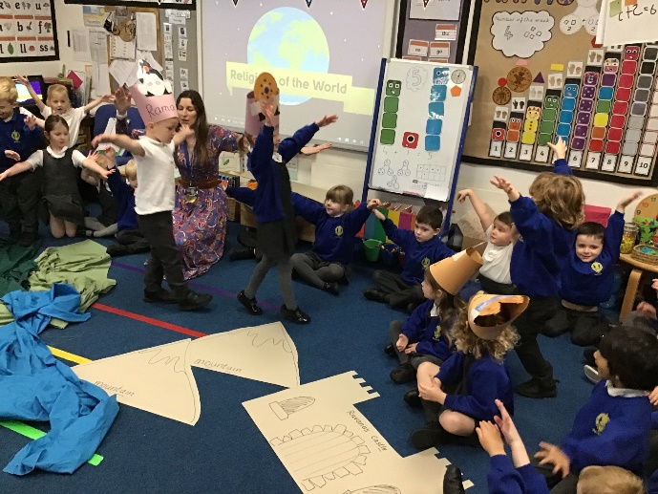
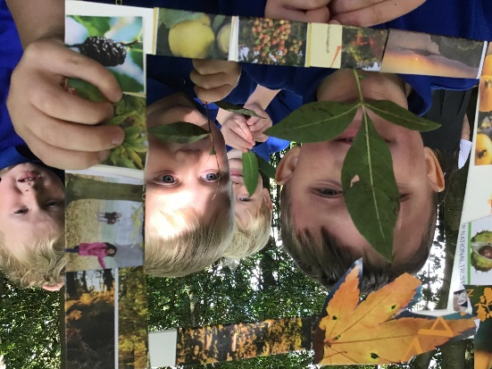
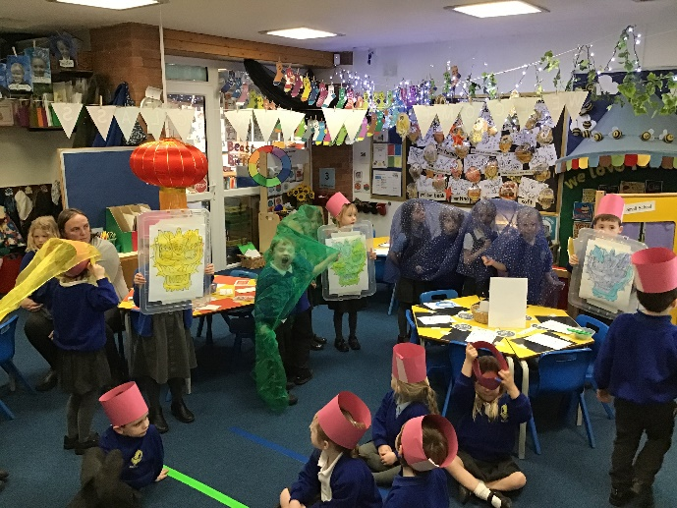
Holmes Chapel Primary School
Welcome to Reception

Slide 2
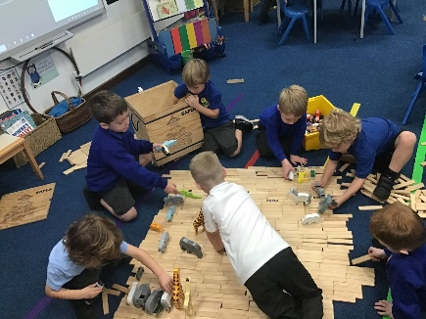
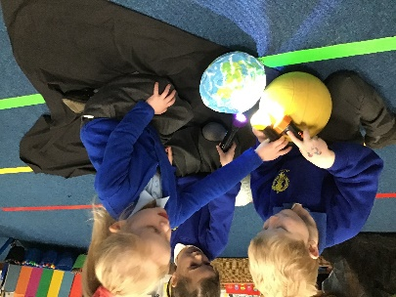
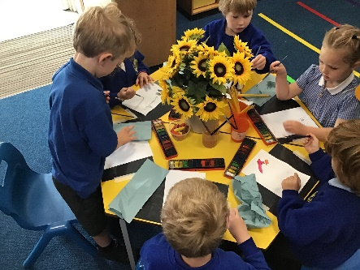
Holmes Chapel Primary School
Learning:
Play based curriculum – Our learning is fun, active and child-led.
Our learning is based on the Early Years Foundation Stage 7 areas of learning:
Personal Social Emotional Development
Physical Development
Communication and Language
Literacy
Maths
Understanding the World
Expressive Arts and Design
Each half term, we will have a different learning stimulus, throughout which all the different areas of learning will be taught. In the Autumn, we will start with the topic: Superhero, Super me!

Slide 3
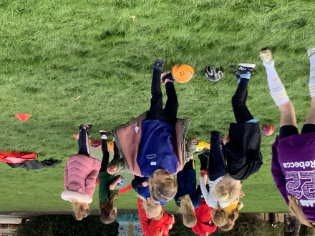
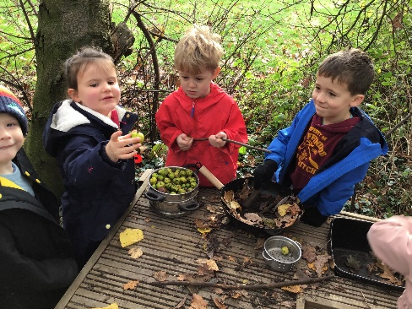
Holmes Chapel Primary School
Key skills coming into Reception
Social skills
Playing with others, sharing and taking turns
Displaying friendly behaviour – greeting adults and other children and using ‘please’ and ‘thank you’
Being aware of rules and learn to follow them
Speaking and listening
Joining in with familiar nursery rhymes and songs
Asking for help
Having the confidence to speak to other children and adults in their class
Sitting quietly and listening to others for short amounts of time.
Learning skills
Being able to recognise their own name
Being happy to share and discuss books and things that interest them

Slide 4
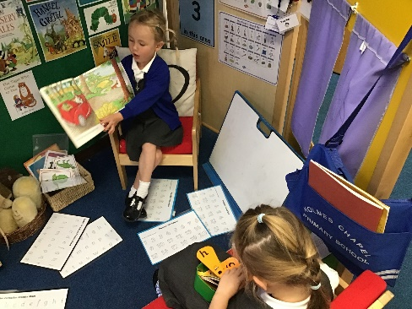
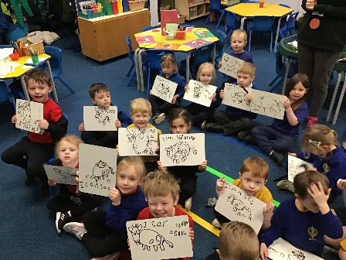
Holmes Chapel Primary School
Organisation
For the first few weeks, the children will be all together whilst they familiarise themselves with the classroom environment, the other children and the staff. We will then split the children into two classes (R and Ra). The children will be registered and taught Phonics, Maths and Literacy in their classes, but will be free to move around our four areas during continuous provision sessions. Teachers and teaching assistants will work with all children across both classes throughout the week.
Once the children have found their feet, we will assign them all a Year 6 buddy. This has proved very popular with both the Reception and the Year 6 children. They are a friendly face around school and we meet up to share activities regularly.

Slide 5
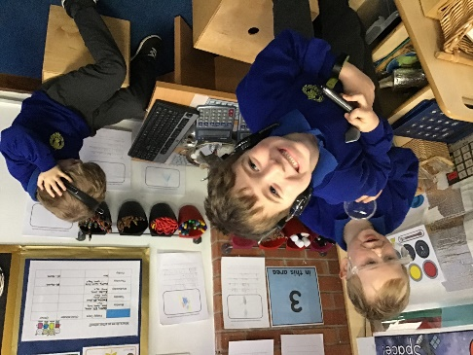
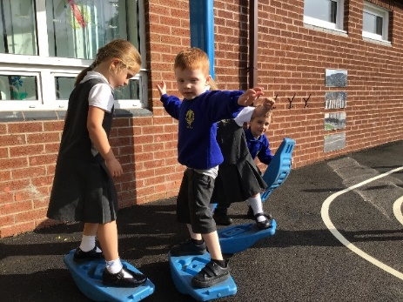
Holmes Chapel Primary School
Helping your child be ready for school
Can your child:
Go to the toilet independently and manage their own personal hygiene, including washing their hands and blowing their nose with a tissue?
Put on and zip up their own coat?
Follow simple instructions?
Feed themselves using a knife and fork?
Dress and undress for PE by themselves?

Slide 6
Holmes Chapel Primary School
General Housekeeping
Bags: The children will need a small bag which will fit in their A4 reading folder and water bottle. Please do not send big bags in – they end up getting trampled on! Your child will be provided with a reading folder and water bottle.
Snacks: Children can bring in a healthy snack from home to eat at morning play. Alternatively a selection of fruit is provided for all children daily, or they can purchase toast (25p tbc – to be pre-ordered weekly via Parent Pay). Please ensure your child has a full water bottle in school every day (no juice or squash please).
Lunch: All KS1 children are entitled to a free school meal. There is a choice of two meals daily – at least one of which will be vegetarian. Menus are available for you to view at home and meals can be pre-selected (via parent pay), or the children can tell us which option they would like on the day. Alternatively you can send your child in with a packed lunch. It is very important that you inform us of any allergies. All snacks and packed lunches must be nut free.
Medication: If your child has been prescribed medication, this must be handed into the school office and a consent form completed.
Dropping off and collecting: Gates will open at 8:40am and registration is taken at 8:50am. This allows for a calmer start to the day, as the children come in gradually. Please say goodbye to your child at the Reception gate, where there will be a member of staff to welcome them. School finishes at 3:20pm, please wait until your child is at the front of the line, before giving us a wave. Children will only be released to known adults. If you have made arrangements for an alternative adult to collect your child, you must inform the office.

Slide 7
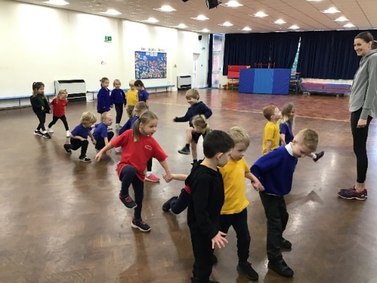
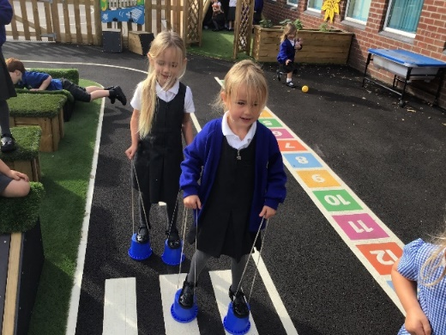
Holmes Chapel Primary School
Uniform
Grey shorts, trousers, skirts or pinafore
Blue and white summer dress
White or blue polo shirt
Blue sweatshirt or cardigan
Black school shoes- suitable for running around outside in – must be velcro
www.samdaleandson.co.uk – Provides branded school items
PE kit: team colour t-shirt, black shorts and black pumps in a named drawstring bag
All children will need a PE kit in school. This should be sent in at the start of each half term and will be sent home to be washed at the end of a half term. Their PE bag and ALL the items in it should be clearly named.

Slide 8
Holmes Chapel Primary School
Communication
We would like all parents to feel they can come and speak to us with any questions or concerns they have. Our priority at drop off and pick-up is ensuring that all children enter and leave the school safety, so it will not always be possible to speak to you at these times. If you leave a message with the office, we will contact you as soon as we can.
Please tell us who is picking up: regular and last minute arrangements
If your child is unwell, please email the school office each day
Website – Reception Gallery weekly photos (if we have permission) and half-termly information
Information evening/stay and play sessions – Phonics date TBC
Website, Weekly newsletter from the Principal via Website (School Spider).
Emails: Class emails will not be checked during the day, if you have information about your child that we need to know urgently, please contact the school office and they will get a message to us.
Mrs Noble/Mrs May: classr2025@holmeschapelprimary.cheshire.sch.uk
Miss Sanchez: classra2025@holmeschapelprimary.cheshire.sch.uk
School office: admin@holmeschapelprimary.cheshire.sch.uk

Slide 10



Slide 11



Antenatal appointments
Babies Together 0-1
Health Development Checks
Stay and Play 0-5
Little Stars (SEND play group)
0-5 in term time / 0-11yrs school holidays
Young Parents (under 25)
Weaning
Cherubs

Slide 12

Our digital offer is the Family Hub ‘in your hand’ and offers valuable support and signposting to those who need universal and extra help.

Slide 13


Slide 14


Slide 15
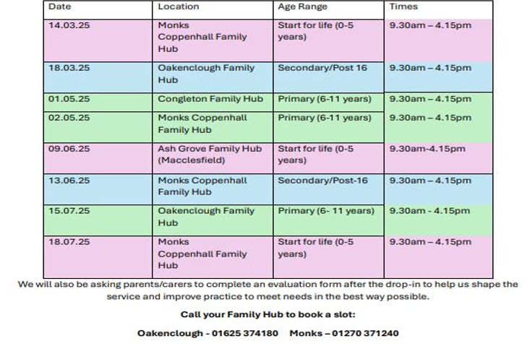


Slide 16


Slide 17

School Readiness Questionnaire
Autumn Term

