Slide 1

English Friday 26 February
Finally, it is time to write your diary.
Are you going to be Sally writing your diary or Sam writing your diary?
Use your plan to write a paragraph for each day of your diary.
What to include in your plan
dates
first person writing – i. me. my
past tense
thoughts, feelings, emotions
adverbs of time
sequence
list sentence
repetition sentence
full stop, finger space, capital letter
Good paragraphs will include:
The features of diary writing
A list sentence or repetition
Full stops and tall capital letters
Good spelling
Fabulous paragraphs will include:
The features of diary writing
A list sentence
Repetition
Full stops, tall capital letters
! ? commas
Accurate spelling
Extra details
sound button

Slide 2
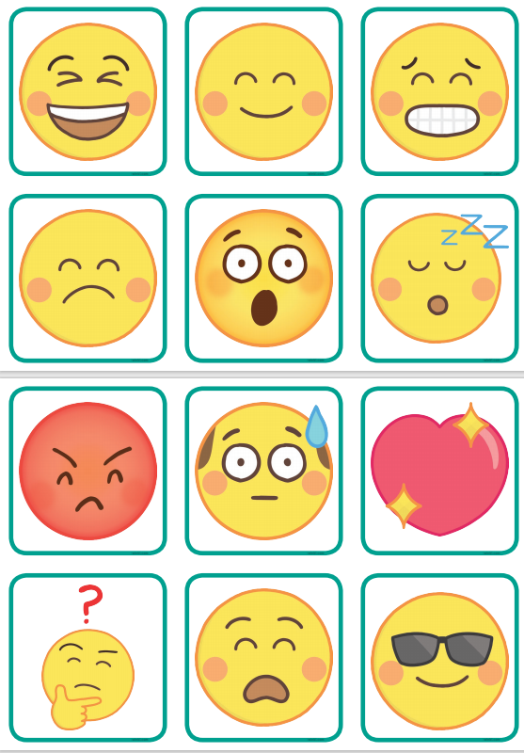
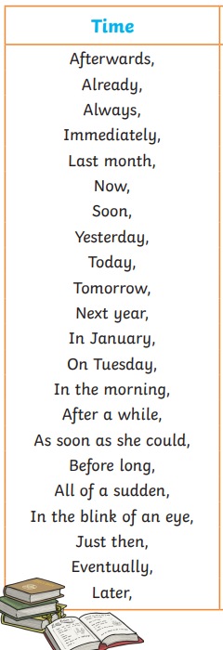
sound button

