Slide 1
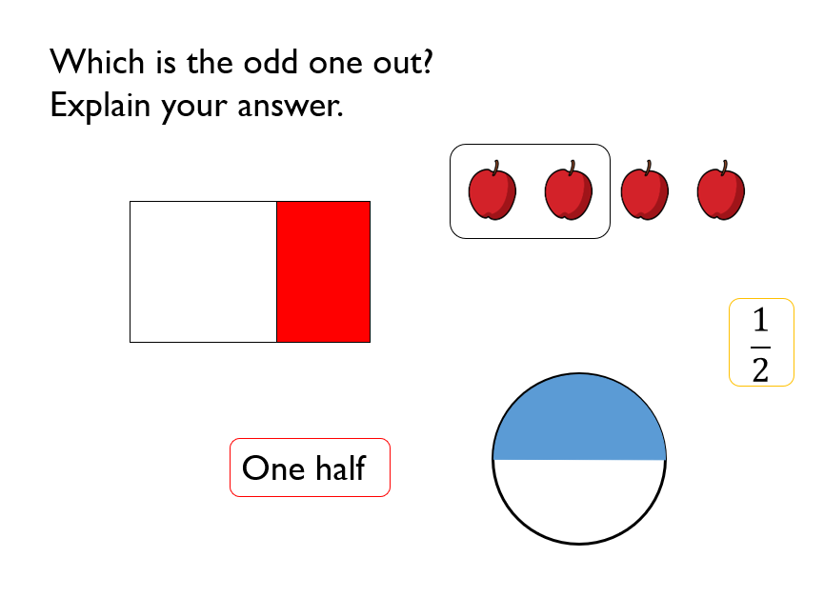

Slide 2
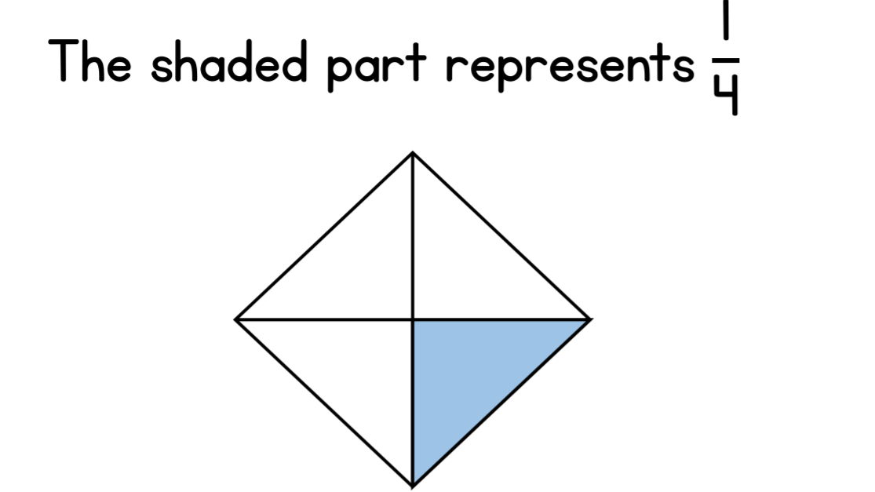
True or false?

Slide 3
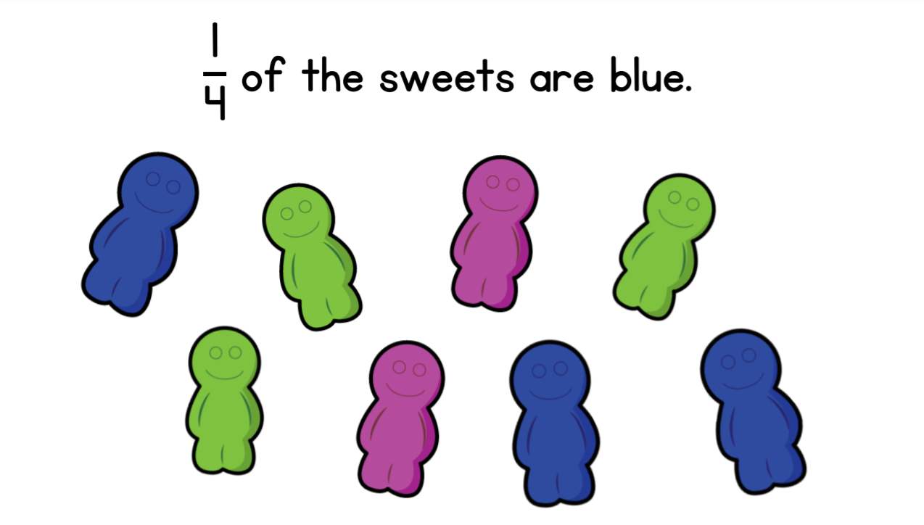
First work out what is ¼ of 8 using the bar model.
Then answer the question. True or False?
Is there another way to work out ¼ of 8?
8

Slide 4
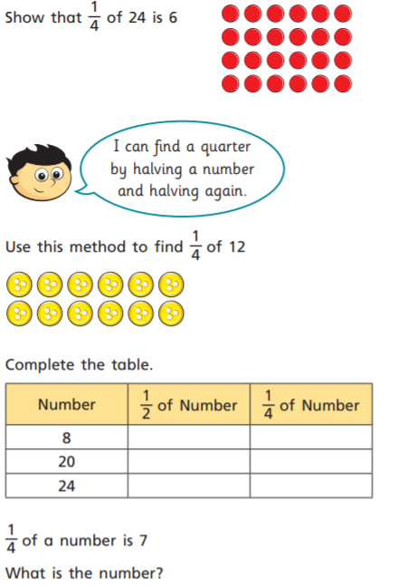
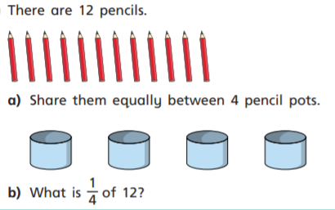
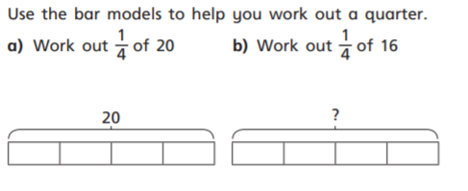

Slide 5
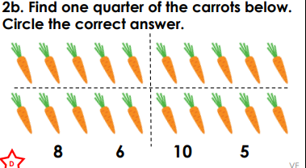
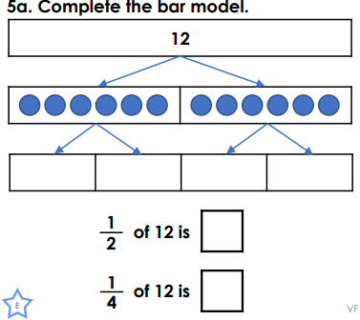
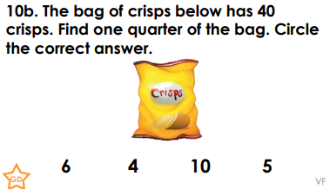
*
**
***
Choose a question to answer.
Then you have a go at showing a quarter in any way you like.
You might want to draw something, or collect objects together or send me a picture showing quarters. It’s up to you.

