Slide 1
‘ED’openers
Remember:
If a sentence begins with an ‘ed’ word, then it must have a comma.
You must think very carefully where the comma should be placed.
- Sometimes it is directly after the ‘ed’ word.
- Sometimes the ‘ed’ word makes a phrase or subordinate clause (which doesn’t make sense on its own) and the comma is inserted after that.
e.g. Excited, the children trudged through the fresh blanket of snow
that lay thickly on the ground.
Excited by what they saw, the two youngsters giggled happily as
the tiny snow flakes danced around in the breeze.

Slide 2

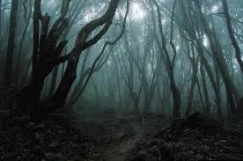
.
Mesmerised by the brightness of the forest, the two children stared around in awe and wonder.
Petrified, the siblings edged their way nervously under the looming tunnel of yew trees.

Slide 3


Use the word bank or your own ‘ed’ word to produce descriptive sentences beginning with an ed word.
gobsmacked astounded
confused terrified
petrified puzzled dazzled dazed
frightened shocked excited
determined exhausted consumed engulfed surprised paralysed
astonished mesmerised
bewildered delighted
worried stunned amazed
determined exhilarated

