Slide 1

English Thursday 25 February
Today we are planning our diary writing and tomorrow we will write the sentences and paragraphs.
Watch me talk you through the planning on our online learning page for today.
Use the table to help you plan your paragraphs.
I have attached the emojis and adverbs of time to help you today.
What to include in your plan
dates
first person writing – i. me. my
past tense
thoughts, feelings, emotions
adverbs of time
sequence
list sentence
repetition sentence
full stop, finger space, capital letter
sound button

Slide 2
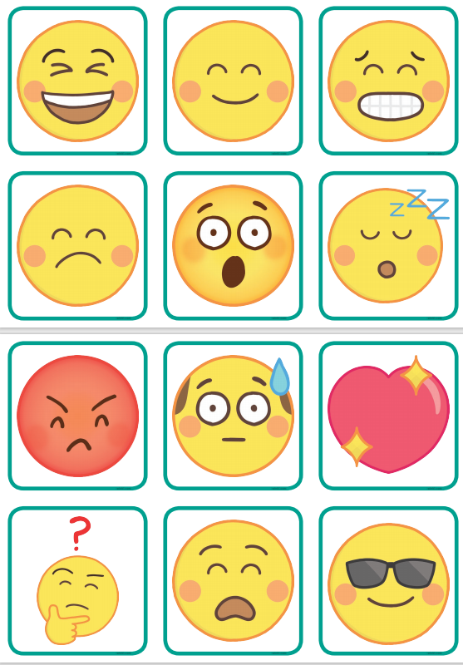
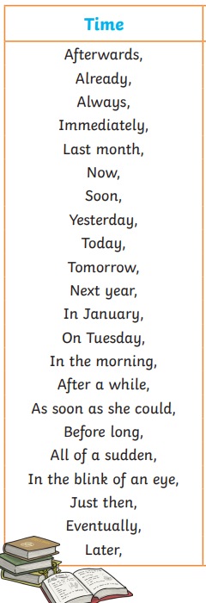
sound button

Slide 3
Thursday 25 February
Diary Plan
sound button
Sunday 2 September 1666 | Monday 3 September 1666
This morning, After a while, wonder what ? worrying smell Chores – lit the fires, swept the floors and baked some bread | Today, Later, terrible frightened checked the house checked next door checked out on the street

Slide 4
Sunday 2 September 1666 | Monday 3 September 1666
sound button

