Slide 1


Year 3 – Spring Block 3 – Statistics
Step 1: Pictograms
© Classroom Secrets Limited 2019

Slide 2
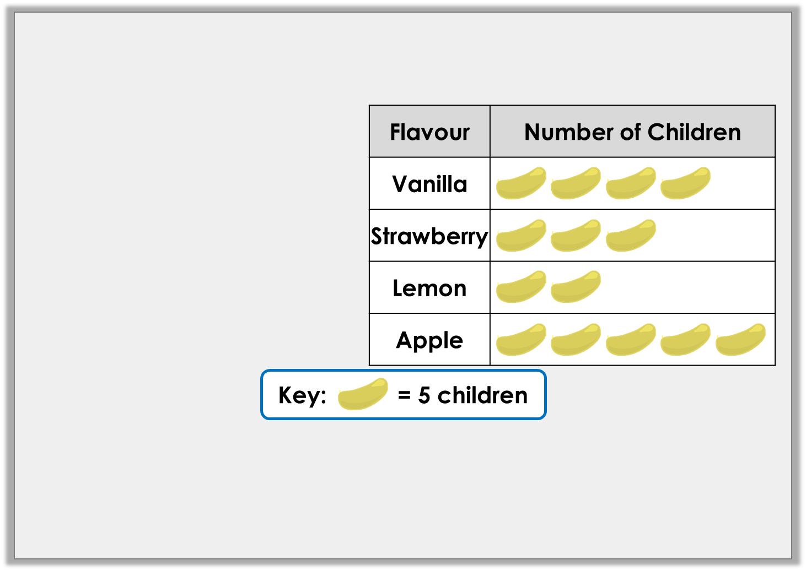
Introduction
Jack has used this tally chart to draw the pictogram.
Has he interpreted the tally chart correctly? What errors can you find?
Flavour | Number of Children
Vanilla
Strawberry
Lemon
Apple
© Classroom Secrets Limited 2019

Slide 3
Introduction
Jack has used this tally chart to draw the pictogram.
Has he interpreted the tally chart correctly? What errors can you find?
No, Jack has not interpreted the tally chart correctly. He should have 2 images for strawberry and 1 image for lemon.
Flavour | Number of Children
Vanilla
Strawberry
Lemon
Apple
© Classroom Secrets Limited 2019

Slide 4
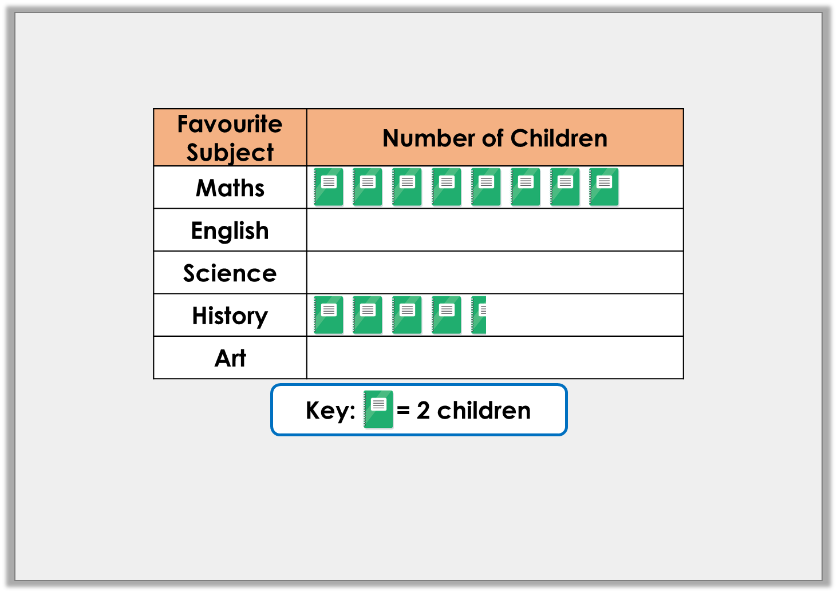
Varied Fluency 1
Complete the missing sections using the information below.
A. | Half the number of children who like Maths, like English.
B. | 4 more children like Art than History.
C. | 3 more people like Science than English.
© Classroom Secrets Limited 2019

Slide 5
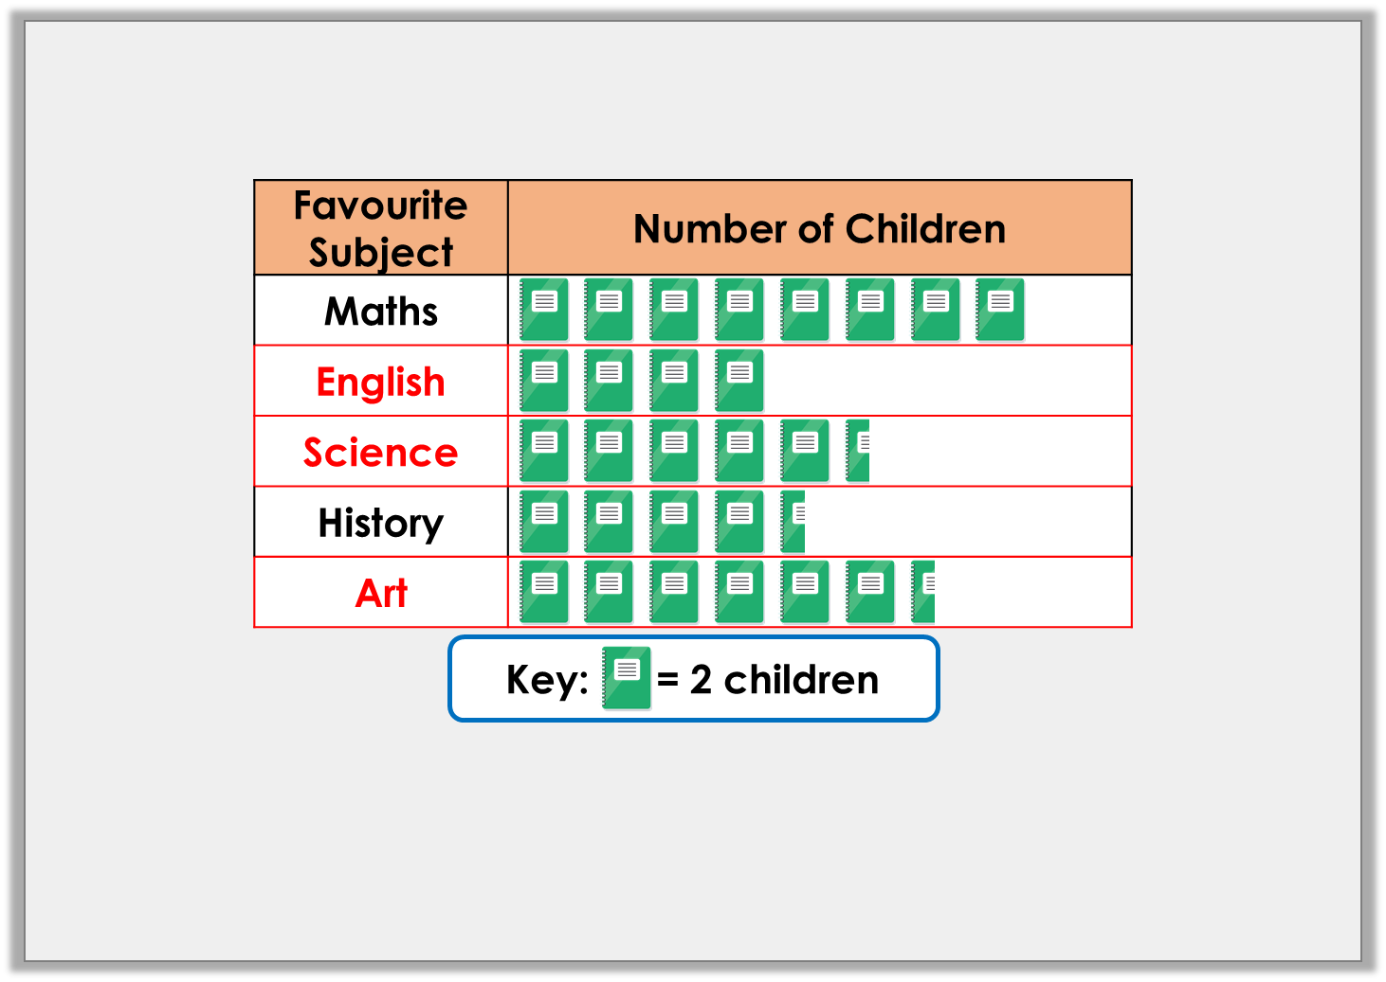
Varied Fluency 1
Complete the missing sections using the information below.
A. | Half the number of children who like Maths, like English.
B. | 4 more children like Art than History.
C. | 3 more people like Science than English.
© Classroom Secrets Limited 2019

Slide 6
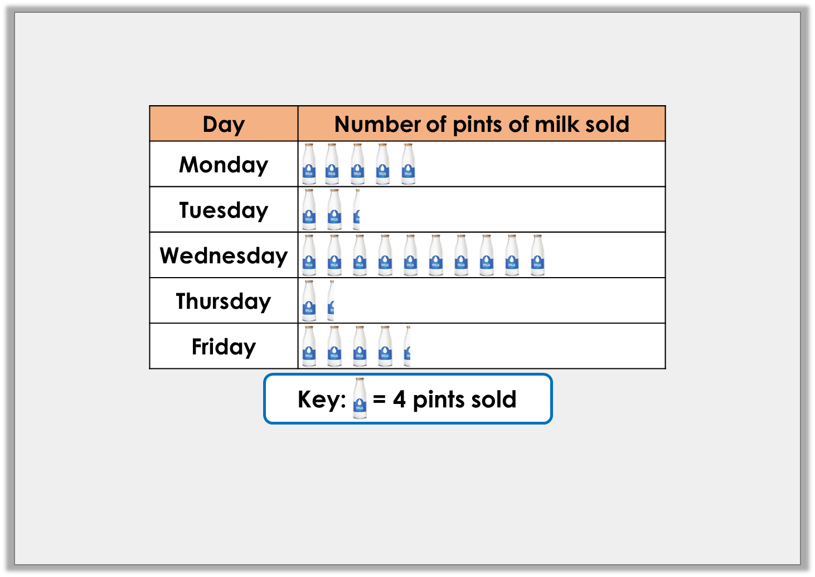
Varied Fluency 2
Answer the questions about the pints of milk sold.
A. | How many pints were sold on Monday?
B. | How many more pints were sold on Friday than on Thursday?
C. | How many pints were sold on Wednesday and Friday?
D. | How many fewer pints were sold on Tuesday than on Monday?
© Classroom Secrets Limited 2019

Slide 7
Varied Fluency 2
Answer the questions about the pints of milk sold.
A. | How many pints were sold on Monday? 20
B. | How many more pints were sold on Friday than on Thursday? 12
C. | How many pints were sold on Wednesday and Friday? 58
D. | How many fewer pints were sold on Tuesday than on Monday? 10
© Classroom Secrets Limited 2019

Slide 8
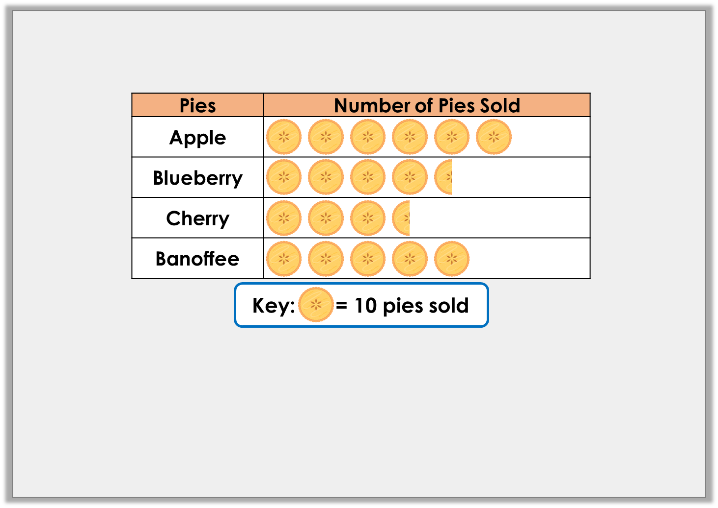
Reasoning 1
Zac has created this pictogram.
He thinks only 15 more apple pies were sold than cherry pies. True or false? Convince me.
© Classroom Secrets Limited 2019

Slide 9
Reasoning 1
Zac has created this pictogram.
He thinks only 15 more apple pies were sold than cherry pies. True or false? Convince me.
No, Zac is incorrect because…
© Classroom Secrets Limited 2019

Slide 10
Reasoning 1
Zac has created this pictogram.
He thinks only 15 more apple pies were sold than cherry pies. True or false? Convince me.
No, Zac is incorrect because 60 apple pies were sold and 35 cherry pies were sold. 60 – 35 = 25. 25 more apple pies were sold compared to cherry pies.
© Classroom Secrets Limited 2019

Slide 11
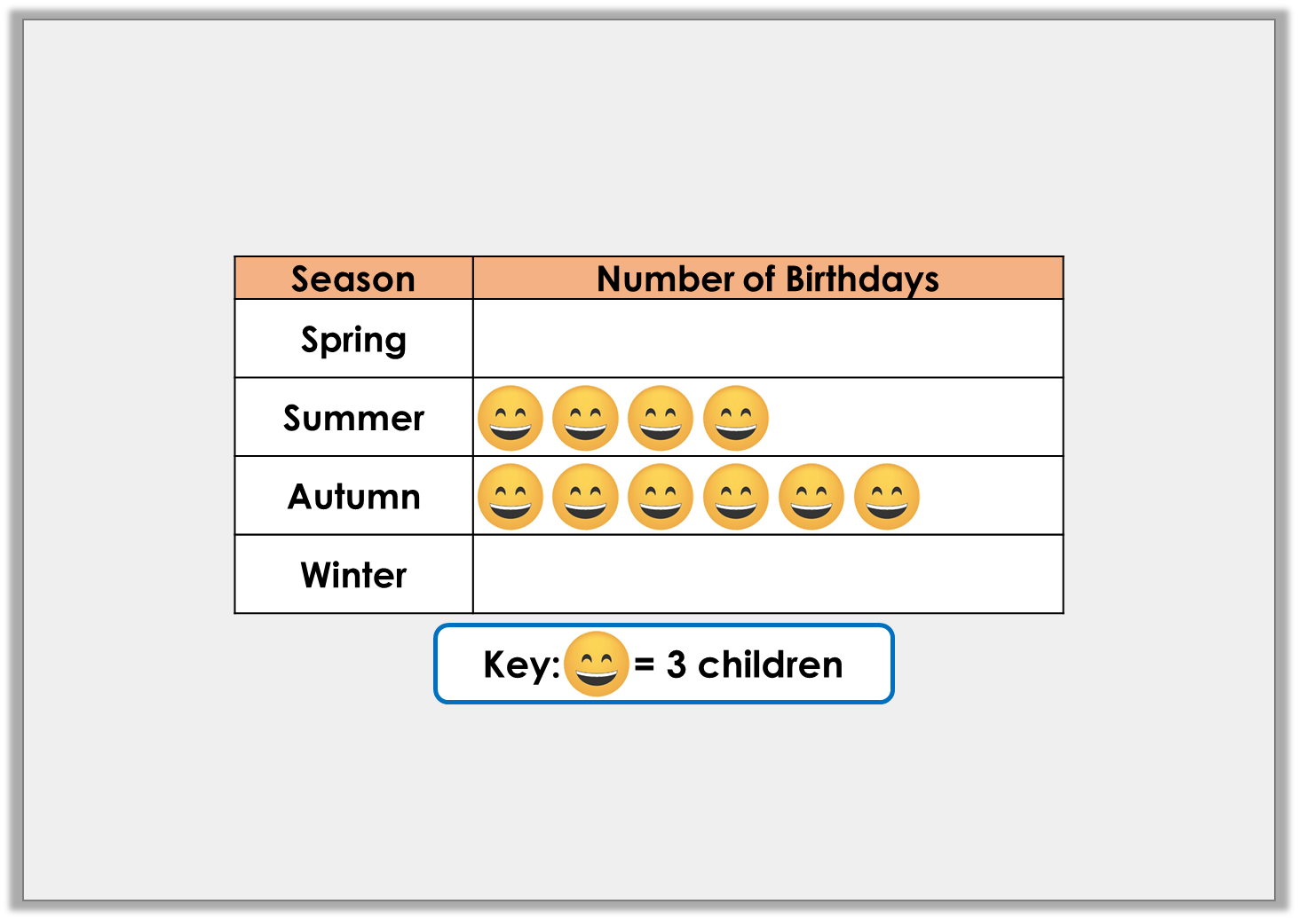
Problem Solving 1
Anika is drawing a pictogram. She knows more children have a birthday in Winter than Spring, but fewer children have a birthday in Winter than Autumn.
Complete the pictogram showing one of the possibilities.
© Classroom Secrets Limited 2019

Slide 12
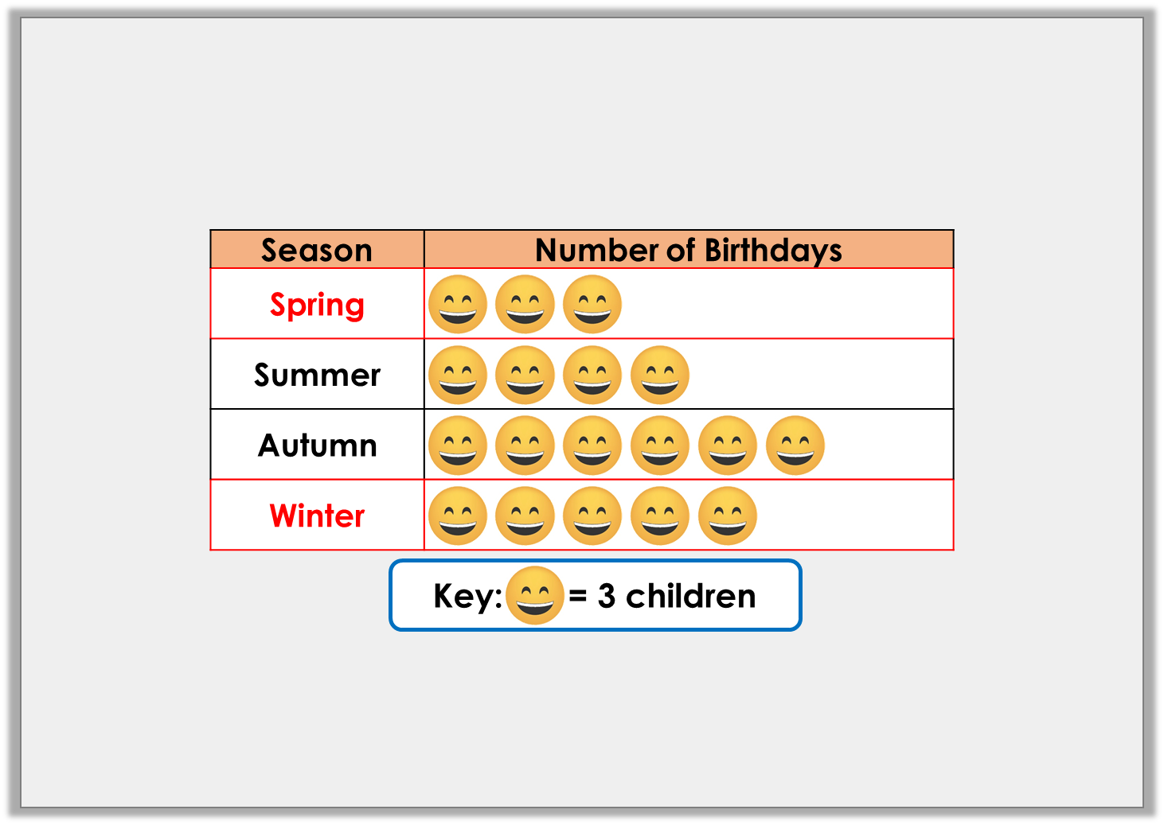
Problem Solving 1
Anika is drawing a pictogram. She knows more children have a birthday in Winter than Spring, but fewer children have a birthday in Winter than Autumn.
Complete the pictogram showing one of the possibilities.
Various answers, for example: See table.
© Classroom Secrets Limited 2019

Slide 13
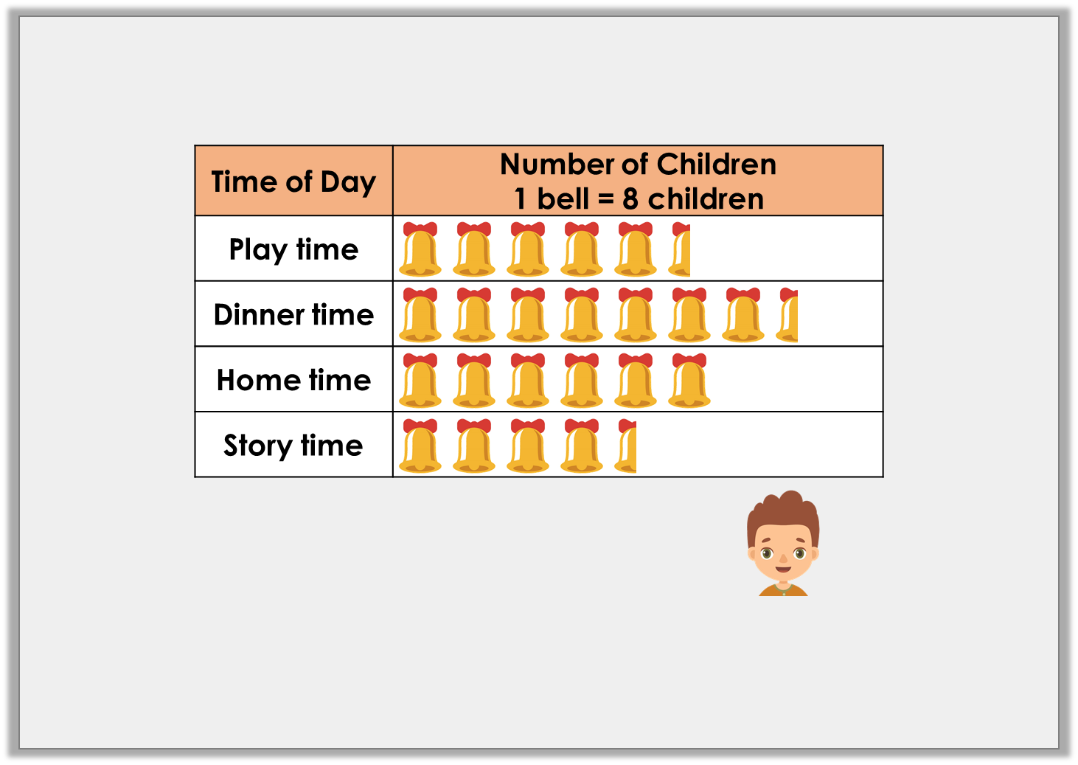
Reasoning 2
Archie draws a pictogram to show KS2’s favourite time of the day.
Is he correct? Explain your answer.
Twice as many children like dinner time than story time.
© Classroom Secrets Limited 2019

Slide 14
Reasoning 2
Archie draws a pictogram to show KS2’s favourite time of the day.
Is he correct? Explain your answer.
No, Archie is incorrect because…
Twice as many children like dinner time than story time.
© Classroom Secrets Limited 2019

Slide 15
Reasoning 2
Archie draws a pictogram to show KS2’s favourite time of the day.
Is he correct? Explain your answer.
No, Archie is incorrect because 36 children voted story time and 60 children voted dinner time. That is a difference of 24.
Twice as many children like dinner time than story time.
© Classroom Secrets Limited 2019

