Slide 1
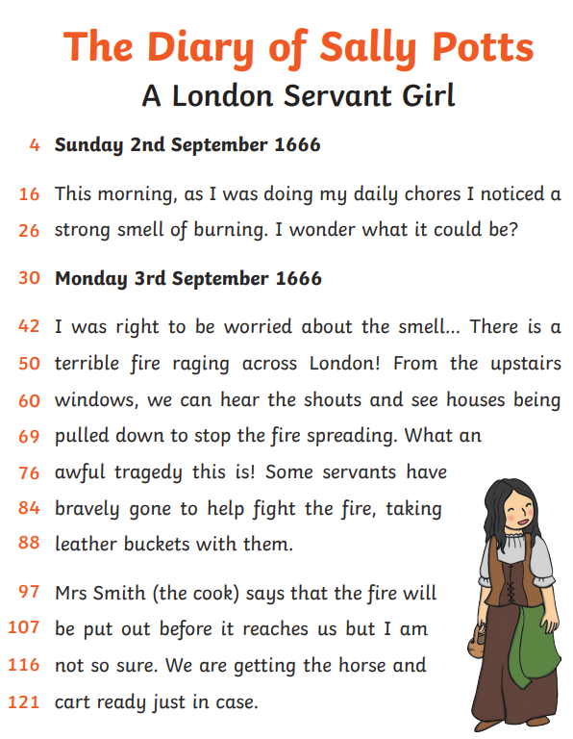
English Wednesday 24 February
Diaries use adverbs of time to help us understand when something happened, the order of events.
Sally starts her diary with:
‘This morning,’
We are going to practise using adverbs of time. There is rather a lot to choose from.

Slide 2
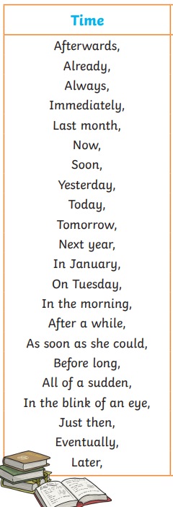
This is just a selection of the possibilities.
Only one task today.
Think about Sally and see if you can choose some appropriate adverbs of time to help you write about Sally and the events that happened around her.a Write at least 6 sentences, please.
I’ll have a go.
This morning, as I was doing my chores, I could smell burning.
After a while, I noticed an orange glow in the distance.
Before long, people were emptying their houses.
Just then, I heard shouts from a street nearby.
Some of you will have spotted the comma that comes after the adverb of time words. See if you can include this as well.

