Slide 1
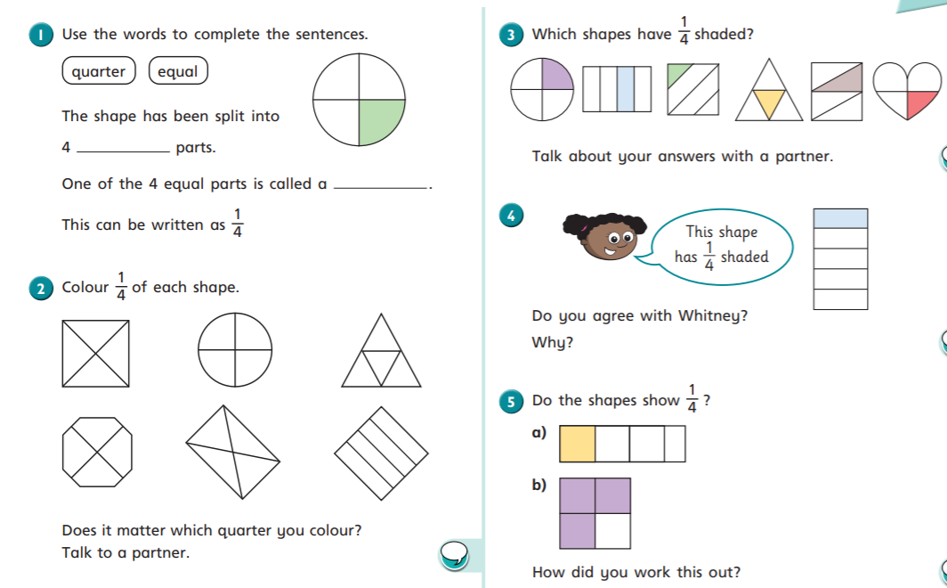

Slide 2
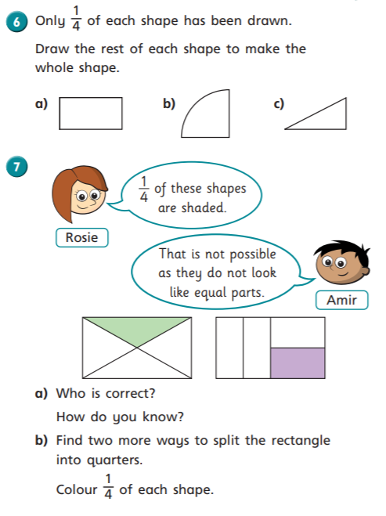
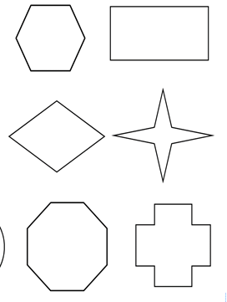
Cut out these shapes and then fold to show quarters.
Or draw lines on these shapes to show quarters.
Remember quarters means 4 equal parts.

Slide 3
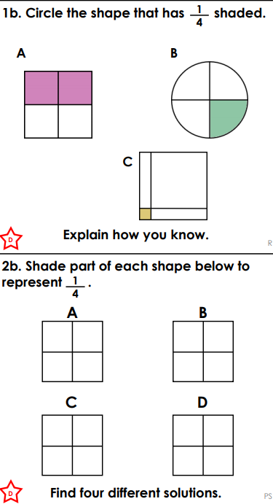
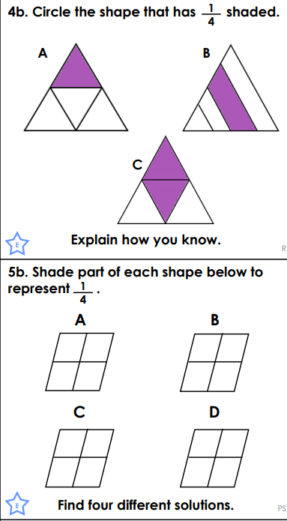
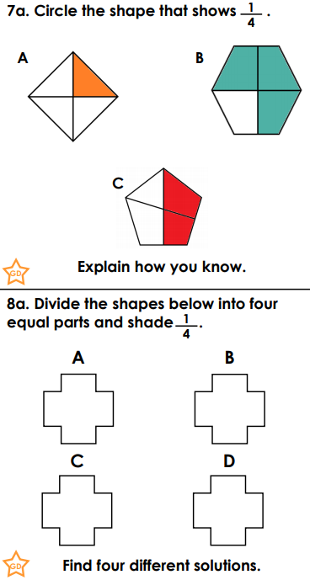
*
**
***
Choose a set of questions to answer.

