Slide 1
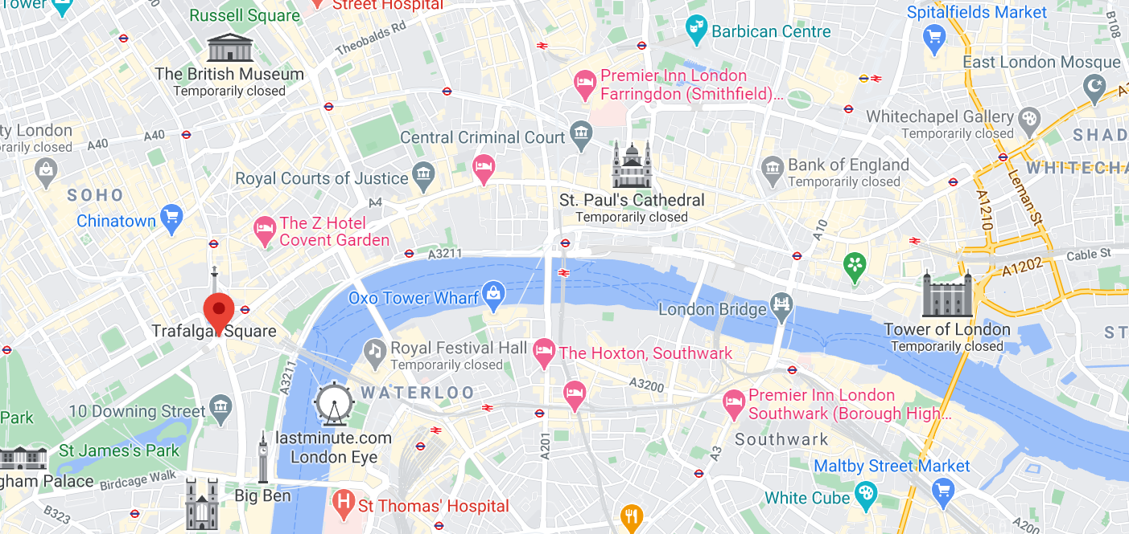
Geography Wednesday 24 February
Finally, we are off to London. Have you been to London? How did you travel to London? How did you travel around the city? What sites did you see?
Google London, choose ‘maps’ and zoom in so that you can see the street names. If you drop the Google man onto the blue line on the River Thames you can enjoy a river cruise. I wonder which famous sites you will see from the river?

Slide 2
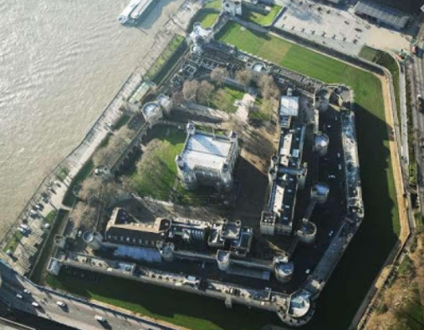
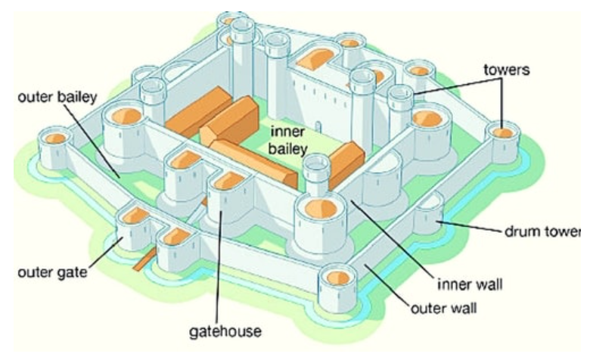
The Tower of London
The Tower of London is nearly 1000 years old. It is a concentric castle.
Can you spot the ‘soft c’ in concentric?
Concentric means one circle inside another. The Tower of London has one wall inside another. Can you see the inner wall and the outer wall?
The green around the outside is where the moat used to be.
outer bailey towers inner wall outer wall outer gatehouse outer gatehouse
Label the concentric castle diagram

Slide 3
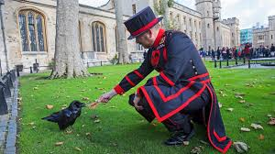
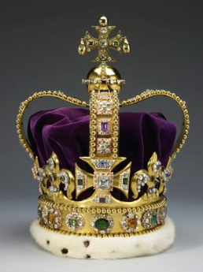
Who looks after the Tower of London? Watch this clip to find out.
https://www.hrp.org.uk/tower-of-london/history-and-stories/yeoman-warders-at-the-tower-of-london/#gs.60ns=V8
https://www.hrp.org.uk/tower-of-london/history-and-stories/the-crown-jewels/#gs.0S2Z5Vw
Every night the Tower gates are locked. Watch the ceremony here:
https://www.youtube.com/watch?v=UPPl6bFwHOg

Slide 4
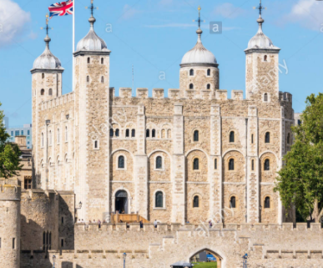
London is the capital city of ……………………………………..
The national flower is the ……………………………………….
North, South, East or West?
London is in the ……………………………………….. of England.
London is next to the River ………..……
True or false?
The Tower of London was a fortress.
It was a royal palace.
It has been used as a prison.
It has been used to keep animals like lions.
Guy Fawkes was imprisoned there.
Draw the national flower.
They are all true!

