Slide 1
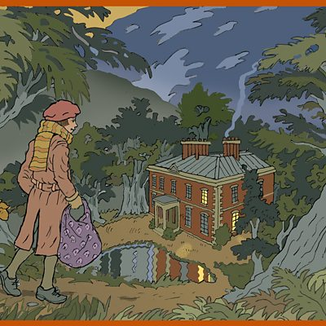
Journey to Druid’s Bottom
23.02.21

Slide 2
Over the next couple of weeks, we are going to be writing a descriptive narrative based on Carrie and Nick’s first journey to Druid’s Bottom.
Task 1
Today, you are going to think about the events of day from waking up in the morning to bursting through the door at Druid’s Bottom. You are going to use the planning sheet provided to jot down ideas and vocabulary for each of the paragraphs. (Read Chapter 4 again to remind you what happened.) Think about what the children might see, hear, smell, feel. What are their actions?

Slide 3
Children wake up in bed, go downstairs and meet Aunty Lou (who has a dreadful cold) and Mr Evans in the kitchen.
Children eat breakfast and Mr Evans sends them for the goose. They wrap up warmly.
The children exit the house and walk through the (snowy) village to the style.
The children clamber over the style and enter the woodland. The path leads to a tunnel of yew trees.
The children go through the tunnel and end up in a large field with a huge house at the end. They scamper across the field and barge through the door.
tiredly crept, sleepily stumbled, carefully edged , staggered across
Carrie stumbles out of bed and staggered across to the window.
ruffled, sleepily, sluggishly, tiredly, warm bed, cosy bed
Nick – hair tousled, lying sleepily in bed
Dark in their bedroom – blackout blinds drawn.
yawned, stretched, pulled blanket over his face
Paragraph 1
Mr Evans bellowed up the stairs.
Thick snow on the ground.
screamed, screeched, yelled,
crisp, white, blanket, snowflakes danced

Slide 4
Task 2
For your second task, you are going to practise writing sentences beginning with ly words.
Remember
If a sentence begins with an ‘ly’ word then it usually needs a comma.
You must think very carefully where the comma should be placed.
Sometimes it is directly after the ‘ly’ word.
Sometimes the ‘ly’ word makes a phrase or subordinate clause (which doesn’t make sense on its own) and the comma is inserted after that.
e.g. Cautiously, the two siblings approached the tunnel of yews.
Desperately trying not to awaken Aunty Lou, the children crept
silently out of the house.

Slide 5
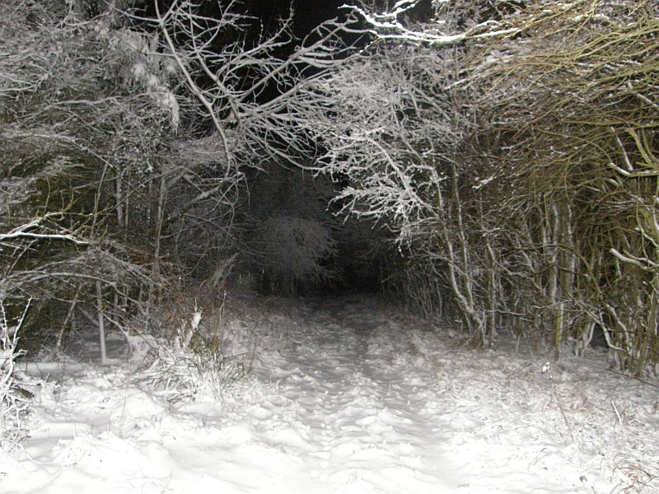
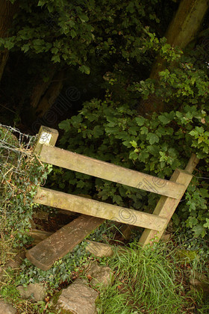
Anxiously, the youngsters edged their way through the frosty thicket.
Cautiously, the children climbed over
the wooden style.

Slide 6
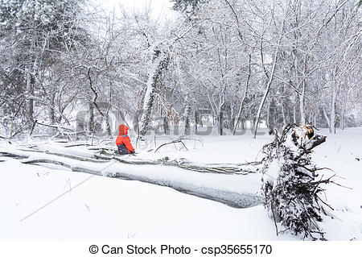
Immediately rising to his feet, Nick dusted the powdery snow off his coat and began to follow his beloved sister.

Slide 7
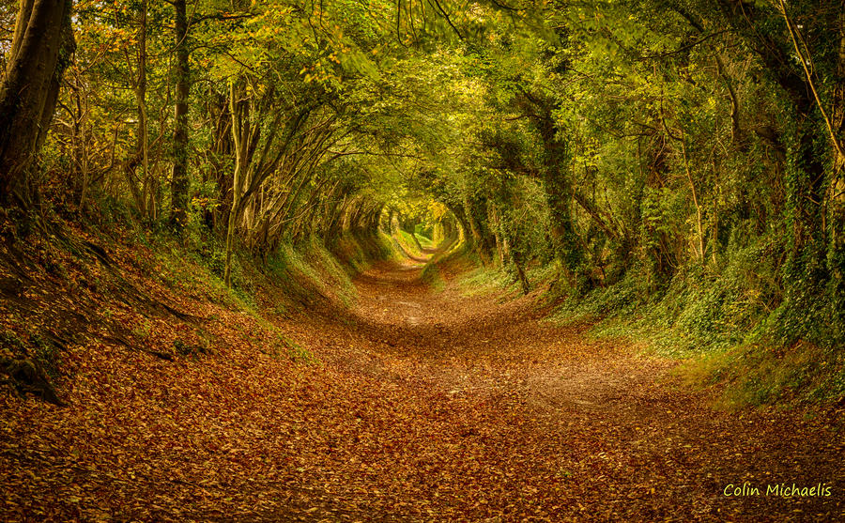
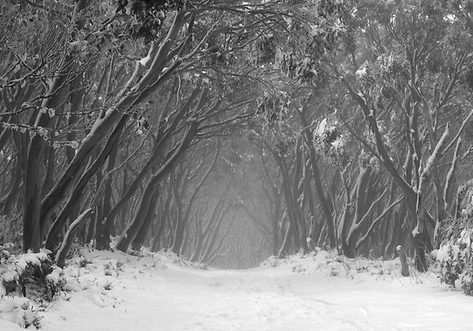
Can you use the following words (or your own ly words) to produce your own sentences? Can you add adjectives to your sentences to add to the description?
Frantically
                Eventually Suddenly
                Carefully
                Quickly Foolishly
Confidently Cautiously Nervously
Anxiously
Loudly
Hastily

